Slide 1
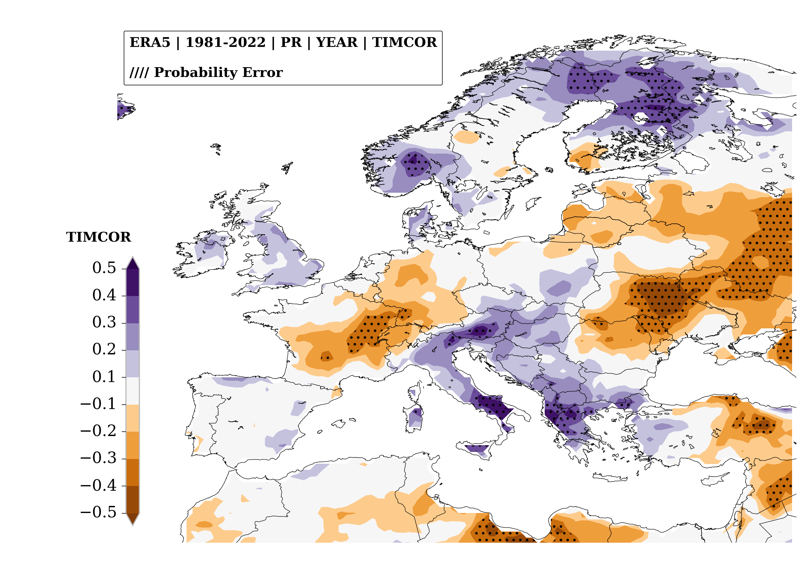

Trends in Annual Mean Precipitation
xxxx
xxx

