Slide 1


Slide 2
Projected changes in meteorological drought risk under future climate change scenarios
Christoph Menz
Research Department II: Climate Resilience
Potsdam Institute for Climate Impact Research

Slide 3
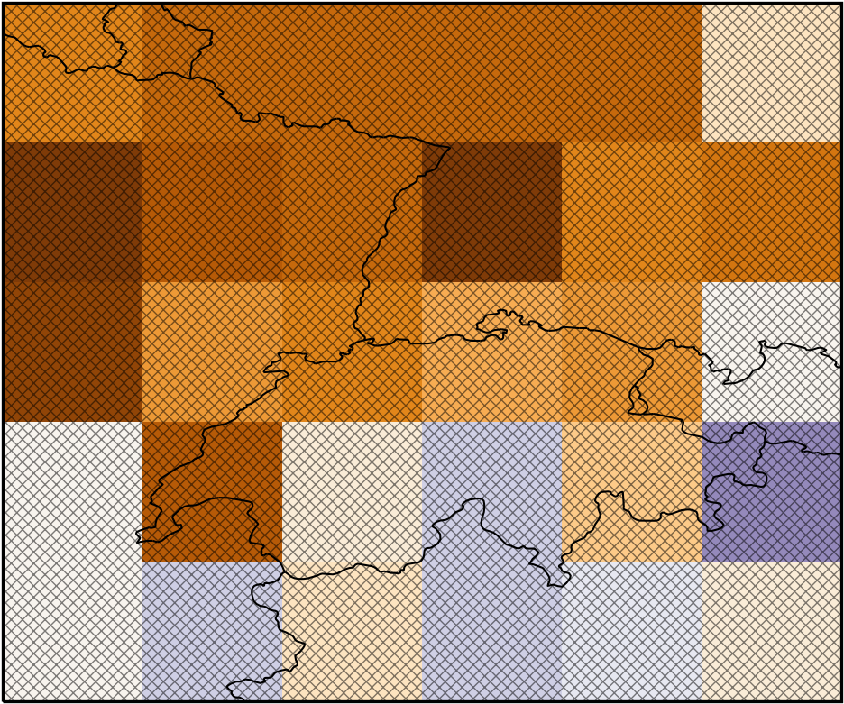
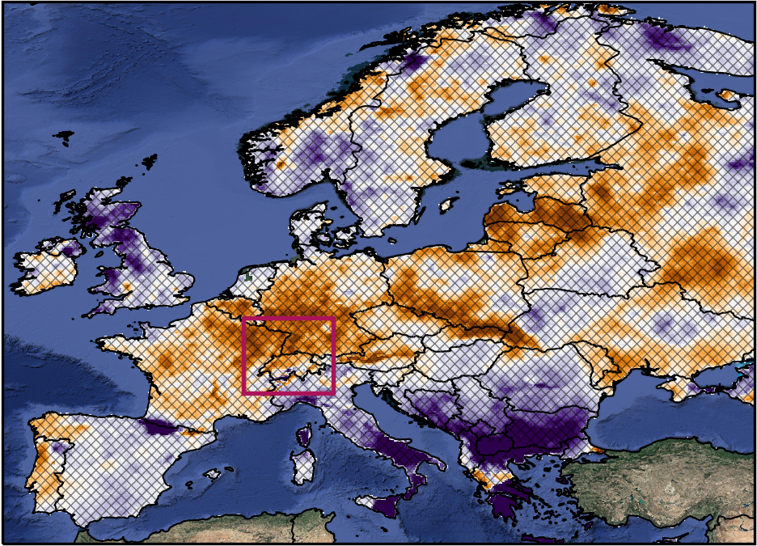

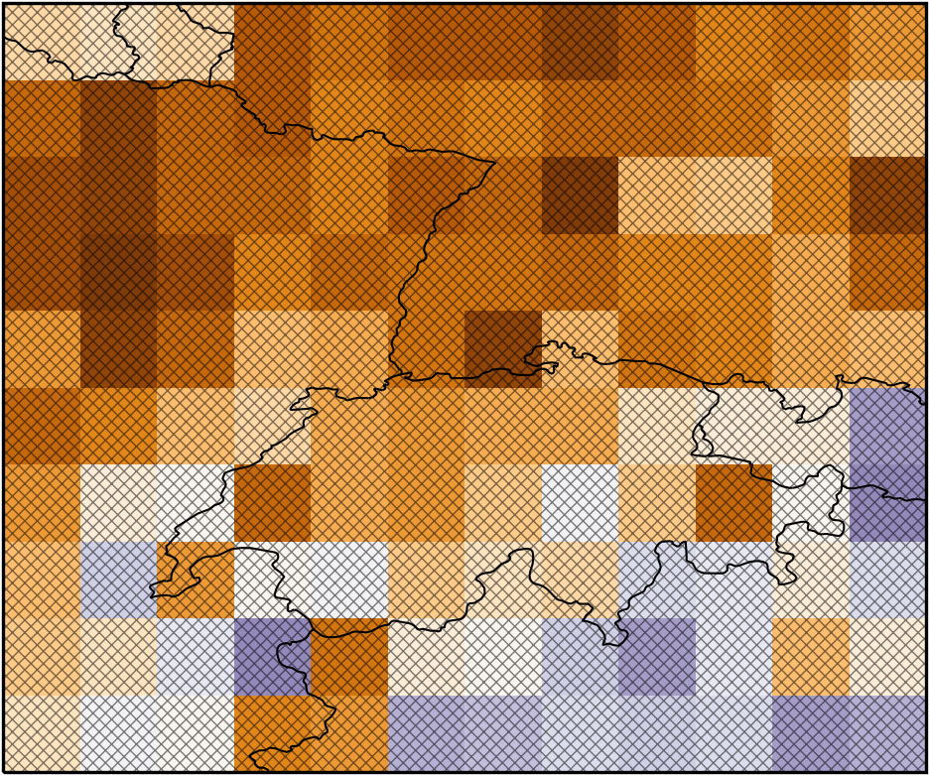
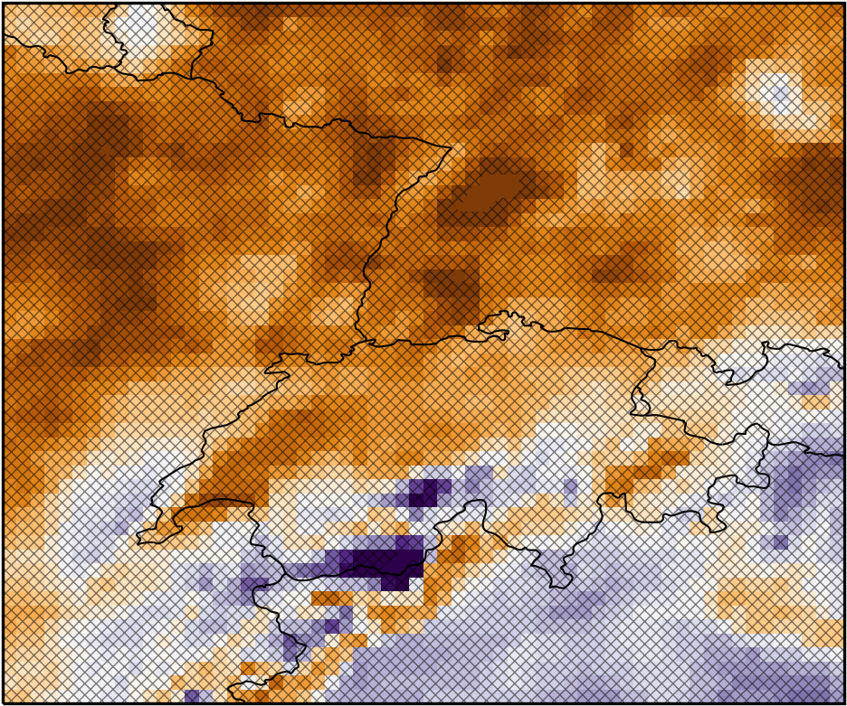
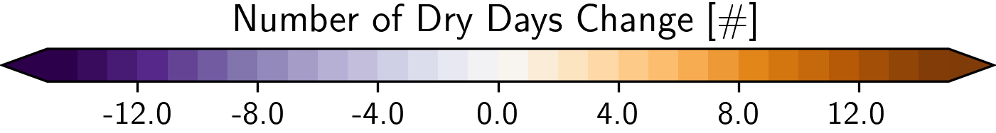
Motivation
100 km
Observed
Climate Change
2001-2020
vs.
1981-2000
50 km
10 km
E-OBS v24.0e
Annual accumulation
90% Significance level

Slide 4
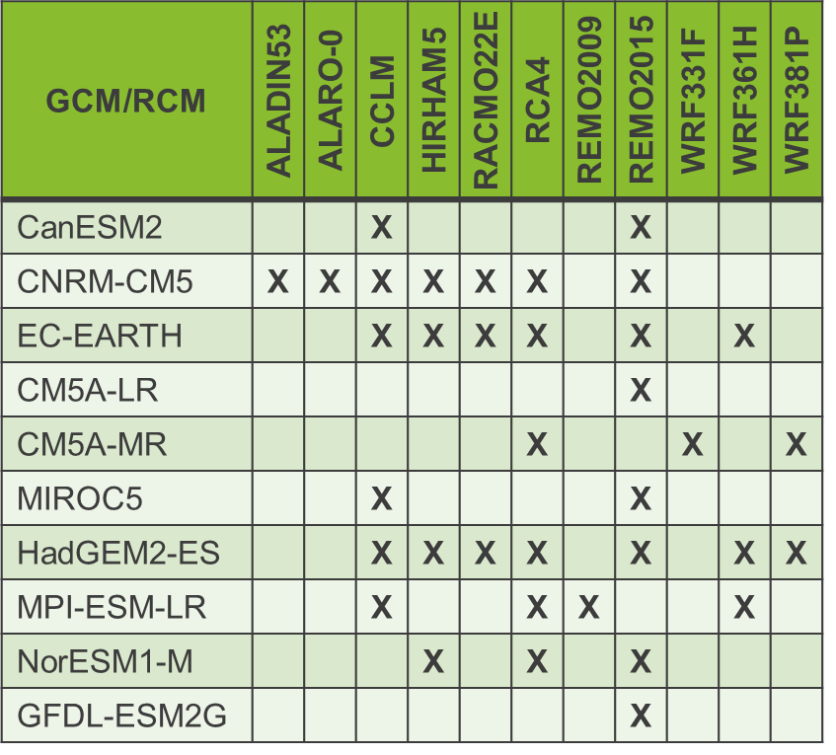
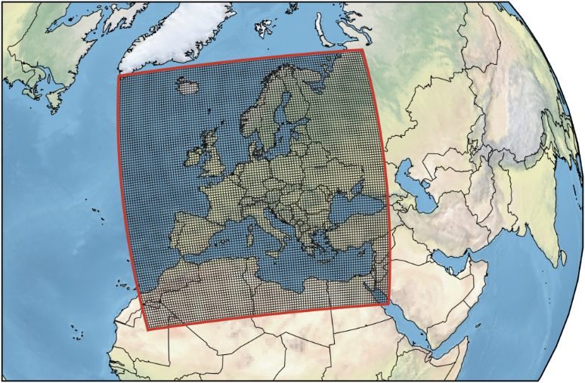
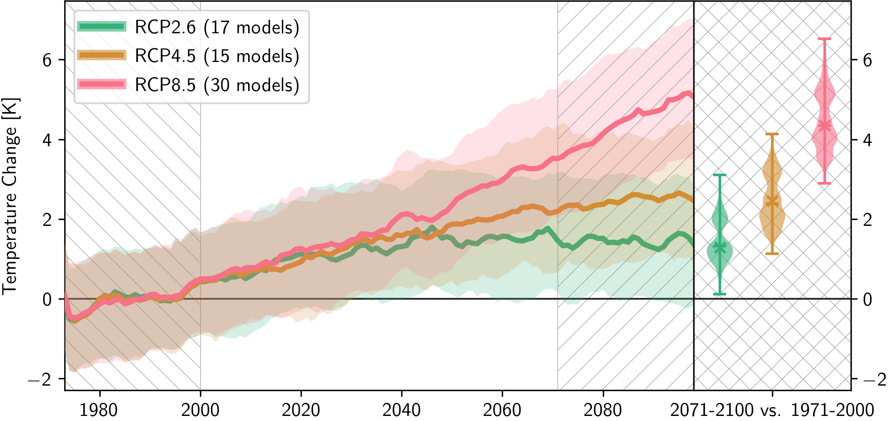

Regional Climate Projections
Ensemble of 62 high resolution regional climate model simulations
CORDEX-EUR11 framework: Europe @12.5km
Daily temperature and precipitation

Slide 5
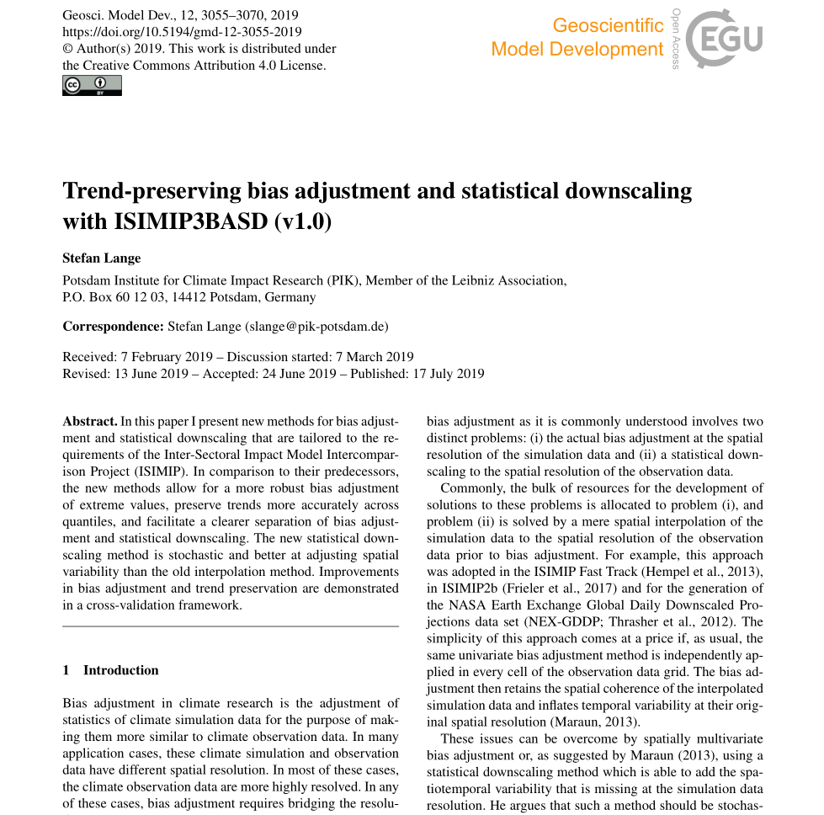
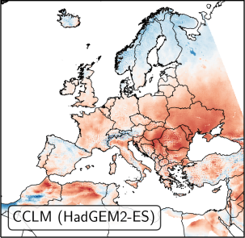
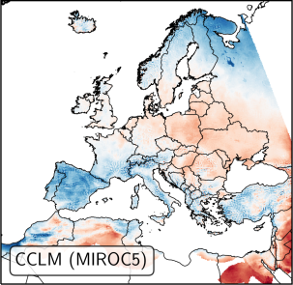
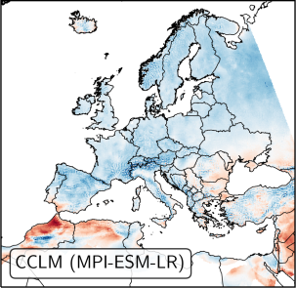
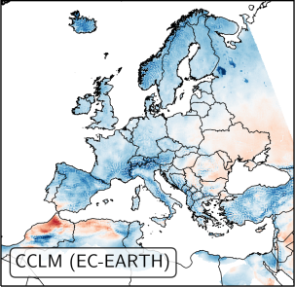
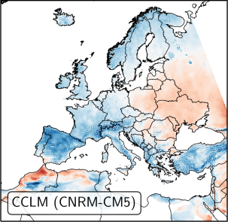
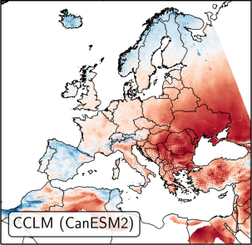
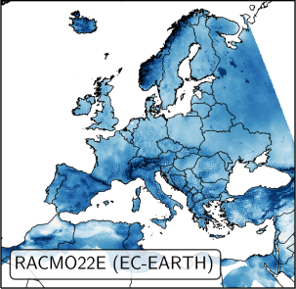
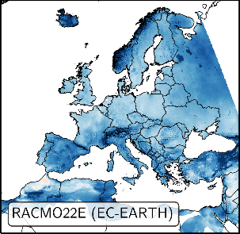
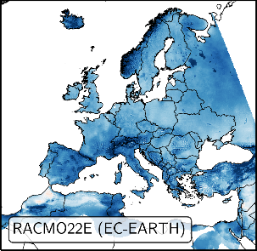
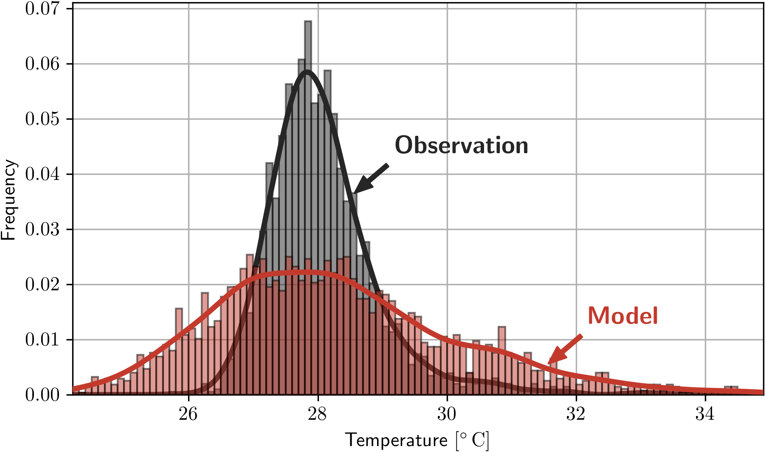
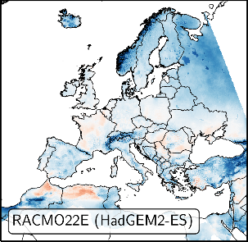
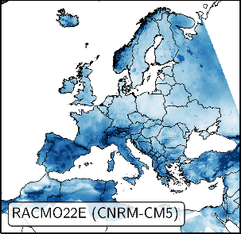
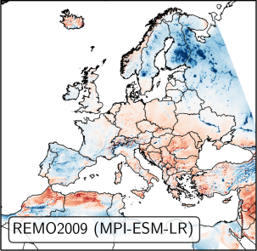
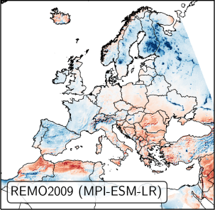
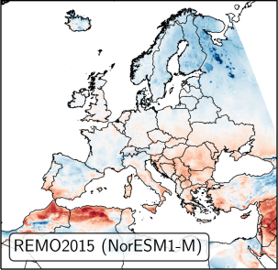
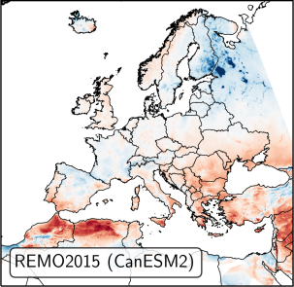
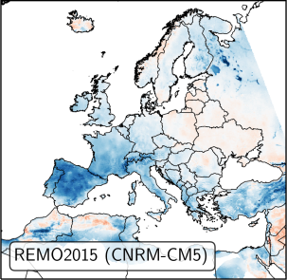
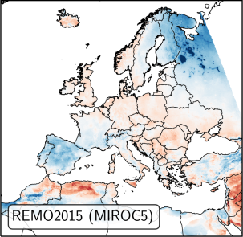
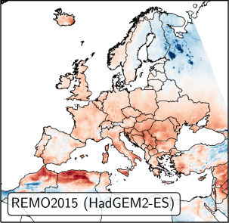
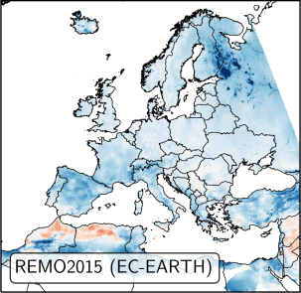
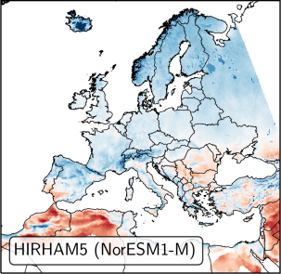
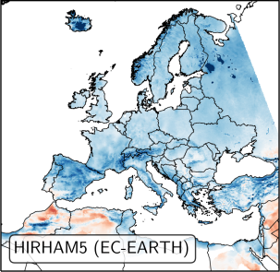
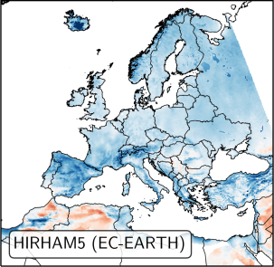
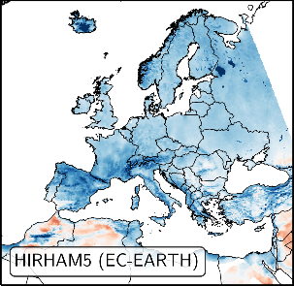
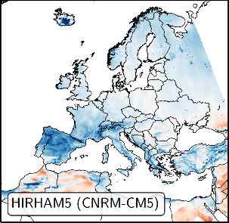
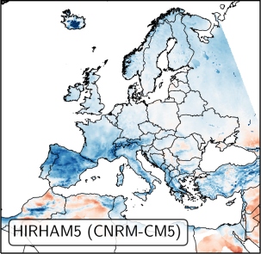
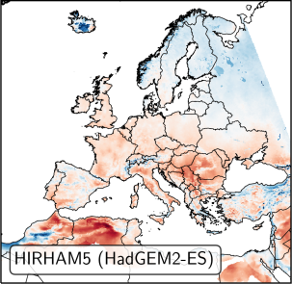
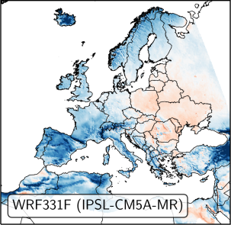
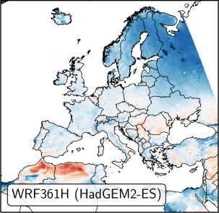
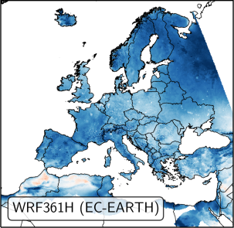
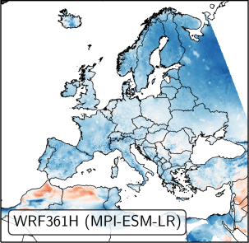
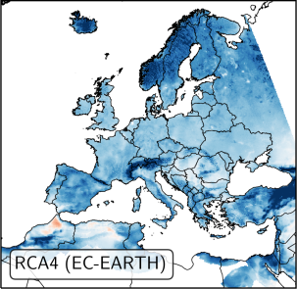
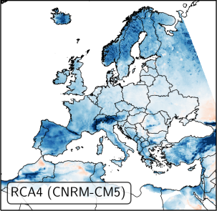
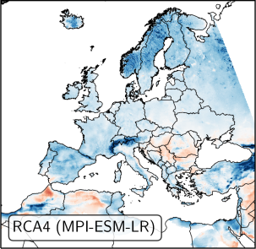
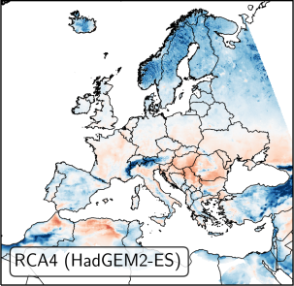
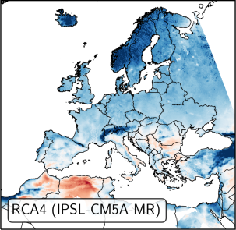
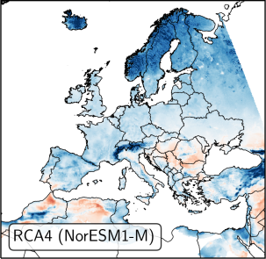
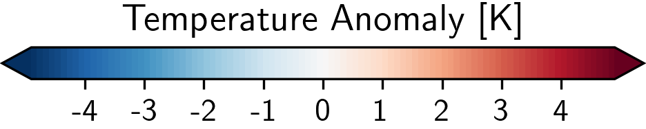
Bias Adjustment
Needed Properties
Distribution focused bias adjustment
Adjust especially tails of distribution
Preserve trend of each model in every percentile
Not Explicitly Considered
Consecutive/long lasting events
(e.g., drought spells)
1971-2000
Reference: E-OBS v19.0e

Slide 6
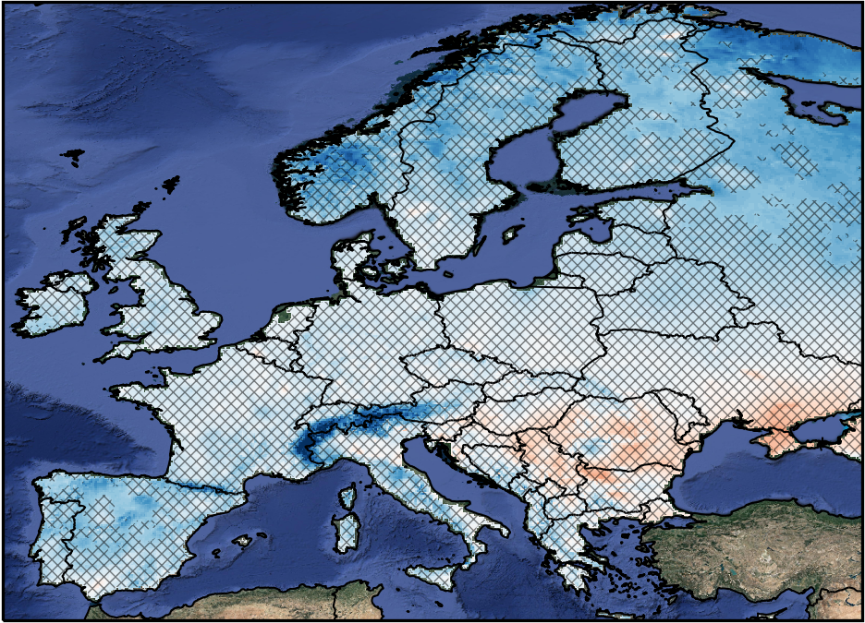
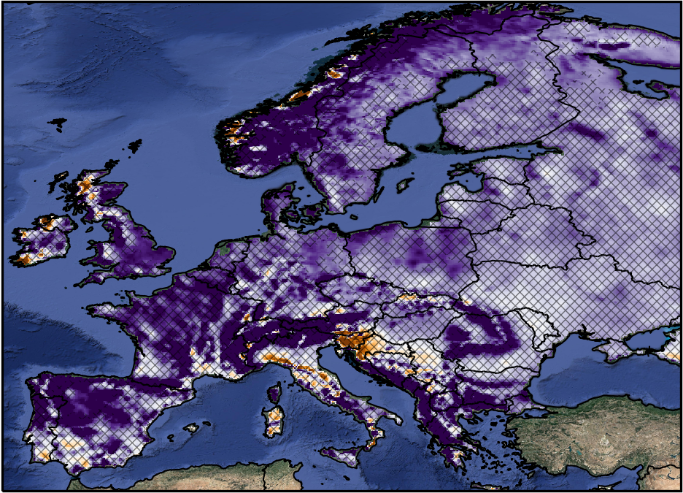
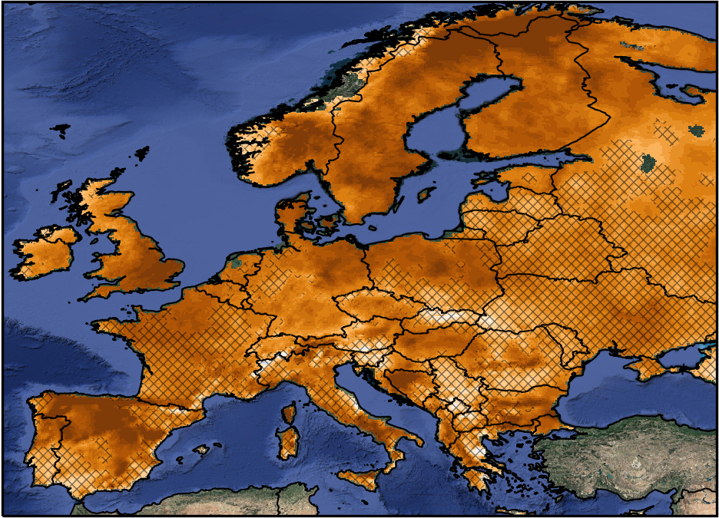






Bias Adjustment - Evaluation
1971-2000 vs. E-OBS v24.0e
Temperature
Precipitation
Dry Spell Total Length
Biased
Bias Adjusted
min. 7 days below 0.1mm

Slide 7







Regional Climate Projections – General Overview
Global Models
Regional Models
CMIP 5 (IPCC-AR5)
CMIP 6 (IPCC-AR6)
CORDEX-EUR11
DJF
JJA
2071-2100 vs. 1971-2000 RCP8.5/SSP5-8.5 90% Significance Level

Slide 8





Regional Climate Projections – Drought Spell Change
# Dry Days
Dry Spell Frequency
Length of Most Severe Drought
2071-2100 vs. 1971-2000
CORDEX-EUR11 RCP8.5
Annual Changes
90% Significance Level
min. 7 days below 0.1mm

Slide 9









Regional Climate Projections – # Dry Days Change Time Series
Annual # dry days change
CORDEX-EUR11 RCP8.5
Ref: 1971-2000
10a moving average filter
ME
SC
BI
AL
FR
EA
IP
MD

Slide 10



Regional Climate Projections – SPEI Change
SPEI – 3 Month
SPEI – 12 Month
2071-2100 vs. 1971-2000
CORDEX-EUR11 RCP8.5
Annual Changes
90% Significance Level
Potential Evapotranspiration based on Hargreaves

Slide 11
Summary
Ensemble of 62 high resolution regional climate model simulations are available for the project
Bias adjustment reduces bias significantly, also for prolonged drought event
North-South gradient in climate change signal, but different border between different ensembles
Increase number of drought events and length of drought spells
Precipitation related changes are uncertain with any ensemble (CMIP5, CMIP6 and CORDEX-EUR11)
  High natural variability
  High inter-model variability
Strongest changes anticipated for France, Italy and Balkans
Long-scale SPEI (>12 month) show stronger increase

