Slide 1
Update on climate change impacts in West Country
Fred F. Hattermann, Potsdam Institute for Climate Impact Research

Slide 2
Outline
Climate change in West Country
Impacts on water, vegetation and extremes
Main messages

Slide 3
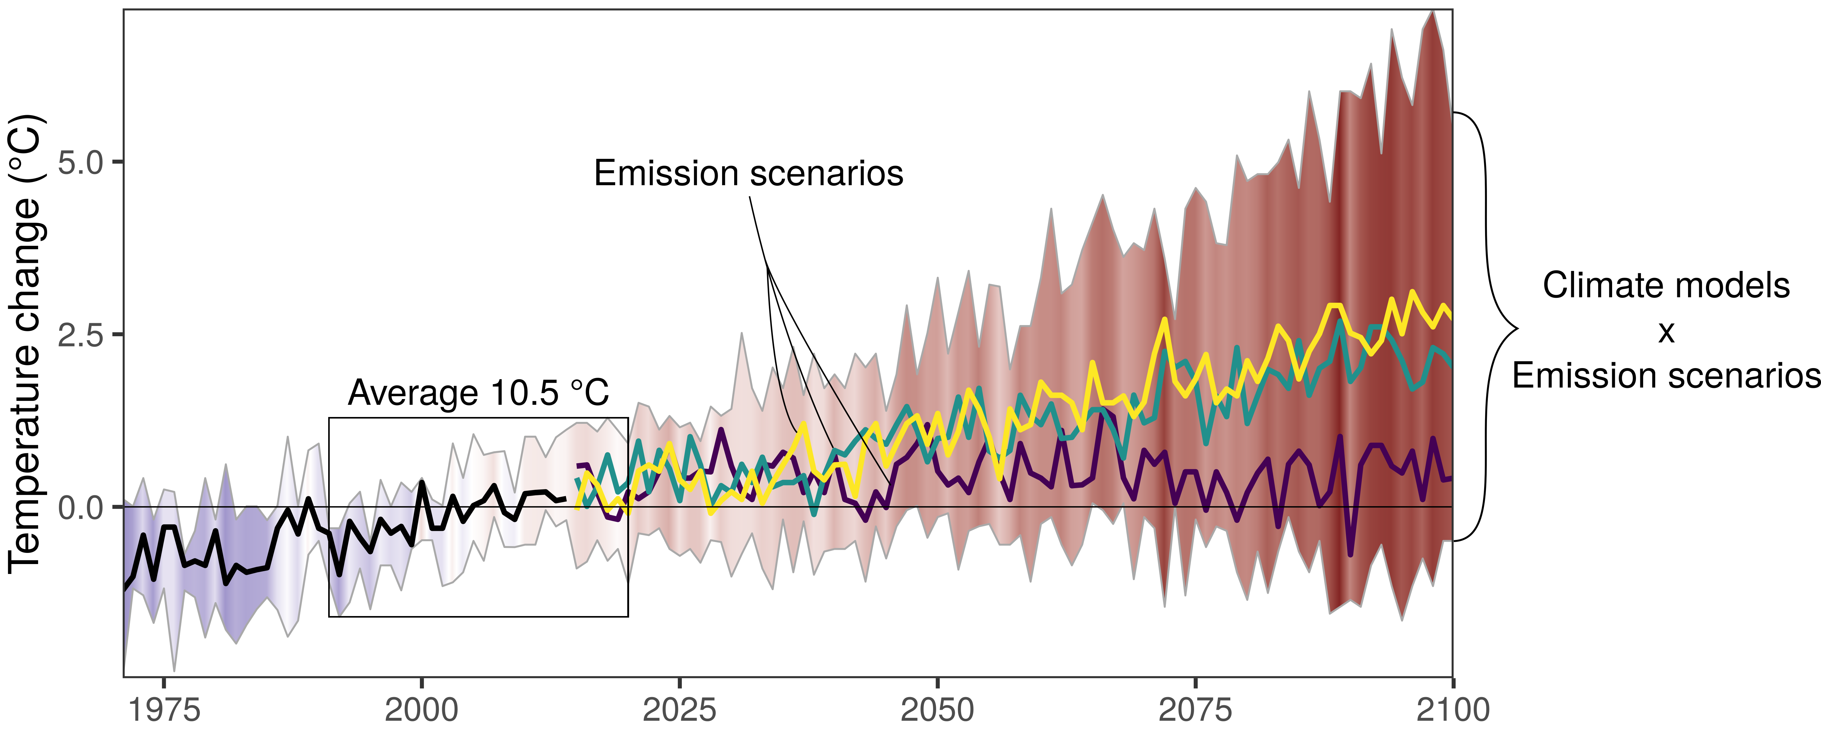

Temperature Projections – West Country Region
Workshop II: West Country Region - Climate vulnerability, Impacts and Projections
Projected climate changes for the West Country Region relative to 1991-2020
Strong temperature increase over 21st century relative to current conditions.
Increase depends much on the emission scenario → Time for action!
cold
warm
Data: ISIMIP 3b

Slide 4
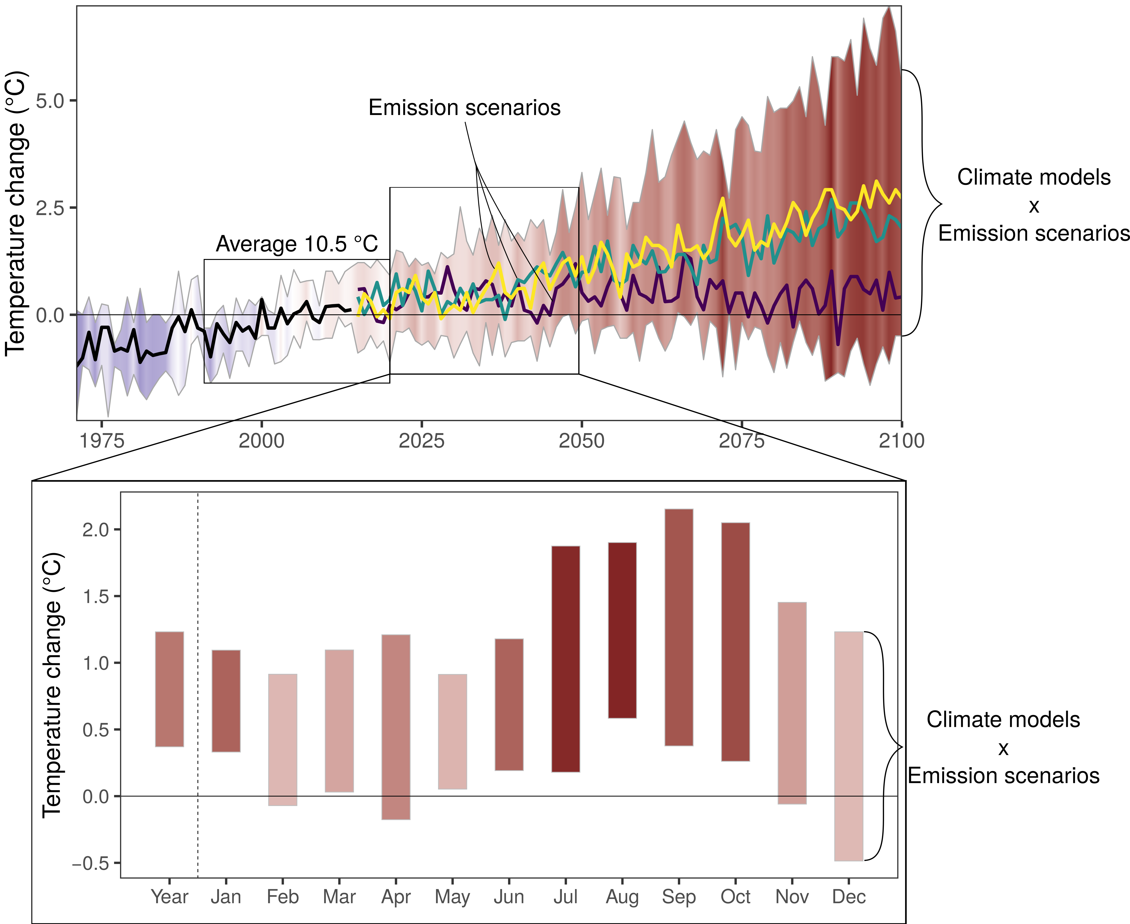
Temperature Projections – West Country Region
Workshop II: West Country Region - Climate vulnerability, Impacts and Projections
Projected climate changes for the West Country Region relative to 1991-2020
Strong temperature increase over 21st century relative to current conditions.
Increase depends much on the emission scenario → Time for action!
Next 30 years: ~ 1.0 °C
Temperature increase stronger in summer (~ 1.5 °C in Aug) than in winter (~ 0.7 °C in Dec).
cold
warm
Data: ISIMIP 3b

Slide 5
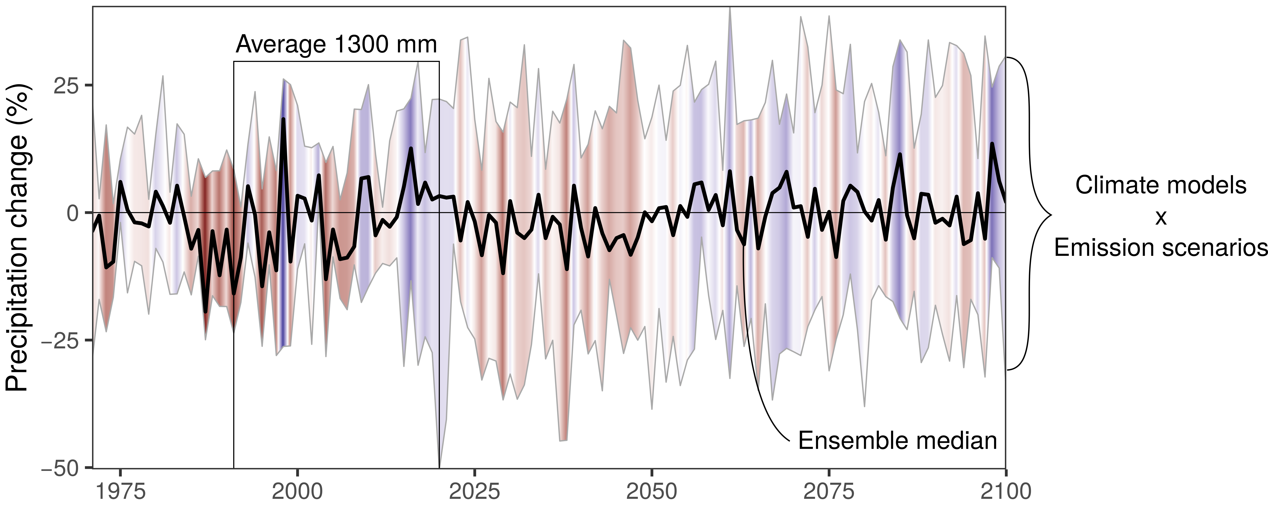
Precipitation Projections – West Country Region
Workshop II: West Country Region - Climate vulnerability, Impacts and Projections
Projected climate changes for the West Country Region relative to 1991-2020
Little variation in rainfall projections.
→ All is well?
wet
dry
Data: ISIMIP 3b

Slide 6
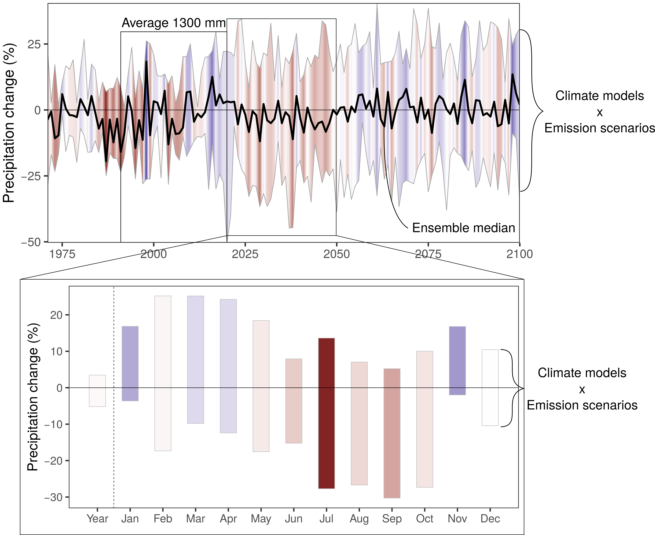
Precipitation Projections – West Country Region
Workshop II: West Country Region - Climate vulnerability, Impacts and Projections
Projected climate changes for the West Country Region relative to 1991-2020
Little variation in rainfall projections.
→ All is well?
NO!
Summer becomes drier (drought risk?)
Winter becomes wetter (flood risk?)
Large uncertainties in projections (caused primarily by climate models rather than emission scenarios).
wet
dry
Data: ISIMIP 3b

Slide 7





PROJECTIONS – WEST COUNTRY REGION (RECAP)
Workshop II: West Country Region - Climate vulnerability, Impacts and Projections
According to projections, the West Country Region is likely to deal with
>
Hotter summers
And milder winters
The increase of average temperatures will depend on emissions
Wetter Winters
Drier summers
No clear changes in overall precipitation averages
HEATSTRESS RISKS
FLOOD RISKS
Heatstress, drought and flood will be more remarkable and recurrent in the region
DROUGHT RISKS

Slide 8
West Country
Impacts on water availability, vegetation and extremes

Slide 9
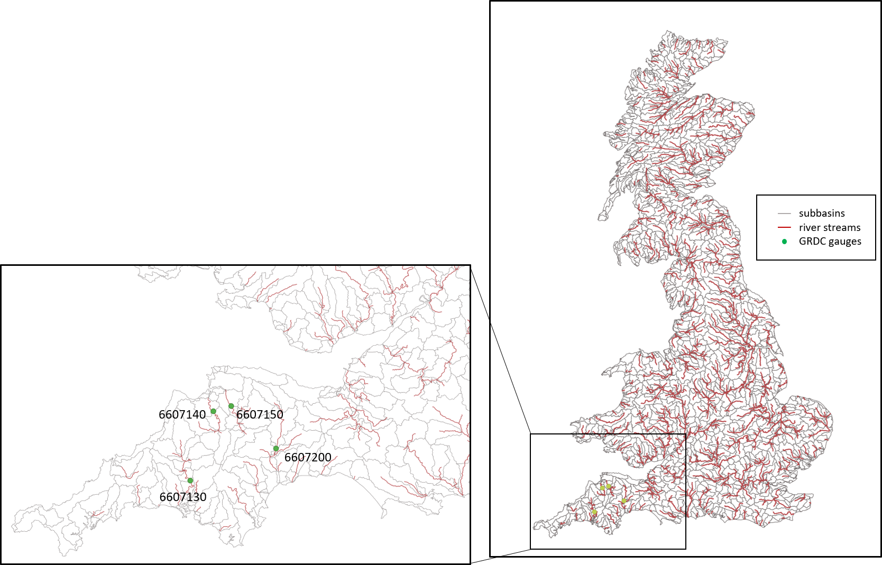
Impacts on river discharge and extremes

Slide 10
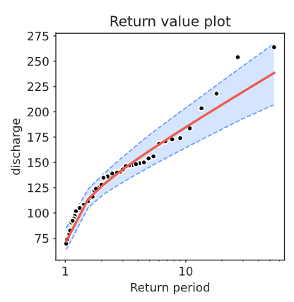
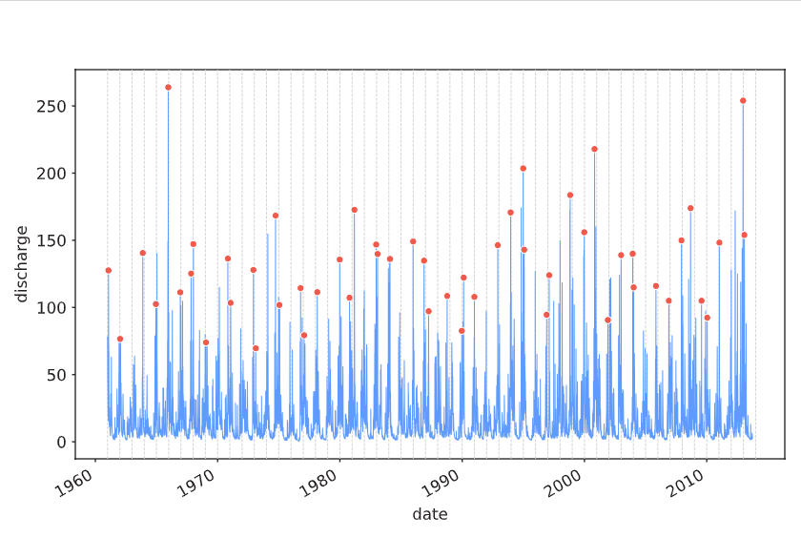
First step: Investigation of observed discharge (River Exe)
Observed discharge and extremes (River Exe)
Flood
statistics
Daily discharge River Exe [m³/s]
Return period [a] Discharge [m³/s]
5 161.5
10 184.8
25 214.2
50 236.0
100 257.7
250 286.2

Slide 11
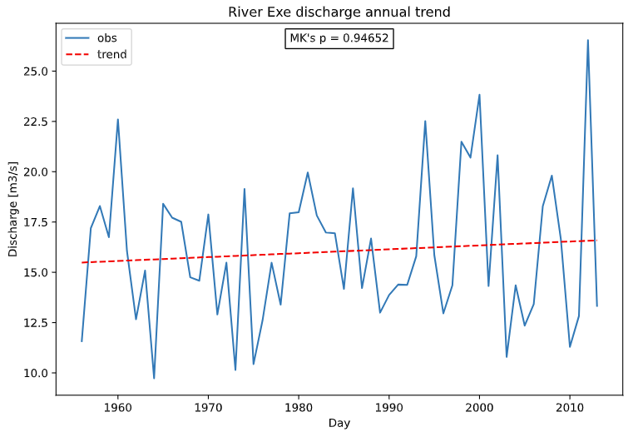
River Exe, development of river discharge
Trend in annual discharge (River Exe)

Slide 12
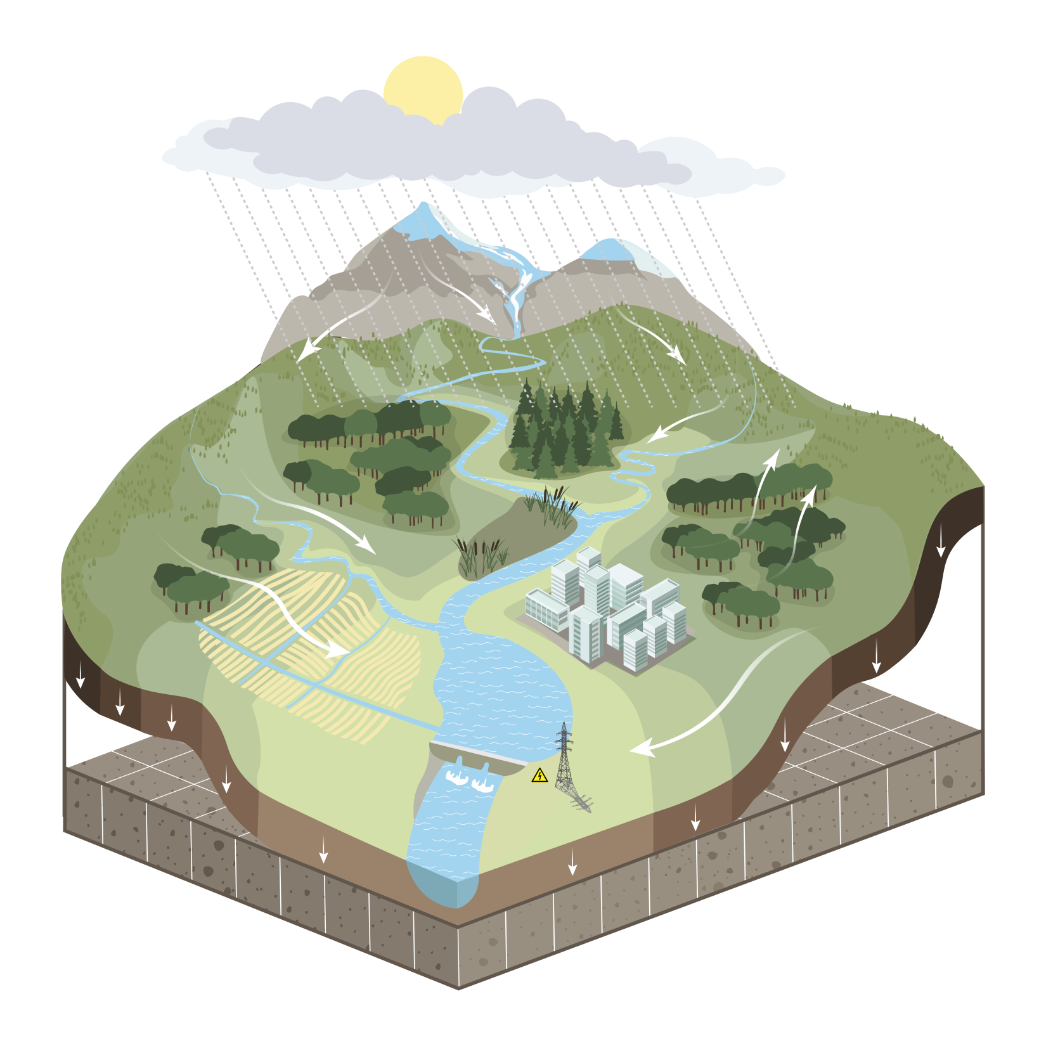
Eco-hydrological model SWIM
Natural processes
Weather / climate (input)
  Precipitation (rain & snow)
  Temperature, solar radiation, rel. humidity
Hydrology
  Infiltration
  Runoff: surface, sub-surface, groundwater
  River discharge
  Evapotranspiration
Vegetation
  Natural: forests, grasslands, savannah...
  Managed crops
Glaciers

Slide 13
Eco-hydrological model
Water and land management
Crop management
  Crop rotations
  Fertilization
Irrigation
  Crop water demand / deficits
  Water use efficiency
Water allocation
Reservoirs
  Hydropower
  Flood protection
  Water supply

Slide 14
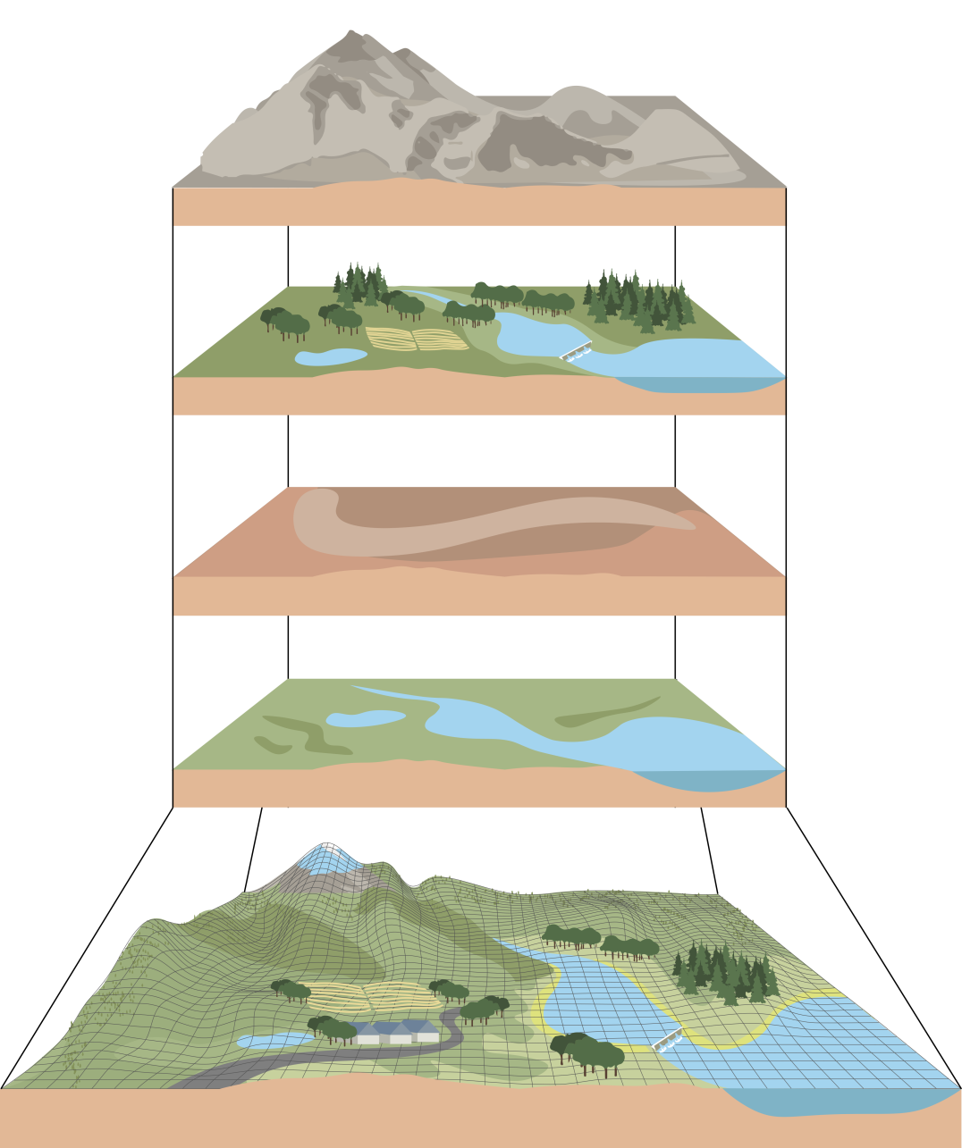
Spatial data
Basic GIS layers
Elevation, slope (DEM)
European Soil Map
CORINE land use map
Digital Elevation Model of 100 m resolution
Climate data of European Weather Service
ISIMIP climate scenario data
Land use / cover (LULC)
Natural, managed
Soils
Climate input
Other
Reservoirs, irrigation,
wetlands, glaciers, elevation
Hydrotopes (HRUs)

Slide 15

Rivers and observed stations considered in the model set-up
No of catchments: 344
No of subbasins: 1630
No of hydrotopes: 47948
No. of discharge station: 167

Slide 16
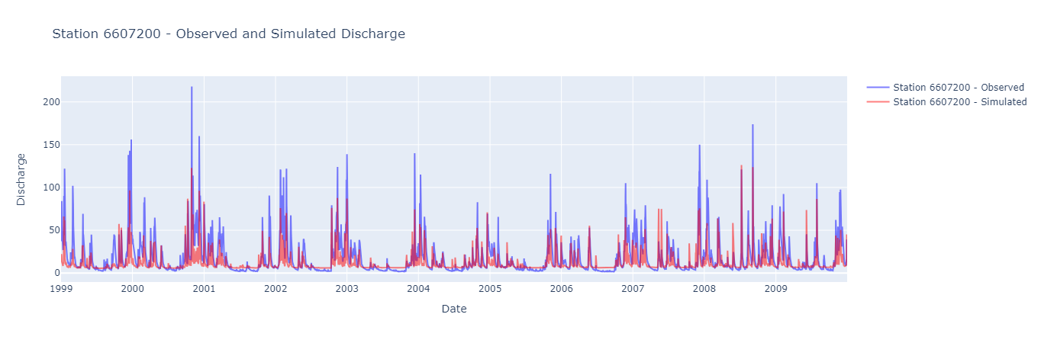
Comparison of observed and modeled discharge
Workshop II: Westcountry – Climate vulnerability, Impacts and Projections
SWIM was applied for 344 river catchments in GB, including 4 located in Westcountry:
River Tamar
River Torridge
River Taw
River Exe
(Global multi-goal calibration using observed discharge at XYZ stations and sattelite ET data)
Example: River Exe –
modelled and observed discharge [m³/s]

Slide 17
Projected annual and seasonal discharge (River Exe)
Workshop II: Westcountry – Climate vulnerability, Impacts and Projections
Development of annual discharge until end of the century (River Exe)

Slide 18
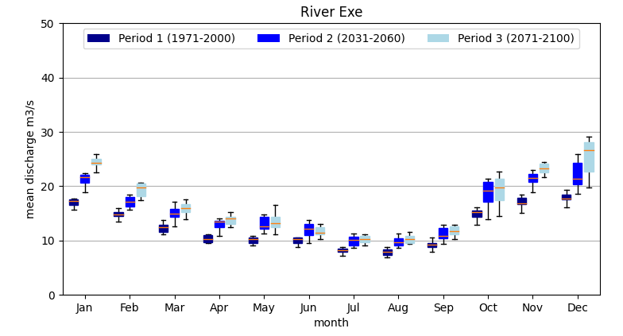
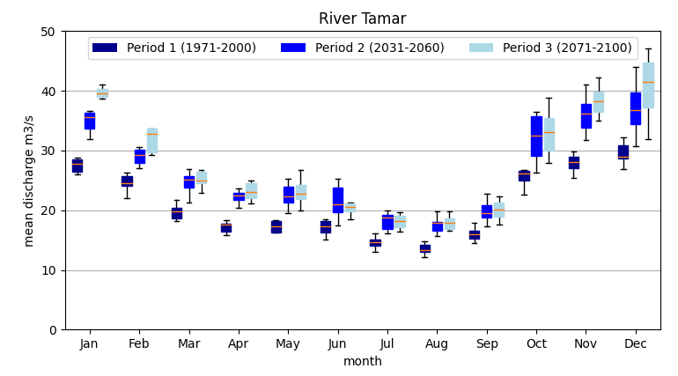
Projected annual and seasonal discharge (River Exe)
Workshop II: Westcountry – Climate vulnerability, Impacts and Projections
Development of monthly discharge (River Exe)
Development of monthly discharge (River Tamar)

Slide 19
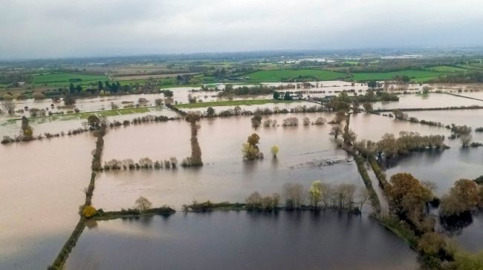
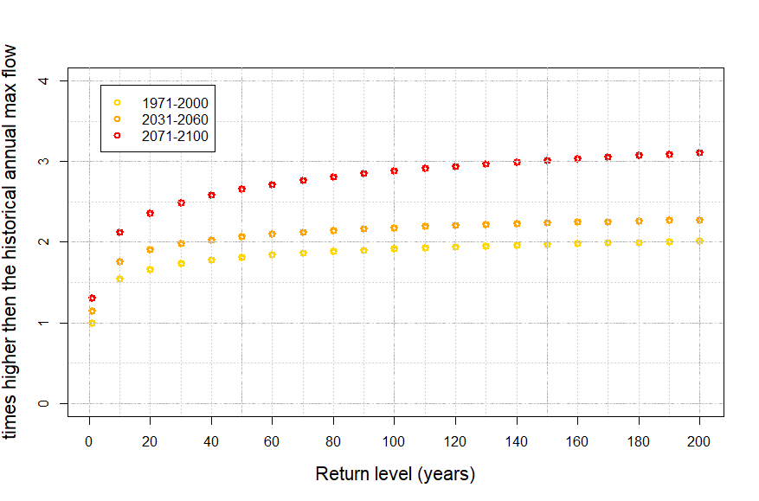
Development of flood hazard – hot scenario
Workshop II: Westcountry – Climate vulnerability, Impacts and Projections
Projected changes in flood hazard (River Exe) – hot scenario RCP585
River Exe – change in flood return levels high end scenario
More
often
Strong increase in flood risk mid – end of century
More

Slide 20
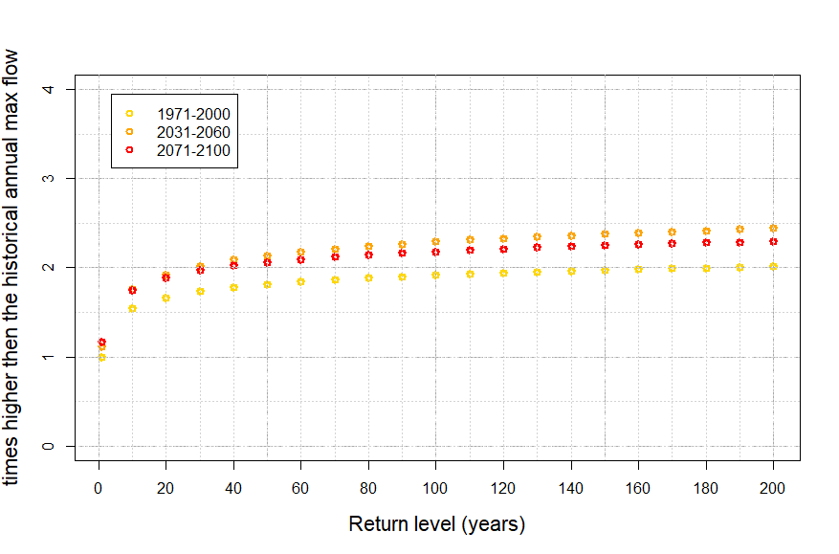
Development of flood hazard – green scenario
Workshop II: Westcountry – Climate vulnerability, Impacts and Projections
Projected changes in flood hazard (River Exe) – green scenario RCP126
River Exe – change in flood return levels low-end scenario
River Exe – change in flood return levels high end scenario
After increase until mid of the century a slow decrease in flood hazard

Slide 21
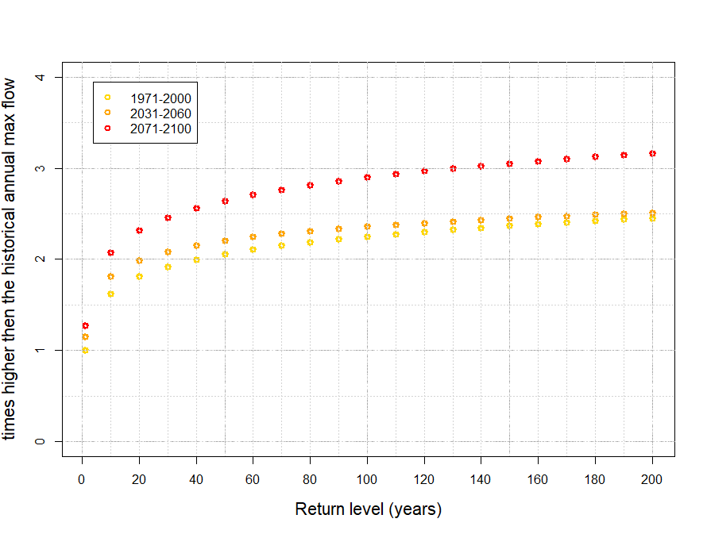
Development of flood hazard – hot scenario
Workshop II: Westcountry – Climate vulnerability, Impacts and Projections
Projected changes in flood hazard (River Tamar) – hot scenario RCP585
River Tamar – change in flood return levels high-end scenario
Strong increase in flood risk mid – end of century

Slide 22
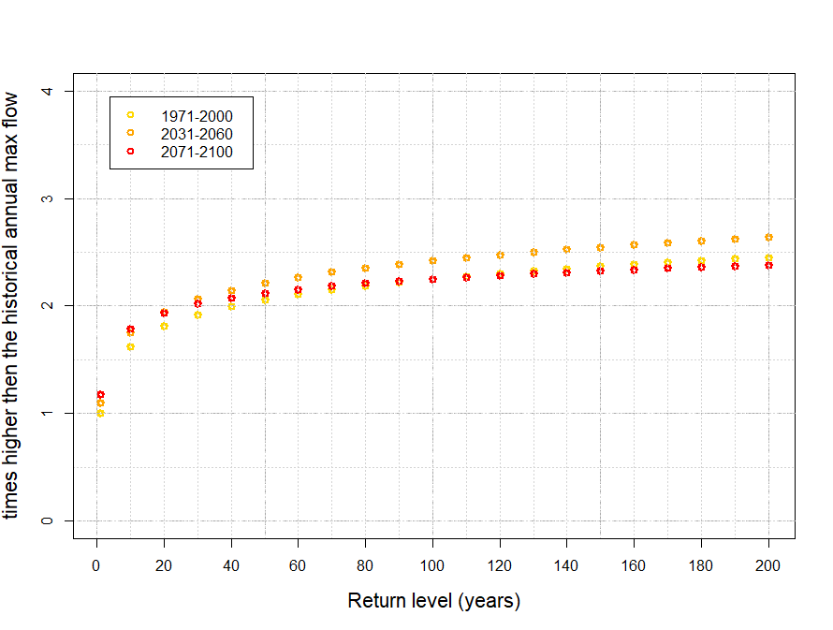
Development of flood hazard – green scenario
Workshop II: Westcountry – Climate vulnerability, Impacts and Projections
Projected changes in flood hazard (River Tamar) – green scenario RCP126
River Tamar – change in flood return levels low-end scenario
After increase until mid of the century a stronger decrease in flood hazard

Slide 23
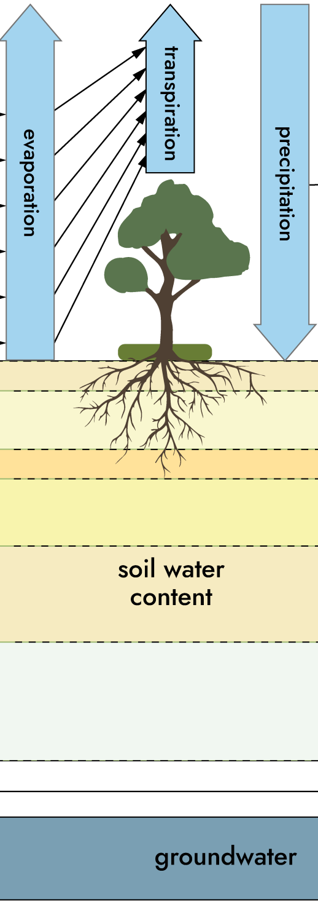
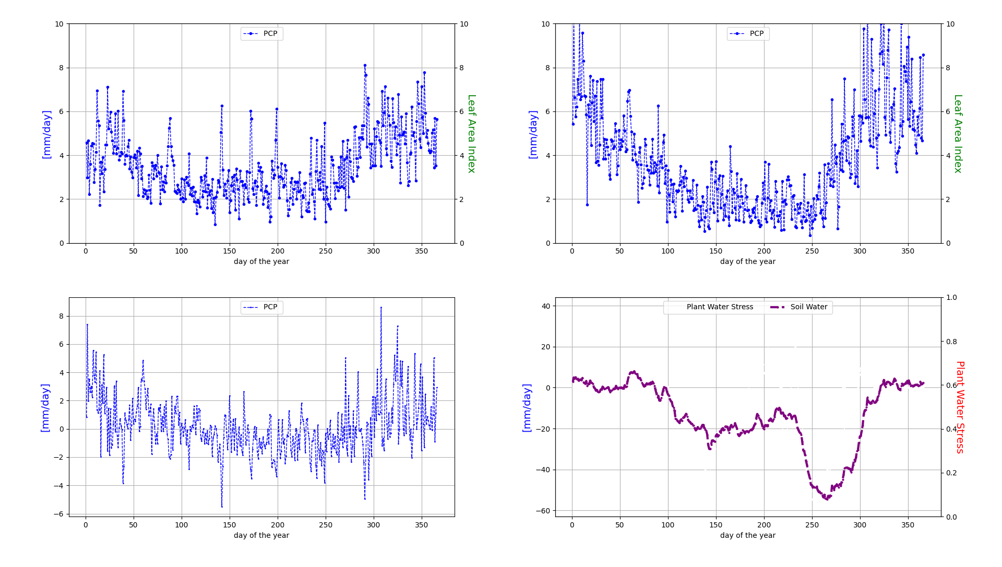
Change in hydrological processes at plot scale
Workshop II: Westcountry – Climate vulnerability, Impacts and Projections
Soil water flows and vegetation growth (arable land)
1971-2000
2071-2100
precipitation

Slide 24
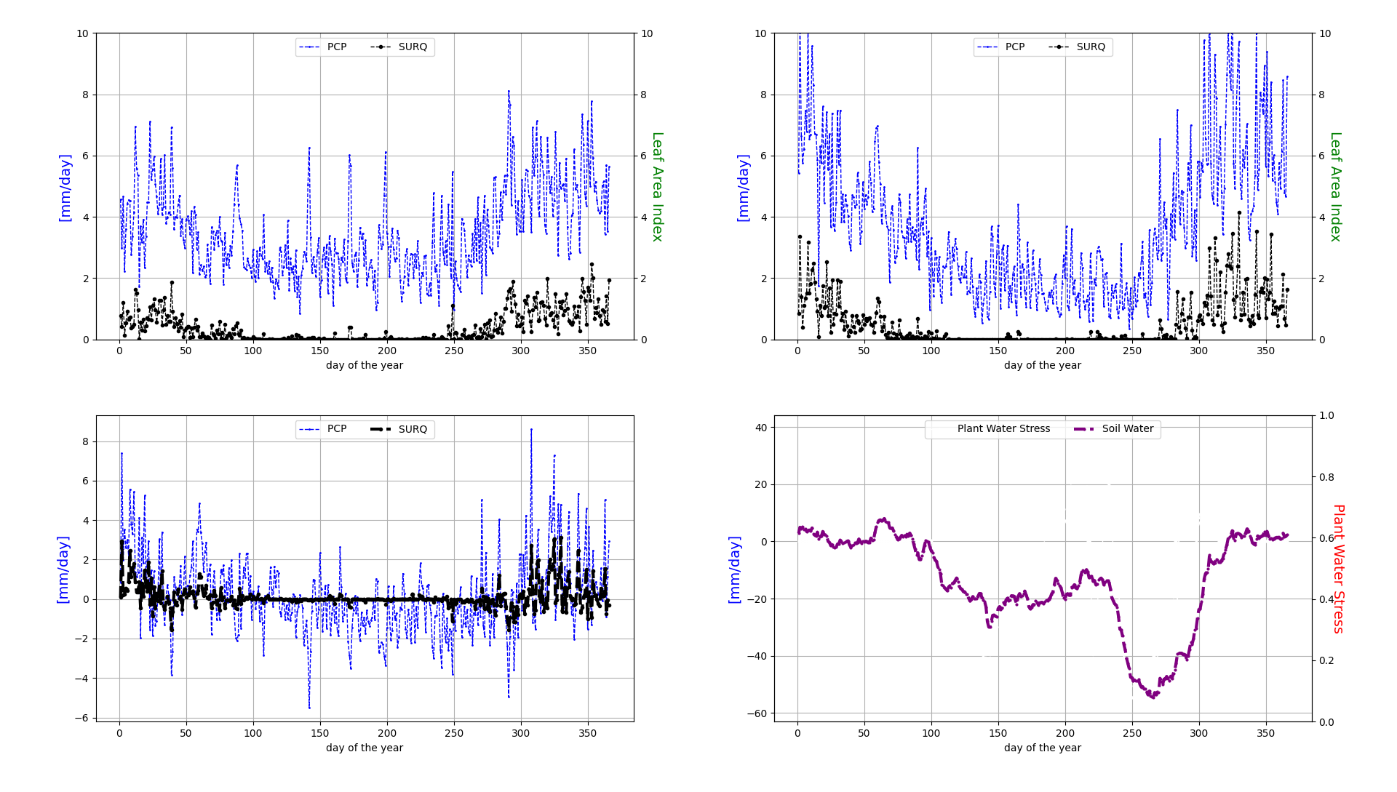
Change in hydrological porcesses at plot scale
Workshop II: Westcountry – Climate vulnerability, Impacts and Projections
Soil water flows and vegetation growth
1971-2000
2071-2100
Surface runoff

Slide 25

Change in hydrological porcesses at plot scale
Workshop II: Westcountry – Climate vulnerability, Impacts and Projections
Soil water flows and vegetation growth
1971-2000
2071-2100
Groundwater recharge

Slide 26
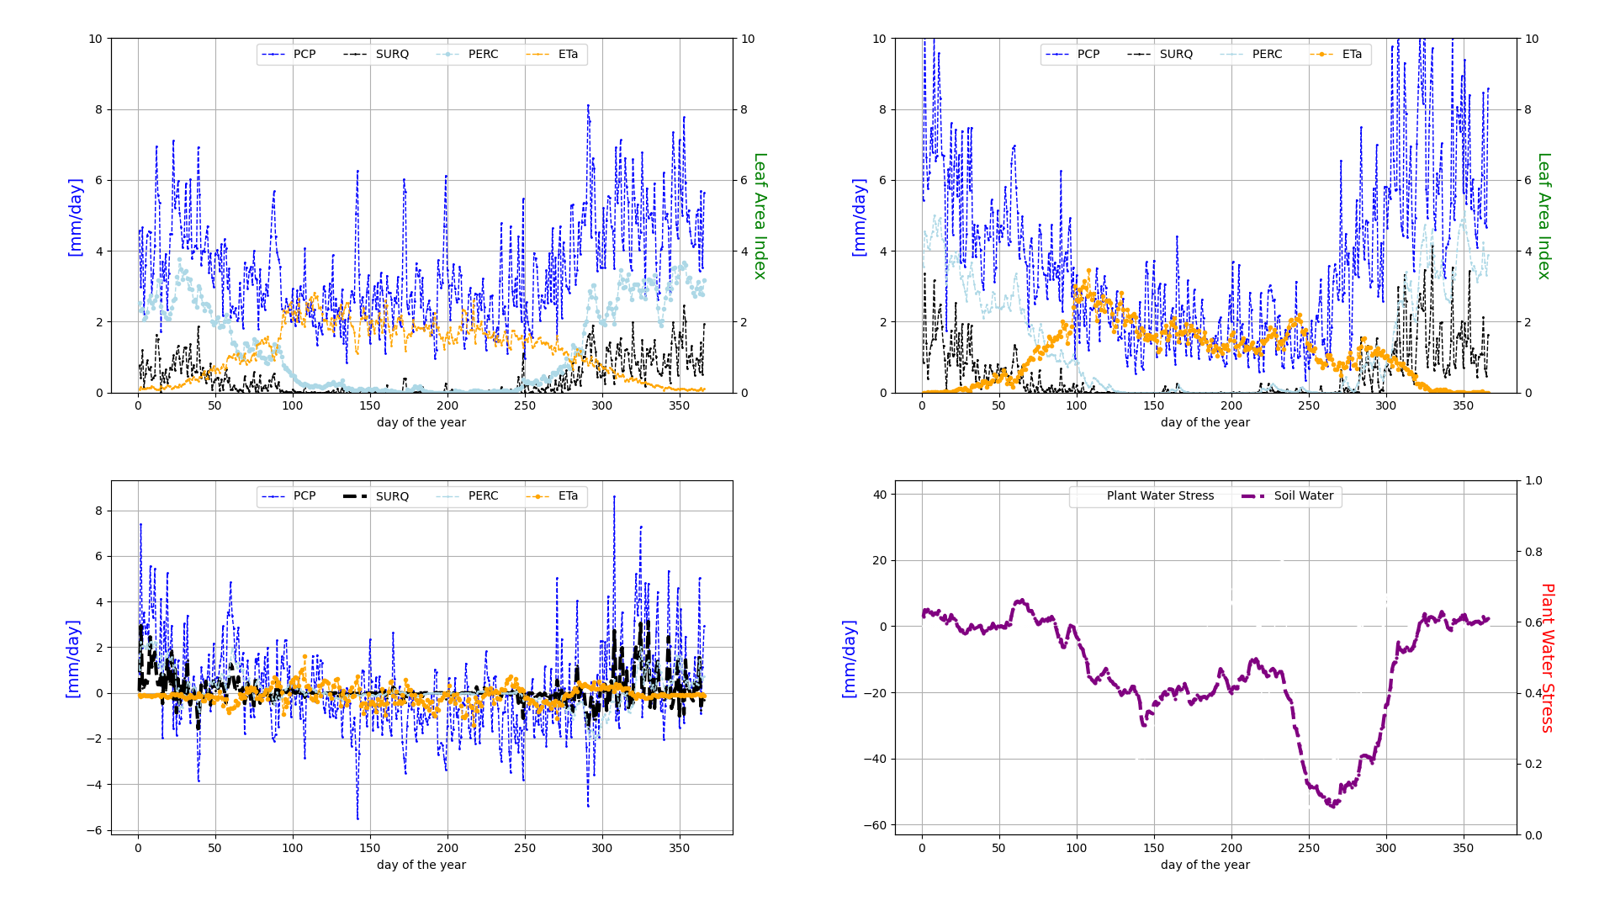
Change in hydrological porcesses at plot scale
Workshop II: Westcountry – Climate vulnerability, Impacts and Projections
Soil water flows and vegetation growth
1971-2000
2071-2100
Evapotranspiration

Slide 27
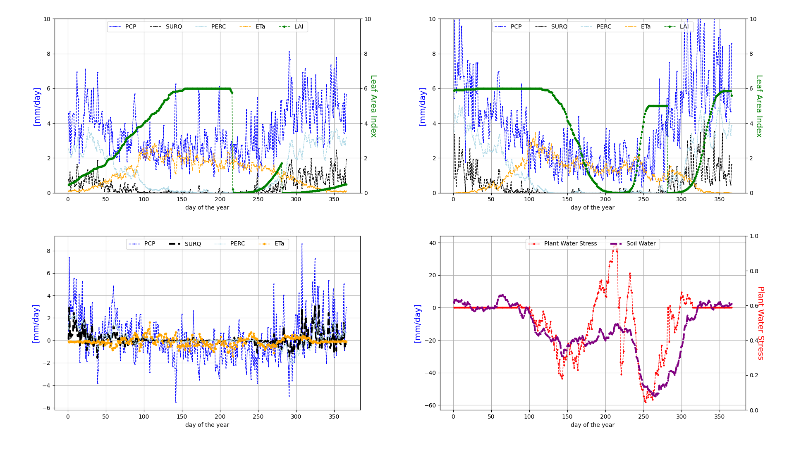
Change in hydrological porcesses at plot scale
Workshop II: Westcountry – Climate vulnerability, Impacts and Projections
Soil water flows and vegetation growth
1971-2000
2071-2100
Leaf Area Index

Slide 28
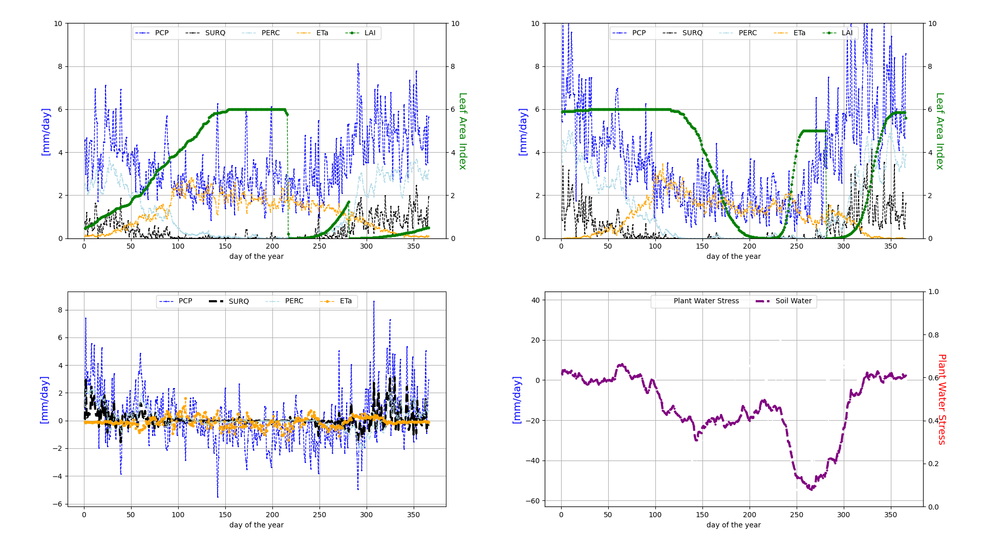
Change in hydrological porcesses at plot scale
Workshop II: Westcountry – Climate vulnerability, Impacts and Projections
Soil water flows and vegetation growth
1971-2000
2071-2100
Leaf Area Index
Soil water

Slide 29
Change in hydrological porcesses at plot scale
Workshop II: Westcountry – Climate vulnerability, Impacts and Projections
Soil water flows and vegetation growth
1971-2000
2071-2100
Leaf Area Index
Soil water
Water stress

Slide 30
Impacts on water quality

Slide 31
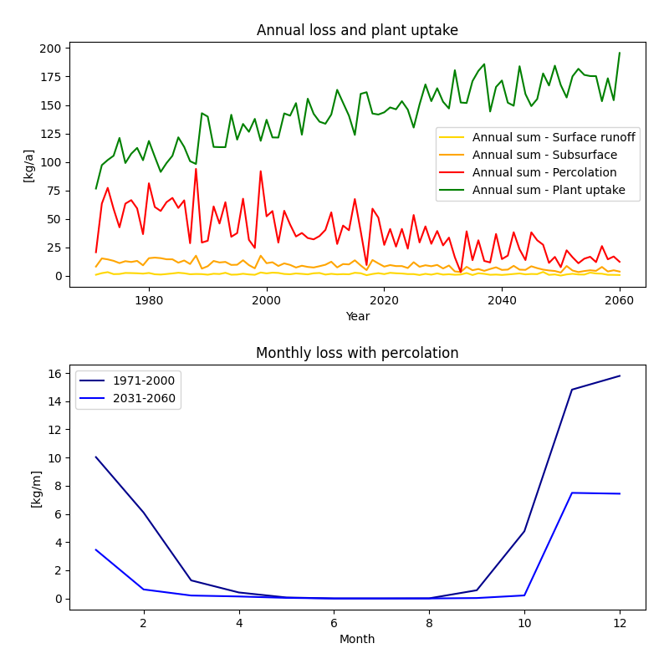
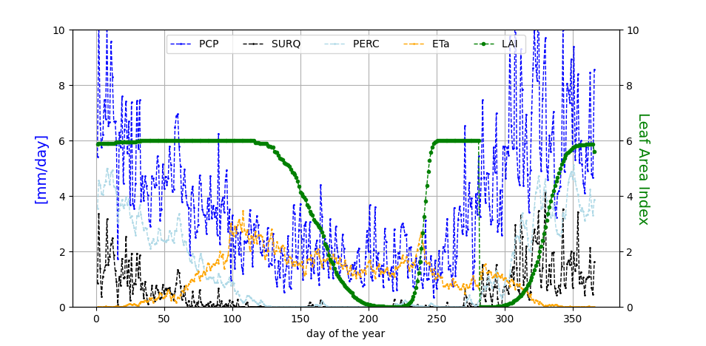
Impacts on water quality
Change in nutrient flows (total nitrogen):
Plant uptake
Very management dependent
Second crop? Fertilizer regime?
Cover crops are relevant
Losses
Past: High losses in winter with percolation

Slide 32
Impacts on health and outdoor productivity

Slide 33
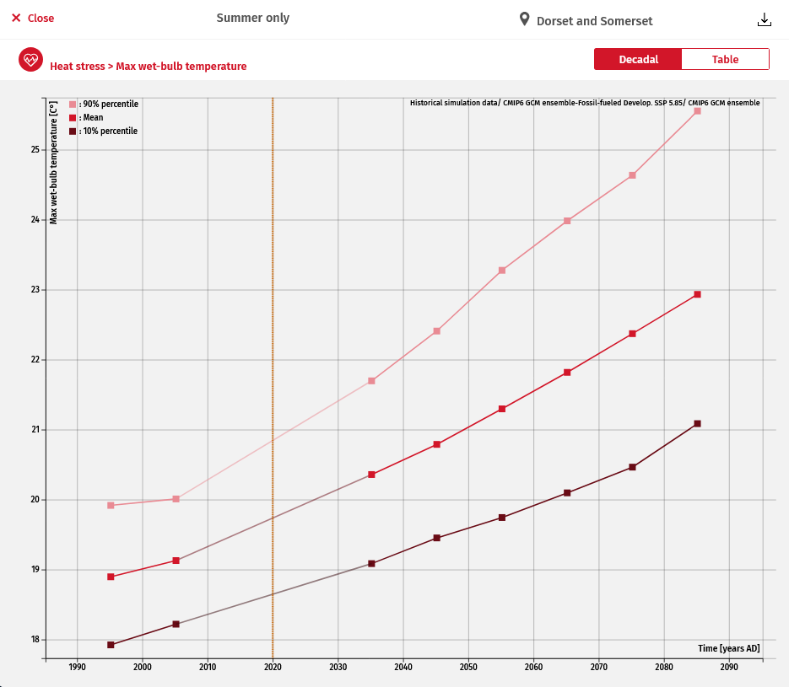
Simulations and projections
Workshop II: Westcountry – Climate vulnerability, Impacts and Projections
Health: Wet Bulb Globe Temperature
Wet Bulb Globe Temperature (WBGT) is a measurement used to assess the risk of heat related illnessess due to exposure to the current temperature, humidity, wind speed and solar radiation parameters.
Max WBGT corresponds to the daily maximum values of WBGT.
< 25.6°C - 27.7°C = White: 5 min rest every 30 min
27.8°C - 29.4°C = Green: 5 min rest every 25 min
29.5°C - 31°C = Yellow: 5 min rest every 20 min
31.1°C - 32.1°C = Red: 5 min rest every 15 min
> 32.2°C = Black: Suspend athletic activities recommended

Slide 34
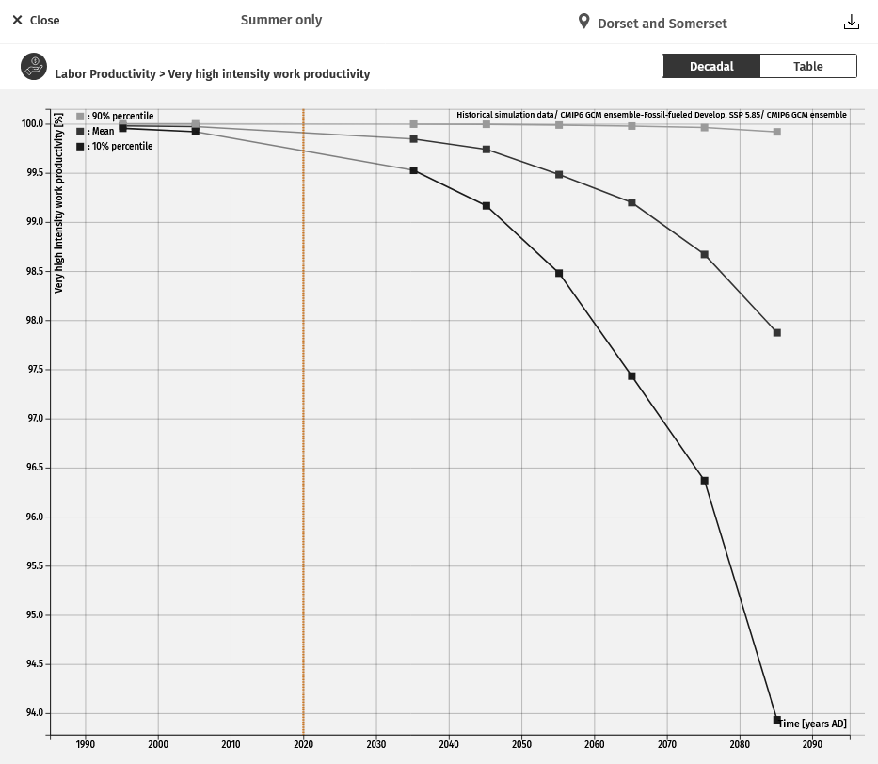
SWIM model simulations and projections
Workshop II: Egaleo – Climate vulnerability, Impacts and Projections
Outdoor productivity
Labor productivity denotes the maximum potential work output achievable by an individual in a day. This measure is represented as a percentage (%) to indicate the proportion of work that can be achieved under current climatic conditions. It is mainly derived from the impact of heat on productivity, as exposure to heat stress tends to diminish the average worker's capacity to perform tasks efficiently.
There are 4 different levels of labor productivity levels, each corresponding to a certain amount of work intensity:
200W = Low intensity work
300W = Medium intensity work
400W = High intensity work
500W = Very high intensity work

Slide 35
Summary
Hotter summers and warmer winters -> extension of the vegetation period and increasing water vegetation demand (EvapoTranspiration)
Wetter winters and drier summers -> drier soils in summer, more water stress, but in winter increase in groundwater recharge leading to more water in rivers (also in summer)
More intense precipitation -> increase in flood number and intensity, more surface runoff, more erosion and phoshorous losses. Riparian zones and wetlands to counteract
Longer vegetation period -> two crops? But wetter soil conditions in spring and fall may lead to problems with cultivation. Increasing Temperature/vegetation period may foster biotic risks (Pest and diseases)
More vegetation in winter -> May lead to more nutrient (nitrate) uptake and reduce losses with percolation. Cover crops in winter are important.
Higher water temperatures in rivers -> stimulate algae growth and blooming
Cropping and fertilization schemes have to be adapted accordingly

Slide 36
Thanks!
Any questions?

