Slide 1
Hydroclimatic Risks
Fred F. Hattermann & Peter Hoffmann
et al.

Slide 2

Who we are

Slide 3
Goals
Quantification of climate risks at the regional scale will be improved and provided for end-user oriented applications.
Cross-sectoral regional impact assessments to analyze sectoral feedbacks and conflicts, to support adaptation planning, and to improve societal resilience.

Slide 4
Achievements 2023
Papers:
- 7 published, 2 accepted, 4 in review, and 8 submitted
- 9 first authorships
Projects:
13 projects running (EU, BMBF, DFG, Worldbank, Ministries…)
Education (lectures, PhDs, Master, workshops)
Media communication

Slide 5
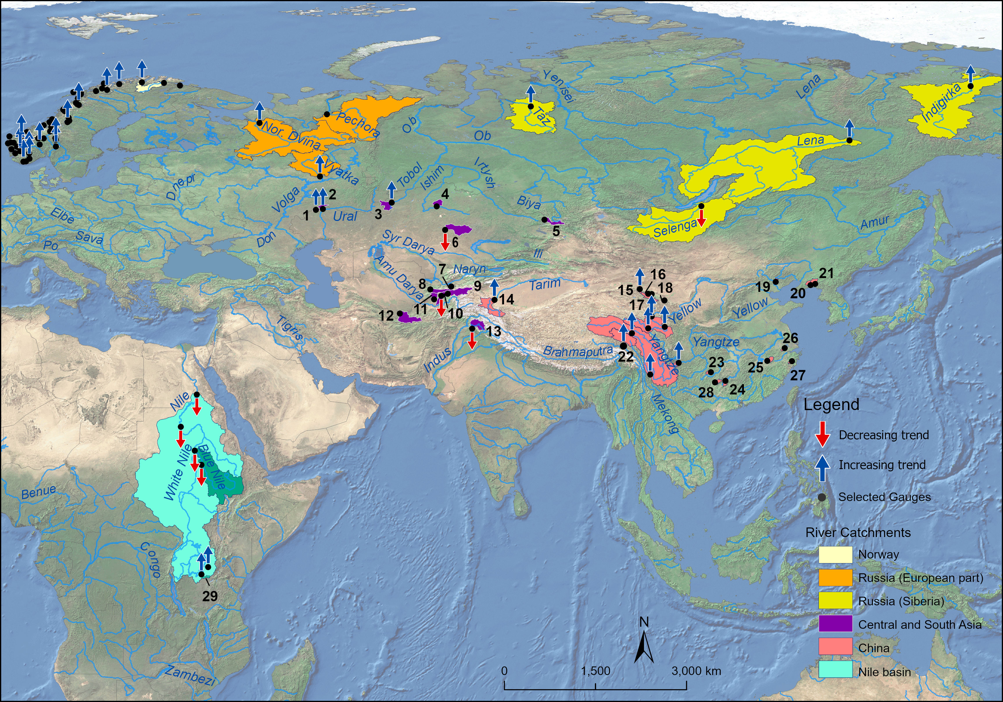
Highlights #1: Special Issue in Climatic Change
Title: Exploring the contribution of climate change to recent trends in hydrological processes
10 Articles,
3 first authorships,
3 co-autorships
9 accepted, 1 almost accepted
General results: more increase than decrease, increase often in moutains/ headwaters

Slide 6
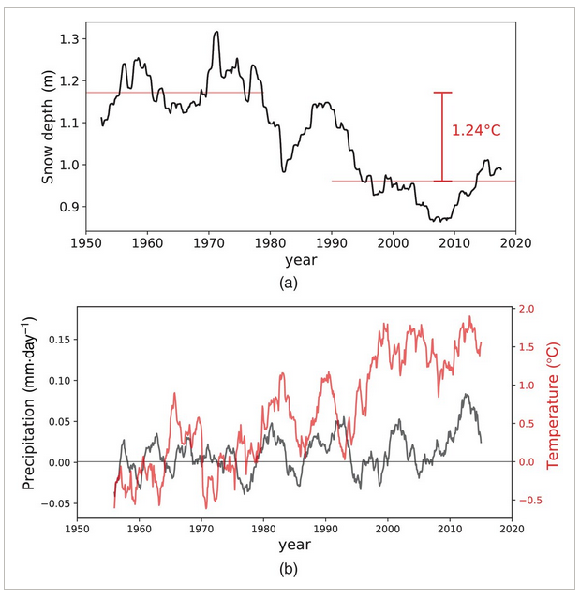
Highlights #2: Selected publications
Fallah, F., Didovets, I., Rostami, M., Hamidi, M. (2024): Climate change impacts on Central Asia: Trends, extremes and future projections. International Journal of Climatology
Fallah, B., Rostami, M. (2024) Exploring the impact of the recent global warming on extreme weather events in Central Asia using the counterfactual climate data ATTRICI v1.1. Climatic Change 177, 80 https://doi.org/10.1007/s10584-024-03743-0

Slide 7
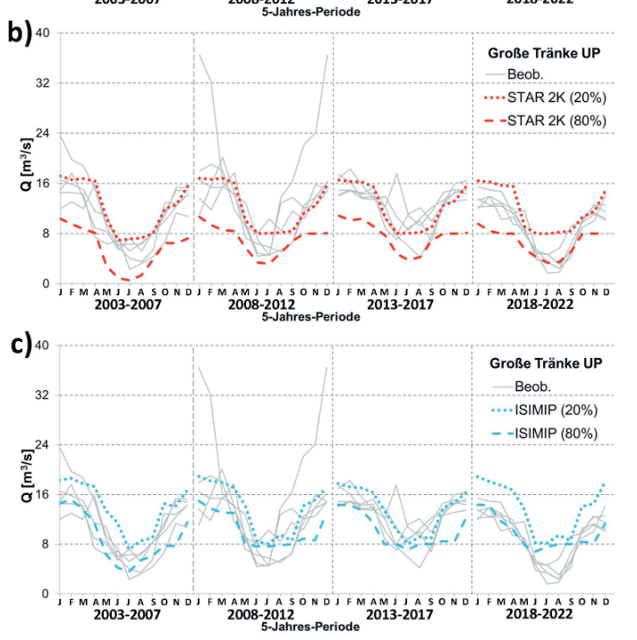
Highlights #2: Selected publications
Koch, H., Gädeke, A. Hattermann, F. (2024): Szenarien des globalen Wandels im bergbaugeprägten Spreegebiet – Ein Rückblick nach 20 Jahren. Hydrologie & Wasserbewirtschaftung, 68, (2), 73-89. DOI: 10.5675/HyWa_2024.2_1

Slide 8
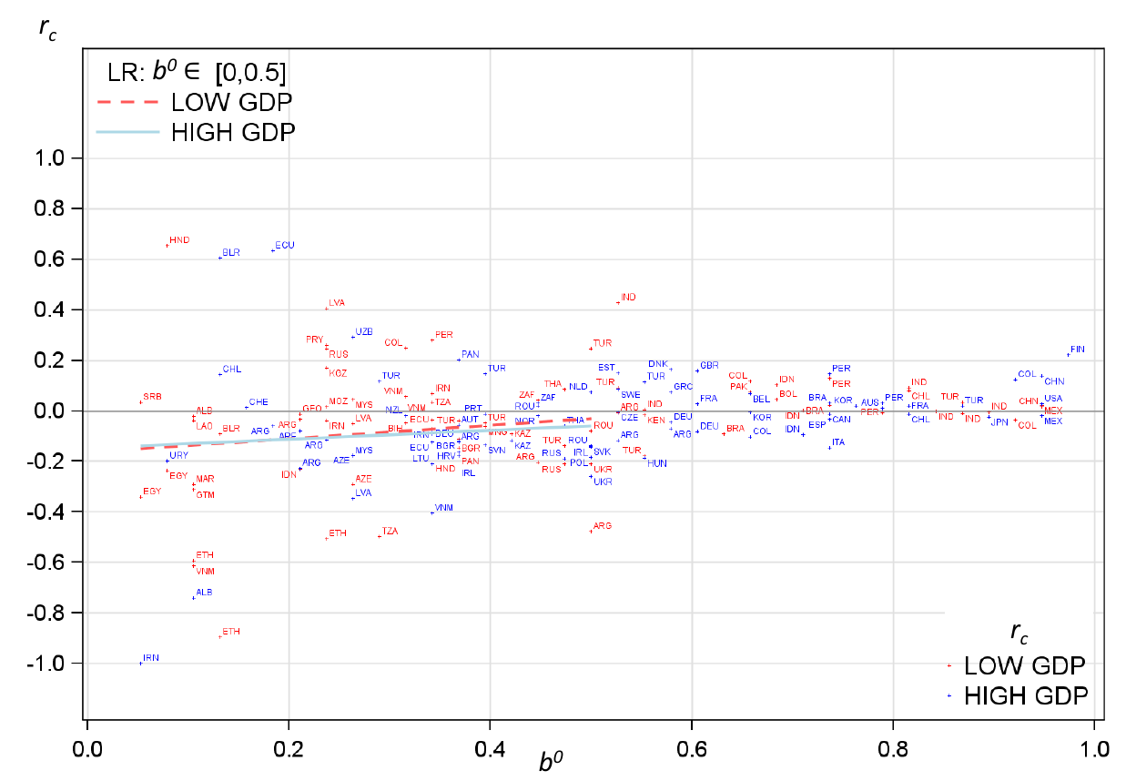
Highlights #2: Selected publications
Wechsung et al. :
The explanatory contribution of day-to-day temperature variability to variation in the annual growth rate of the regional Gross Domestic Product (GDP) is negligible!
Economic growth remains yet homeostatic to day–to–day temperature variability
Wechsung F., Ritter. M, Hoffmann P. & Wall G.
manuscript in pre-submission stage for Future Earth, submission January 2024
Kotz, M., Wenz, L., Stechemesser, A. et al. Day-to-day temperature variability reduces economic growth. Nature Climate Change (2021).
Fig.: Correlation coefficient between DTA and GDP per capita dependent on the degree of balance.

Slide 9

Highlights #2: Selected publications
Brasseur, G.P., Jacob, D., Schuck-Zöller, S. (eds) Klimawandel in Deutschland. Springer Spektrum, Berlin, Heidelberg. https://doi.org/10.1007/978-3-662-66696-8_11#
Co-authors of 4 chapters

Slide 10
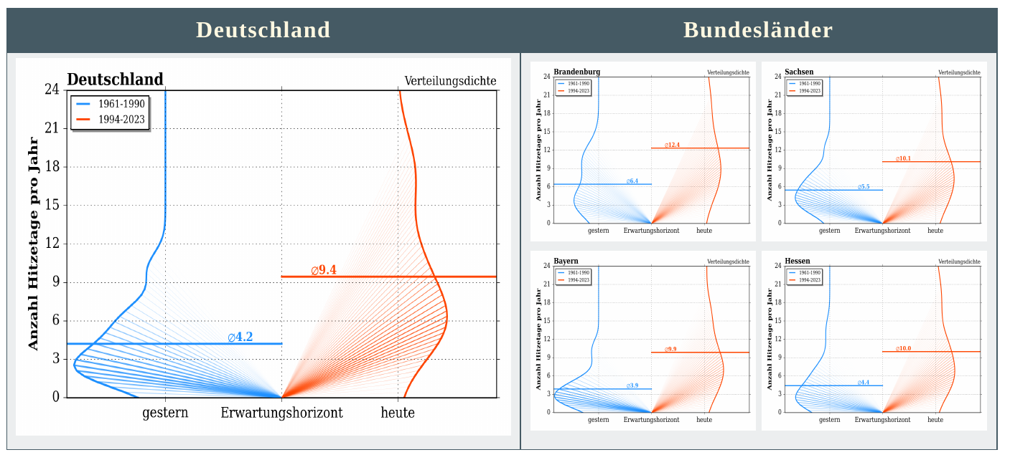
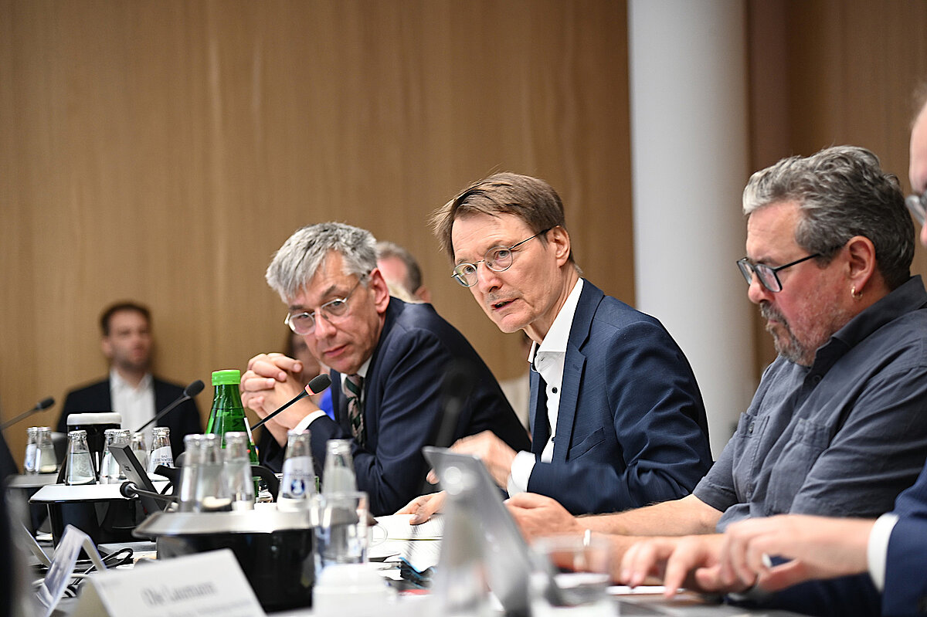
Highlights #3: Selected events
P. Hoffmann: Keynote about Heatwaves in Europe at the Heat Protection Conference
organized by Prof. Karl Lauterbach (BMG) in Berlin, May 2024
Expectation horizons for hot days: yesterday versus today
https://www.pik-potsdam.de/en/institute/departments/climate-resilience/news/before-the-next-wave-of-heat-protection

Slide 11
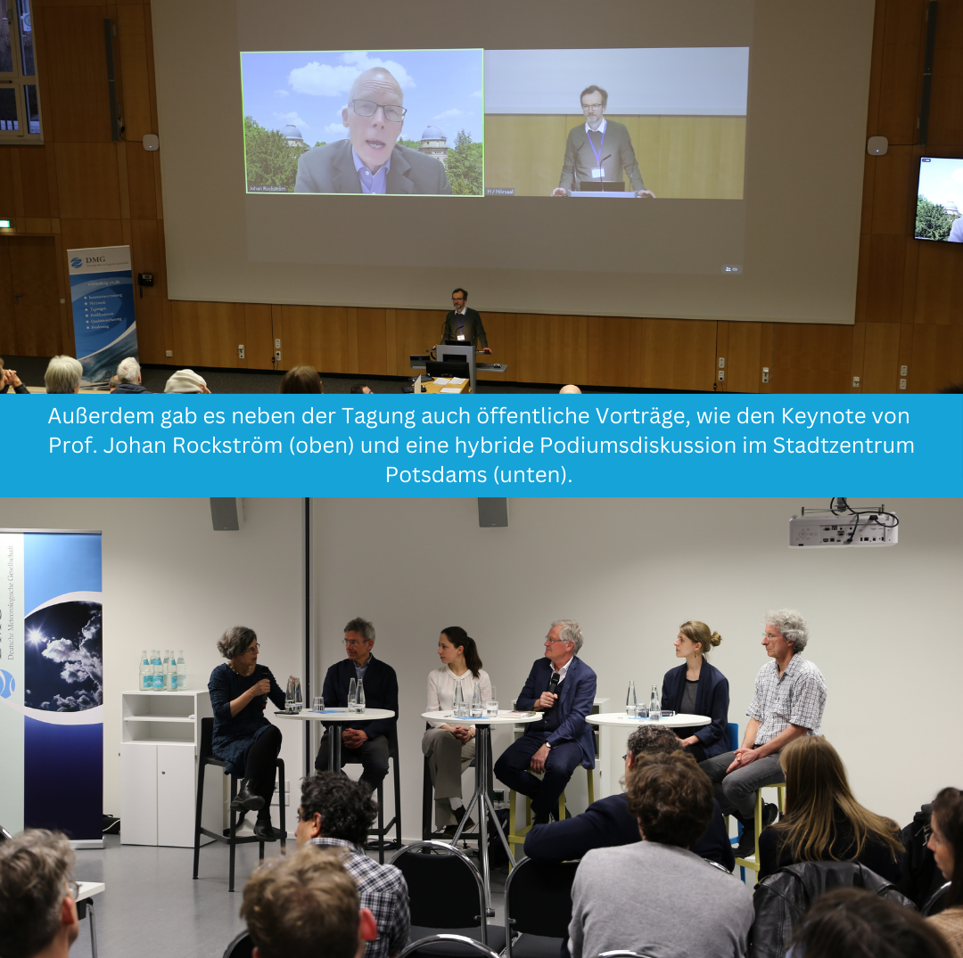
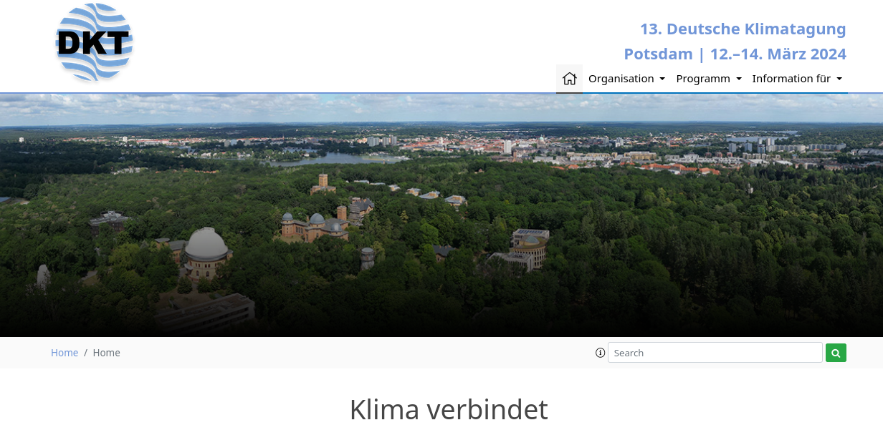
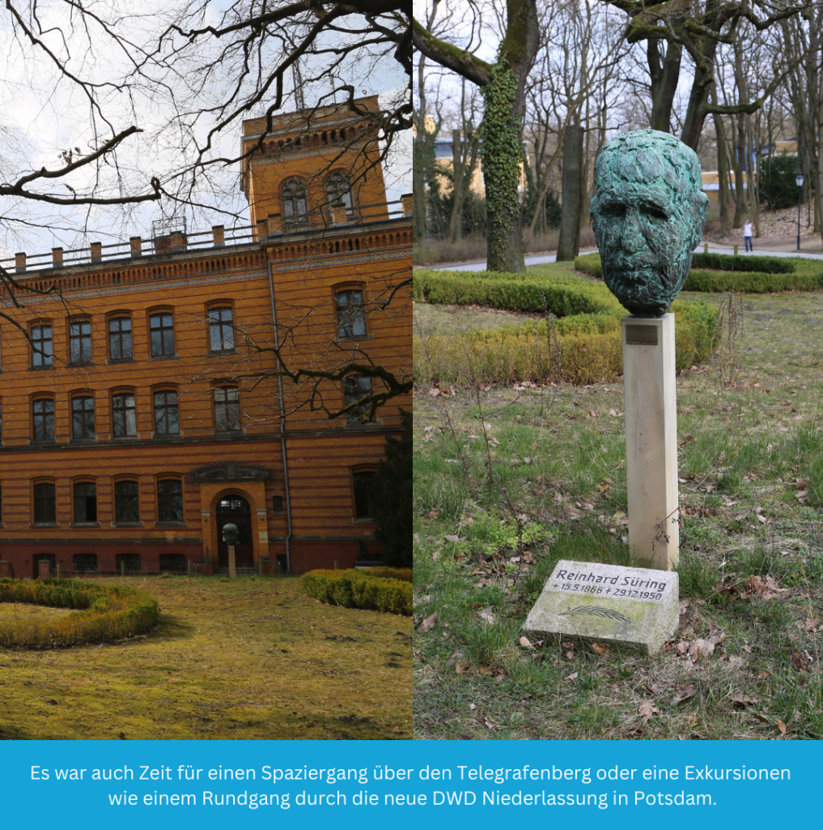
Highlights #3: Selected events
P. Hoffmann
Co-Organized the Event together with GFZ, AWI, DWD, FUB, DMG
contributions also from other RD2 members

Slide 12
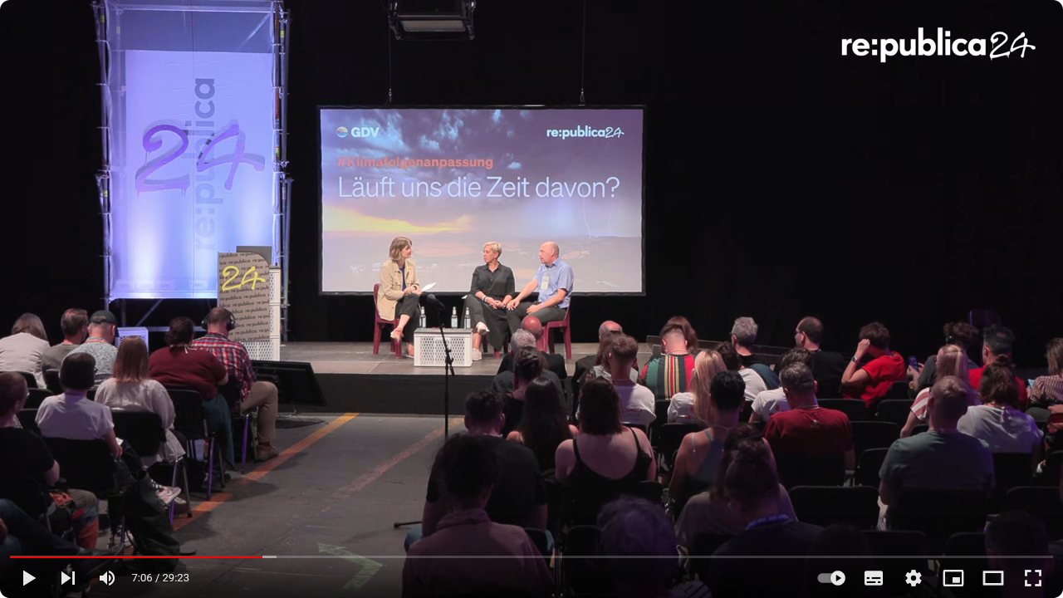
Highlights #3: Selected events
Re:Publica 24:
Fred Hattermann panel discussion with the Deputy Chief Executive Officer of the GDV (German Insurance Association)
https://www.youtube.com/watch?v=6YUPtyMTNOc

Slide 13
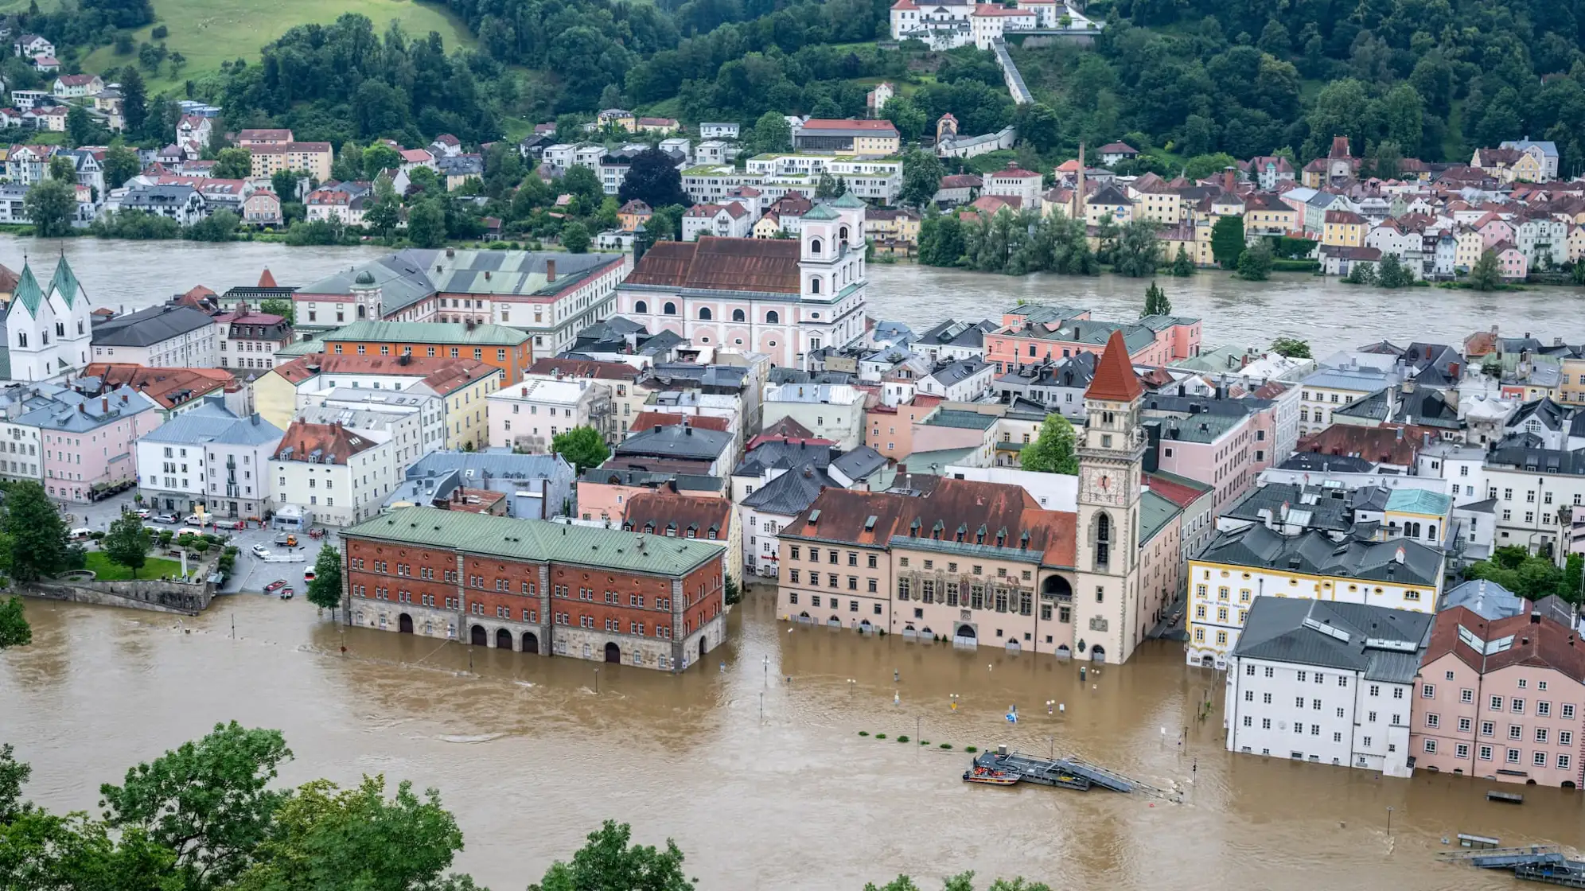
Highlights #4: HyR in the media
Numerous interviews in tv, radio and print media, main topic at the moment the floods in Central Europe
Foto: Armin Weigel/dpa

Slide 14
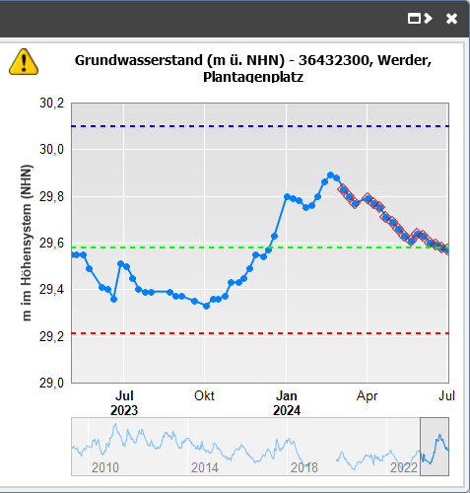
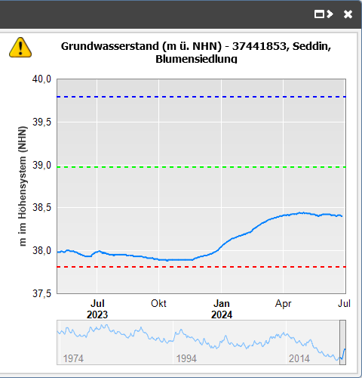
Highlights #4: HyR in the media
Another topic: Has the drought come to an end?
Close to river
Far from river
https://apw.brandenburg.de/#

Slide 15
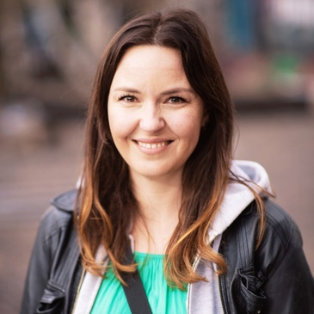


Highlights #5: New team members
Stefanie Wesch
&
Friedrich Busch
&
Diegopablo Pineda Schwarz

Slide 16

Projects
13 running projects
3 submitted
2 submitted soon
3 in preparation
3-4 of the submitted projects were either already approved or almost approved, but were put on hold due to the federal budget negotiations
New project: KARO (BMEL, Klimaresiliente Anbauverfahren zur Risiko-Optimierung – unter besonderer Berücksichtigung der Ziele der Ackerbaustrategie und ihrer regionalen Erfordernisse)

Slide 17
Thanks!

