Slide 1
Fred F. Hattermann
Potsdam Institute for Climate Impact Research hattermann@pik-potsdam.de
Earth System Analysis &
Stewardship

Slide 2
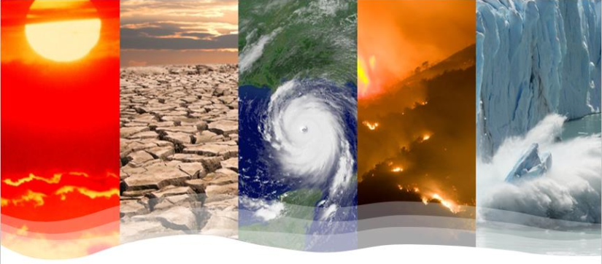
Key questions addressed
What is the role of water in the climate cycle?
Which processes are relevant?
What are the interactions with vegetation?
How can the water cycle and the water nexus be modelled?
What are possible adaptation measures and strategies?

Slide 3

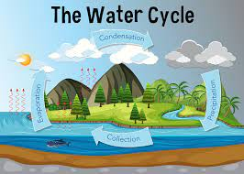
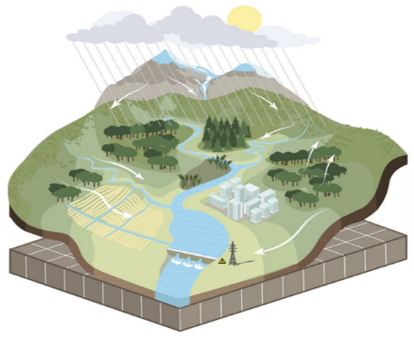

What we will do
Theory
Background and conceptualization
Examples
Modelling and interpretation
Application
Presentation of selected topics

Slide 4

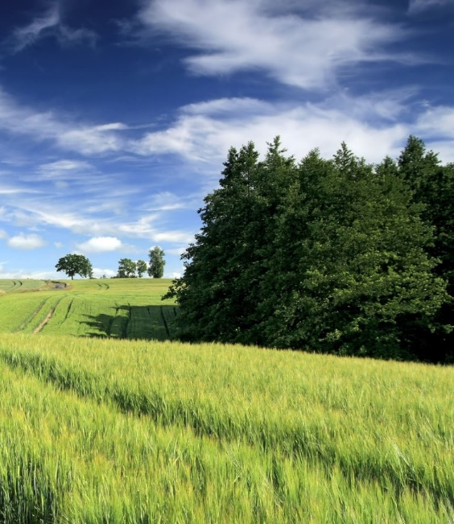

The water nexus, processes and interpretation
Climate
Soils
Water
Vegetation
Energy

Slide 5
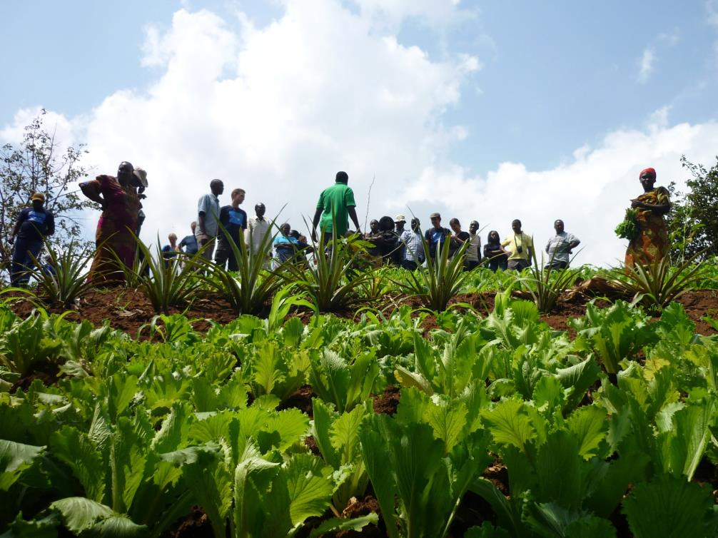
Solutions

Slide 6
Outline
Monday Nov. 20
The hydrological classics: Background and presentation about AMOC, presentation of topics
Tuesday Nov. 21
Water as a basic need, water as a threat: The nexus water – energy – food – health, hydrological extremes, erosion, selection of topics
Wednesday Nov. 22
Eco-hydrological modelling, groupwork
Thursday Nov. 23
Groupwork
Friday Nov. 24
Presentation of selected tasks, visiting PIK

Slide 7

Water is life
Nearly 97% of the world’s water is salty or otherwise undrinkable. Another 2% is locked in ice caps and glaciers. That leaves just 1% for all of humanity’s needs.
Water regulates the Earth’s temperature and the temperature of the human body, carries nutrients and oxygen to cells, and removes wastes.
75% of the human brain is water and 75% of a living tree is water.
A person can live about a month without food, but only a few days without water.

Slide 8
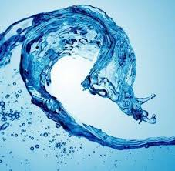
Water can be a threat
Water is a problem, when
having too much;
having too low;
having water of low quality.

Slide 9
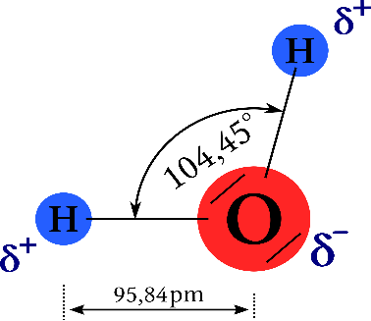
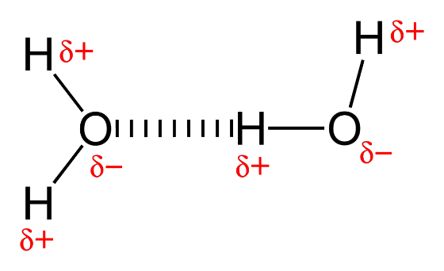
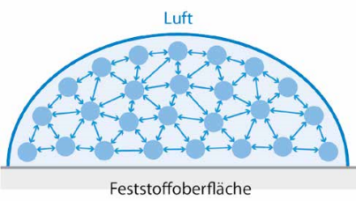

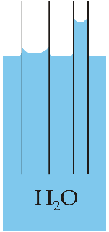
Properties of water
Dipol
Wassermolekül, Wikimedia Commons contributors, CC BY-SA.
Wasserstoffbrückenbindung, Wikimedia Commons contributors, public domain.
Water surface tension
Wasserläufer auf Wasseroberfläche, Wikimedia Commons contributors, CC BY-SA.
Aus: Fohrer, 2016.
Kapillary effect
Kapillareffekt beim Wasser, Wikimedia Commons contributors, verändert, CC BY-SA.

Slide 10
Conversion millimeter into litre
4. Niederschlag I
4.2 Niederschlagsmessung
1 mm (rain) = 1 litre / m²

Slide 11
Summary: Energy distribution on Earth’s surface
High latitudes receive light at low angles
Regions near the equator receive light at 90º
-> Light energy is more concentrated near the equator. In other words, there is a greater flux per unit area (W/m²)
Earth

Slide 12
Excess energy at the equator is transferred towards the poles by convection cells
net radiation
surplus
Energy
net radiation
deficit
90 45 0 45 90
Latitude

Slide 13
The rising air creates a
circulation cell, called a Hadley Cell
H
solar radiation
L
Rising air -> low pressure
Sinking air -> high pressure
H

Slide 14
Circulation cells and precipitation
Rising air cools; the air’s capacity to hold water drops: Clouds & Rain!
Air cools, sinks
No rain in regions
where air is
descending
Rising air is replaced
Warm air rises
HIGH
LOW
HIGH

Slide 15
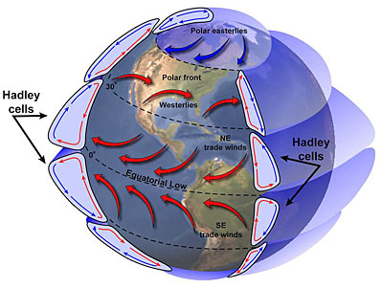
Global Atmospheric Flux and Ciculation Cells
Credit: NASA

Slide 16
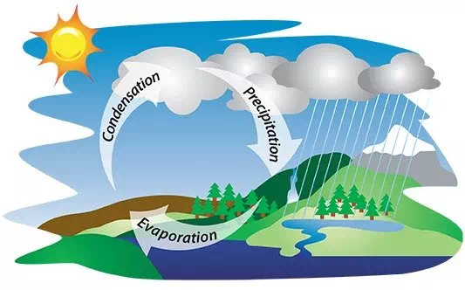
Water cycle, simple
Main processes:
Precipitation
Evaporation
Condensation
Driver:
Solar radiation and gravity

Slide 17
Weather depends on Energy Transport in the Earth System
Solar energy received is greatest
near the equator.
Energy is moved from the equator to the poles.
Energy is transferred by wind and ocean currents
and these are coupled!
Examples: Monsoon and ENSO

Slide 18
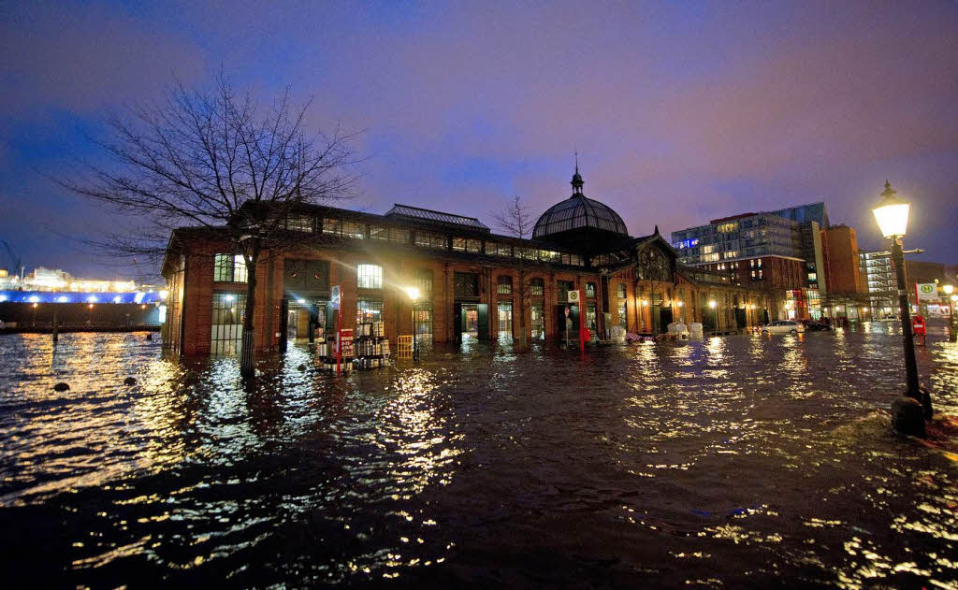
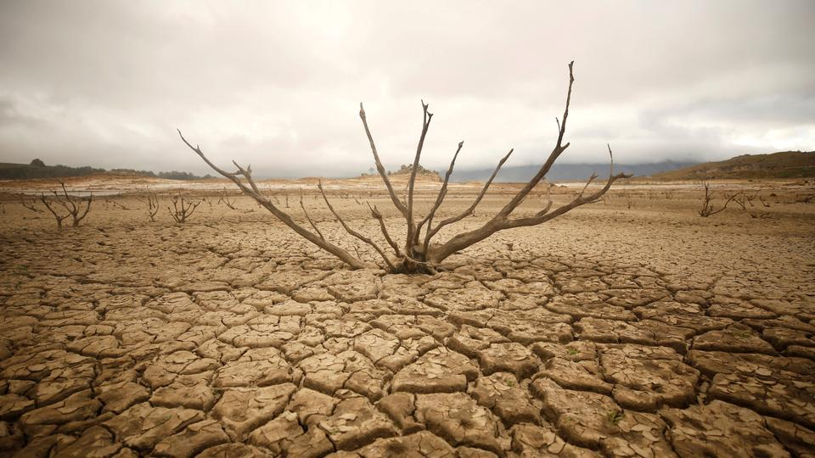
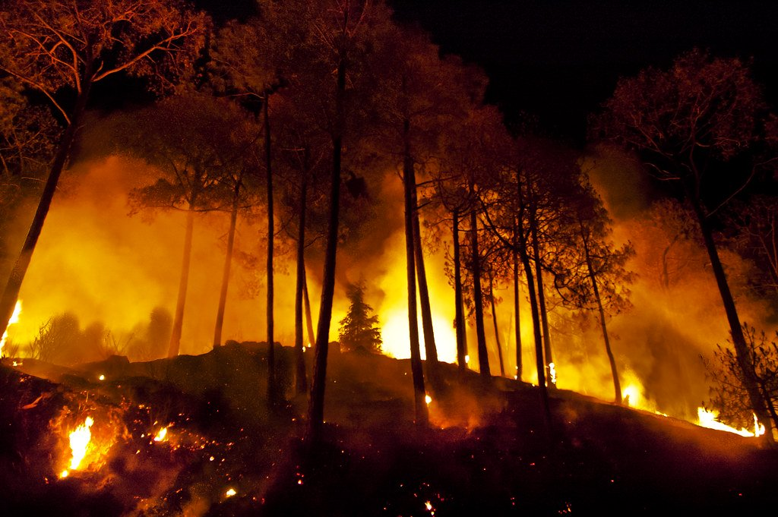
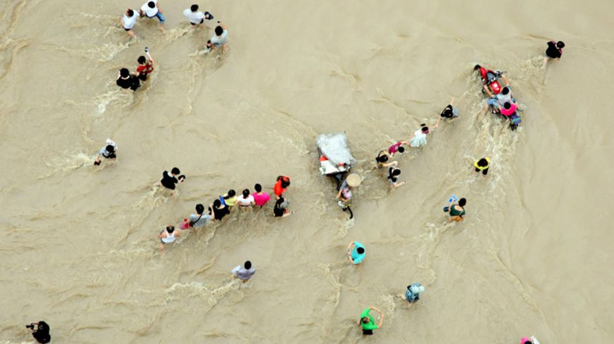
Is this climate change?

Slide 19
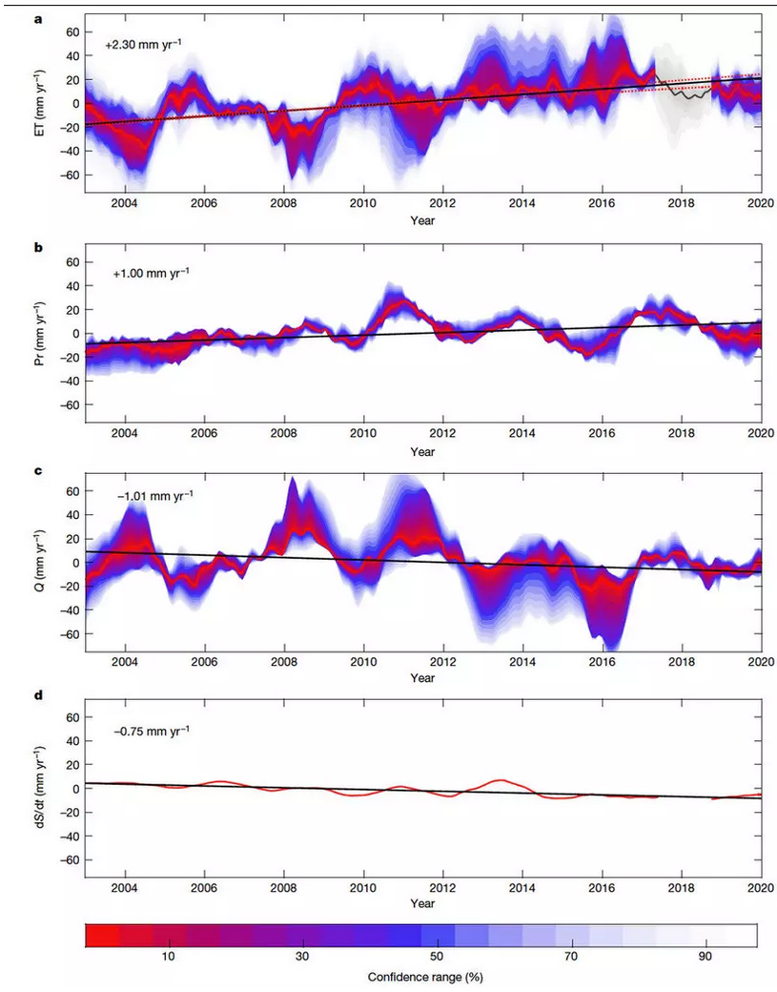
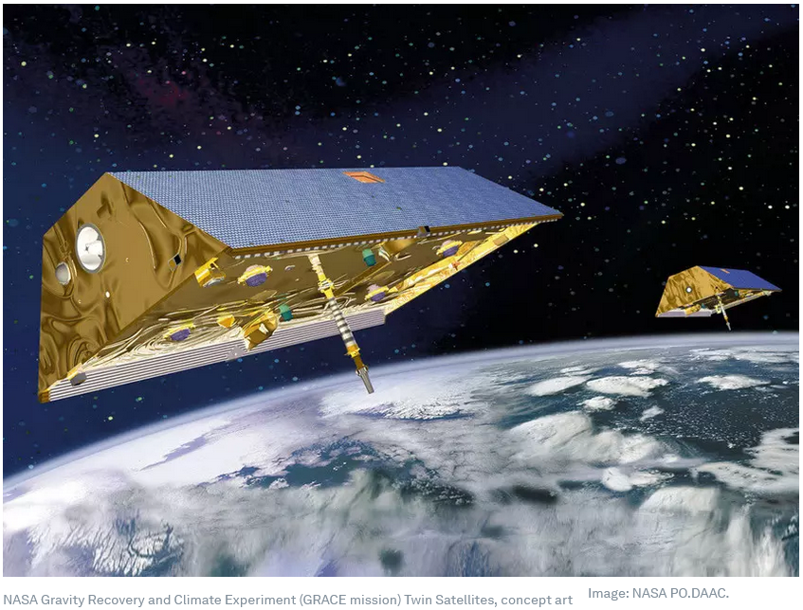
Global water trends
Evapotranspiration
Precipitation
Runoff
Gravity Recovery and Climate Experiment (GRACE)
Groundwater
Pascolini-Campbell et al (2021)
Notes:
Pascolini-Campbell, M. et al. (2021) A 10 per cent increase in global land evapotranspiration from 2003 to 2019, Nature, doi:10.1038/s41586-021-03503-5

Slide 20
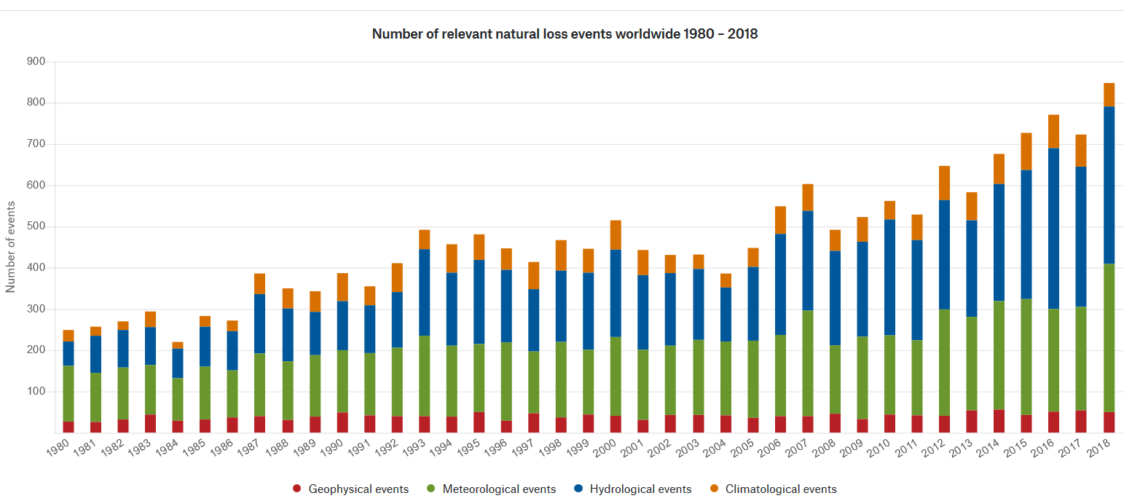
Number of events worldwide (Munich Re NatCat)
Number!

Slide 21
Hydrological tasks
After Dyck & Peschke (1995):
Exploration of the water cycle
Calculation of the water balance over different scales (earth, continents, river basins, water management systems) for different periods of time
Determination of water resources (usable share of groundwater and surface water)
Hydrological forecasts (water level, runoff, groundwater recharge, ice)
Investigation of runoff regimes (especially extreme runoff)
Use and management of water ressources

Slide 22
Literatur
Maidment, D.R. (1993): Handbook of Hydrology, McGraw-Hill, New York.
Fohrer, N. (2016): Hydrologie. Utb Taschenbuchreihe. (Sehr gutes Lehrbuch für „Einsteiger*innen“).
Dyck, S. & Peschke, G. (1995): Grundlagen der Hydrologie, 3. Auflage, Verlag für Bauwesen, Berlin.
Baumgartner, A. & Liebscher, H.J. (1996): Allgemeine Hydrologie: quantitative Hydrologie, 2. Auflage, Borntraeger, Stuttgart.
Nützmann, G. & Moser, H. (2016): Elemente einer analytischen Hydrologie. Springer Verlag. (sehr aktuell, gute Abbildungen, verständlich)
Wohlrab, B., Ernstberger, H., Meuser, A., Sokollek, V. (1992): Landschaftswasserhaushalt. Verlag Paul Parey Berlin. 352 S. Fachübergreifendes Lehrbuch, das Bezug auf die Wasserhaushaltskomponenten auf der Landschaftsebene Bezug nimmt. Umfassende Begriffsdefinitionen.
Maniak, U. (2005): Hydrologie und Wasserwirtschaft: Eine Einführung für Ingenieure. 5. Aufl., Springer, Berlin. Grundlagen zum Wasserhaushalt, sehr viel hydrologische Modellierung.

Slide 23
„The hydrological classics“
The water cycle
Precipitation
Evapotranspiration
Discharge
Storage

Slide 24
1. The water cycle

Slide 25
Definition (DIN 4049)
Water cycle
Continuous sequence of changes in the state and location of water with the main components precipitation, runoff, evaporation and atmospheric water vapour transport.
Water balance
Quantitative recording of the components of the water cycle and the change in supply in an area under consideration during a period of observation.

Slide 26
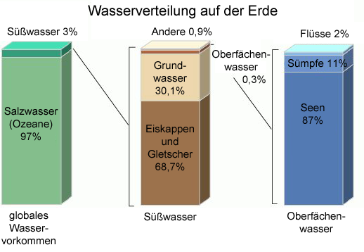
Water balance, global
Roughly:
Ca. 3 % freshwater, of that:
  2/3 in glaciers
  1/3 in groundwater
  < 1 % surface water (directly usable)
Globale Wasserbilanz aus Fohrer (2016), Zahlen nach Korzun (1978).

Slide 27
Water cycle, simple
Main processes:
Precipitation
Evaporation
Condensation
Driver:
Solar radiation and gravity

Slide 28
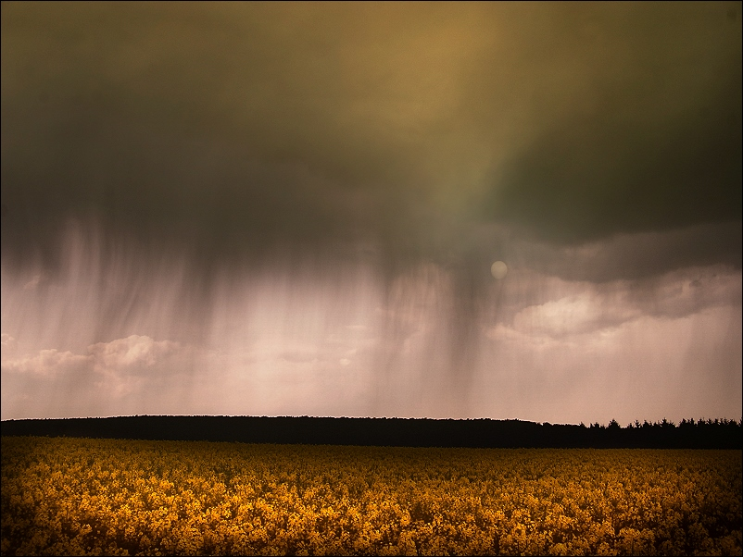
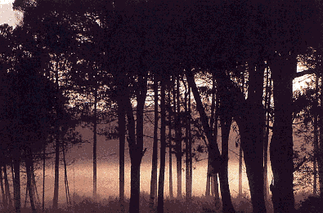
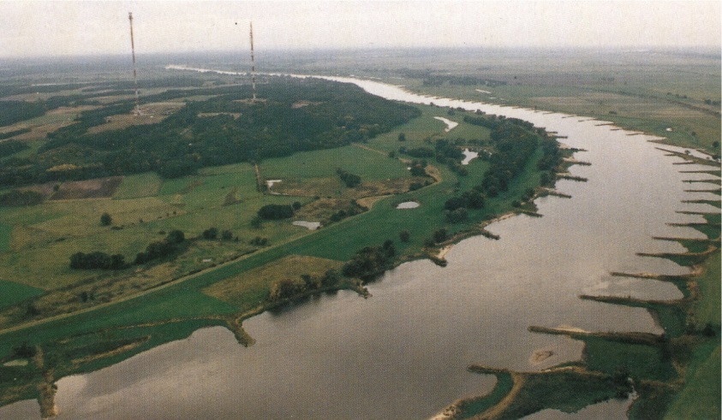
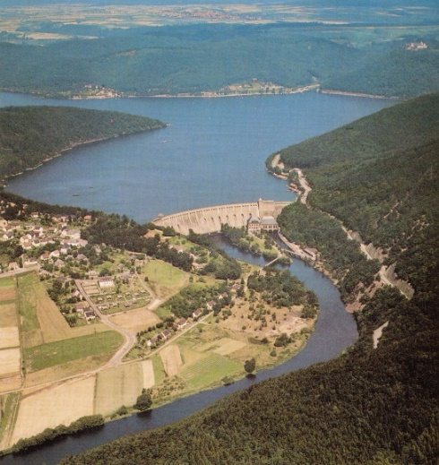
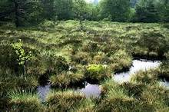
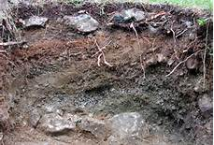
Water balance equation
Precipitation
Evaporation
=
Discharge
+/- storage
+
+

Slide 29
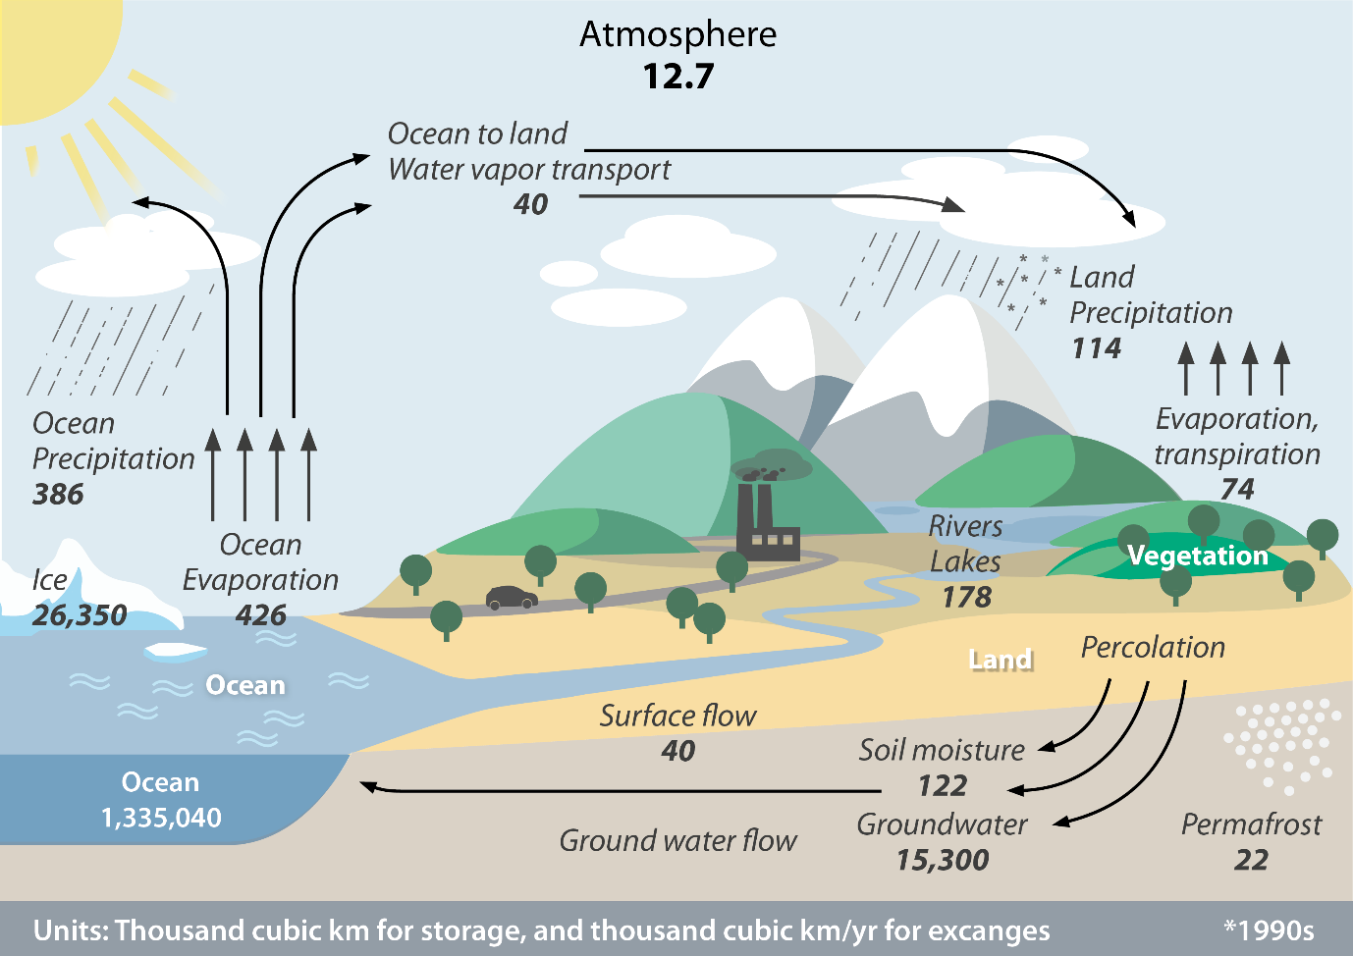
Water cycle, global
Water reservoirs
Oceans, inland waters, glaciers, groundwater, atmosphere, soil water, organisms ...
Processes
Precipitation,
evaporation,
seepage,
Runoff
The global water cycle. Illustration: GIZ (2020) with data from Trenberth et al. (2011).

Slide 30
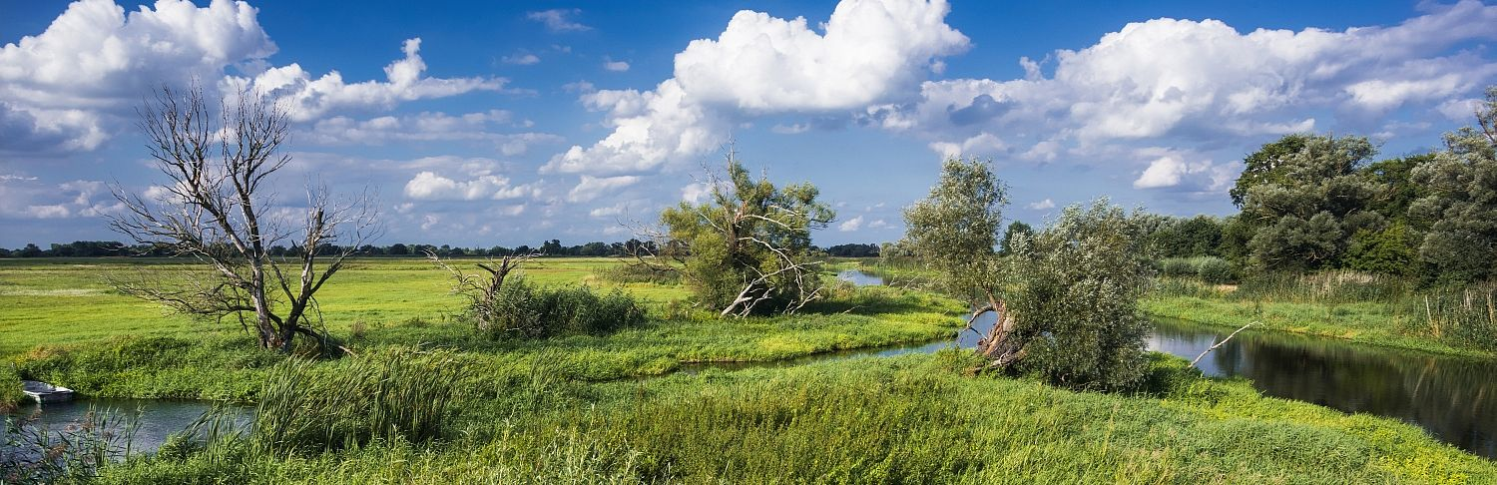
Water balance Brandenburg
Precipitation ~600 mm
Evapotranspiration ~500 mm
Runoff/
Discharge ~100 mm
+/-Storage

Slide 31
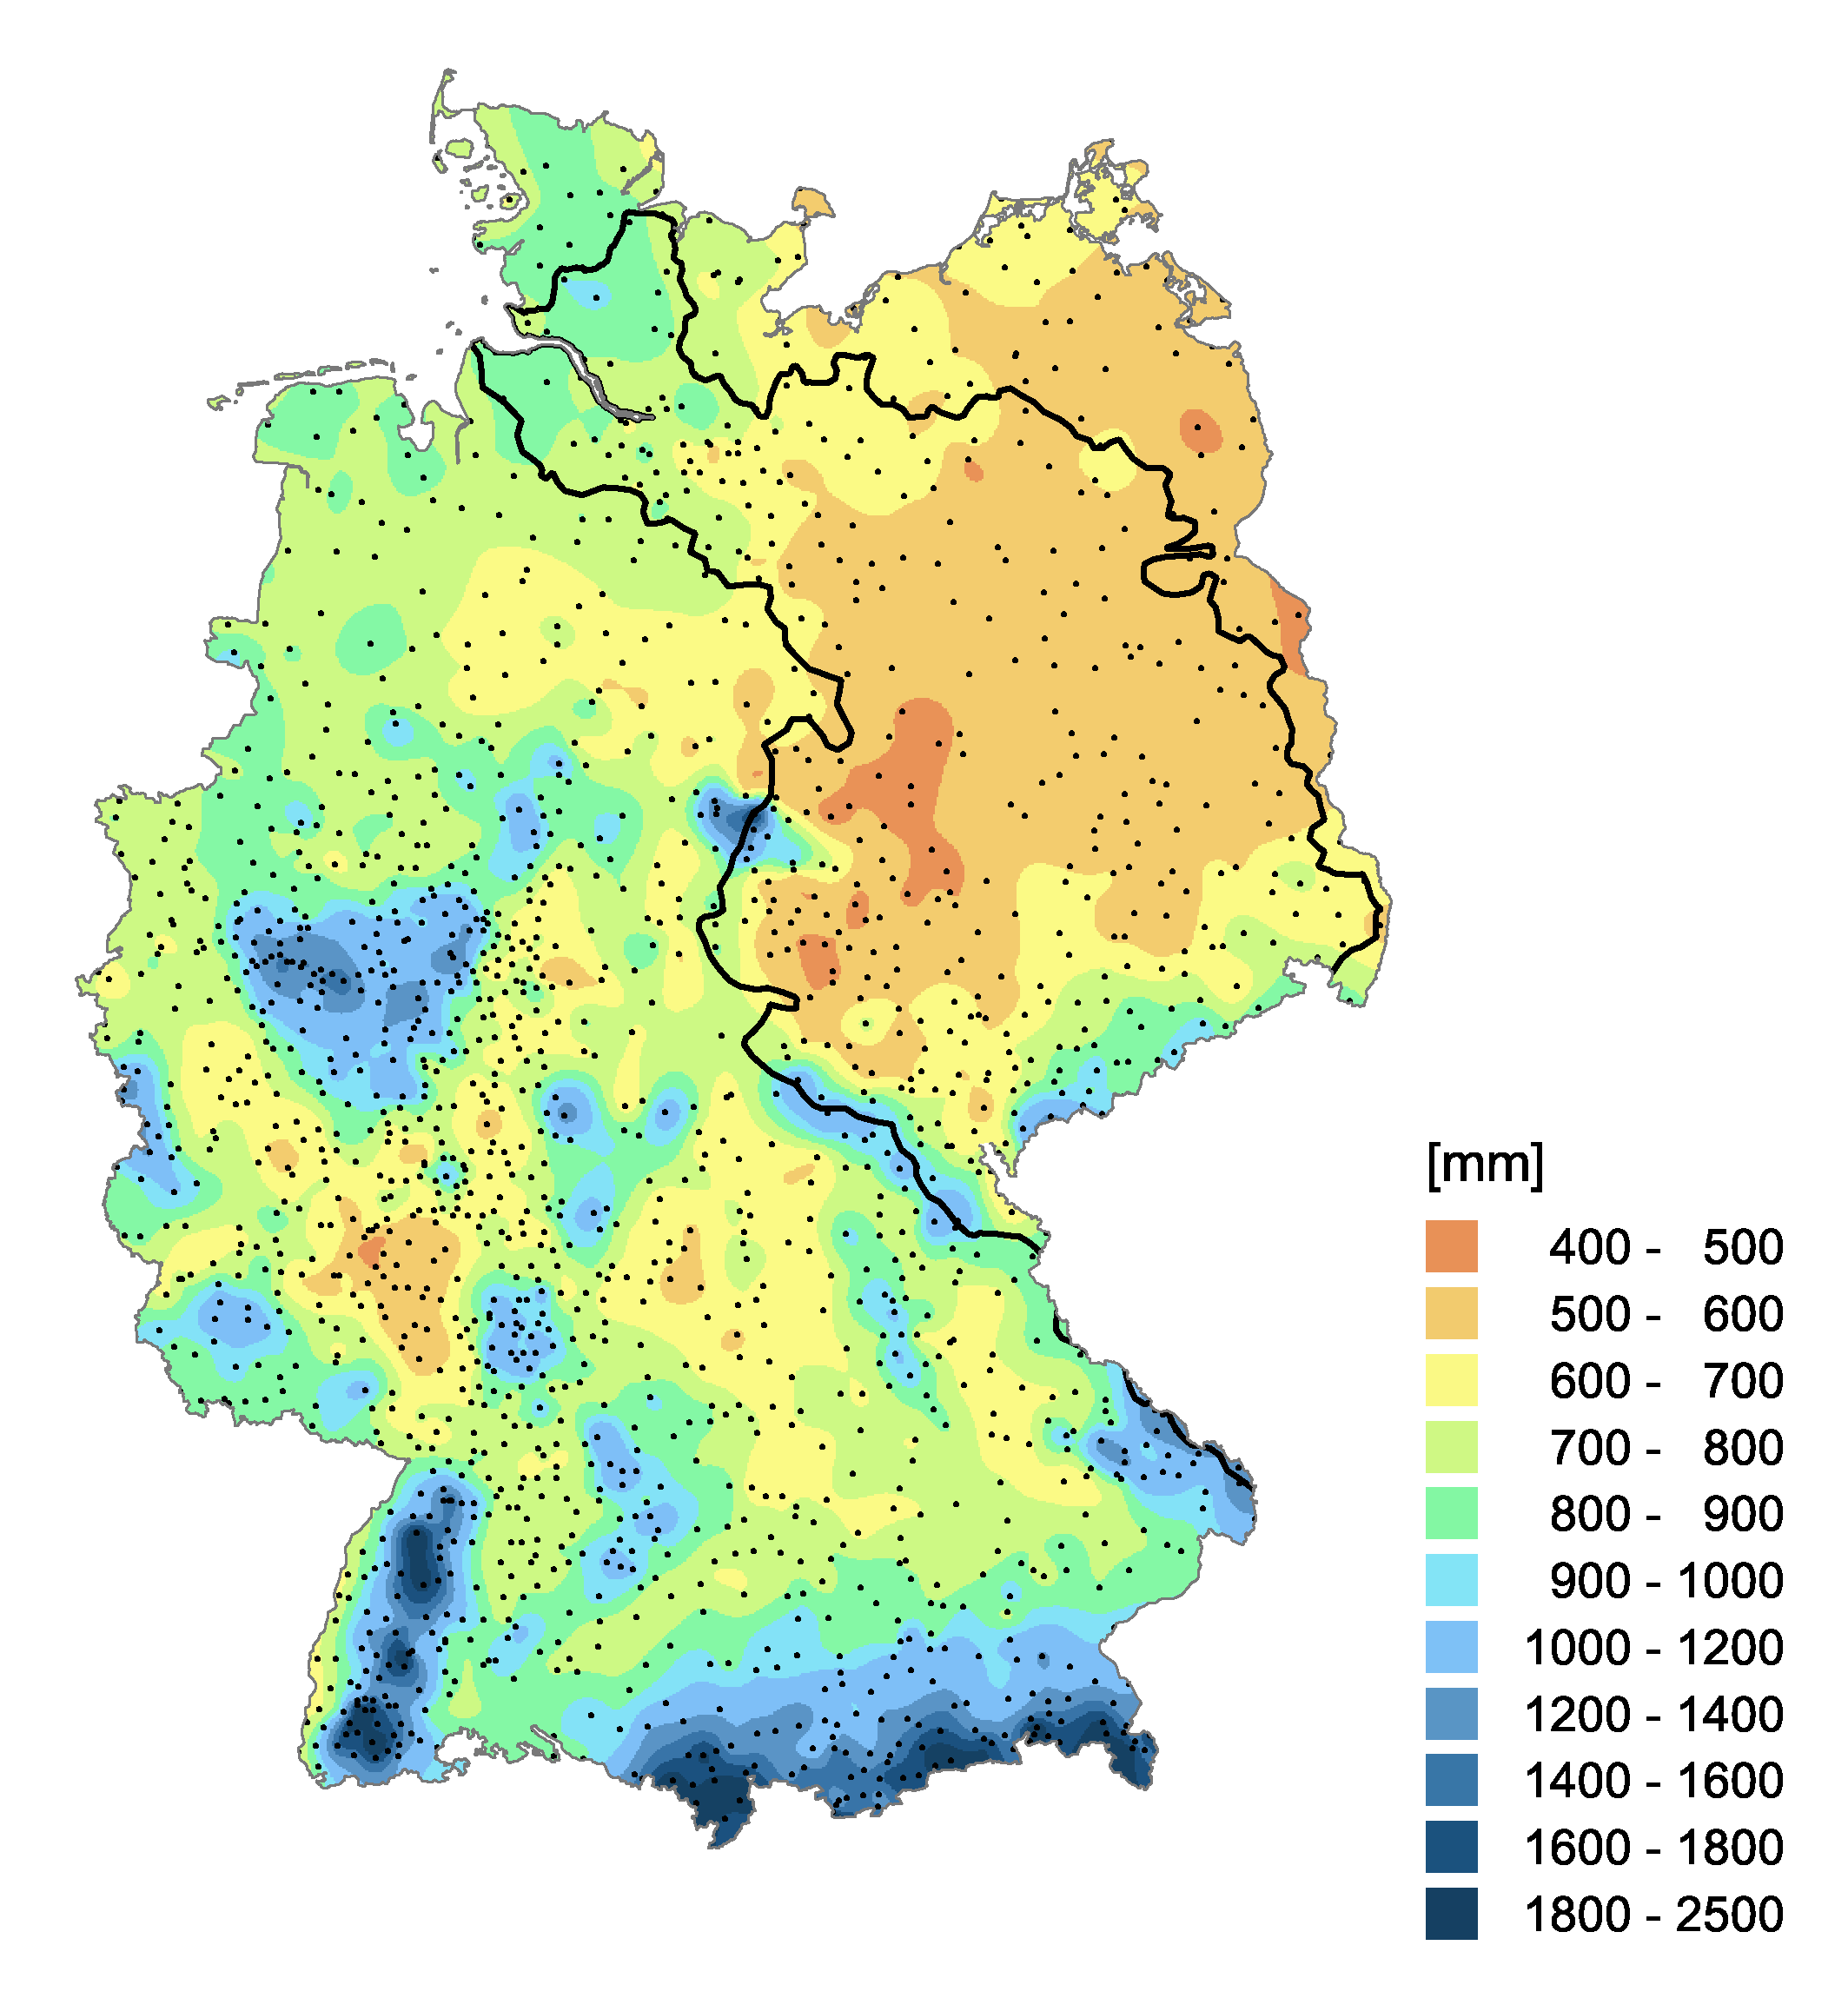
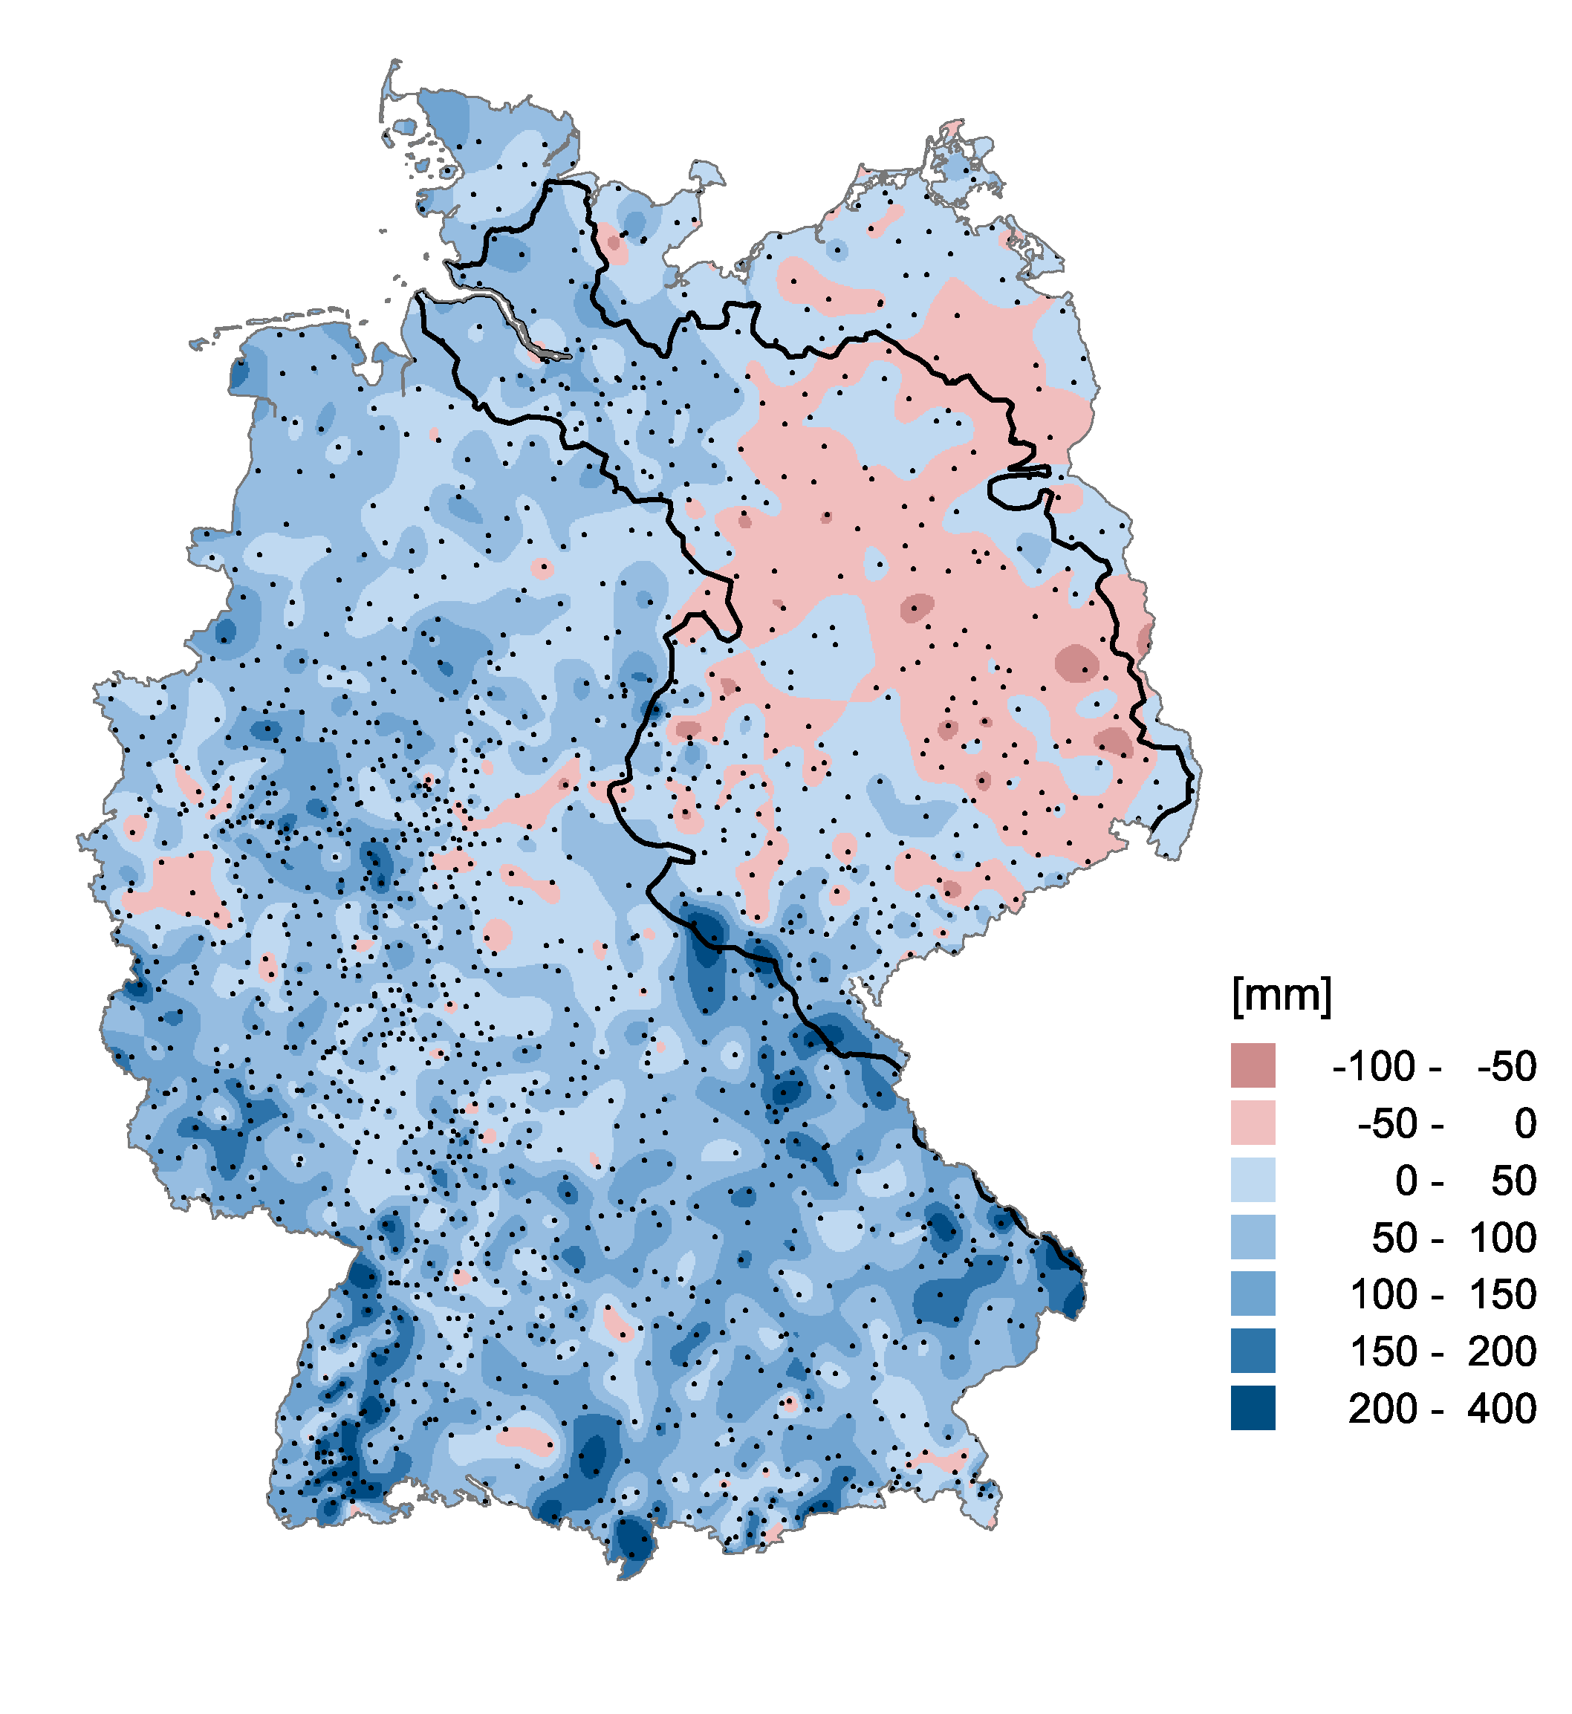
Precipitation in Germany
Mean precipitation 1951-2003
Trend in precipitation 1951-2003
Data: Wodinski, Gerstengarbe and Werner, PIK Potsdam

Slide 32
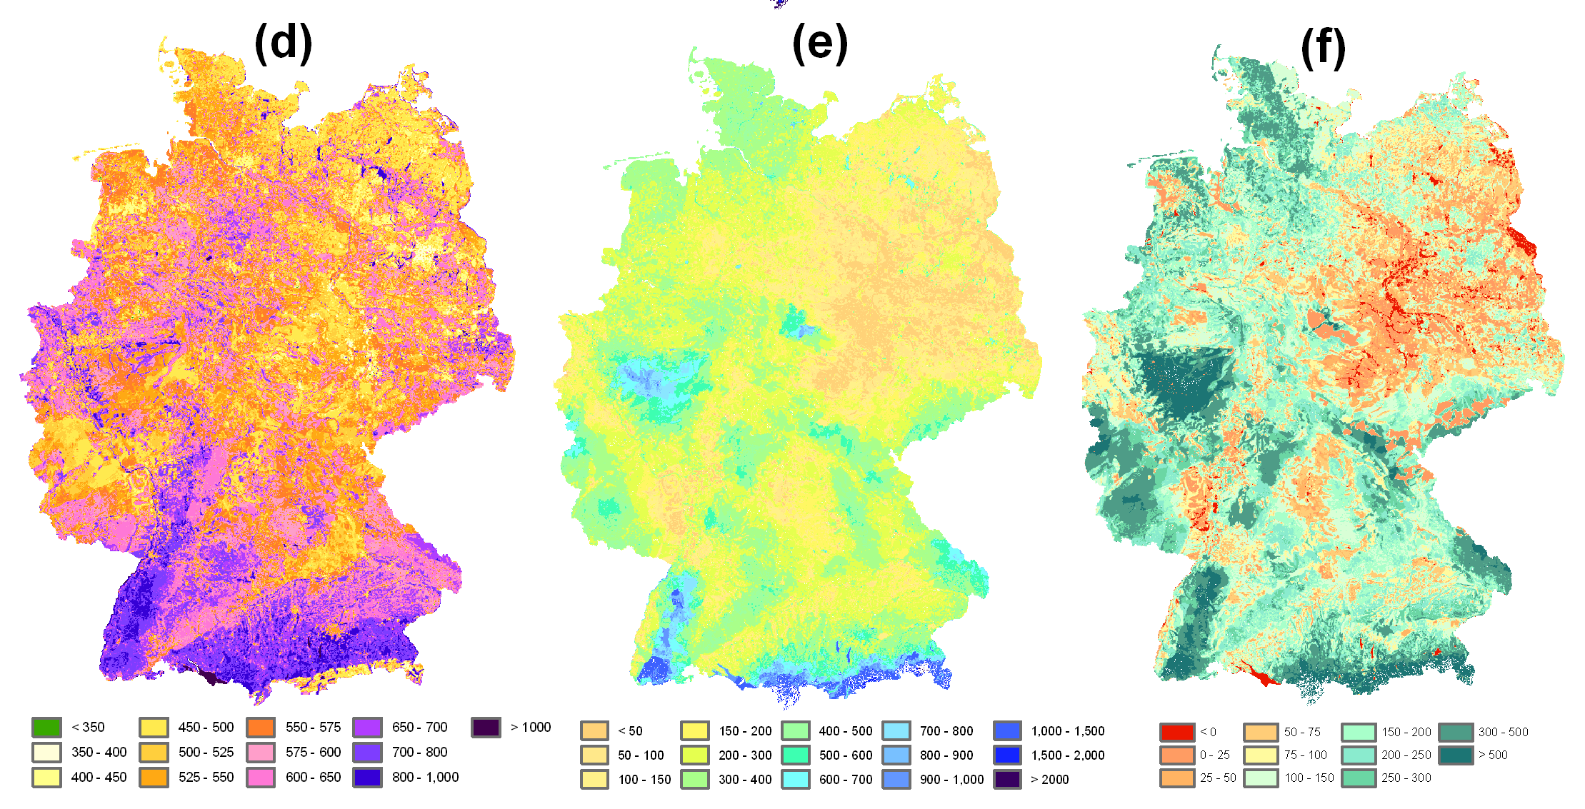
Components of the water balance Germany
Evapotranspiration
Runoff
GW-recharge
Huang et al. 2010

Slide 33
Seasonal water balance Elbe EZG
Evapotranspiration
Elbe
Precipitation
Discharge

Slide 34
2 Precipitation

Slide 35
Precipitation
2.1 Formation of precipitation
2.2 Precipitation monitoring
2.3 Precipitation in Germany and global

Slide 36
2 Precipitation
2.1 Formation of precipitation

Slide 37
Water cycle, simple
Main processes:
Precipitation
Evaporation
Condensation
Driver:
Solar radiation and gravity

Slide 38
Conversion millimeter into litre
4. Niederschlag I
4.2 Niederschlagsmessung
1 mm (rain) = 1 litre / m²

Slide 39
Water cycle, global
Water reservoir
Oceans, inland waters, glaciers, groundwater, atmosphere, soil water, organisms ...
Processes
Precipitation,
evaporation,
seepage,
Runoff
The global water cycle. Illustration: GIZ (2020) with data from Trenberth et al. (2011).

Slide 40
Definition of precipitation
4. Niederschlag I
4.1 Entstehung von Niederschlag
Precipitation is generally understood to be the water precipitated from the atmosphere that has previously passed from the gaseous phase (water vapour) into the liquid or solid phase.
In meteorology, a distinction is made between precipitation that has settled on surfaces (dew, hoarfrost, etc.) and precipitation that is falling (rain, snow, hail, etc.).
Metéoron (Greek) means sky or air phenomena.

Slide 41
Definition of precipitation
4. Niederschlag I
4.1 Entstehung von Niederschlag
According to DIN 1996, precipitation is: "Water of the atmosphere that has been formed in the air after condensation or sublimation of water vapour and, as a result of gravity, either moves to the earth's surface (falling precipitation) or has reached the earth's surface (settled precipitation)".
41

Slide 42
Formation of precipitation
4. Niederschlag I
4.1 Entstehung von Niederschlag
The three preconditions for the formation of precipitation:
Saturation of the air with water vapour (relative humidity > 100%). For this to happen, the temperature of the body of air must be equal to the dew point temperature*. This is usually the result of cooling experienced by a rising or expanding air parcel.
Phase transition (condensation, freezing).
Growth of droplets and ice particles (aerosols important).
* Dew point = temperature corresponding to the saturation vapour pressure. If temperature below dew point -> condensation, precipitation

Slide 43
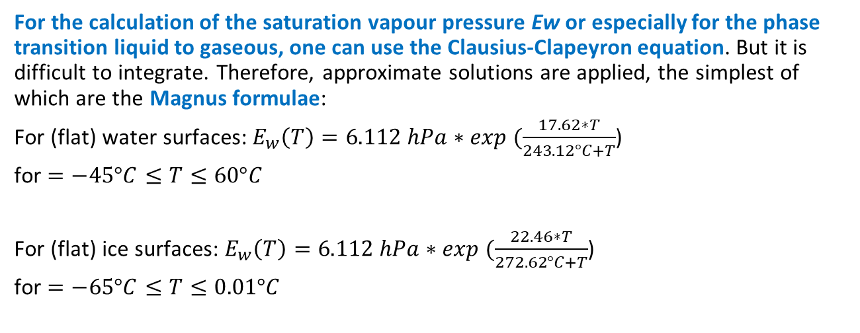
Calculation of saturation vapour pressure
4. Niederschlag I
4.1 Entstehung von Niederschlag
For the calculation of the saturation vapour pressure Ew or especially for the phase transition liquid to gaseous, one can use the Clausius-Clapeyron equation. But it is difficult to integrate. Therefore, approximate solutions are applied, the simplest of which are the Magnus formulae:
For (flat) water surfaces:$E_{w}\left(T\right)=6.112 hPa∗exp (\frac{17.62∗T}{243.12°C+T}$)
for $=−45°C≤T≤60°C$
For (flat) ice surfaces: $E_{w}\left(T\right)=6.112 hPa∗exp (\frac{22.46∗T}{272.62°C+T}$)
for $=−65°C≤T≤0.01°C$

Slide 44
Some results of the Magnus formula
4. Niederschlag I
4.1 Entstehung von Niederschlag
Temperature [°C] | -20 | -10 | 0 | +10 | +20 | +30
Saturation water content [g/m³] | 1,1 | 2,4 | 4,8 | 9,4 | 17,2 | 30,3
Saturation vapour pressure p_{v,s} [Pa], 1 Pa = 1 N/m² | 124 | 285 | 611 | 1228 | 2339 | 4244

Slide 45
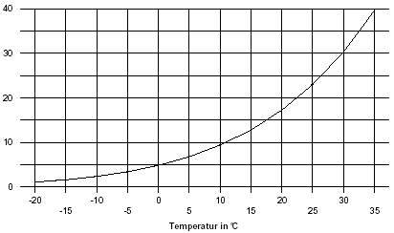
Saturated water content of the atmosphere is a non-linear function of temperature
4. Niederschlag I
4.1 Entstehung von Niederschlag
θ [g/m³]
θ (18°C) - θ (15°C) = 2.5 g/m³ (= 19,4 %)

Slide 46
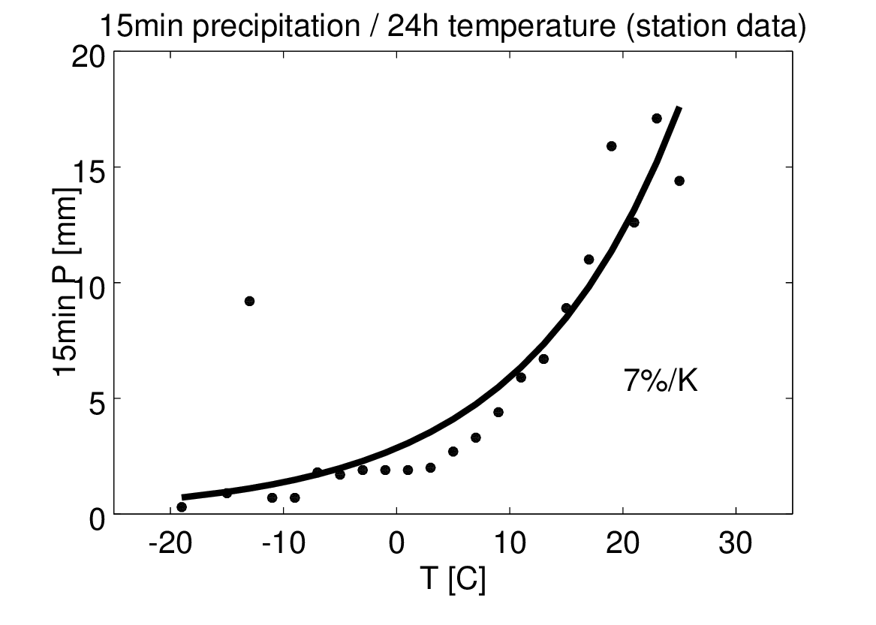
Increase of intense precipitation with temperature
Increasing extreme rainfall intensities through climate change
15min precipitation,
99.9% Quantile,
Stations Brixenbachtal, Längental, Ruggbachtal
?
15min
Bürger, Uni Potsdam, personal communication

Slide 47
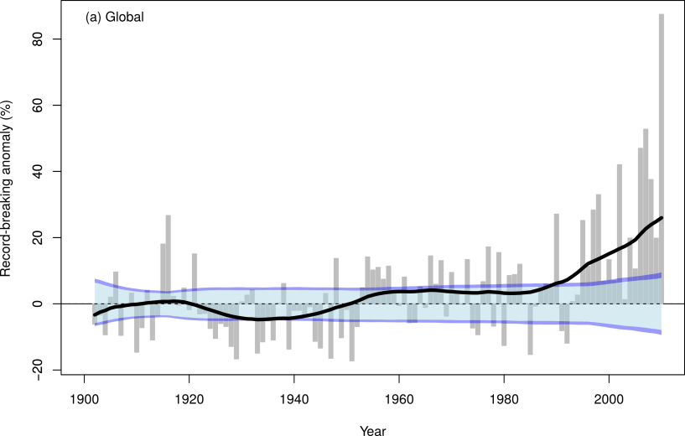
Daily Rainfall Records Increase Globally
88%
The saturation vapour pressure regulates the daily amounts of heavy rainfall.
This increases at a rate of 7% per degree of warming (Clausius-Clapeyron).
26%
Lehmann et al., Climatic Change, 2015

Slide 48
4. Niederschlag I
4.1 Entstehung von Niederschlag
Precipitation types
Direct condensation or sublimation of water vapour at or near the earth's surface:
Liquid form: Dew (condensation)
Solid forms: Frost (resublimation), frozen dew
Falling precipitation: Indirect condensation or sublimation in the free atmosphere, precipitation from clouds:
Liquid form: Rain
Solid forms: Snow, hail, sleet

Slide 49
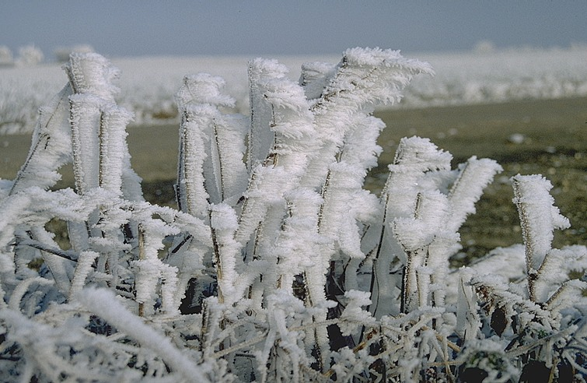
Frost
Source: Karlsruher Wolkenatlas

Slide 50
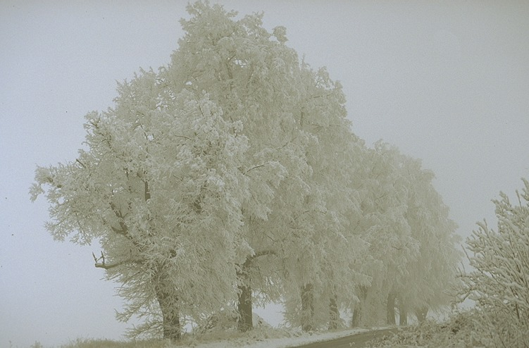
Snow
Source: Karlsruher Wolkenatlas

Slide 51
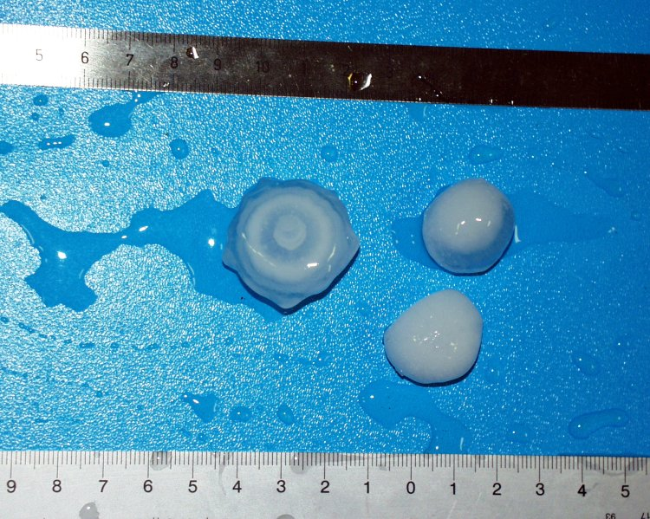
Hail
Source: Karlsruher Wolkenatlas

Slide 52
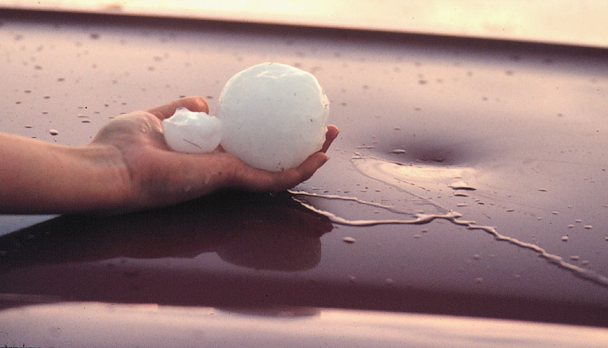
Hail
Quelle: http://www.chaseday.com/hail.htm

Slide 53
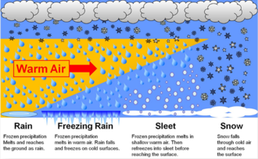
Advective (front) precipitation
4. Niederschlag I
4.1 Entstehung von Niederschlag
Typical precipitation types associated with a warm front advancing over cold air masses
53

Slide 54
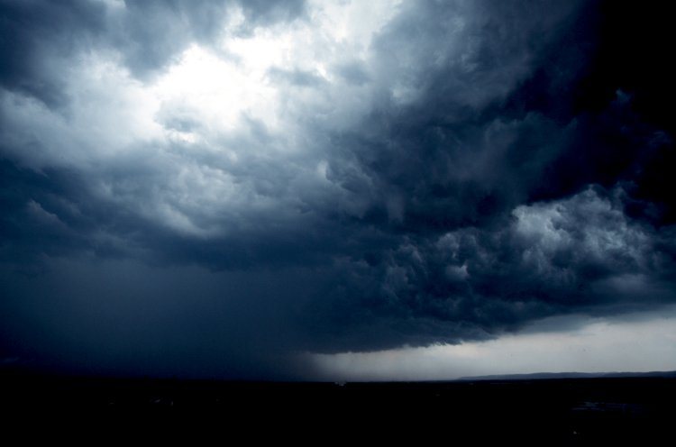
Advective (front)
Source: Karlsruher Wolkenatlas

Slide 55
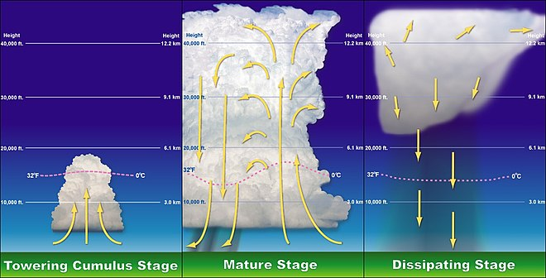
Convective

Slide 56
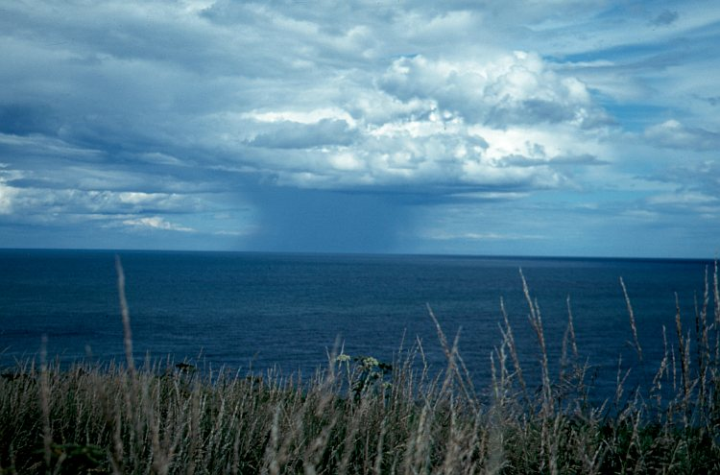
Convective rain – thunder storms
Source: Karlsruher Wolkenatlas

Slide 57
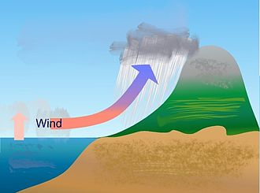
Orographic

Slide 58
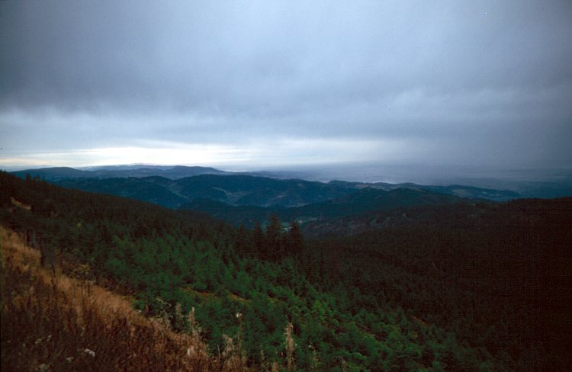
Orographic
Source: Karlsruher Wolkenatlas

Slide 59
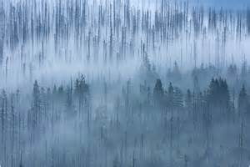
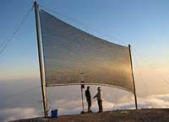

Settled precipitation
4. Niederschlag I
4.1 Entstehung von Niederschlag
This form of precipitation has its special significance in:
Cloud forests (e.g. Andes, Canary Islands)
Coastal deserts (e.g. Southwest Africa, Northern Chile)

Slide 60
2 Precipitation
2.2 Monitoring of precipitation

Slide 61
Conversion millimeter into litre
4. Niederschlag I
4.2 Niederschlagsmessung
1 mm (rain) = 1 litre / m²

Slide 62
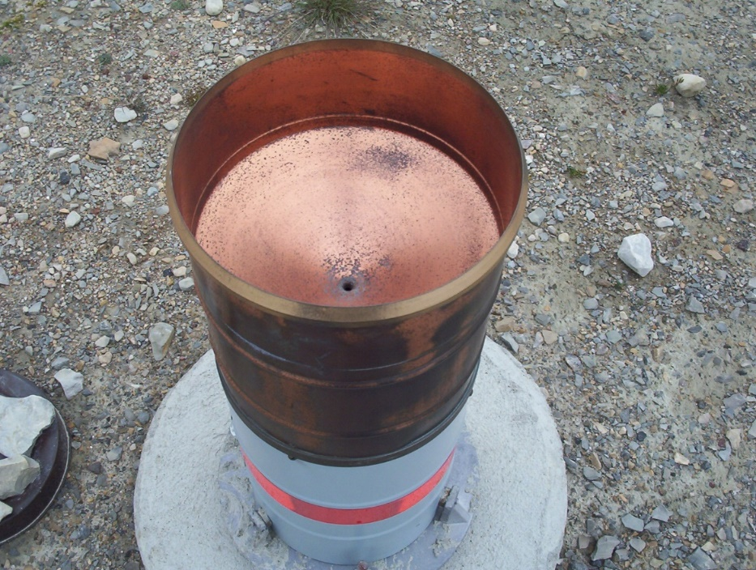
Hellmann rain gauge (ombrometer)
4. Niederschlag I
4.2 Niederschlagsmessung
Large measurement errors (20-100 %!) are problematic because of:
the small reference area,
the influence of evaporation and spray water,
snow bonnets, wind influence as well as wetting influence.
In addition, inhomogeneities in the environment interfere, e.g. with plant growth, high-rise construction.
200 cm²

Slide 63
Undercatch
4. Niederschlag I
4.2 Niederschlagsmessung
Classical observartions techniques underestimate precipitation by 10-20% at least.
Undercatch larger for snow
Empirical and physically based methods to correct exist
63

Slide 64
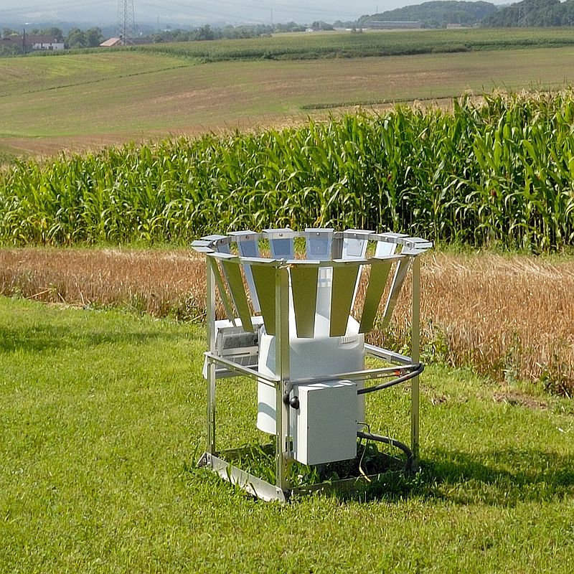
Advanced rain gauges
Precipitation gauge based on the weighing principle with wind protection
Many types and variations exist
Often digital
Comparability!?

Slide 65
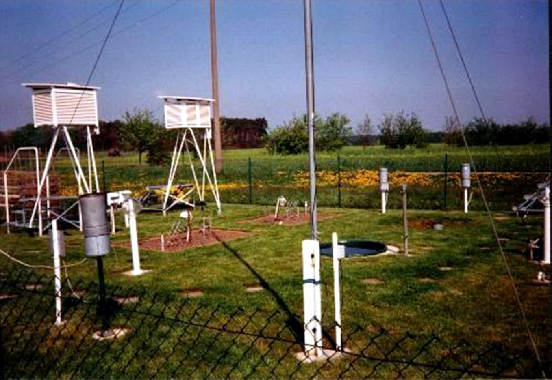
Synoptic station
4. Niederschlag I
4.2 Niederschlagsmessung

Slide 66


Observation network in Germany
4. Niederschlag I
4.2 Niederschlagsmessung
2242 stations before 2010
1218 stations since 2010

Slide 67


Radar monitoring of precipitation
4. Niederschlag I
4.2 Niederschlagsmessung
Radar station of the DWD (Reach per station 150 km)

Slide 68
Radar monitoring
4. Niederschlag I
4.2 Niederschlagsmessung
Radar cannot directly measure the precipitation height on the ground.
The radar impulses reflected by raindrops only provide an areal distribution of the strength of the radar echoes. Since the strength of the backscatter depends on the size and quantity of the raindrops, the precipitation height can be calculated using empirical relationships and correction methods.
The radar data are calibrated by means of precipitation measurements on the ground.
The DWD radar network comprises 16 radar sites, each with a radius of 128 km, which ensure extensive coverage of Germany.

Slide 69

Radar monitoring
4. Niederschlag I
4.2 Niederschlagsmessung
[mm]

Slide 70


Interpolation of point measurements
4.3 Niederschlagsauswertung
Gebietsniederschläge
?

Slide 71

Weighted mean and polygon method
4.3 Niederschlagsauswertung
Gebietsniederschläge – Thiessen-Polygone (nächster Nachbar)

Slide 72

Inverse distance
4.3 Niederschlagsauswertung
Gebietsniederschläge – Inverse Distanz
raster point

Slide 73
Inverse distance
4.3 Niederschlagsauswertung
Gebietsniederschläge – Inverse Distanz
Gut für uneinheitlich verteilte Stationen, als Interpolationsmethode weiche Übergänge

Slide 74
Inverse distance
4.3 Niederschlagsauswertung
Gebietsniederschläge – Inverse Distanz
Example (with p=1, n=2):
z(u2)=4
z(u1)=2
Z*(u0)=?
d1=5
d2=3
z(u2)=4
z(u1)=2
Z*(u0)=?
d1=8
d2=3

Slide 75

Isohyetes (zones of the same hight)

Slide 76

Geostatistical methods
4.3 Niederschlagsauswertung
Gebietsniederschläge – Geostatistische Verfahren
2) Data analysis
2) Observations
3) Variogram
5) Error analysis!
4) Interpolation
with Kriging

Slide 77
Comparison of the methods

Slide 78
Reanalysis data is another possible combination of spatial and point data
Weather forecast data and station data are combined;
In the process, a weighted combination of measured values and older model predictions is interpolated onto the model grid using various mathematical methods (so-called data assimilation);
In a numerical forecast model, the computational domain is discretised with grid cells so that the relevant physical quantities, such as temperature, precipitation, air pressure, density and wind speed, can be represented in three-dimensional space and as a function of time.

Slide 79

Reanalysis data
Weather forecasts are available worldwide in high temporal and spatial resolution
They are constantly updated with observations (data assimilation)
(Source: European Meteorological Service)

Slide 80



Example: Re-analysis data for Tanzania

Slide 81

The COSTRA system of the DWD: Information about intense precipitation

Slide 82
2 Precipitation
2.3 Precipitation in Germany and global

Slide 83


Recent precipitation Potsdam
https://www.pik-potsdam.de/de/produkte/klima-wetter-potsdam/wetteranalyse
T
P

Slide 84


Annual precipitation total (left) and trend (right)

Slide 85
Seasonal distribution of precipitation
4.4 Niederschläge in Deutschland und Weltweit
Niederschläge in Deutschland
Evapotranspiration
Elbe
Niederschag
Abfuss

Slide 86

Global precipitation
Wasserkreislauf
2.2 Der globale Wasserkreislauf

Slide 87
Precipitation records
4.4 Niederschläge in Deutschland und Weltweit
Extreme des Niederschlages
Precipitation records
Continent | Land | Location | Value | Year
Europe | Croatia | Crkvice | 4648 mm | 1881
 | Germany | Balderschwang (Allgäu) Potsdam | 3503,1 mm 788,8 mm | 1970 1981
Africa | Kamerun | Debundscha | 10287 mm | 1932
America | USA | Paradise (Mt. Rainier) | 31100 mm (Schnee) | 1970/71
 | Kolumbia | Lloro | 13299 mm | 1929
Asia | India | Cherrapunji | 26461 mm | 1860/61
Australia | Queensland | Bellenden Ker | 8636 mm | 1909

Slide 88
Precipitation records
4.4 Niederschläge in Deutschland und Weltweit
Extreme des Niederschlages
Daily precipitation records
Continent | Land | Ort | Wert | Anmerkung
Africa | La Reunion | Cilaos | 1870 mm | 15.03.-16.03.1952
Europe | Deutschland | Zinnwald Potsdam | 312.0 mm 105.7 mm | 12.08.2002 08.08.1978
Monthly precipitation records
Asia | Indien | Cherrapunji | 9300 mm | 1970/71
Europe | Deutschland | Oberreute (Bodensee) Potsdam | 777 mm 202.3 mm | Juli 1954 Juli 1907
Snow records
America | USA | Paradise (Mt. Rainier) | 31100 mm | 1970/71
Europe | Deutschland | Zugspitze Potsdam | 8300 mm 700 mm | 02.04.1944 1969/70

Slide 89


Orographic precipitation La Reunion
Klimadiagramme
Saint Denis/Reunion
La Reunion

Slide 90
3. Evapotranspiration

Slide 91
Evapotranspiration
4.1 Definition and processes
4.2 Monitoring
4.3 Evaporation in Germany and global

Slide 92
3. Evapotranspiration
3.1. Definition and processes

Slide 93
Definition
DIN 4049-3
Evaporation is a process in which water changes from the solid or liquid aggregate state to the gaseous state at temperatures below the boiling point.
Unit of measurement: mm/unit of time

Slide 94

Evaporation
When the molecules of a liquid collide, they transfer energy based on how they collide with each other.
When a molecule near the surface absorbs enough energy to overcome the vapour pressure, it will escape and enter the surrounding air as a gas.
Boundary layer

Slide 95
Water cycle, global
Der globale Wasserkreislauf. Darstellung: GIZ (2020) mit Daten aus Trenberth et al. (2011).

Slide 96
Water balance Brandenburg
Precipitation ~600 mm
Evapotranspiration ~500 mm
Runoff/
Discharge ~100 mm
Evapotranspiration:
Transpiration: ~50–70 %
Interception: ~15–40 %
Evaporation: ~5–25 %
+/-Storage

Slide 97


Water balance and energy balance are coulpled via evaporation
Water balance
N + V + Q + ΔS = 0
N | Precipitation
V | Evaporation
Q | Runoff
ΔS | Storage
Energy balance
R_{n} + H + G + LE = 0
R_{n} | Net radiation
H | Sensible heat flux
G | Ground heat flux
LE | Latent heat flux

Slide 98
Evaporation - phase transformation
The following transition heats L*, which depend on the temperature, apply to phase transitions of the water.
At 0 °C they are:
solid fluent: L* = 333,6 kJ/kg
fluent gas: L* = 2 500,6 kJ/kg
solid gas: L* = 2 834,2 kJ/kg
As a comparison:
The heating of water from 0 °C to 100 °C (no change in the state of aggregation): 418 kJ/ kg.
~1/6 of the energy needed at the same initial temperature to complete the phase transition by evaporation

Slide 99
Evapotranspiration
Evapotranspiration = Evaporation + Transpiration
Foto: Prof. Miegel (Uni Rostock)

Slide 100

Evaporation
Evaporation happens from surfaces such as
Water surface
Soil without vegetation cover
Interception (from vegetation surface)
Snow surfaces

Slide 101

Evaporation
Evaporation happens from surfaces such as
Water surface
Soil without vegetation cover
Interception (from vegetation surface)
Snow surfaces

Slide 102

Evaporation
Evaporation happens from surfaces such as
Water surface
Soil without vegetation cover
Interception (from vegetation surface)
Snow surfaces

Slide 103

Evaporation
Evaporation happens from surfaces such as
Water surface
Soil without vegetation cover
Interception (from vegetation surface)
Snow surfaces

Slide 104

Transpiration
Transpiration is the evaporation from plant surfaces due to biotic processes.
It mainly involves the release of water through the stomata.
Plants are able to regulate this release by closing and opening the stomata.
techalive.mtu.edu

Slide 105


Plant evapotranspiration
Stomatal transpiration / stomatal resistance
In plants, water is generally released through special adjustable door cells called stomata. CO₂ is absorbed through the same openings.
The extent of water release in different plant species can vary by more than two orders of magnitude.
The control of the stomata is regulated by the turgor (pressure of the cell).
In warm regions there are special adaptations for the transpiration of plants, because there the plant is always faced with the problem that it has to absorb CO2 through the stomata on the one hand, but also loses water again as a result. To reduce this problem, many plants have, for example, sunken stomata with special hairs.

Slide 106

Competition CO₂ in H₂O out
Net product photosynthesis:
6 CO₂ + 6 H₂O → C₆H₁₂O₆ + 6 O₂
Net product respiration:
C₆H₁₂O₆ + 6 O₂ → 6 CO₂ + 6 H₂O
https://www.tasmeemme.com/

Slide 107

C3 and C4 plants
5. Verdunstung
5.2 Physikalische Grundlagen
C4 plants actively bind CO₂ using additional energy.
This allows them to close the stomata further and consume less water per biomass produced.
However, they have a higher temperature optimum and are less energy efficient.

Slide 108
Share [%] of the two components
Proportion of evaporation components on average in Central European landscapes:
Transpiration: ~50-70 %
Interception evaporation: ~15-40 %
Evaporation: ~5-25 %

Slide 109
Effects on evaporation
Evaporation is physically dependent on the following factors:
Solar radiation as a source of energy
Air temperature (which in turn depends on solar radiation)
Air humidity and thus the saturation deficit of the air
Wind movement, especially its turbulence and thus the greater mixing of the air

Slide 110
Potential and actual evapotranspiration
Potential evaporation (PE) or potential evapotranspiration (PET) is defined as the amount of evaporation that would occur if sufficient water is available.
Actual evapotranspiration (AET) is the net result of atmospheric demand for moisture from a surface and the ability of the surface to supply moisture.
Therefore, PET is a measure of the demand side, AET is limited by the supply.
A dryland is a place where annual potential evaporation exceeds annual precipitation.

Slide 111

Potential evapotranspiration
Maximum possible evaporation of a site under given meteorological conditions with optimal water supply -> Conversion of the total energy supply
PET exclusively dependents on meteorological (atmospheric) variables (temperature, humidity, wind, radiation)
Examples of potentially evaporating surfaces:
Evaporation from free water surfaces (lakes, rivers ...)
Evaporation from moist soil (after rain events or during irrigation)
Evaporation from snow cover
AET = PET
(e.g. over lakes)

Slide 112

Actual evapotranspiration AET
Value of evaporation actually occurring at a site
Depending on atmospheric, soil and vegetation conditions and availability of water
AET << PET
Even AET = 0
(during drought)

Slide 113
Equations to calculate PET
The Penman equation describes evaporation (E) from an open water surface, and was developed by Howard Penman in 1948. Penman's equation requires daily mean temperature, wind speed, air pressure, and solar radiation to predict E.
The Penman–Monteith equation refines weather based potential evapotranspiration (PET) estimates of vegetated land areas. It is widely regarded as one of the most accurate models, in terms of estimates.
The Priestley–Taylor equation was developed as a substitute to the Penman–Monteith equation to remove dependence on observations.

Slide 114
3. Evapotranspiration
3.2 Monitoring

Slide 115


Evaporimeter
Evaporation kettles filled with water are used to determine the evaporation by measuring the decrease of the water level.

Slide 116

Lysimeter

Slide 117

Lysimeter
Lysimeter system in Groß Lysewitz
Lysimeter in Brandis (Sachsen)
Quelle: Fohrer, 2006

Slide 118


Lysimeter
Quelle: in Anlehnung an Schröder et al. 1994

Slide 119
3 Evapotranspiration
3.3 In Germany and global

Slide 120



AET 1961-90 for Germany, hyd. atlas and modelled
5. Verdunstung
5.5 Anteil der Verdunstung an der Wasserbilanz
Hydrological atlas Modelled (Model SWIM, PIK)
120

Slide 121

AET in Berlin
5. Verdunstung
5.5 Anteil der Verdunstung an der Wasserbilanz
evaporation
http://www.stadtentwicklung.berlin.de/umwelt/umweltatlas/

Slide 122
Effects of vegetation cover
Ratio of annual evaporation to annual precipitation as a function of vegetation (exemplary)
Bare soil
Arable land (cerials)
Arable land (root crops)
Pasture
Forest
Water surface
Quelle: Nacken (RWTH Aachen)

Slide 123
Influence of vegetation cover on water balance
Influence of vegetation cover (stand age in brackets) on the water balance of a pine and a beech forest near Eberswalde (annual precipitation 620 mm) compared to Grass.
Interception
Evapotranspiration
Groundwater recharge
Source: following Müller 2009
Pine (coniferous)
Beech (broadleef)

Slide 124
Seasonal distribution of evapotranspiration
4.4 Niederschläge in Deutschland und Weltweit
Niederschläge in Deutschland
Evapotranspiration
Elbe
Precipitaion
Discharge

Slide 125

Potential evapotranspiration

Slide 126

Actual transpiration

Slide 127
Global water trends
Evapotranspiration
Precipitation
Runoff
Gravity Recovery and Climate Experiment (GRACE)
Groundwater
Pascolini-Campbell et al (2021)
Notes:
Pascolini-Campbell, M. et al. (2021) A 10 per cent increase in global land evapotranspiration from 2003 to 2019, Nature, doi:10.1038/s41586-021-03503-5

Slide 128
Outline
Monday Nov. 20
The hydrological classics: Background and presentation about AMOC, presentation of topics
Tuesday Nov. 21
Water as a basic need, water as a threat: The nexus water – energy – food – health, hydrological extremes, erosion, selection of topics
Wednesday Nov. 22
Eco-hydrological modelling, groupwork
Thursday Nov. 23
Groupwork
Friday Nov. 24
Presentation of selected tasks, visiting PIK

Slide 129



In the news yesterday
West-Antarctic shelf-ice reaches tipping point at 1.5°C
Death of Amazon dolphins – 100-year drougt in Amazon: Did we pass the tipping point?
Share of renewables was 80 % yesterday.

Slide 130
4 Discharge

Slide 131
Discharge
4.1 Definition and processes
4.2 Monitoring
4.3 Discharge in Germany and global

Slide 132
4 Discharge
4.1 Definition and processes

Slide 133
Definition discharge and runoff
In hydrogeology, runoff (according to DIN 4049-1) is defined as water moving on and under the land surface under the influence of gravity.
In hydrology, discharge (abbreviation Q) is the volume of water leaving a catchment area under the effect of gravity within a certain time.
If the runoff is divided (normalised) by the EZG area, it is referred to as runoff donation.

Slide 134





River types
http://homepage.hispeed.ch/heiner.brogli/Exo/omu/Geopage.htm

Slide 135

Flow generation: boundary conditions
Area features
Relief
Soil properties
Geology
Groundwater conditions
Vegetation
Hydrometeorological conditions
Pre-humidity
Precipitation amount and intensity
Temperature
Evaporation
Proportion of snowfall
Presence of glaciers
Anthropogenic influences
Land use
Degree of sealing
Drainage system / sewerage

Slide 136


Surface flow
Mechanisms:
Due to infiltration excess
Rainfall intensity > Infiltrability of the soil
Also known as Hortonian runoff (after Horton, 1933).
Through saturation surplus
The ground surface is saturated and can no longer absorb water.
Return Flow
Runoff that has briefly infiltrated and then exfiltrated back to the surface.
Quelle: Fohrer (2016).

Slide 137

Interflow
= Water that flows to the water body through near-surface, (often) unsaturated soil layers.
Important processes:
Infiltration
Surface runoff, possibly with return flow
Rapid lateral runoff through preferential flow paths (macropores, root zone, gravel layer, etc.)
Matrix flow (soil matrix)
Quelle: Fohrer (2016).

Slide 138

Groundwater discharge
= Water that reaches the saturated zone through percolation and flows to the watercourse following the gradient.
Slow process, provides most of the base flow.
Macropores (e.g. karst) can also lead to rapid groundwater recharge and thus also to the contribution of groundwater during runoff events
Q_{BHW}: Basisabfluss bei Hochwasser. Q_{BTW} : Basisabfluss bei Trockenwetter. Quelle: Fohrer (2016).

Slide 139

Hydrograph
Source: https://www.bbc.co.uk/scotland/education

Slide 140
Discharge regime after Pardé
= Mean seasonal discharge behaviour of a river.
Pardé coefficient: ratio of mean monthly to mean annual discharge of each month: MQm_{i}/MQa with i = month
Pluvial: influenced by rain. Maximum occurs delayed to the maximum of the raining season, depending on the residence time of the water in the EZG.
Nival: influenced by snowmelt.
Glacial: influenced by glacier melt.
Complex regime: Has several maxima in the year, e.g. pluvio-nival regime.

Slide 141

Discharge regime: examples
Blau: Ems, Pegel Greven; rot: Inn, Pegel Passau; grün: Rhein, Pegel Mainz, Quelle: Fohrer (2016).

Slide 142

Discharge regime along the River Danube
m.a.s.l.
<100
100
200
300
400
500
1000
1500
2000
2500
>3000

Slide 143
4 Discharge
4.2 Monitoring

Slide 144
Monitoring of discharge
The discharge (or flow) Q is defined as the quantity of water flowing through the
cross-section A of a watercourse within a unit of time.
Direct measurement
The volume of water flowing through a watercourse per unit of time is measured directly, e.g. with a bucket.
Cumbersome and only possible for small bodies of water
Indirect measurement
With the measurement of water level h, the discharge is determined via a discharge curve, where h = f (Q)
Measurement of velocity v and determination of cross-section A

Slide 145

Venturi channel
Narrowing of the flow cross-section A
Flow change: flowing to shooting
Water level clear measure of flow
Quelle: Wikimedia Commons contributors, CC BY-SA.

Slide 146

Monitoring weir
Weir = threshold, which is dimensioned in such a way that a shooting flow condition occurs
The discharge can be clearly determined from the water level upstream of the weir if the weir parameters are known.
Strong intervention in the flowing water is necessary!
Thomson-/Dreieckswehr, Quelle: Fohrer (2016).

Slide 147
Tracer / dillution method
Tracer = marking substance (e.g. colour tracer or salt), which is discharged into the water at a known concentration.
Downstream, concentration is measured in the watercourse
The greater the dilution, the greater the discharge

Slide 148


Water level gauges
Water level gauges are measuring devices of various designs for determining the water level in bodies of water.
http://www.computerart-3d.de/projekte/pegelhaus-querschnitt/

Slide 149

Rating curve
In hydrology, a rating curve is a graph of discharge versus stage
… for a given point on a stream, usually at gauging stations, where the stream discharge is measured across the stream channel with a flow meter.

Slide 150



Measuring and calibration via flow velocity
Mechanical measuring blade
Induction probe:
Magnetic field -> Water flow with free charge carriers induces electric voltage
ADCP (Acoustic Doppler Current Profiler):
Ultrasound Doppler effect (frequency shift) on scattering bodies in water
Sources: Mueller et al. (2013) and Ott HydroMet GmbH.

Slide 151

Flow velocity field
Measurement of flow velocities across the watercourse cross-section
A (vertically and horizontally) non-uniform velocity v distribution occurs in a flow cross-section A. Causes: Roughness of the wetted cross-section, friction forces, turbulence.
Source: Fohrer (2016).

Slide 152
4 Discharge
4.3 Regional and global discharge

Slide 153
Water balance
Precipitation
Evaporation
=
Discharge
+/- storage
+
+

Slide 154
Water cycle, global
Water reservoirs
Oceans, inland waters, glaciers, groundwater, atmosphere, soil water, organisms ...
Processes
Precipitation,
evaporation,
seepage,
Runoff
The global water cycle. Illustration: GIZ (2020) with data from Trenberth et al. (2011).

Slide 155
Seasonal distribution of discharge
4.4 Niederschläge in Deutschland und Weltweit
Niederschläge in Deutschland
Evapotranspiration
Elbe
Precipitaion
Discharge

Slide 156

Global discharge
Li et al. 2018, Water

Slide 157

The largest rivers
(length)

Slide 158

The largest rivers
(discharge)

Slide 159
Group work: please answer the questions!
How is the global share of saltwater and freshwater?
What are the three main components of the water balance?
How much water is 600 mm of precipitation?
What is undercatch of observed precipitation?
How high is evapotranspiration, if precipitation is 950 mm and runoff 250 mm?
Is the saturated water content of the air a linear or non-linear function of T?
What is potential and what actual evapotranspiration?
What are reanalysis data?
How can precipitation, evapotranspiration and runoff be measured?
What are discharge regimes?
How much water flows in a river if the wetted river cross-section is 5 m² and the flow velocity 2 ms⁻¹?
What is the „Water Nexus“?

Slide 160
Outline
Monday Nov. 20
The hydrological classics: Background and presentation about AMOC, presentation of topics
Tuesday Nov. 21
Water as a basic need, water as a threat: The nexus water – energy – food – health, hydrological extremes, erosion, selection of topics
Wednesday Nov. 22
Eco-hydrological modelling, groupwork
Thursday Nov. 23
Groupwork
Friday Nov. 24
Presentation of selected tasks, visiting PIK

Slide 161
Possible task for the groupwork
Adaptation in a water related sector / field:
Cities (adaptation to flash floods, droughts, heat waves),
Nature based solutions in river basins or landscapes,
Re-thinking water storage (at different scales),
Adaptation to counteract erosion,
Integrating adaptation and mitigation,
Water re-use
…

Slide 162
Thanks!

Slide 163


AMOC*
*Atlantic meridional overturning circulation (AMOC)

Slide 164
https://upload.wikimedia.org/wikipedia/commons/a/ab/Thermohaline_circulation.svg
https://scijinks.gov/gulf-stream/

