Slide 1


Klimafolgenforschung am PIK
Fred F. Hattermann
Deputy Head of Research Department II „Climate Resilience“
Notes:
1
1

Slide 2
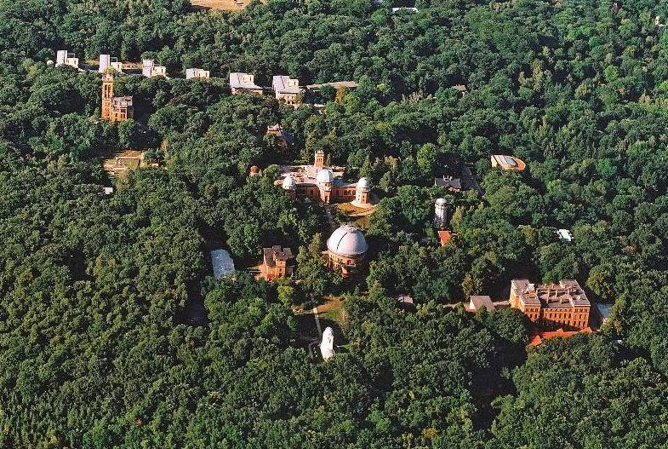
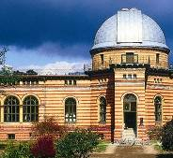
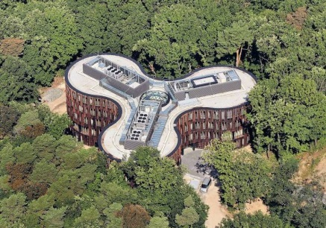
Telegraph Hill: Location
GFZ
PIK
AWI
Süring Hall
PIK
Michelson Hall
PIK
“Trefoil”
Building Site
Helmert Tower
PIK
GFZ
Great Refractor
AIP
Library
Einstein Tower
AIP - Astrophysical Institute Potsdam
AWI - Alfred-Wegener-Institute for Polar- and Marine Research
GFZ - German Research Centre for Geosciences
PIK - Potsdam Institute for Climate Impact Research

Slide 3
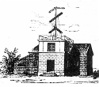
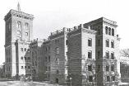
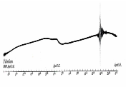

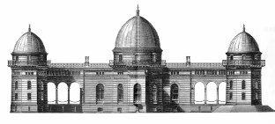


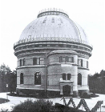


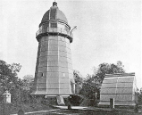


Telegraphenberg: Scientific Breakthroughs
1832/33 Opto-Mechanical Telegraph Line Station No. 4 Potsdam
Secular Station Potsdam
Ernst von Rebeur-Paschwitz
1861-1895
First Solution of Einstein‘s Equations
Reinhard Süring
1866-1950
1889 First Record of Teleseismic Earthquake
Albert Einstein
1879-1955
Karl Schwarzschild
1873-1916
Friedrich Robert Helmert
1843-1917
1904 Interstellar Matter Large Refractor
1881 Michelson Experiment
Johannes Hartmann
1865-1936
1870-1950 Potsdam Datum Point Helmert Tower
Albert Abraham Michelson, 1852-1931

Slide 4
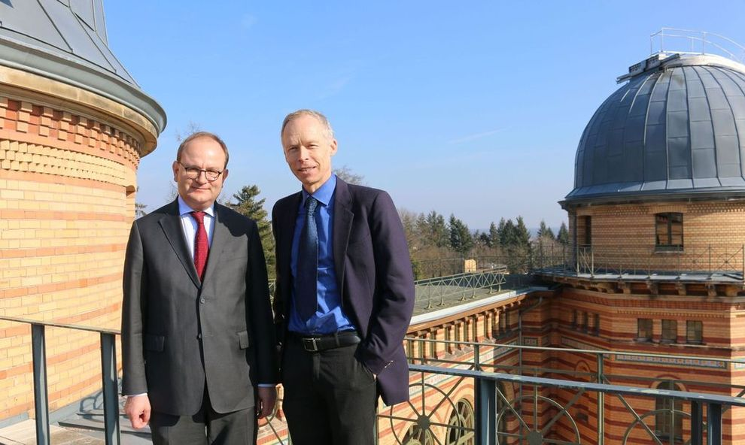
PIK´s new Co-Directors
Ottmar Edenhofer and Johan Rockström
Abgeordneter des Außenministeriums: Gerhard Schlaudraff

Slide 5
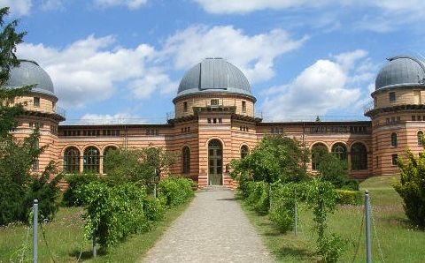




What we do: address crucial scientific questions in the fields of global change, climate impacts and sustainable development.
Who we are: natural and social sciences work together to generate interdisciplinary insights and to provide society with sound information for decision making.
How we work: systems and scenarios analysis, modelling, computer simulation, and data integration.
Founded in 1992 – Four Research Domains.
Ca. 300 employees, more than 100 guest scientists
Research Domains
Earth System Analysis
Oceans, Atmosphere and Biosphere in Past, Present and Future
Transformation Pathways
Climate Risks and Sustainable Development
Climate Resilience
Climate Impacts and Adaptation
Complexity Science
Machine Learning, Nonlinear Methods and Decision Strategies
Photo H. Bach

Slide 6
Key Figures PIK

Slide 7

Funding
31.8
million €
total funding
19.2
million €
third-party funding
in / year: 2021
12.6
million €
institutional funding

Slide 8
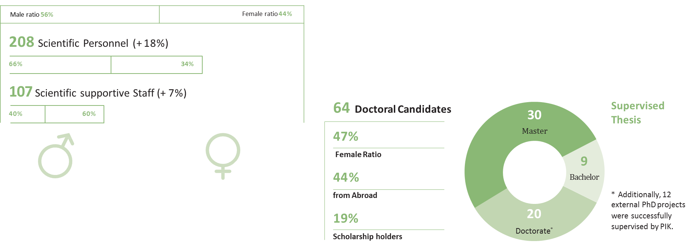
Employment Figures & Junior Researchers
315 Total Staff

Slide 9

Publications
Web of Science-indexed Article Further articles
Data and software publications
Books
Book chapters
5%
4 %
1 %
Publications and Citation Development
Source: Web of Science (WoS) Core Collection, Indexes: SCI-EXPANDED, SSCI Timespan=1998-2019, Date: 06.02.2019
5%
Reports
2 % Beiträge
zu Reports
80 %
WoS-indexed Article
per Year
4 %
Citations lt. WoS
per Year
350
24,500
417
Publications
300
21,000
250
17,500
200
14,000
2018: 333 Web of Science- indexed Articles with 41%
PIK-primary author rights, among others:
150
10,500
Nature Nature Climate Change Nature Communications
7
100
7,000
16
9
50
3,500
Nature Scientific Reports Nature Sustainability
Nature Energy Nature Plants Science Advances
PNAS
5
0
0
3
1
1
5
5

Slide 10

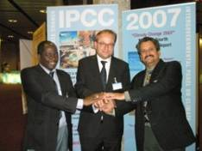
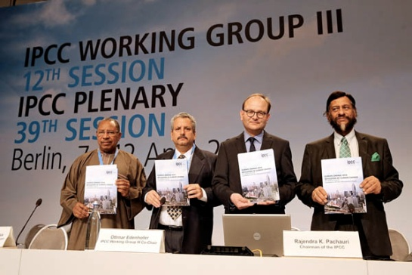
Intergovernmental Panel on Climate Change (IPCC)
Election in 2007
Presentation of the AR5 in 2014 in Berlin
2021/2022
PIK researchers contributing to IPCC special reports and to
the forthcoming 6th Assessment Report
Ramon Pichs Madruga (Cuba), Ottmar Edenhofer und Birama Diarra (Youba Sokona)

Slide 11

PIK in the Media
22,400
Posts in international online media
14,000
Mentions in German-language print media
340
Contributions from
PIK scientists on television and radio
130
PIK researchers were quoted in the international media

Slide 12

Honors
PIK ranked as the top environmental think tank worldwide 2018
Source: TTCSP Global Go To Think Tank Index Report

Slide 13

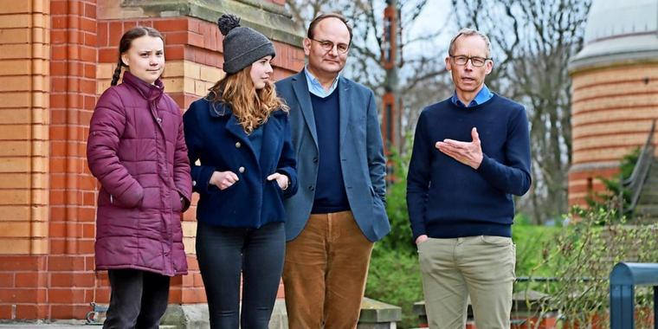
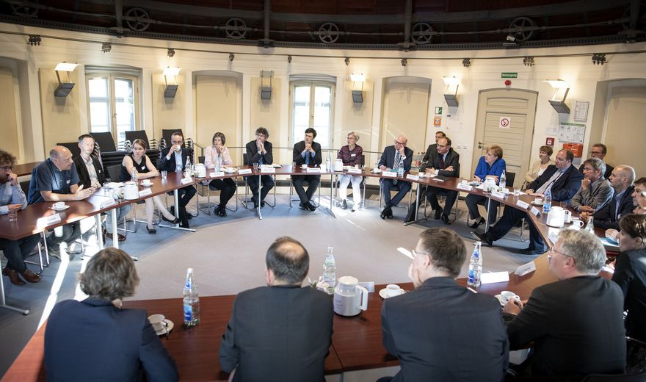
Policy advise

Slide 14
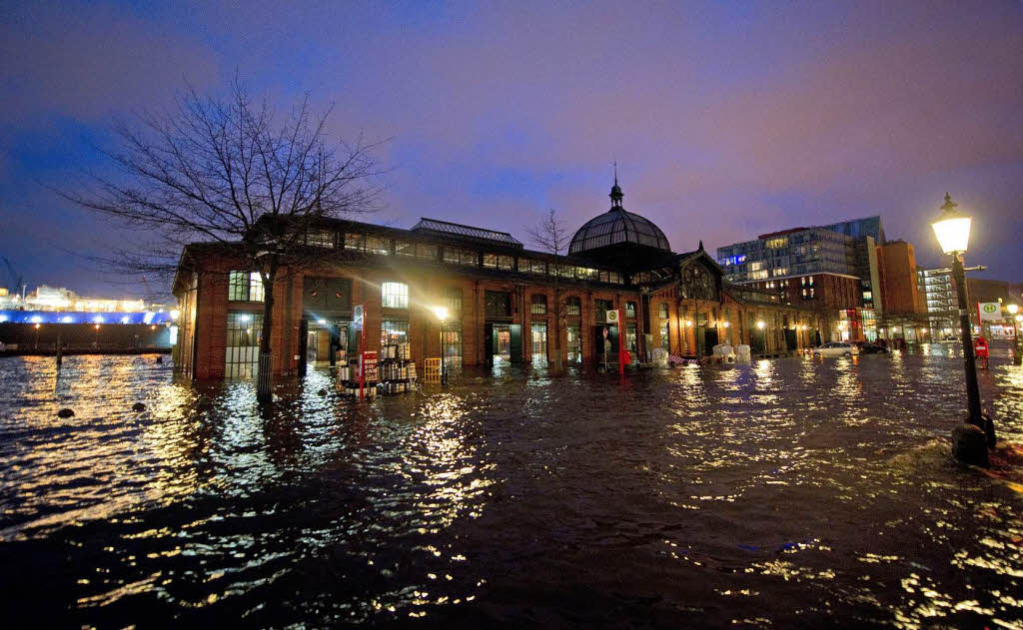
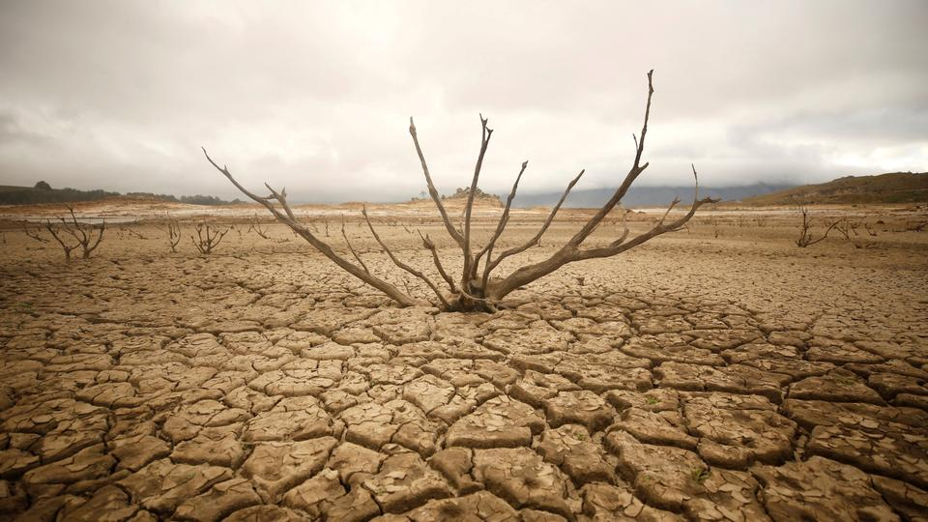
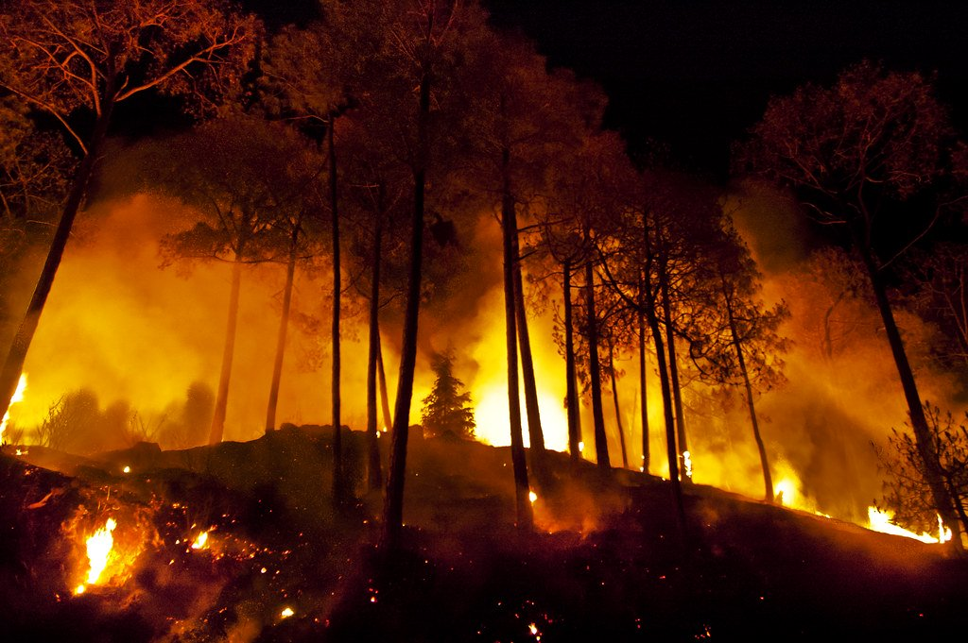
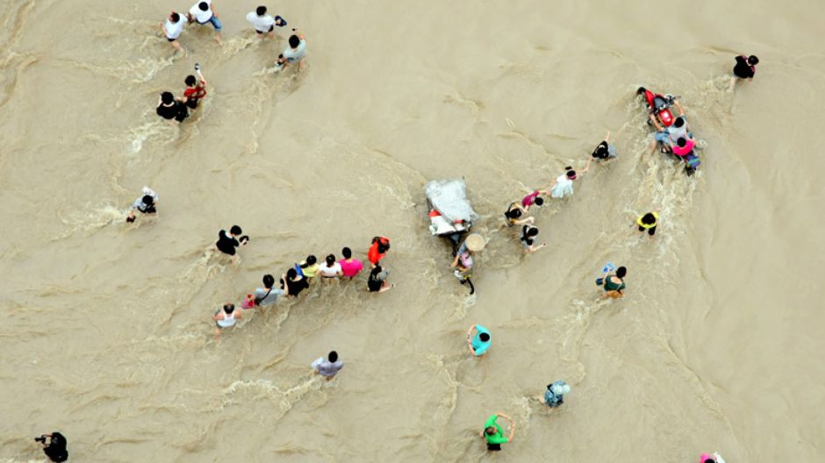
Is this climate change?

Slide 15
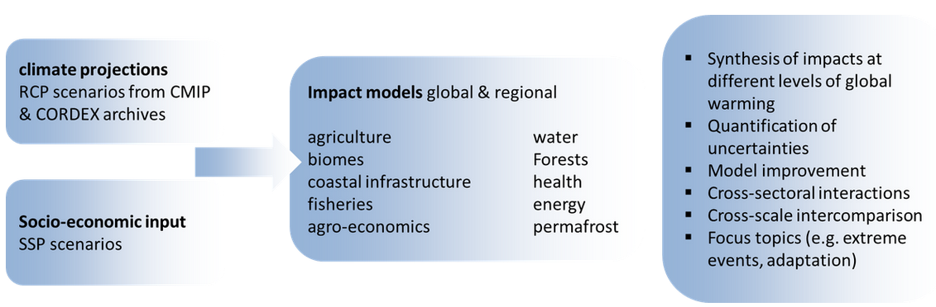
The Inter-Sectoral Impact Model Intercomparison Project (ISIMIP) – Coordinted by PIK
ISIMIP was initiated by the Potsdam Institute for Climate Impact Research (PIK) and the International Institute for Applied Systems Analysis (IIASA) and has since grown to involve over 100 modelling groups from around the world.
Source: https://www.isimip.org/about/#simulation-rounds

Slide 16
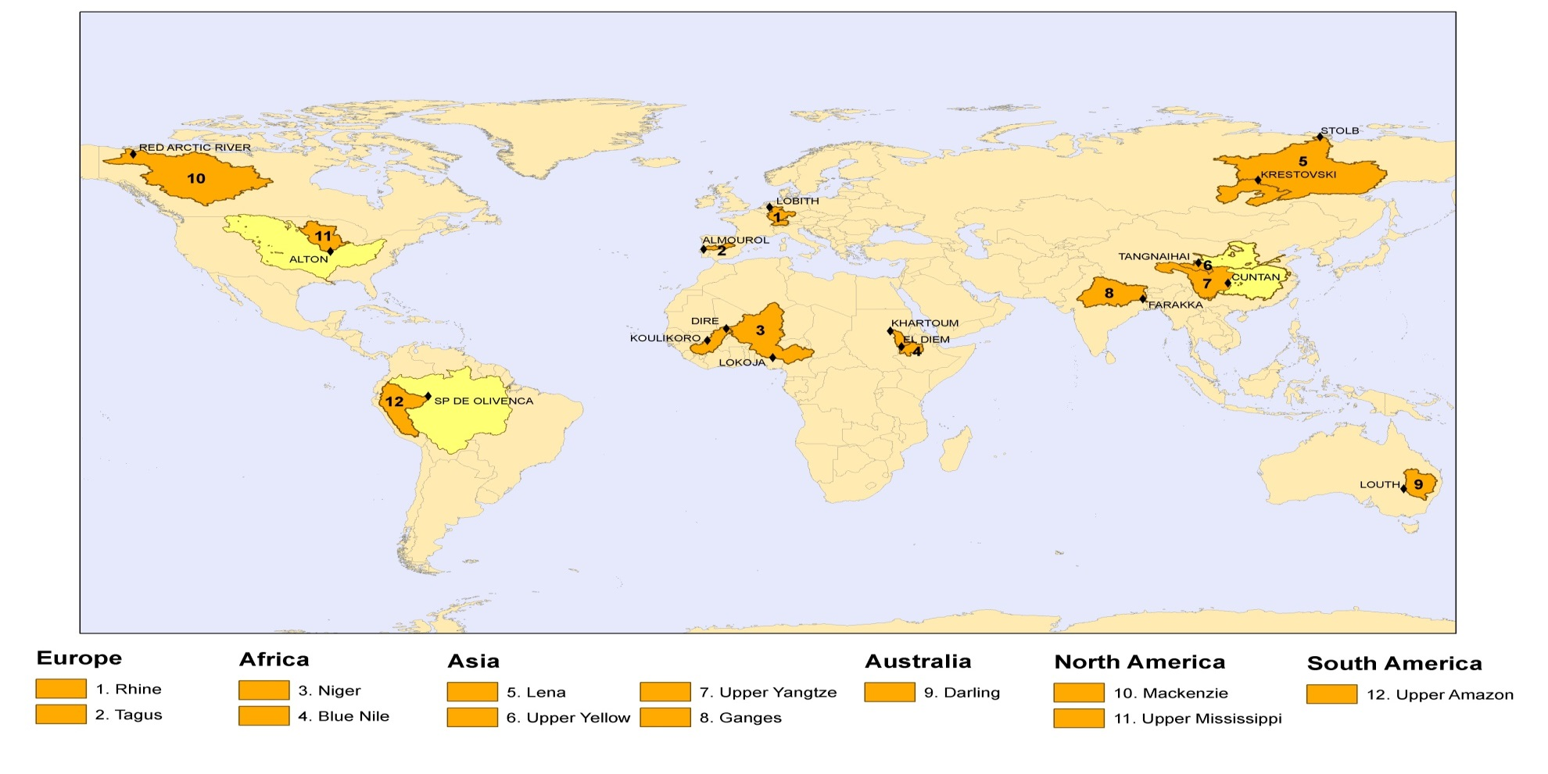
Global and regional studies for intercomparison
Mackenzie
Lena
U. Mississippi
Rhine
U.Yellow
Tagus
Ganges
U. Yangtze
U.Niger
Blue Nile
U.Amazon
Darling

Slide 17
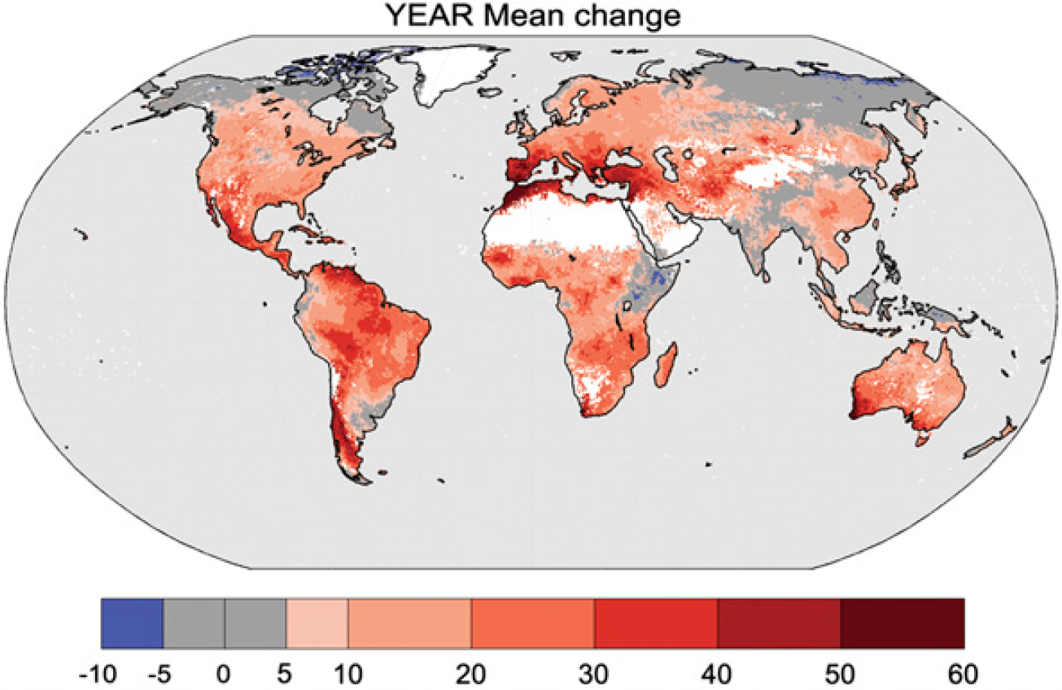
Percentage change in the occurrence of days under drought conditions for the period 2070–2099 relative to 1976–2005 under RCP8.5
Prudomme et al. 2014, PNAS

Slide 18
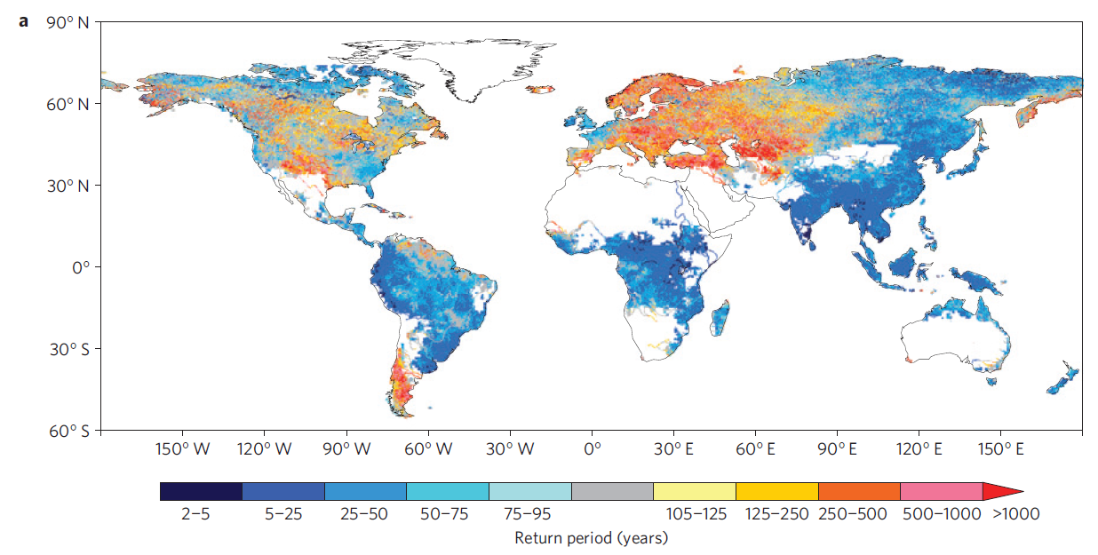
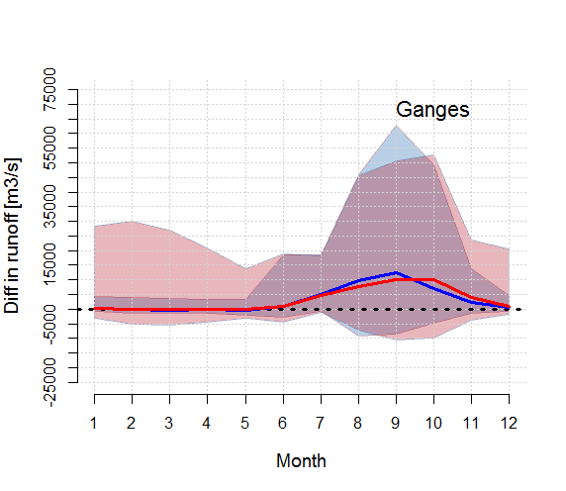
Global and regional scale results
Hirabayashi, Nat. Clim. Ch. 2013
Hattermann et al., Clim. Change 2017

Slide 19
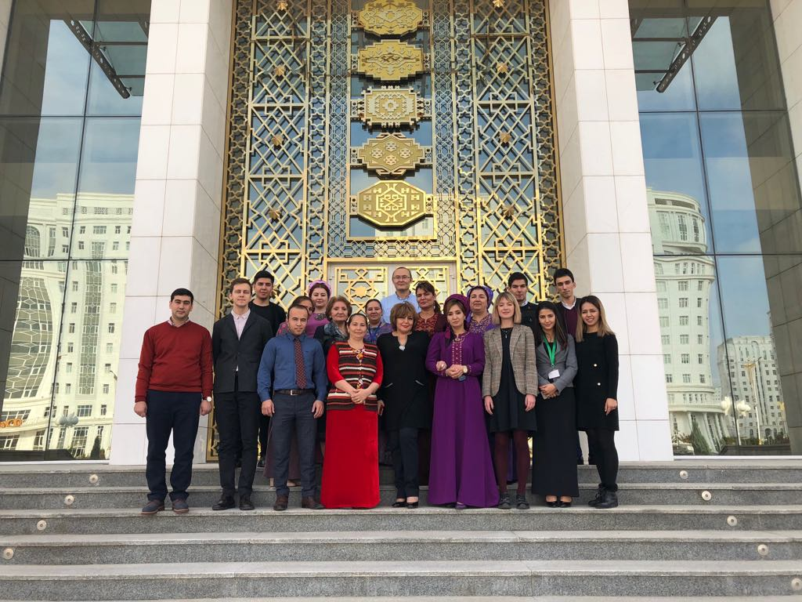
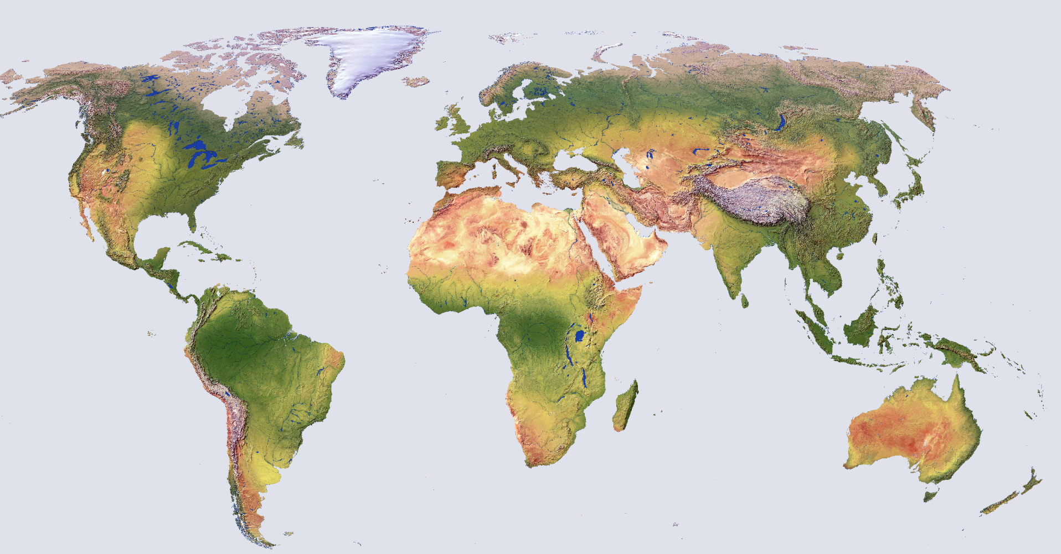
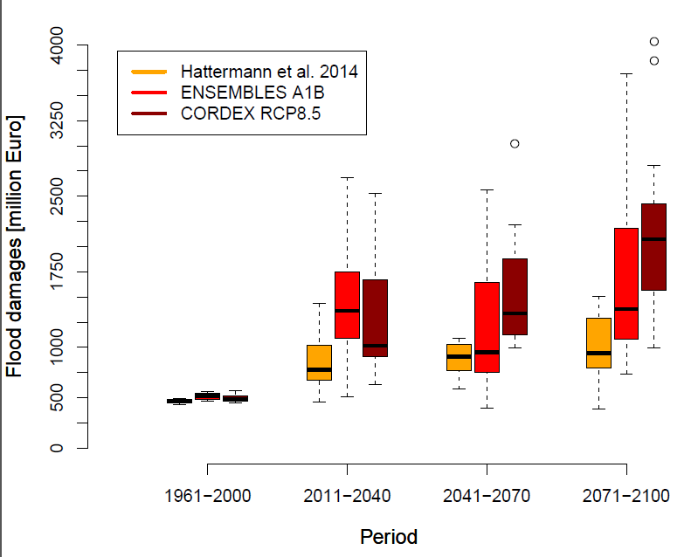
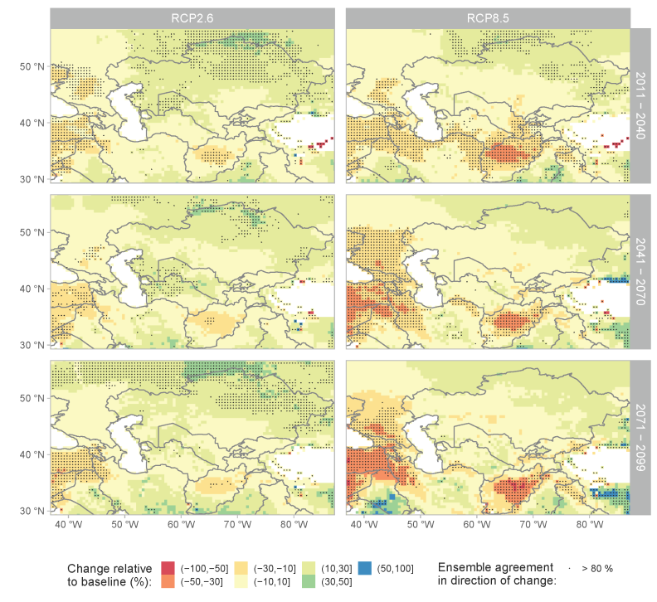
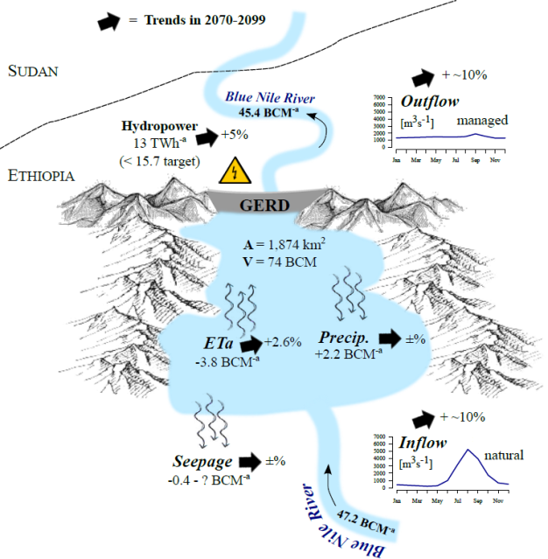
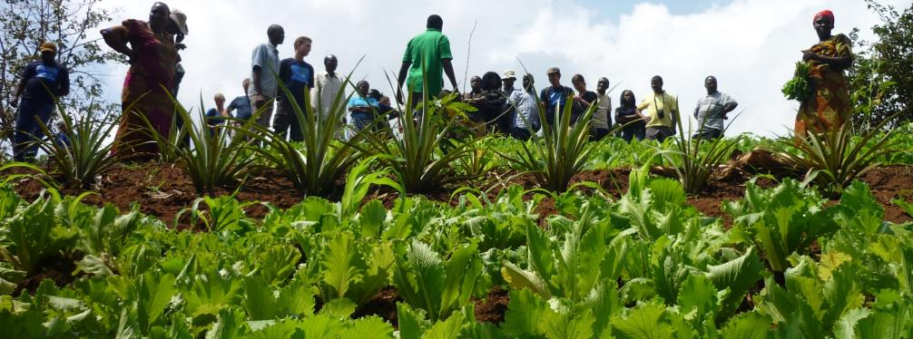

Global and regional focus

Slide 20
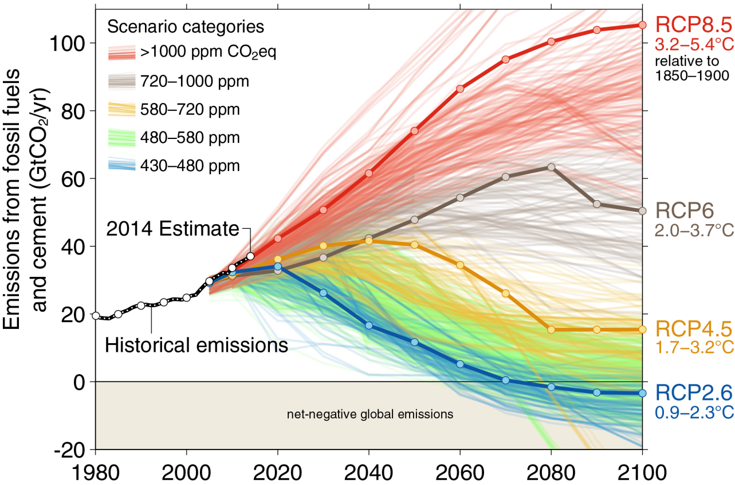
From emissions to temperatures
Business-as-usual in red
Budget: 400 Gt CO2
Current annual emission: 40 Gt CO2
World Meteorological Organization, 2014.

Slide 21
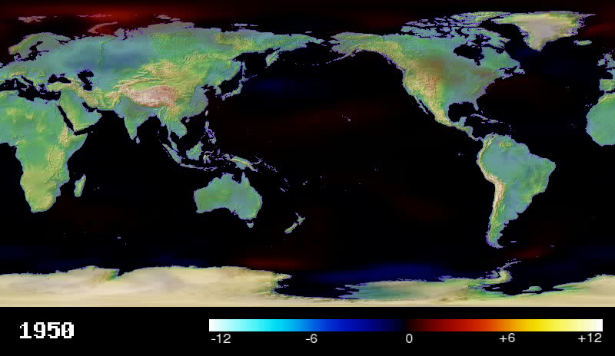
Average climate scenario

Slide 22

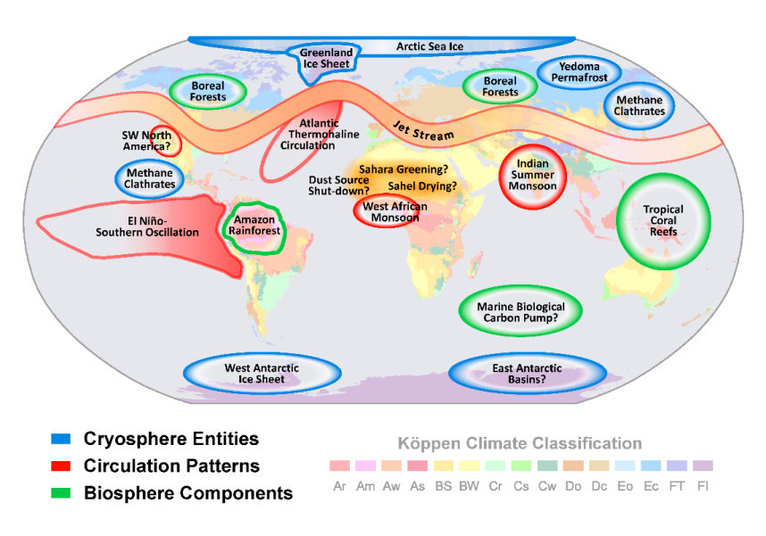
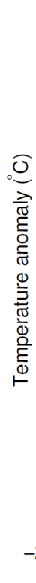
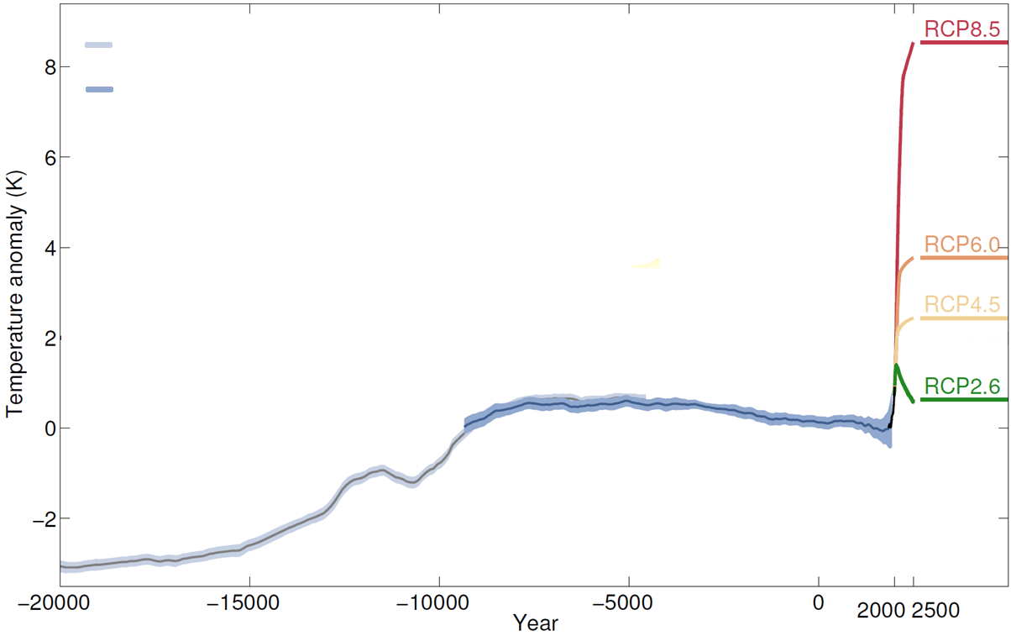

Climate tipping points
Risks at the horizon
Shakun et al. 2012
business-as-usual
Marcott et al. 2013
Antarctica
West
East
Antarctica
©PIK
Holocene
Present-day
Humans are a geological force
Crucial parts of the climate system
are at risk of tipping even within
the Paris range of 1.5 – 2°C
in accordance
with Paris Agreement
Last
Ice Age
Schellnhuber, Rahmstorf, Winkelmann, Nature Climate Change (2016)

Slide 23
Thanks!

Slide 24
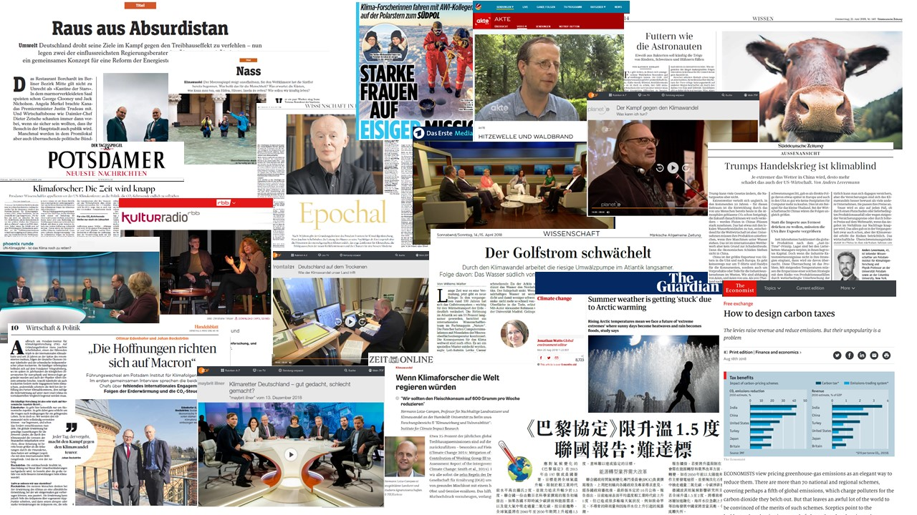
Media Reach of PIK
Approx. 14,000 articles in German print media with an edition of 220 million copies
More than 20,000 articles in international online media 340 contributions to radio (170) and TV (170)
In total, more than 130 PIK scientists were mentioned or cited

