Slide 1


Detection and attribution of flow and sediment fluxes in the Nile basin
Albert Nkwasa¹, Schlemm, Annika¹, Celray James Chawanda¹, Ann van Griensven^{1,2}
¹ Hydrology and Hydraulic Engineering Department, Vrije Universiteit Brussel (VUB), 1050 Brussel, Belgium
² Water Science & Engineering Department, IHE Delft Institute for Water Education, 2611 AX Delft, The Netherlands

Slide 2
Main objective
To detect and attribute climate change impacts on the flow and sediment loads in the Nile basin for the historical period
Case study basin
Nile basin
Climate data to be used
ISIMIP3A (Historical + Detrended)
Hydrological model
SWAT+ (Bieger et al., 2017; Arnold et al., 2018)

Slide 3
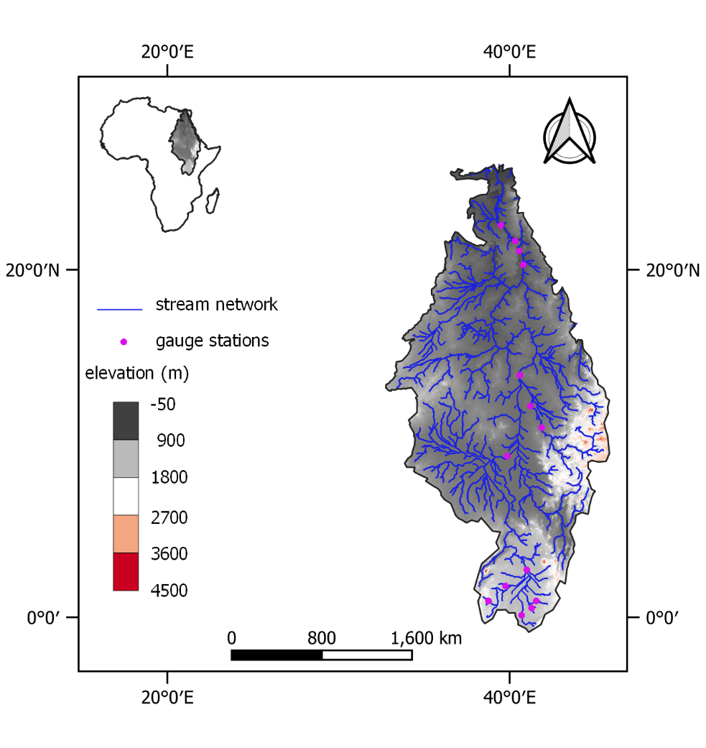
Study area

Slide 4
Timescale
Finish model evaluation
Finish writing paper
Finish detection + attribution analysis
Mar 2022
Jan 2022
May 2022

