Slide 1
Changes of Surface Runoff at 1-4 ºC Global Warming in China
Hemin Sun, Tong Jiang, Ziyan Chen, Yu Gong, Miaoni Gao
14th Dec. 2021

Slide 2
Main Objectives
By analyzing the changes of surface runoff under different warming levels in China, to explores the changes of average and extreme runoff in China under the background of climate change.
Projected changes in temperature and precipitation;
Projected changes in surface runoff;
Changes in climate variables for each 0.5 ºC of global warming;
Changes in extreme events for each 0.5 ºC of global warming.

Slide 3
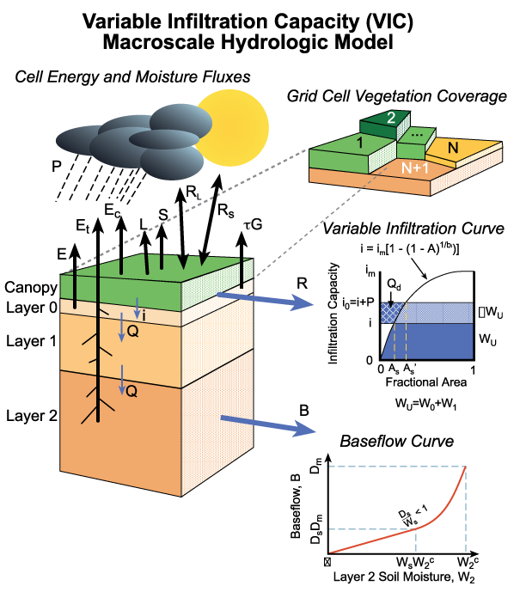
Study Area, Data and method
Data type | Description | Resolution
Observe Meteorological Data | Observe meteorological Data (air temperature, precipitation and wind, et al. ) from 1961 to 2014. | 2479 stations, daily
Climate Model Data | 5 CMIP6 models: CanESM5, CNRM-ESM2-1, IPSL-CM6A-LR, MIROC6 and MRI-ESM2-0. (maximum temperature, minimum temperature and precipitation et al.) from 1961 to 2100. | daily
Hydrological Data | Observe surface runoff data from 1961 to 2012. | 87 stations, monthly
DEM | SRTM 90 (Shuttle Radar Topography Mission) | 90 m
Soil Data | IGBP-Soil (Sand, Clay, Bulk density) | 1:100
Land Use Data | Global Land Cover data for the year of 2000 | 1 km

Slide 4
Hydrological Model Calibration and Validation
NSE
R2
KGE
RSR
Calibration
Validation

Slide 5
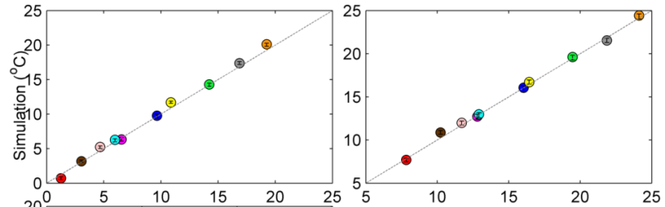

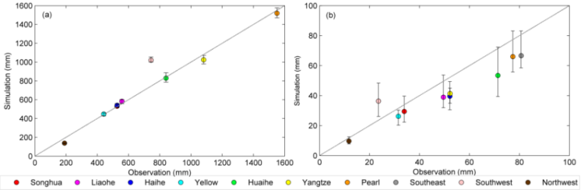

CMIP6 Model Performance Evaluation
Average Temperature
Maximum Temperature
Minimum Temperature
Annual Precipitation
Annual Maximum Precipitation
观测
模拟
 | Average Temperature | Maximum Temperature | Minimum Temperature | Annual Precipitation | Annual Maximum Precipitation
CC | 0.98 | 0.98 | 0.99 | 0.88 | 0.87
BIAS | 0.25（4%） | 0.31（2.4%） | -0.01（-0.8%） | -8.1（-1.35%） | -4.9（-14.5）
RMSE | 1.4 | 1.4 | 1.5 | 261.7 | 13.3

Slide 6
Changes in temperature for the 1995–2100 under SSPs in China
SSP1-1.9：0.02 ºC/10a
SSP1-2.6：0.11 ºC/10a
SSP2-4.5：0.29 ºC/10a
SSP3-7.0：0.51 ºC/10a
SSP4-3.4：0.20 ºC/10a
SSP4-6.0：0.38 ºC/10a
SSP5-8.5：0.69 ºC/10a

Slide 7
Changes in precipitation for the 1995–2100 under SSPs in China
SSP1-1.9：3.8 mm/10a
SSP1-2.6：6.1 mm/10a
SSP2-4.5：9.9 mm/10a
SSP3-7.0：11.4 mm/10a
SSP4-3.4：8.1 mm/10a
SSP4-6.0：10.7 mm/10a
SSP5-8.5：15.4 mm/10a

Slide 8
Changes in surface runoff for the 1995–2100 under SSPs in China
SSP1-1.9：2.4 mm/10a
SSP1-2.6：3.0 mm/10a
SSP2-4.5：4.3 mm/10a
SSP3-7.0：3.4 mm/10a
SSP4-3.4：3.8 mm/10a
SSP4-6.0：4.5 mm/10a
SSP5-8.5：5.3 mm/10a

Slide 9
Planning
Finished the VIC model calibration and validation;
Finished the CMIP6 models Evaluation.
Plan to complete extreme events analysis.
Plan to complete paper writing
Dec., 2021
Feb., 2022
  May, 2022
1
3
5
2
4
Jan., 2022
March, 2022
Plan to complete 1-4 ºC global warming analysis
Plan to complete analysis, start to write the paper.

Slide 10
~Thank you~

