Slide 1
Attribution of streamflow change in the Upper Yangtze and the Upper Yellow
River Basins
Shanshan Wen, Buda Su, Jinlong Huang, Shan Jiang, Yanjun Wang

Slide 2
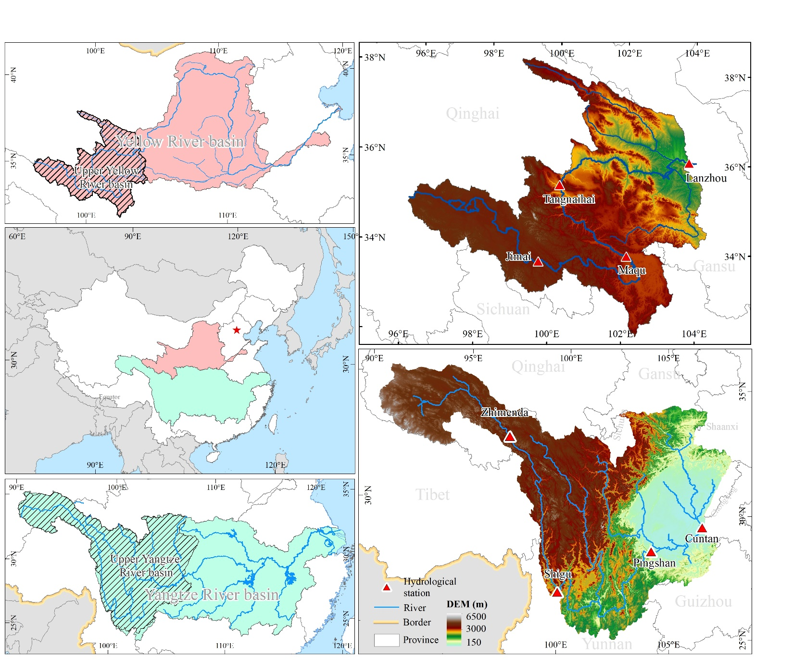
Research basins
2.2×10⁵ km²
Upper Yellow River Basin
Annual mean
tem: 3.8 °C
Prec: 440 mm
Discharge: 1000 m³/s
Upper Yangtze River basin
Annual mean
tem: 12.3 °C
Prec: 1018 mm
Discharge: 11000 m³/s
8.1×10⁵ km²

Slide 3
Objective
to explore if anthropogenic influence on climate has affected the magnitude of mean and extremes flows, and to what extend? What the differences between these two basins with different climate and surface conditions?

Slide 4
Data
Discharge
the Upper Yangtze River Basin
Cuntan,
Pingshan,
Shigu,
Zhimenda;
Daily, 1979-2013
the Upper Yellow River Basin
Lanzhou,
Tangnaihai,
Maqu,
Jimai;
Daily, 1961-2014

Slide 5
Data
GIS data:
DEM: SRTM, 90 m
Soil: Harmonized World Soil Database (FAO, 2009)
Landuse: Global Land Cover data for the year of 2000 (Bartholomé and Belward 2005).
Climate data:
Observed data: GSWP3-W5E5，1901-2019
Counterfactual data: cf.GSWP3-W5E5, 1901-2019
In situ meteorological observations: 1961-2019

Slide 6
Methods
Hydrological models
SWAT (Arnold et al. 1998)
VIC (Liang et al. 1994)
HBV-D (Bergström, and Forsman 1973; Krysanova et al. 1999)
Model evaluation
Five-step comprehensive model evaluation
Goodness-of-fit criteria: NSE, KGE, R2, RSR

Slide 7
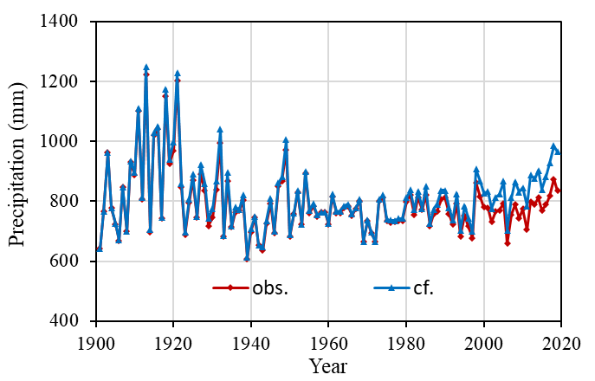
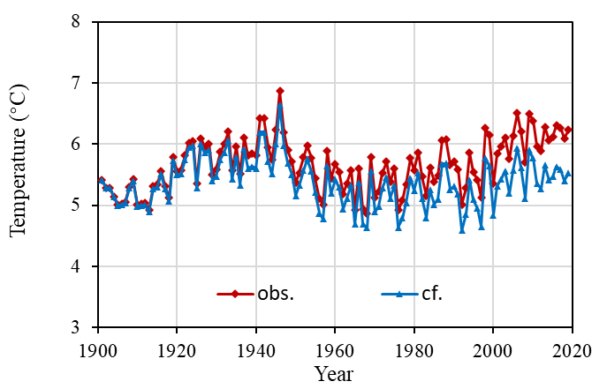
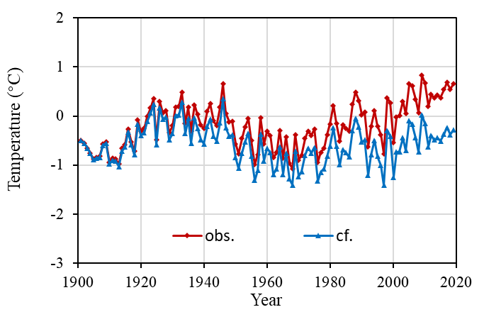
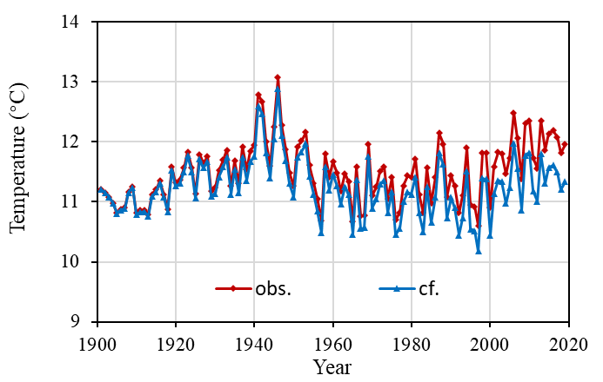
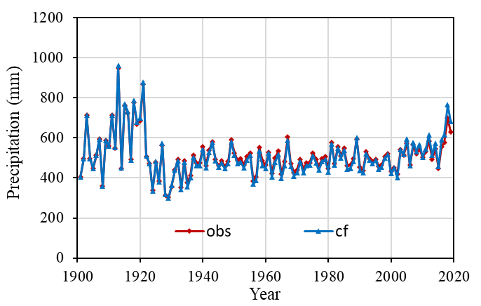
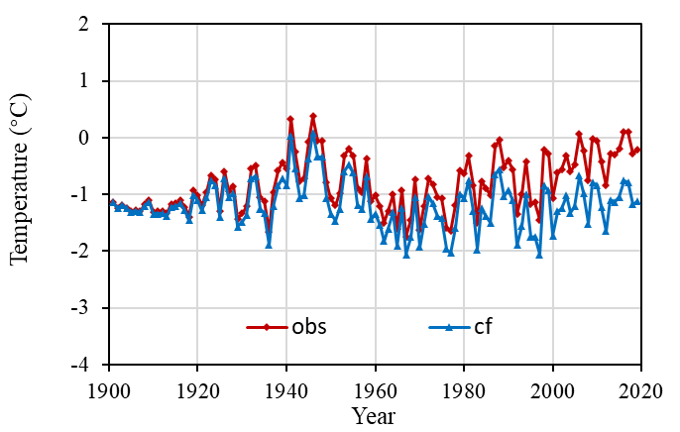
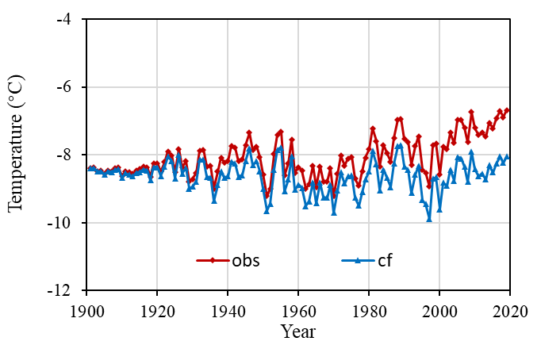
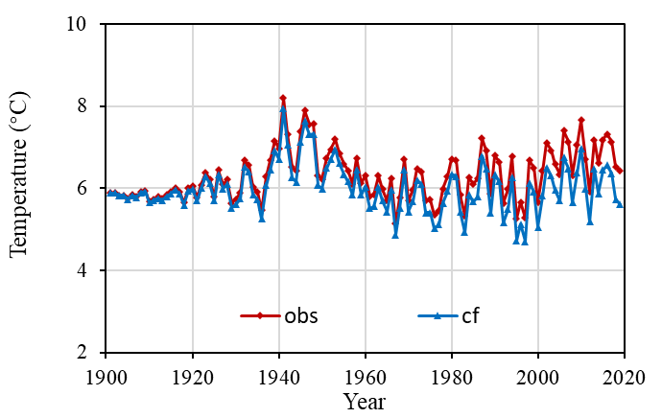
Obs. VS cf. data
Obs. : GWSP3-W5E5
cf. : Counterfactural
the Upper Yangtze River Basin
Pre
Tmean
Tmin
Tmax
the Upper Yellow River Basin
Pre
Tmean
Tmin
Tmax

Slide 8
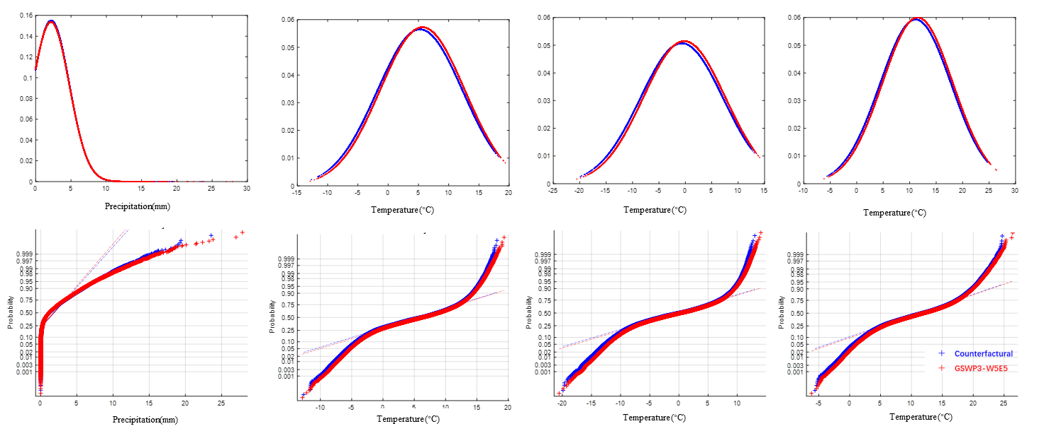
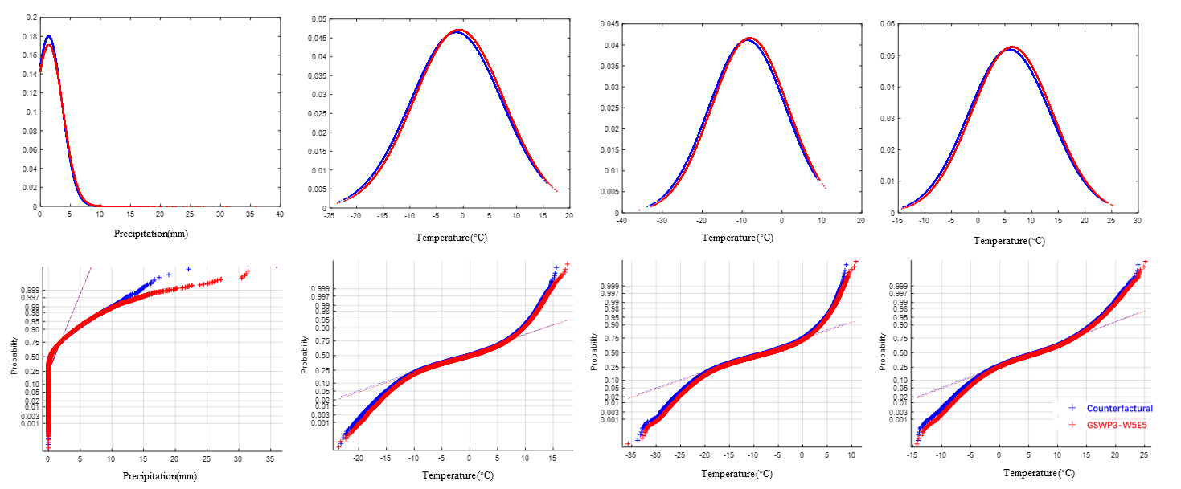
Obs. VS cf. data
the Upper Yangtze River Basin
Pre
Tmean
Tmin
Tmax
the Upper Yellow River Basin
Pre
Tmean
Tmin
Tmax

Slide 9
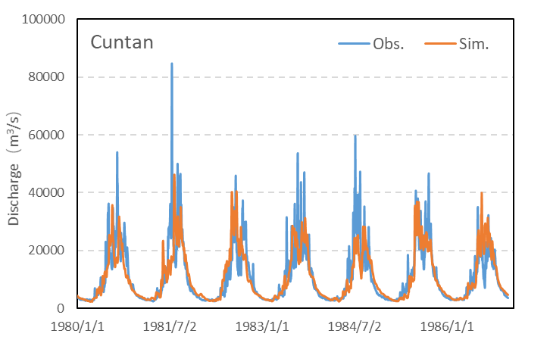
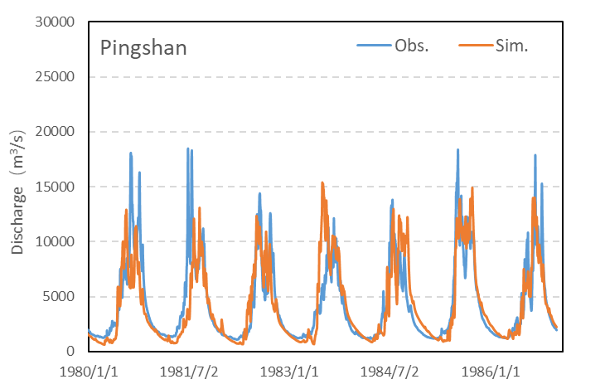
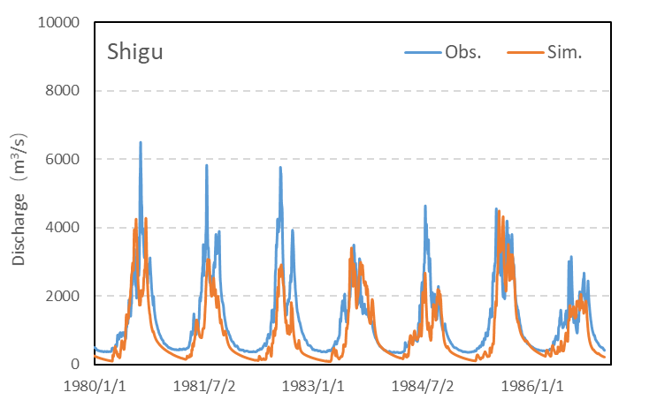
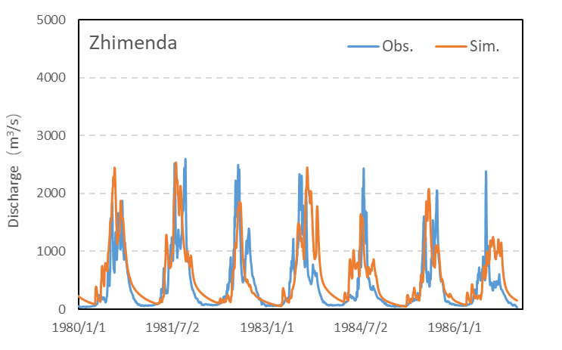
Model calibration & validation
Table Criteria of fit of SWAT hydrological model in the calibration period and the validation period in the Upper Yangtze River Basin, based on multi-gauge comprehensive calibration / validation procedure
 | Periods | Station | SWAT
 |  |  | Nash | R2 | KGE | RSR
Calibration | 1979-1996 | Cuntan | 0.88 | 0.88 | 0.91 | 0.35
 |  | Pingshan | 0.89 | 0.89 | 0.91 | 0.31
 |  | Shigu | 0.71 | 0.88 | 0.62 | 0.51
 |  | Zhimenda | 0.64 | 0.82 | 0.60 | 0.55
Validation | 1997-2004 (wet) | Cuntan | 0.89 | 0.89 | 0.91 | 0.32
 |  | Pingshan | 0.88 | 0.89 | 0.84 | 0.35
 |  | Shigu | 0.83 | 0.91 | 0.75 | 0.41
 |  | Zhimenda | 0.32 | 0.83 | 0.33 | 0.82
 | 2005-2013 (dry) | Cuntan | 0.86 | 0.86 | 0.92 | 0.38
 |  | Pingshan | 0.82 | 0.84 | 0.86 | 0.42
 |  | Shigu | 0.78 | 0.88 | 0.69 | 0.47
 |  | Zhimenda | 0.64 | 0.89 | 0.51 | 0.6

Slide 10
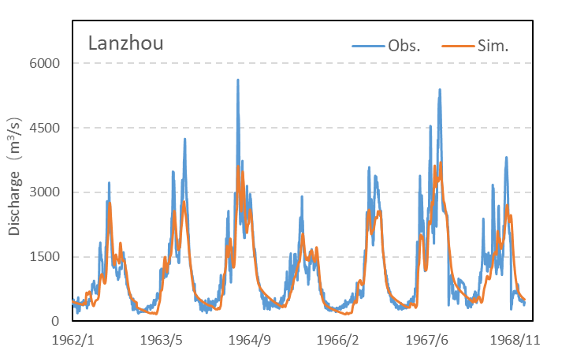
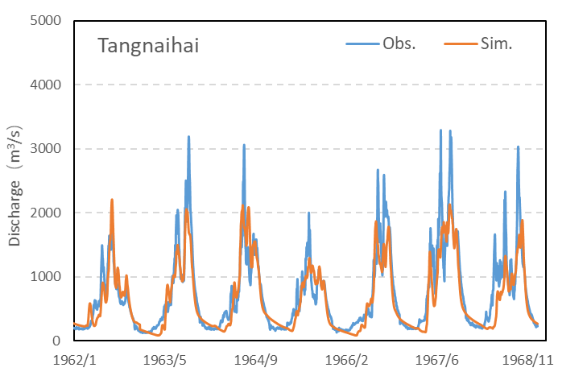
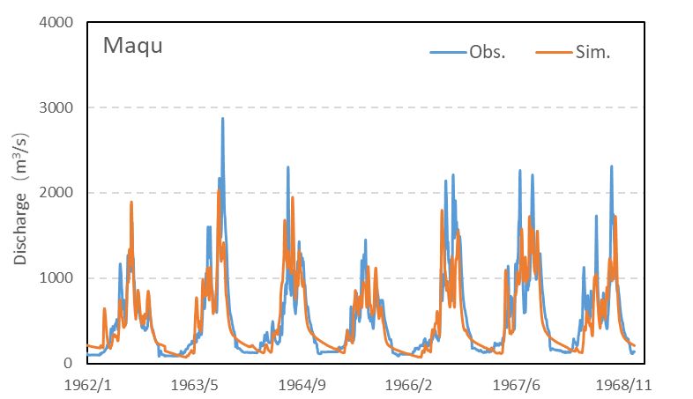
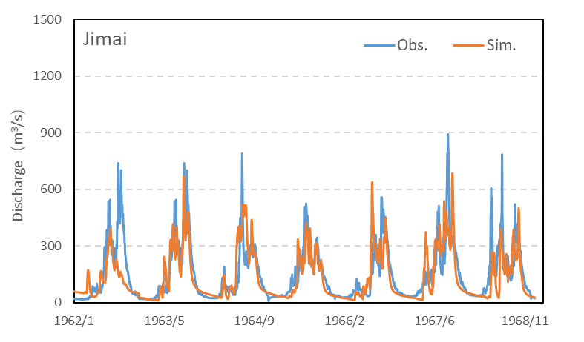
Model calibration & validation
Table Criteria of fit of SWAT hydrological models in the calibration period and the validation period in the Upper Yellow River Basin, based on multi-gauge comprehensive calibration / validation procedure
 | Periods | Station | SWAT
 |  |  | Nash | R2 | KGE | RSR
Calibration | 1961-1968 | Lanzhou | 0.79 | 0.81 | 0.8 | 0.45
 |  | Tangnaihai | 0.77 | 0.79 | 0.77 | 0.48
 |  | Maqu | 0.67 | 0.68 | 0.76 | 0.58
 |  | Jimai | 0.58 | 0.61 | 0.76 | 0.65
Validation | 1971-1975 (dry) | Lanzhou | 0.48 | 0.63 | 0.73 | 0.72
 |  | Tangnaihai | 0.77 | 0.79 | 0.79 | 0.48
 |  | Maqu | 0.72 | 0.73 | 0.81 | 0.52
 |  | Jimai | 0.62 | 0.64 | 0.72 | 0.61
 | 1982-1986 (wet) | Lanzhou | 0.66 | 0.72 | 0.82 | 0.58
 |  | Tangnaihai | 0.83 | 0.84 | 0.8 | 0.41
 |  | Maqu | 0.82 | 0.82 | 0.84 | 0.42
 |  | Jimai | 0.7 | 0.71 | 0.84 | 0.55

Slide 11
Next steps
Model calibration and validation
Flow simulations
Detection and attribution

Slide 12
Thank you !

