Slide 1


Detection and attribution of hydrological changes in Arctic river basins: methodological aspects
Olga Nasonova, Yeugeniy Gusev, Evgeny Kovalev
Water Problems Institute, Russian Academy of Sciences, Moscow
Notes:
2

Slide 2
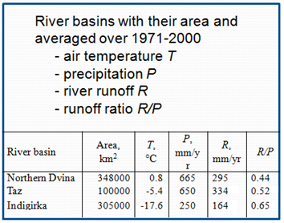
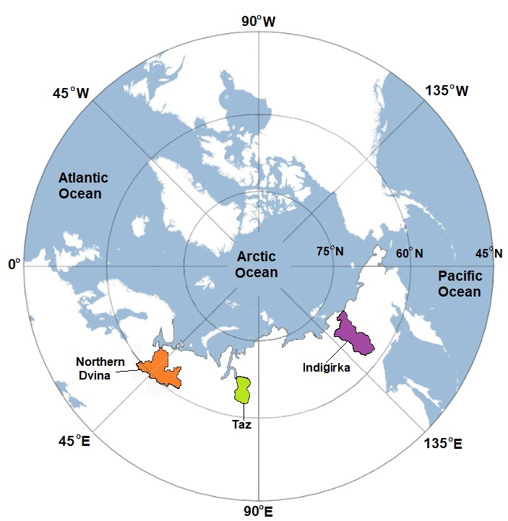
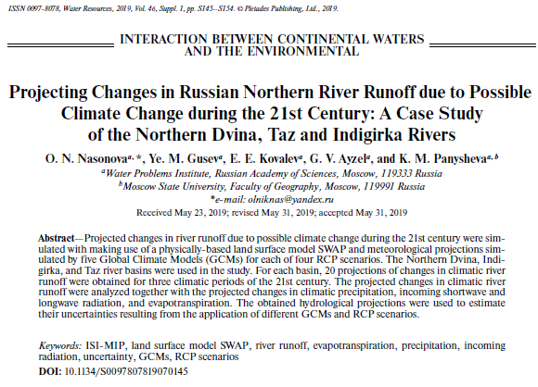
Arctic river basins
RUSSIA

Slide 3
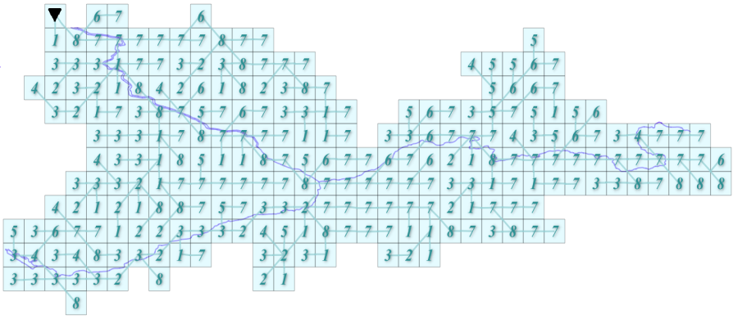
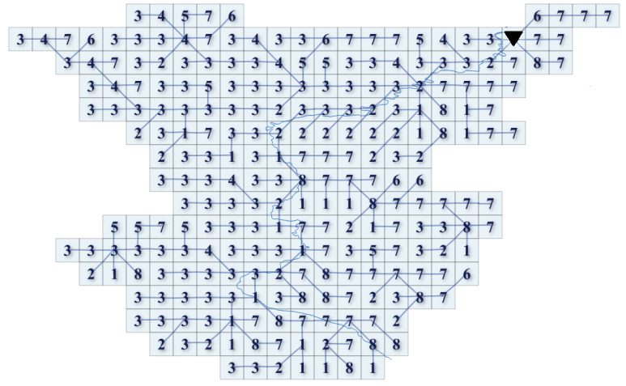
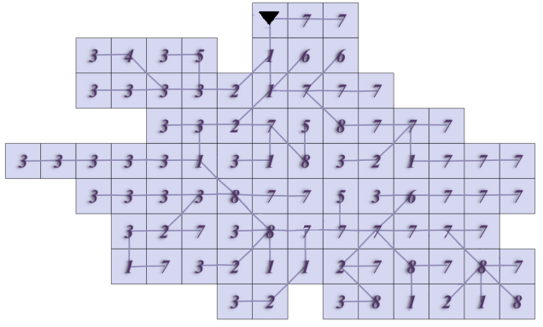
Schematization of the river basins
Northern Dvina
The basins were presented as a set of regular grid cells (with a spatial resolution 0.5°×0.5° in latitude and longitude) connected by a river network.
Indigirka
Taz
River basin | Streamflow gauge station |  |  | Area, km² | Number of grid cells
 | Name | Latitude | Longitude
Northern Dvina | Ust’-Pinega | 64.13 | 42.17 | 348000 | 248
Taz | Sidorovsk | 66.60 | 82.28 | 100000 | 88
Indigirka | Vorontsovo | 69.58 | 147.35 | 305000 | 243

Slide 4
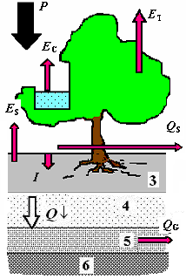
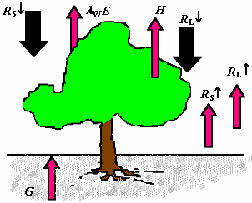
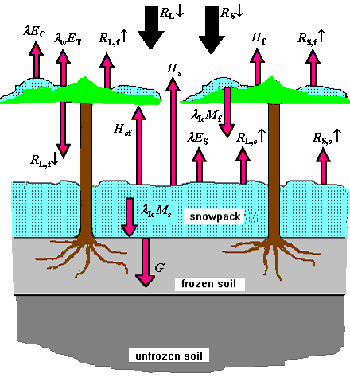
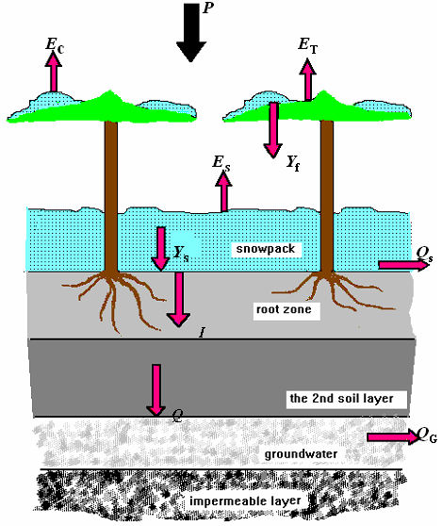
Land surface model SWAP
Water balance components
Heat balance components
Warm season
Cold season

Slide 5
Meteorological forcing data
♦ Incoming shortwave radiation
♦ Incoming longwave radiation
♦ Precipitation
♦ Air temperature
♦ Air humidity
♦ Wind speed
♦ Air pressure
ISIMIP3a: historical daily data for 1901-2019
• factual – «obsclim»
• counterfactural – «counterclim»

Slide 6
Hydrological observations
River runoff at the basin outlets of the
• Northern Dvina (1957 – 2003)
• Taz (1962 – 1996)
• Indigirka (1950 –1994)
Snow water equivalent (SWE) – 1966-2019
Notes:
16

Slide 7
Model parameters
Vegetation parameters (vegetation class, LAI, albedo, roughness length, greenness fraction, vegetation height, rooting depth) were taken or derived from the ECOCLIMAP database.
Soil parameters (porosity, field capacity, wilting point, hydraulic conductivity at saturation, soil matric potential at saturation and B-parameter in parameterisation by Clapp & Hornberger were calculated with equations by Cosby et al. and data on soil texture (CLAY and SAND) from ECOCLIMAP.
Calibrated parameters:
• Adjustment factors for
• soil hydraulic conductivity at saturation K₀ ;
• rooting depth h_{r} .
• Coefficient k_{h0} for soil column depth in h₀ = k_{h0} h_{r} .
• Adjustment factor for snow free albedo of the land surface alb_{sum}.
• Albedo of fresh snow alb_{sn}.
• Manning coefficient n.
• Effective velocity of water movement in a channel network u_{e}.
Notes:
16

Slide 8
Calibration and validation
SCE-UA - Shuffled Complex Evolution method
Objective function:
Condition: ⎪Bias⎪≤ 5%
Observations: 1) river runoff at basin outlets
2) SWE
Notes:
16

Slide 9
Simulating river runoff and SWE
ISIMIP3a: historical daily data for 1901-2019
• factual – «obsclim»
• counterfactural – «counterclim»
Analysis of the results
Paper
Notes:
16

Slide 10
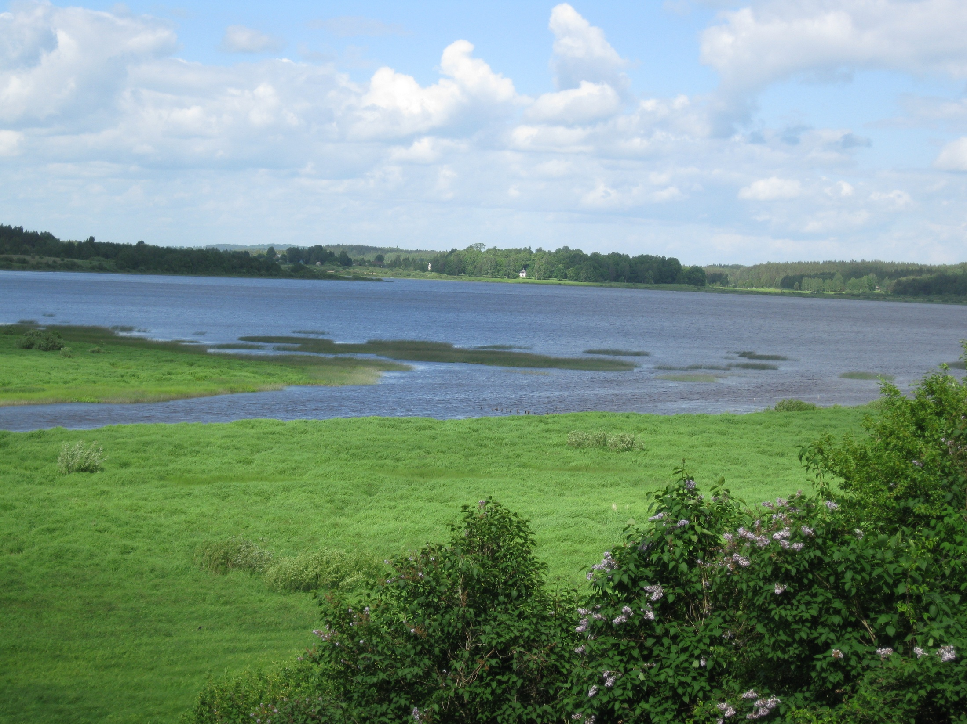
Thank you!

