Slide 1
A generalized streamflow-based analysis for climate change impact detection and attribution
Jens Kiesel^{1,2}, Pechlivanidis I⁴, Addor N⁵, Melsen L⁶, Kratzert F⁷,
Klotz D⁷, Shen L², Fohrer N¹, Domisch S², Newman A⁴
1 Christian-Albrechts-University Kiel, Dep. of Hydrology and Water Resources Management, Kiel, Germany
2 Leibniz-Institute of Freshwater Ecology and Inland Fisheries (IGB) Berlin, Dep. of Ecosystem Research, Germany
3 National Center for Atmospheric Research (NCAR), Boulder, USA
4 Swedish Meteorological and Hydrological Institute, Norrköping, Sweden
5 University of Exeter, Department of Geography, England
6 Wageningen University, Department of Environmental Sciences, Netherlands
7 Johannes Kepler University Linz, Institute of Bioinformatics, Austria

Slide 2
The general idea...
...is, to detect and attribute climate change impacts for the historical period in a multi-basin multi-model study

Slide 3
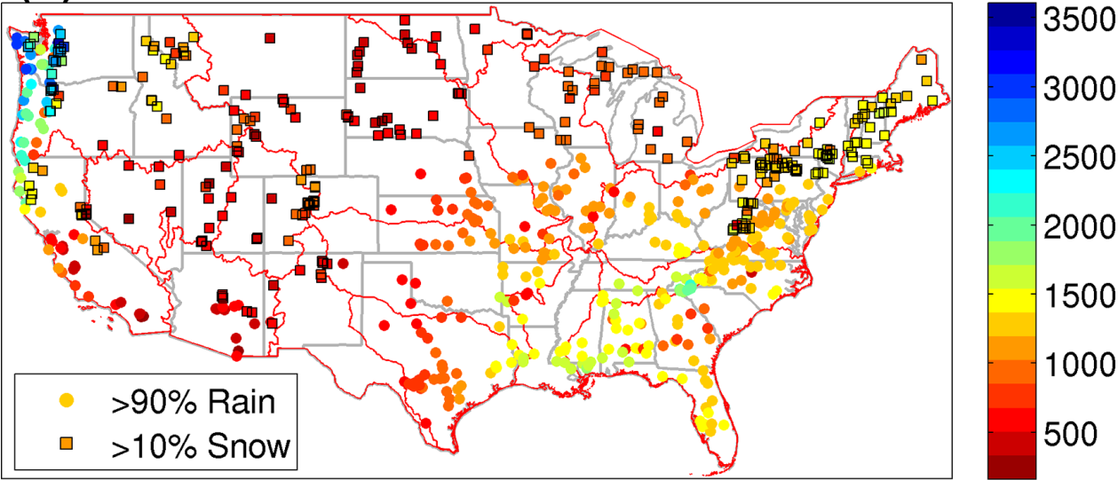
The Catchment Attributes and Meteorology for Large Sample Studies (CAMELS) dataset
High-quality observed data for 671 gauges across all climate and ecoregions of the USA
Climate, geology, hydrology, soil, topography and vegetation attributes lumped for each basin
Mostly headwater basins (4 – 25,000 km², av. 800km²) with little anthropogenic influence
Ready-to use dataset for multiple hydrological models (VIC, HBV, SAC, LSTM)
PCP (mm yr⁻¹)
Newman et al. (2015) HESS

Slide 4
The steps needed to get this to work...
Update CAMELS dataset:
- extend streamflow time series, update meteorological dataset (daymet v2 to daymet v4)
Obtain behavioural hydrological models for the observed baseline
- 2000-2014 calibration and 1985-1999 validation
- 5-step evaluation criteria (Krysanova et al. 2018 HSJ)
Obtain hindcasted climate change:
- download ISIMIP 3a counterfactual (50x50km: gswp3-w5e5)
- download ISIMIP 3b CMIP6 (50x50km: gfdl-esm, ipsl-cm6a, mpi-esm, mri-esm, ukesm)
- (ISIMIP 1km, LOCA climate change 32 downscaled CMIP5 models)
Run hindcasted data through the behavioural models
- calculate CAMELS spatial basin averages for each climate model dataset per time step
- run bias adjusted (1985-2014) and non-bias adjusted data through the models
Identify simulated streamflow change from hindcast vs observation:
- detection of the climate change signal in all streamflow time series

Slide 5
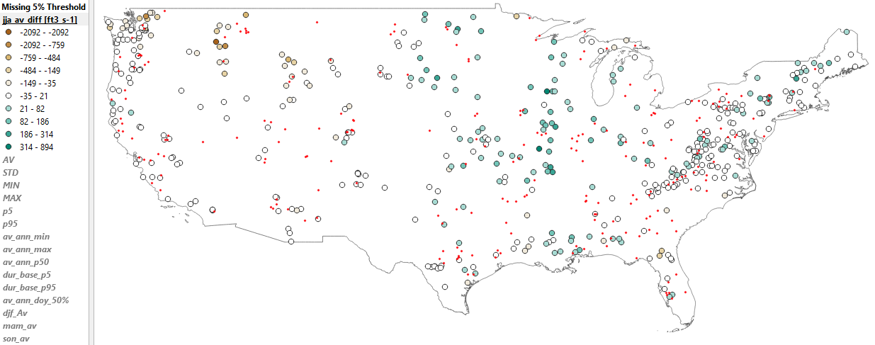
Observed streamflow change in seasonality
(1950-1980, 1990-2020)
441 basins remaining (<5% gaps)

Slide 6
The steps needed to get this to work...
Update CAMELS dataset:
- extend streamflow time series, update meteorological dataset (daymet v2 to daymet v4)
Obtain behavioural hydrological models for the observed baseline
- 2000-2014 calibration and 1985-1999 validation
- 5-step evaluation criteria (Krysanova et al. 2018 HSJ)
Obtain hindcasted climate change:
- download ISIMIP 3a counterfactual (50x50km: gswp3-w5e5)
- download ISIMIP 3b CMIP6 (50x50km: gfdl-esm, ipsl-cm6a, mpi-esm, mri-esm, ukesm)
- (ISIMIP 1km, LOCA climate change 32 downscaled CMIP5 models)
Run hindcasted data through the behavioural models
- calculate CAMELS spatial basin averages for each climate model dataset per time step
- run bias adjusted (1985-2014) and non-bias adjusted data through the models
Identify simulated streamflow change from hindcast vs observation:
- detection of the climate change signal in all streamflow time series

Slide 7
Resources
Servers available at IGB Berlin (climate data storage and processing)
Servers available at NCAR (hydrological model runs)
Many team members but the study is not embedded in a particular project... (time constraints)
Problems, questions and constraints
- due to observed streamflow we are restricted to the post 1950 time period
- we will need to apply an adapted 5-step evaluation for the models
- we use different ‘observed’ climate data (not W5E5) and run an ‘additional’ bias adjustment
- ISIMIP 3a counterfactual: we can wait (correction issue GSWP3 vs 20CRv3)
- ISIMIP 3a counterfactual 1km: it would be advantageous because the CAMELS basins are small
(but probably 5km are sufficient as well)

