Slide 1
The contribution of climate change impacts on streamflow in Nordic catchments
Xue Yang¹ and Shaochun Huang²
¹State Key Laboratory of Eco-Hydraulics in Northwest Arid Region, Xi’an University of Technology, Xi’an, Shaanxi, China
²Norwegian Water Resources and Energy Directorate (NVE), Oslo, Norway

Slide 2
Preliminary objectives
To identify trends of different streamflow percentiles in Nordic catchments
To evaluate the contribution of climate change impacts on different streamflow percentiles

Slide 3
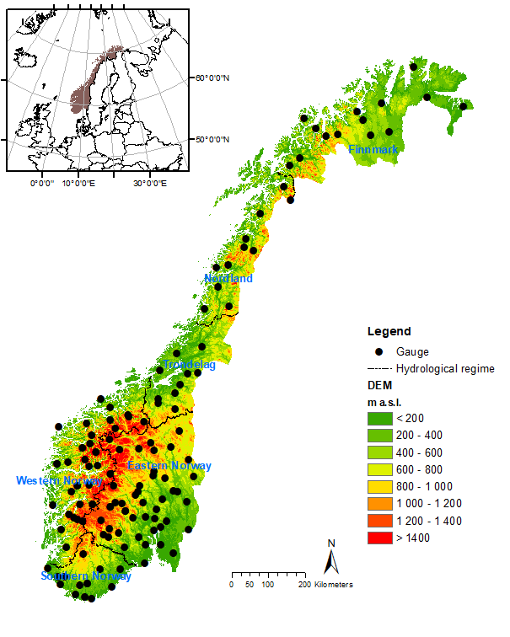
Study area
86 natural catchments in Norway
May include some near-natural catchments in Sweden.

Slide 4
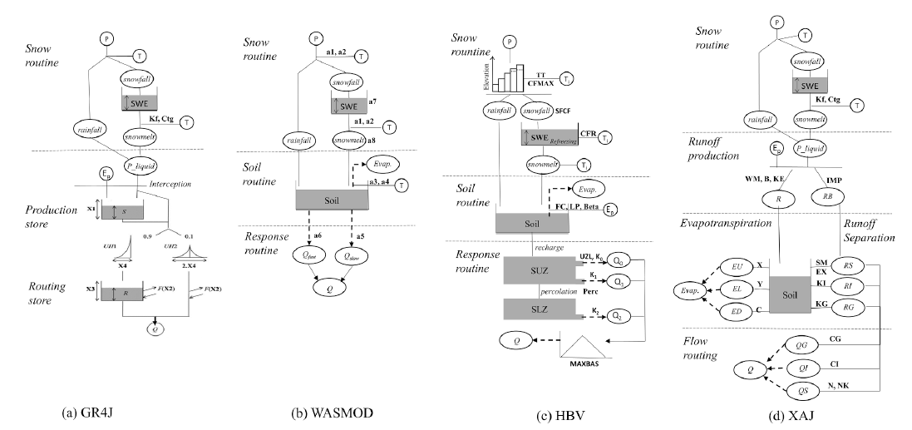
Model

Slide 5
Data
Historical
Counterfactual
(Picontrol and historical from GCMs)
All should be 1 km data.
Will download it soon
Not available now

