Slide 1
Preliminary paper title
Climate-driven hydrological changes in geographically different river basins: the changes detection, attribution and mechanisms analysis
Gelfan Alexander^{1,2}, Kalugin Andrei¹, Krylenko Inna^{1,2}
¹Water Problems Institute, Russian Academy of Sciences
²Hydrological Dep., Moscow State University

Slide 2
Objectives
1) To detect changes in the historical streamflow series for large river basins in the different physiographic and climatic conditions
2) To analyze, whether the detected changes are attributed to the climatic drivers
3) To answer the question: what are the specific mechanisms of the observed climatic changes transformation into the attributed hydrological changes of different basins?

Slide 3
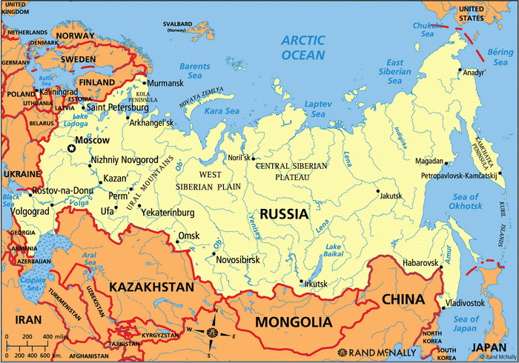
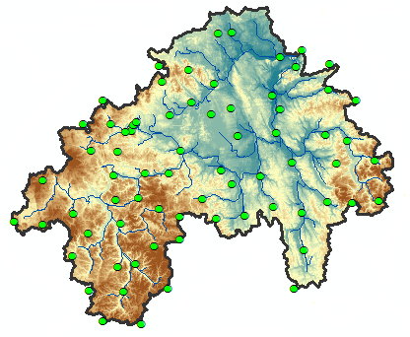
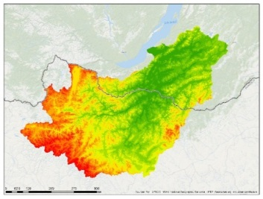
Study basins
VYATKA RIVER BASIN
Northern forest zone Temperate humid climate F=129,000 km²
T_{annual}=3.2^{O}C
P_{annual}=700 mm
LENA RIVER BASIN
Subarctic and temperate continental arid climate
F=2,490,000 km²
T_{annual}=-8- -17^{O}C
P_{annual}=280-400 mm
95% permafrost
SELENGA RIVER BASIN
Forest-steppe zone
Continental arid climate
F=447,000 km²
T_{annual}=-2^{O}C
P_{annual}=350 mm
OKA RIVER BASIN
Southern forest zone Temperate semi-humid climate
F=245,000 km²
T_{annual}=5.4^{O}C
P_{annual}=600 mm

Slide 4
Preliminary paper structure
I. DETECTING¹ CHANGES (TRENDS?) in the long-term historical series:
annual flow, seasonal flow, high flow (observations, basin outlet)
mean annual air temperature, precipitation, air humidity (reanalysis, averaged over a catchment)
¹“detection” is demonstrating that a change has been observed that is significantly different (in a statistical sense) from what can be explained by natural internal variability
II. MODEL EVALUATION for reproducing river flow regime including long-term changes (trends?) or lack of changes in streamflow series for the historical period
III. ATTRIBUTION² OF THE DETECTED CHANGES (TRENDS) in the long-term historical streamflow simulation series to the climatic driver(s)
²“attribution” is demonstrating that the detected change is consistent with the responses of the hydrological system to the given climatic driver(s), and not consistent with alternative, physically plausible explanations
IV. ANALYSING PRINCIPAL PHYSICAL MECHANISMS (snow?, evaporation?, soil freezing/thawing?…) OF THE DETECTED BASIN RESPONSES TO THE CLIMATIC DRIVERS

Slide 5
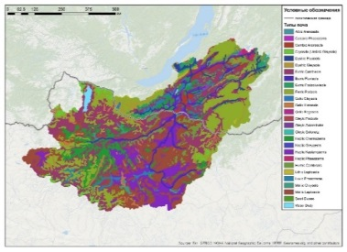
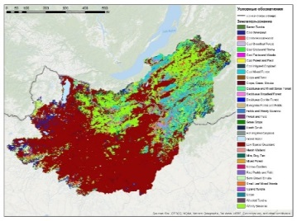
Data
Monthly river discharge series at the basins outlets (observations; >50yrs)
Meteorological reanalysis ISI-MIP 3a (1901-2019 )
DEM data - HYDRO1K database
Soil parameters - HSWD database
Land-use - Global Land Cover Characterization (GLCC)

Slide 6
Methods
Regional hydrological models based on the ECOMAG modelling platform
Detection (probably Kundezewicz, Radziejewski, 2006)
Comparison of the observes and simulated trends
(probably Santer et al., 2000)
Attribution (numerical exps with ISI-MIP counterfactual data)

Slide 7
Modelling and analysis will be ready by the end of May, 2022
The paper will be written by the end of September, 2022
Thank you!

