Slide 1
Attribution of climate change on streamflow in Central Asian catchments
Didovets, Nurbatzina, Fallah, Hattermann, Krysanova et al.;

Slide 2
Main objective
To detect the climate change attribution on seasonal and annual streamflow across various catchment in Central Asia
Case study river basin(s)
12+ river catchments
Climate data to be used
ISIMIP3A
Hydrological model
SWIM
Period: historical

Slide 3
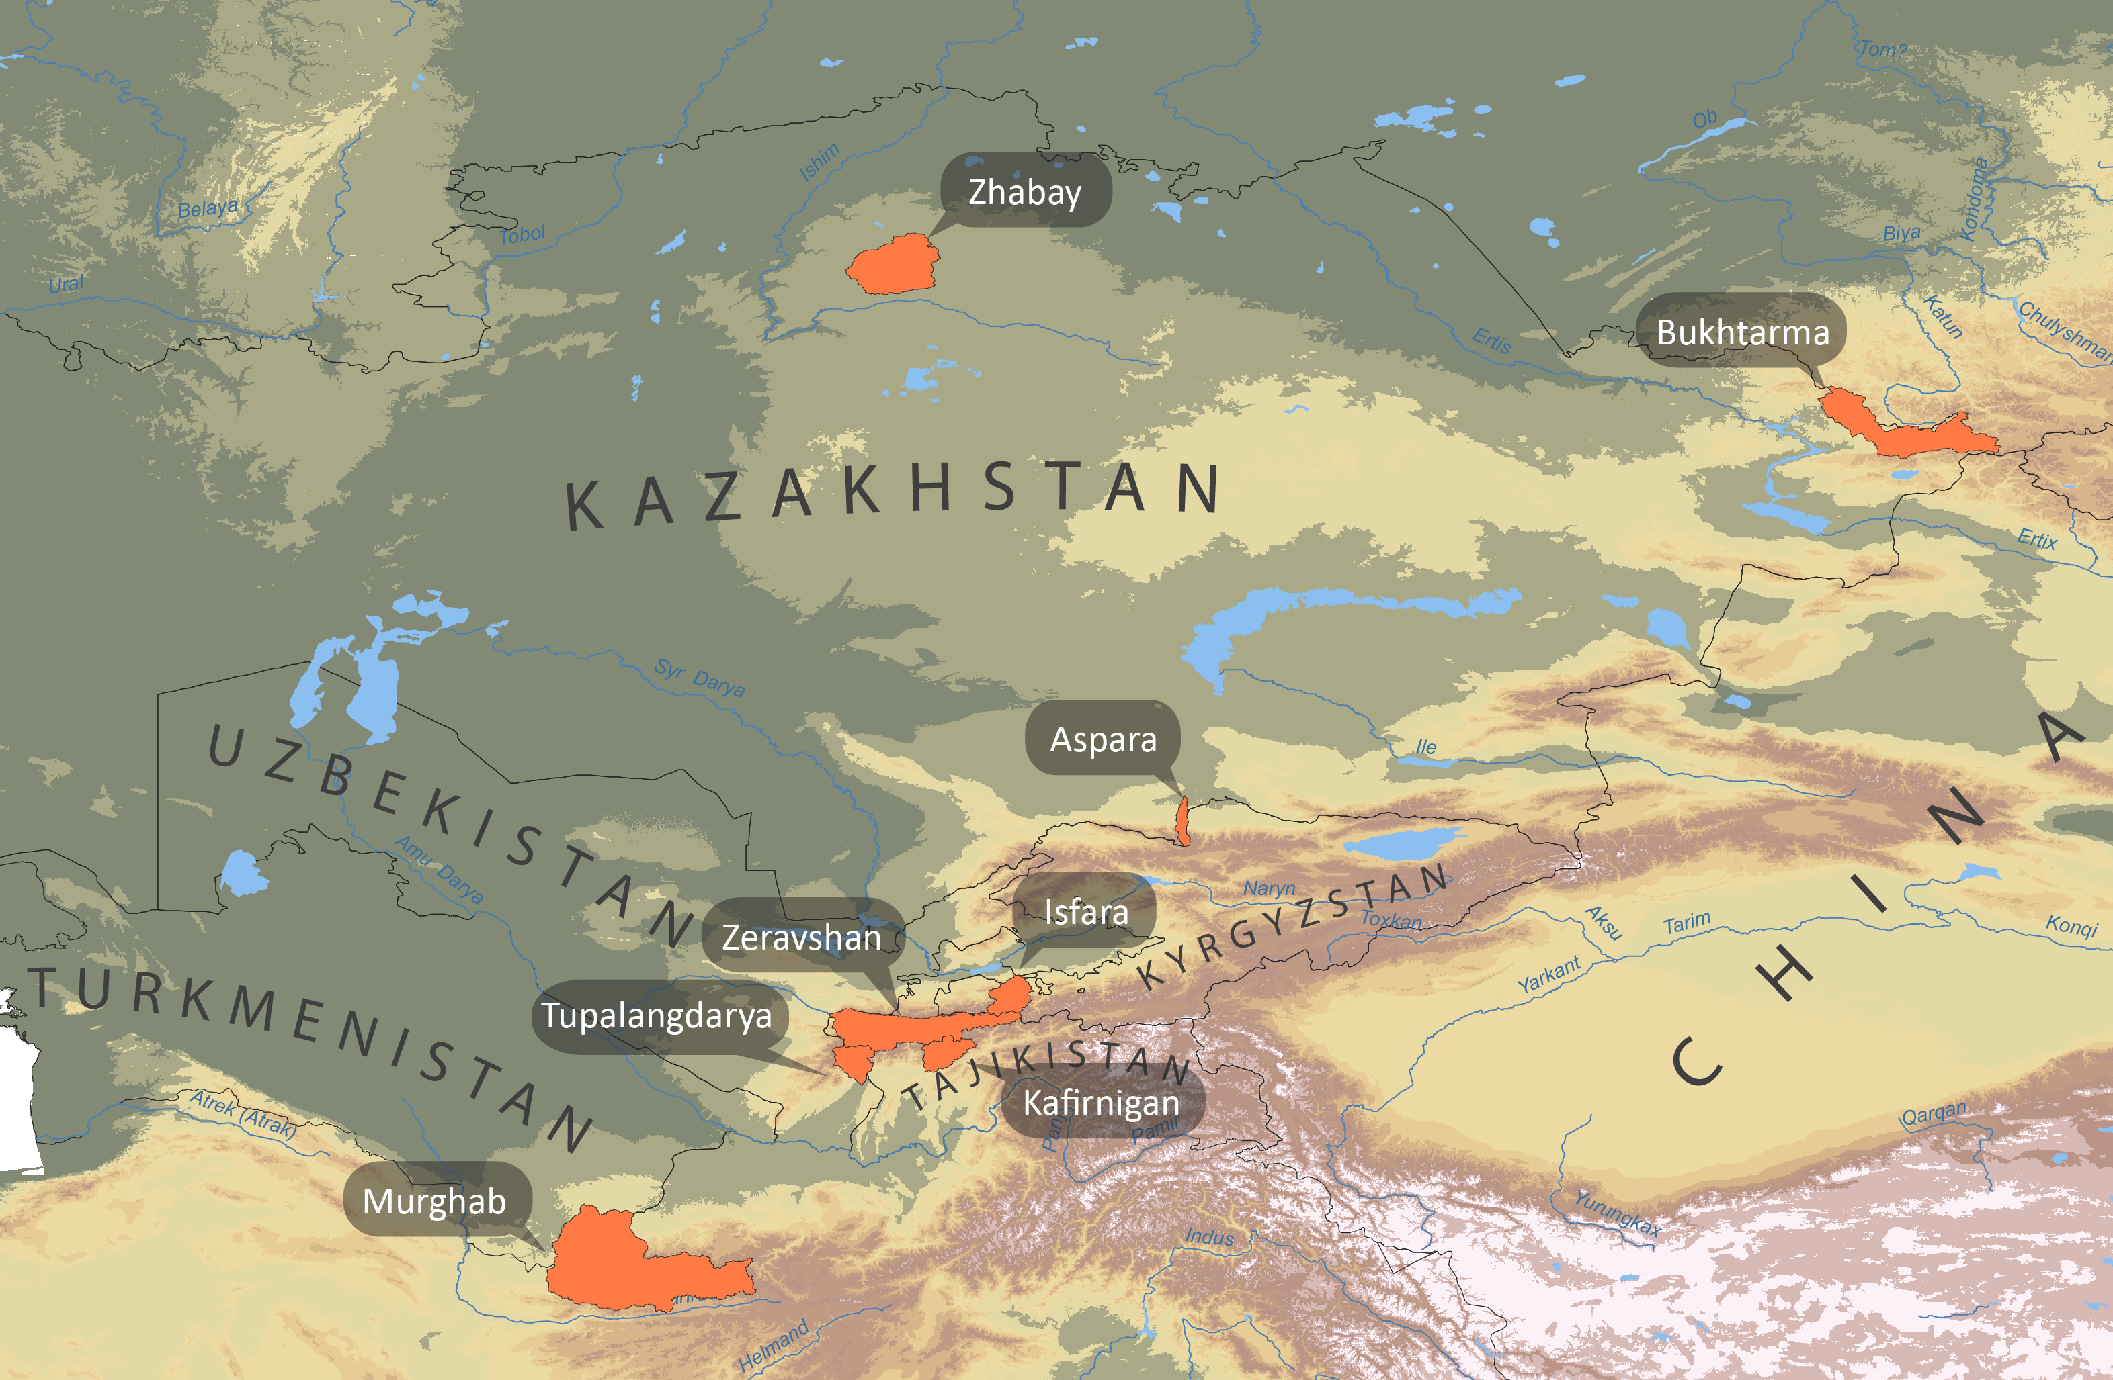
Case study river basin(s)
Didovets et al. 2021

Slide 4
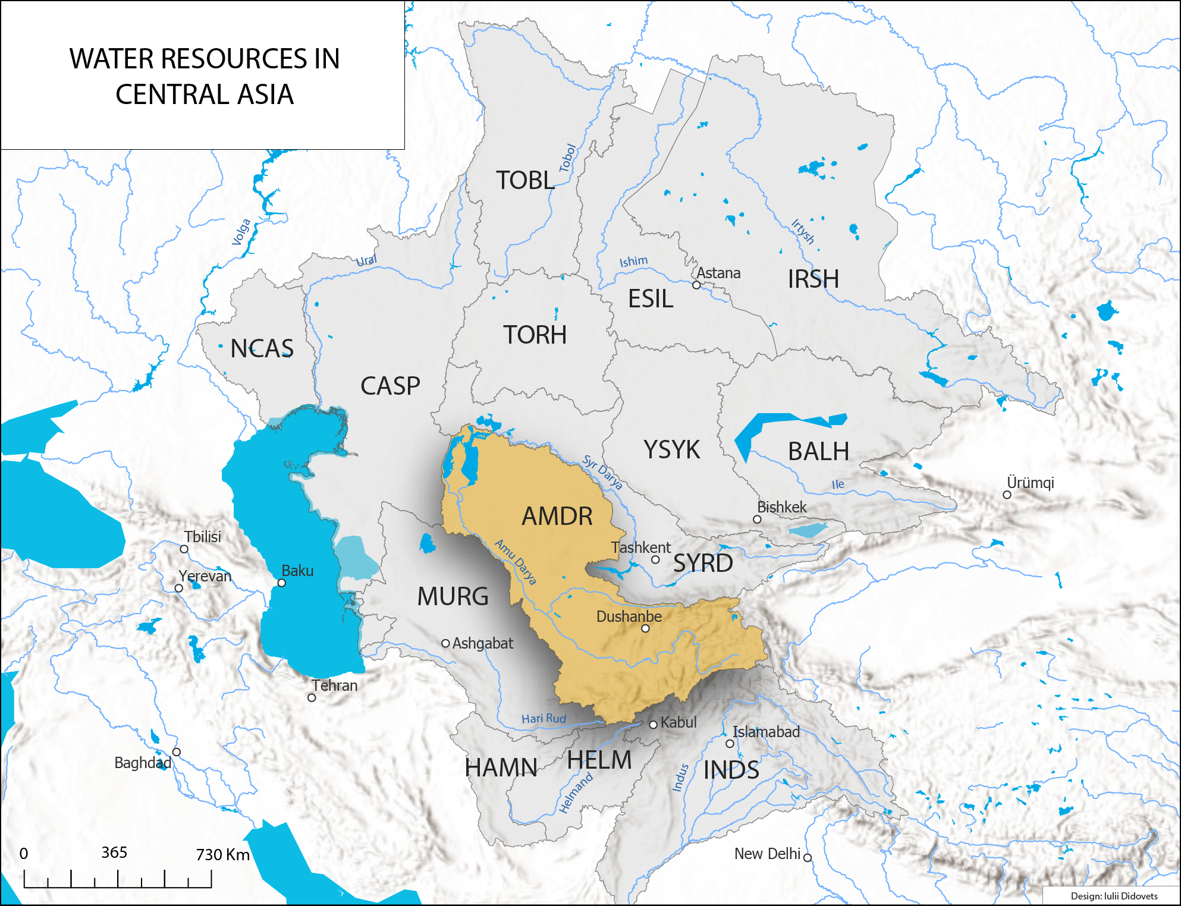
Case study river basin(s)

Slide 5
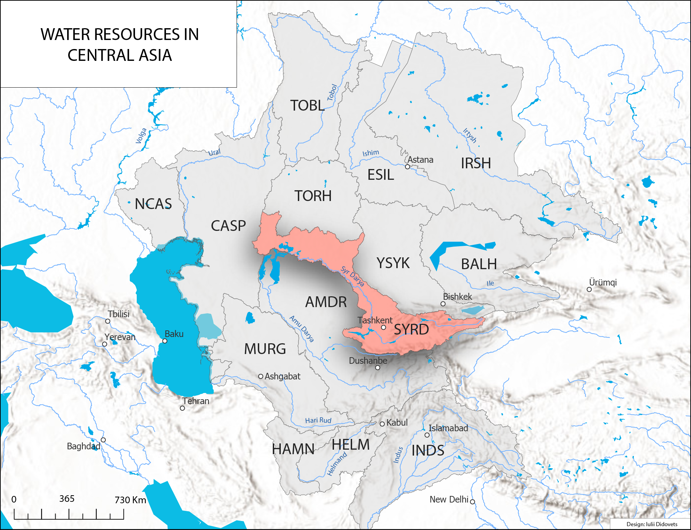
Case study river basin(s)

Slide 6
