Slide 1
Modelling Food and Land System Transformations within Sustainable Development Pathways
Isabelle Weindl, Bjoern Soergel, Elmar Kriegler
PIAM and IMAGE modelling teams and the SHAPE consortium
RD2 Seminar | 15 May 2025

Slide 2
Outline
Towards sustainable food and land futures: Target-seeking scenarios
Multiple sustainable development pathways (SDPs): Scenario co-creation in the SHAPE project
Quantifying food and land transformations: A multi-model and multi-scenario assessment
Summary

Slide 3
Towards sustainable food and land futures
Target-seeking scenarios

Slide 4
What are sustainable futures?
Leach et al. (2018), Global Sustainability

Slide 5
What are sustainable futures?
What is desirable and for whom?
What do we know about conditions and drivers that result in desirable system states?
What do we know about conditions and drivers that result in undesirable system states?
How do these conditions and drivers develop in space and time?
Can we define those states for sub-systems?
Leach et al. (2018), Global Sustainability

Slide 6
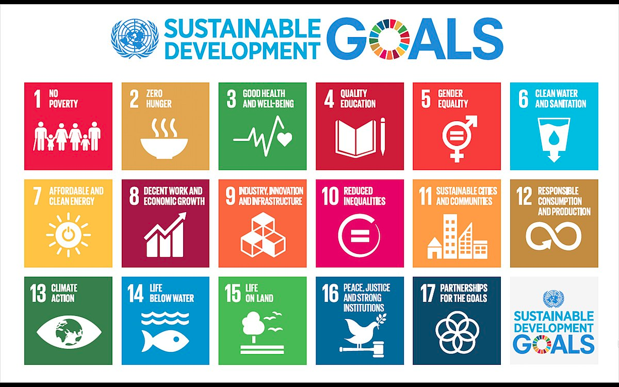
Sustainability challenges arising from food and land systems

Slide 7
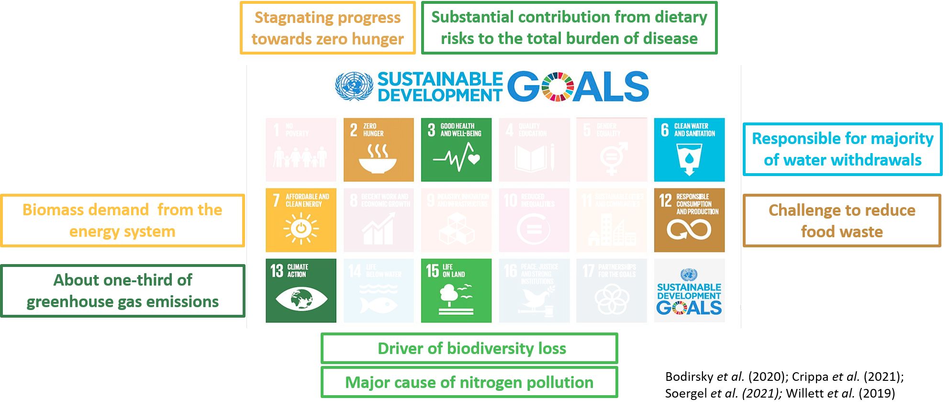
Sustainability challenges arising from food and land systems

Slide 8

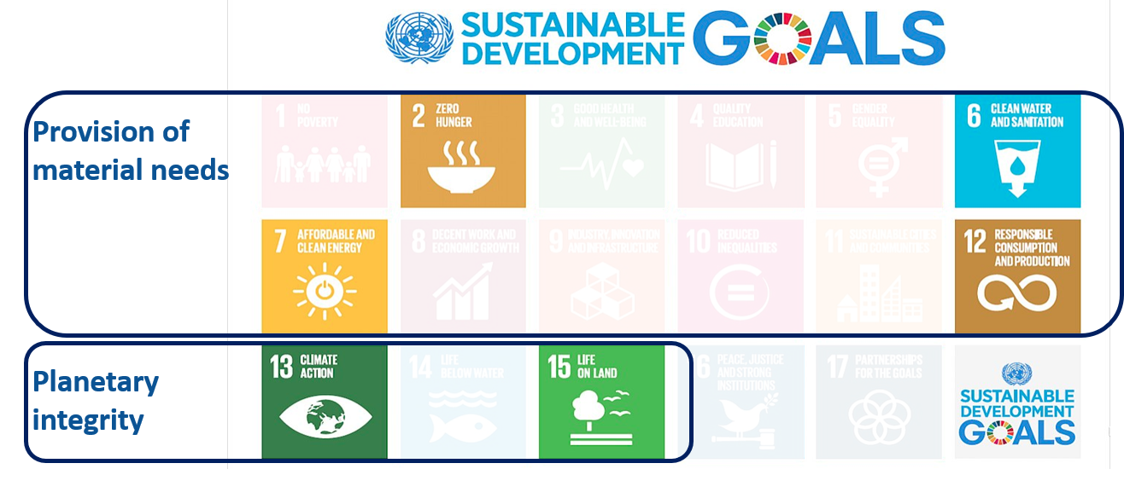
Sustainable land and food systems
reduce trade-offs between two important SDG clusters,
while increasing synergies with human health .

Slide 9
Sustainable land and food systems
reduce trade-offs between two important SDG clusters,
while increasing synergies with human health .
And are part of whole-economy pathways.

Slide 10
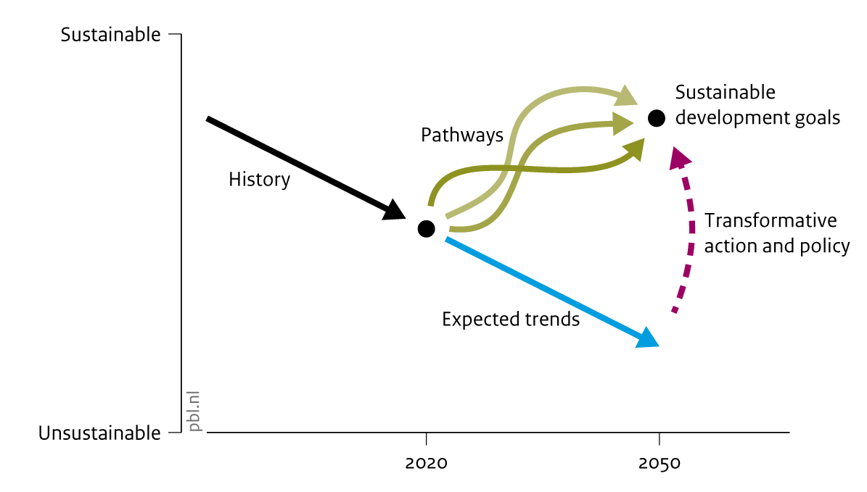
How to meet multiple sustainable development goals simultaneously?
Concept of “target-seeking scenarios”: pathways from the current to a desirable future state
Sustainable development Pathways (SDPs)
are designed as target-seeking scenarios
  achieving the SDGs in 2030,
  subsequently maintaining sustainable development and
  meeting the climate targets of the Paris agreement.
Source: PBL

Slide 11
Defining a sustainable development target space for 2030 and 2050
Concept of a “target space”: Translation of the political SDG goals and targets into science-based indicators and associated target values
Motivation:
How to design target-seeking scenarios of sustainable development that can be quantified by current (integrated assessment) models?
van Vuuren et al. (2022), One Earth

Slide 12
Defining a sustainable development target space for 2030 and 2050
Key principles underlying the target space:
Societal relevance
Science-based
Valid for 2030 and beyond
Quantifiable
Transparent
Actionable and achievable
Availability of data and knowledge
van Vuuren et al. (2022), One Earth

Slide 13
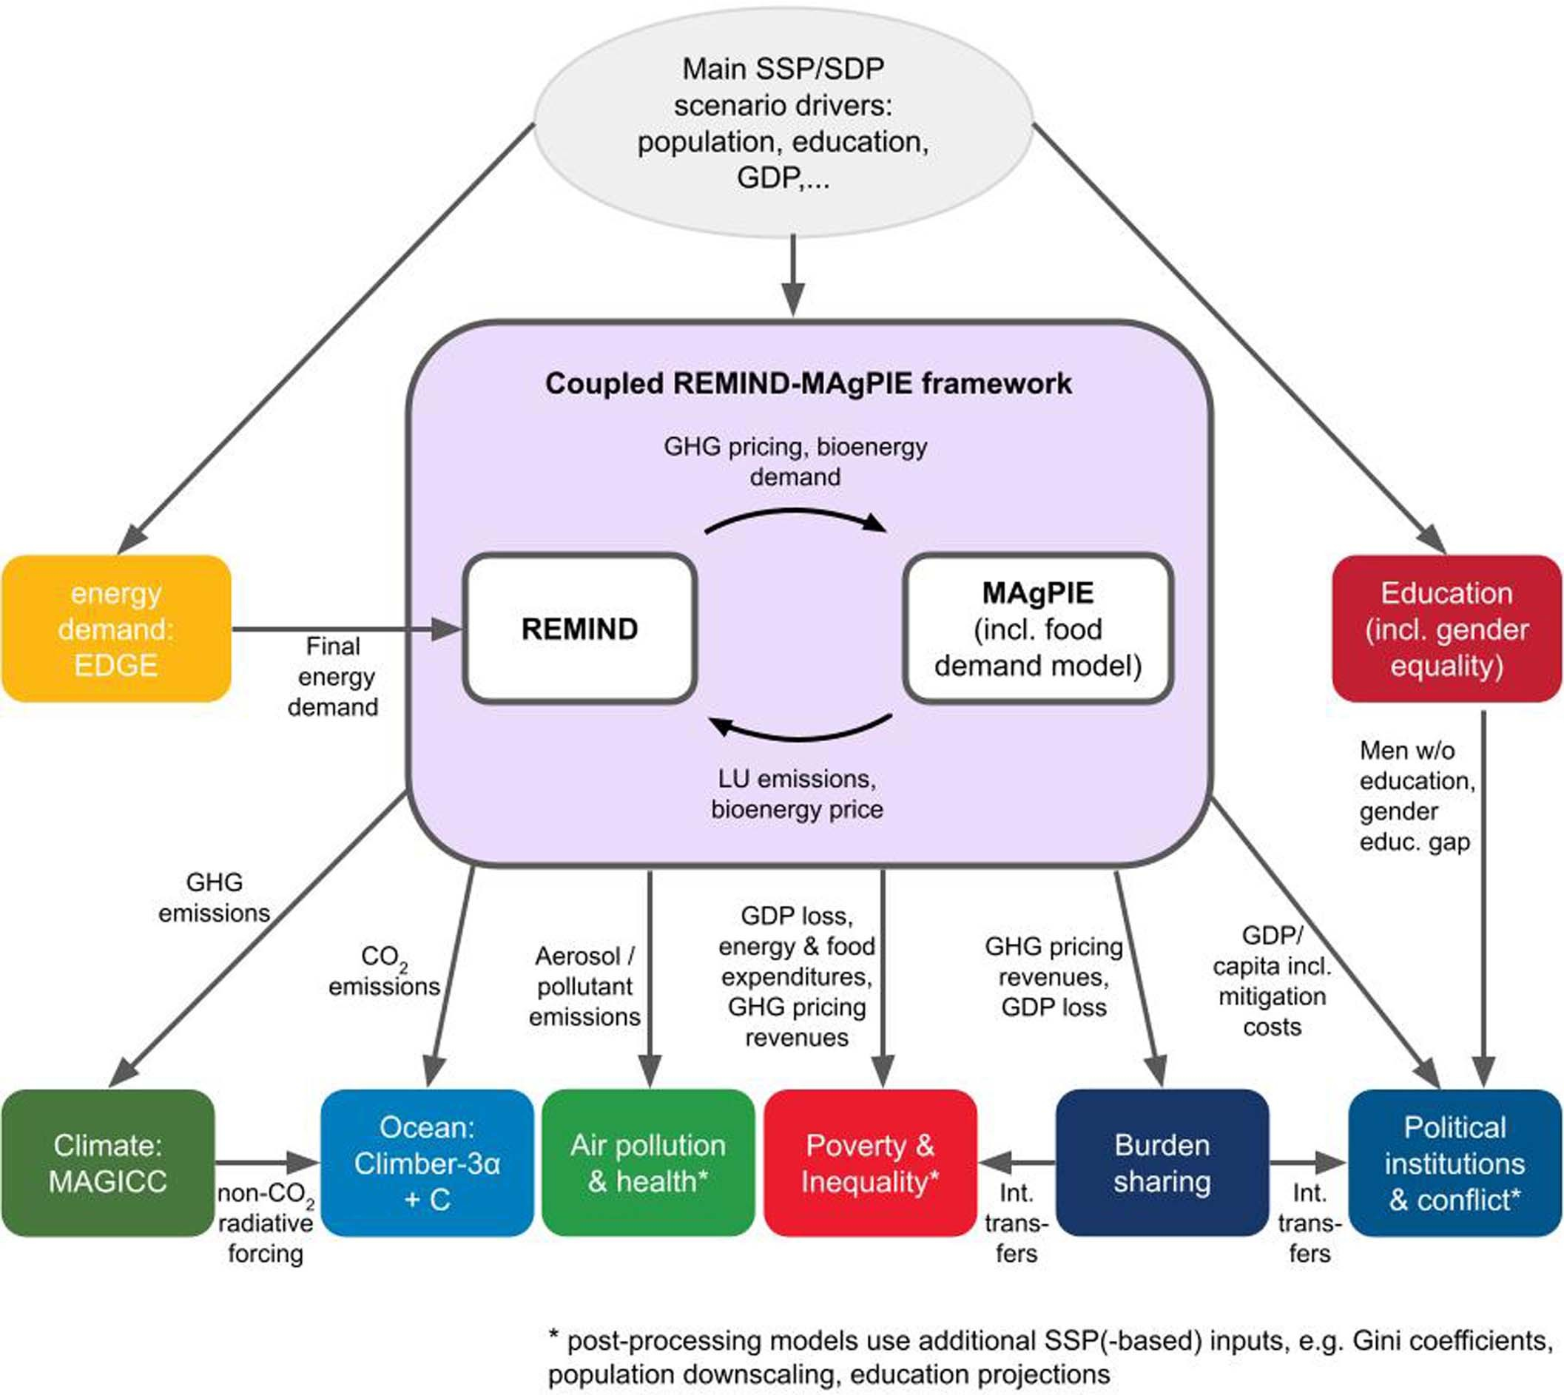
A first single-SDP quantification covering all SDGs
Modelling framework built around REMIND–MAgPIE for quantifying a sustainable development pathway (SDP):
The linkage between REMIND and MAgPIE is bi-directional (iterative soft coupling)
The linkages to the downstream models for further SDG indicators are one-directional.
The most relevant variables passed between models are specified next to the arrows.
Soergel et al. (2021), Nature Climate Change

Slide 14
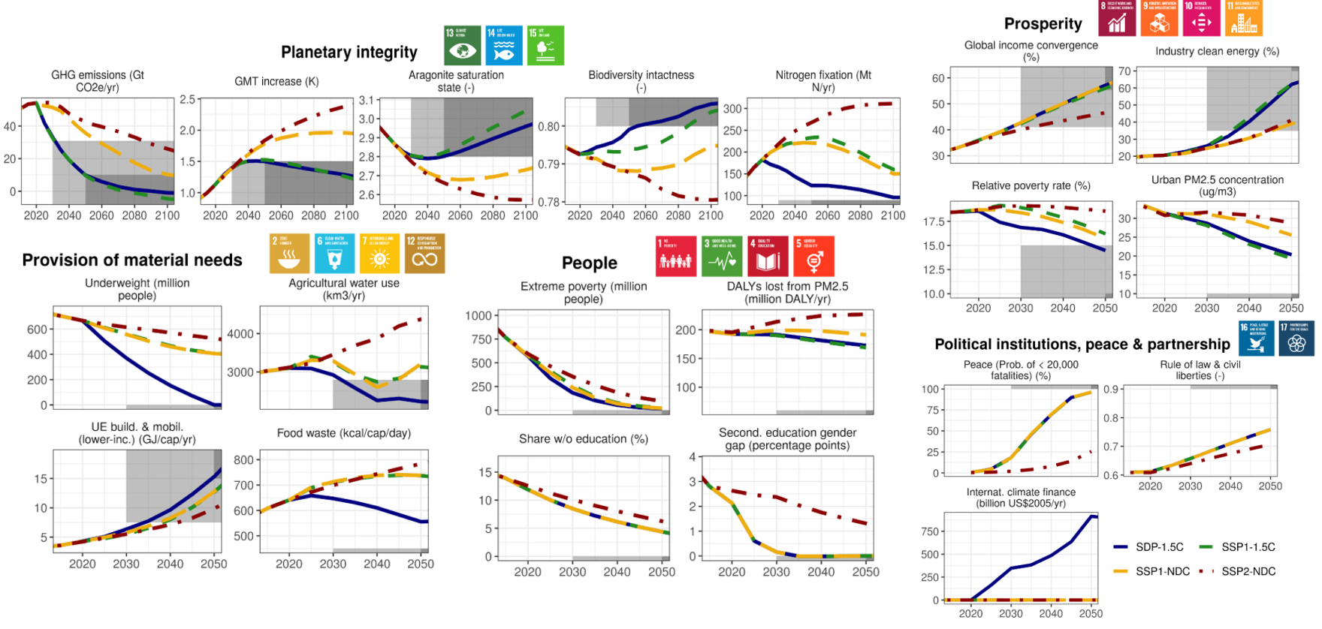
A first single-SDP quantification covering all SDGs
Soergel et al. (2021), Nature Climate Change

Slide 15
Multiple sustainable development pathways (SDPs)
Scenario co-creation in the SHAPE project

Slide 16
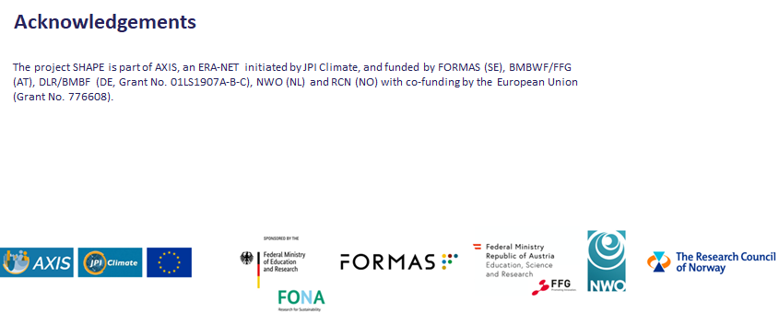
Sustainable Development Pathways achieving Human well-being while safeguarding the climate And Planet Earth

Slide 17
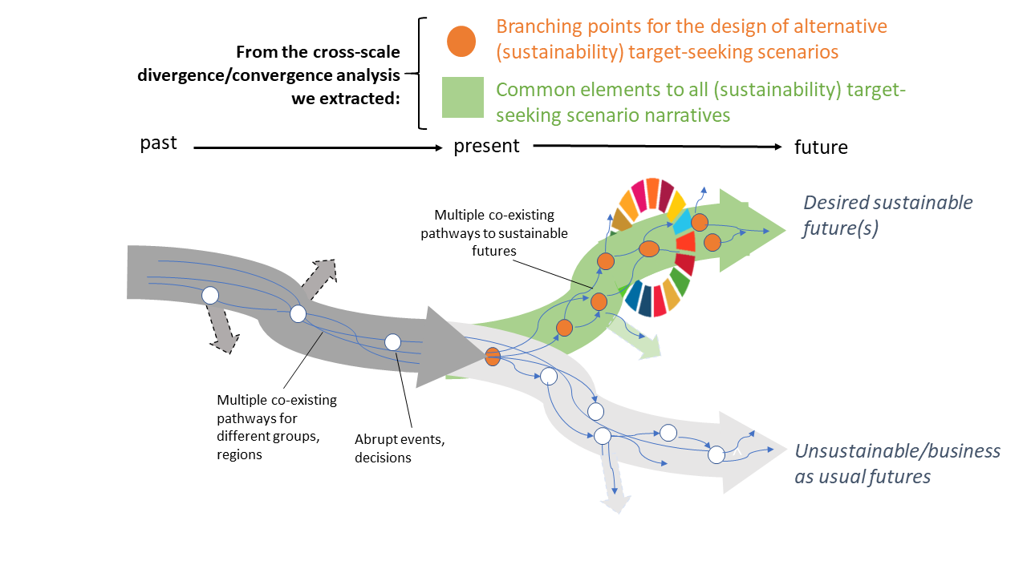
From a single sustainable future to multiple narratives for SDPs
Reflecting different perspectives through multiple SDPs
Holistic coverage of SDG+ space (2030-2050+)
Combining multiple sub-transformations of human-society-nature systems
Exploiting synergies and mitigating trade-offs
Aguiar et al. (2020); Roy et al. (2019); Fazey et al. (2016)

Slide 18
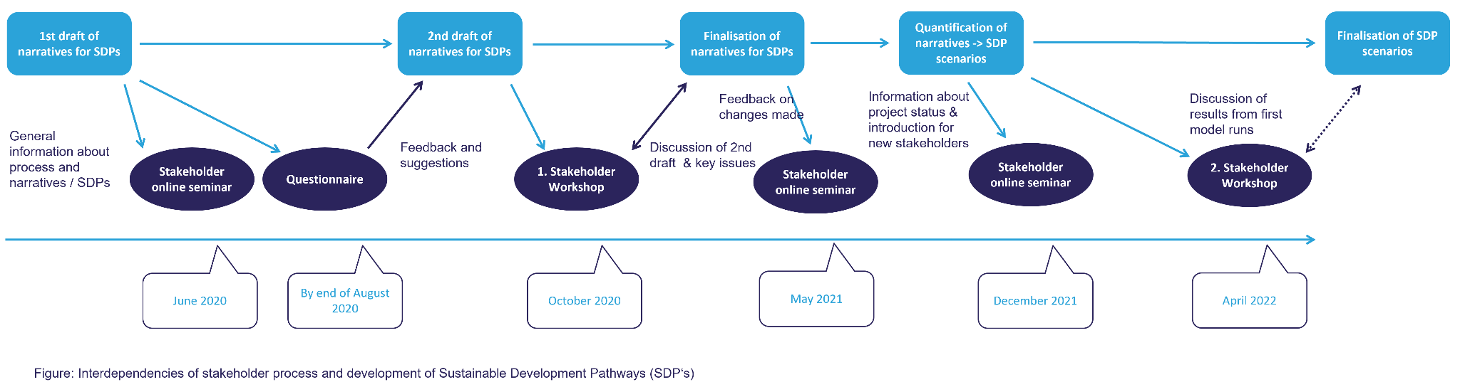
Co-creation of SDP narratives and SDP scenario quantification

Slide 19
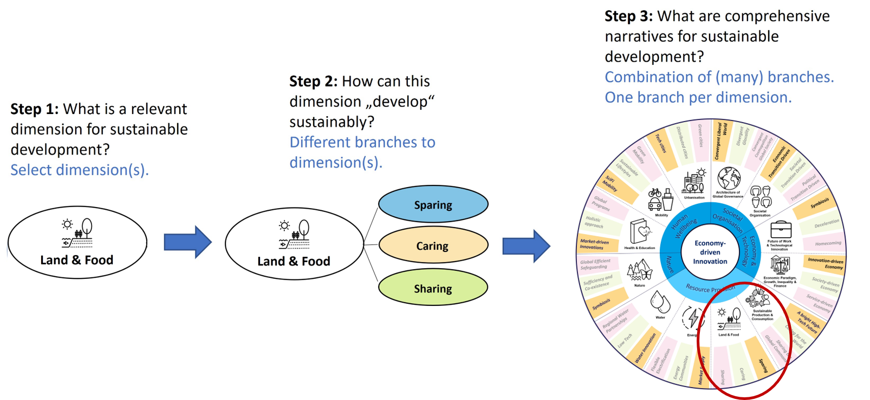
Scenario building & co-design process for multiple SDPs
Dimensions:
Health & Education
Mobility
Urbanisation
Architecture of Global Governance
Societal Organisation
Future of Work & Technological Innovation
Economic Paradigm, Growth, Inequality & Finance
Biodiversity & Ecosystems
Sustainable Production & Consumption
Land & Food
Energy
Water

Slide 20
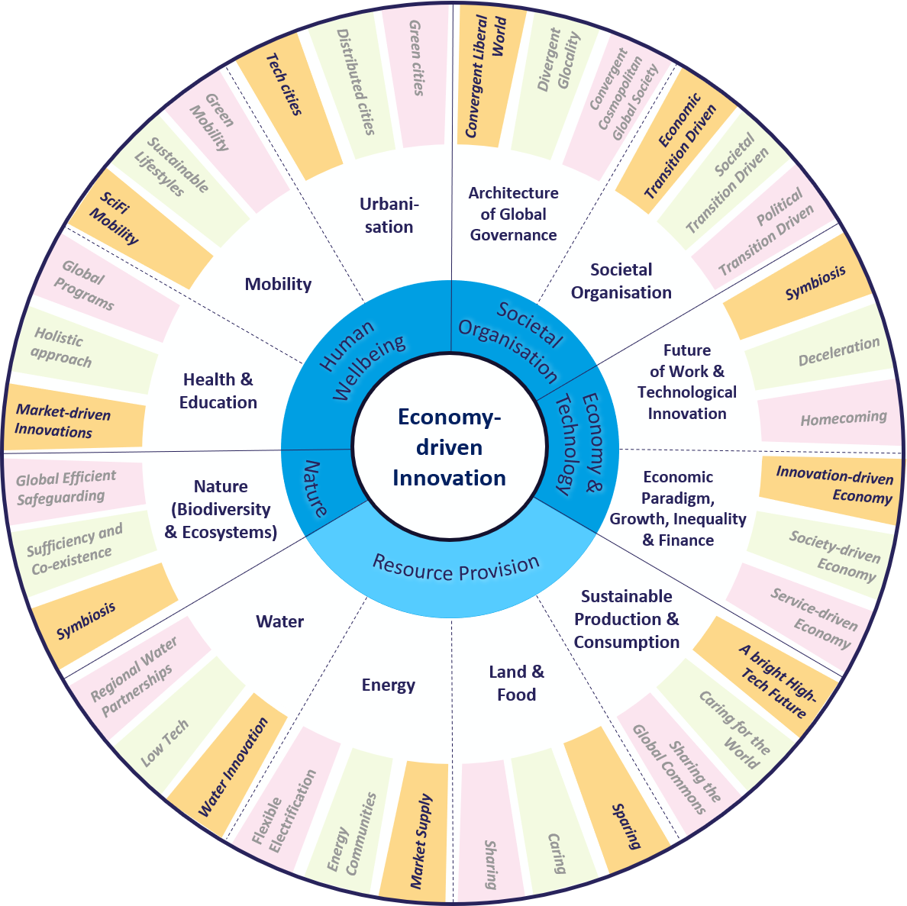
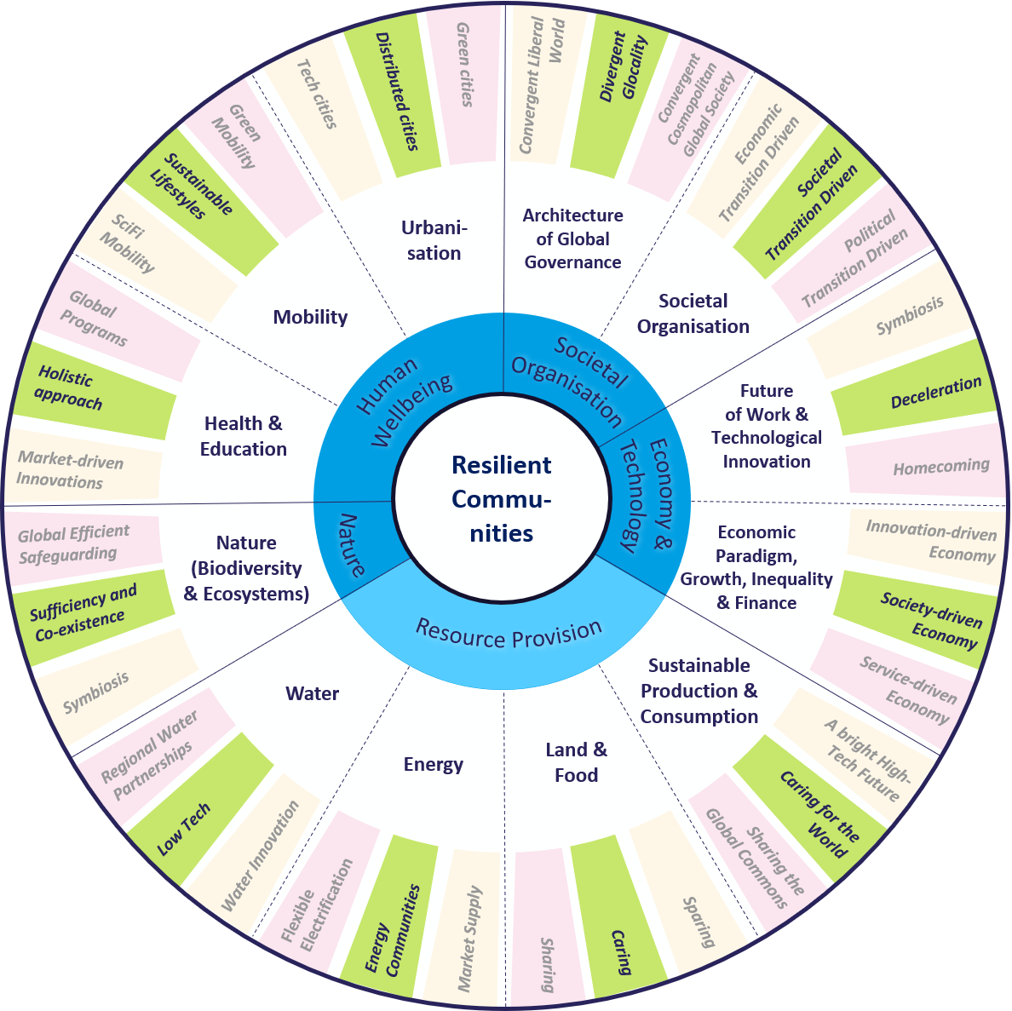
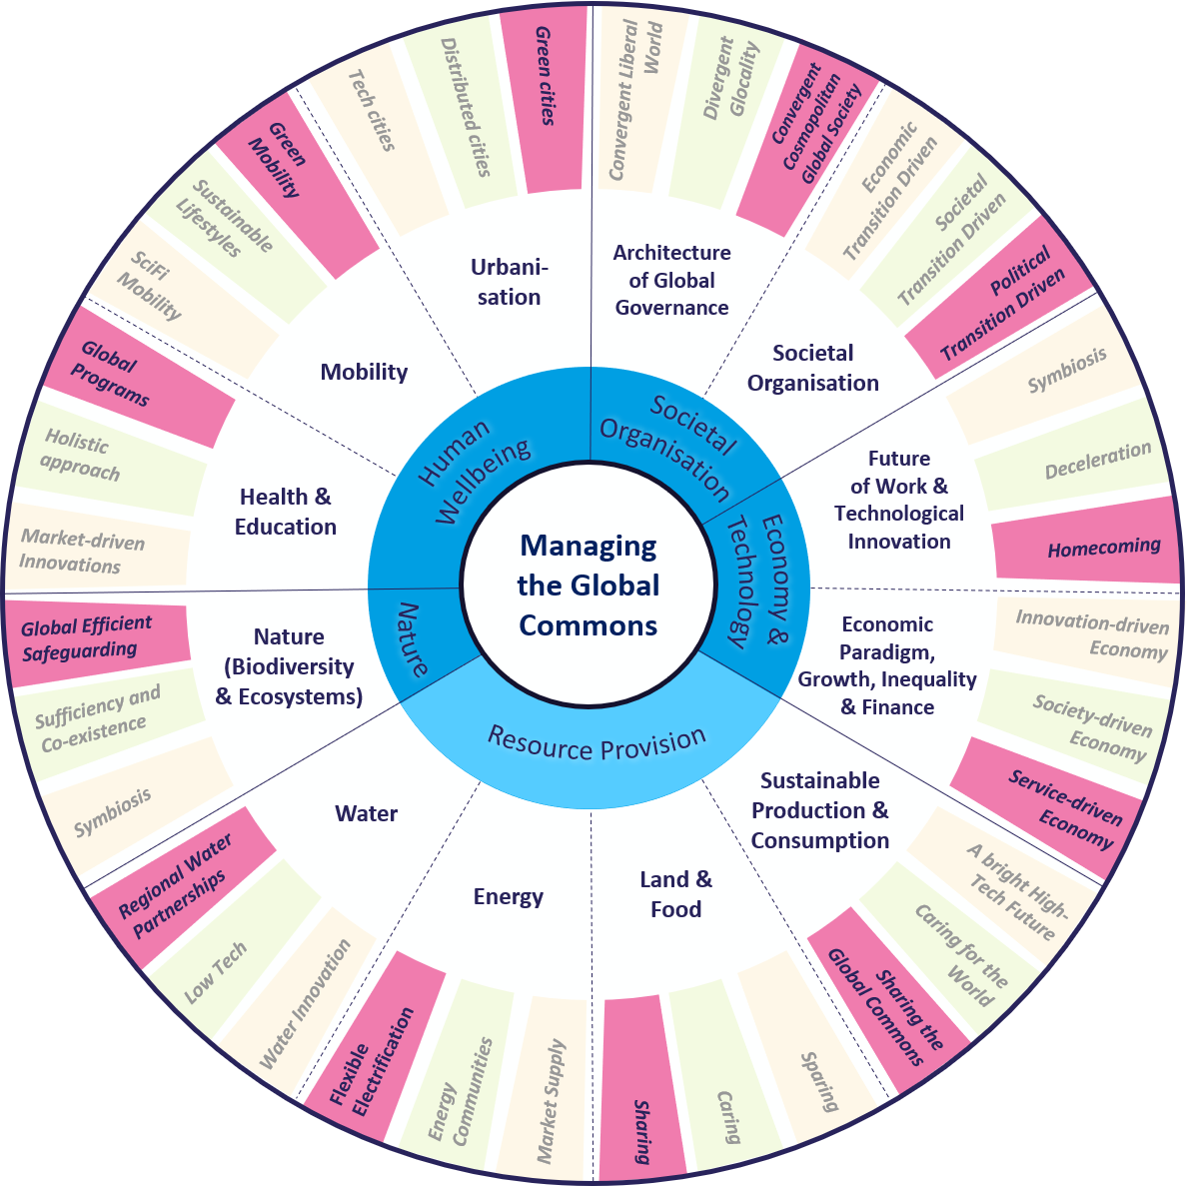
Scenario building & co-design process for multiple SDPs
→ Translate narratives to modelling protocol
+ continued stakeholder dialogue & co-design over entire process
-> scenarios designed to reflect different
(regional, societal, economic) perspectives on how to pursue SD

Slide 21
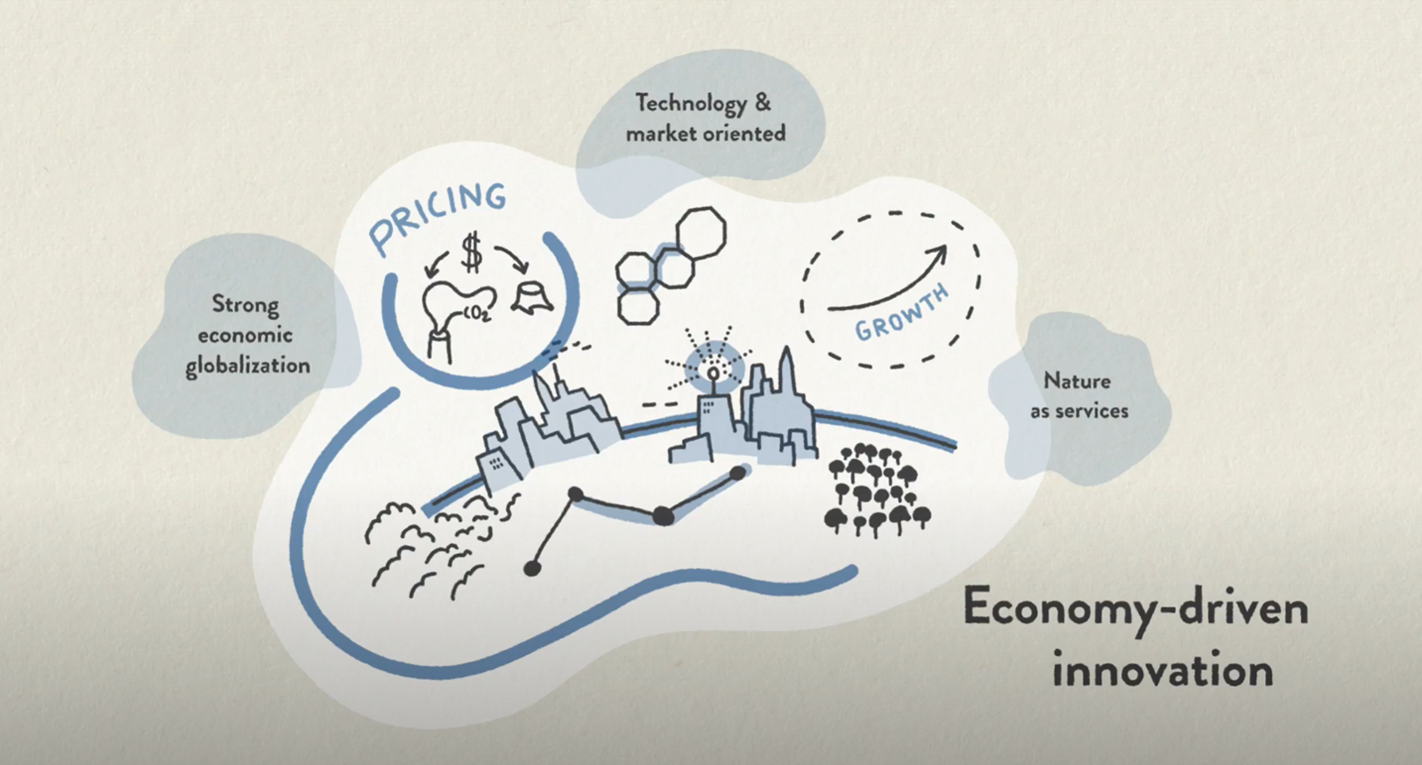
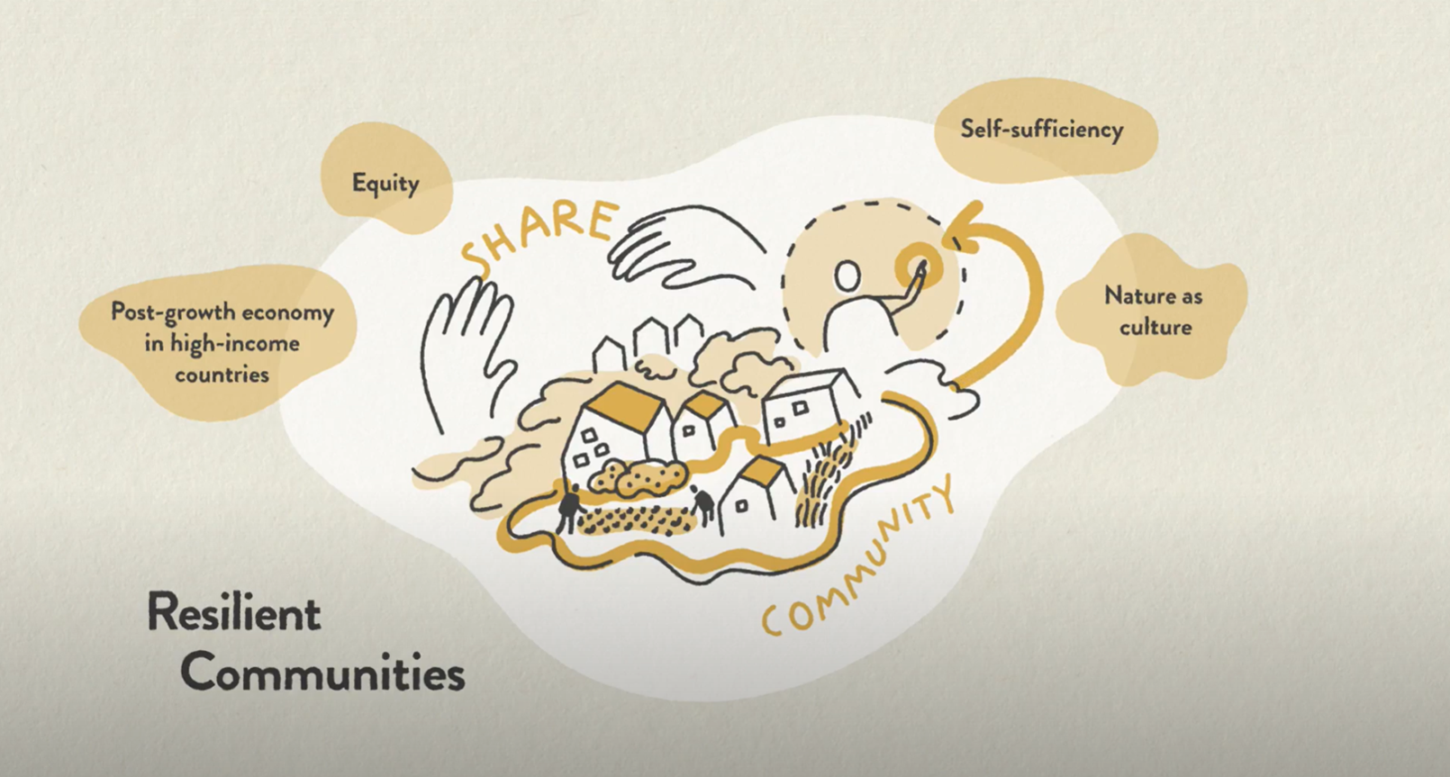
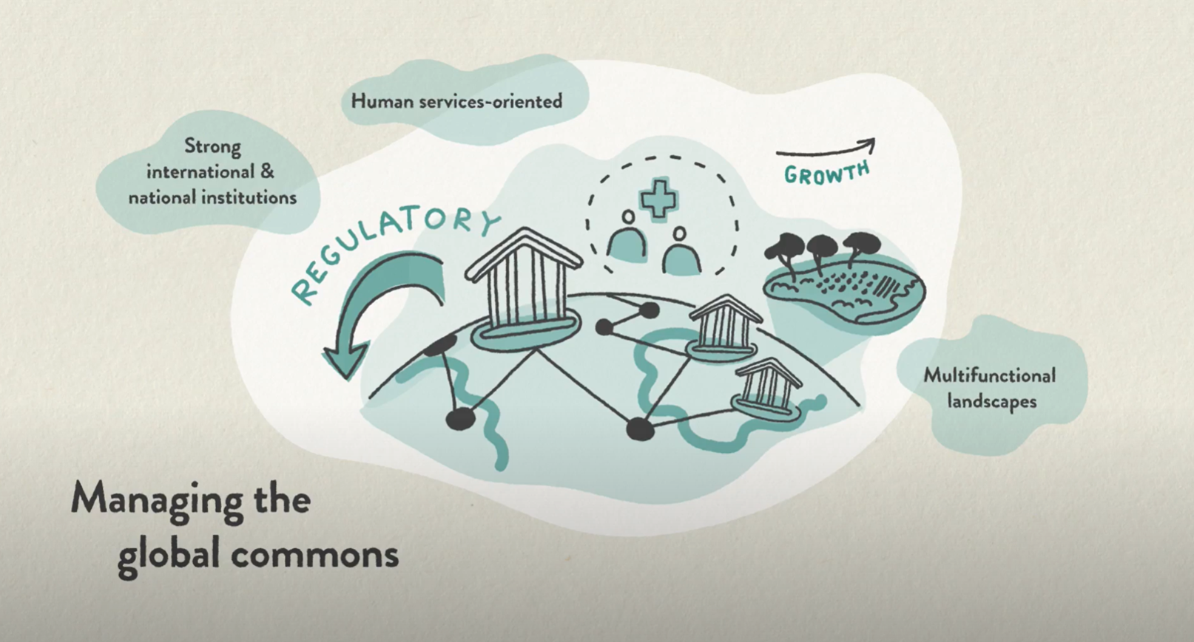
SHAPE SDP narratives
reflecting different perspectives on how to pursue SD
Economy-driven Innovation (SDP-EI)
Technology and innovation
Continued economic growth, medium to strong convergence, reduction of inequality
High demand for material and energy services, very high efficiency
Resilient Communities (SDP-RC)
Solidarity, well-being, equitable access to resources
Post-growth in high-income countries, continued economic growth in Global South, very rapid reduction of inequality
Lifestyle change, low material consumption patterns
Managing the Global Commons (SDP-MC)
Strong international & national institutions
Moderate economic growth, fast reductions of inequality
Medium demand for material and energy services, orientation towards human services, high recycling rates
Illustrations by Elsa Wikander / Azote
Size of population is the same in all 3 SDPs, but there are changes in all dimensions (economy, technology, values, governance, etc.)

Slide 22
Governance and policy mixes across SDPs
Economy-driven Innovation (SDP-EI)
Markets as key drivers of innovation, opportunity and wealth
States as regulators to align market outcomes with societal objectives
Preference for economic instruments
Resilient Communities (SDP-RC)
Networks of communities, civil society, private sector and (sub-) national authorities as drivers of transformation
States as partners to support development and resource sharing
Preference for information instruments
Managing the Global Commons (SDP-MC)
Governments (hierarchies) as main driver of transformation
States and global institutions as leaders and orchestrators
Preference for regulatory instruments
Illustrations by Elsa Wikander / Azote
Dombrowsky et al. (2025), ERL

Slide 23
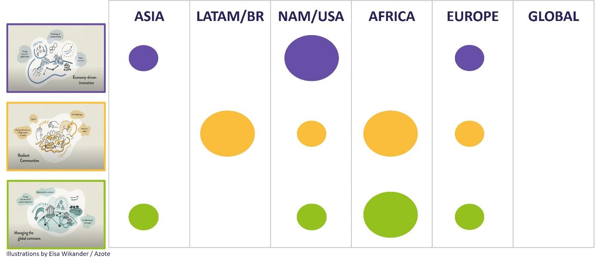
SHAPE SDP narratives
reflecting different regional preferences on how to pursue SD?

Slide 24
Sustainable development pathways (SDPs)
Multi-model scenario quantifications

Slide 25
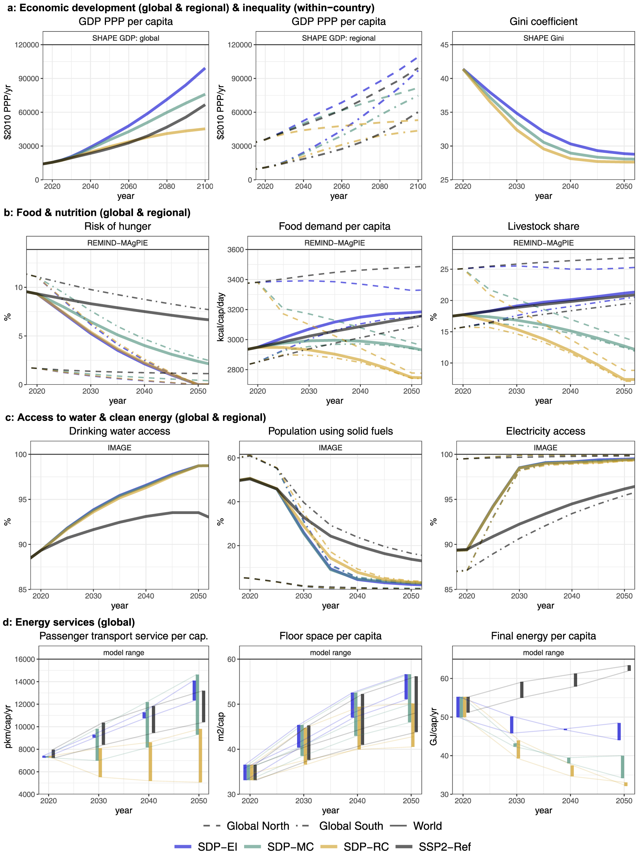
SHAPE SDP scenarios
Common whole-economy features (Soergel et al. 2024)
Assumptions:
Core drivers such as population, education & demographics are the same (from SSP1)
Harmonized inputs for GDP and Gini coefficients were specifically derived for each SDP (Min et al. 2024)
Energy consumption and services differ across SDPs.
In all SDPs, energy consumption converges between Global North and Global South.
Energy access was evaluated against decent living standards (Kikstra et al. 2025)
Soergel et al. (2024), ERL

Slide 26
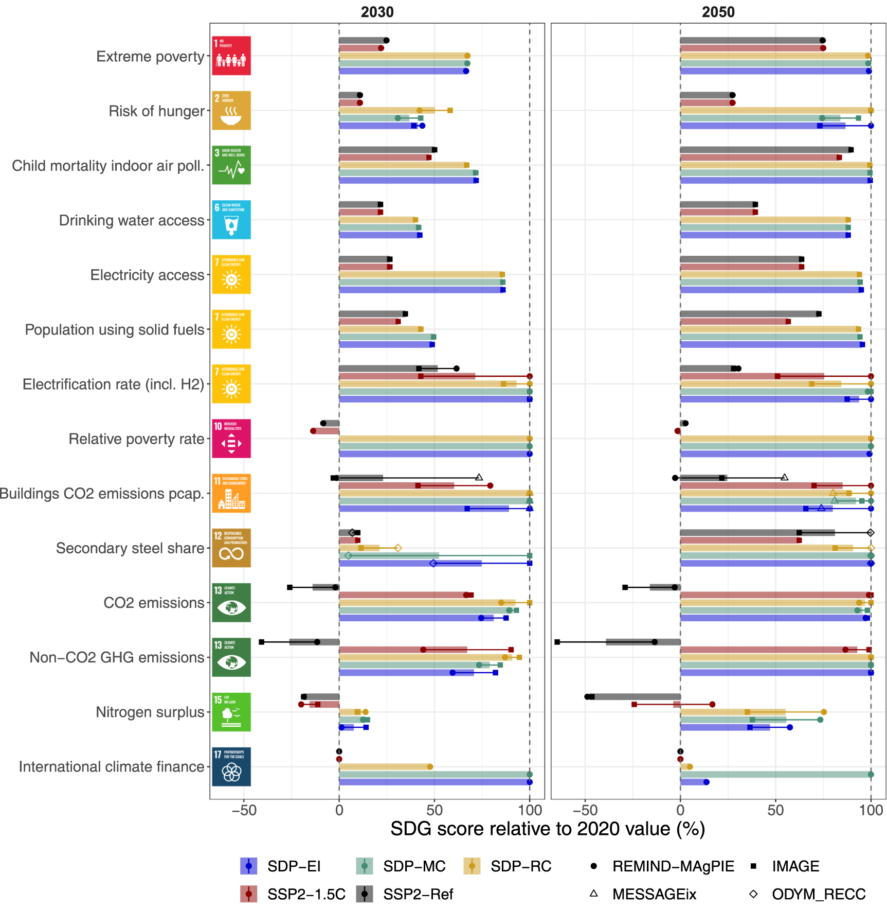
SHAPE SDP scenarios
Common whole-economy features (Soergel et al. 2024)
Evaluation of SDG-relevant indicators against the “target space”:
All SDPs meet the 1.5°C target (allowing for small and temporary overshoot).
All SDPs (SDP-EI, SDP-MC, SDP-RC) make substantial progress towards many SDGs (e.g. energy access, food security, reduced inequality, environment)
The more narrow “climate-only” pathway SSP2-1.5C risks compromising other SDGs.
Soergel et al. (2024), ERL

Slide 27
Deep dive: food and land transformations
Evaluation of the food and land system transformations within the SDPs:
Based on indicators across the domains of
Food intake and demand
Agricultural demand
Efficiency
Land
Biodiversity
GHG emissions
Joint presentation of:
Scenario characteristics
as delineated in the modelling protocol and based on the SDP narratives
&
Scenario quantifications
as modelled by IMAGE and REMIND-MAgPIE based on harmonized drivers and model-specific assumptions

Slide 28
Excerpt (L&F)
Modelling protocol
Characteristics | Economy-driven Innovation (SDP-EI) |  | Resilient Communities (SDP-RC) | Managing the Global Commons (SDP-MC)
General
GDP growth rate | High in all regions; medium to strong convergence |  | Post-growth in developed countries; medium to high in other countries; strong convergence | Moderate in developed countries; high in other countries; strong convergence
Trade | Globalized |  | Regionalized | Globalized
Food demand
Dietary patterns | Partial substitution of livestock products with animal-free alternatives; overcoming hunger | Fast transition to sustainable and healthy diets; overcoming hunger and overnutrition | Fast transition to sustainable and healthy diets; overcoming hunger and overnutrition | Medium-paced transition to sustainable and healthy diets; overcoming hunger and overnutrition
Food waste | Minor reduction | Strong reduction | Strong reduction | Medium reduction
Ecosystem protection
Land protection | Strong; focus on carbon sequestration and price-based policy instruments; peatland protection and restoration |  | Medium; focus on biodiversity and regulatory policy instruments; peatland protection and restoration | Co-existence; focus on biodiversity in managed landscapes and in vulnerable habitats, mix of policy instruments; peatland protection and restoration
Environmental flow protection | Very high |  | High | Very high
Agricultural management
Agricultural productivity | High increase |  | Convergence: increase in low productive systems, stable yields in efficient systems | Medium increase
Nitrogen use efficiency | High |  | Medium | High
Irrigation efficiency | High |  | Medium | High
Land-based mitigation
Re/afforestation | High carbon sequestration potential through managed plantations; notable limits on land availability according to the land-sparing principle |  | Low carbon sequestration through deliberate re/afforestation; preference for natural regrowth on abandoned land | Medium carbon sequestration potential through re/afforestation; low human intervention and certain limits to land availability
Bioenergy (energy crops) | High (irrigation possible) |  | Low (rainfed only) | Medium (rainfed only)

Slide 29
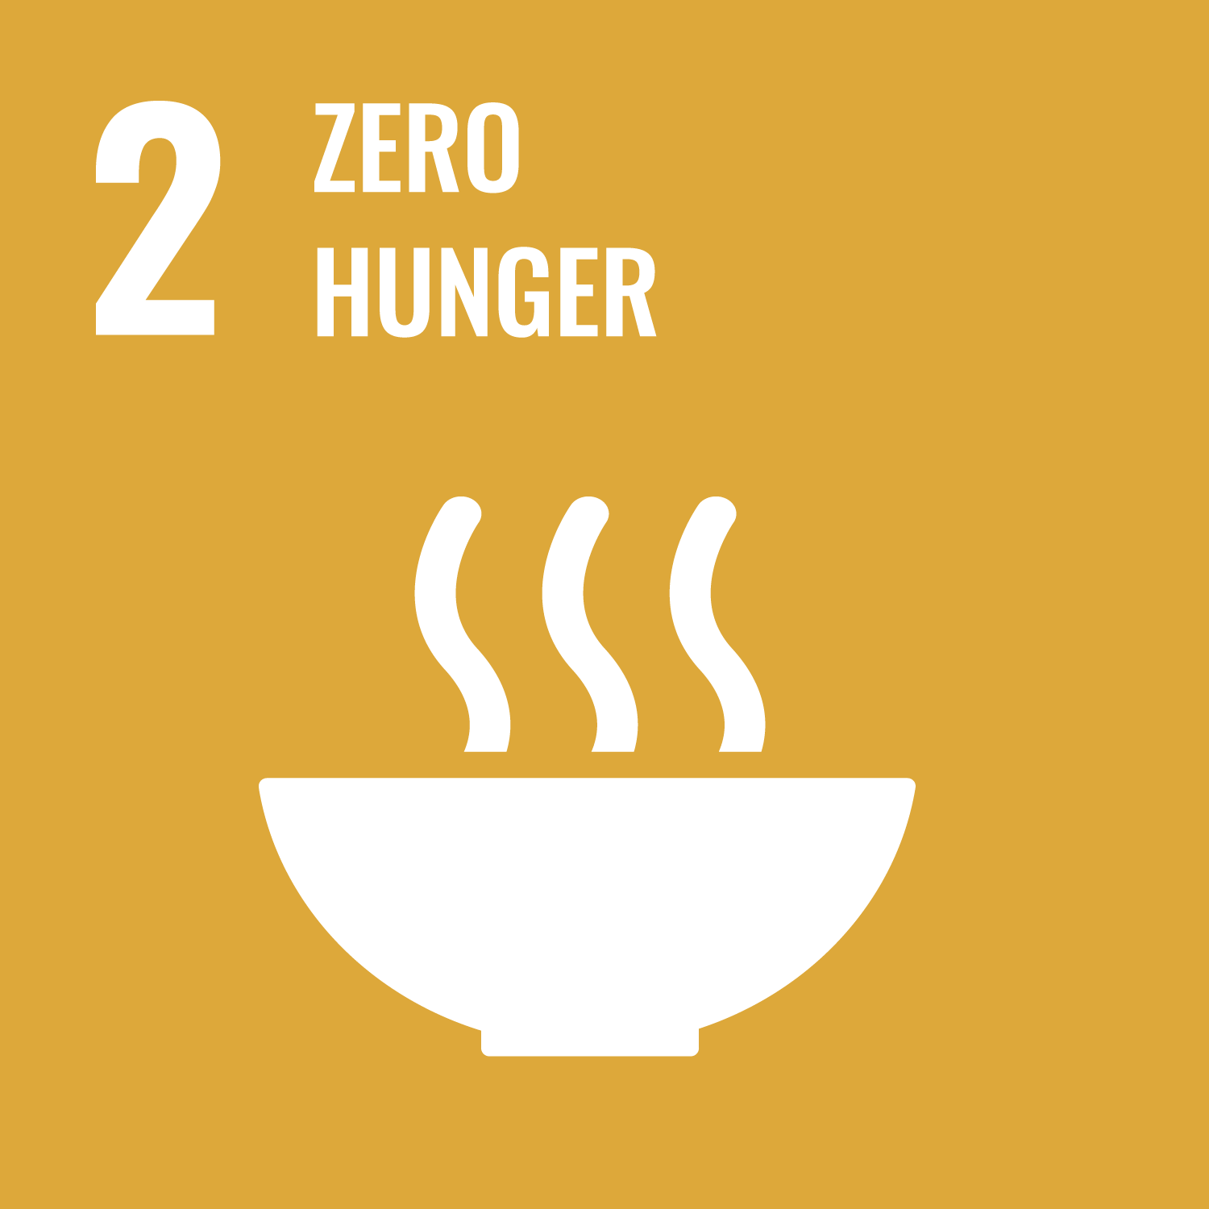


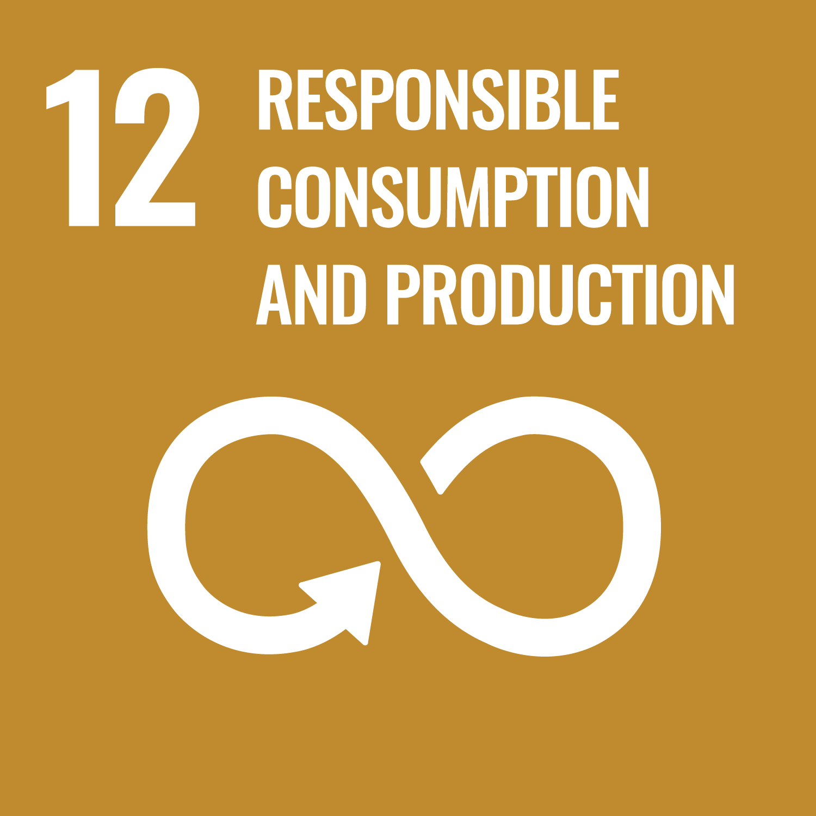
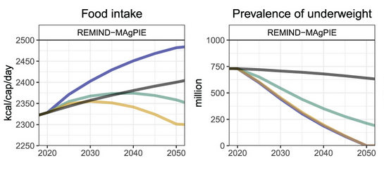
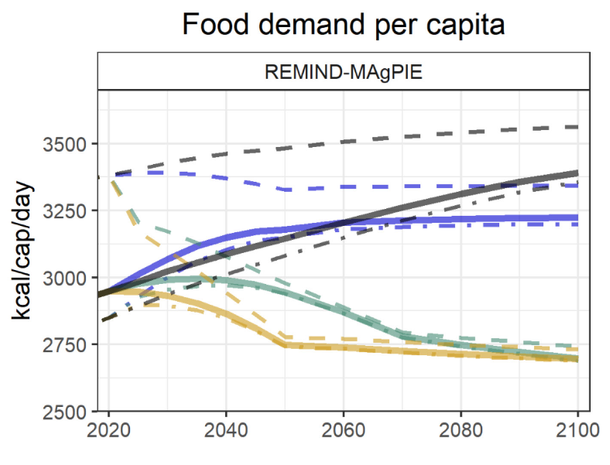
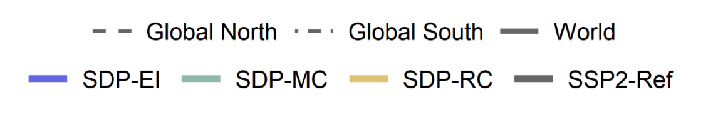
Food intake and demand
Scenario assumptions / quantitative drivers
SDP-EI: Sufficient calorie intake & modest reduction of food waste. Increase in animal-free meat & milk alternatives.
SDP-RC: Rapid transition to healthy calorie intake and nutrition (EAT-Lancet diet). Very low levels of food waste.
SDP-MC: Gradual transition to healthy calorie intake and nutrition (EAT-Lancet diet). Low levels of food waste.
Weindl et al. (2024), ERL

Slide 30
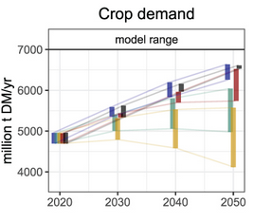
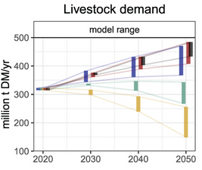
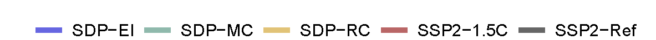
Agricultural demand
Models:
REMIND-MAgPIE
IMAGE
SDP-EI: Sufficient calorie intake & modest reduction of food waste. Increase in animal-free meat & milk alternatives.
SDP-RC: Rapid transition to healthy calorie intake and nutrition (EAT-Lancet diet). Very low levels of food waste.
SDP-MC: Gradual transition to healthy calorie intake and nutrition (EAT-Lancet diet). Low levels of food waste.
Crop demand does not includes 2nd generation bioenergy crops.
Weindl et al. (2024), ERL

Slide 31
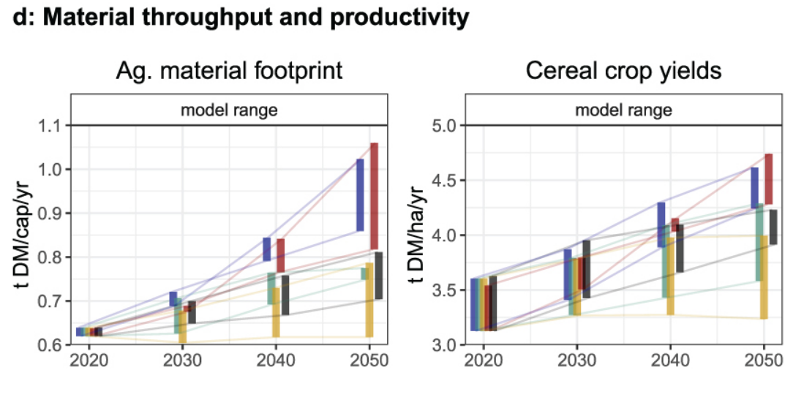
Efficiency
Models:
REMIND-MAgPIE
IMAGE
SDP-EI: High increase in agricultural productivity; high potential for bioenergy use.
SDP-RC: Convergence: increase in low-productive systems, stable yields in efficient systems; low potential for bioenergy use.
SDP-MC: Medium increase in productivity; medium potential for bioenergy use.
Agricultural material footprint is calculated as the total crop demand for all purposes (including bioenergy) per capita.
Weindl et al. (2024), ERL

Slide 32
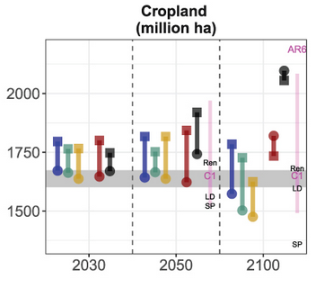
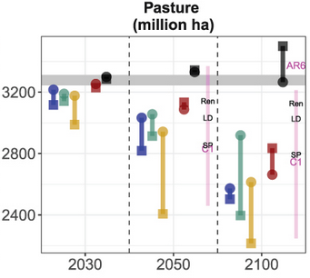
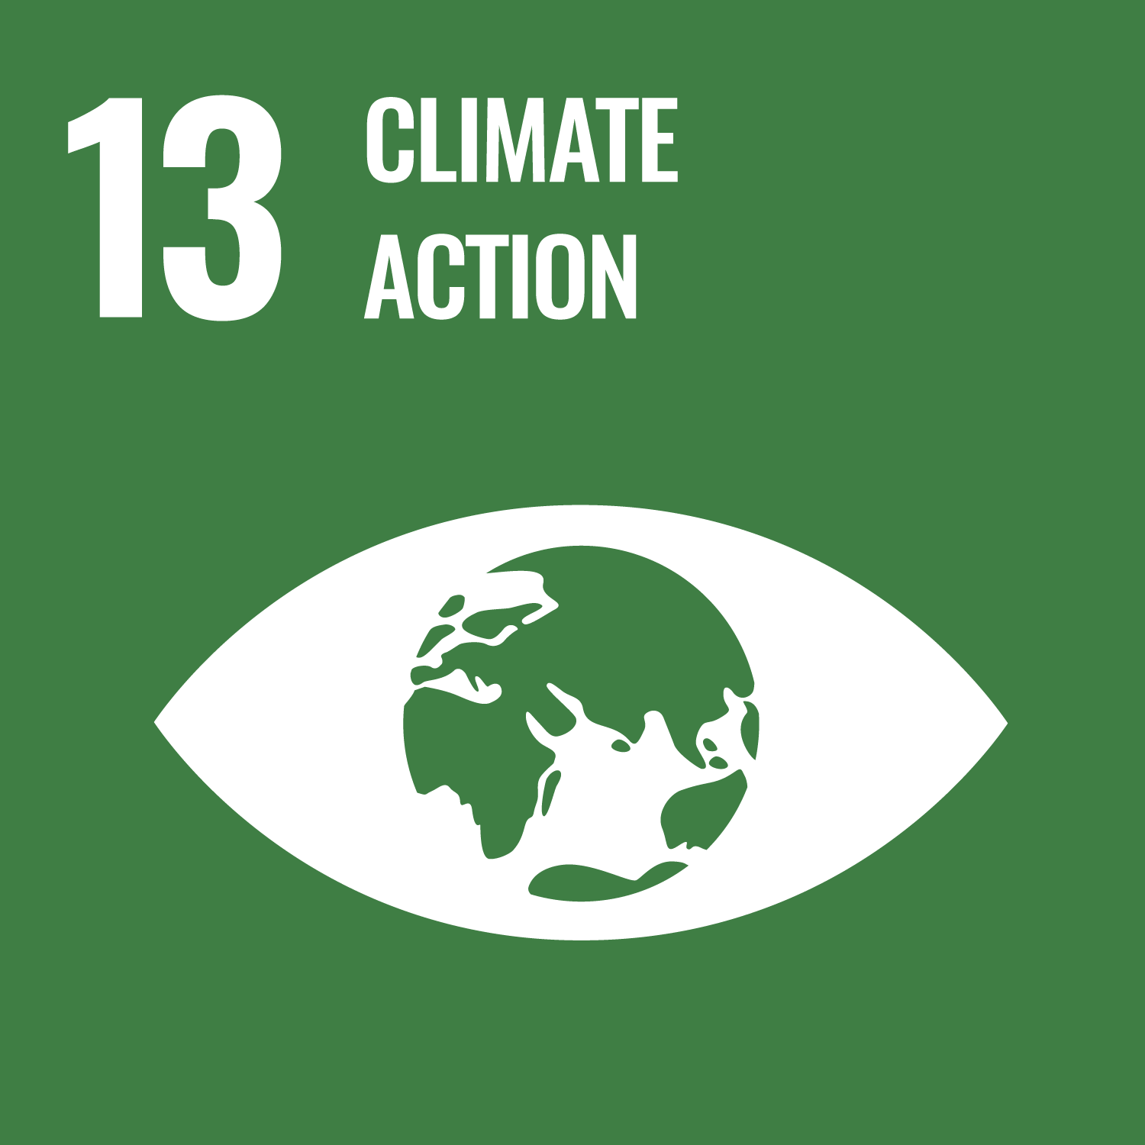
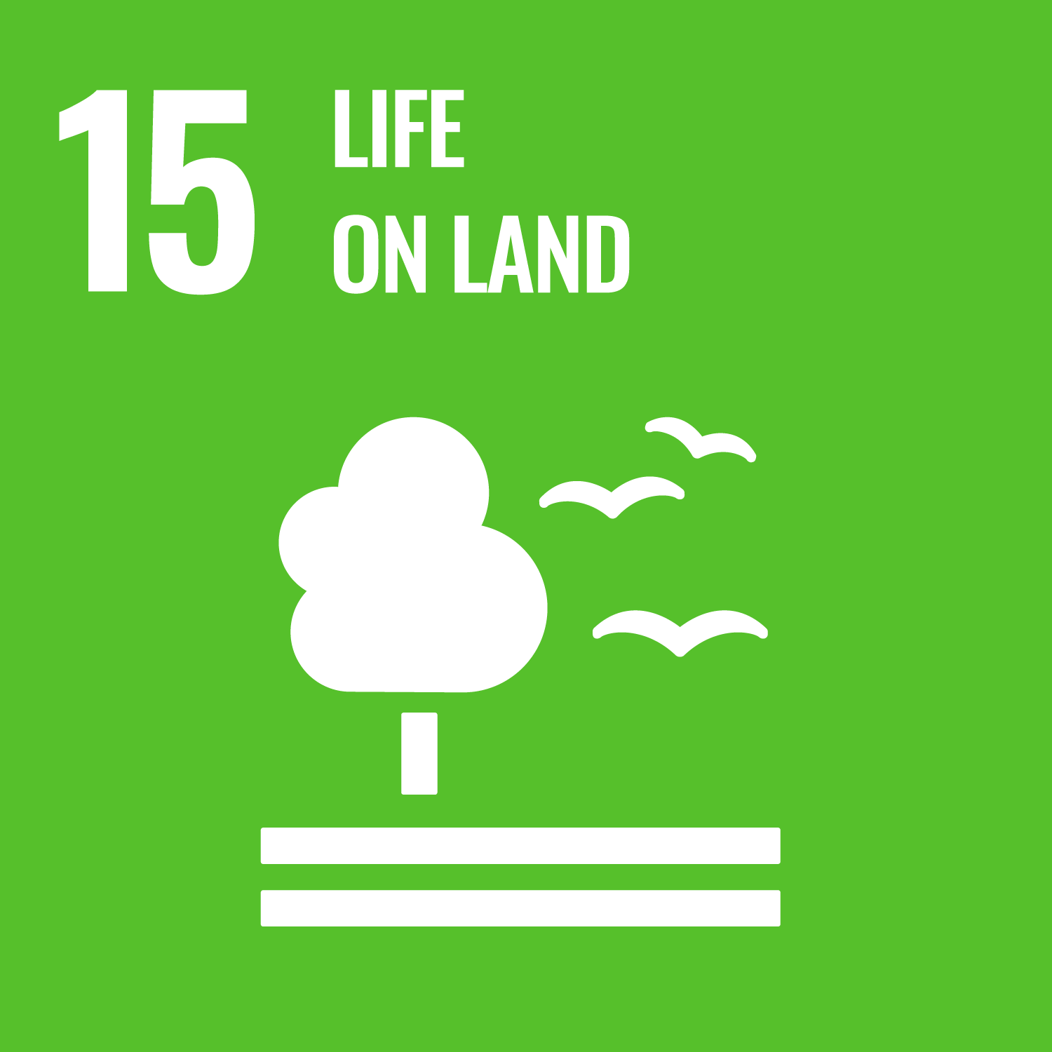
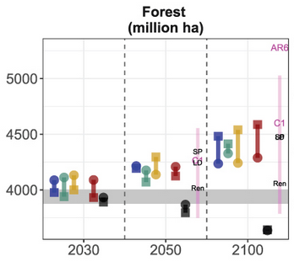
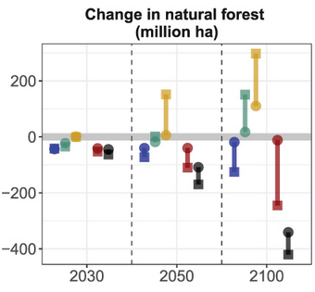
Land
SDP-EI: Focus on carbon sequestration and price-based policy instruments (e.g. carbon-price incentivized afforestation).
SDP-RC: Focus on biodiversity and regulatory instruments; preference for natural regrowth.
SDP-MC: Focus on biodiversity in
managed landscapes and in vulnerable habitats; mix of policy instruments.
Magenta lines: 10-90% ranges of 1.5°C scenarios from the IPCC AR6 scenario DB with no/low overshoot (C1); C1 label represents the median; labels IMP-SP, IMP-Ren and IMP-LD for the three illustrative mitigation pathways.
Weindl et al. (2024), ERL

Slide 33
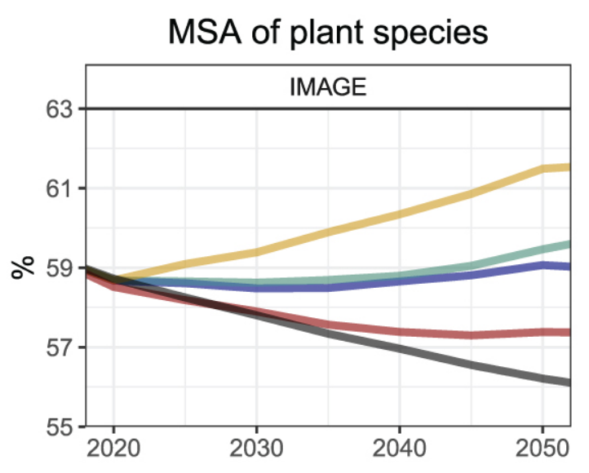
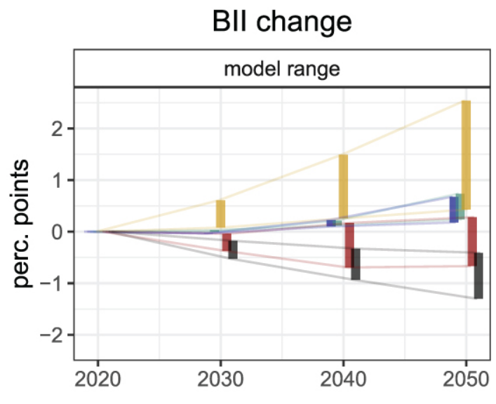
Biodiversity
SDP-EI: Focus on carbon sequestration and price-based policy instruments (e.g. carbon-price incentivized afforestation).
SDP-RC: Focus on biodiversity and regulatory instruments; preference for natural regrowth.
SDP-MC: Focus on biodiversity in
managed landscapes and in vulnerable habitats; mix of policy instruments.
Models:
REMIND-MAgPIE
IMAGE
Weindl et al. (2024), ERL

Slide 34
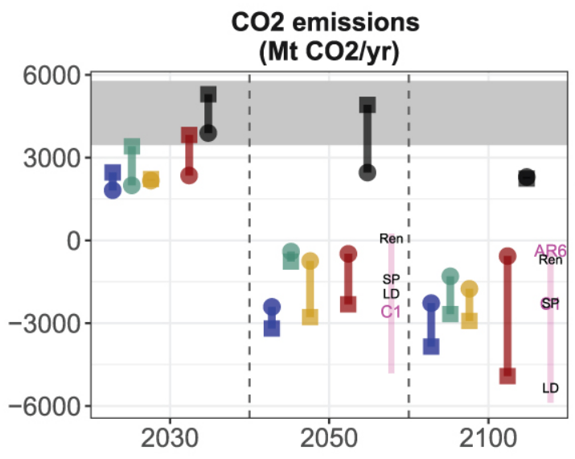
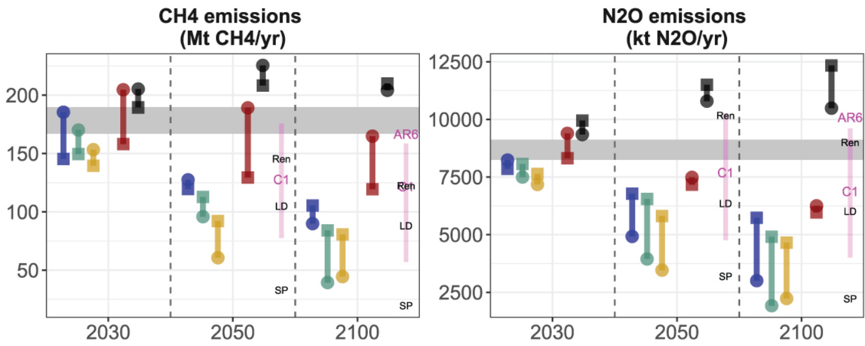
GHG emissions
SDP-EI: previous assumptions; peatland protection / restoration; non-CO2 GHG mitigation
SDP-RC: previous assumptions; peatland protection / restoration; non-CO2 GHG mitigation
SDP-MC: previous assumptions; peatland protection / restoration; non-CO2 GHG mitigation
Magenta lines: 10-90% ranges of 1.5°C scenarios from the IPCC AR6 scenario DB with no/low overshoot (C1); C1 label represents the median; labels IMP-SP, IMP-Ren and IMP-LD for the three illustrative mitigation pathways.
Weindl et al. (2024), ERL

Slide 35
How are policy strategies represented in the SDPs?
SDP narratives reflect
governance modes &
preferences for policy instruments
SDP quantifications reflect
SD interventions
that are endogenously or exogenously modelled
Key question
How do qualitative narrative descriptions correspond to quantitative scenario modelling?
Approach (Dombrowsky et al. 2025)
Literature review on policy mix criteria
Interviews with modeling teams (REMIND-MAgPIE, IMAGE, MESSAGE)
Comparison of narratives with modelled scenarios

Slide 36
Policy appraisal of the quantified SDPs
IAM representation of policy instruments and purposes is limited:
Well represented: economic policy instruments such as carbon pricing; to some extent, mixes of economic and regulatory instruments (e.g., afforestation incentives); demand pull (e.g., taxes)
Underrepresented: informational instruments (e.g., food labelling), technology push (e.g., patent law) and systemic policy purposes (e.g., infrastructure and education), especially in the area of behavioral change
The interventions quantified by the models broadly correspond to the referred policy instruments described in the SDP narratives.
Narratives also support ex-post interpretation of interventions where models do not explicitly define a policy instrument.
The SDPs improve the overall diversity of policy mixes compared to earlier, climate-only IAM scenarios.
Huge challenges remain.

Slide 37
Summary

Slide 38
Key insights
A rapid ramp-up of ambition is needed for meeting climate targets and SDGs. The SHAPE SDPs illustrate diverse scenario quantifications for such pathways that go beyond typical “climate-only” scenarios — each with distinct benefits and trade-offs.
Food and land transformations are essential levers for SD: healthier diets, biomass use, biodiversity protection, and measures for land-based climate mitigation play major roles.
Narrative-based scenario design and scenario co-creation with stakeholders improve the relevance and richness of model-based assessments
While IAMs represent interactions among energy, the economy, climate, and land, they are not well suited to represent SDGs relating to human development and governance.
Ex-post pathway appraisal in terms of policy assumptions and policy mixes reduces this gap and connects quantitative scenarios to qualitative analysis of the governance dimension.

Slide 39
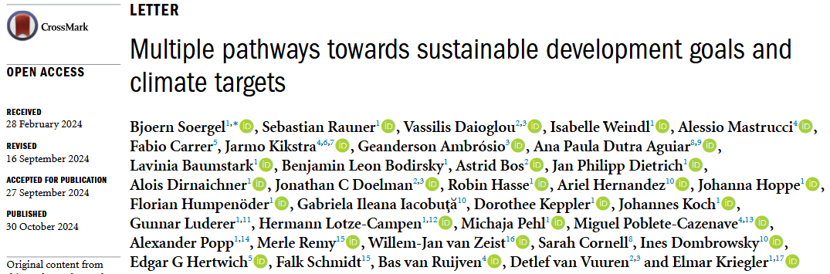
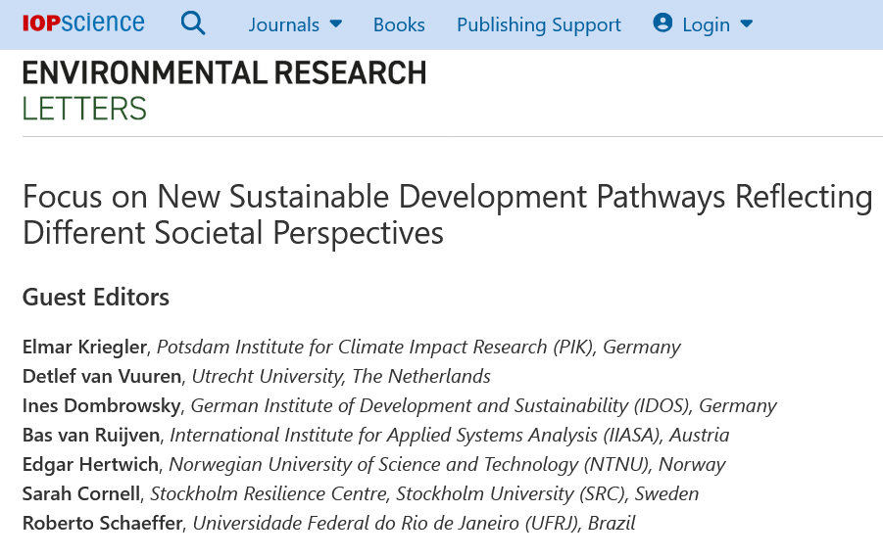
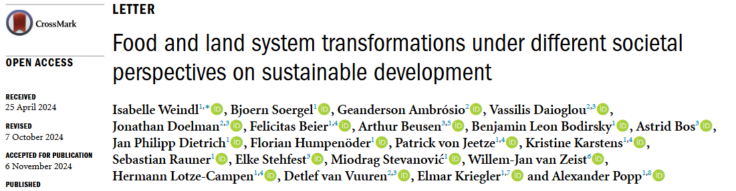
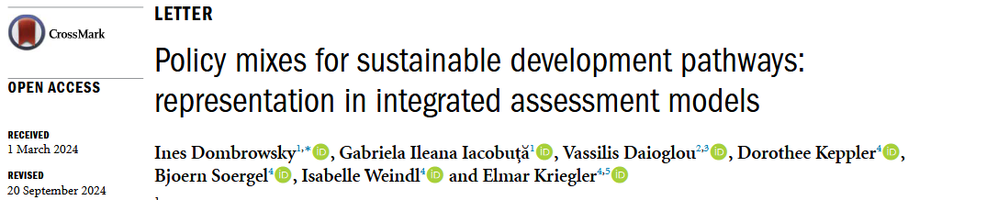
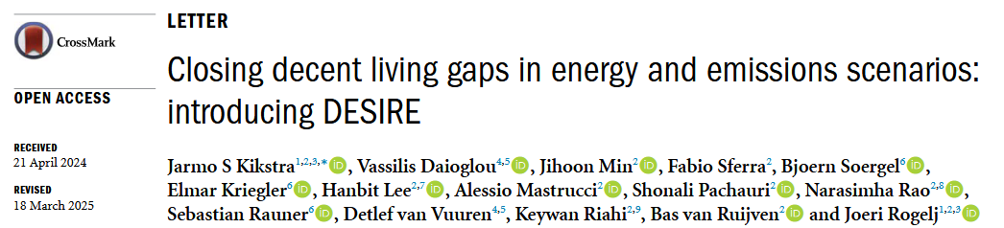
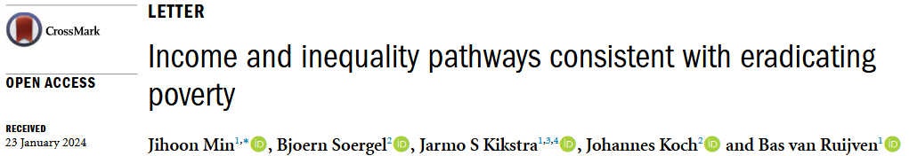
Core publications in ERL focus issue

Slide 40


Slide 41
Thank you!

Slide 42
References
Aguiar, A.P.D. et al. Co-designing global target-seeking scenarios: A cross-scale participatory process for capturing multiple perspectives on pathways to sustainability. Global Environmental Change, 65, p. 102198 (2020). doi.org/10.1016/j.gloenvcha.2020.102198.
Bodirsky, B. L. et al. The ongoing nutrition transition thwarts long-term targets for food security, public health and environmental protection. Sci. Rep. 10, 19778 (2020).
Crippa, M. et al. Food systems are responsible for a third of global anthropogenic GHG emissions. Nat. Food 1–12 (2021). doi:10.1038/s43016-021-00225-9.
Dombrowsky, I. et al. Policy mixes for sustainable development pathways: representation in integrated assessment models. Environ. Res. Lett. 20.1 (2025). doi: 10.1088/1748-9326/ad993a.
Kikstra, J. et al. Closing decent living gaps in energy and emissions scenarios: introducing DESIRE. Environ. Res. Lett. 20.5 (2025). doi: 10.1088/1748-9326/adc3ad.
Leach, M. et al. Equity and sustainability in the Anthropocene: a social–ecological systems perspective on their intertwined futures. Global Sustainability, 1, p. E13 (2018). doi.org/10.1017/sus.2018.12.
Min, J. et al. Income and inequality pathways consistent with eradicating poverty. Environ. Res. Lett. 19.11 (2024). doi: 10.1088/1748-9326/ad7b5d
Riahi, K. et al. Mitigation Pathways Compatible with Long-term Goals, in Climate Change 2022: Mitigation of Climate Change. Contribution of Working Group III to the Sixth Assessment Report of the Intergovernmental Panel on Climate Change. Cambridge University Press, pp. 295–408 (2022). doi.org/10.1017/9781009157926.005.
Soergel, B. et al. A sustainable development pathway for climate action within the UN 2030 Agenda. Nat. Clim. Change 11, 656–664 (2021).
Soergel, B. et al. Multiple pathways towards sustainable development goals and climate targets. Environ. Res. Lett. 19.12 (2024). doi: 10.1088/1748-9326/ad80af.
van Soest, H.L. et al. Analysing interactions among Sustainable Development Goals with Integrated Assessment Models. Global Transitions, 1, pp. 210–225 (2019). doi.org/10.1016/j.glt.2019.10.004.
van Vuuren, D.P. et al. Defining a sustainable development target space for 2030 and 2050. One Earth, 5(2), pp. 142–156 (2022). doi:10.1016/j.oneear.2022.01.003.
Weindl, I. et al. Food- and land-system transformations under different societal perspectives on sustainable development. Environ. Res. Lett. 19.12 (2024). doi: 10.1088/1748-9326/ad8f46.
Willett, W. et al. Food in the Anthropocene: the EAT–Lancet Commission on healthy diets from sustainable food systems. The Lancet (2019). doi:10.1016/S0140-6736(18)31788-4.

Slide 43
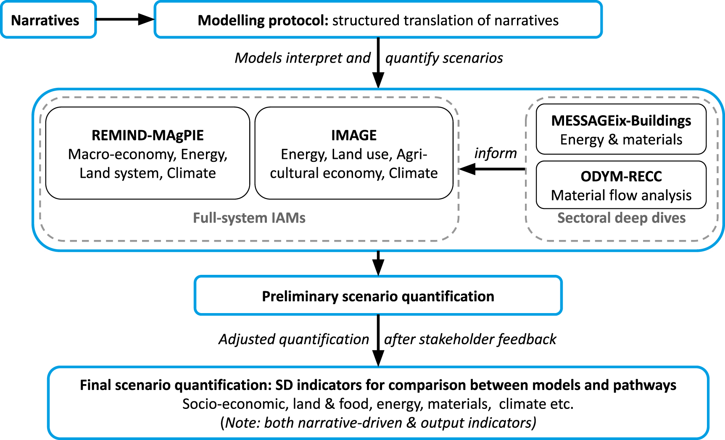
Setup: SHAPE model comparison of sustainable development pathways
Soergel et al. (2024), ERL

Slide 44
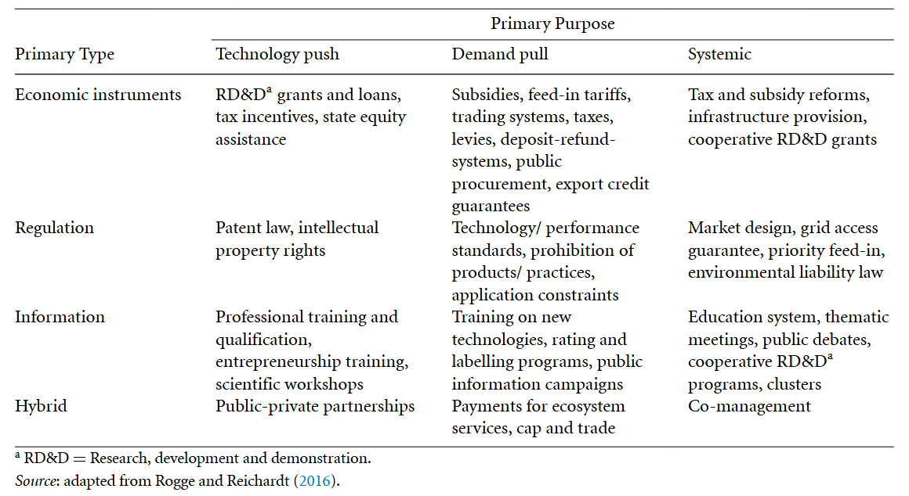
Types and purposes of policy instruments
Dombrowsky et al. (2025), ERL

Slide 45
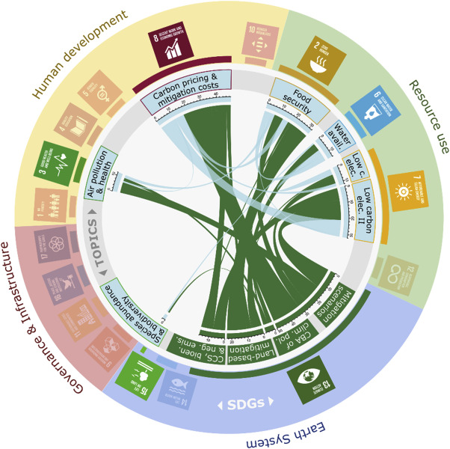
SDG interactions in the IAM literature
IAMs were originally developed to study interactions among energy, the economy, climate, and land.
IAMs cover the SDGs related to climate owing to their design.
Most IAMs cover additional areas related to resource use and the Earth system.
Some other dimensions of the 2030 Agenda are also represented.
van Soest et al. (2019), Global Transitions
Chord width is proportional to the number of documents that simultaneously feature two topics. Climate topics are in green while non-climate ones are in light blue.

Slide 46
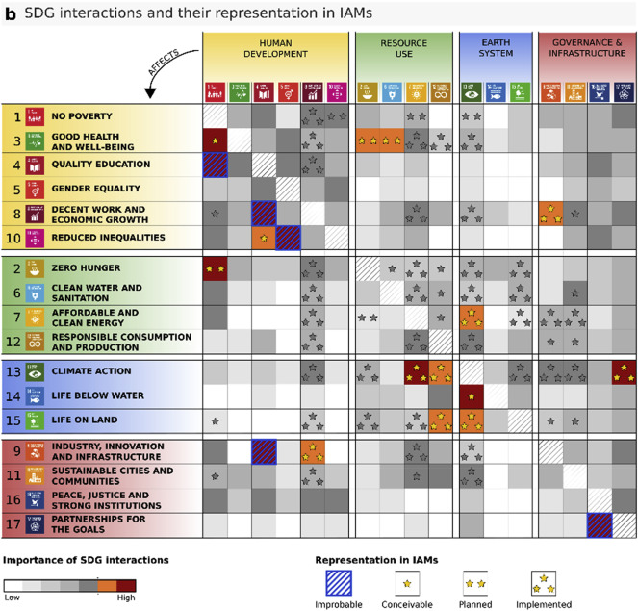
IAM capacities to model SDG interactions
Modelers survey: Well-covered SDGs are in the resource use and Earth system clusters (SDGs 13, 7, 2, 15, 6).
SDGs relating to human development and governance & infrastructure are generally more difficult for IAMs to quantify.
Way forward: model development and combining models into multi-model frameworks can help fill some gaps.
van Soest et al. (2019), Global Transitions

Slide 47
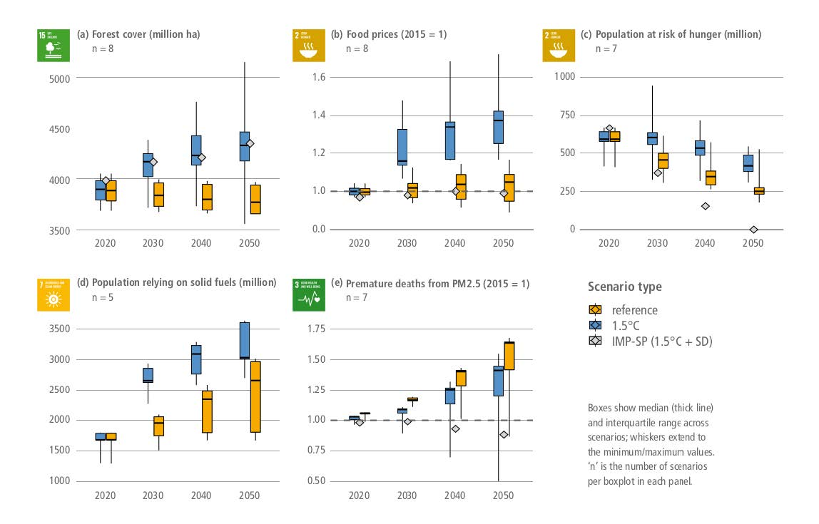
Coverage of SDGs and SDPs in AR6 (WG3)
Multi-(model,scenario,indicator) analysis of mitigation-SDG interactions based on AR6 scenario DB (still limited SDG indicator availability)
SDP scenario from Soergel et al.: Illustrative Mitigation Pathway “Shifting Pathways” (IMP-SP)
Key insight from subchapter 3.7: Targeted SD policies can boost co-benefits of mitigation policies, and compensate for adverse side effects
IPCC AR6 WG3, Ch.3, Fig. 3.38

Slide 48
Defining a sustainable development target space for 2030 and 2050
Key principles underlying the target space:
Societal relevance
    the target space addresses areas of sustainable development organized around the 17 SDGs; wherever possible, indicators and target values directly related to the SDGs or objectives from other international agreements are used
van Vuuren et al. (2022), One Earth

Slide 49
Defining a sustainable development target space for 2030 and 2050
Key principles underlying the target space:
Science-based
    the indicators need to address the most pressing dimensions of human development (people), socio-economic wellbeing (prosperity), national and international security (peace), and global environmental change (planet) as discussed in the scientific literature, such as the processes prioritized in the Planetary Boundaries framework
    Target values: where consensus exists on science-based targets that must be achieved by 2030 or
    later, these should be used
van Vuuren et al. (2022), One Earth

Slide 50
Defining a sustainable development target space for 2030 and 2050
Key principles underlying the target space:
Valid for 2030 and beyond
    the indicators should relate to both the SDG time frame (2030) and the long-term (2050 and beyond) and account for path dependency
    Target values: for 2050, target values either retain absolute 2030 measures (e.g., zero hunger, energy
    access for all) or even improve upon these values; in the latter cases, the values are set to achieve a decent life for all
van Vuuren et al. (2022), One Earth

Slide 51
Defining a sustainable development target space for 2030 and 2050
Key principles underlying the target space:
Quantifiable
    the targets should be well suited for inclusion in quantitative analyses, capturing as many features as possible in state-of-the-art integrative models; they also need to be unambiguous and measurable
    Target values: target values need to be specified clearly and with appropriate precision in order to be suitable for quantitative analysis
van Vuuren et al. (2022), One Earth

Slide 52
Defining a sustainable development target space for 2030 and 2050
Key principles underlying the target space:
Transparent
    the set should be clearly defined, and individual
    indicators should be easy to understand (e.g., avoiding multidimensional indices); the number of indicators per
    issue should be as low and complementary as possible
    [...] selecting indicators that describe end values of
    system transformation rather than the means to achieve them
    Target values: target values should ensure consistency
    across the indicators for the different SDGs and be linked to the principles underlying the SDGs and the objectives of other international agreements
van Vuuren et al. (2022), One Earth

Slide 53
Defining a sustainable development target space for 2030 and 2050
Key principles underlying the target space:
Actionable and achievable
    the indicators should be actionable and
    sensitive to policy initiatives (and thus link to
    system transformations)
    Target values: the target values are derived from existing agreements; targets should be reachable,
    for instance, demonstrated by some countries reaching the target
van Vuuren et al. (2022), One Earth

Slide 54
Defining a sustainable development target space for 2030 and 2050
Key principles underlying the target space:
Availability of data and knowledge
    indicators are only useful if data are
    available to monitor progress
    Target values: the target values need to be rooted in data and knowledge
van Vuuren et al. (2022), One Earth

Slide 55
Defining a sustainable development target space for 2030 and 2050
van Vuuren et al. (2022), One Earth
The process for defining and applying the target space

Slide 56
Defining a sustainable development target space for 2030 and 2050
van Vuuren et al. (2022), One Earth
The target space can also be used to assess exploratory scenarios like SSP2.

