Slide 1




Climate Change in Central Asia: Patterns and Projections
Prof. Dr. Fred Hattermann, Dr Iulii Didovets and Dr. Bijan Fallah
hattermann@pik-potsdam.de
didovets@pik-potsdam.de

Slide 2

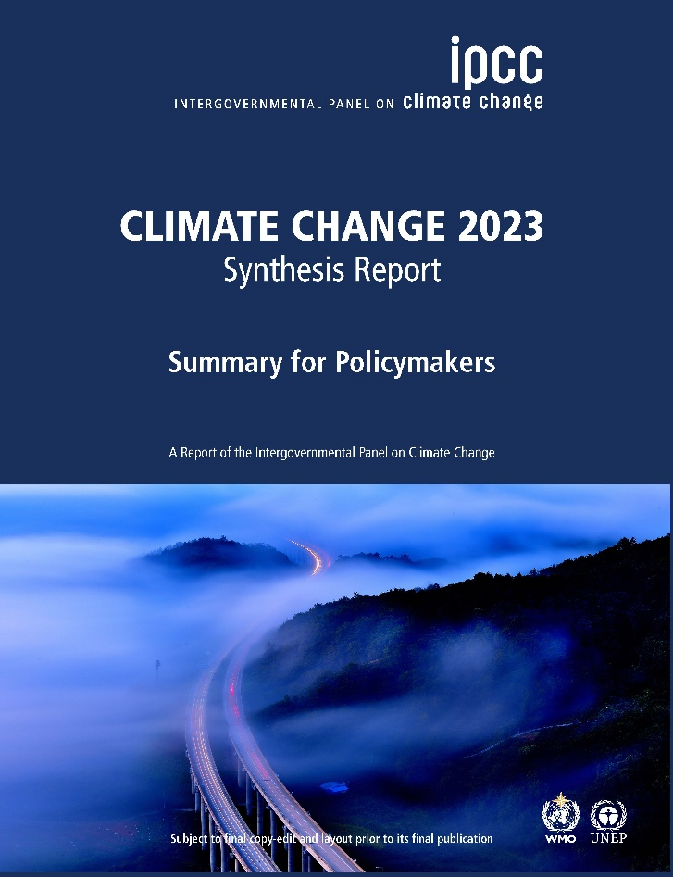
“Climate change is one of the biggest challenges of our times”
“Climate change is a threat to human well-being and planetary health”
Reference: IPCC_AR6_SYR_LongerReport Page: 55https://www.eea.europa.eu/themes/climate/climate-change-is-one-of

Slide 3
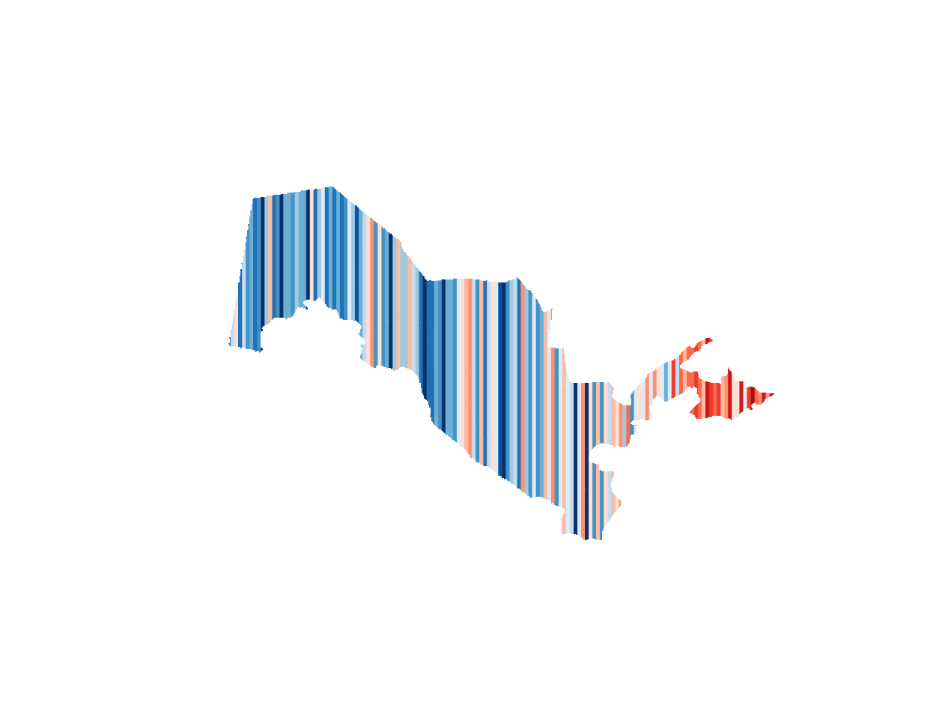
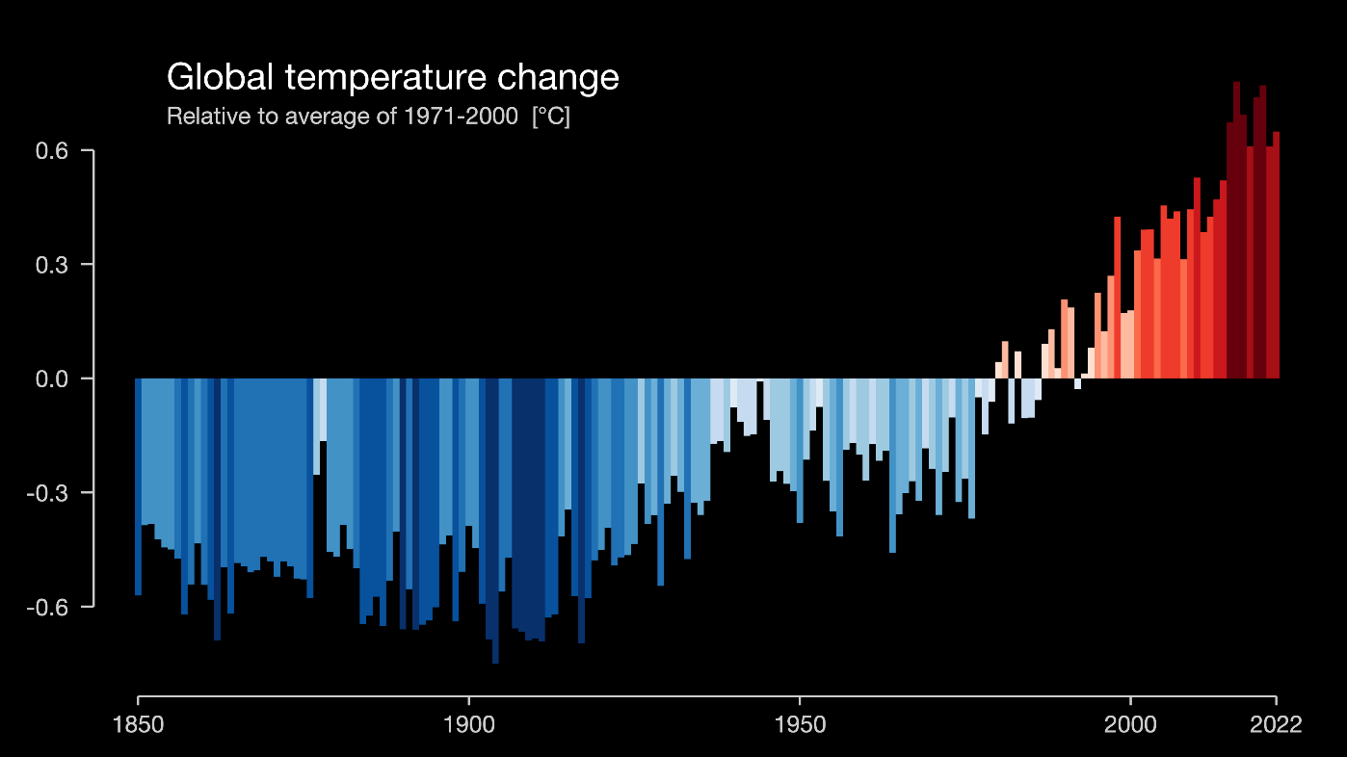
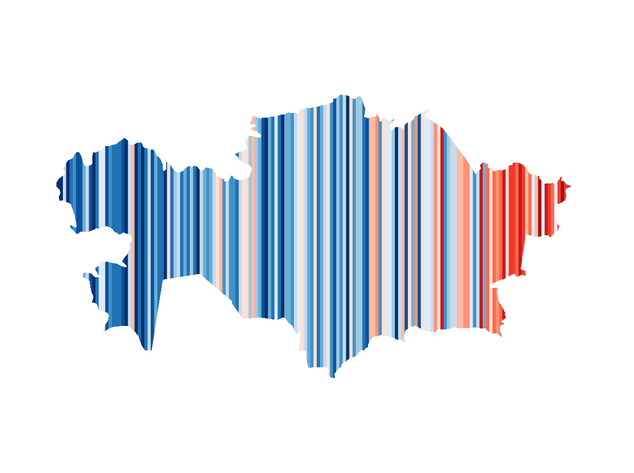
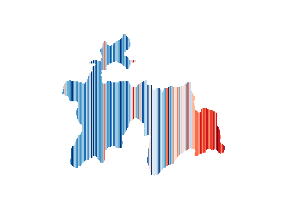
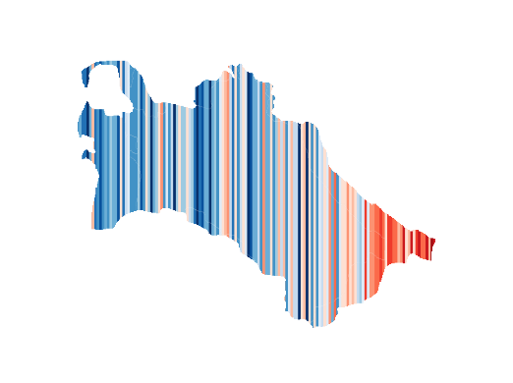

Climate change trends
Central Asia
1877
2022
Year
#showyourstipes
3
Notes:
Uzbekistan
The temperature increase in Central Asia is higher compare to global trends

Slide 4
Climate change trends
Central Asia
1877
2022
Year
#showyourstipes
4
Notes:
Tajikistan

Slide 5
Climate change trends
Central Asia
1877
2022
Year
#showyourstipes
5
Notes:
Kyrgyzstan

Slide 6
Climate change trends
Central Asia
1877
2022
Year
#showyourstipes
6
Notes:
Turkmenistan

Slide 7
Climate change trends
Central Asia
1877
2022
Year
#showyourstipes
7
Notes:
Kazakhstan

Slide 8
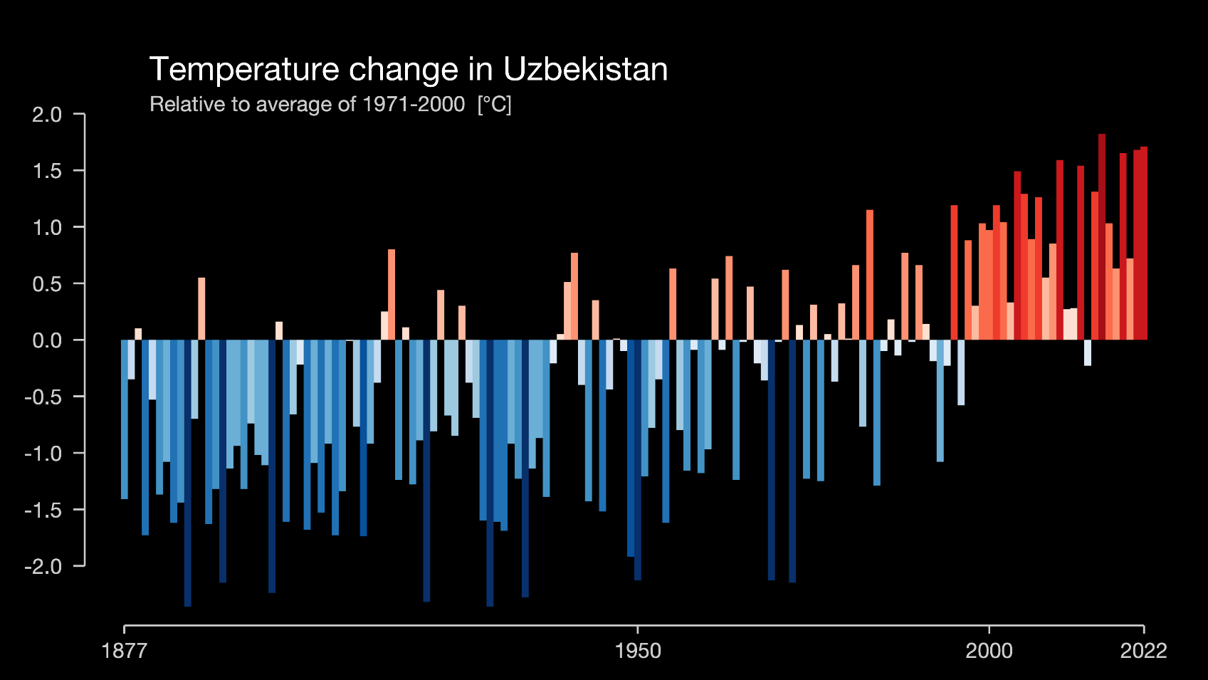
Climate change trends
Uzbekistan
#showyourstipes
8

Slide 9
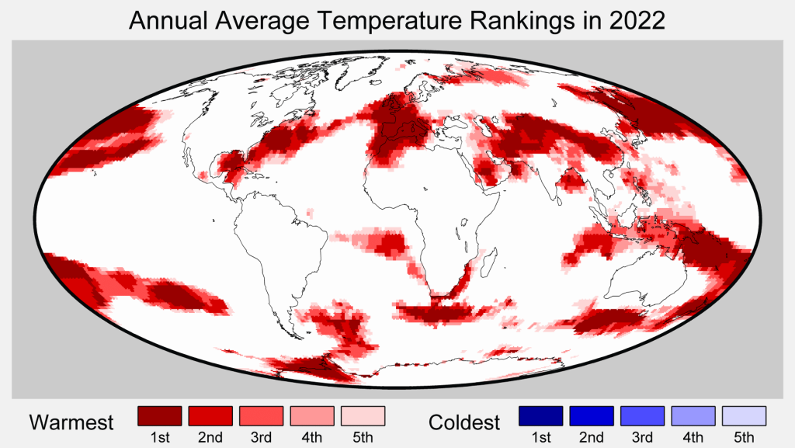
Since 1850
https://berkeleyearth.org/global-temperature-report-for-2022/
Notes:
The panel shows the rankings of the annual average temperature for the last year, 2022, from the observations (Berkeleyearth) since 1850. in the Black rectangular where Central Asia is, you see many areas which experienced the warmest year on record in 2022!! Significantly, over elevated areas of Central Asia, which are the water and snow reservoirs for the whole region.

Slide 10
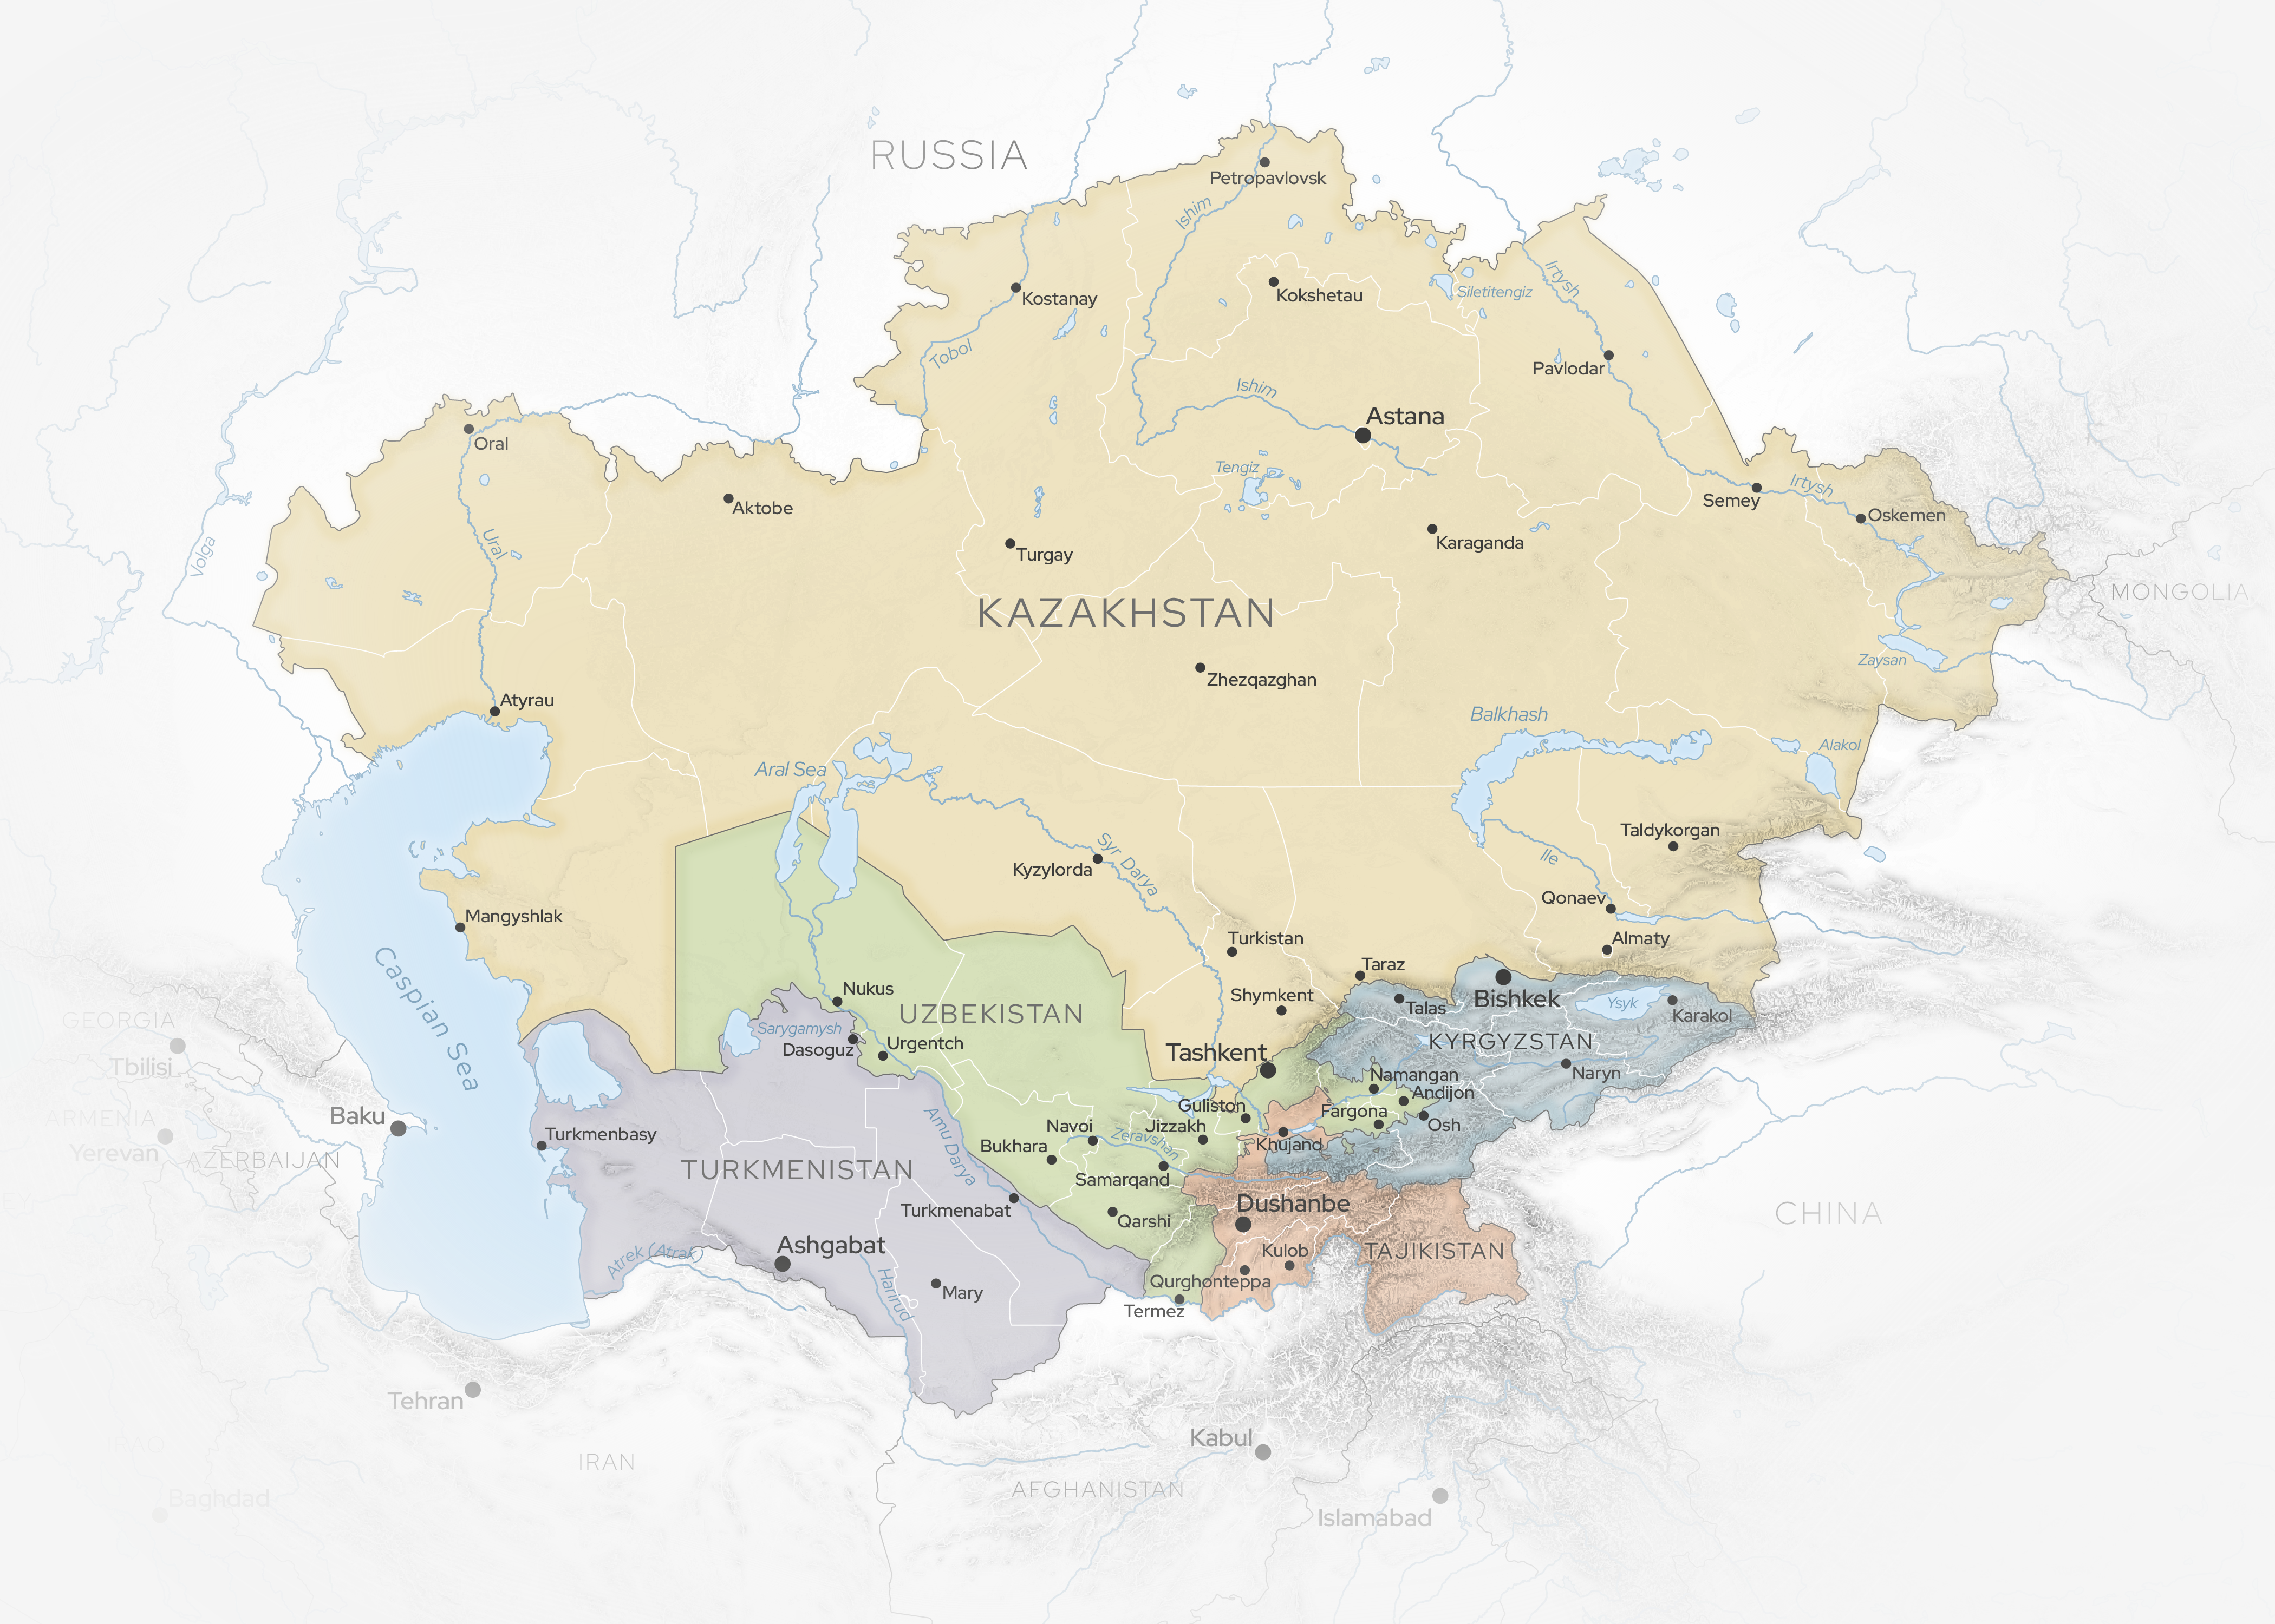
Water resources in Central Asia
Water scarce region with strong dependence on water resources
Most rivers are fed by snow and ice melt in the high mountains and don’t drain into the ocean but into endorheic lakes, Amu Darya and Syr Darya into the Aral Sea
Majority of glaciers in the region are losing mass since 1960

Slide 11



Importance of water resources in Central Asia
GDP from Agriculture
Irrigated land
Share of energy from HPP
20-22%
90%
85%
(except for Kazakhstan - 5%)
Turkmenistan
Usbekistan
Kyrgyzstan
98%
Tajikistan
63%
Afghanistan
Source: World Bank
Development Indices

Slide 12
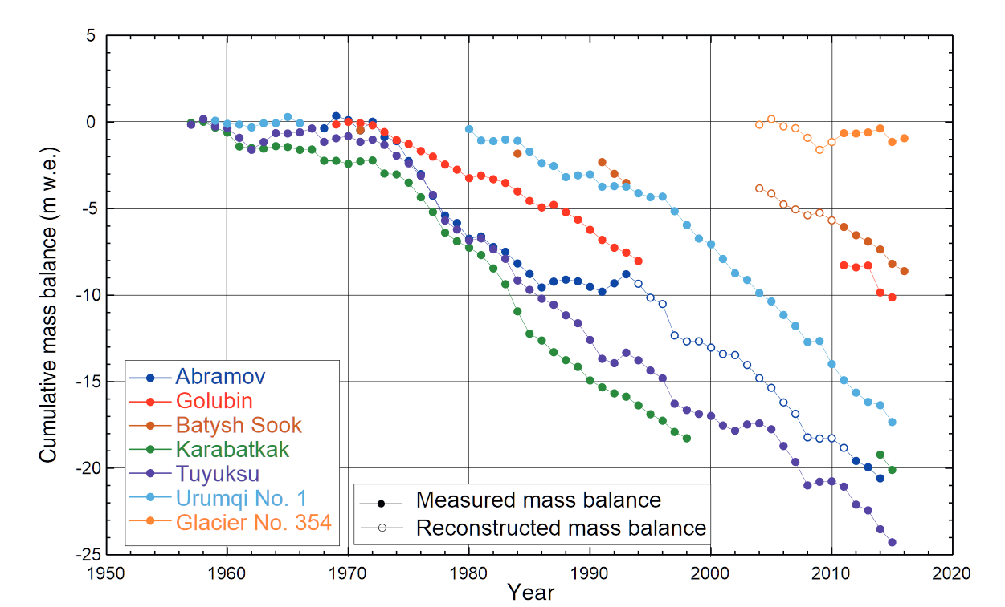
Impact on glaciers
  Barandun et al (2018) and Hoelze et al. (2017): substantial surface glacier mass loss in the three Kyrgyz glaciers since 2000
  Glacier mass loss projected: 50% less ice by the end of the century
  Annual runoff is expected to increase by mid-century then shrinking glacier areas will lead to runoff reductions later in the twenty-first century.
Cumulative mass balance measurements for glaciers in Central Asia. Filled dots are direct glaciological measurements, and non-filled dots are reconstructed values. (Hoelzle et al. , 2017 )

Slide 13
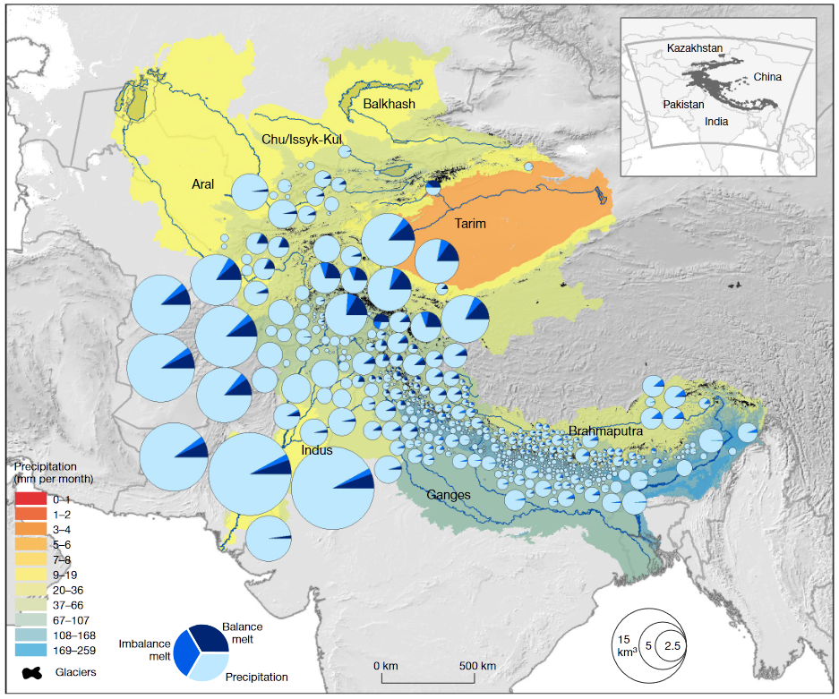
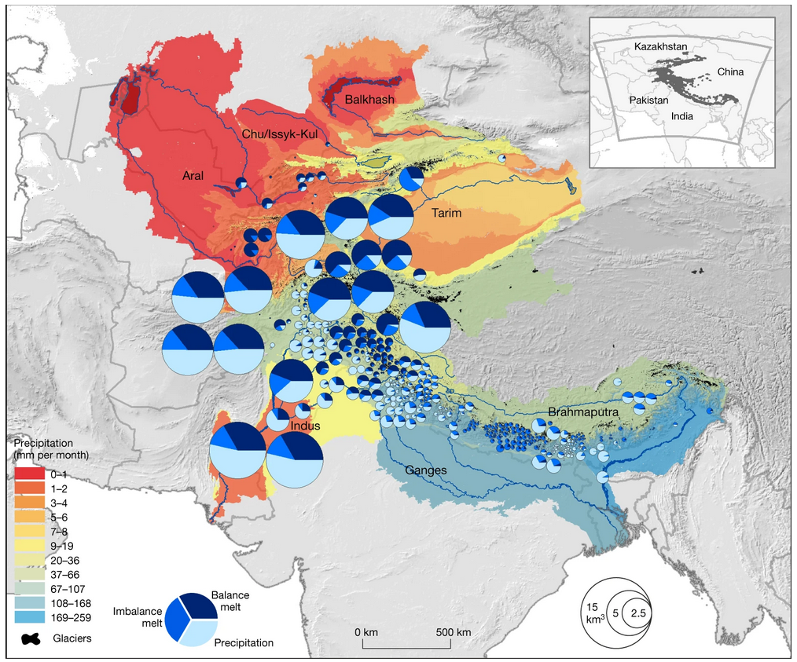
Impact on glaciers
Precipitation and glacial melt inputs in an average and drought year. (Hamish D. Pritchard, 2019)
Notes:
The current and future state of glaciers of the Tienshan Mountains, which are known as the “water tower” of Central Asia have a huge impact on future development

Slide 14
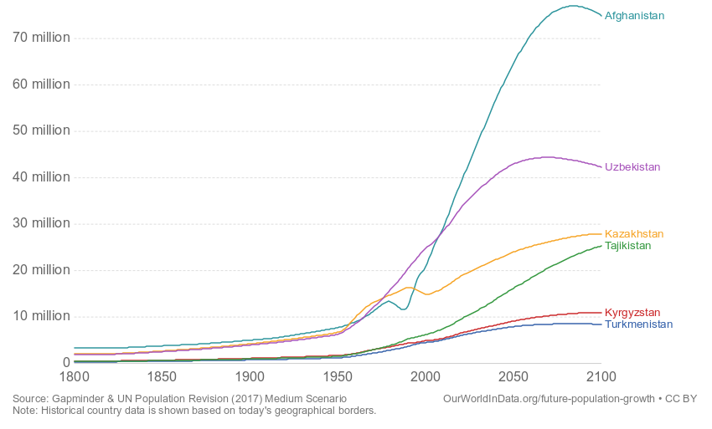
Population projection (UN medium scenario)
Source: Our World in Data

Slide 15
A comprehensive climate impact assessment concretizes and prioritizes adaptation strategies at the regional and national levels.

Slide 16
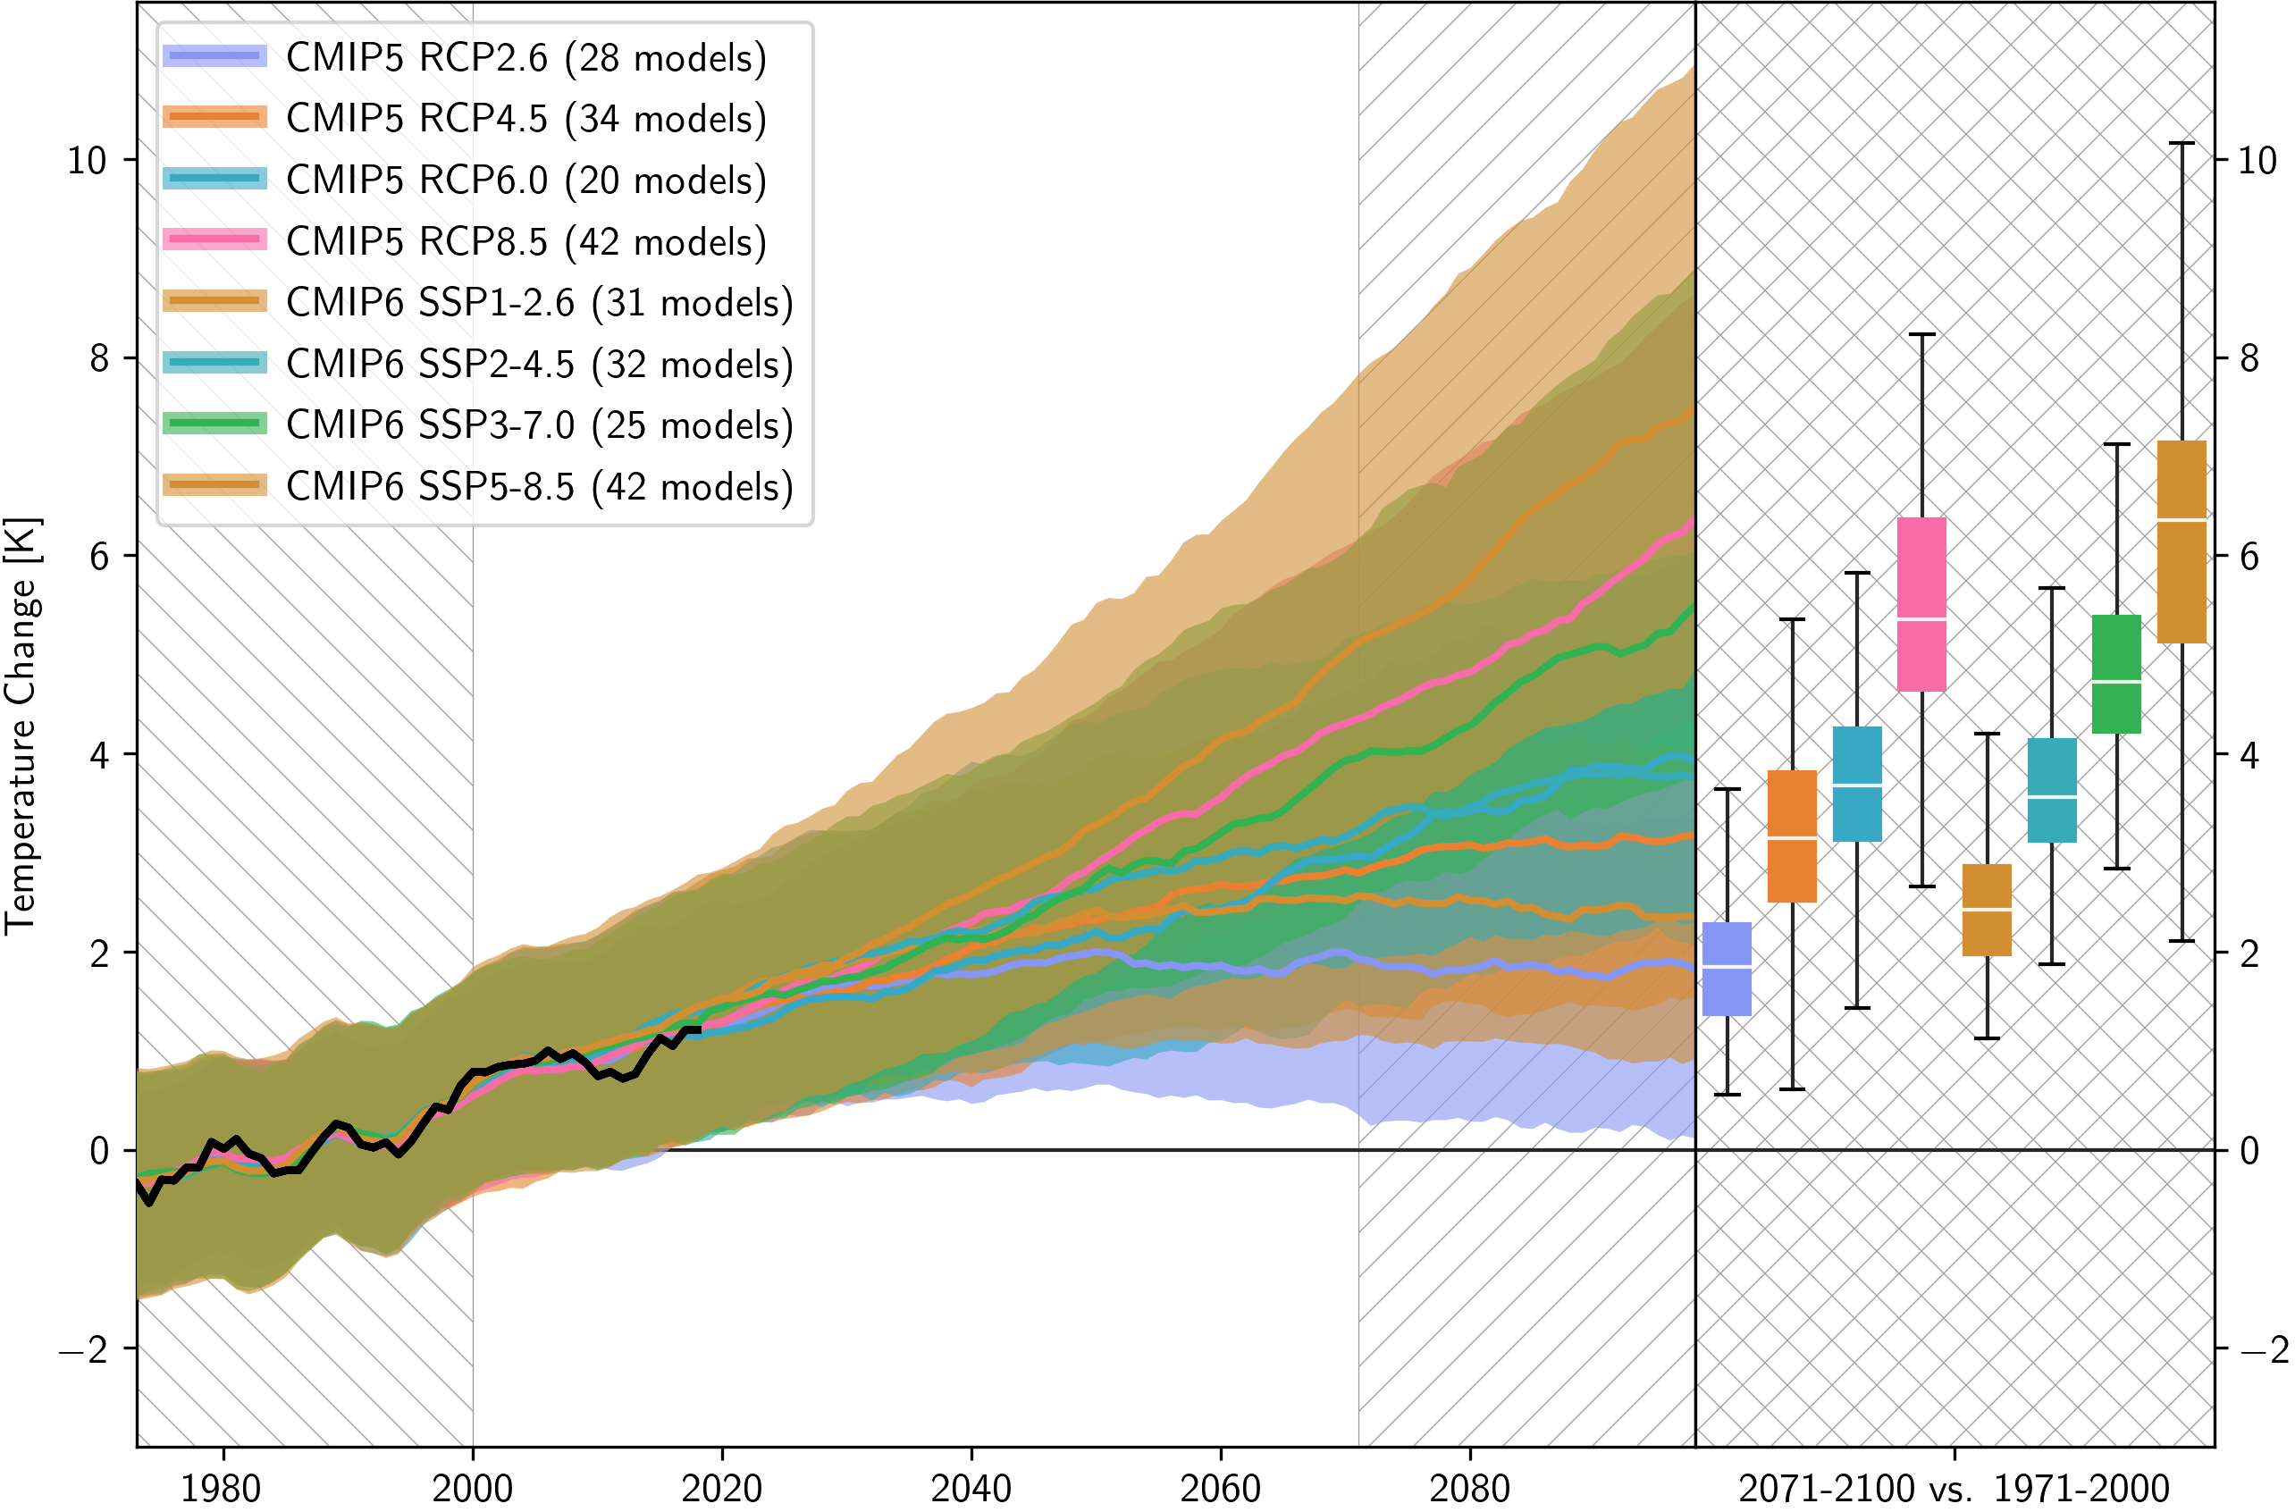
Central Asian Temperature Change
ERA5
©Bijan Fallah, PIK
Notes:
The left panel shows the Temperature change (2071-2100 vs 1971-2000) over the Central Asian domain from CMIP5 and CMIP6 models for 4 different scenarios:
CMIP5 : RCP2.6, RCP4.5, RCP6.0 and RCP8.5
CMIP6: SSP1-2.6, SSP2-4.5, SSP3-7.0 and SSP5-8.5
The solid black line is the trend from ERA5 reanalysis data. The shadings show the model spread. The main point is that the new IPCC models , i.e. CMIP6 show even more warming in Central Asia.

Slide 17
Future changes
Mean annual Temperature, C
RCP 8.5 scenario
21
5.5
19
3
17
1.7
15
Ref
13
1990
2040
2090

Slide 18
Future changes
Mean annual Temperature, C
RCP 8.5 scenario
21
5.5
19
3
17
1.7
15
Ref
13
1990
2040
2090

Slide 19
Future changes
Mean annual Temperature, C
RCP 8.5 scenario
21
5.5
19
3
17
1.7
15
Ref
13
1990
2040
2090

Slide 20
Future changes
Mean annual Temperature, C
RCP 8.5 scenario
21
5.5
19
3
17
1.7
15
Ref
13
1990
2040
2090

Slide 21
Future changes
Number of days with T > 30 C per year
RCP 8.5 scenario
120
Whole Central Asia
97
57 days
44
26
5
Kazakhstan
Turkmenistan
Kyrgyzstan
Tajikistan
Uzbekistan
Notes:
The number of days with hot temperature will double by the end of the century

Slide 22
Future changes
Number of days with T > 30 C per year
RCP 8.5 scenario
172
150
Whole Central Asia
103
55
112 days
35
Kazakhstan
Turkmenistan
Kyrgyzstan
Tajikistan
Uzbekistan

Slide 23
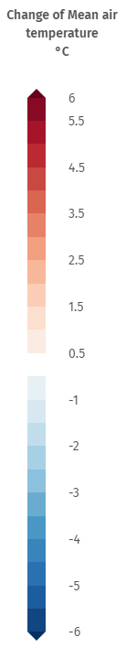
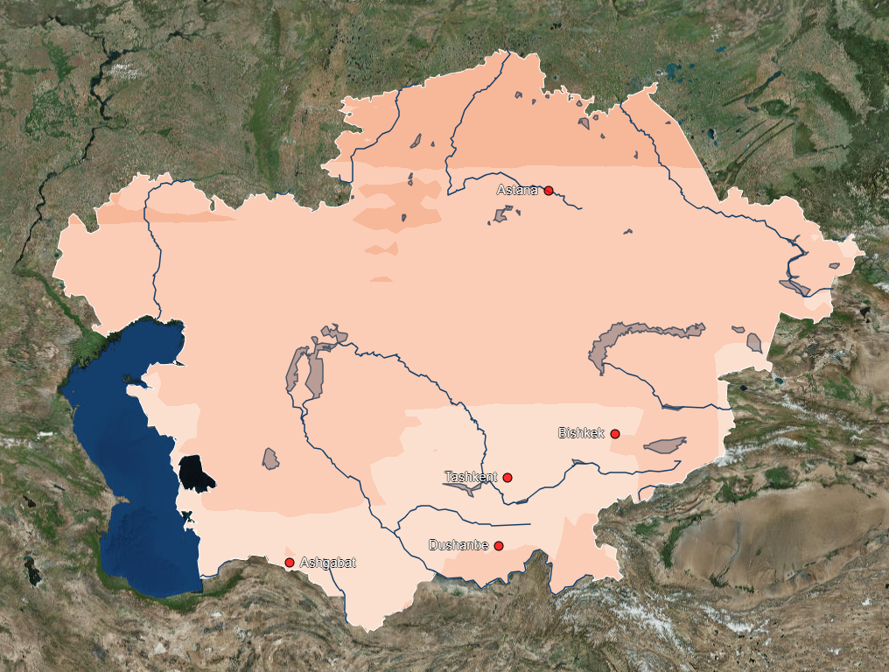
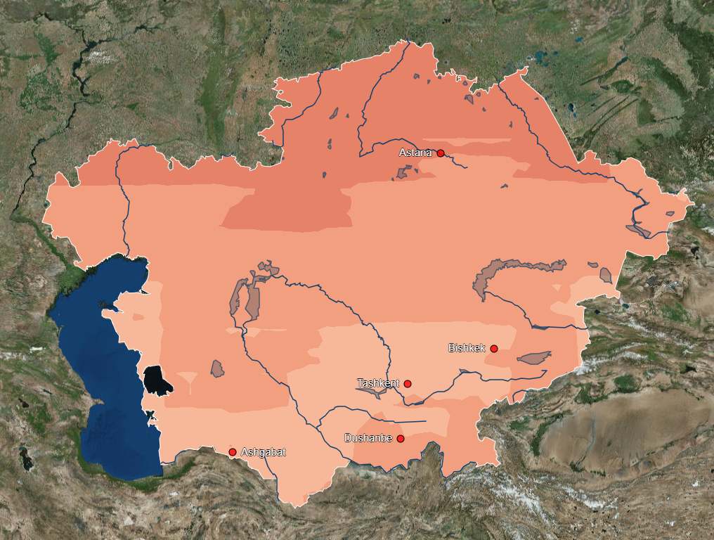
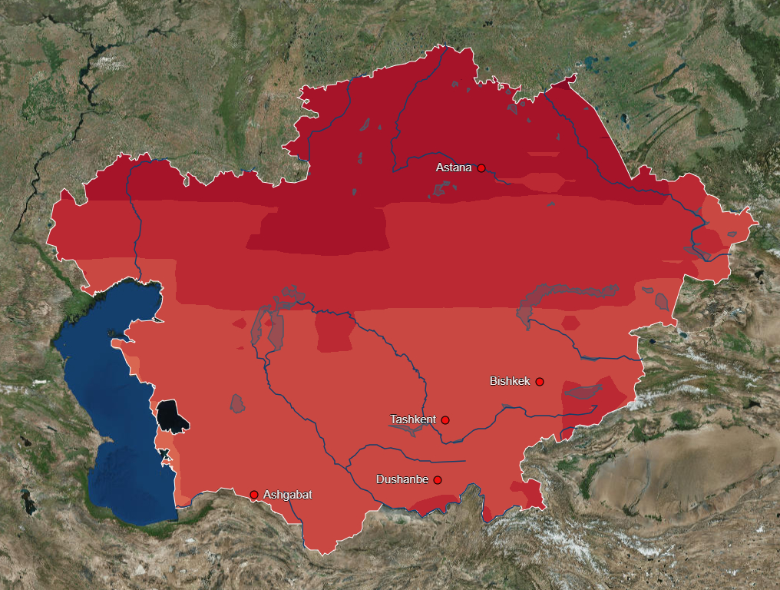
Temperature change (SSP5-RCP8.5)
2010-2040
2040-2070
2070-2100

Slide 24
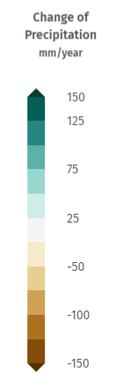
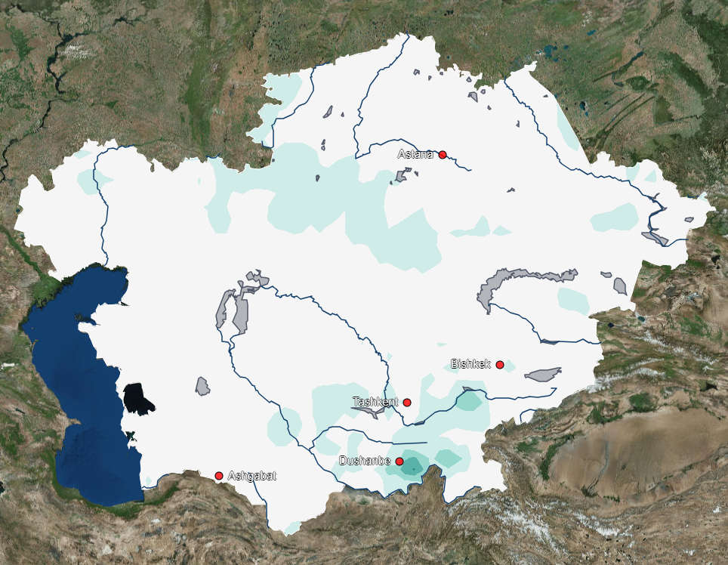
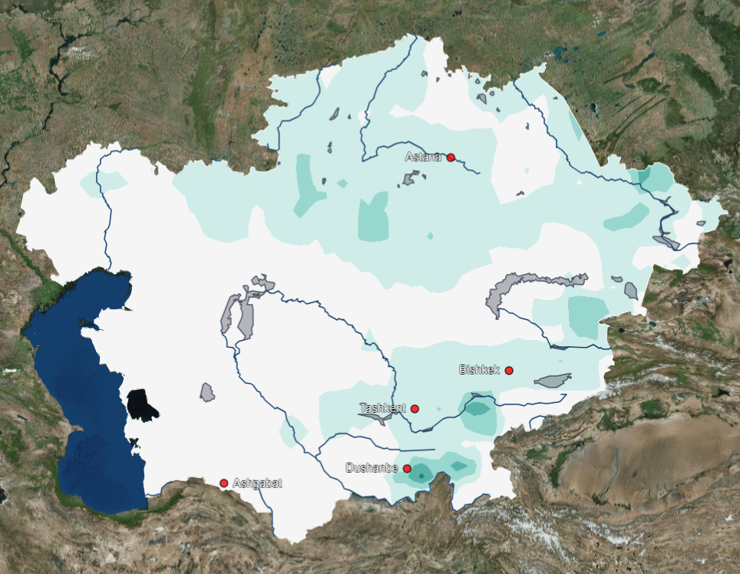
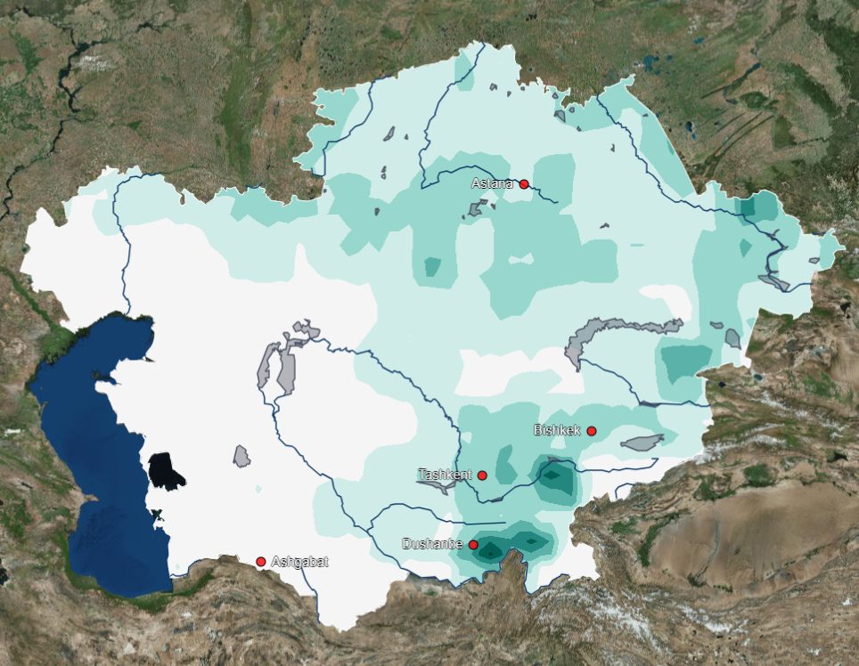
Precipitation change (SSP5-RCP8.5)
2010-2040
2040-2070
2070-2100

Slide 25
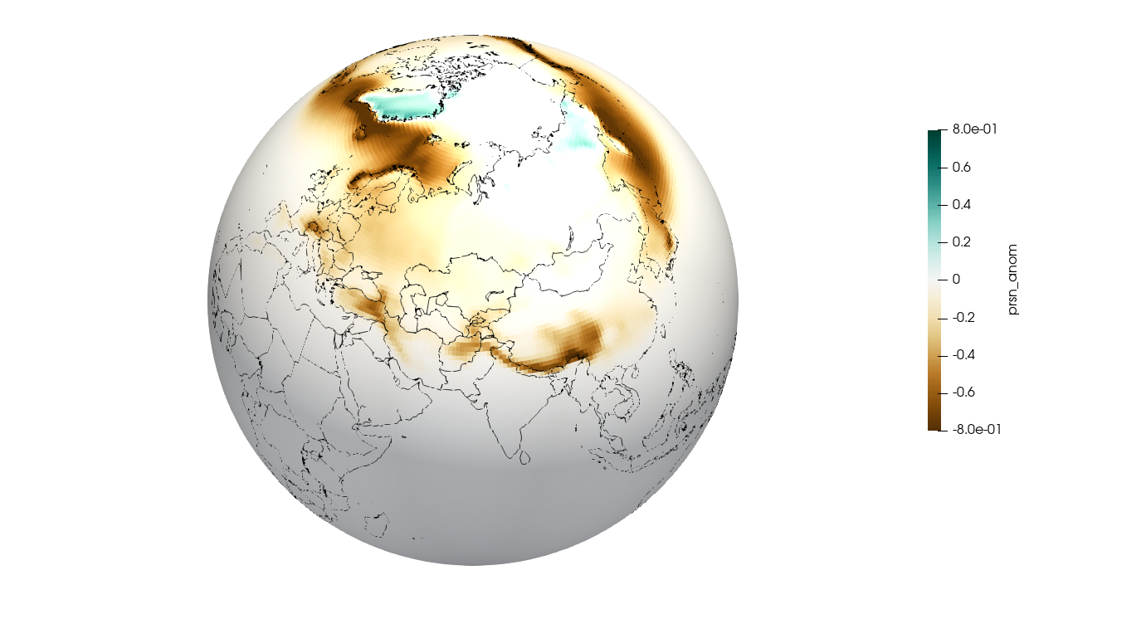
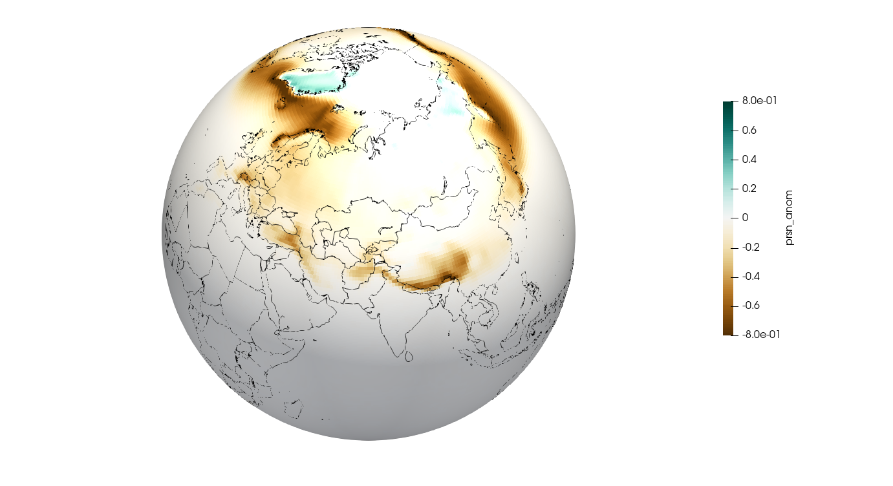
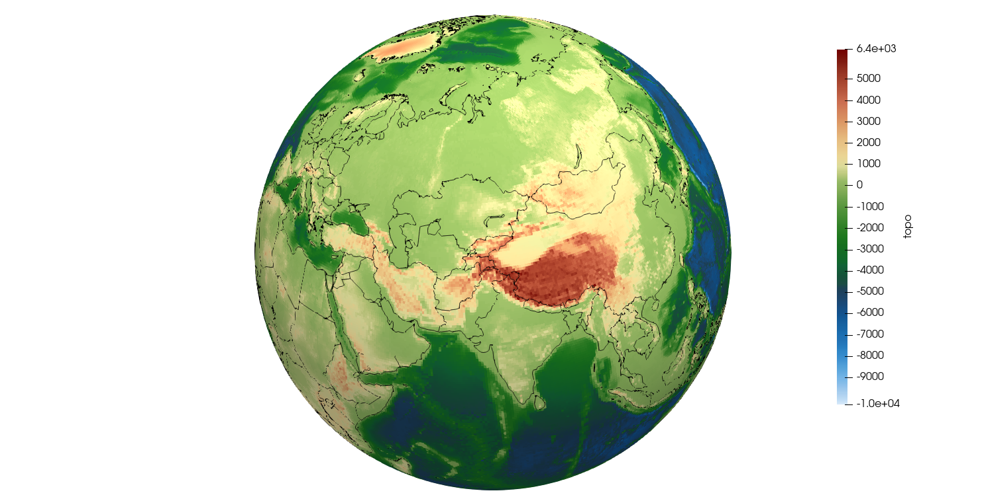
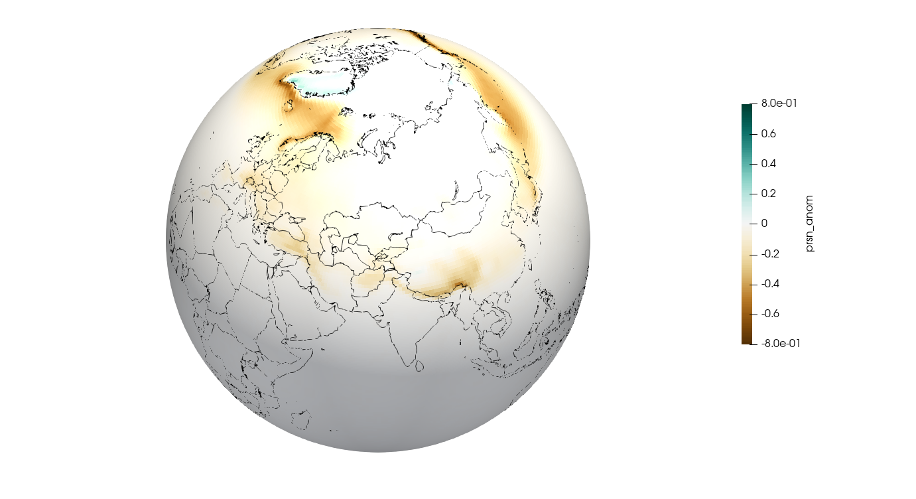
Snowfall change mm/day
Long-term (2081-2100) SSPs (rel. 1850-1900) - Annual climate change.
Topography
SSP1-2.6
SSP3-7.0
SSP5-8.5
©Bijan Fallah, PIK
Notes:
One key concern in Central Asia is that although the total precipitation might increase, the precipitation will shift from snow to rain in colder seasons. The consequence is water scarcity during the warmer seasons when agriculture needs water. Especially over the mountains of Central Asia: The two elevated countries of Tajikistan and Kyrgyzstan who act as providers of water for the whole of Central Asia.

Slide 26
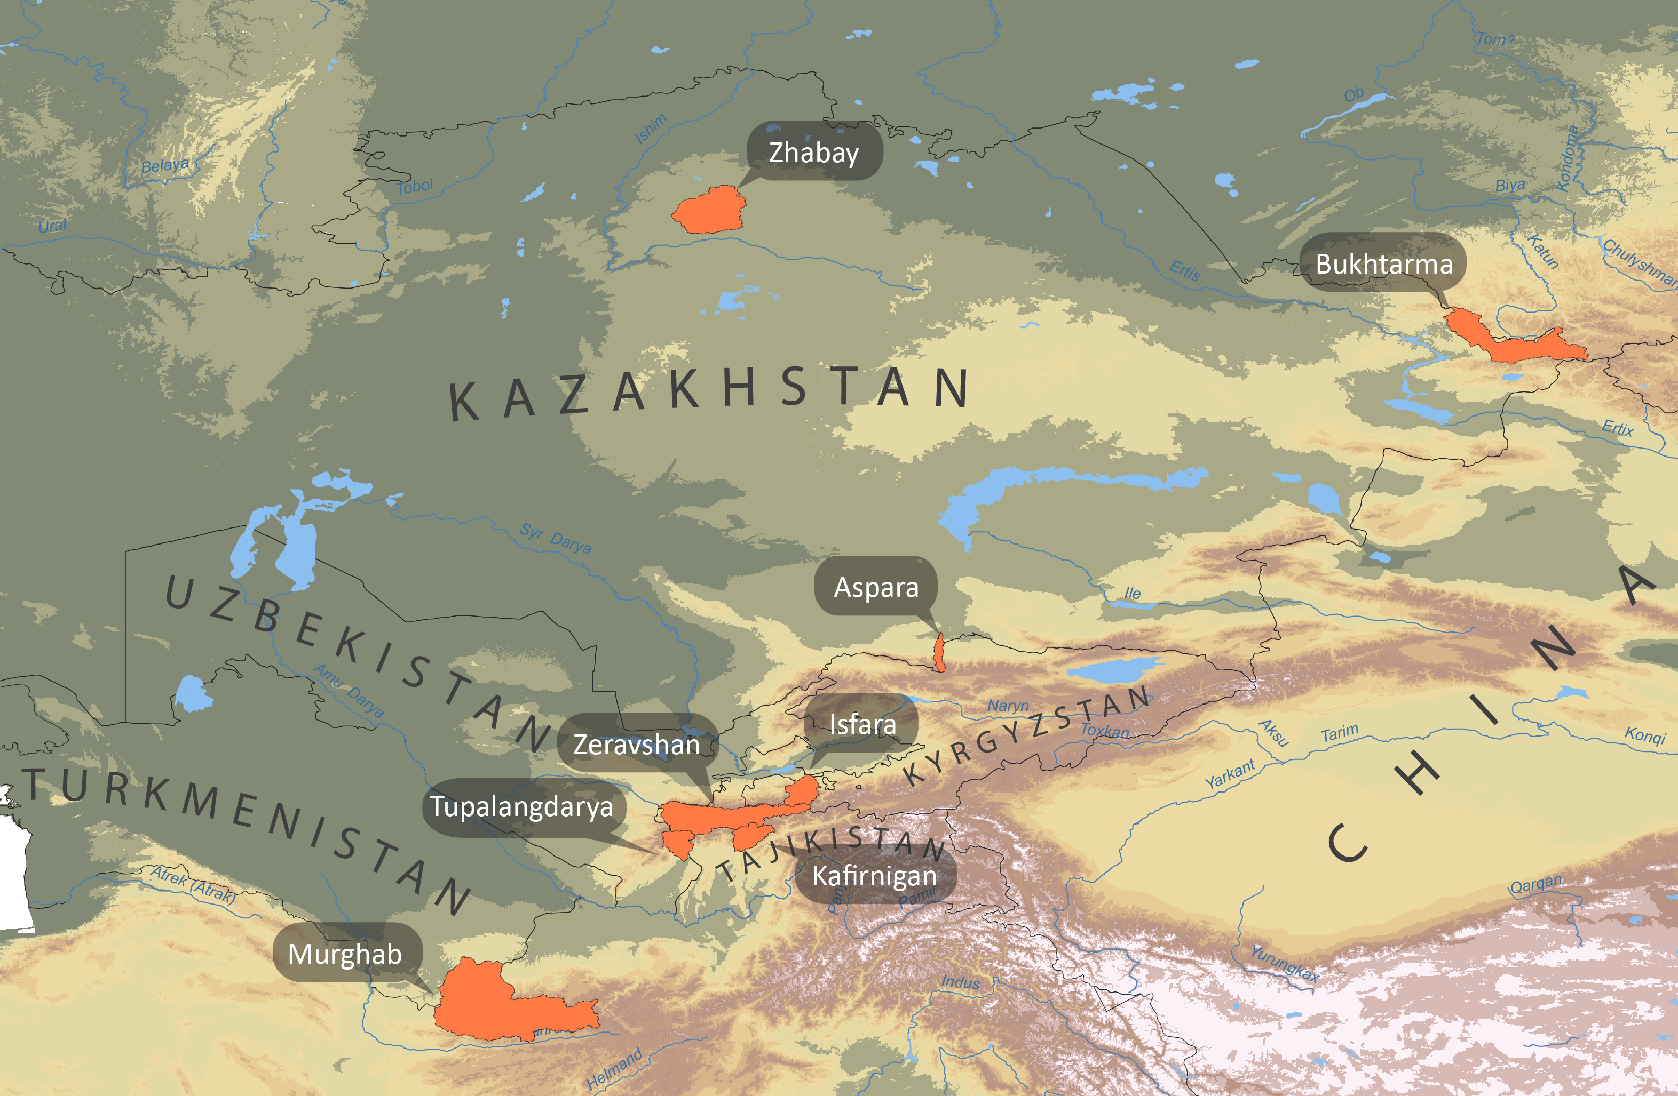
Hydrological Impacts
Source: Didovets et al. 2021

Slide 27
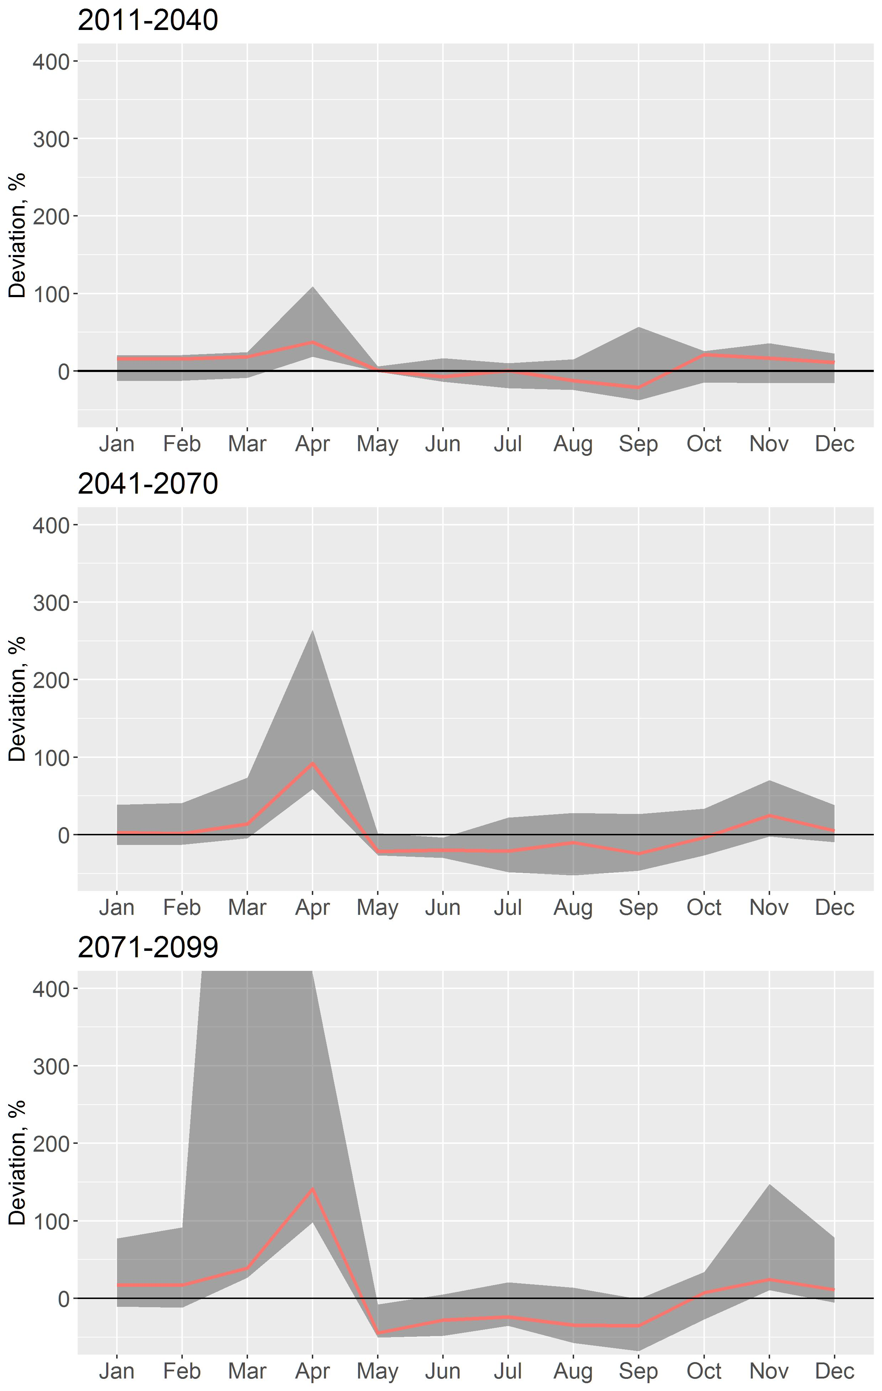
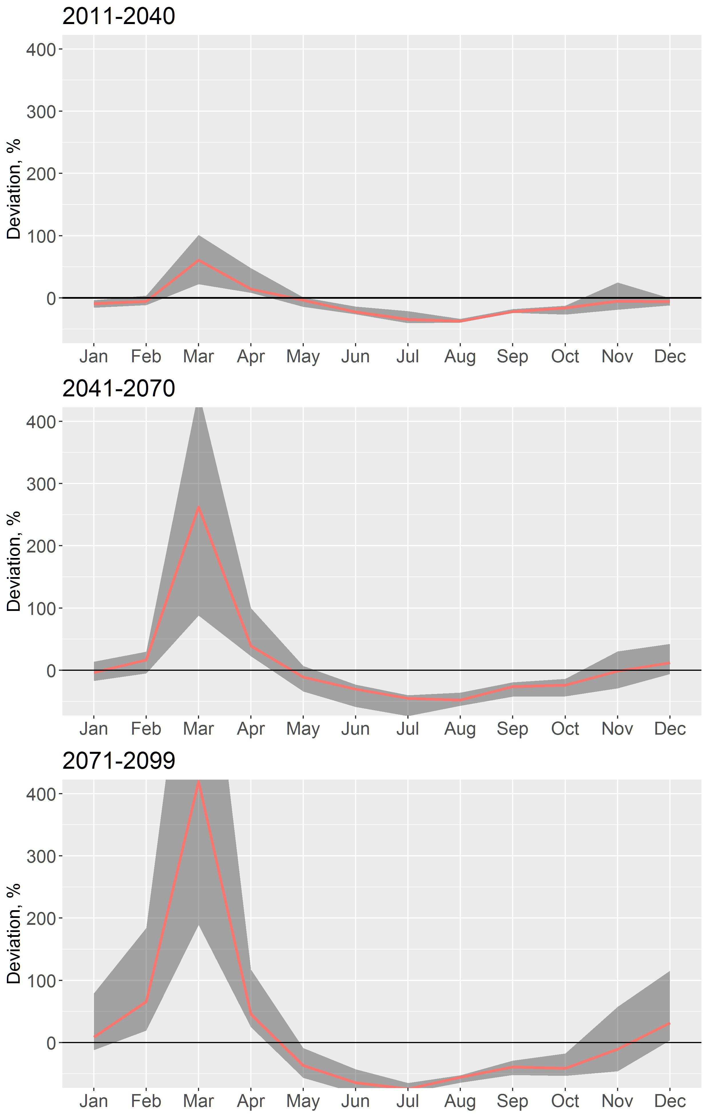
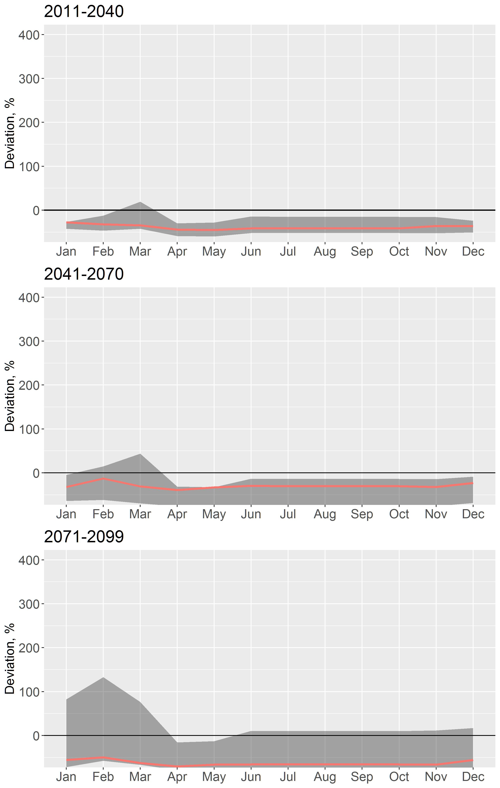
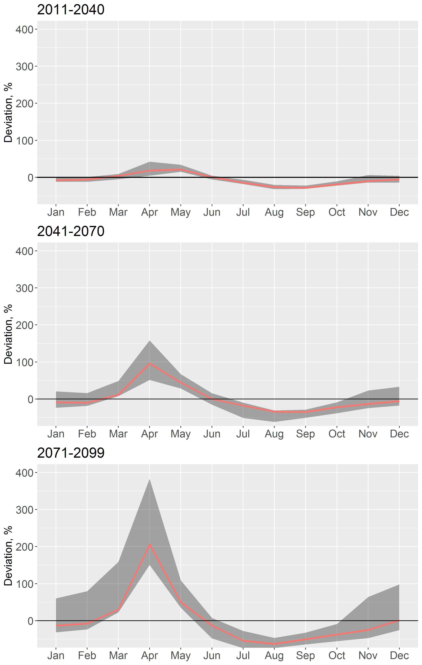
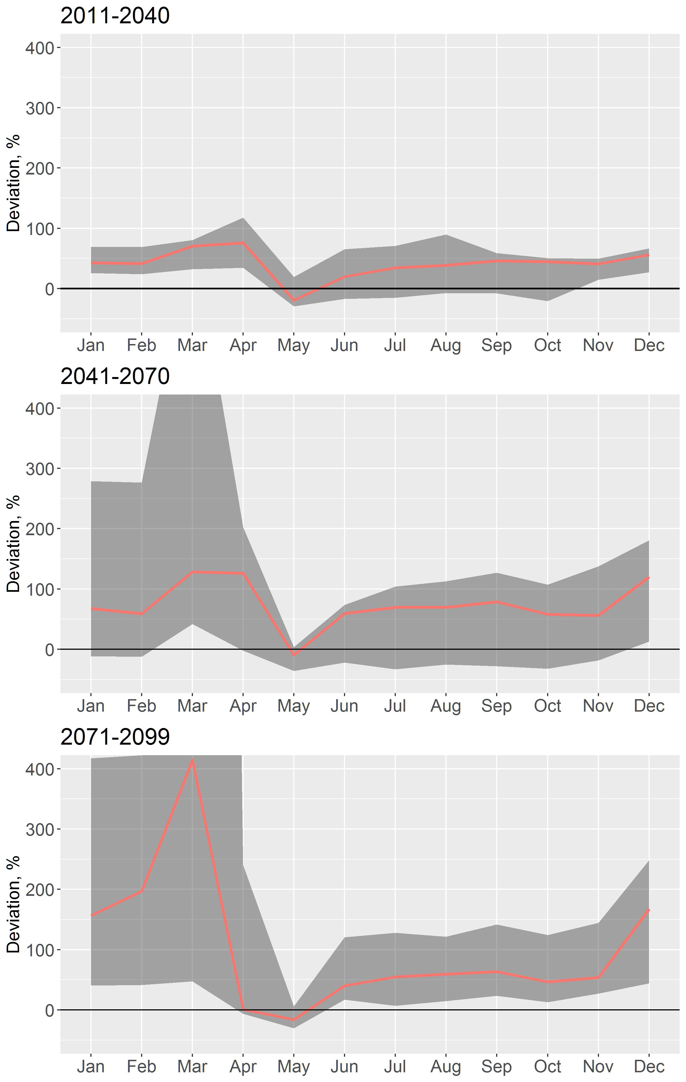
Hydrological Impacts:
Shifts in seasonality, decrease of discharge during summer months, increase in N.Kazakhstan, decrease in Southern part of the region
Bukhturma
Kafirnigan
Murghab
Zeravshan
Zhabay
RCP8.5, ISI-MIP Scenarios
Source: Didovets et al. 2021
Notes:
River discharge will increase in the north and reduce in the south of the study area.
The mean monthly river discharge is projected to decrease mainly in summer months.
It is expected to have a shift in the peak of river discharge up to one month.
Zhabay – north of Kazakhstan
Buhturma –north-east of Kazakhstan
Murghab – south
Kafirnigan and Zeravshan – center of the domain (high mountains)

Slide 28
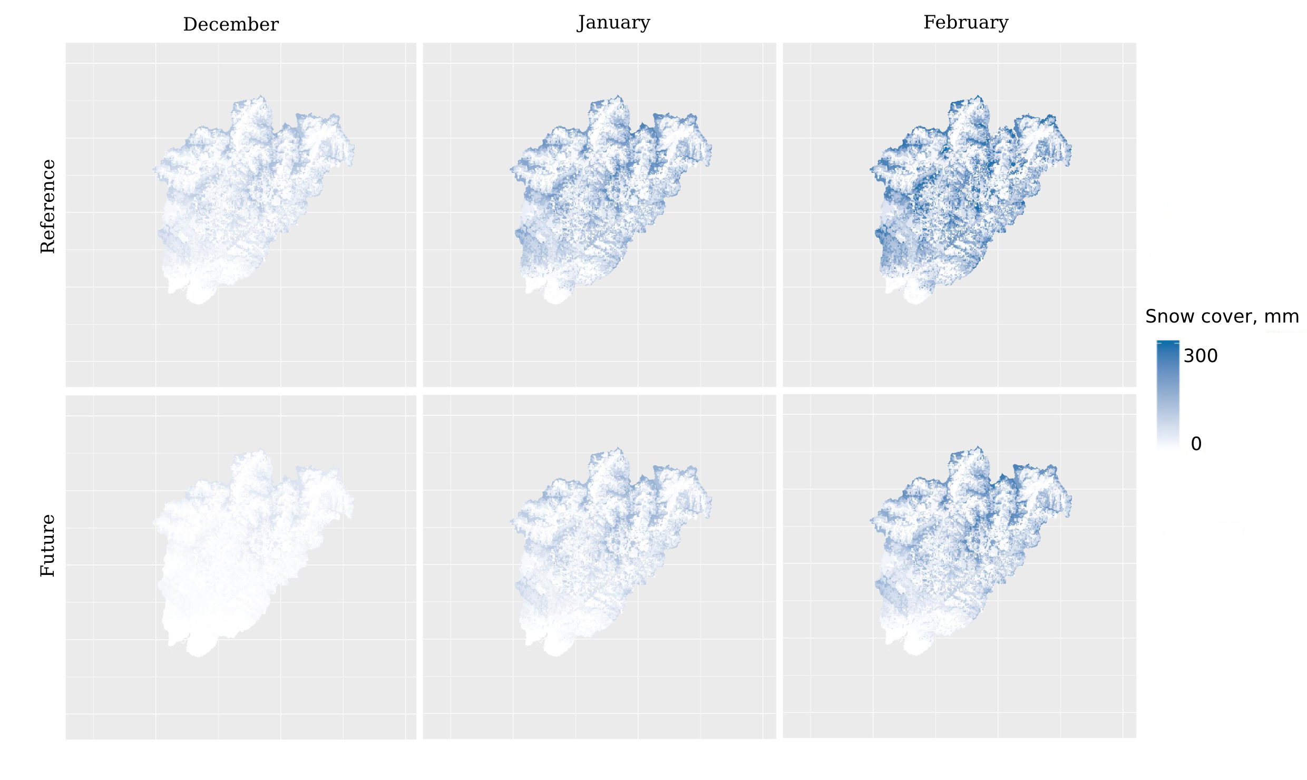
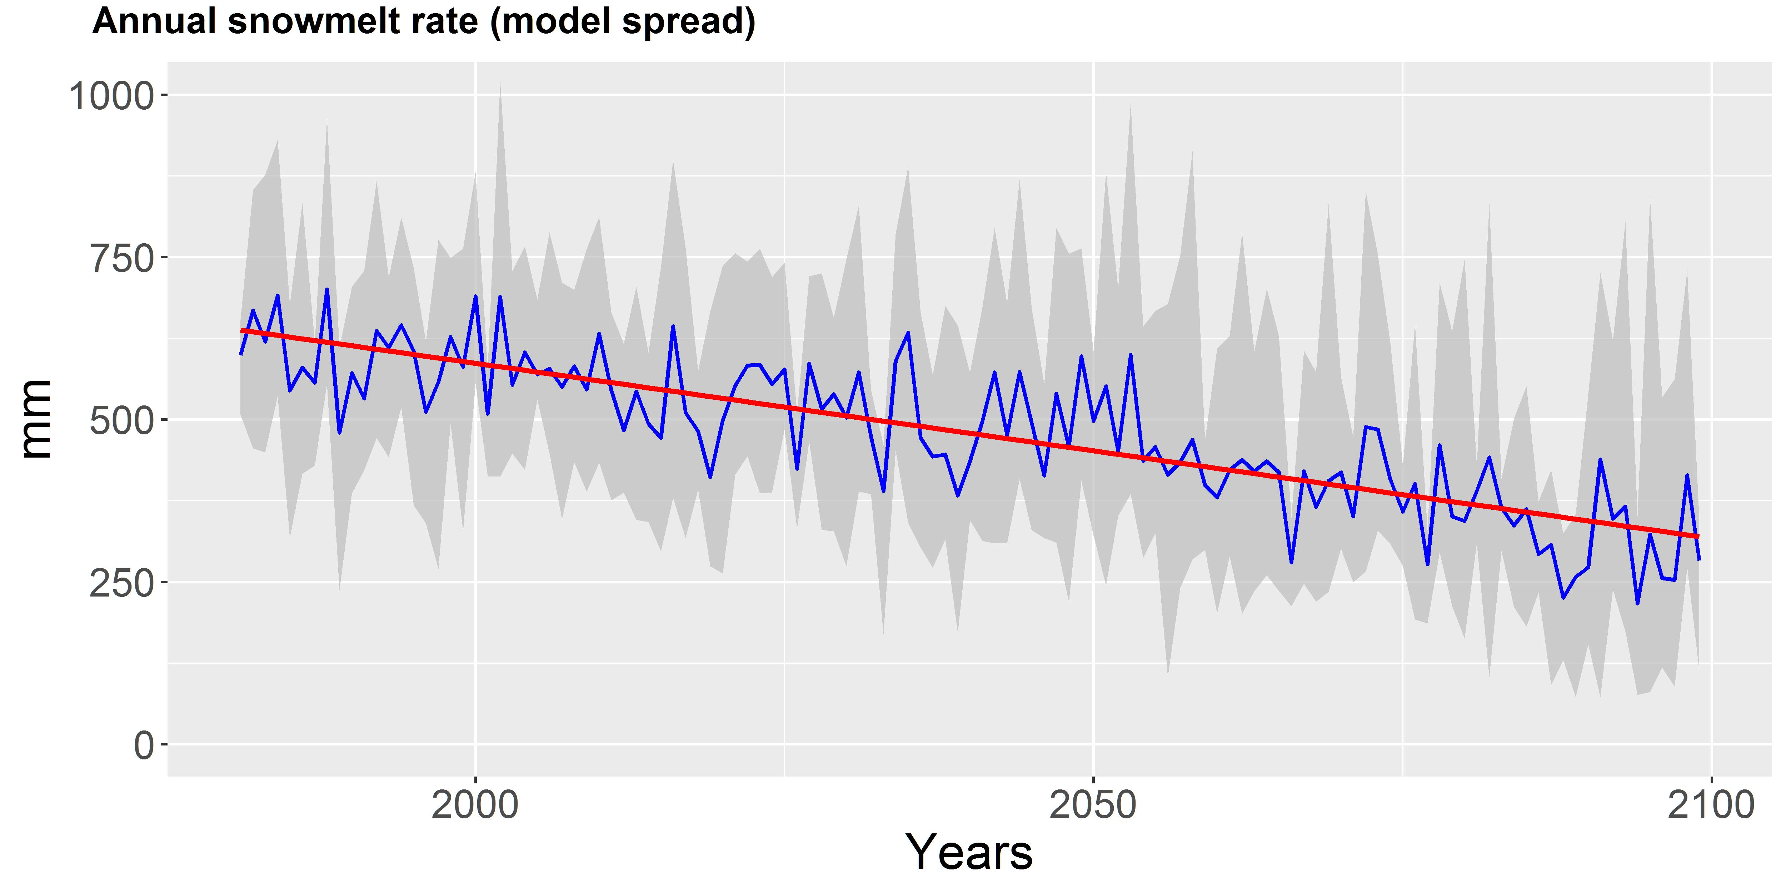
Snow availability (Kafirnigan River)
Notes:
RCP 8.5 (end of end of the century)
Snow accumulation period will decrease to the end of the century.

Slide 29

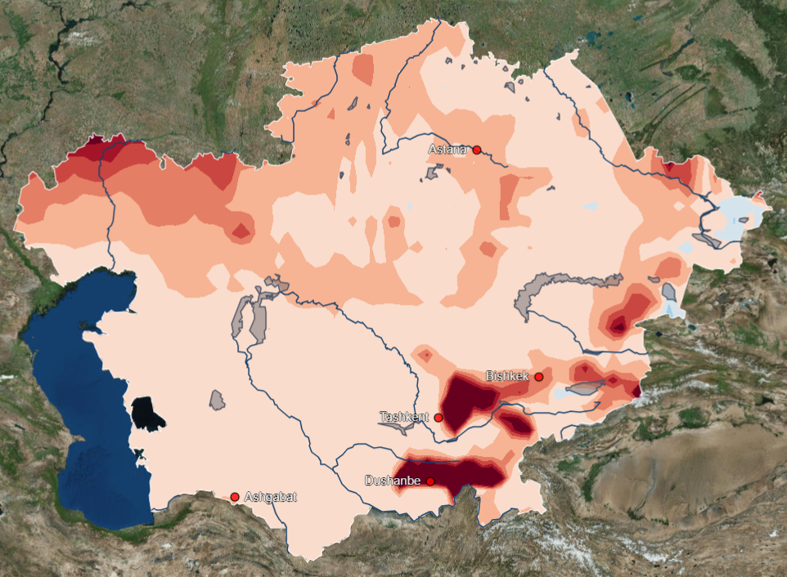
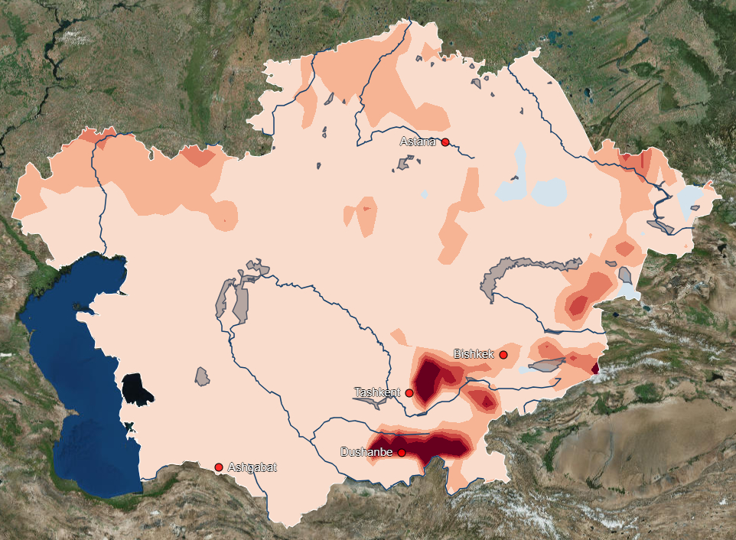
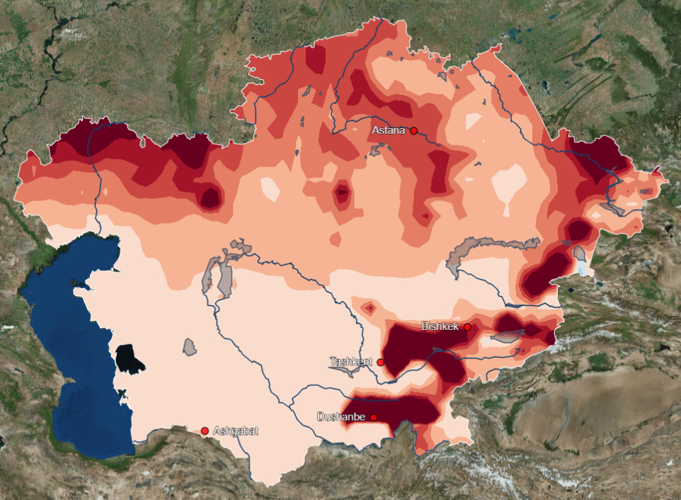
Snow water Equivalent (SSP5-RCP8.5)
2010-2040
2040-2070
2070-2100

Slide 30
Thank you

Slide 31
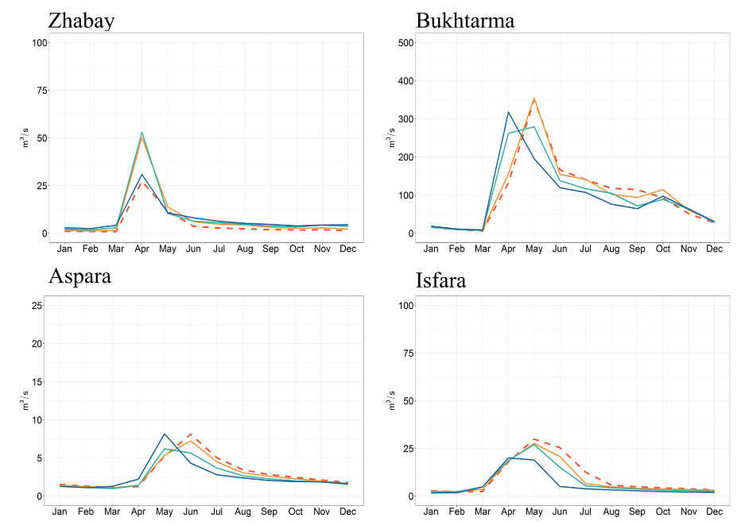
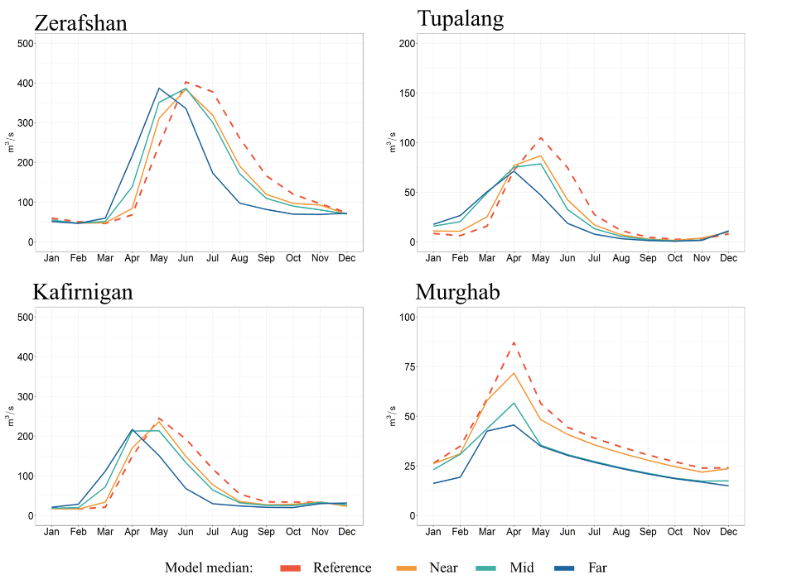
Hydrological Impacts:
Shifts in seasonality, decrease of discharge during summer months, increase in N.Kazakhstan, decrease in Southern part of the region
RCP8.5, ISI-MIP Scenarios
Source: Didovets et al. 2021

