Slide 1
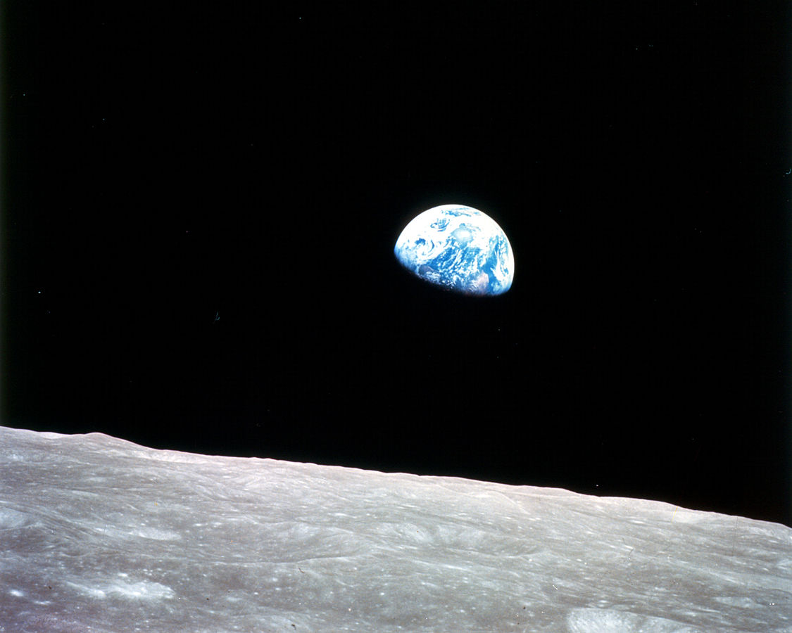
A Planetary Health
perspective
on the climate crisis
Prof. Dr. Dr. med. Sabine Gabrysch
Potsdam Institute for Climate Impact Research
Charité – Universitätsmedizin Berlin
Heidelberg Institute of Global Health
Source: Pixabay

Slide 2
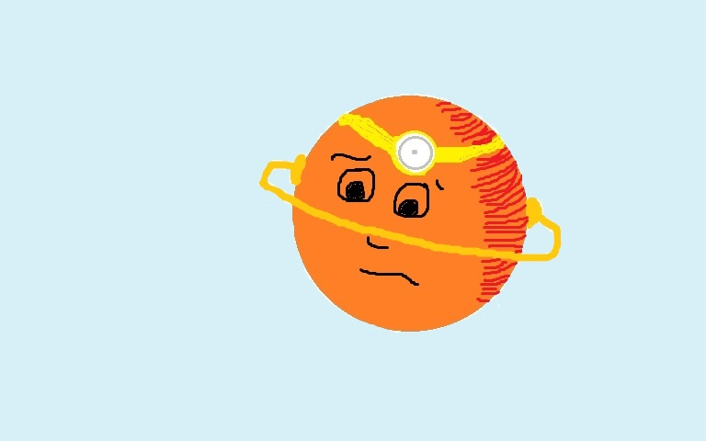
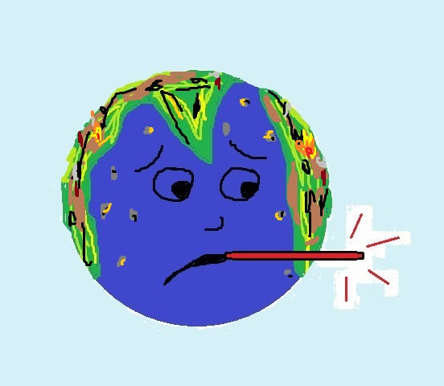
Oh dear, this does not look good…
This seems a case of advanced-stage
Homo sapiens infestation!
You have sustained severe forest burns and are running a fever from an excess of greenhouse gases…
Notes:
This is planet earth seeing the doctor. >>>
The joke continues: “But don’t worry, that will pass…”

Slide 3
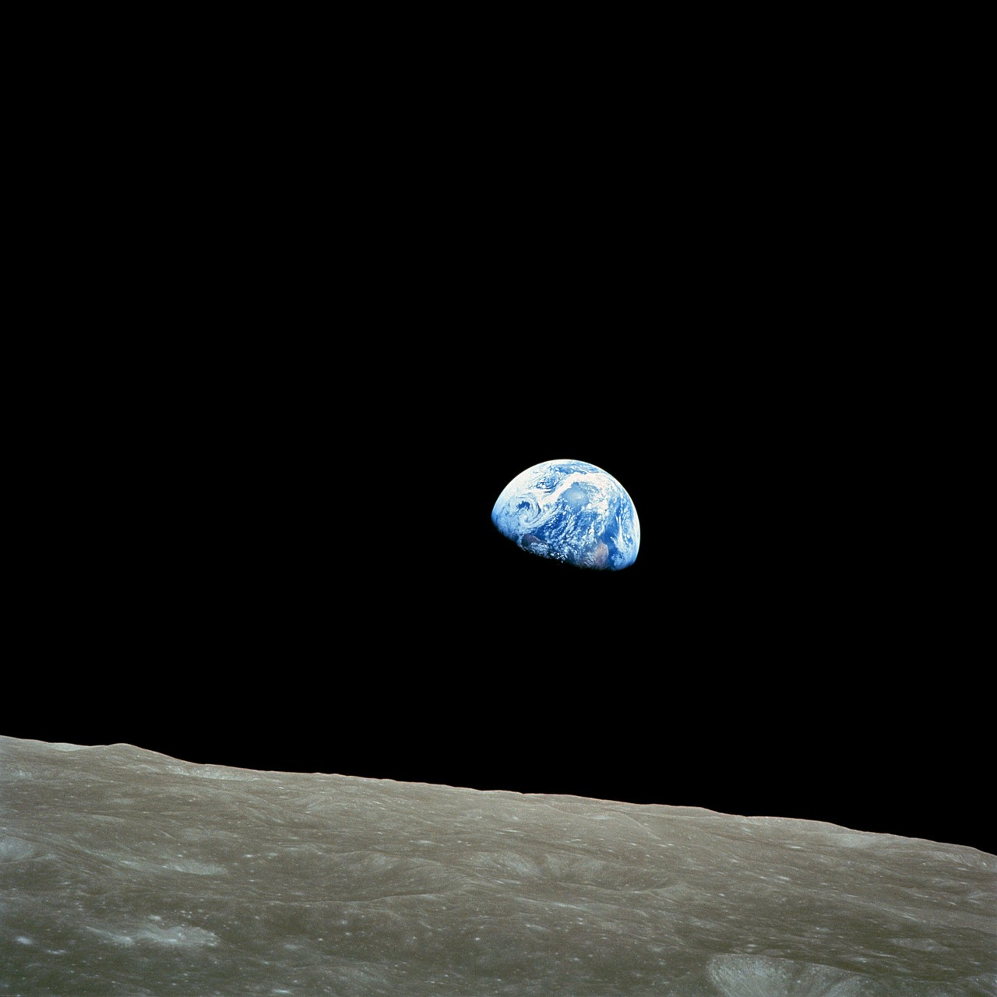

Structure
What is Planetary Health?
Medical history and exam
Diagnosis and prognosis
Therapy options
Source: Pixabay
Notes:
The talk has 4 parts. First I will say some words about planetary health.
Then we will take the perspective of a planetary physician to look at the state of planet earth and its human population.
We take a medical history and examine the patient.
We make a diagnosis and discuss the prognosis.
And we talk about therapy options.

Slide 4
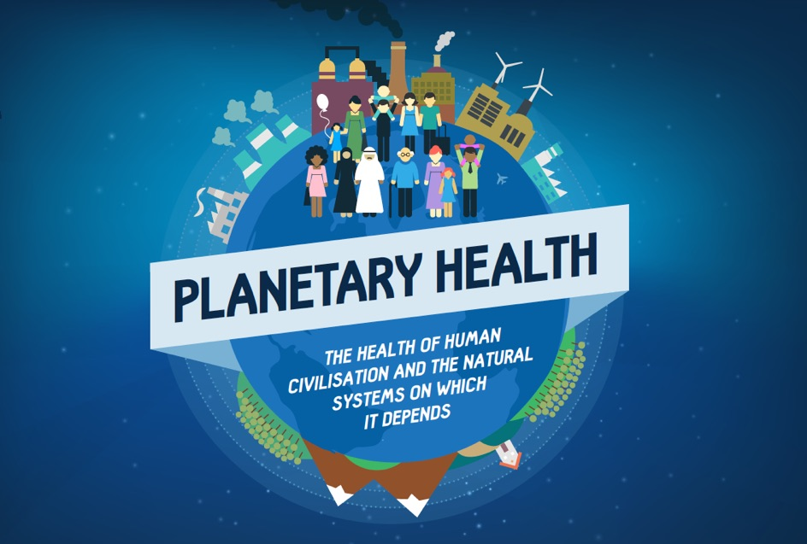






Source: The Lancet
= Health of humans
and of planet Earth
Notes:
Broadly speaking, Planetary Health is about the health of humans and the natural systems of our planet.
More precisely, it comprises the health of humans and other living beings, of populations and ecosystems, and of the whole living planet Earth, appreciating the deep connectedness of all beings.
PH builds on similar comprehensive concepts like EcoHealth and OneHealth. The various concepts developed in different disciplinary traditions and were shaped differently over time.
One Health originates from veterinary medicine and has a focus on human-animal interactions and infectious diseases, mainly zoonoses and antibiotic resistance.
EcoHealth has strong roots in ecology and looks at socio-ecological systems.
PH is the newest and still developing very dynamically. It considers the planetary scale most explicitly.

Slide 5
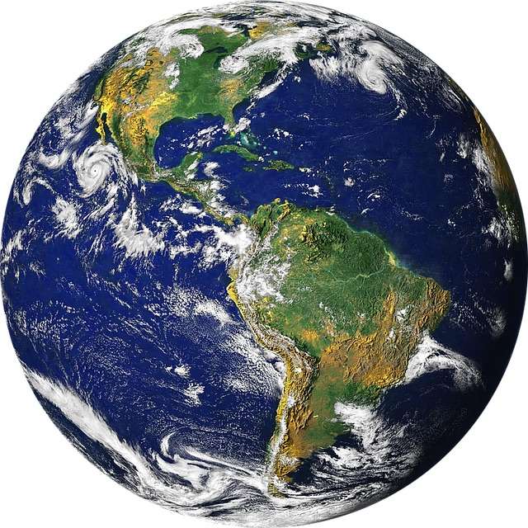
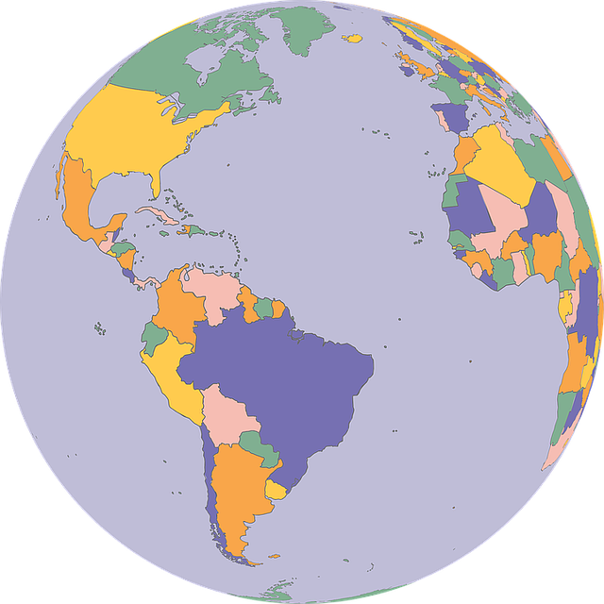
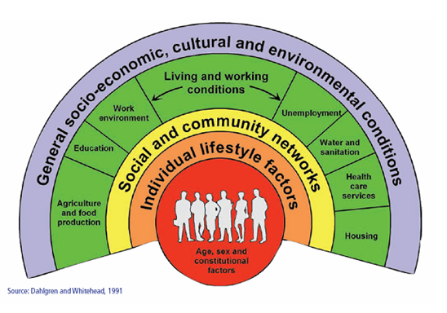
Public → Global → Planetary Health
Social, economic, political
determinants
Human-made and natural systems of the planet
Global health issues
Global determinants
Specific populations
Sources: Dahlgren&Whitehead, Pixabay
Notes:
PH also builds on
Public Health, where we look at the health of populations and the social, economic and political factors shaping it, and on
Global Health which considers global and transnational health issues as well as cross-border determinants of health needing global cooperation,
PH goes beyond these by not only considering the human, but explicitly also the natural systems of the planet.

Slide 6



Matryoshka principle
Planetary
Health
Global
Health
Public
Health
Source: Pngimg.com
Notes:
The preceding concepts are of course still valid and important, and are so-to-say contained in the new concept.
Similar to these Russian nesting dolls (animation).
In the end, action is usually local and national, even when the thinking and planning was done on a global and planetary scale.

Slide 7
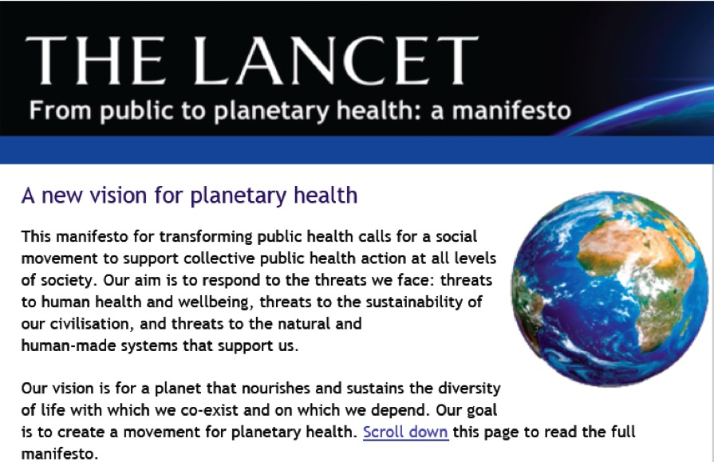
2014
“The harms we continue to inflict on our planetary systems are a threat to our very existence as a species.“
http://www.thelancet.com/journals/lancet/article/PIIS0140-6736%2814%2960409-8/fulltext
Notes:
In 2014 a very clear and visionary manifesto was published in the medical journal The Lancet, titled „From public to planetary health“.
Well worth reading, just one page. It is a call to action, for a new social movement.

Slide 8


2014
Our patterns of overconsumption are unsustainable and will ultimately cause the collapse of our civilisation.
The gains made in health and wellbeing over recent centuries, including through public health actions, are not irreversible; they can easily be lost.
We have created an unjust global economic system that favours a small, wealthy elite over the many who have so little.
The idea of unconstrained progress is a dangerous human illusion.
http://www.thelancet.com/journals/lancet/article/PIIS0140-6736%2814%2960409-8/fulltext
Notes:
Here a few more quotes > > >

Slide 9
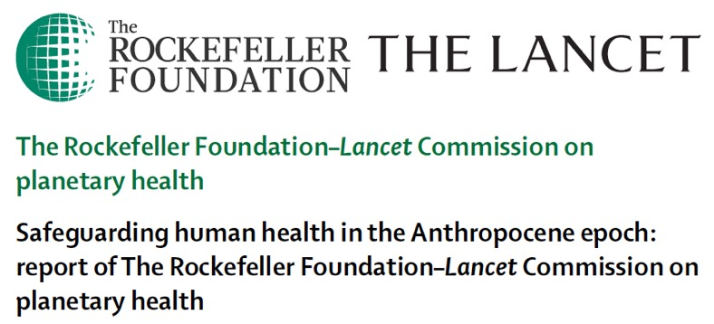
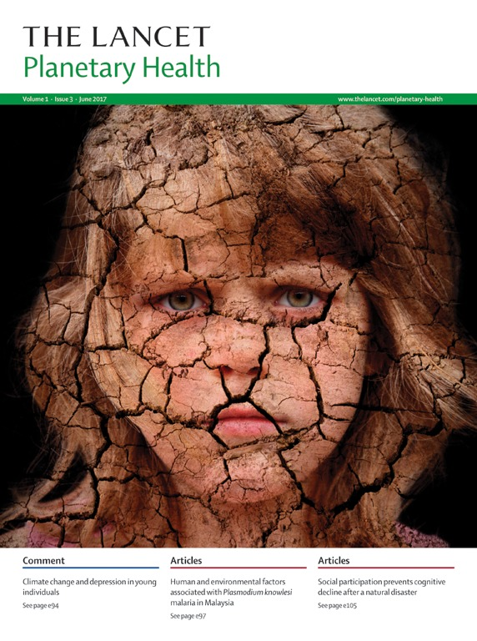

Whitmee et al. 2015
www.planetaryhealthalliance.org
since 2015
since 2017
Notes:
One year later, a comprehensive scientific report on planetary health was published by a joint comission of the Rockefeller Foundation and The Lancet.
The „Planetary Health Alliance“ was founded, based at Harvard, and the scientific journal The Lancet Planetary Health was launched.

Slide 10
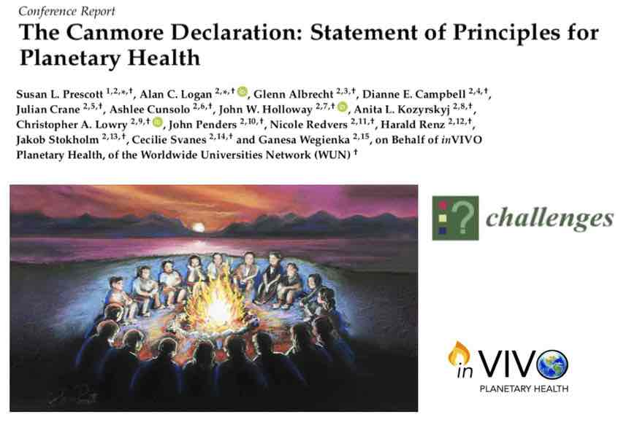
„We are a progressive scientific movement providing evidence, advocacy and inspiration
to align the interests of vitality
​of people, place and planet.“
2018
www.invivoplanet.com/about-us.html
Notes:
In 2018 the inVIVO Planetary Health netwerk published the Canmore Declaration, a consensus statement on principles for PH.

Slide 11
Planetary Health
Human
health
Political, economic, social systems
Natural systems of the planet
Relationships
Transdisciplinary
Notes:
Put simple, Planetary Health deals with the foundations of human health and with the relationships between these.
This includes political, economic and social factors that influence health, but also the natural systems of our planet on which the existence of human civiliation depends.
The methodological approach is transdisciplinary.

Slide 12
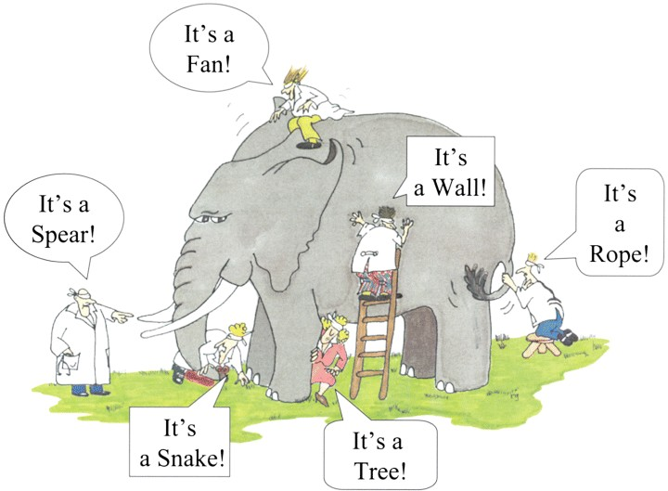
Transdisciplinarity
Graphic: G.R. Guzlas, Copyright: J.G. Saxe, available at www.nature.com
Notes:
What does that mean? Different disciplines, including health sciences, social sciences, natural sciences, but also humanities as well as local communities join their perspectives. Only then can we understand the elephant, the big picture.

Slide 13
Planetary Health: Key challenges
based on Lancet Commission 2015
(1) Imagination challenge: Rethink the relationship between humans and the planet
(2) Knowledge challenge: Quantify health impacts of global environmental change
(3) Implementation challenge: Develop and evaluate solution strategies for a sustainable lifestyle
3
Humans
1
Planet
2
https://www.thelancet.com/commissions/planetary-health
Notes:
The Lancet commission identified three key challenges of planetary health:
Imagination challenge: Rethinking the relationship between humans and nature or planet. What is progress, and questions like that.
Knowledge challenge: including the health consequences of global environmental changes. How do these backfire?
Implementation challenge: Developing, implementing and evaluating solution strategies for a more sustainable way of living. How do we get from knowledge to action?

Slide 14
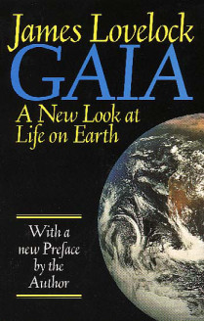
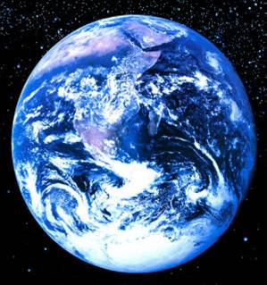
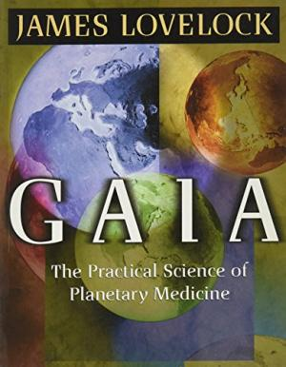
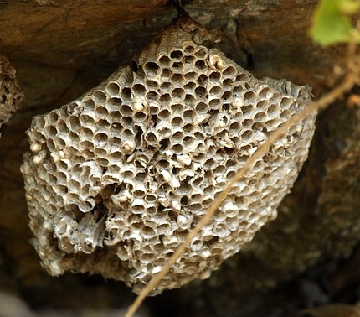
- THEORY
Superorganism
Self-regulation
Emerging properties
Homeostasis
Source: Pixabay
Notes:
In fact, the Gaia theory from the 70s is also very related to Planetary Health.
It says that the Earth as a whole is like a living organism, a superorganism with self-regulatory features and so-called emerging properties.
Similar to a bee hive which can keep temperature constant within a certain range, although the individual bees as insects cannot regulate their body temperature.
This means we humans are one part of a bigger entity, our living planet Earth.

Slide 15
Structure
What is Planetary Health?
Medical history and exam
Diagnosis and prognosis
Therapy options
Source: Pixabay
Notes:
Now on to the medical history.

Slide 16
Medical history: key symptoms
Climate change
    Higher temperatures and more extreme weather events
    Melting of polar ice, glaciers and permafrost
Pollution
    Air pollution with aerosols from combustion processes
    Release of chemicals and plastics into water and soils
    Overfertilization of water bodies with nitrogen and phosphate
Biodiversity loss
    Loss of natural ecosystems, incl. tropical forests, swamps, reefs
    Massive decrease of populations of wild mammals, birds, reptiles, amphibians, fish, insects, etc.
    Extinction of species
Notes:
What symptoms does the patient have?
One is climate change. The earth has a fever, it is getting warmer and the weather is more variable and less predicable with more extreme events, e.g. more heat and drought, leading to fires, but also more heavy rains and floods. And with rising temperatures, polar ice, glaciers and permafrost are melting.

Slide 17
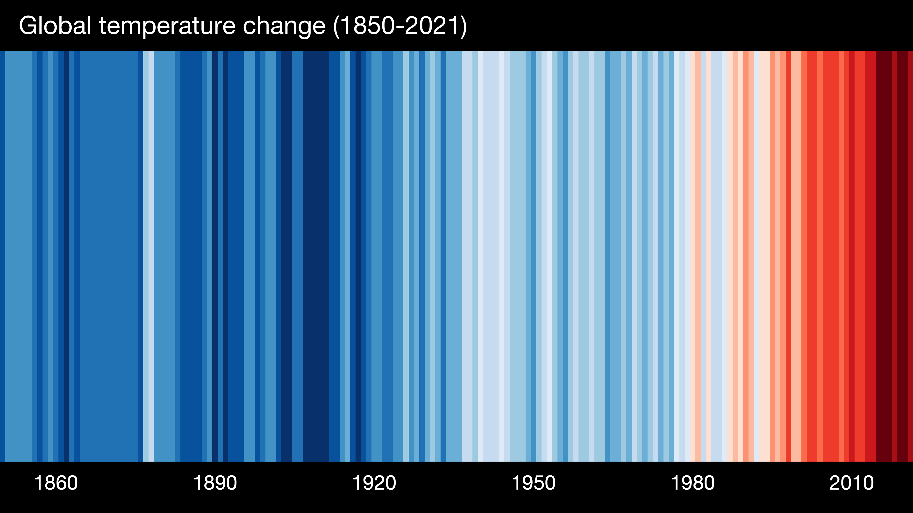
Global mean temperature
Source: Prof. Ed Hawkins, https://showyourstripes.info
Notes:
Here the fever curve with coloured stripes, blue is colder, red is warmer than average since 1850.
No statistical knowledge is needed to see the clear increase in temperature. So far by about 1.1 or 1.2°C.

Slide 18

CO₂ concentration over last 300 years
Source: Scripps Institution of Oceanography; https://keelingcurve.ucsd.edu/
Notes:
This graph shows the most important greenhouse gas, carbon dioxide over the last 300 years: before industrialisation the CO2 concentration was 280 ppm and now it is above 420 ppm.

Slide 19
CO₂ concentration over 10.000 years
Holocene:
Development of agriculture
and human civilizations
Source: Scripps Institution of Oceanography; https://keelingcurve.ucsd.edu/
Notes:
This is over the last 10,000 years, the holocene, a very stable period (animation) with CO2 ranging between 260 and 280. Note the spike on the left.

Slide 20
CO₂ concentration over 800.000 years
→ Homo sapiens
Source: Scripps Institution of Oceanography; https://keelingcurve.ucsd.edu/
Notes:
And this is the last 800,000 years, over ice ages, with lower CO2, and interglacials. Here the current spike.
This increase is higher and way faster than from the last glacial maximum – with around 180 ppm (point) – to before industrialisation with around 280 ppm.
The last time CO2 was this how was millions of years ago. Homo sapiens exists maybe since about 300.000 years (animation).

Slide 21
Medical history: key symptoms
Climate change
    Higher temperatures and more extreme weather events
    Melting of polar ice, glaciers and permafrost
Pollution
    Air pollution with aerosols from combustion processes
    Release of chemicals and plastics into water and soils
    Overfertilization of water bodies with nitrogen and phosphate
Biodiversity loss
    Loss of natural ecosystems, incl. tropical forests, swamps, reefs
    Massive decrease of populations of wild mammals, birds, reptiles, amphibians, fish, insects, etc.
    Extinction of species
Notes:
2nd symptom: pollution of air, water and soil with waste products and toxic chemicals. The air is polluted from burning fossil fuels and forest fires. A huge number of new chemicals have been released into ecosystems, including pesticides and fertilizer from agriculture and ever more plastic waste.

Slide 22
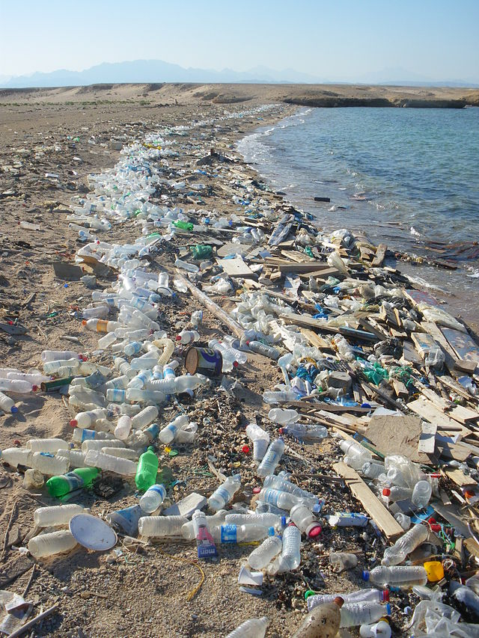
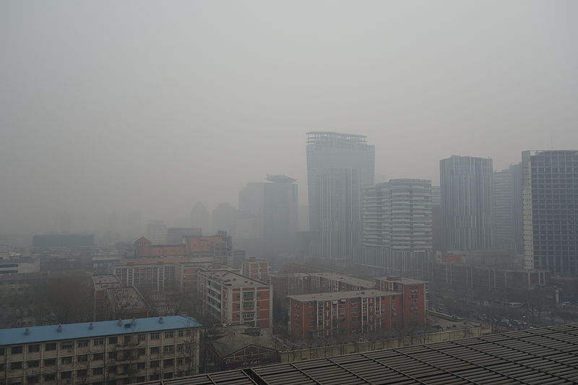
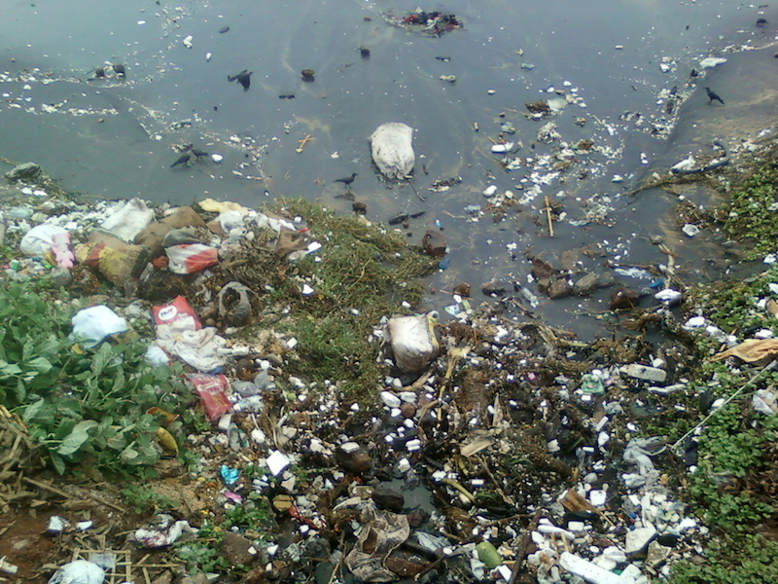
Quelle: Wikimedia, Kentaro Iemoto
Source: Wikimedia
Source: Wikimedia, Adityamadhav83
Notes:
Here some impressions.

Slide 23
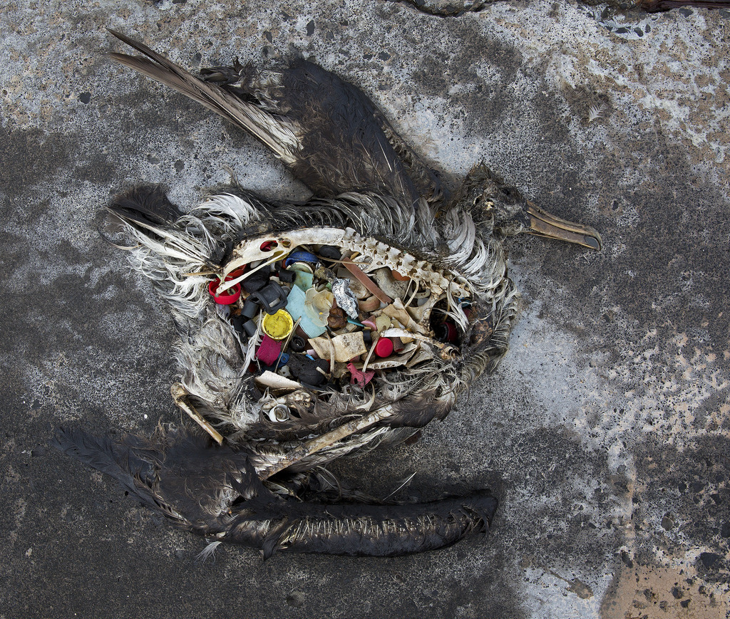
Trailer: https://www.youtube.com/watch?v=iJnrABfEF1o
Albatros chick
with plastics,
Midway island
Source: Flickr, by Dan Clark/USFWS
Notes:
A photo from the film “Midway”. Even on this remote pacific island, the Albatros chicks die because their stomachs are full of plastic.

Slide 24
Medical history: key symptoms
Climate change
    Higher temperatures and more extreme weather events
    Melting of polar ice, glaciers and permafrost
Pollution
    Air pollution with aerosols from combustion processes
    Release of chemicals and plastics into water and soils
    Overfertilization of water bodies with nitrogen and phosphate
Biodiversity loss
    Loss of natural ecosystems, incl. tropical forests, swamps, reefs
    Massive decrease of populations of wild mammals, birds, reptiles, amphibians, fish, insects, etc.
    Extinction of species
Notes:
3rd symptom is a massive loss of biodiversity. Natural ecosystems are degraded and lost. Populations of wild animals are shrinking and species go extinct at an alarming rate. We are entering a new mass extinction.

Slide 25
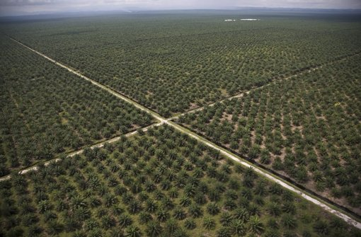
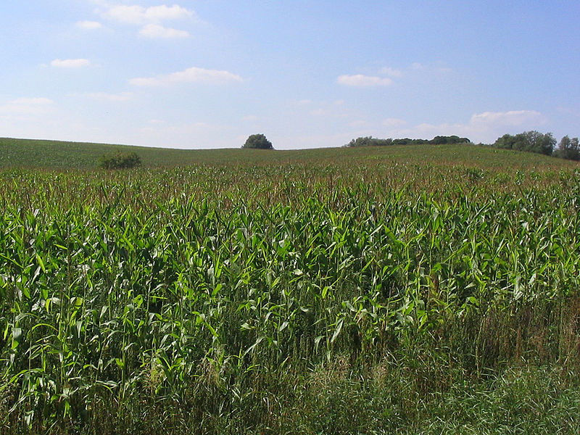
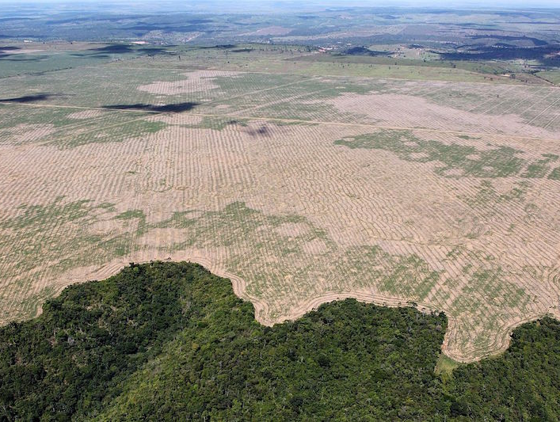
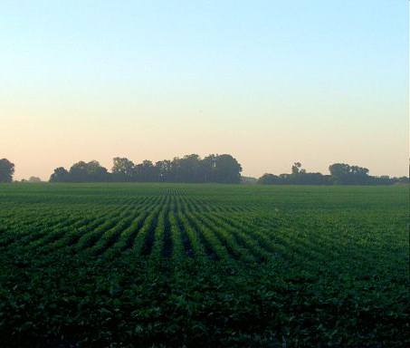
Palm oil in Indonesia
Maize in Germany
Source: Greenpeace
Source: Wikimedia, Darkone
Soy in Argentina
Deforestation in Brazil
Source: Wikimedia, Felipe Werneck - Ascom/Ibama
Source: Wikimedia, Alfonso
Notes:
Here some pictures from the earth surface.

Slide 26
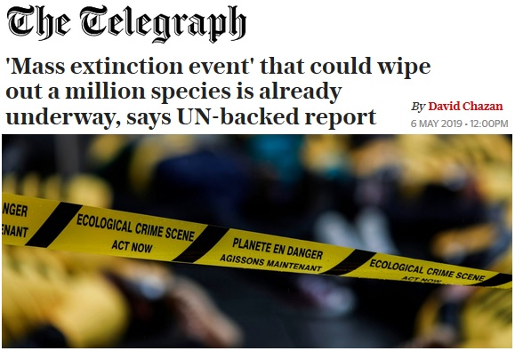
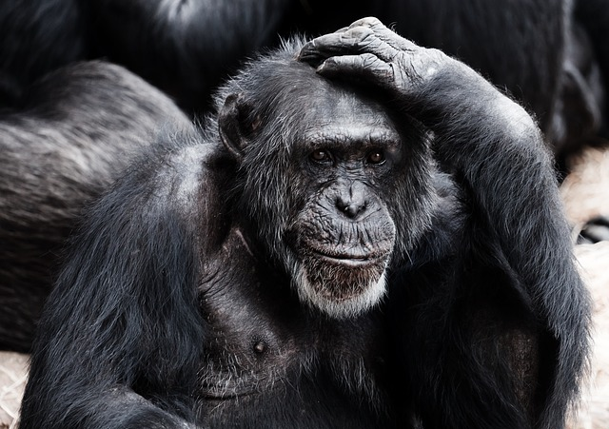
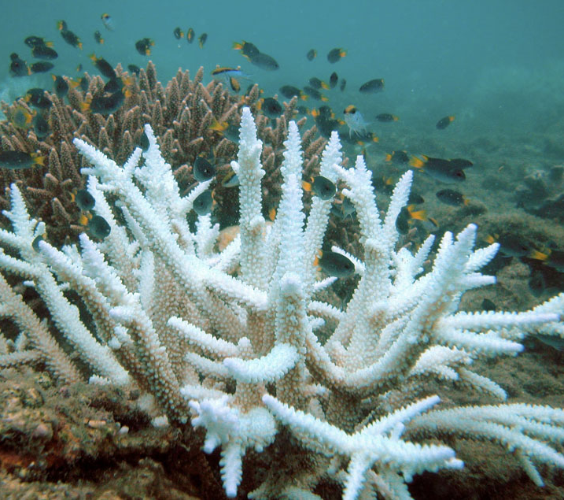
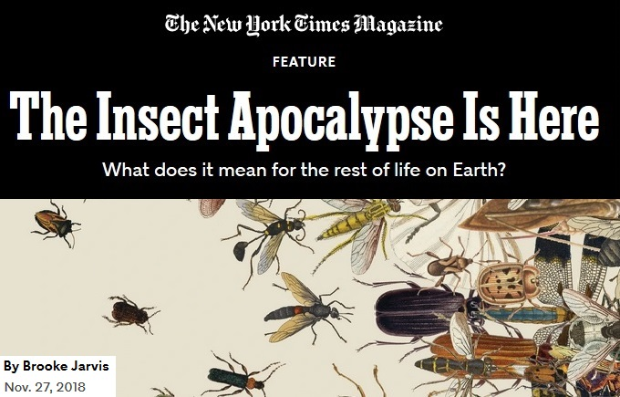
Source: Pixabay
Source: https://www.telegraph.co.uk/news/2019/05/06/mass-extinction-event-could-wipe-million-species-already-underway/
Based on: https://ipbes.net/global-assessment
Source: https://www.nytimes.com/2018/11/27/magazine/insect-apocalypse.html
Coral bleaching
Source: Wikipedia
Notes:
Species extinction affects big mammals such as rhinos and apes, but also amphibians and insects as well as plants.
Biodiversity is also lost under water. The warming leads to bleaching and dying of corals, and the species-rich coral reefs disappear.

Slide 27
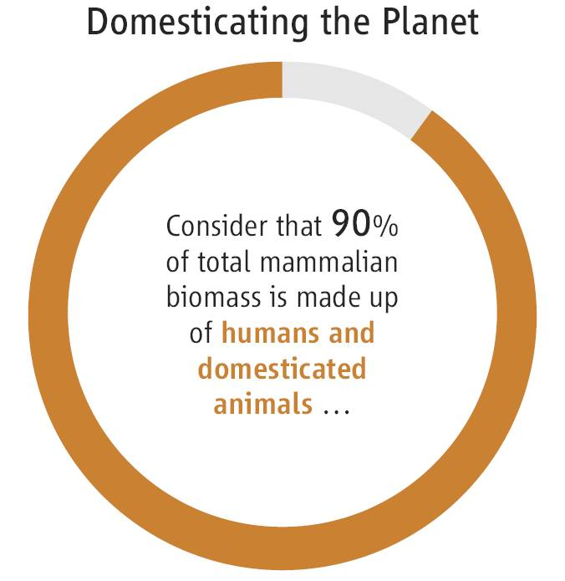
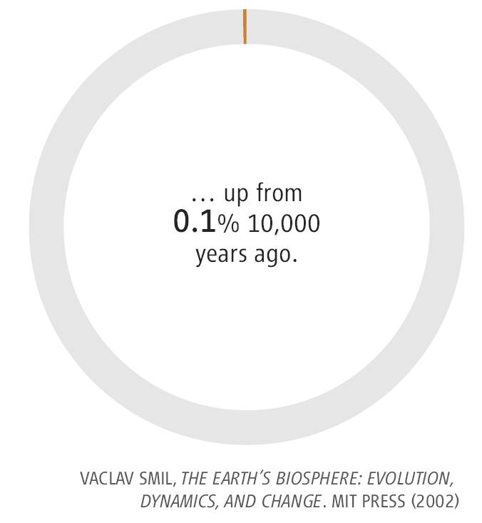
Planet of humans
Notes:
By now, 90% of the biomass of mammals are humans and their domesticated animals.

Slide 28
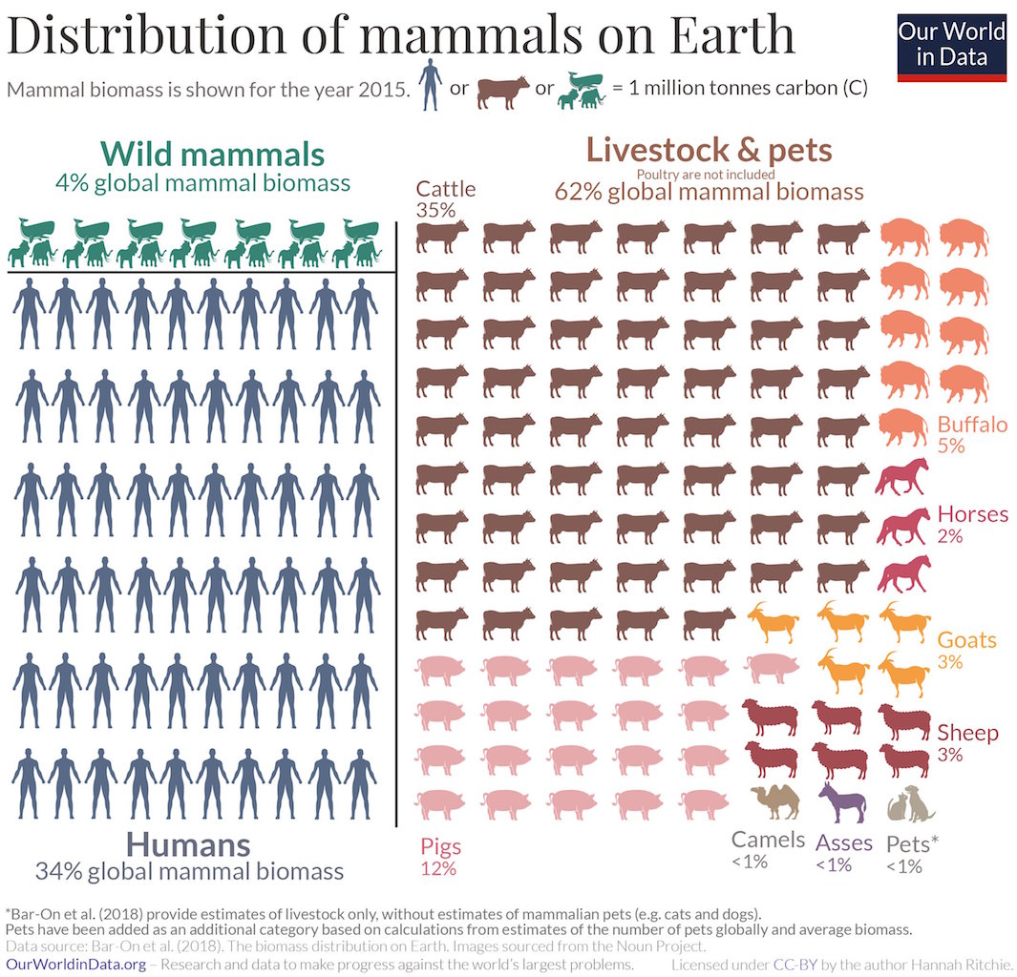
Notes:
That’s what this looks like: Humans (point), domestic animals, wild mammals.

Slide 29

Human footprint = Population x Consumption
Population (in billion)
7.0
2010
2.5
1950
1.8
1900
Consumption
(GDP per person in 1990 intl$)
1,100
2,100
adapted from National Geographic 2012
7,800
Notes:
The human ecological footprint increased because firstly, human population increased and, secondly, per-capita consumption increased and this multiplies.
Here shown as an area. From 1900 to 1950, and then a huge increase to 2010. This is called „The Great Acceleration“.

Slide 30

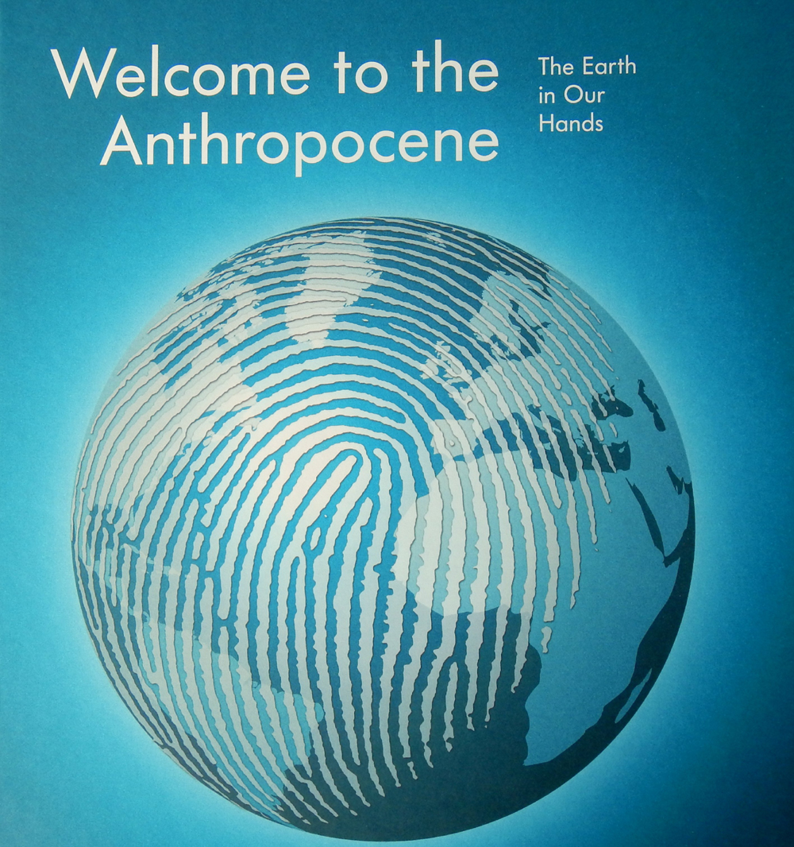
Anthropocene
= Age of humans
New geological era
Humans as the most influencial factor on planet Earth
Or rather “Capitalocene”?
Notes:
The human influence on the planet is now so large, so global, that geologists have suggested we are in a new geological era following the holocene: the anthropocene, the age of humans.
Some have suggested to rather call it capitalocene as it is not humans in itself, but our economic system.

Slide 31
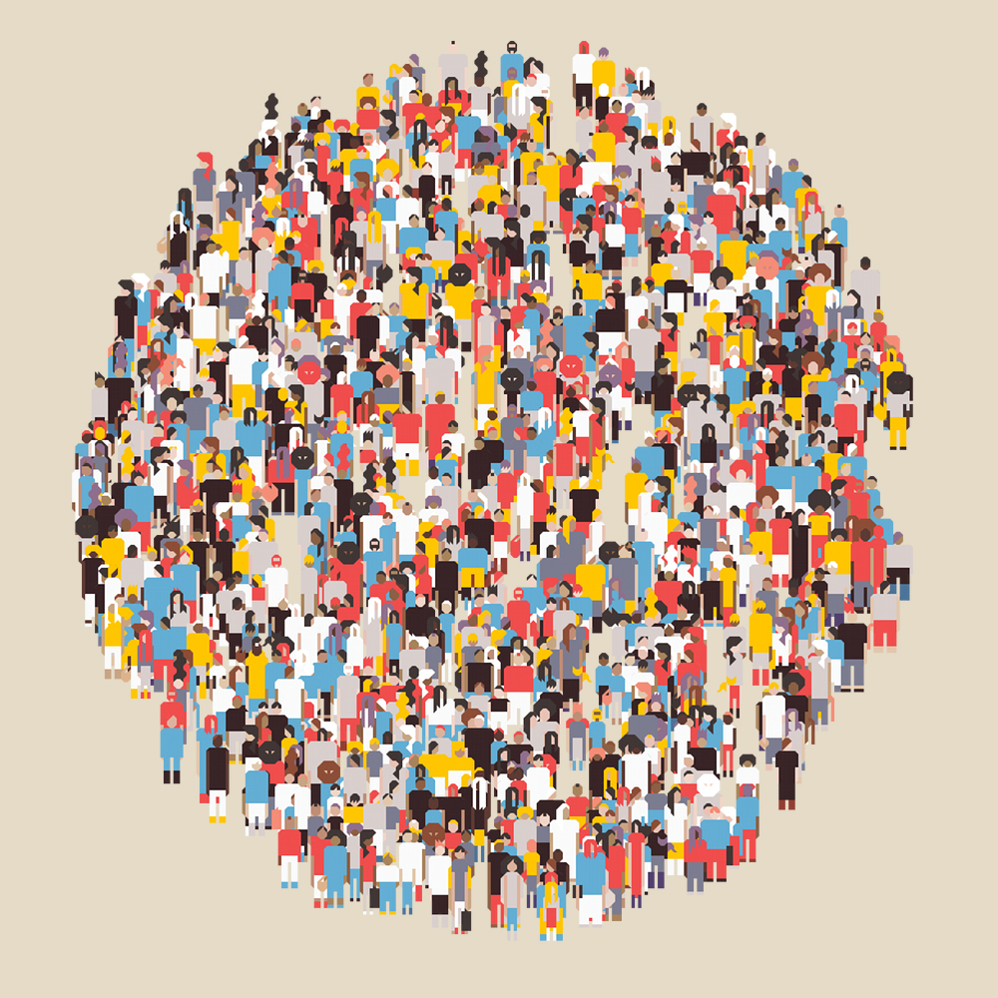
Human health
Suffering of the poorest
820 million people hungry
5 million child deaths per year
Better health and survival for most
Child mortality ↓ to 4%
Life expectancy ↑ to 72 years
Fertility ↓ to 2-3 babies per woman
Chronic diseases
Overweight ↑ to 2 billlion
Diabetes ↑ > 400 million
↑ Heart attacks, strokes
Pandemics
Influenza, HIV, COVID-19
Source: Eero Pitkanen
Sources: WHO, FAO
Notes:
So how are the humans themselves doing?
With rising prosperity, we saw huge health improvements for billions of people over the last decades: child mortality dropped dramatically and life expectancy increased. Fertility halved over the last 50 years to 2.5 children per woman globally which means population growth is slowing down.
However, one billion people still live in extreme poverty. Over 800 million people do not have enough food. Over 5 million children die every year from diseases that are preventable or curable such as birth complications, undernutrition and infections.
At the same time, obesity increased tremendously with now 2 billion people overweight or obese. And as a consequences chronic diseases like diabetes and cardiovascular diseases are on the rise worldwide.
In addition, pandemics are a major threat to human health, including influenza, HIV/AIDS and now COVID.

Slide 32
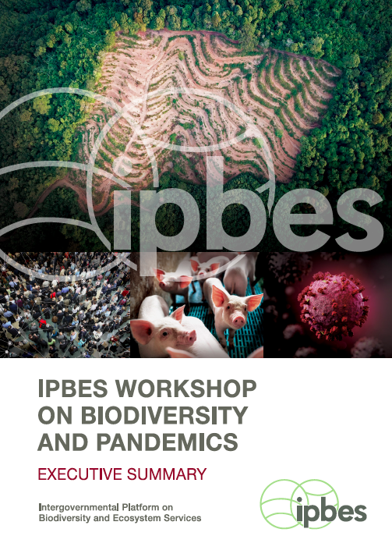
Pandemics
Rampant deforestation, uncontrolled expansion of agriculture, intensive farming, mining and infrastructure development, as well as the exploitation of wild species have created a ‘perfect storm’ for the spillover of diseases.
Dr. Peter Daszak
https://ipbes.net/pandemics
Notes:
In fact, COVID-19 is also a symptom of the planetary illness we are describing.
The same human activities that drive CC and biodiversity loss also drive pandemic risk.
Land use change for agriculture and livestock production, disrupting natural ecosystems, plus hunting and trading wild animals.
Which increases contact between wildlife, domestic animals and people and their microbes, and thus the risk of new diseases.
Besides preparing better, prevention of pandemics before they emerge should be a priority.

Slide 33
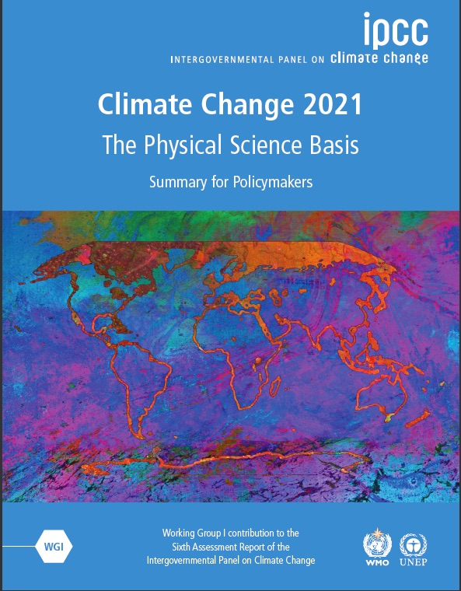
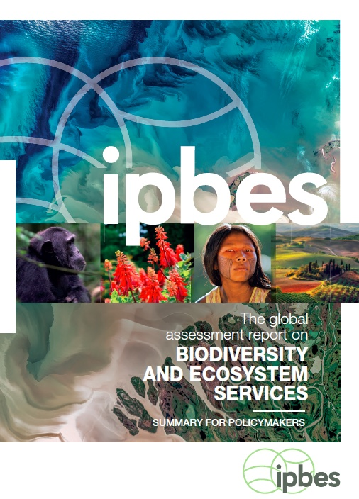
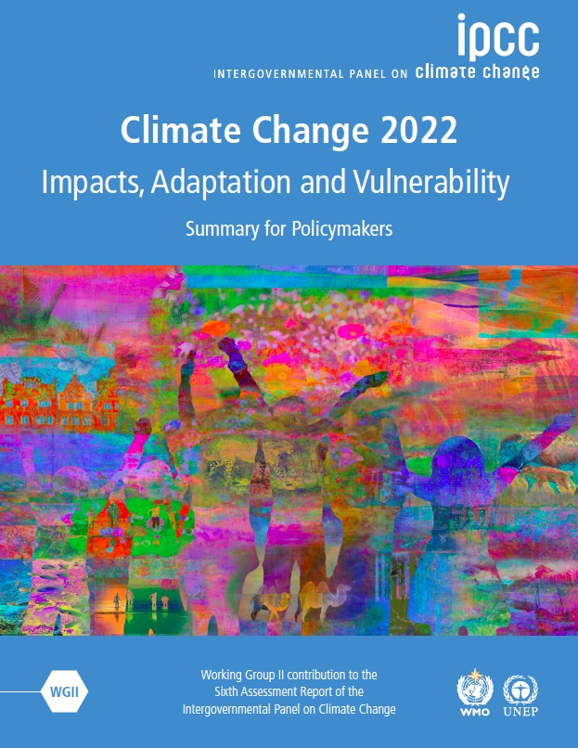
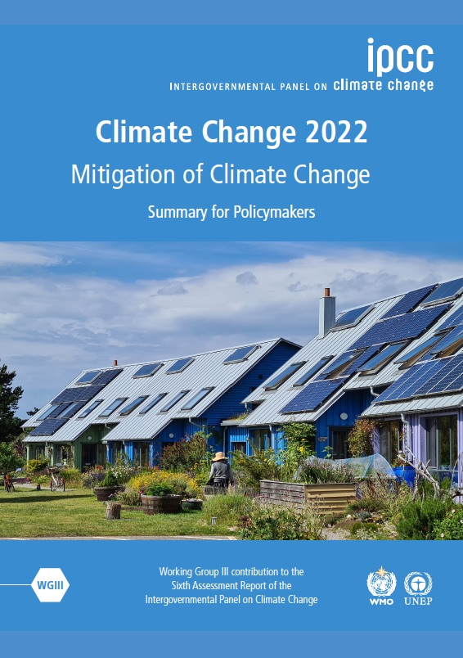
2019
https://www.ipcc.ch
https://ipbes.net/global-assessment
Notes:
Here some important diagnostic reports on the state of planet Earth, on the climate from the IPCC and on biodiversity from IPBES.

Slide 34
Structure
What is Planetary Health?
Medical history and exam
Diagnosis and prognosis
Therapy options
Source: Pixabay
Notes:
Now moving to diagnosis and prognosis.

Slide 35
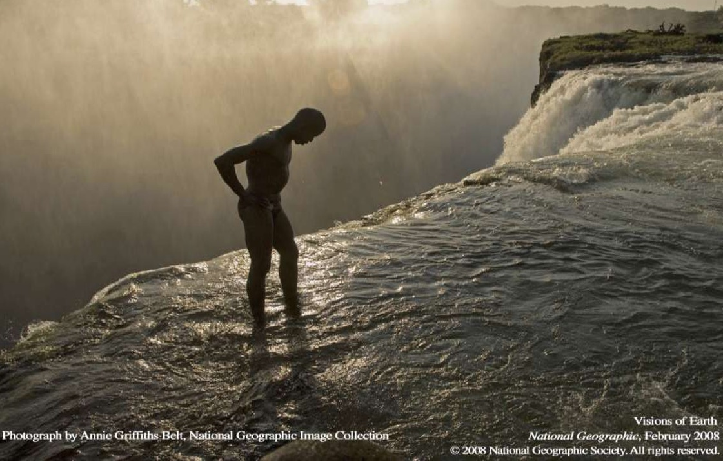
Planetary boundaries
Rockström et al. 2009, Steffen et al. 2015
Source: Johan Rockström’s slides
Notes:
The concept of the planetary boundaries can be useful here.
As with this waterfall, it is advisable not to go too close to the edge, but keep a safe distance.

Slide 36
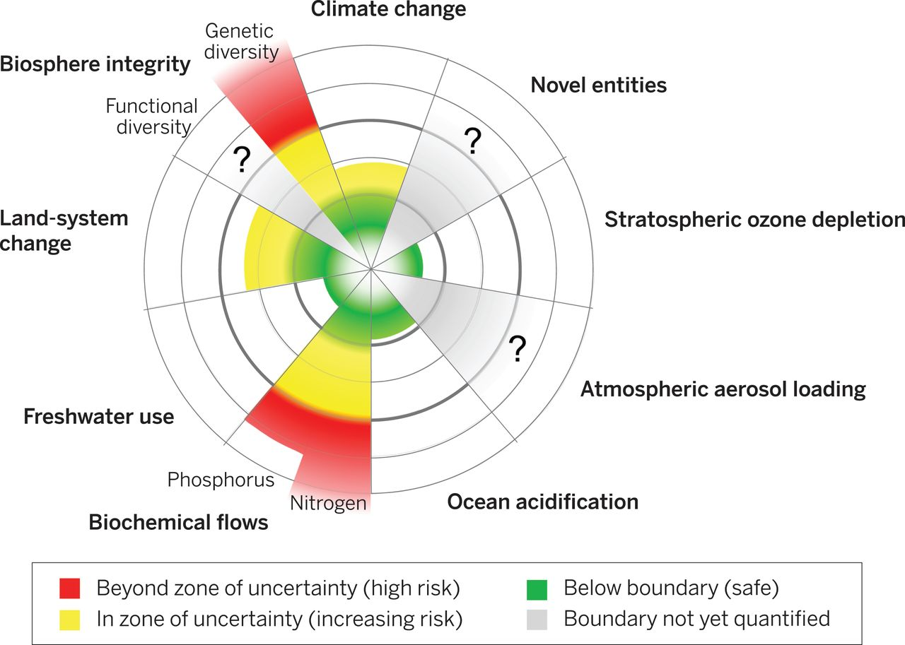
Planetary boundaries
Steffen et al., Science 2015
Notes:
Scientists have defined measurable indicators and thresholds for different subsystems of the planet.
Similar to diagnostic parameters in medicine which show inhowfar body functions are within the normal range.
Of these planetary boundaries, we already transgressed some, such as biodiversity and we are close for others.

Slide 37
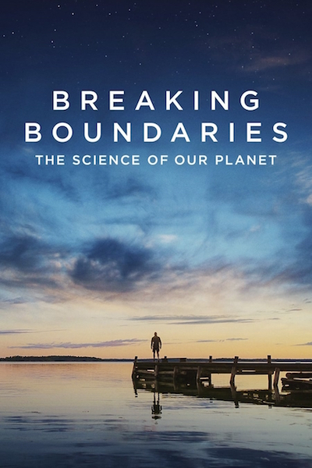
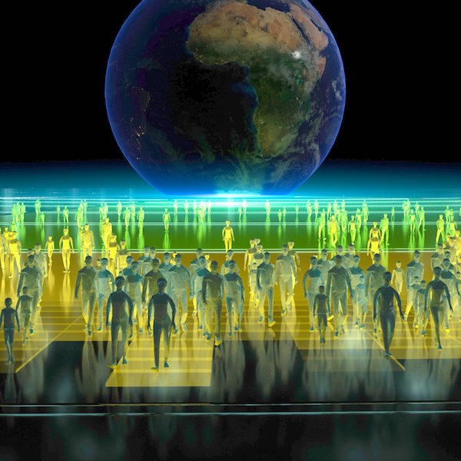
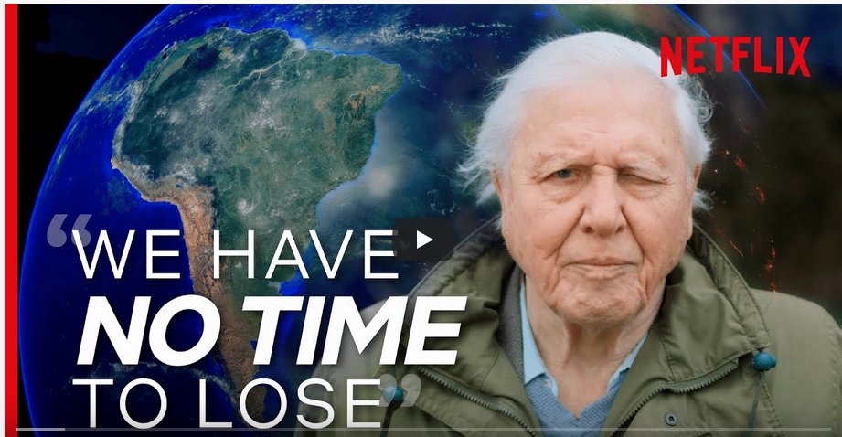
https://www.stockholmresilience.org/research/research-news/2021-04-30-new-netflix-documentary-brings-the-planetary-boundaries-to-the-world.html
Notes:
A netflix documentary with David Attenborough and Johan Rockström explains this in detail.

Slide 38


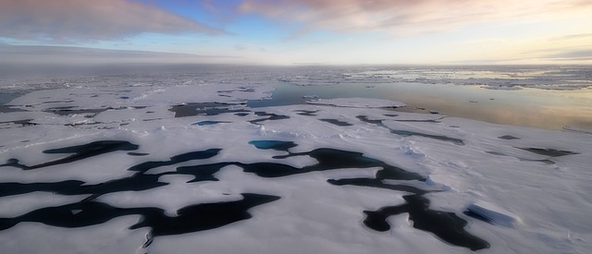
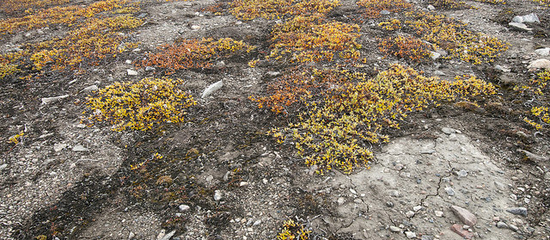
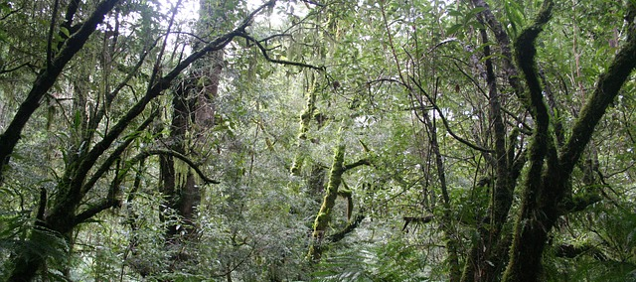
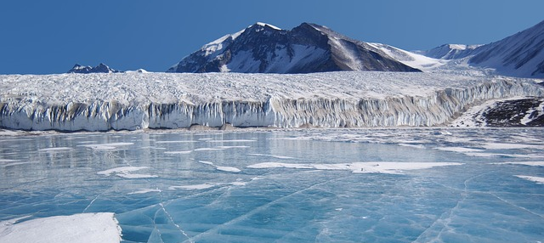
Tipping elements
Non-linear changes
Self-amplifying feedback loops
  Melting Arctic → Less reflection of solar irradiation
  Thawing of permafrost
  → Release of methane
Source: : www.grida.no/resources/3953, GRID, Peter Prokosch
Sources: Pixabay
  Forest dieback → Release of CO₂ instead of absorption of CO₂
  Melting of continental glaciers
  → Sea level rise
Source: Pixabay
Notes:
One thing that is important to understand is that living systems don't repond in a linear way, not in the body and not in nature.
First the system buffers for a while until reaching a limit when it suddenly changes or collapses or tips over.
And sometimes like in a domino the next systems also collapses.
For biodiversity and for the climate system several tipping elements and positive feedback loops exist.
One example: The greenland ice sheet melts as it gets warmer and the thinner it gets, the warmer the air around it and it melts even more and from some point it will melt down completely. Which leads to 7m sea level rise in the long run.

Slide 39


Prognosis: climate scenarios
(based on IPCC)
+3.0°C
+2.0°C
+1.5°C
Crop failure
Water stress
Coral bleaching
Extreme events
(heat, flood, drought)
Sea-level rise
Loss of ecosystems
Crop failure
Water stress
Coral bleaching
Extreme events
(heat, flood, drought)
Sea-level rise
Loss of ecosystems
Crop failure
Water stress
Coral bleaching
Extreme events
(heat, flood, drought)
Sea-level rise
Loss of ecosystems
Notes:
Which brings us to the prognosis – What are the likely consequences?
At 1.5°C global warming, impacts are severe, but with some effort and good luck, we may be able to still handle them.
At 2°C chances are already much worse.
3°C or more would just be a nightmare. It is very unlikely that human civilisation can successfully adapt to such conditions.

Slide 40
Paris Agreement
United Nations Framework Convention on Climate Change
197 parties (incl. EU)
Article 2
1. This Agreement (...) aims to strengthen the global response to the threat of climate change, in the context of sustainable development and efforts to eradicate poverty, including by:
(a) Holding the increase in the global average temperature to well below 2 °C above pre-industrial levels and pursuing efforts to limit the temperature increase to 1.5 °C above pre-industrial levels, recognizing that this would significantly reduce the risks and impacts of climate change;
https://unfccc.int/files/meetings/paris_nov_2015/application/pdf/paris_agreement_english_.pdf
Notes:
Which is why the global community has agreed in Paris to stay well below 2°C of global warming, ideally 1.5°C. Here the original text.
If all the concrete action commitments of all countries so far would be fulfilled, where would we end up?
Still at around 2.7°C! So while the Paris agreement is there, the commitments are still insufficient to meet its goals.
--
https://unfccc.int/news/updated-ndc-synthesis-report-worrying-trends-confirmed

Slide 41
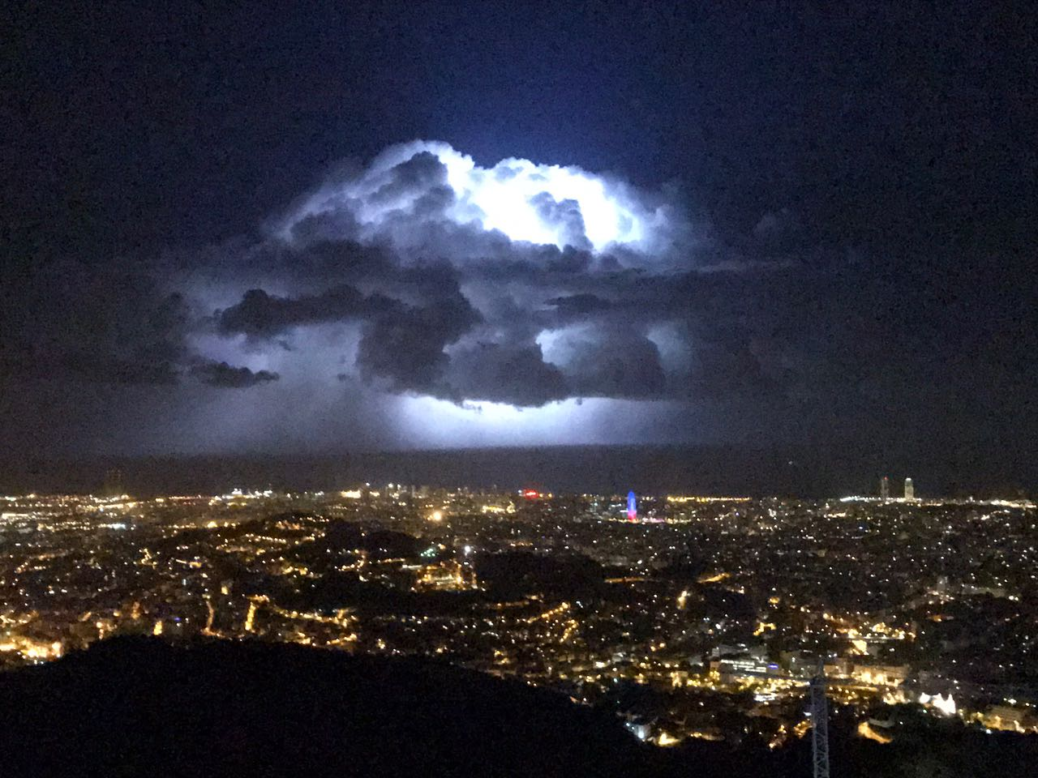
Global environmental change
8 billion humans
Source: Oliver Dippel
Notes:
So what does this mean? The earth has seen mass extinctions before, the last one with the dinosaurs. The planet will survive.
It‘s about the animals that live now, corals, bees, chimps, and the plants and fungi.
And it‘s about us humans (animation), our survival and well-being, our civilisation, peace and freedom,
with now 8 billion people, many in coastal areas who all want to eat and drink every day.

Slide 42

Humanity
branch = climate stability
Notes:
We basically harm ourselves, and our children and all generations to come.

Slide 43
Planetary Health: Key challenges
based on Lancet Commission 2015
(1) Imagination challenge: Rethink the relationship between humans and the planet
(2) Knowledge challenge: Quantify health impacts of global environmental change
(3) Implementation challenge: Develop and evaluate solution strategies for a sustainable lifestyle
3
Humans
1
Planet
2
https://www.thelancet.com/commissions/planetary-health
Notes:
If we destabilize the earth system, how exactly does this backfire on our own health, on direct and more indirect pathways?

Slide 44

Health impacts of anthropogenic global environmental change
Source: Sam Myers, Lancet 2017
http://www.thelancet.com/pdfs/journals/lancet/PIIS0140-6736(17)32846-5.pdf
Notes:
It is important to realize that the consequences of global environmental changes on health are filtered by social dynamics, these mediating factors (show).
Ideally to the better, e.g. through successful adaptation measures. But could also be to the worse, e.g. through conflicts over scarce resources.

Slide 45




Direct health effects
Storms
Floods
Droughts → fire
Heat
Source: THW
Source: Pendleton Marines, California 2018,
Photo by Cpl. Dylan Chagnon
Source: Public domain
Notes:
Direct health effects can be caused by extreme events such as floods, storms, heat and fires.
Heat waves are killing people here in Europe, and for already hot regions like South Asia it is even worse.
The devastating impacts of floods are felt in many places around the world, including here in Germany.

Slide 46




Indirect health effects
Source: Pixabay
Ecologically mediated
Mosquitoes → Infections
Crop failures → Undernutrition
Pollen → Allergies
Socially mediated
Poverty
Conflicts
Migration
Source: Wikipedia, Oxfam East Africa
https://www.flickr.com/photos/oxfameastafrica/5758386784
Source: FAARM-Projekt
Source: Wikipedia, Andy Hall/Oxfam
Notes:
Indirect health effects can be mediated through changes in ecosystems.
This includes increased transmission of infectious diseases when for example mosquitoes move to new areas, e.g. malaria into African highlands.
It also includes undernutrition and famines when harvests fail due to droughts or floods.
But also increase in allergies as there are more pollen in the air and during longer periods.
The health effects mediated by social dynamics are more difficult to quantify but potentially enormous.
This includes increases in poverty, political destabilization and violent conflicts over scarce resources, migration and displacement, because of conflicts or due to sea level rise, with many negative health impacts including on mental health.

Slide 47
Health
1 billion
rich people
1 billion people in extreme poverty
Ecological damage
Source: Pixabay
Notes:
Here the around 8 billion people globally. 1 billion very poor, 1 billion fairly rich, the rest somewhere in the middle.
The increase in human well-being and health (axis) on this development path (street) has been at the expense of hugely increasing the ecological damage to the planet (add axis), as our use of natural resources is now exhausting the planet’s buffer capacity.

Slide 48






Health
Pollution
Climate change
Biodiversity loss
1 billion
rich people
1 billion people in extreme poverty
Ecological damage
Source: Pixabay
Notes:
And with some delay, this is now backfiring via global environmental changes threatening our livelihood and our health. (flash)
The poorest are the most vulnerable, but everybody is affected – as we now experience more and more.

Slide 49

How do I communicate the diagnosis?
Notes:
The situation is serious. If we don’t act, it is life-threatening, a planetary emergency.
How does a good doctor communicate a serious diagnosis?
By telling the full truth, explaining, listening, accepting the emotions, denial, desperation, that priorities in life completely change,
and help the patient accept this and jointly discuss the way forward.

Slide 50

Shared diagnosis? Urgency clear?
Source: Bettina Nutz: www.bettinanutz.de; CC-BY-NC-ND: https://creativecommons.org/licenses/by-nc-nd/4.0
Notes:
Because if there is no shared diagnosis and sense of urgency, it‘s very hard to discuss the treatment.
And in the planetary crisis, the situation often resembles that in the cartoon. (give break to read)
Many people have not fully understood the diagnosis.

Slide 51
Structure
What is Planetary Health?
Medical history and exam
Diagnosis and prognosis
Therapy options
Source: Pixabay
Notes:
Moving to therapy. And as in medicine, there are immediate measures, medium and long-term measures to be taken.

Slide 52

Emergency aid
    Reduce speed quickly! Then change course…
    Stop ecologically harmful subsidies (air travel, coal, meat production, etc.)
    Stop building new fossil fuel mines and power plants
    Stop destruction of nature (swamps, forests, etc.)
    Stop humus loss in soils
    Stop release of harmful chemicals and plastics
Source: building on BUND Climate Emergency Aid Plan
Notes:
In an emergency, one first needs to stabilize the condition of the patient.
Similarly, we need to stop harming the planet further, stop harmful subsidies, more coal plants, deforestation, loss of swamps and soils, stop further pollution.
Seems very obvious, but is not happening yet.

Slide 53

Health
1 billion
rich people
1 billion people in extreme poverty
Ecological damage
Source: Pixabay
Notes:
In the long run, we have to tackle a double challenge. Stopping environmental destruction and at the same time reducing social inequality.
We have to get into this corner: achieving good health for all at low ecological cost, as envisioned in the SDGs.

Slide 54



Health
1.5°C
2°C
Ecological damage
Source: Pixabay
Notes:
One can also imagine this coordinate system like a mountain, the higher up, the healthier. The SDGs are on a high plateau here.
The environmental destruction path ends somewhere as there is a limit of how much ecological damage we can survive.
Humanity has been moving at high speed along this path, towards the abyss, causing the whole mountain to slide.
As we continue, we enter increasingly slippery slopes and tipping points.
We need to quickly get on paths towards the SDGs, good health at low ecological cost – which means a turnaround for the rich.
And the poorest will need some support to climb up directly, to leapfrog the environmentally destructive development stage.

Slide 55
Planetary boundaries
Steffen et al., Science 2015
Notes:
This is a reminder that although I focus on climate change in this talk, we need to consider all the planetary systems when we treat the patient.
Not just treat the fever and forget about the liver or the kidney.

Slide 56

Remaining carbon budget
= How much CO₂ can we still emit to have a good chance to keep global warming under 1.5°C in the long term?
Remaining from 2020 according to IPCC:
For 1.5°C (in 67% of models): approx. 400 Gt
Global emissions per year: approx. 42 Gt
CO₂ budget:
400 Gt
Sources: www.ipcc.ch/report/ar6/wg1, Table SPM.2,
www.mcc-berlin.net/en/research/co2-budget.html
Source: Pixabay
Notes:
For therapy planning, we need to know what our remaining carbon budget is, that means:
How much CO2 can we still emit into the atmosphere before we cross dangerous planetary boundaries?
According to the most recent IPCC report, if we emit another 400 Gt, we would stay below 1.5°C in two thirds of the models.
Annual global emissions are around 42 Gt.

Slide 57

What does that mean?
CO₂ budget:
400 Gt
Detox! Become clean
  Achieve net-zero carbon emissions as soon as possible
Limited amount of drugs until then
  Emit a maximum of 400 Gt CO₂ during the detox
Organize and distribute wisely
  Ration, minimize withdrawal symptoms
  Distributional justice
Oil
Coal
Source: Pixabay
Notes:
What does this mean?
We have to become clean asap, i.e. stop burning fossil fuels and emitting CO2 to the atmosphere. Which means we need to quickly decarbonize our economy.
We only have a quota of 400 Gt globally – that was in January 2020, so now already less – during this withdrawal phase.
So we have to organize this intelligently. If we continue to be wasteful over the next few years, it will then become impossible to achieve the goal.
And we have to distribute wisely. The 400 Gt was global. Who is allowed how much? At the same time, we need to fight poverty…

Slide 58
Reduction scenarios
Inaction until 2025
→ Cold turkey then…
CO₂ emissions (Gt/year)
50
40
30
20
10
0
Source: adapted from Deutsche Welle, according to Global Carbon Project
The earlier we start, the less steep the reduction.
RISK
1990 2000 2010 2020 2030 2040 2050
Notes:
Which path do we choose to get to net zero emissions within the budget? The green path has already been missed by now as all previous easier ones.
As the area under the curve matters, the later we start reducing, the more abrupt we need to reduce. Switching off things suddently of course implies much higher societal and economic costs.
And we we then don’t manage to reduce that steeply, we will overdraw the budget, the earth will heat up more with ever higher risks for livelihoods and health.
Which is why it is so important to start act quickly and reduce emissions.

Slide 59

Carbon inequality
Richest 10%
2nd
3rd
4th
5th
6th
7th
8th
9th
Poorest 10%
21
8
5
3
2
1
1
1
½
½
The richest 10% emit 50%.
Global annual emissions: 42 Gt CO₂
The poorest 50%
emit just 10%.
Global population wealth deciles
Quiz question: Where should we start to reduce?
Source: Oxfam “Extreme Carbon Inequality”, 2015
Notes:
These are 42 coffee beans. They represent the 42 Gt global annual CO2 emissions.
And I am showing you a distribution over the entire world population, divided into 10 evenly sized groups, according to their wealth.
The poorer half of the world population only emits a 10th of the total, 4 beans. The richest 10% of people emit half, 21 beans.
Quiz question: Where should we start to reduce?

Slide 60

Fair play!?
USA
Germany
42 Gt / 7.7 billion people
= 5.5 t / person
Global
average
India
CO₂ emissions
per person 2013:
1.5 t
5.5 t
9 t
17 t
Source: A change of course 2017. https://www.boell.de/sites/default/files/change-of-course.pdf
Notes:
Here emissions per person are shown by countries. In Germany we emit around 9t per person and year, much above the global average.
The climate crisis cannot be discussed without talking about justice. Who caused the problem? Who can invest in the transition? Who is struggling to survive and even more in a changing climate? Who already has a high living standard and is consuming luxury and where are millions of people striving towards a decent life?
It is clear that the rich industrial countries have to reduce faster and help the others.

Slide 61


Great Transformation
Source: WBGU
Notes:
To accomplish that in the time left until natural systems will crumble, small step-wise improvements are not sufficient, we need a radical reshaping of our whole way of living, our way of doing business, a Great Transformation of society. An unprecedented challenge. Will we make it?

Slide 62

Problems can never be solved with the same mindset
that created them.
Albert Einstein (1879-1955)
Notes:
It will require some major shifts in our way of thinking, as problems can never be solved with the same mindset that created them, as Einstein wisely realized.

Slide 63
Planetary Health: Key challenges
based on Lancet Commission 2015
(1) Imagination challenge: Rethink the relationship between humans and the planet
(2) Knowledge challenge: Quantify health impacts of global environmental change
(3) Implementation challenge: Develop and evaluate solution strategies for a sustainable lifestyle
3
Humans
1
Planet
2
https://www.thelancet.com/commissions/planetary-health
Notes:
This brings us to the core of the problem, the relationship between humans and the planet.

Slide 64
Relationship with nature
humans
nature
Notes:
In the previous graph, I also showed humans and planet separated. Through our technological advances we imagine we are independent from nature.
And we have also distanced ourselves emotionally, regarding nature as a pile of resources.

Slide 65
Relationship with nature
humans
nature
Notes:
In reality, we are of course part of nature. We are living beings, we breathe air, drink water, eat other living beings.
Millions of microbes live in our guts, on our skin, are vital for our well-being.
Exploitation of nature worked fine for a while, while there were relatively few humans and a lot of nature.

Slide 66
Relationship with nature
humans
nature
Notes:
This has changed. In the anthropocene, the whole planet is influenced by humans, there is virtually no untouched nature any more.
So nature is part of us and we are part of nature.

Slide 67

Why should I care about biodiversity?
Notes:
We need to realize that we humans are one component of a highly complex web of life, one part of our living planet, and that we totally depend on it.
Our health, our society, our economy all depend on functioning ecosystems, on a stable climate.

Slide 68

Ethical dimension
Value?
Exploitation?
Awe?
Connectedness?
Source: Sabine Gabrysch
Notes:
This also has an ethical dimension.
What value do we assign nature? Is our relationship characterized by exploitation or by awe and connectedness?

Slide 69




Albert Schweitzer’s
Ehrfurcht vor dem Leben:
“I am life
that wants to live
in the midth of life
that wants to live.”
Source: Pixabay
Pope Francis
Source: Deutsches Bundesarchiv
The Dalai Lama:
“Love and compassion are necessities, not luxuries. Without them, humanity
cannot survive.”
2015
Source: Wikimedia, author: Christopher Michel
Notes:
Albert Schweitzer‘s Ethics of Reverence for life is an attempt to overcome our restricted ethics that only contains humans.
The encyclical letter Laudato Si by Pope Francis is called „On Care for our common home“ which refers to planet earth.
He talks about awe and wonder towards nature versus the attitude of a master, consumer and exploiter.
And the Dalai Lama emphasizes that it is not enough to train our brains, we need to develop our hearts towards more compassion if we want to survive.

Slide 70




Old wisdom…
“The earth does not belong to man, man belongs to the earth. All things are connected. (…)
Man did not weave the web of life, he is merely a strand in it. Whatever he does to the web, he does to himself.”
Source: Speech of Chief Seattle, 1854
Source: Pixabay
Source: Sabine Gabrysch
Notes:
Of course these insights are not really new and neither is the idea of planetary health.
Many indigenous peoples have preserved this wisdom over generations and a spiritual relationship to nature or Mother Earth.

Slide 71
Human nature
Notes:
It is also a question of what we believe is human nature, our Menschenbild, image of man. This shapes our behaviour.
Are humans greedy, selfish and only thinking of her personal advantage as the homo economicus in the models of the economists?
Or are humans generous, compassionate with others and stand up for justice?

Slide 72


Fight of two inner wolves
Hatred
Envy
Greed
Love
Joy
Generosity
Arrogance
Egoism
Anger
Humility
Compassion
Serenity
Source: Pixabay
Notes:
Well, we are not either or, both options are inside us.
In each person, the two wolves from the Indian fable are fighting. Greed against generosity, arrogance against humility, competition against collaboration.

Slide 73
And which wolf will win?
The one you feed!
Hatred
Envy
Greed
Love
Joy
Generosity
Arrogance
Egoism
Anger
Humility
Compassion
Serenity
Source: Pixabay
Notes:
And which wolf will win? The one we feed! Both as an individual and as society.
Societal structure plays an important role here, in what kind of world we grow up and live.
Is greed considered normal and boasting nearly a duty or are other values important?

Slide 74

Pan-
demics
Chronic
diseases
Biodiversity
loss
Climate
change
Pollution
Stress
Burnout
Source: Pixabay
Notes:
When looking deeper at the common roots of global environmental and health problems, our image of man and of nature, our illusion of being separate from nature may play an important role.

Slide 75
Planetary Health: Key challenges
based on Lancet Commission 2015
(1) Imagination challenge: Rethink the relationship between humans and the planet
(2) Knowledge challenge: Quantify health impacts of global environmental change
(3) Implementation challenge: Develop and evaluate solution strategies for a sustainable lifestyle
3
Humans
1
Planet
2
https://www.thelancet.com/commissions/planetary-health
Notes:
Now let‘s talk about concrete solution strategies for a sustainable and healthy lifestyle.

Slide 76


Taking action!
ECOLOGICAL FOOTPRINT
= Human demand on nature
www.footprintcalculator.org
Change own consumption
ECOLOGICAL HANDPRINT
Jointly influence political decision-making
Change structures
Source: Pixabay
Notes:
The ecological footprint is well known. Everybody can calculate his or her own footprint with online tools. It is important to make efforts to reduce it, already for one’s own credibility. But it is not sufficient.
We need to jointly change the structures that are hurting people and nature, we need to influence politics, contribute to the Great Transformation of society - that is the handprint.
One example: taking the train instead of flying is footprint. Pushing politicians so that trains become the cheaper and easier choice is handprint.

Slide 77
Changing the rules
Politics
Groups
Individuals
Notes:
Which means we have to change the rules by which we play, the structures, and these are decided higher up. The leverage is highest on the top.
But also on the middle levels we can achieve a lot, at work places, schools, universities, hospitals, etc. And they all interact.

Slide 78



Solutions with synergies: Win-win!
https://drawdown.org/publications/climate-poverty-connections-report, https://doi.org/10.3390/ijerph182413339
Notes:
There are plenty of solutions already. Many are synergistic, win-win solutions, good for the planet, and also good for reducing poverty and for our own health also in the short term. Because there are common roots to our problems, there are also common solutions.

Slide 79



Transport and mobility
Source: Pixabay,
MabelAmber
Source: Wikimedia, Kentaro Iemoto
https://sharingcitiesalliance.knowledgeowl.com/help/copenhagen
Source: Wikimedia, Shyaulis Andrjus
Notes:
Take the transport sector. It is responsible for ¼ of GHG emissions in Europe and the main source for particulate matter pollution.
At the same time, physical inactivity, traffic noise and accidents, and air pollution are major risk factors for various chronic diseases.
A transport shift towards pedestrian- and bicycle-friendly mobility would be a huge gain for climate and health.

Slide 80


Renewable instead of fossil fuels
→ Avoiding 3.6 million deaths per year globally due to outdoor air pollution
Source: Lelieveld et al., PNAS 2019; https://www.pnas.org/cgi/doi/10.1073/pnas.1819989116
Photo right: Pixabay; andreas160578 ; https://pixabay.com/de/photos/photovoltaik-photovoltaikanlage-2138992/
Notes:
When we stop burning fossil fuels to mitigate climate change, this would avoid an estimated 3.6 million deaths worldwide every year, only through outdoor air pollution. Many also in Europe as you can see on this map.

Slide 81

Agroecology
Permaculture
Agroforestry
Regenerative agriculture etc.
Agriculture
Source: Wikimedia
Notes:
Agriculture is a key cause of deforestation, land degradation and species loss, including through pesticide use.
Altogether, the food system is responsible for around one quarter of global greenhouse gas emissions.
Growing food differently, with approaches learning from nature, we can preserve biodiversity, mitigate climate change and improve human nutrition and health.

Slide 82


Planetary Health diet:
www.thelancet.com/commissions/EAT
Source: www.daserste.de/information/wissen-kultur/w-wie-wissen/ernaehrung-136.html
Notes:
Unhealthy diets are one of the biggest risk factors for diseases and premature death worldwide.
The EAT-Lancet commission has published recommendations for the so-called Planetary Health diet, both healthy and sustainable.

Slide 83

Planetary Health diet:
www.thelancet.com/commissions/EAT
Germany:
Source: www.daserste.de/information/wissen-kultur/w-wie-wissen/ernaehrung-136.html
Notes:
In Germany, the average plate looks rather like this.
A lot less meat (in red, show on left) and a lot more vegetables (in green) would be a huge win for climate, animals and humans.

Slide 84
Planetary Health diet:
www.thelancet.com/commissions/EAT
Can avoid about 11 million premature deaths per year globally, a reduction by around 20%!
Can feed about 10 billion people within planetary boundaries
Source: www.daserste.de/information/wissen-kultur/w-wie-wissen/ernaehrung-136.html
Notes:
Adopting such a diet could avoid 11 million premature deaths worldwide every year and could feed humanity sustainably.
Isn't this great news!?

Slide 85
Conclusions
"Climate change is the biggest global health threat of the 21st century.“
The Lancet 2009
"Tackling climate change could be the greatest global health opportunity of the 21st century.“
The Lancet 2015
Source: www.thelancet.com/climate-and-health
Notes:
In conclusion, here two summary statements made by The Lancet commissions on climate change and health.
1. “Climate change is the biggest global health threat of the 21st century."
Because it destroys living conditions on the planet. Storms and floods, heat and drought, harvest failures and famines, infections, conflicts and migration.
It hits poorest people most and first and enhances inequality. It threatens the survival of our civilisation.
2. “Tackling climate change could be the greatest global health opportunity of the 21st century."
What we need to do for the climate is basically similar to what we need to do for health. A win-win situation!
Making cities easy to walk and bike to have more exercise. Reducing air pollution. Eating less meat and more vegetables. All these are good for the planet and good for our health.

Slide 86

Given the interconnected nature of climate change, loss of biodiversity, land degradation, and air and water pollution, it is essential that these problems are tackled together.
Human well-being, now and in the future, depends on a healthy planet.
Transforming humankind’s relationship with nature is the key to a sustainable future.
https://www.unep.org/resources/making-peace-nature
Notes:
In 2021, a UNEP report was published that looks at the three crises – climate change, biodiversity loss and pollution – and their solutions together.
And connects them to human health. Its title is Making peace with nature. It demands a new relationship to nature and to each other.
UN General Secretary Guterres has made it very clear in his speech that we are in an emergency and need to act accordingly.

Slide 87

Source: WBGU report “World in Transition” 2011, fig. 3.4.1, from Grin, Rotmans & Schot 2010, based on Geels & Schot 2010
Notes:
In this graph from the 2011 WBGU report on the Great Transformation, we see the mainstream in the middle.
Many good solutions exist already, but are still in a niche, shown down here in the graph. These are the pioneers.
Sudden events in megatrends, up here, can disrupt the mainstream and open windows of opportunity which allows those niche ideas to become the new mainstream. We are currently in such a time period. A window of opportunity has been opened with the FFF climate movement and now with the corona crisis.

Slide 88





London
Quelle: Thomas Katan
Berlin
Quelle: Leonhard Len
Quelle: Public Domain
Quelle: Sabine Gabrysch
Notes:
More and more people are realizing that we are in a planetary emergency.

Slide 89


www.klimawandel-gesundheit.de
https://healthforfuture.de/
https://planetary-health-academy.de/
Charité Berlin, Climate strike, 20 Sept 2019. Source: Dominik Butzmann
Notes:
The health professions are also increasingly active for healthy people on a healthy planet.
The Health for Future movement has grown tremendously in Germany with groups now in over 60 cities.

Slide 90

COVID-19 as a wake-up call?
https://www.csc-blog.org/en
Notes:
And COVID has also shaken the mainstream "normality" quite a bit. We are experiencing what it means to be in a crisis.
A crisis that highlights the vulnerability of our health, our health systems, our societies.
We realize how close everything is connected on this planet.
This could be an opportunity to reconsider our priorities, what kind of future we want.

Slide 91

Ukraine war
https://doi.org/10.5281/zenodo.6366131
Notes:
Und while COVID is still ongoing, the next crisis has started due to Russia’s attack on Ukraine.
Beside the humanitarian catastrophe, the war has impacts on energy and food security worldwide.
Together with some colleagues we have published this statement on the food security crisis that has been co-signed by over 600 experts.
We argue that when treating the acute food crisis we cannot afford to ignore the other crises, but instead, we should double down on the transformation towards resilient, sustainable and healthy food systems, and tackle all crises together.

Slide 92

IPCC report
IPCC AR6 WG2, Abb. SPM.1
Notes:
When the Ukraine war had just started, the IPCC Working Group 2 published their new report which looks at climate change, ecosystems and human systems (point) in a very integrated way. In the centre, as you can see, is the health of humans, ecosystem and the whole planet.

Slide 93


www.wbgu.de/discussionpaper-health
Notes:
The German Advisory Council on Global Change to the German government, WBGU, of which I am a member, is currently working on the links between global environmental change, development and health.
We recently published a discussion paper and are gathering inputs for our report on planetary health which we plan to publish next year.

Slide 94
Planetary Health
1. Our lifestyle is making us ill and is destroying the planet.
2. Healthy people can only exist on a healthy planet.
3. We must initiate a civilizational transformation for planetary health.
Healthy
planet
Healthy
societies
Healthy relationship
between
humans and Nature
Notes:
It’s about positive change, away from destruction and exploitation, towards healing, well-being and quality of life.
Connecting the health perspective with the sustainability and justice perspective.
Hoping that the concept of Planetary Health, the realization how deeply our own well-being is connected with nature, with animals and with other humans around the world, how incredibly vulnerable we are, each one of us and as a society, but also how amazingly powerful we can be together, that this can accelerate change, create an exponential dynamic, like a viral spread of social change…?

Slide 95
Healthy living
environments
Healthy
health systems
Healthy
mobility
Healthy
food systems
Healthy production &
consumption patterns
Healthy
planet
Healthy
societies
Healthy relationship
between
humans and Nature
Notes:
We then sketch how win-win solutions can look in several domains of action.
Including our food systems, cities, mobility, and also health systems – which are often underfunded, understaffed, and increasingly profit-oriented. There is unmet medical needs in some areas, but also unnecessary medical interventions in others. Health promotion and prevention are terribly neglected.
What would a health-promoting, environmentally friendly and resilient healthcare system look like? How can access to that be provided to all people worldwide?

Slide 96
Healthy living
environments
Healthy
health systems
Healthy
mobility
Healthy
food systems
Healthy production &
consumption patterns
Healthy
planet
Healthy
societies
Healthy relationship
between
humans and Nature
Policy for
planetary
health
Education and
science for
planetary health
Notes:
And then we ask what policies we need for the transformation, and how education and science can be levers for healthy and sustainable way of living.

Slide 97
Source: WBGU report “World in Transition” 2011, fig. 3.4.1, from Grin, Rotmans & Schot 2010, based on Geels & Schot 2010
Notes:
In the WBGU Transformation report in 2011, health was not really featuring. – What role can health play?
Could health, the concept of Planetary Health, provide the much-needed boost for transformative change?
And what else do we need, to ignite and speed up the Great Transformation?
What kind of vision, positive vision, do we need? What kind of understanding of cooperation and power? What role do relationships play and trust? Creativity and inspiration?

Slide 98

Societal change
Social mobilisation
Power structures
Alliances
Positive vision
Experiments
Creativity
Enthusiasm
Quelle: Wikimedia
“First they ignore you,
then they laugh at you,
then they fight you,
then you win.”
Mahatma Gandhi
Notes:
It is pretty clear that the fundamental societal change that we need will not happen by itself and from above. Societal actors need to push for it.
There are massive interests against it. It is not just about facts and knowledge, it is about power.
The transformation towards sustainable societies is resisted by those who profit from the status quo. As Gandhi wisely said: >>>
We need to form alliances, and create a positive vision for a better, healthier, sustainable world which already exists in niches.
There is no blueprint for this transformation, it‘s an unprecedented challenge, we have to experiment, be creative, act into the open. Learning while doing.
And starting to act will unleash a lot of energy. Enthusiasm is important, also having fun!

Slide 99
Critical mass
Notes:
Many people are already part of the movement, probably also some of you. And the good news is, we do not need to convince everybody.
The large majority only has to tolerate the changes. Certain people at the other end of the spectrum we will never convince.
The goal should be to make more people start to act, so we reach a critical mass that has political influence to get to a social tipping point.

Slide 100
Examples of action
Political level
Demonstrations, alliances, petitions, letters to the editor, letters to parliamentarians, lectures, join NGOs,…
Local level
Bicycle lanes, superblocks, urban gardens, repair cafés, food councils, green hospitals, veggie days,…
Individual level
Meat consumption, power supply, transportation choices, shopping second-hand, insect-friendly garden,...
Notes:
Everybody can contribute to the change. Here just a few examples for political actions and concrete local action, beside the individual level.
Everybody can pick what they love. Start in one‘s own organisations like workplace, school, community, and find a few like-minded people.
And build alliances, keep the bigger picture in view and try to change the rules of the game.

Slide 101
What can health professionals do?
Integrate PH & transformation in education and training
Advocate for Planetary Health
Support adaptation and reduce footprint
Develop, implement, and evaluate solutions
Notes:
What can health professionals do specifically?
We can develop, implement and evaluate solutions with win-win potential and accompany their scale-up, for example healthy and sustainable food in cantines, or walk- and bike-friendly cities, and also projects in low-income countries that consider both health and environment.
We should also support the necessary adaptation to climate change, for example the implementation of heat action plans. And of course we should also reduce the ecological footprint of the health sector itself which includes a major shift towards prevention. And divestment of retirement funds.
We can help integrate relevant content into education and training of health professionals, relevant knowledge, but also transformative action. How we can make a change together.
And we can be advocates for health and contribute our expertise in political and societal debates, for example by talking to politicans, writing letters to editor, giving talks. And link up with actors in other areas to build a critical mass.

Slide 102


Societal responsibility
Source: KLUG
Source: Sabine Gabrysch
Notes:
As health professionals, we have a particular responsibility to protect health, and also a high credibility which means we can play an important role in the public debate on the planetary crisis. By warning of the risks, but also pointing to the long-term and short-term health gains.
With that, we stand in a long tradition.

Slide 103
Many thanks !
Slides available! Licence: CC BY-SA 4.0; https://creativecommons.org/licenses/by-sa/4.0/
I tried to correctly attribute all image sources iin the talk and I apologize
for any mistakes I may have made. Please let me know and I will corect them!
More material at
www.pik-potsdam.de/members/gabrysch
Contact: sabine.gabrysch@charite.de
Prof. Dr. Dr. med. Sabine Gabrysch
Potsdam Institute for Climate Impact Research
Charité – Universitätsmedizin Berlin
Heidelberg Institute of Global Health
Source: Pixabay
Notes:
More stuff can be found on my PIK website.
My slides are available with a creative commons license to anyone who wants to use them.
Many thanks!

