Slide 1


Internal Meeting with CGI
Hamburg, 17. April 2019
Climate Challenge
Risks and Opportunities
Dr. Jascha Lehmann
Potsdam Institute for Climate Impact Research

Slide 2
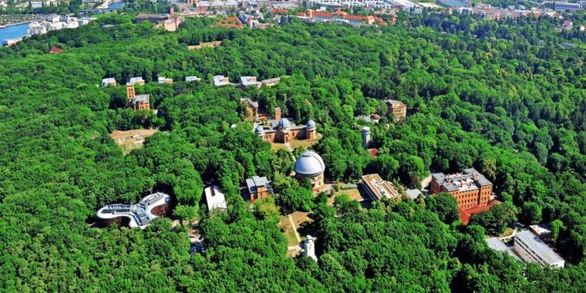
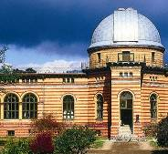
PIK‘s Location – The Telegraph Hill
GFZ
AWI
PIK
PIK
Süring Hall
Michelson Hall
Helmert Tower
PIK
GFZ
Library
Great Refractor
PIK
AIP
“Trefoil”
AIP - Astrophysical Institute Potsdam
AWI - Alfred-Wegener-Institute for Polar- and Marine Research
GFZ - German Research Centre for Geosciences
PIK - Potsdam Institute for Climate Impact Research
Einstein Tower

Slide 3
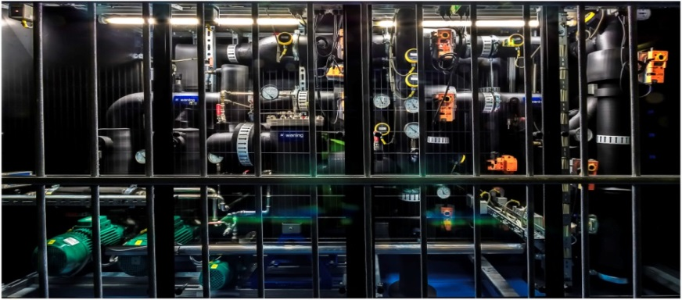

Our Super Computer
636 processors (CPU)
(in total: 5088 processor cores) with scalar
frequencies of up to 3.4 GHz,
20 TB RAM in total,
a set of graphical coprocessors (GPU),
non-blocking infiniband 56Gbps high
performance network,
direct water-cooled processors and
memory, to heat office building(s)
eight times performance /
capacity of previous system
extendible system design
Notes:
Used to run our models.
So, for example, re-construction of last 100 ice ages.

Slide 4
PIK‘s Research Departments
Earth System Analysis:
Oceans, Atmosphere and Biosphere in Past, Present and Future
Stefan Rahmstorf
Wolfgang Lucht
Climate Resilience:
Climate Impacts and Adaptation
Hermann Lotze-Campen
N.N.
Transformation Pathways: Climate Risks and Sustainable Development
Elmar Kriegler (acting)
Katja Frieler (acting)
Complexity Science:
Machine Learning, Nonlinear Methods and Decision Strategies
Jürgen Kurths
Anders Levermann

Slide 5
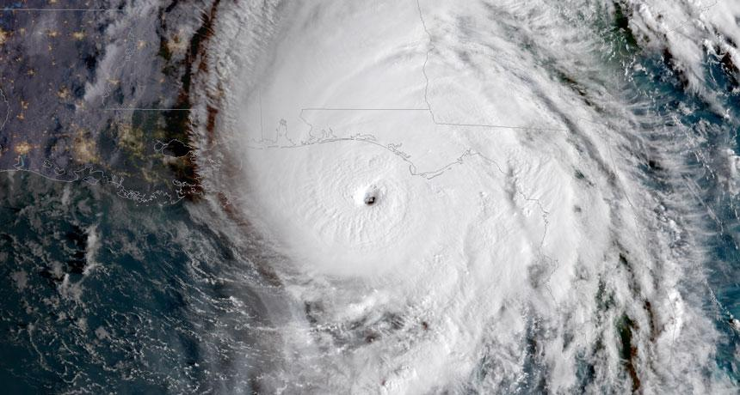
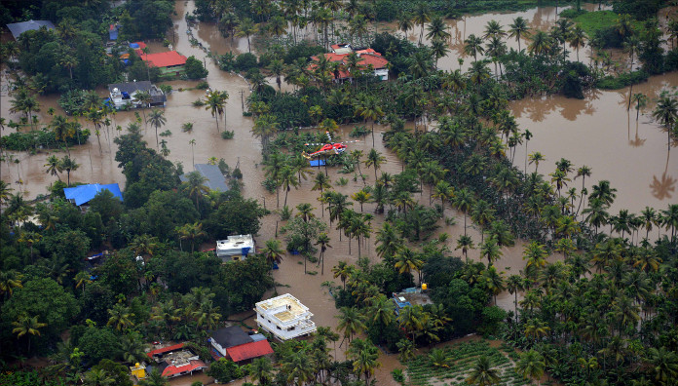
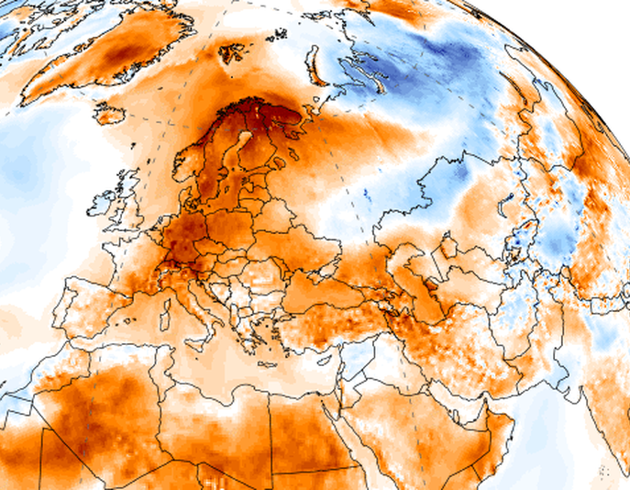
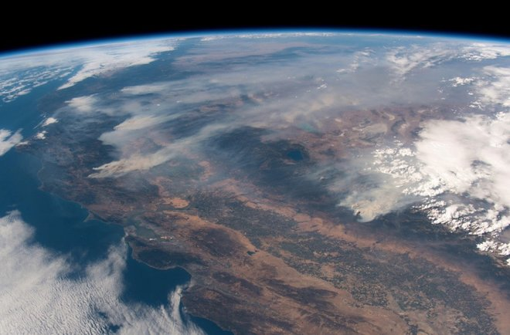
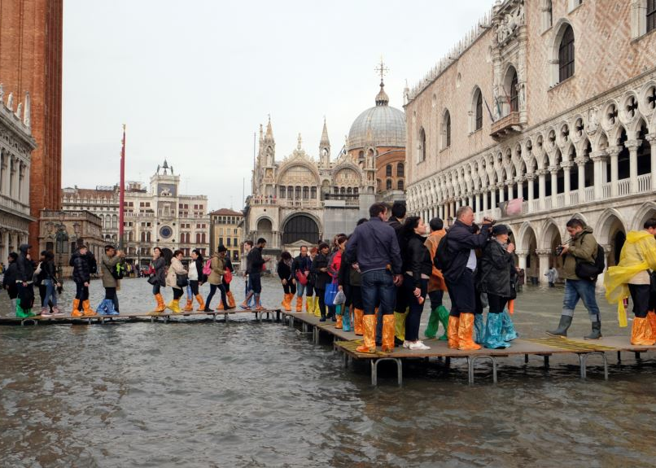
2018 – A Year of Extremes
Rekord-Sturm, Irma, August 2017
Floods in in Kerala, August 2018
Record-Hurricane, Michael, October 2018
Rekord-Fluten in Nepal, Juni 2017
Drought and heat in Europa, Juli 2018
Rekord-Hitzewelle, Luzifer, August 2017
Wildfires in California, August 2018
Rekord-Regen in Berlin, Juni 2017
Waldbrände in Kalifornien, Juni 2017
Floods in Italy, October 2018
Notes:
https://www.theguardian.com/global-development/2017/aug/16/floods-and-devastation-in-india-nepal-and-bangladesh-in-pictures
Wildfires in the North and the South of California. At the so called "Camp Fire" in the North, more than 7100 houses and buildings were destroyed. 42 people died, more than 200 are missing. (13.11.2018)

Slide 6
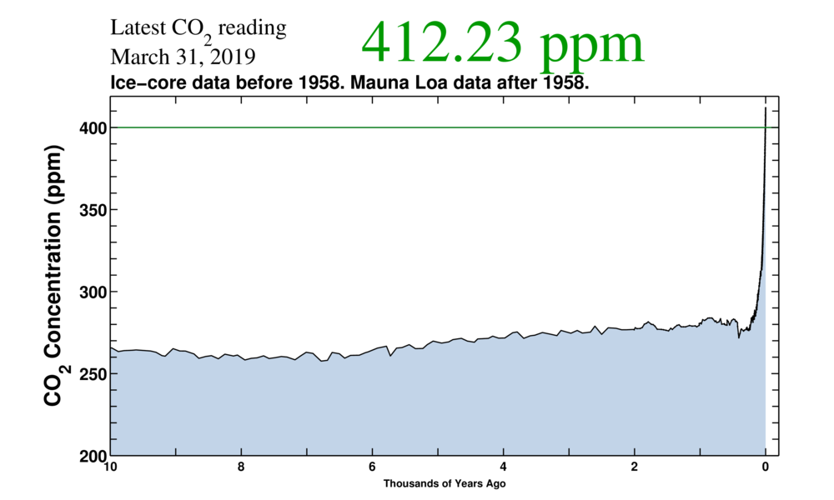
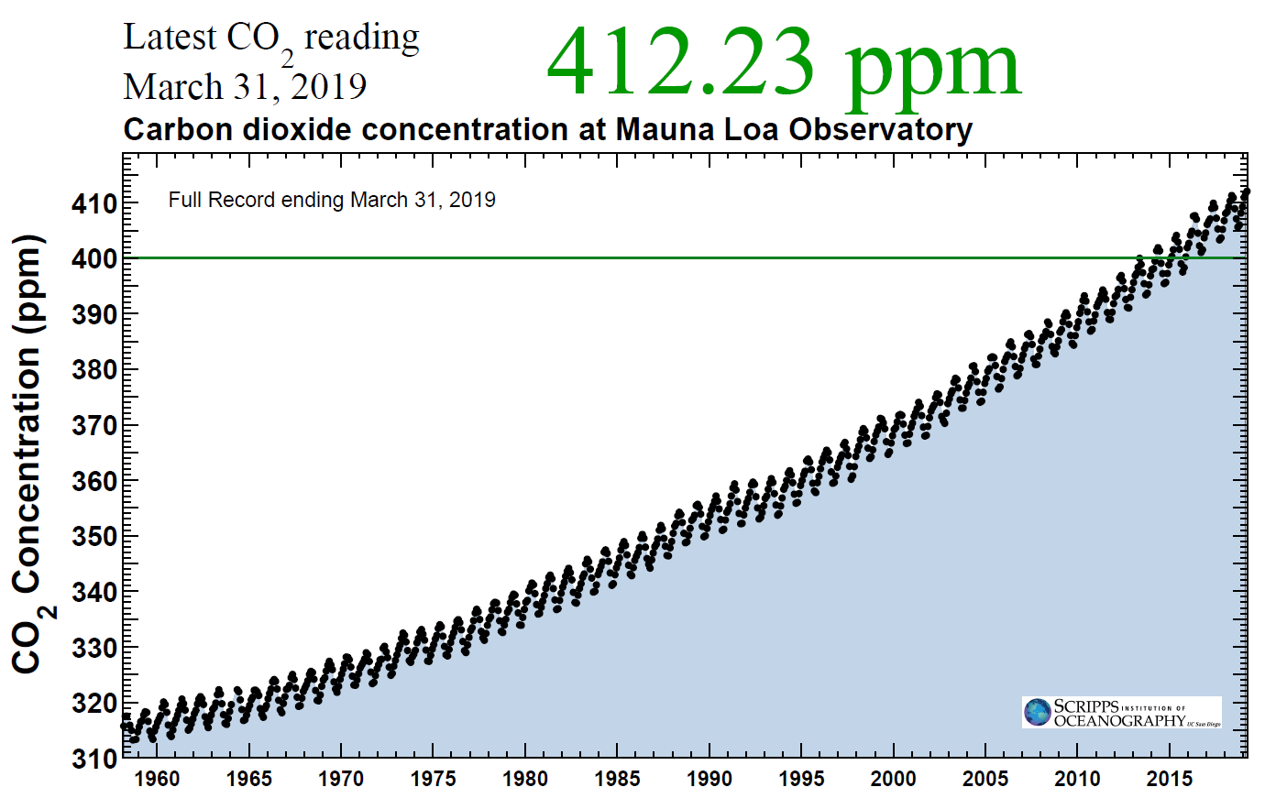
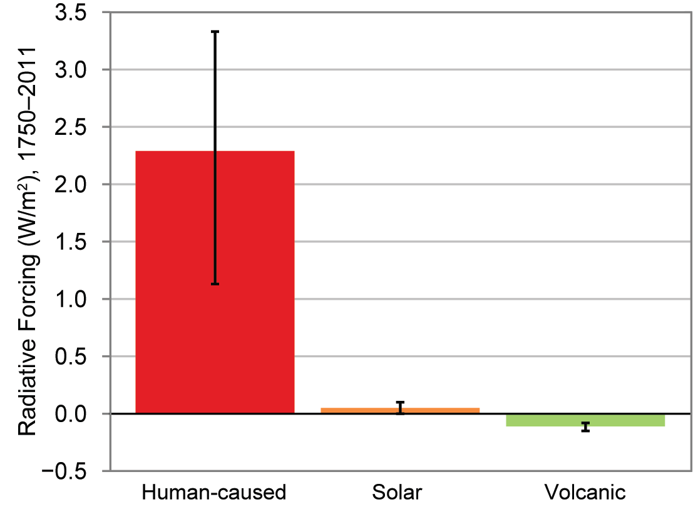
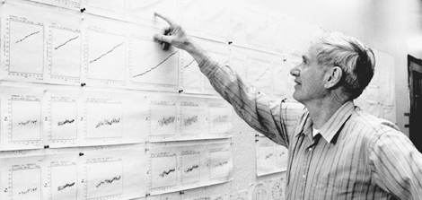
The Cause of Today's Warming
2 W/m²
Radiative Forcing in Watts per square meter since 1750
Charles Keeling
Source: US Climate Science Report 2017
Notes:
By now we not only understand the greenhouse effect, we can also measure it very well.
That is the highest concentration for probably last 3 mio years.

Slide 7
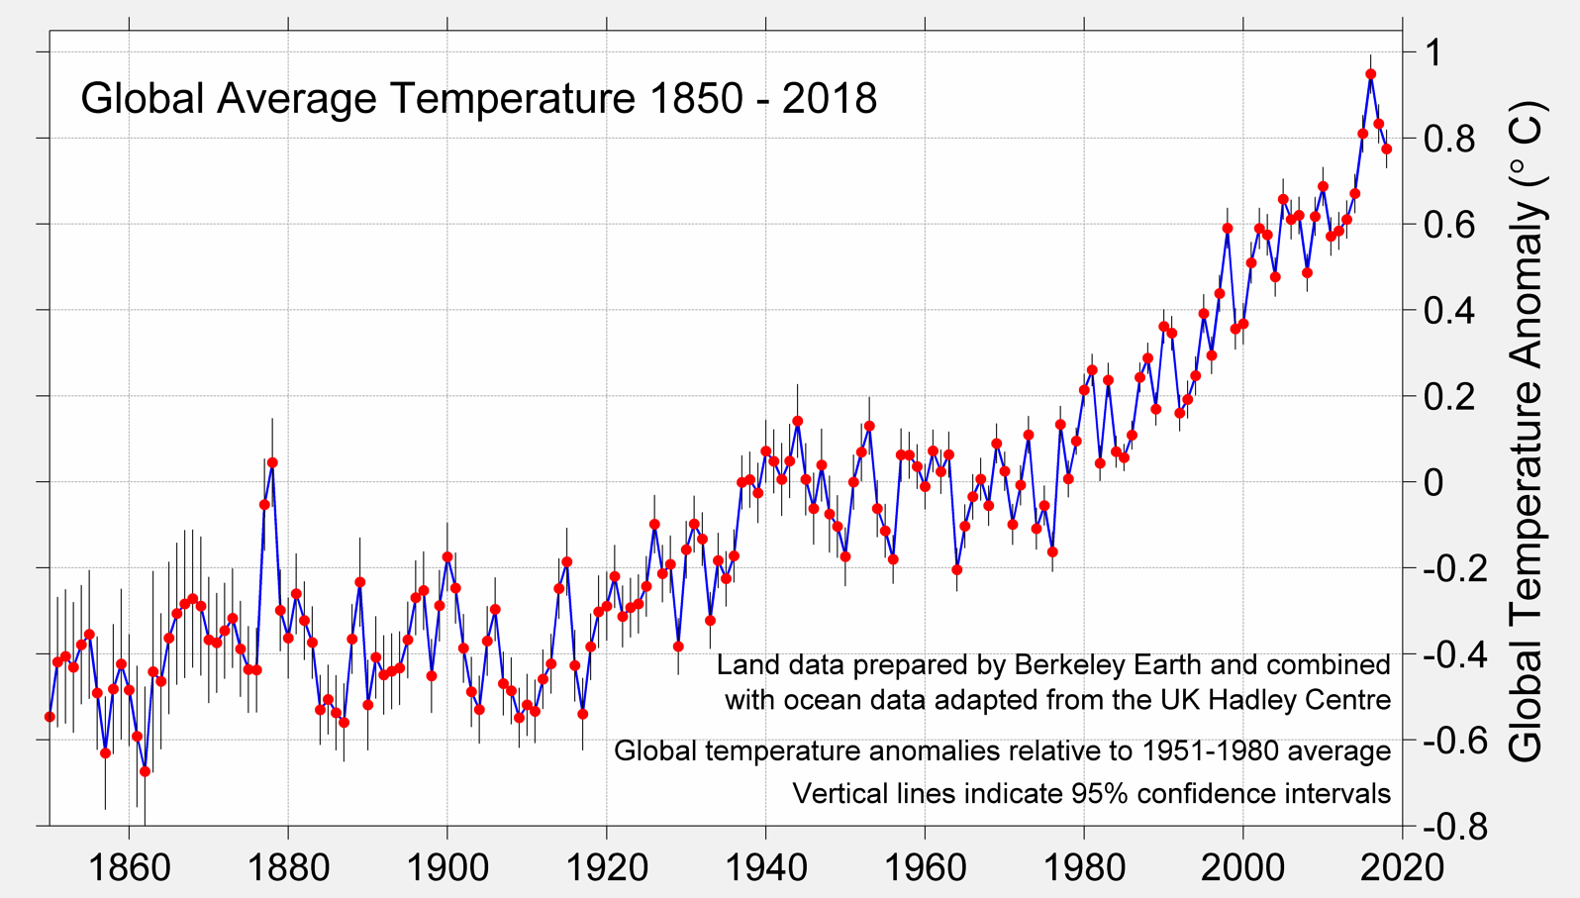
Global Mean Temperature Continues to Rise
El Niño
La Niña
Mt. Pinatubo
Notes:
Pinatubo in 1991
7

Slide 8
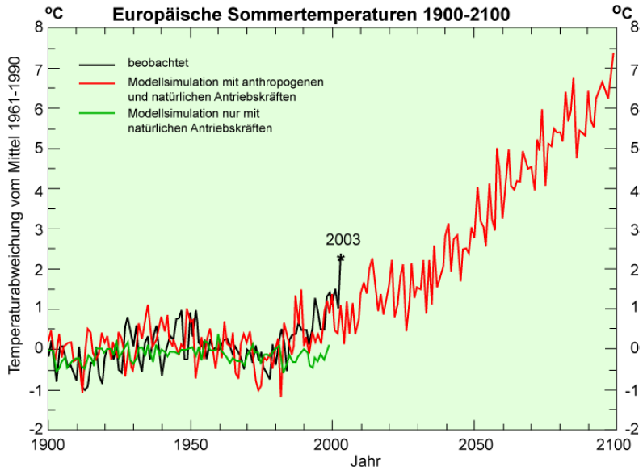
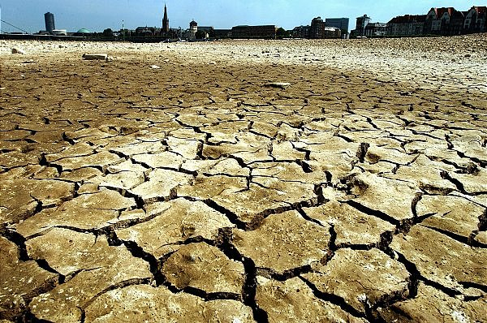
Heat Record of 2003 soon Normality?
Düsseldorf 2003
Notes:
The 2003 European heat wave led to the hottest summer on record in Europe since at least 1540
The heat wave led to health crises in several countries and combined with drought to create a crop shortfall in parts of Southern Europe
European death toll at more than 70,000

Slide 9
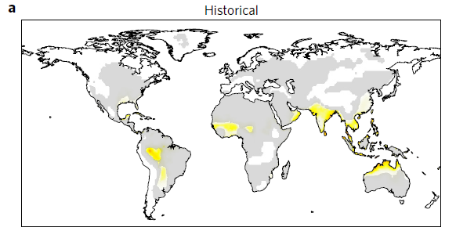
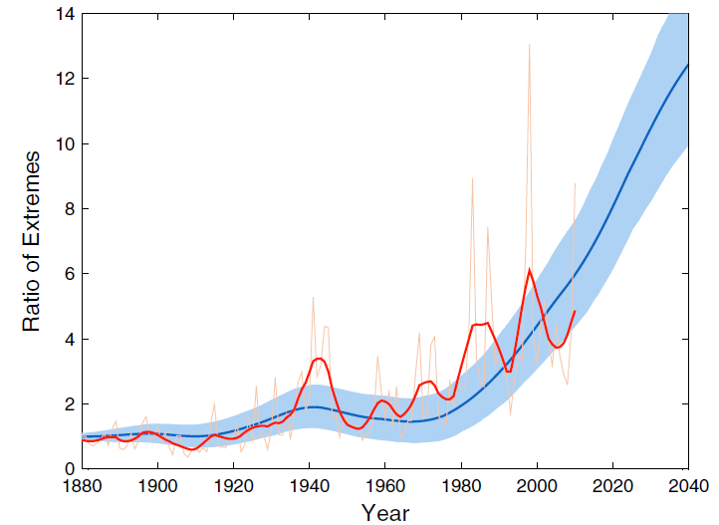
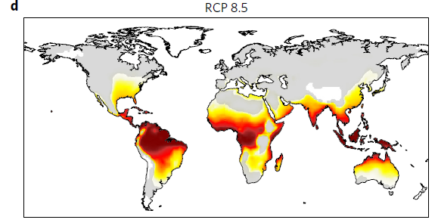
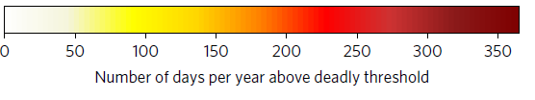
Climate change can bring about conditions exceeding human thermoregulatory capacity
Increase of monthly heat records
Coumou et al., 2013; Mora et al., 2017, Nature Climate Change

Slide 10
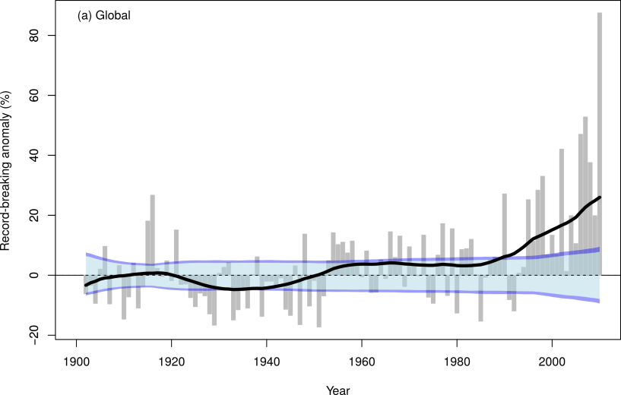
Daily Rainfall Records Increase Globally
88%
The saturation vapour pressure regulates the daily amounts of heavy rainfall.
This increases at a rate of 7% per degree of warming (Clausius-Clapeyron).
26%
Lehmann et al., Climatic Change, 2015

Slide 11
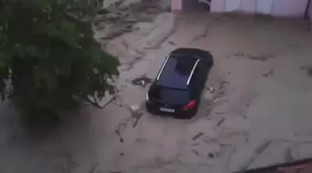
Flash floods in Germany
Braunsbach 29.05.2016
105 l/m² rainfall in 24h
-> once in a century event
Berlin-Tegel, 29.06.17
196,9 Liter per m²
Quelle: facebook/Claudia Rost
Notes:
Tief Mitteleuropa (ähnlich wie 2002 und 2013)
1997: Oderflut
2002: Elbe tritt über die Ufer
2013: Regen mit bis zu 200 Litern pro Quadratmeter Betroffen ist der Süden Deutschlands: die Alt- und Innenstadt von Passau (Bayern) am Zusammenfluss von Donau (l) und Inn ist überflutet

Slide 12
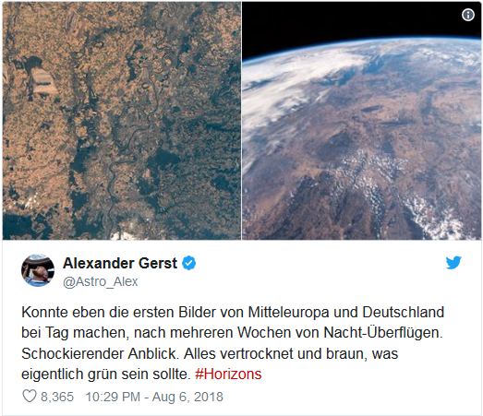
Drought in Europa 2018

Slide 13
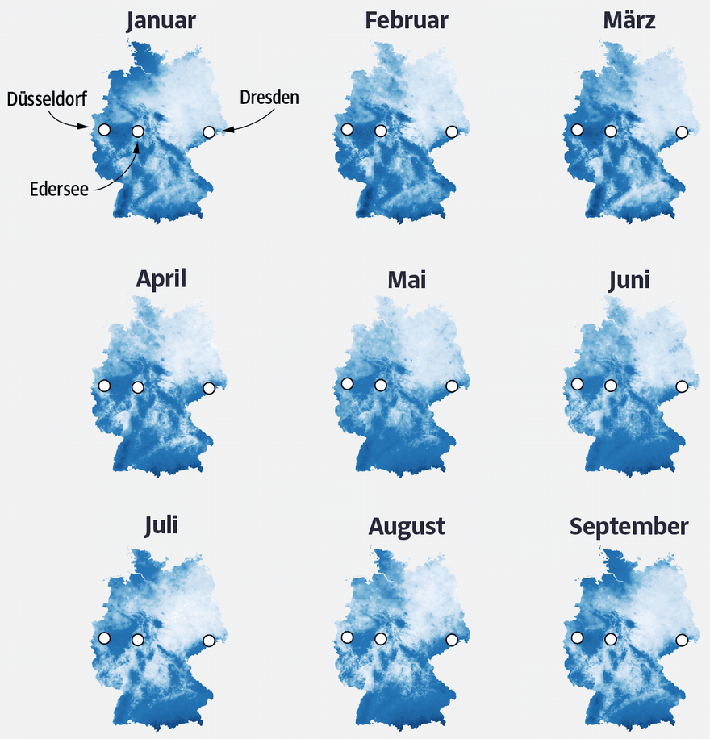
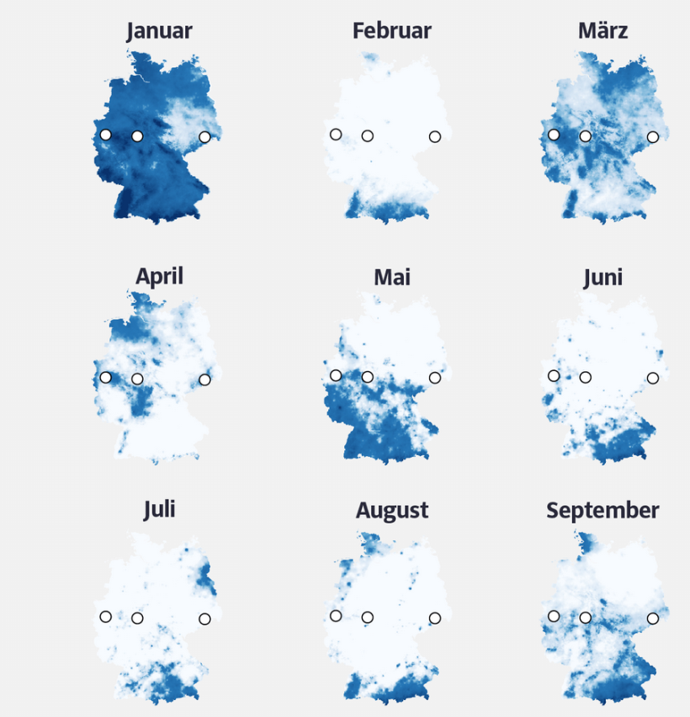
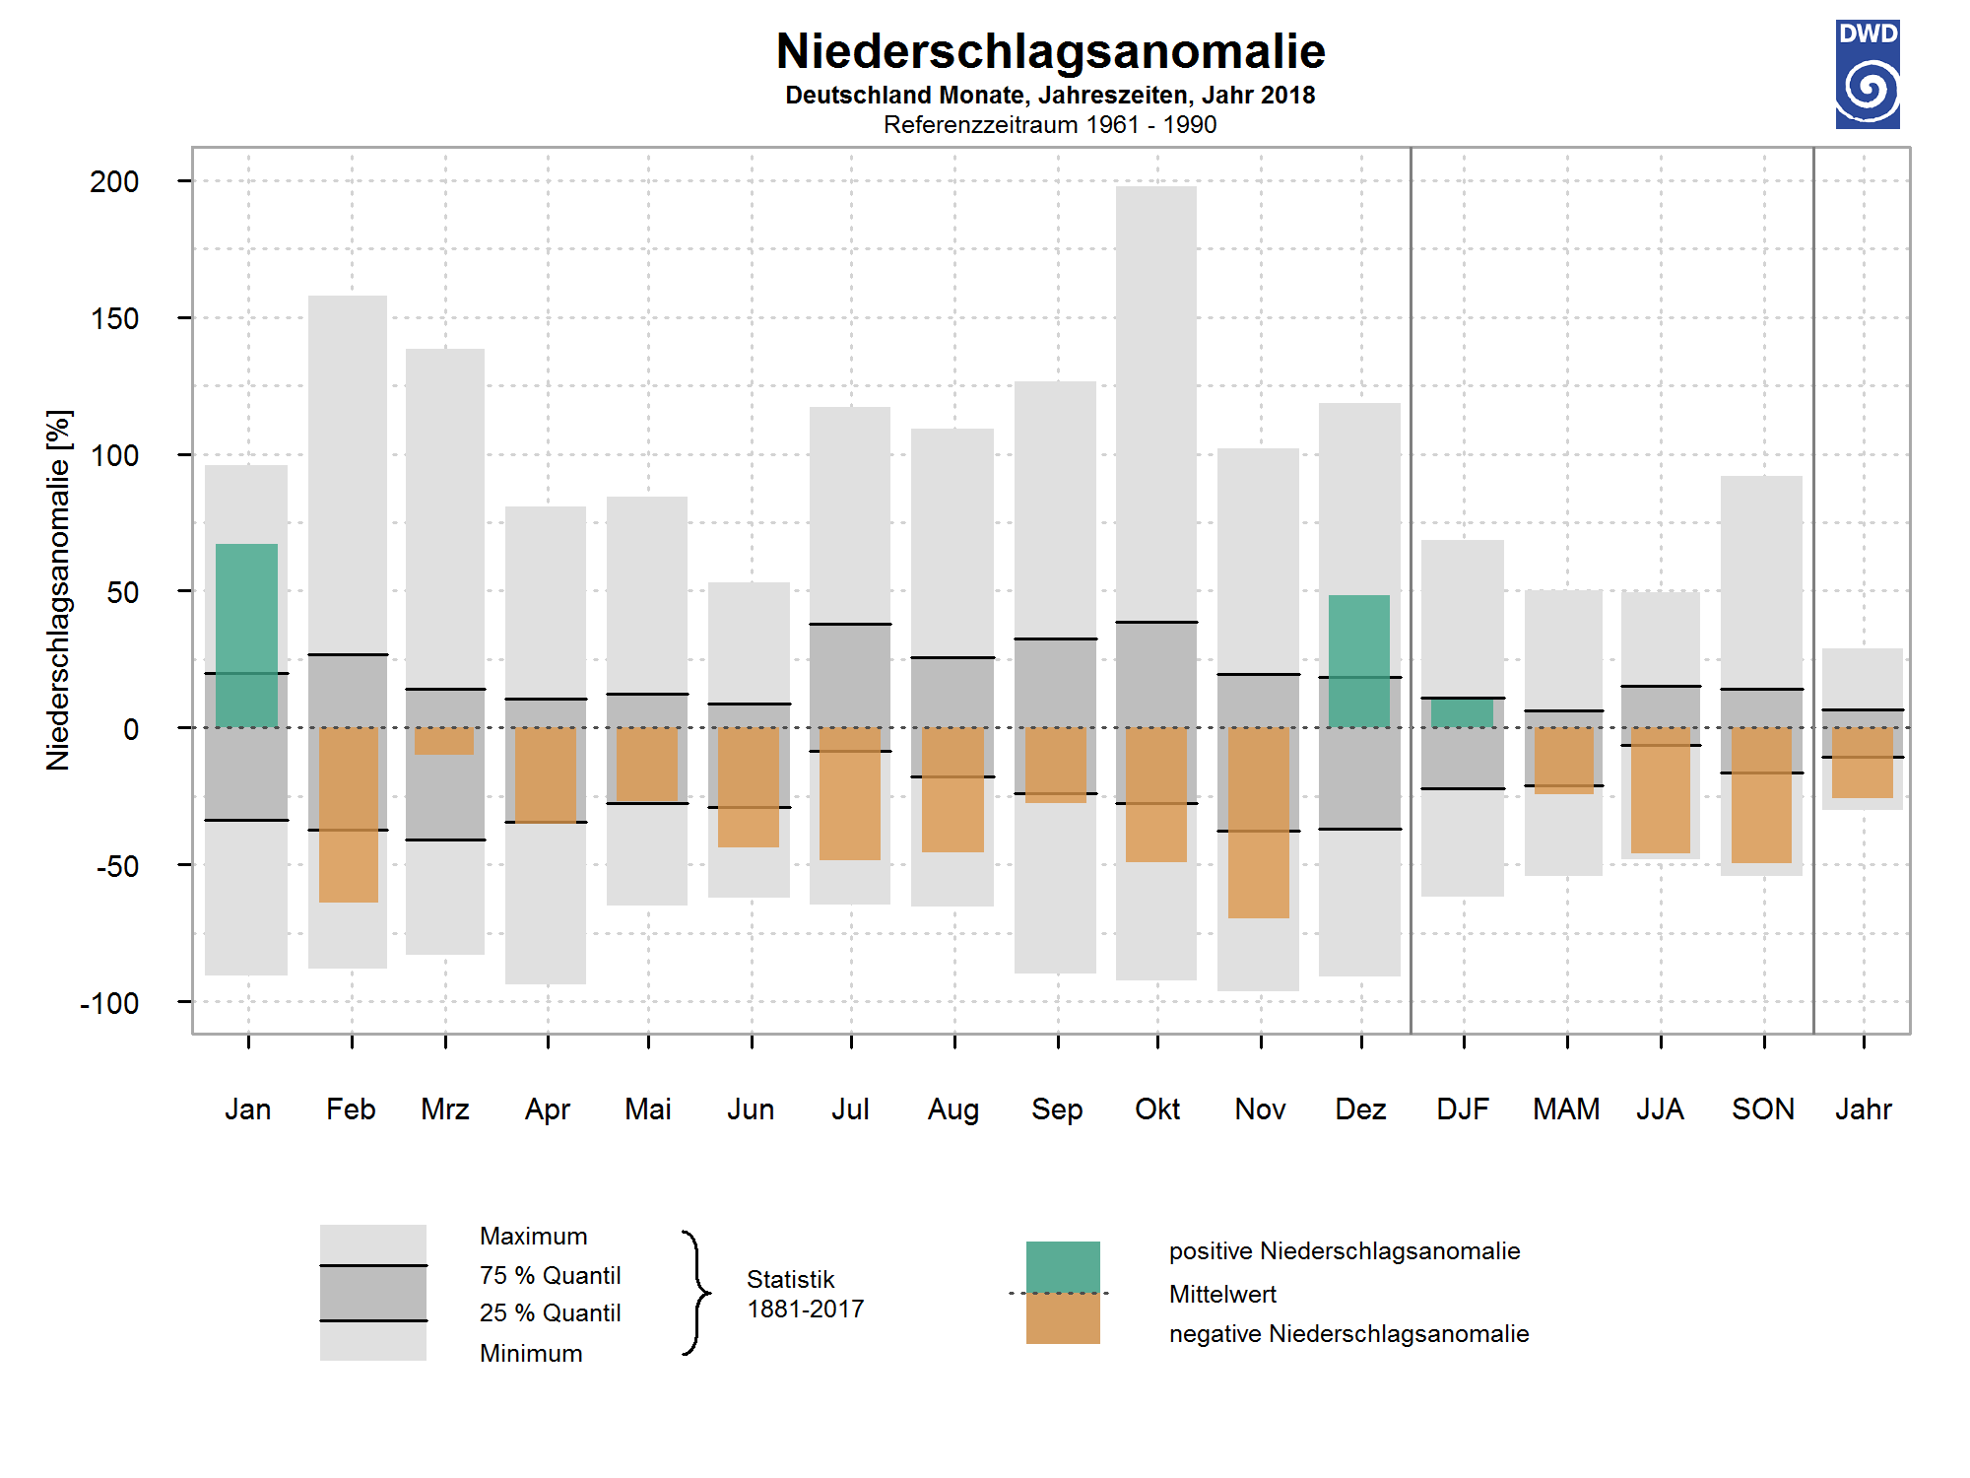
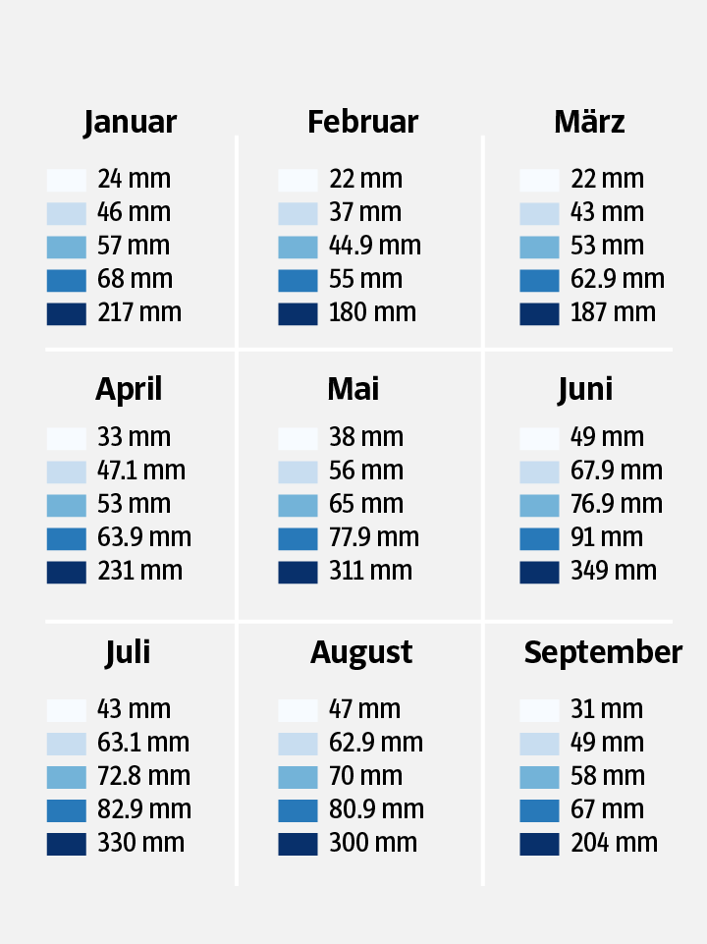
(Heat) Drought-Summer 2018
1960-1990
2018
1960-1990
2018
Source: DWD
Notes:
1960-1990 vs. 2018
- Insgesamt vielen im Sommer 2018 nur 54 % der üblichen Regenmenge

Slide 14
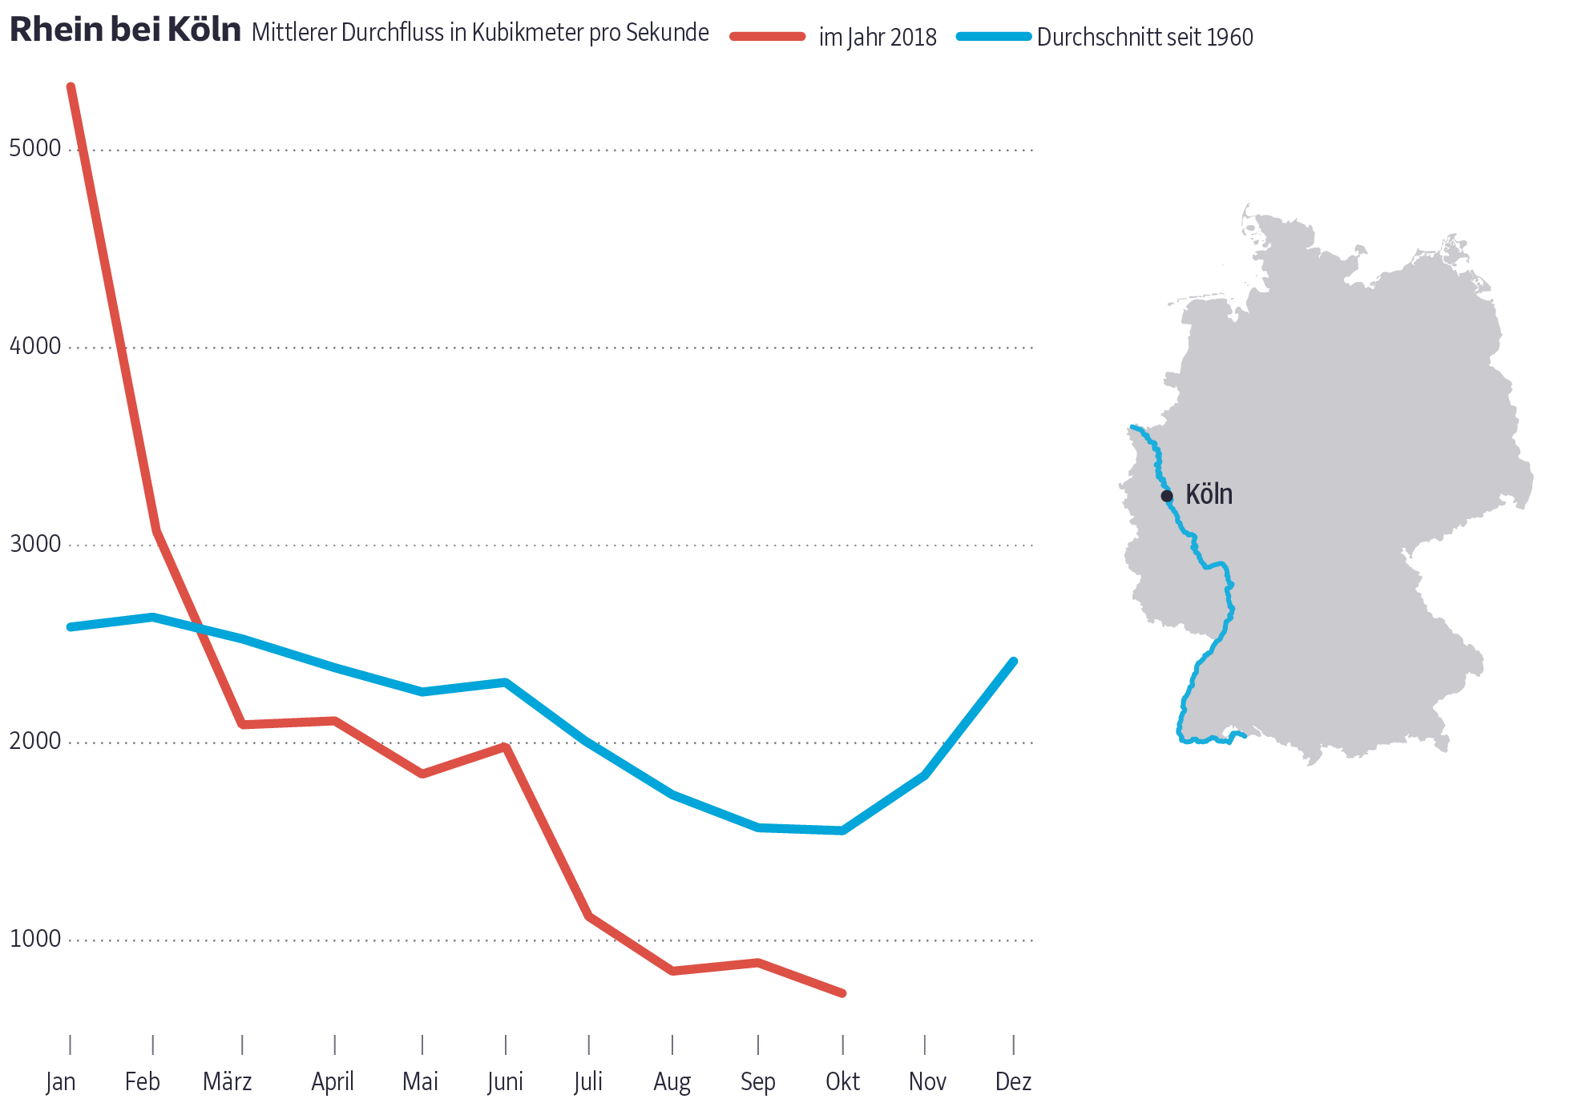
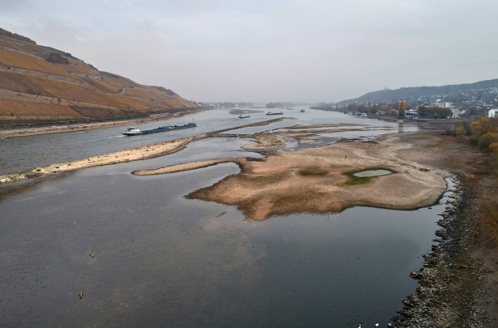
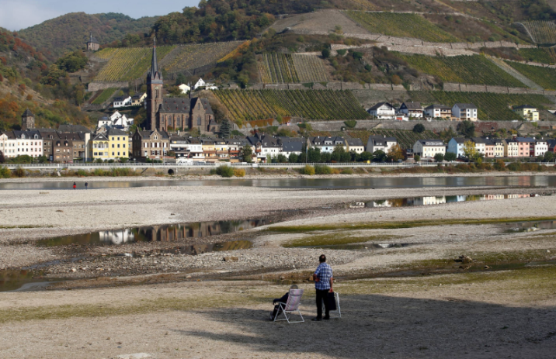
(Heat) Drought-Summer 2018
Bingen am Rhein
Bacharach
Notes:
Thyssenkrupp und BASF mussten zeitweilig ihre Produktion einschränken, Tankstellen den Verkauf stoppen
Bild oben: Bingen
Nild unten: Rhein bei Bacharach, Frachtschiffe können hier nur noch 40% laden

Slide 15
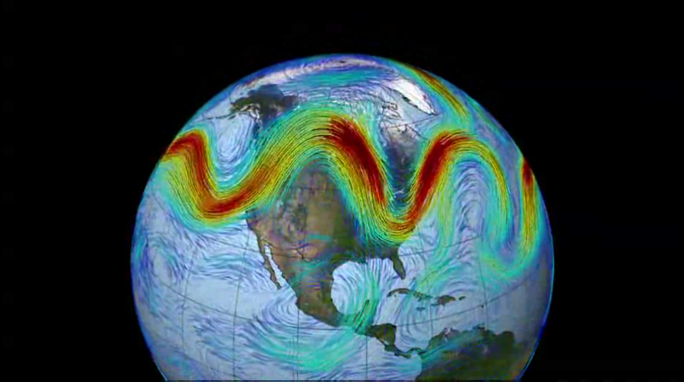
The Meandering Jetstream
Animation
NASA Goddard Space Flight Center
Notes:
This animation shows the jetstream.
Strong westerly winds which circle the globe at around 10 km altitude
Reason why flights from US to Europe are shorter than in the other direction
Exhibits wavy patterns

Slide 16
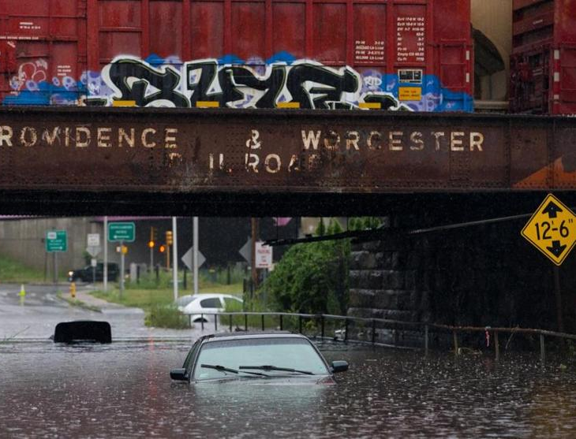
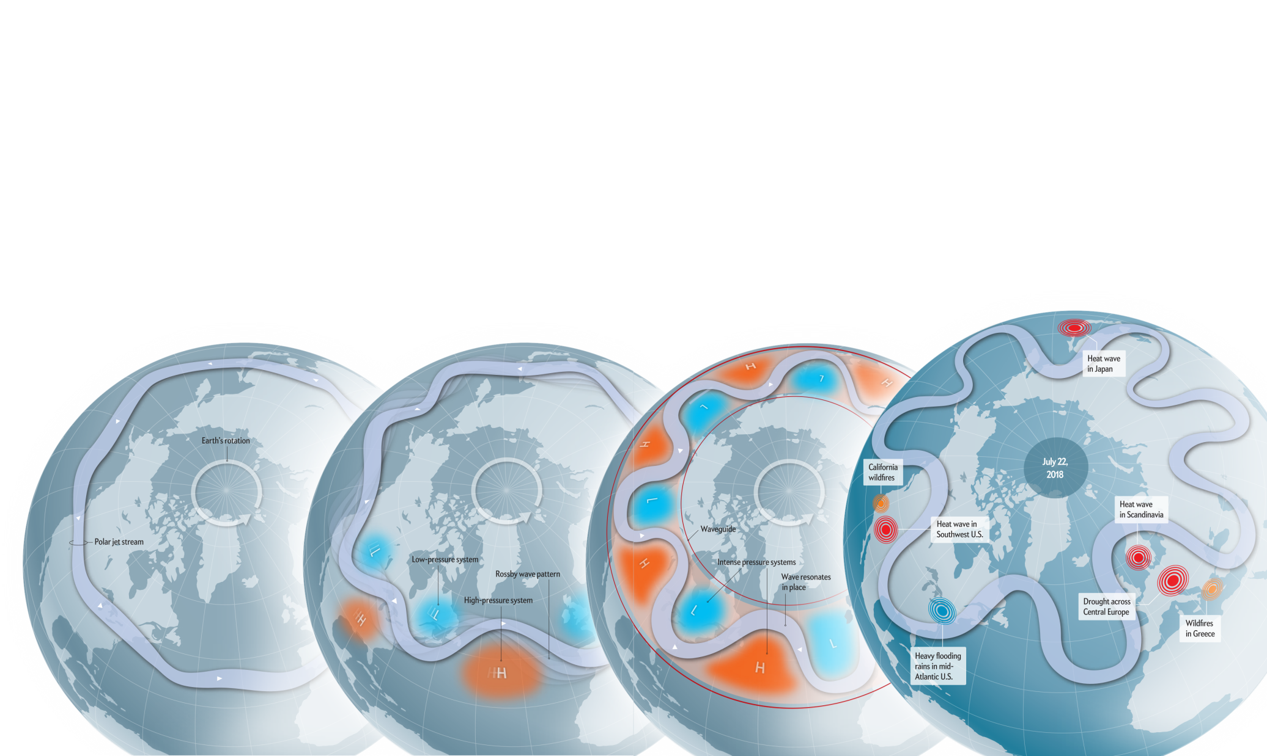
Resonance favors synchronous weather extremes
Drought and Heat in Europa
Torrential rain in Massachusetts
Wildfires in California
Figure: Scientific American
Notes:
Transports high and low pressure systems
Under specific conditions jet stream can resonate: quasi-stationary with high amplitudes
Leads to persistent weather and thus weather extremes

Slide 17
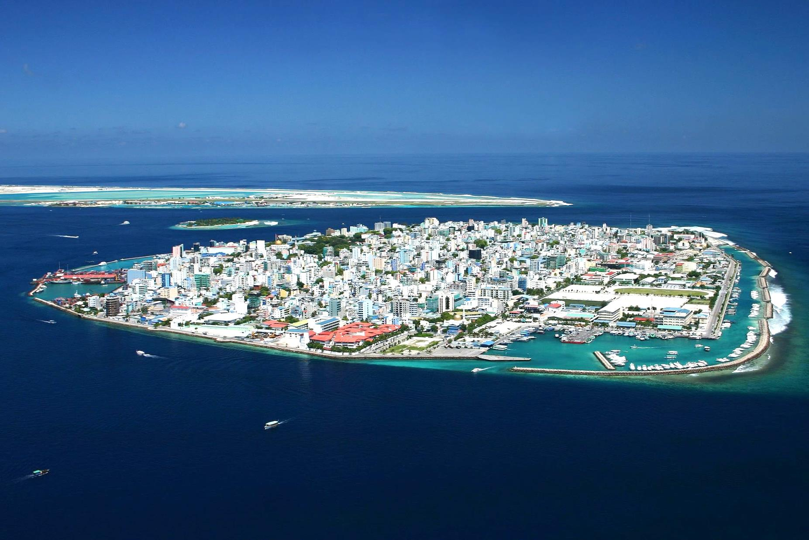
Coastal Cities and Island States Particularly Vulnerable
Malé

Slide 18
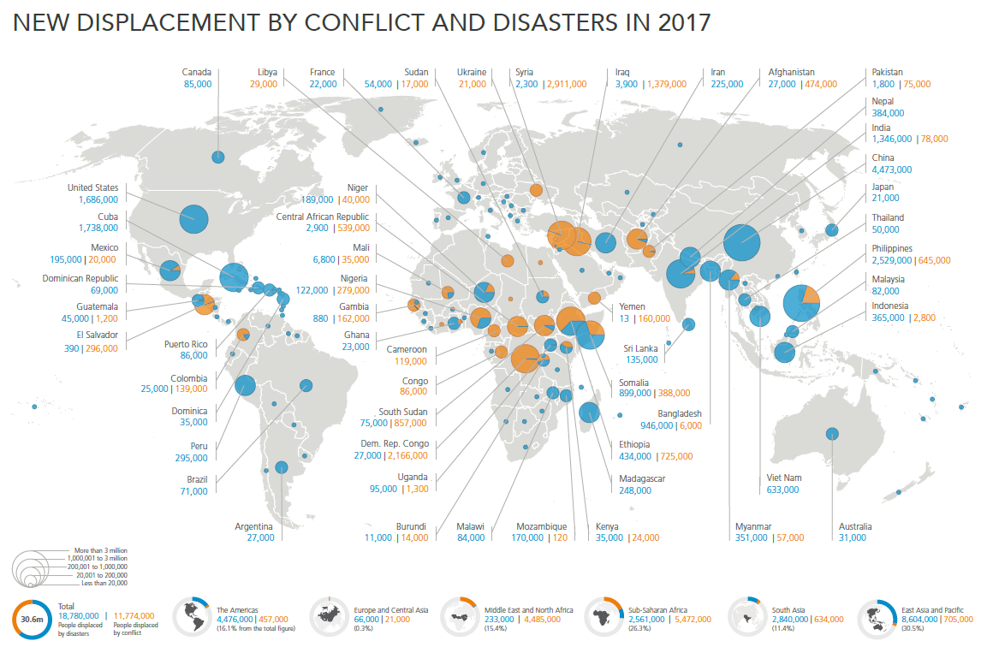
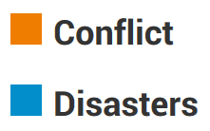

More People Displaced by Natural Disasters Than by Conflicts
2017
Every year about 25 million people are displaced by natural disasters
Notes:
Every year, millions of people around the world are internally (within their countries) displaced both by extreme weather events and by violent conflict.
In fact, the numbers are larger for weather extremes than for conflict.
And many of the weather-related extremes are expected to become more frequent or more intense under climate change.
Some of the displaced people return, some relocate permanently, many are stuck in displaced-persons camps for years.
(The blue circles include also geophysical disasters such as earthquakes, but the large majority are weather-related disasters. And droughts are not even included, because they are slow-onset events and any related migration is harder to identify.)

Slide 19
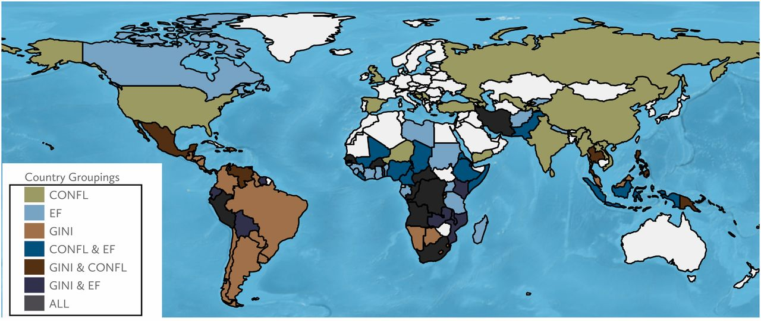
Climate disasters increase risk of armed conflict in multi-ethnic countries
Schleussner et al., PNAS, 2016

Slide 20
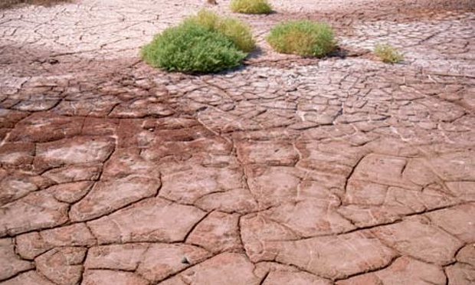
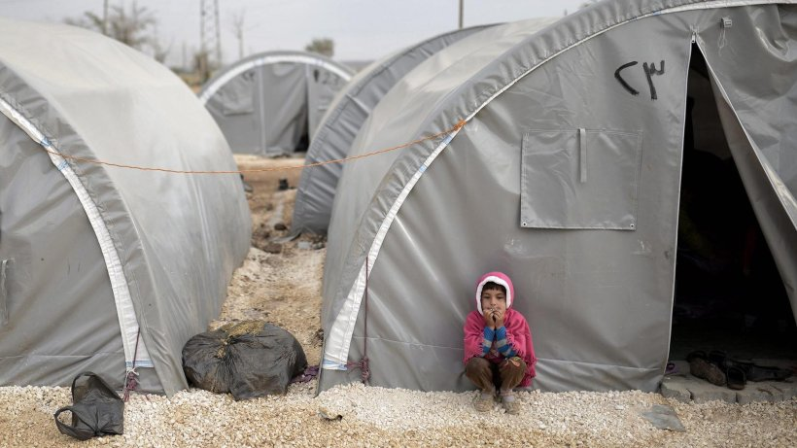
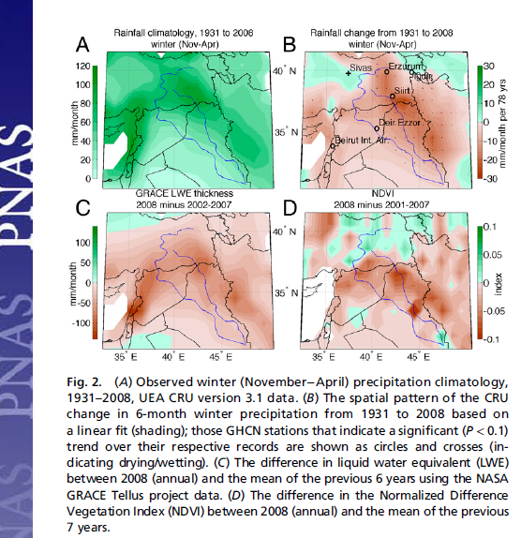
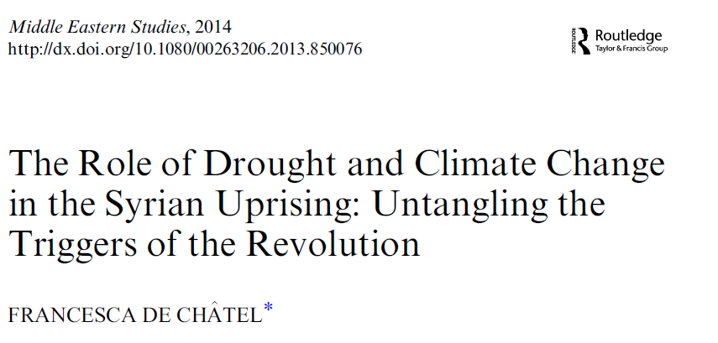

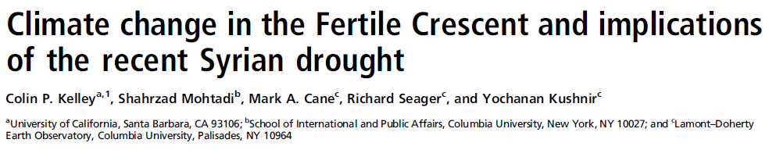
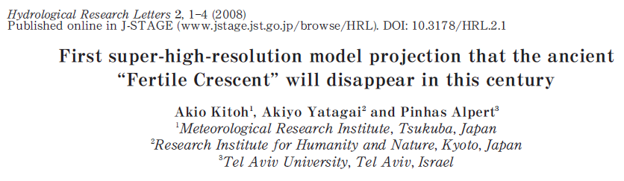
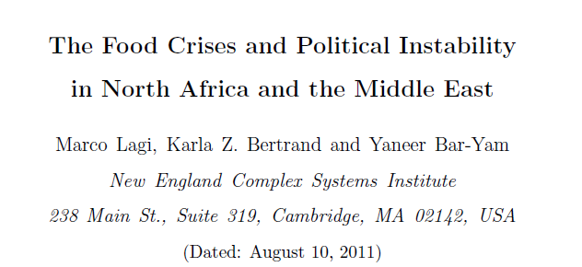
First the Drought, then the Civil War.
Syrien 2009
WBGU 2007
Notes:
2006 to 2010 worst drought in Syrian history
Temperature increase of 6°C
Syrian drought destroyed crops and livestocks -> discplaced up to 1.5 Mio Syrian small farmers had to move into the suburbs of the city
Bad water management and rising food costs

Slide 21
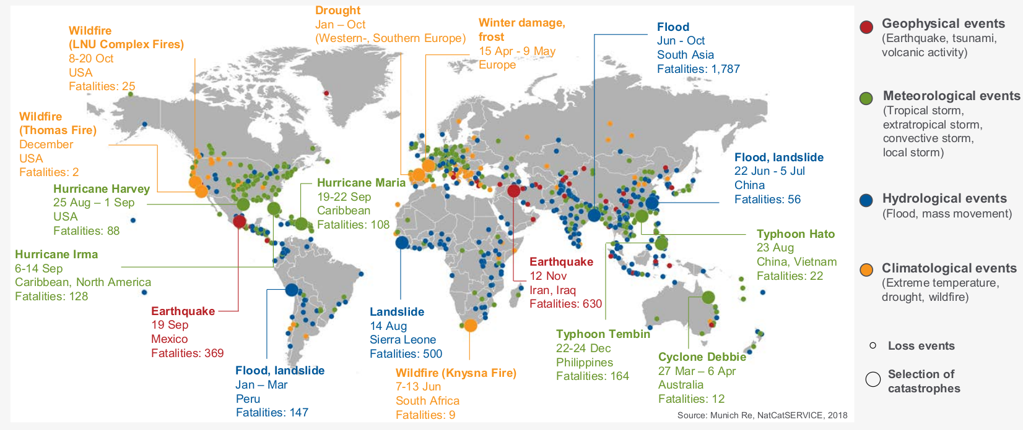
Distribution of natural disasters in 2017
Total losses:
US$ 330bn
Source: Munich Re, NatCatSERVICE, 2018
Notes:
80% of losses due to TCs in 2017

Slide 22
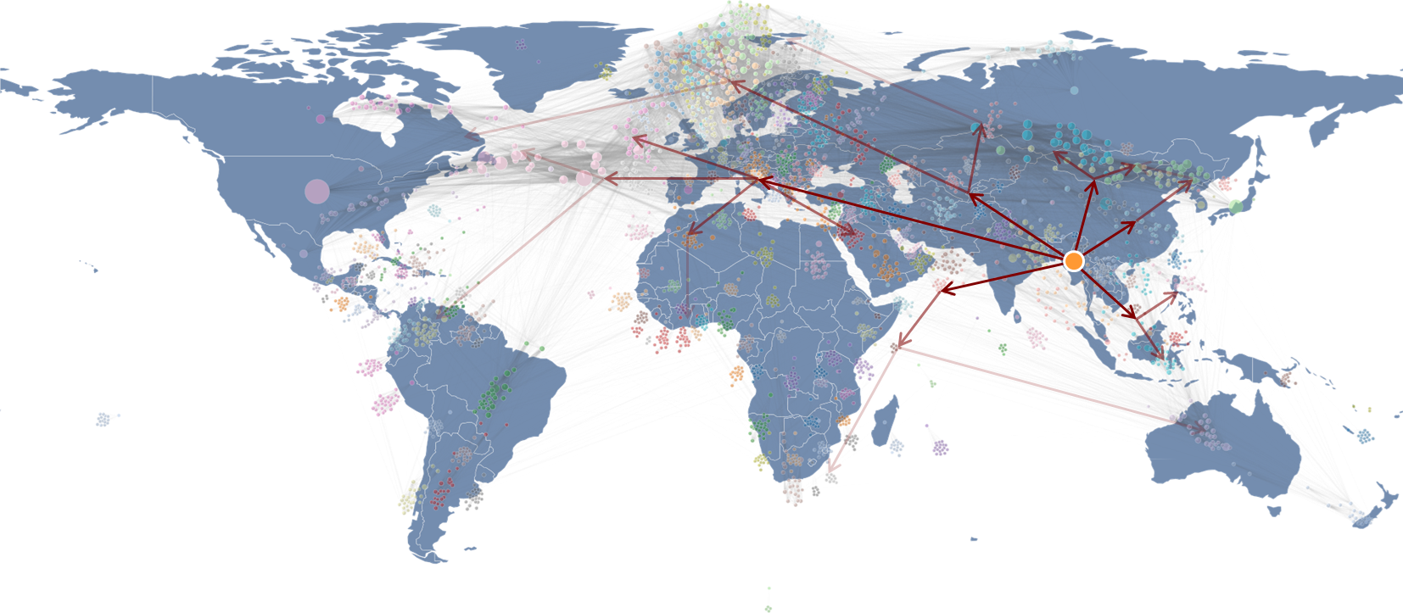
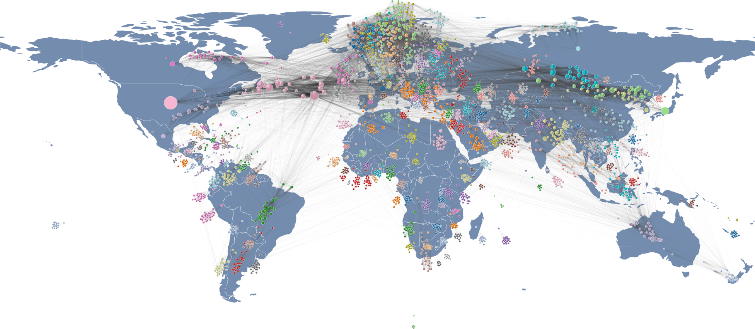
Supply Chain Risks in a Connected World
Global Economic Flows
source: www.zeean.net
Notes:
Acclimate modelliert die dynamische Schadensausbreitung nach einem Event entlang der Lieferbeziehungen zwischen Ländern bzw. Regionen weltweit (n-tier).

Slide 23
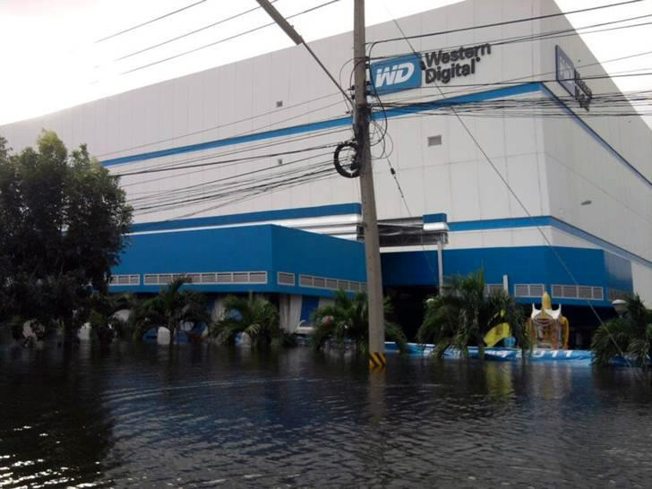
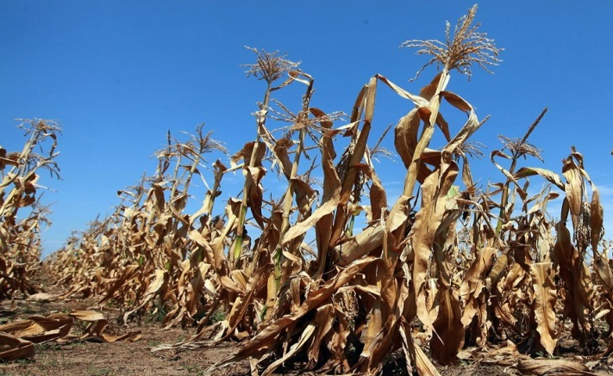



Supply Chain Risks in a Connected World
Preis +20%
Drought in Russia, Ukraine, China, 2010
Floods, Thailand, 2011
?
Global Economic Flows
Increase in crop price
Arab Spring, 2011

Slide 24
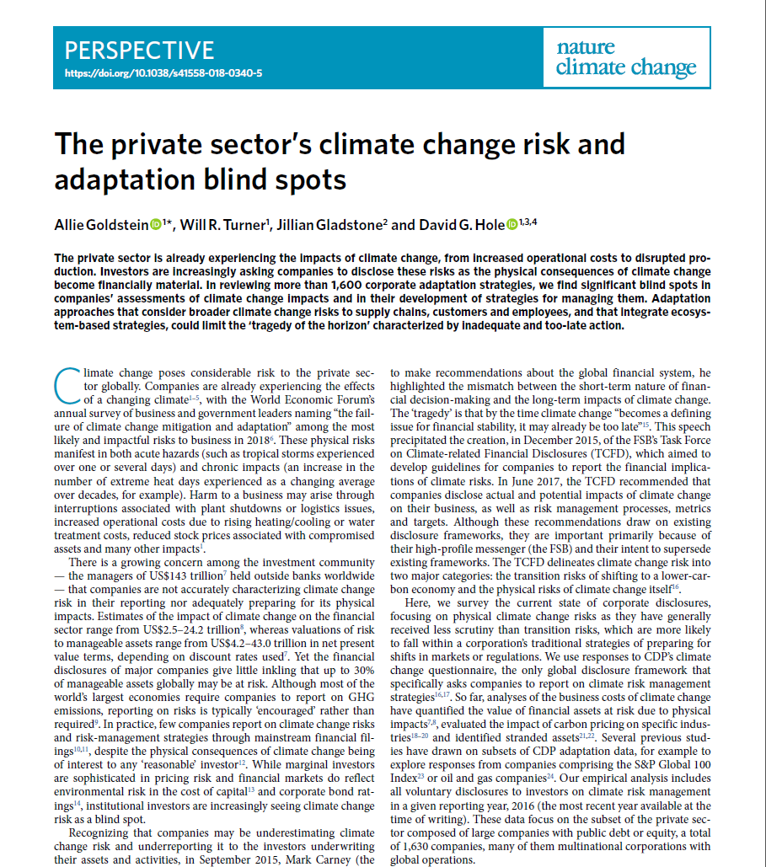
Conclusion
Current risk management strategies from companies:
underestimate the magnitude of the costs of physical climate change risks;
do not consider risks beyond their direct operations;
generally do not report the costs of adaptation;
lack an appreciation for the nonlinearity of climate risks and the potential radical action that implies.
Notes:
The private sector is already experiencing the impacts of climate change, from increased operational costs to disrupted production.
Investors are increasingly asking companies to disclose these risks as the physical consequences of climate change become financially material

Slide 25

Global fossil fuel divestment has doubled in just over a year
Institutions and individuals controlling just under $5.2 trillion in assets are now pledging to divest.
Source: Sustainable Energy for All (SEforALL)
Notes:
https://www.seforall.org/content/global-fossil-fuel-divestment-has-doubled-just-over-year
Institutions and individuals controlling just under $5.2 trillion in assets are now pledging to divest.
Since 2015, Allianz has not financed coal-based business models. Equity stakes have been divested; fixed income investments made before 2015 are in run-off; no new investments have been allowed since 2015. criteria for exclusion are being further sharpened over time.
Allianz will no longer offer insurance for single-site/stand-alone coal power plants or mines and will gradually phase out all coal-based risks from its Property & casualty (P&c) insurance portfolios by 2040.

Slide 26
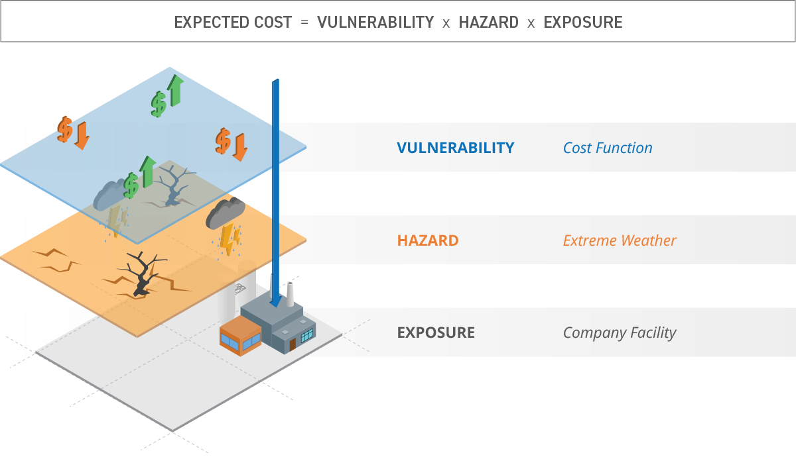

Business Values at Risk due to Climate Change

Slide 27

Calculating Climate VaR: Company Locations

Slide 28

Danone Example: Change in Heat Risk until 2033
Δ annual cost = $1.70M
Total damage = Business Interruption + Asset Destruction
Notes:
Total damage = Business Interruption + Asset Destruction

Slide 29



Climate change is the Biggest Risk Facing our World in 2019
Notes:
4 of top 5 global risks (by likelihood and impact) are global environmental change related

Slide 30

The Paris Agreement
Bildquelle: https://www.wmo.int/media/
Limiting global warming “well below”
2 degrees Celsius
Net-zero emissions of greenhouse gases by mid-21st century
National emission targets regularly reviewed and tightened
Developed countries provide 100 billion USD per year between
2020-2025
Notes:
Aus der Politik kommen die richtigen Signale
Mit dem Pariser Abkommen haben sich 195 Nationen
Viele Nationen und Regierungen scheinen jetzt erst zu begreifen, was sie dort eigentlich beschlossen haben und werden versuchen, sich da wieder herauszumogeln.

Slide 31


Electric Cars on the Rise
End of sale of cars with combustion engine planned by 2025
China's big cities hardly allow cars with combustion engines any more
Notes:
Almost 60 percent of all new cars sold in Norway in March were fully electric, the Norwegian Road Federation (NRF) said on Monday, a global record as the country seeks to end fossil-fueled vehicles sales by 2025.
Electric cars are like smart phones – new jobs required
Quelle:
https://www.autoblog.com/2019/04/01/electric-vehicles-are-now-the-majority-of-cars-sold-in-norway/?guccounter=1&guce_referrer=aHR0cHM6Ly93d3cuZ29vZ2xlLmNvbS8&guce_referrer_sig=AQAAANMiyVMpM56GNVzj03luRHBvAgMPxkhcianz0dn_XJdDsMOIVoTOKou37vZMaFCidQr5u1LZrJB8z5mART1NgwYCSNym6oIhqWRxnd7uLqgYzSI7SbSt67NFUTQYnB1Uepdy87ILI-ojDC0l3wHz941UdOYM6d-RfF7S22KDKQo5

Slide 32

Photovoltaics Spark Optimism
Actual expansion of photovoltaics worldwide regularly exceeds predictions of the International Energy Agency
Source: Twitter @AukeHoekstra
Notes:
Photovoltaic industry will generate thousands of jobs (also in connected industries like batteries)

Slide 35

Germany Reduces – But not Enough
300 million euro CO2 fines planned for 2020-2022
Notes:
https://www.volker-quaschning.de/grafiken/2019-01_Kohleausstieg/index.php

Slide 36

Tipping Points Related to 2°C-Guardrail
Schellnhuber et al. , Nature Climate Change, 2016
Notes:
This is what science can give
Magical boundary – different qualitative regimes

Slide 37


Political Guidelines are Picked up by Economy
Open letter from business to world leaders
22 finance ministers join forces to raise climate ambition
Align policies and practices with the Paris Agreement commitments
Implement carbon pricing
Support climate-related financial disclosure
Encourage business to action
Begging governments to do more
Notes:
left: Respective companies from Alliance have reduced emissions by 9% since 2015 when they committed to Paris agreement
https://www.weforum.org/agenda/2018/11/alliance-ceos-open-letter-climate-change-action/

Slide 38

Worldwide Installed Wind Power is Booming
Quelle: www.volker-quaschning.de

Slide 39

Affected Facilities
Identify all locations that are threatened by coastal flooding
(assume no protection)
16% of all MSCI ACWI enterprise facilities potentially threatened

Slide 40
Top 20 Affected Countries in the MSCI ACWI
29% of all Asian locations are at risk from coastal flooding
13% in Europe (83% in the Netherlands)
Only 7% of locations threatened in the Americas, but still a significant total number

Slide 41

Temperature Development in the Holocene
Marcott et al. 2013, Science
Notes:
The temperature has been reconstructed with proxy data (mainly from sediment cores) and was calibrated with observational data for the period 1850-1950, where both time series overlap. Anomalies relative to 1961-1990.

Slide 42







Century of Cities
Notes:
Most people do and will live in (mega) cities.
Decisions are often made in cities: Bürgermeister von London gegen Brexit. Bürgermeister von Städten und Gemeinden in den USA gegen Abschiebepolitik von Trump

Slide 43



Living Climate-Neutral in Berlin
- 35%
Conclusion: Every individual can contribute to climate stabilization, but without politics it won't work.
https://klimaneutral.berlin/
Notes:
Die Klima-Bilanz der KliB-Haushalte ist rund 35% besser als der deutsche Durchschnitt

Slide 44



Hazard
Exposure
Risk
Vulnerability

Slide 45

Climate Change Intensifies Flooding on US Coast
© Strohbusch
Notes:
Contribution of human-caused sea level rise on nuisance floods since 1950
http://www.climatecentral.org/news/the-human-fingerprints-on-coastal-floods-20050

Slide 46





Why it was colder in Berlin than at the North Pole
Mpemba effect
Rome
Niagra Falls
Acropolis
Notes:
Guardian graphic: https://amp.theguardian.com/environment/2018/feb/27/arctic-warming-scientists-alarmed-by-crazy-temperature-rises?__twitter_impression=true
In February 2018 US and Europe experienced extreme cold leading to extremes shown in figures
This lead some people wonder about global warming
Globally, it was not too cold but actually warmer than it should be
Heat was simply shifted to Arctic which had temperatures 20°C above climatology

Slide 47

Danone Example: Change in Cold and Snow Risk until 2033
Δ annual benefit = $0.97M

Slide 48


How climate change can lead to more cold extremes
previous hypothesis based on correlations
PIK study confirms causal relationship for the first time
Kretschmer et al., 2016, J Clim
Kretschmer et al., 2017, BAMS
Kretschmer et al., 2018, npj
Notes:
Climate change leads to less sea-ice extend in Barents-Kara Sea in autumn
Reduced sea ice can weaken polar vortex in winter
Weak polar vortex can lead to cold spells in US and Europe
Bisherige Studien lieferten nur Hinweise basierend auf Korrelationen. M. Kretschmer und Kollegen zeigten erstmals mit neuartigen Methoden (machine-learning & causal discovery algorithms), dass es tatsächlich einen kausalen Zusammenhang gibt.

Slide 49


Projected Increase in Climate Refugees
Sea level rise may lead to
1,4 Mrd. climate refugees until 2060
2,0 Mrd. climate refugees until 2100
Notes:
Schon heute zwingt der Klimawandel etwa 19,2 Millionen Menschen dazu, ihre Heimat zu verlassen. Das schreibt das „Norwegian Refugee Council“ in einem Bericht über weltweite Fluchtursachen.

Slide 50






Millions of People Threatened by Floods
Germany: possible increase in the number of affected people from 100,000 to 700,000 in 2040
Worldwide: Increase to > 2 million people
Adaptation measures necessary if current standard is to be maintained
Willner et al., Science Advances, 2018
Notes:
Red: Ein Wert von 2 bedeutet, dass 3x mehr Menschen einem Risiko von Überflutungen ausgesetzt sind; 2035 - 2044 im Vergleich zu 1971 - 2004
Green: Levels entsprechen Schutz vor Überflutungen unterschiedlicher “Stärken” (return periods)
Das erstaunliche an der Studie ist, dass man in Deutschland und den USA (also den hoch entwickelten Ländern) einen ähnlichen Anpassungsdruck erwartet wie in Indien und Indonesien – was den Hochwasserschutz anbelangt.

Slide 51




Ongoing Drought in California 2011 – 2017
© AFP
Bild: Damon Winter/NYT/Redux/laif
Notes:
Drought has been so extreme that water usage had to be regulated.

Slide 52

Cognitive Climate Dissonance
Extreme stress activates escape-fight reaction.
If these are ineffective (as with climate change) solidification occurs.

Slide 53

What to do?
© Strohbusch

Slide 54


Paris-Compatible Global Emission Pathways
Figueres et al., Nature, 2017
Notes:
- Mean budget of ~600 Gt CO2 left to limit global warming by 1-5-2.0°C

Slide 55


Current Efforts are not Enough
Source: Climate Action Tracker

Slide 56


The Ecological footprint
© Strohbusch

Slide 57



„There is no Planet B“
13. August 2015
3. August 2016
2. August 2017
1. August 2018
Humanity is using the resources of 1.7 planets
– Germany 3.2 planets!
© Strohbusch
Notes:
https://www.overshootday.org/newsroom/press-release-german/

Slide 58

Stabilisierung bedeutet Reduktion
National Research Council, 2011
Notes:
http://perso.ens-lyon.fr/freddy.bouchet/Climate/Repports/NAS/NRC-ClimateStabilizationTarget.pdf
National Research Council. 2011. Climate Stabilization Targets: Emissions, Concentrations, and Impacts over Decades to Millennia. Washington, DC:

Slide 59


Slide 60



Slide 61











Climate Impacts and Possible Migration Routes
Bangladesh
Philippines
People‘s Republic of China
Indus Delta
Tuvalu
Mekong Delta

Slide 62

Das verbleibende Emissionsbudget sinkt
National Research Council, 2011
Notes:
http://perso.ens-lyon.fr/freddy.bouchet/Climate/Repports/NAS/NRC-ClimateStabilizationTarget.pdf
National Research Council. 2011. Climate Stabilization Targets: Emissions, Concentrations, and Impacts over Decades to Millennia. Washington, DC:

Slide 63

Tipping Elements in the Earth System
Source: PIK 2017

Slide 64

100% Clean and Renewable Wind, Water, and Sunlight
All-Sector Energy Roadmaps for 139 Countries of the World
Jacobson et al. 2016, Joule
Notes:
http://web.stanford.edu/group/efmh/jacobson/Articles/I/CountriesWWS.pdf

Slide 65

Der Meeresspiegel steigt kontinuierlich an
Hohe Emissionen
Niedrige Emissionen
IPCC, AR5, 2013

Slide 66

Climate Monitoring

Slide 67


Slide 68


Slide 69

Projizierte Ertragsänderungen zeigen regionale Abhängigkeit
> +50%
< -50%
CO₂ Düngeeffekt berücksichtigt
Zunahme in höheren Breitengraden
Abnahme in den (Sub-) Tropen
Rosenzweig et al. (2013)

Slide 70

Global Map of Potential Tipping Cascades
Steffen et al, 2018, PNAS

Slide 71
Temperature Trends for the Past 65 Ma and
Potential Geohistorical Analogs for Future Climates
Burke et al. 2018, PNAS

Slide 72



What the World Would Look Like if All the Ice Melted
Natural Geographic, 2013

Slide 73

Wasted capital and stranded assets
“Once climate change becomes a defining issue for financial stability, it may already be too late.”
Quelle: Mark Carney (Head of the Financial Stability Board)
Notes:
1/5 bis 1/3 der weltweiten Reserven an Kohle, Öl und Gas können nicht genutzt werden, wenn das 2 Grad Ziel erreicht werden soll -> stranded assets

Slide 74

Notes:
https://www.carbontracker.org/reports/carbon-bubble

Slide 75


Learning from Earth‘s Past to Understand the Future
Holocene
Source: NASA graph by Robert Simmon, based on data from Jouzel et al., 2007, Science
Notes:
https://earthobservatory.nasa.gov/features/GlobalWarming/page3.php
Last 1-2 Mio years are characterized by glacial cycles (periodicity of ~120.000 Jahre)
Interglacials typically extend for 11.000 –13.000 years

Slide 76





Why the Climate Changes – Long-term Factors:
Milankovic Cycles
The Greenhouse Effect
1941
M. Milankovic
1896
S. Arrhenius
Quelle: Global Warming Art
Notes:
There are different natural drivers for long-term climate change.
One is called Milankovic cycle.
The other is the greenhouse effect (-18°C vs. 15°C)

Slide 77



Most Coral Ecosystems will Face Extinction Even at 1.5°C Global Warming
Great Barrier Reef, March 2016
Frieler et al., Nature Climate Change 2012
Preserving >10% of coral reefs worldwide would require limiting warming to below 1.5 °C
Notes:
Coral bleaching, Lizard Island, Great Barrier Reef, March 2016
Foto: @ XL Catlin Seaview Survey

Slide 78

Irreversible Loss of Greenland Ice-Sheet Could Start
with 1.6°C Temperature Rise
Point of no return:
1–4°C global warming
Robinson et al. 2012, Nature Climate Change
Notes:
Models show that Greenland’s ice sheet masses may become instabile at 1.6-2°C
That means that the melting process could not be stopped any more.
All of Greenland’s ice would be responsible for a sea-level increase of 7 m.

Slide 79





Temperature Projections until 2100
2°C Leitplanke
Notes:
If we manage to reduce CO2 emissions and bring them to net zero by the mid of the century, we will be able to hold the 2° guideline
If simply continue along the old line, we will end up with 4-5° of warming until the end of the century
79

Slide 80






The Die is Cast!
ca. 3,3 m
Sea-Level Equivalent
Ice-Flow Speed
Acceleration
of Ice Flow
Notes:
Current studies show that such a tipping point may have already been crossed in west Antarctic.
If west Antarctica would meld completely, sea level would rise by 8 m.

Slide 81


Projected sea-level rise in Mumbai
4°C
2°C
© Strohbusch

Slide 82
12 September 2012
12 September 1979
Notes:
Figures from: ttps://svs.gsfc.nasa.gov/4435
Graph from: https://svs.gsfc.nasa.gov/vis/a000000/a004500/a004573/frames/3840x2160_16x9_60p/graph/

Slide 83


Conclusion: The Weather is Becoming More Extreme
Climate change is here...
… and it is caused by humans.
Natural fluctuations are increasingly being superimposed by climate change induced long-term trends.
Previously rare events are becoming more frequent.
This is due to dynamic and thermodynamic changes: warming & circulation changes.
Source: David McNew / Getty Images

