Slide 1
Research Activities
Potsdam Institute for Climate Impact Research
Christoph Menz
2024/02/08

Slide 2
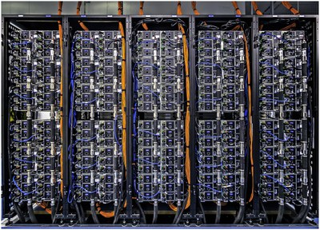
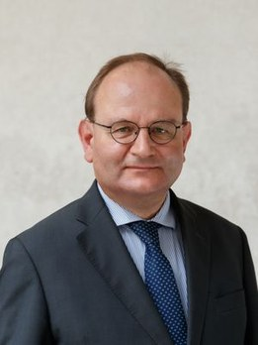
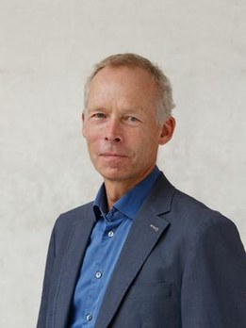
Potsdam Institute for Climate Impact Research
Research Activities
Potsdam Institute for Climate Impact Research
“Advancing the scientific frontier on inter-disciplinary climate impact research for global sustainability and contributing knowledge and solutions for a safe and just climate future”
Founded 1992
Around 400 scientists
Directors: Ottmar Edenhofer & Johan Rockström
PIK is under constant development
Earth System Analysis | Climate Resilience | Transformation Pathways | Complexity Science
Oceans, Atmosphere and Biosphere in Past, Present and Future | Climate Impacts and Adaptation | Climate Risks and Sustainable Development | Machine Learning, Nonlinear Methods and Decision Strategies
Earth System Analysis | Climate Resilience | Transformation Pathways | Complexity Science
Oceans, Atmosphere and Biosphere in Past, Present and Future | Climate Impacts and Adaptation | Climate Risks and Sustainable Development | Machine Learning, Nonlinear Methods and Decision Strategies

Slide 3
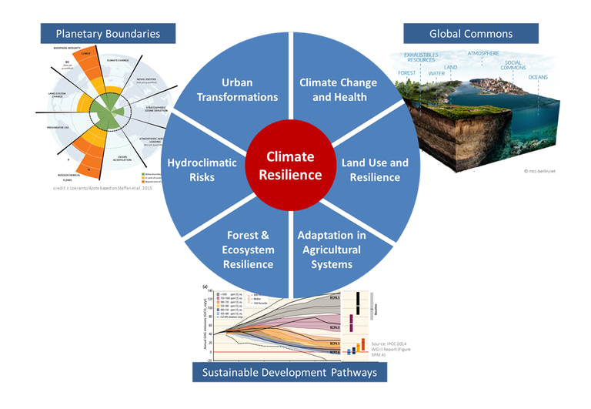
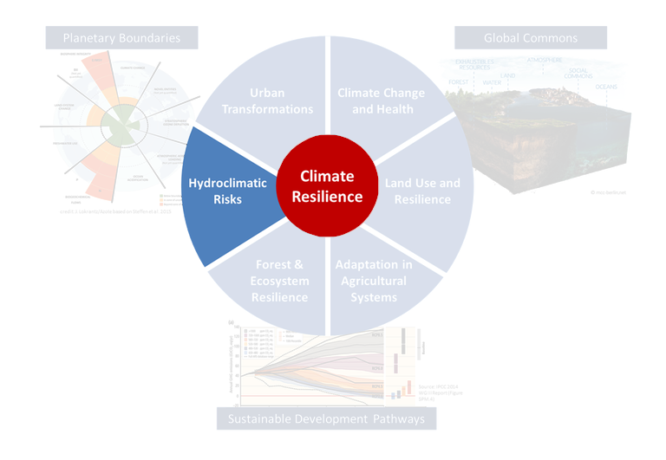
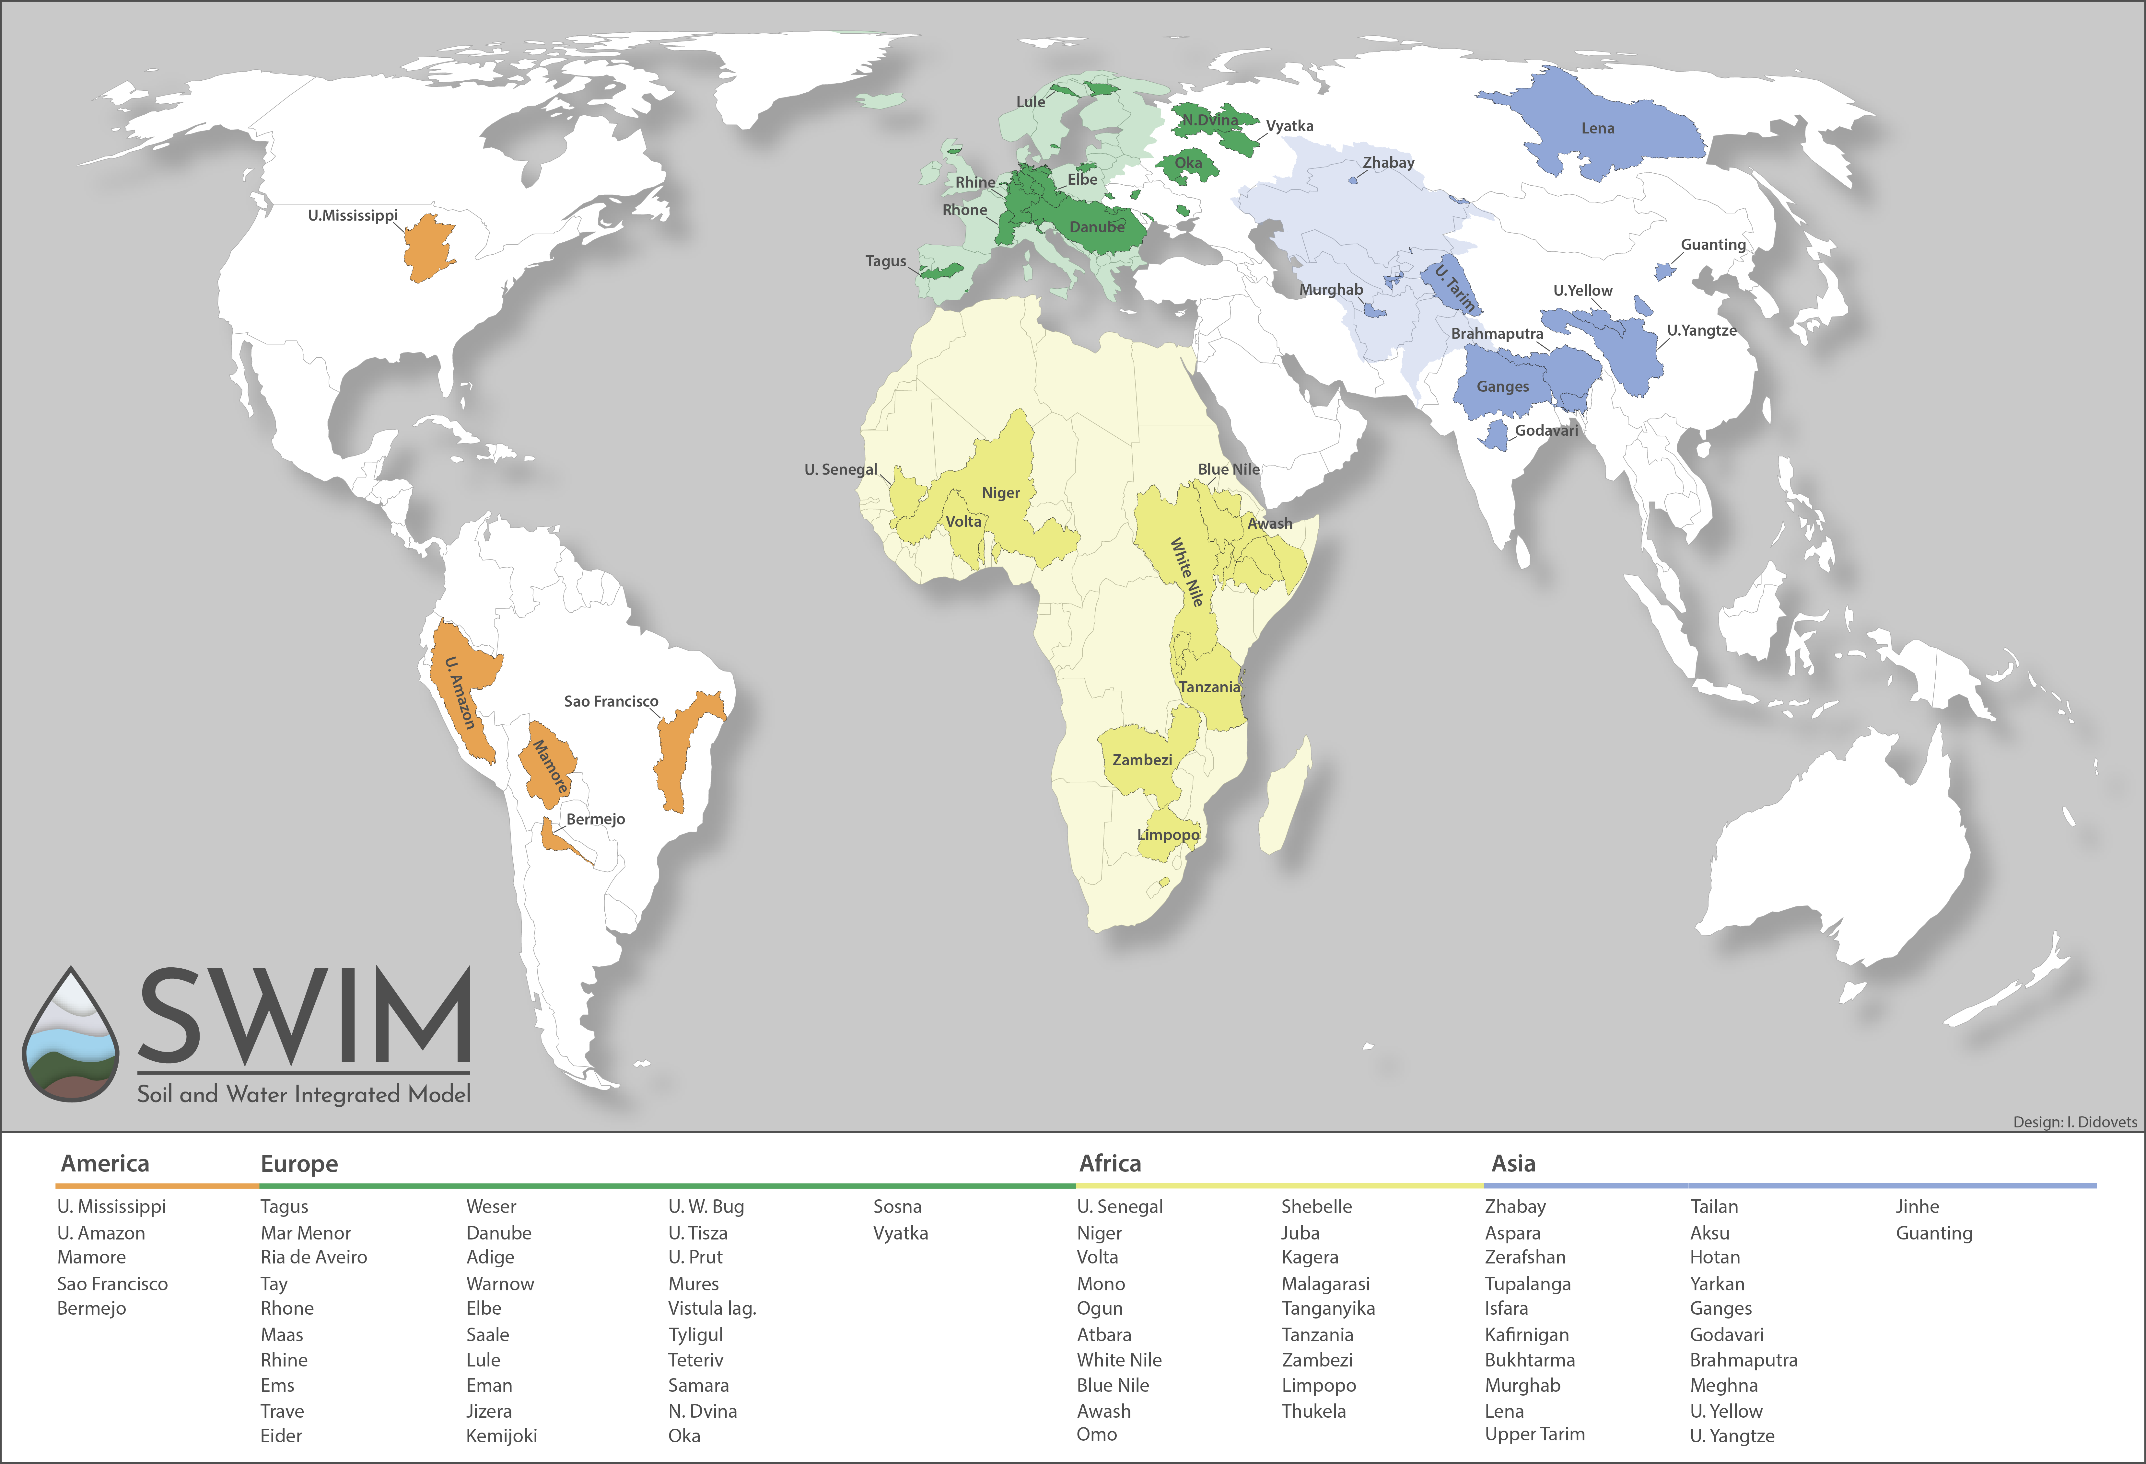
Research Activities
Potsdam Institute for Climate Impact Research
RD2 – Climate Resilience
Hydroclimatic Risks
Potsdam Institute for Climate Impact Research
How can we increase resilience to climate change in different sectors and across scales by managing the global commons within planetary boundaries?
Hydroclimatic Risks
What are human dimensions of climate change in most effected regions?
How to improve robustness of impact assessments?
What are possible chances for a regional carbon free development?
How to achieve regional energy, food and water security under climate change?
Main Tools
Land-Biosphere modelling
Forest modelling
Agricultural modelling
Hydrological modelling

Slide 4
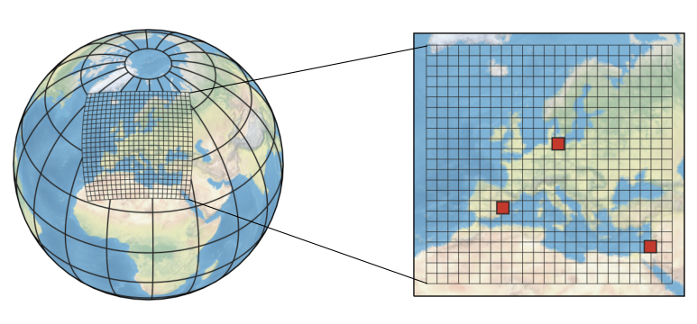
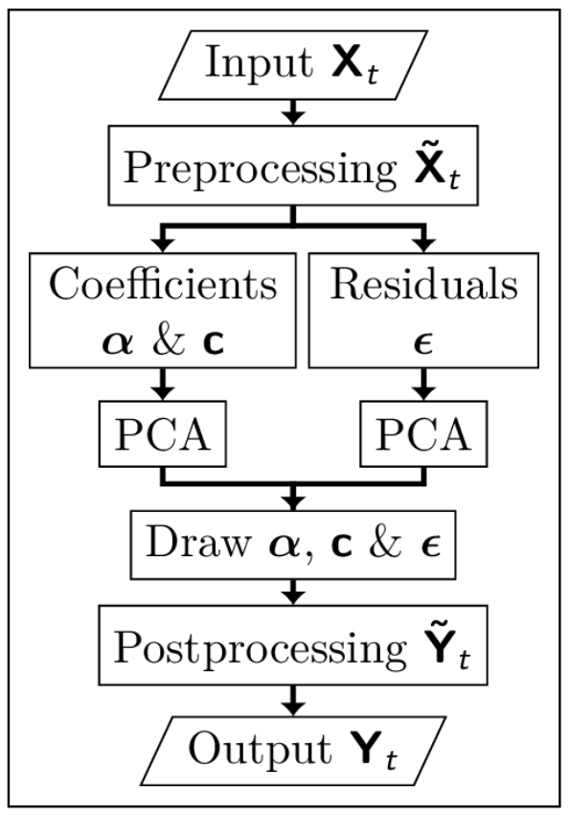
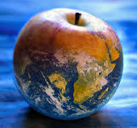
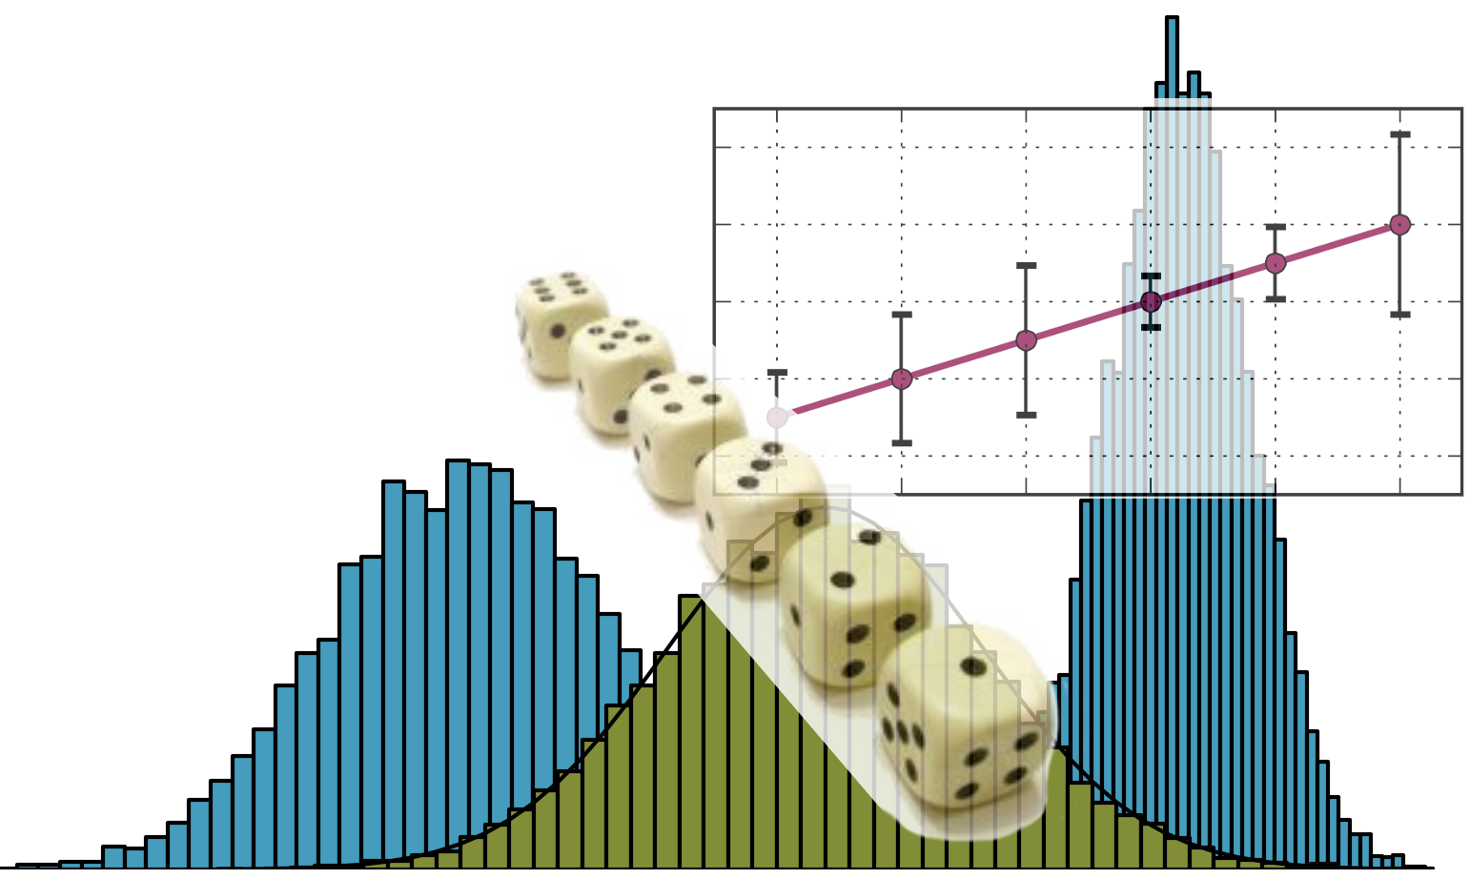
Research Activities
Potsdam Institute for Climate Impact Research
RD2 – Climate Resilience
Hydroclimatic Risks
Personal Research Activities
Potsdam Institute for Climate Impact Research
Modelling
Regional climate modelling
Statistical weather generator
Processing
Diagnostics

Slide 5
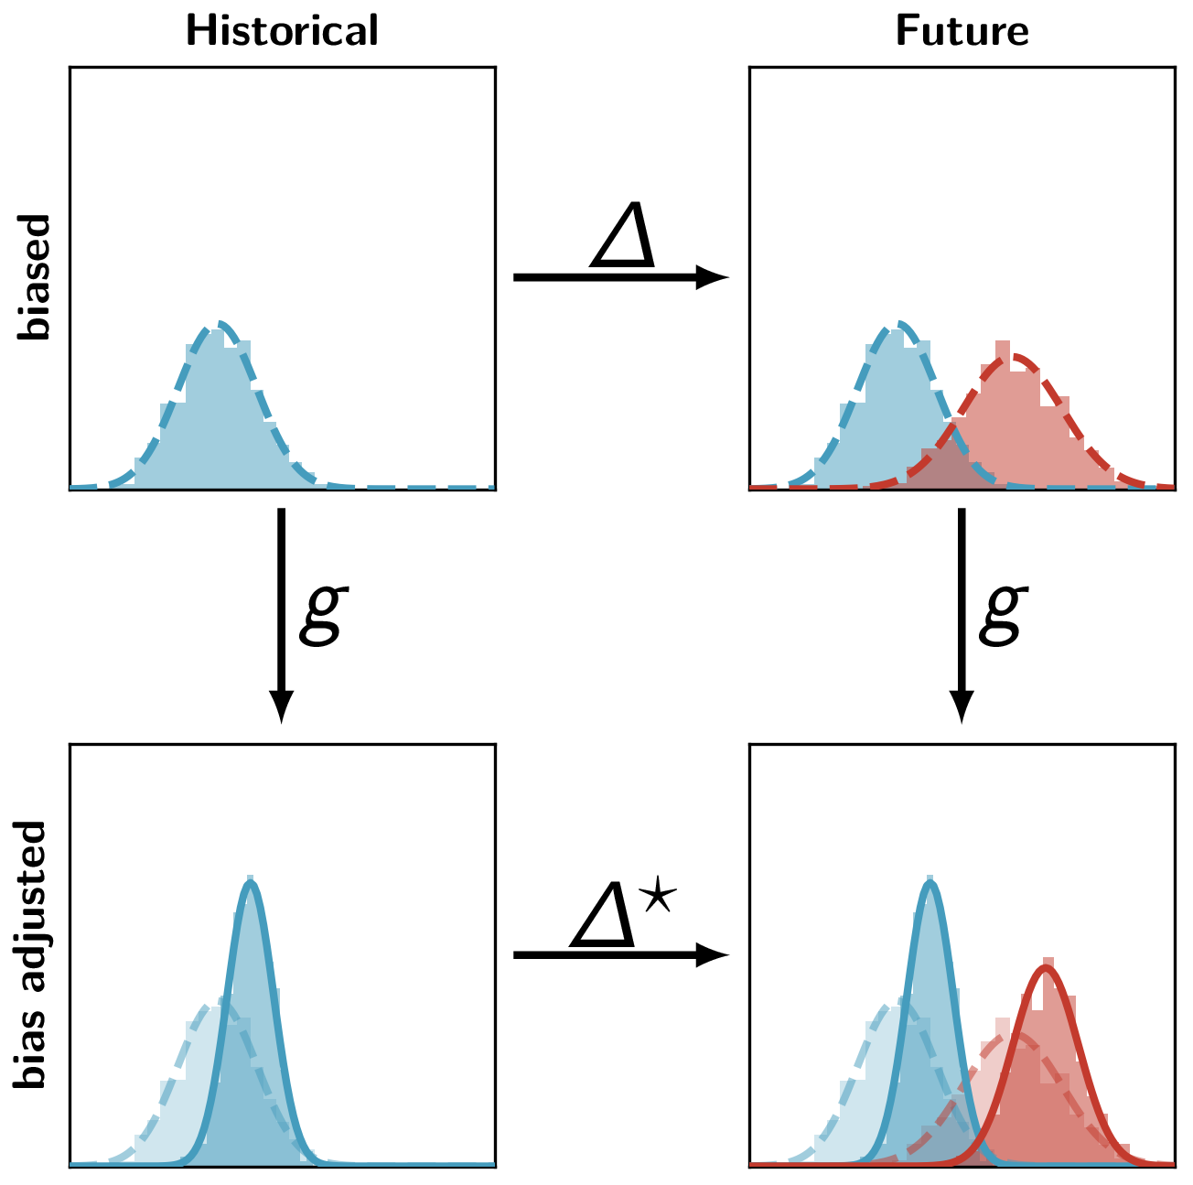
Research Activities
Potsdam Institute for Climate Impact Research
RD2 – Climate Resilience
Hydroclimatic Risks
Personal Research Activities
Potsdam Institute for Climate Impact Research
Modelling
Regional climate modelling
Statistical weather generator
Processing
Bias adjustment
Diagnostics

Slide 6
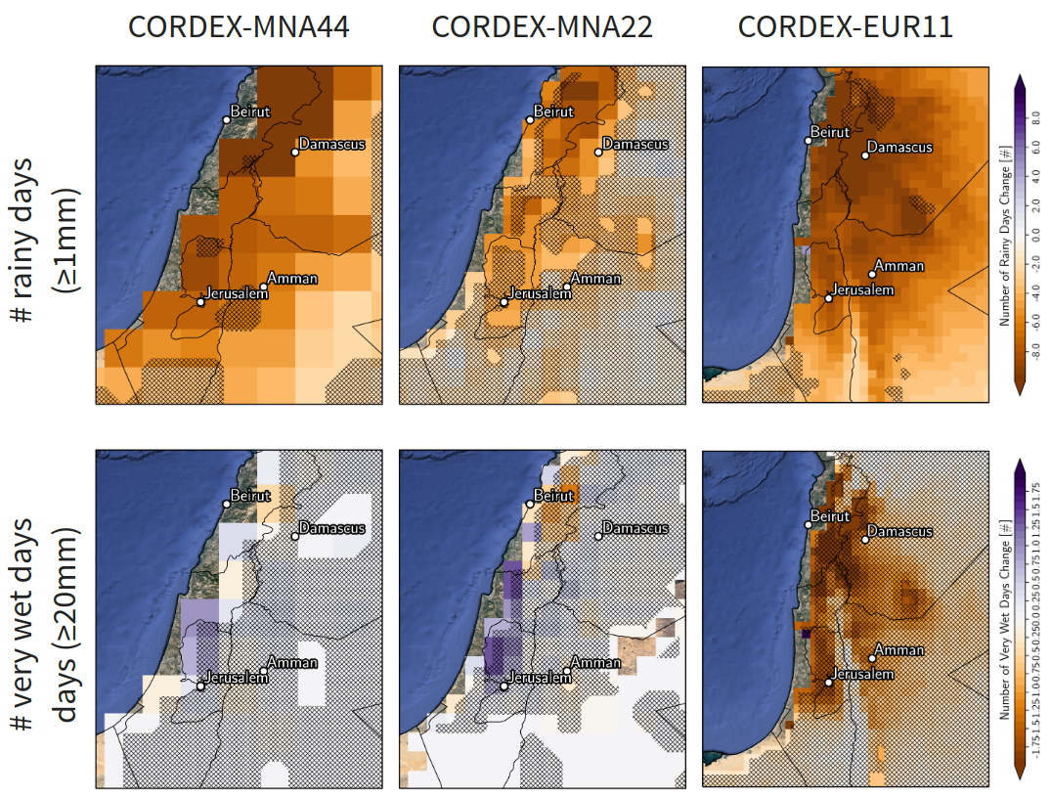
Research Activities
Potsdam Institute for Climate Impact Research
RD2 – Climate Resilience
Hydroclimatic Risks
Personal Research Activities
Potsdam Institute for Climate Impact Research
Modelling
Regional climate modelling
Statistical weather generator
Processing
Bias adjustment
Diagnostics
Hydroclimatic extremes

Slide 7
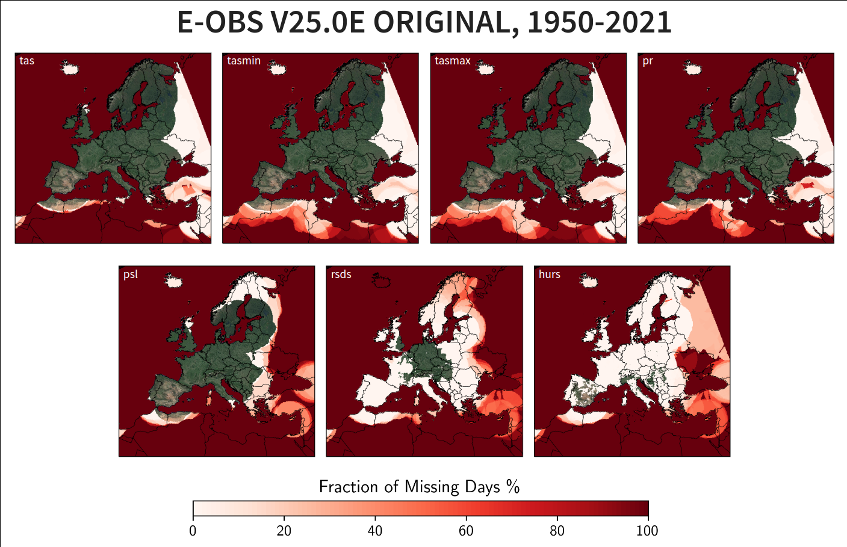
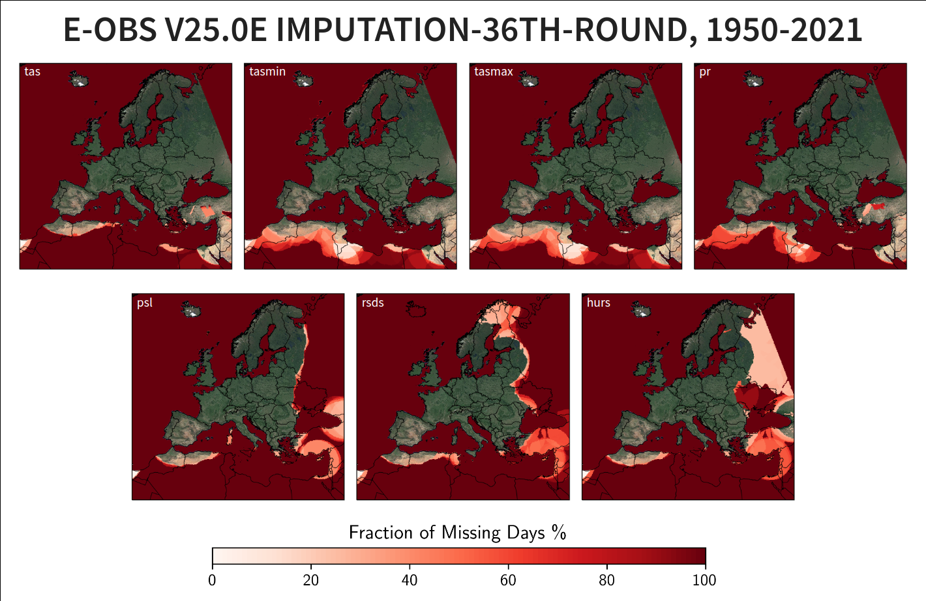
Research Activities
Potsdam Institute for Climate Impact Research
RD2 – Climate Resilience
Hydroclimatic Risks
Personal Research Activities
Potsdam Institute for Climate Impact Research
Modelling
Regional climate modelling
Statistical weather generator
Processing
Bias adjustment
Imputation
Diagnostics
Hydroclimatic extremes

Slide 8
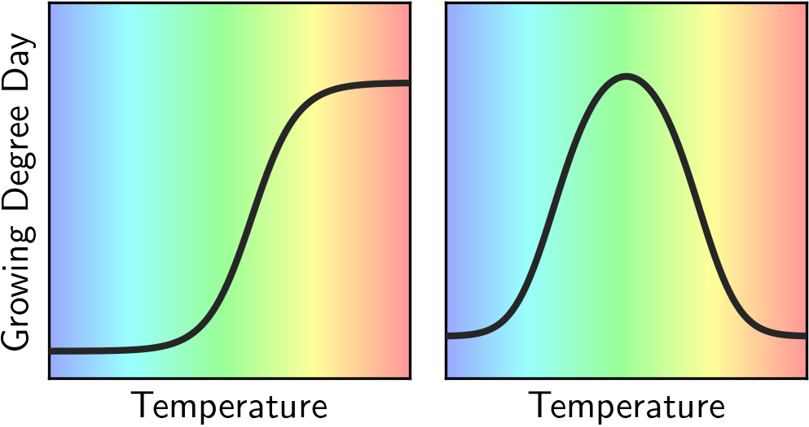
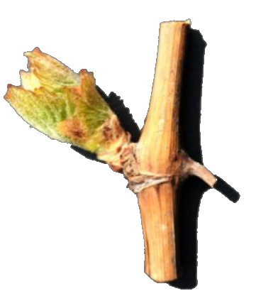
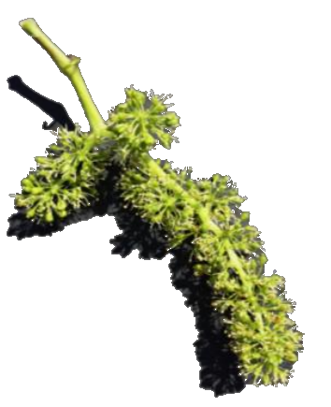
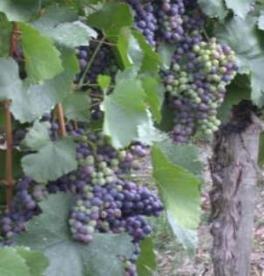
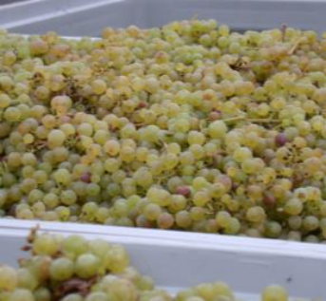
Research Activities
Potsdam Institute for Climate Impact Research
RD2 – Climate Resilience
Hydroclimatic Risks
Personal Research Activities
Potsdam Institute for Climate Impact Research
Modelling
Regional climate modelling
Statistical weather generator
Vine phenology modelling
Processing
Bias adjustment
Imputation
Diagnostics
Hydroclimatic extremes

Slide 9
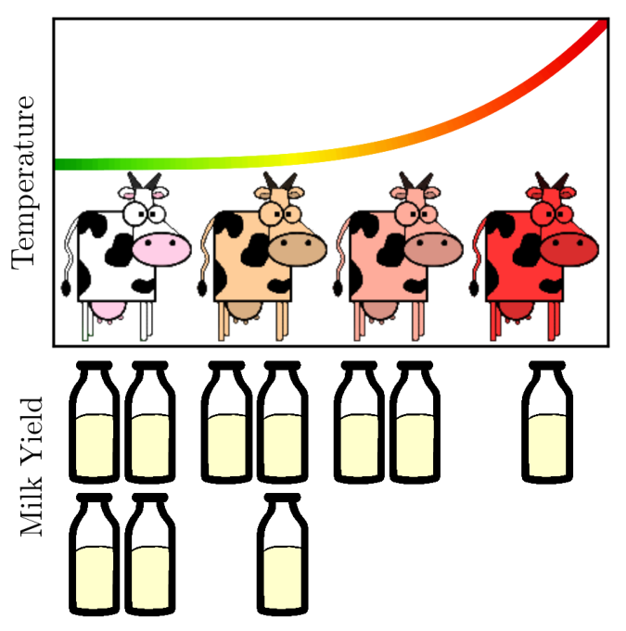
Research Activities
Potsdam Institute for Climate Impact Research
RD2 – Climate Resilience
Hydroclimatic Risks
Personal Research Activities
Potsdam Institute for Climate Impact Research
Modelling
Regional climate modelling
Statistical weather generator
Vine phenology modelling
Processing
Bias adjustment
Imputation
Temporal upsampling
Diagnostics
Hydroclimatic extremes
Impact of climate change on animal

Slide 10
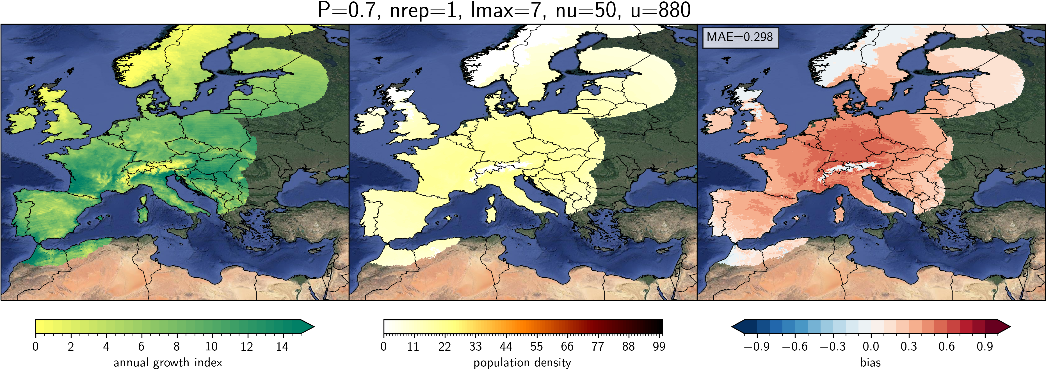
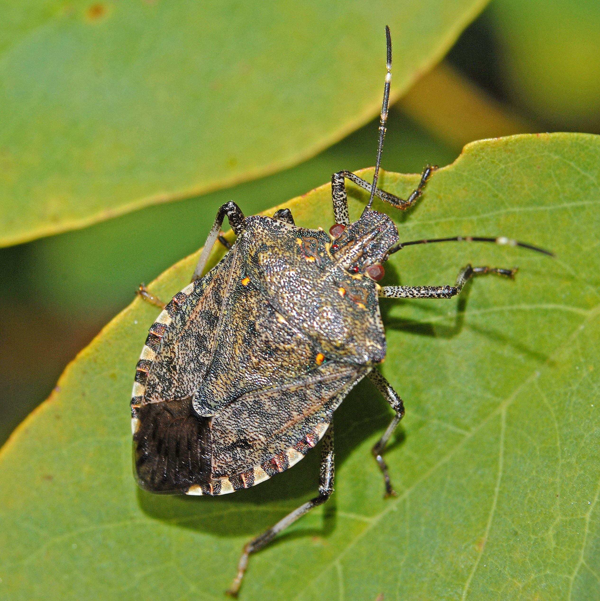
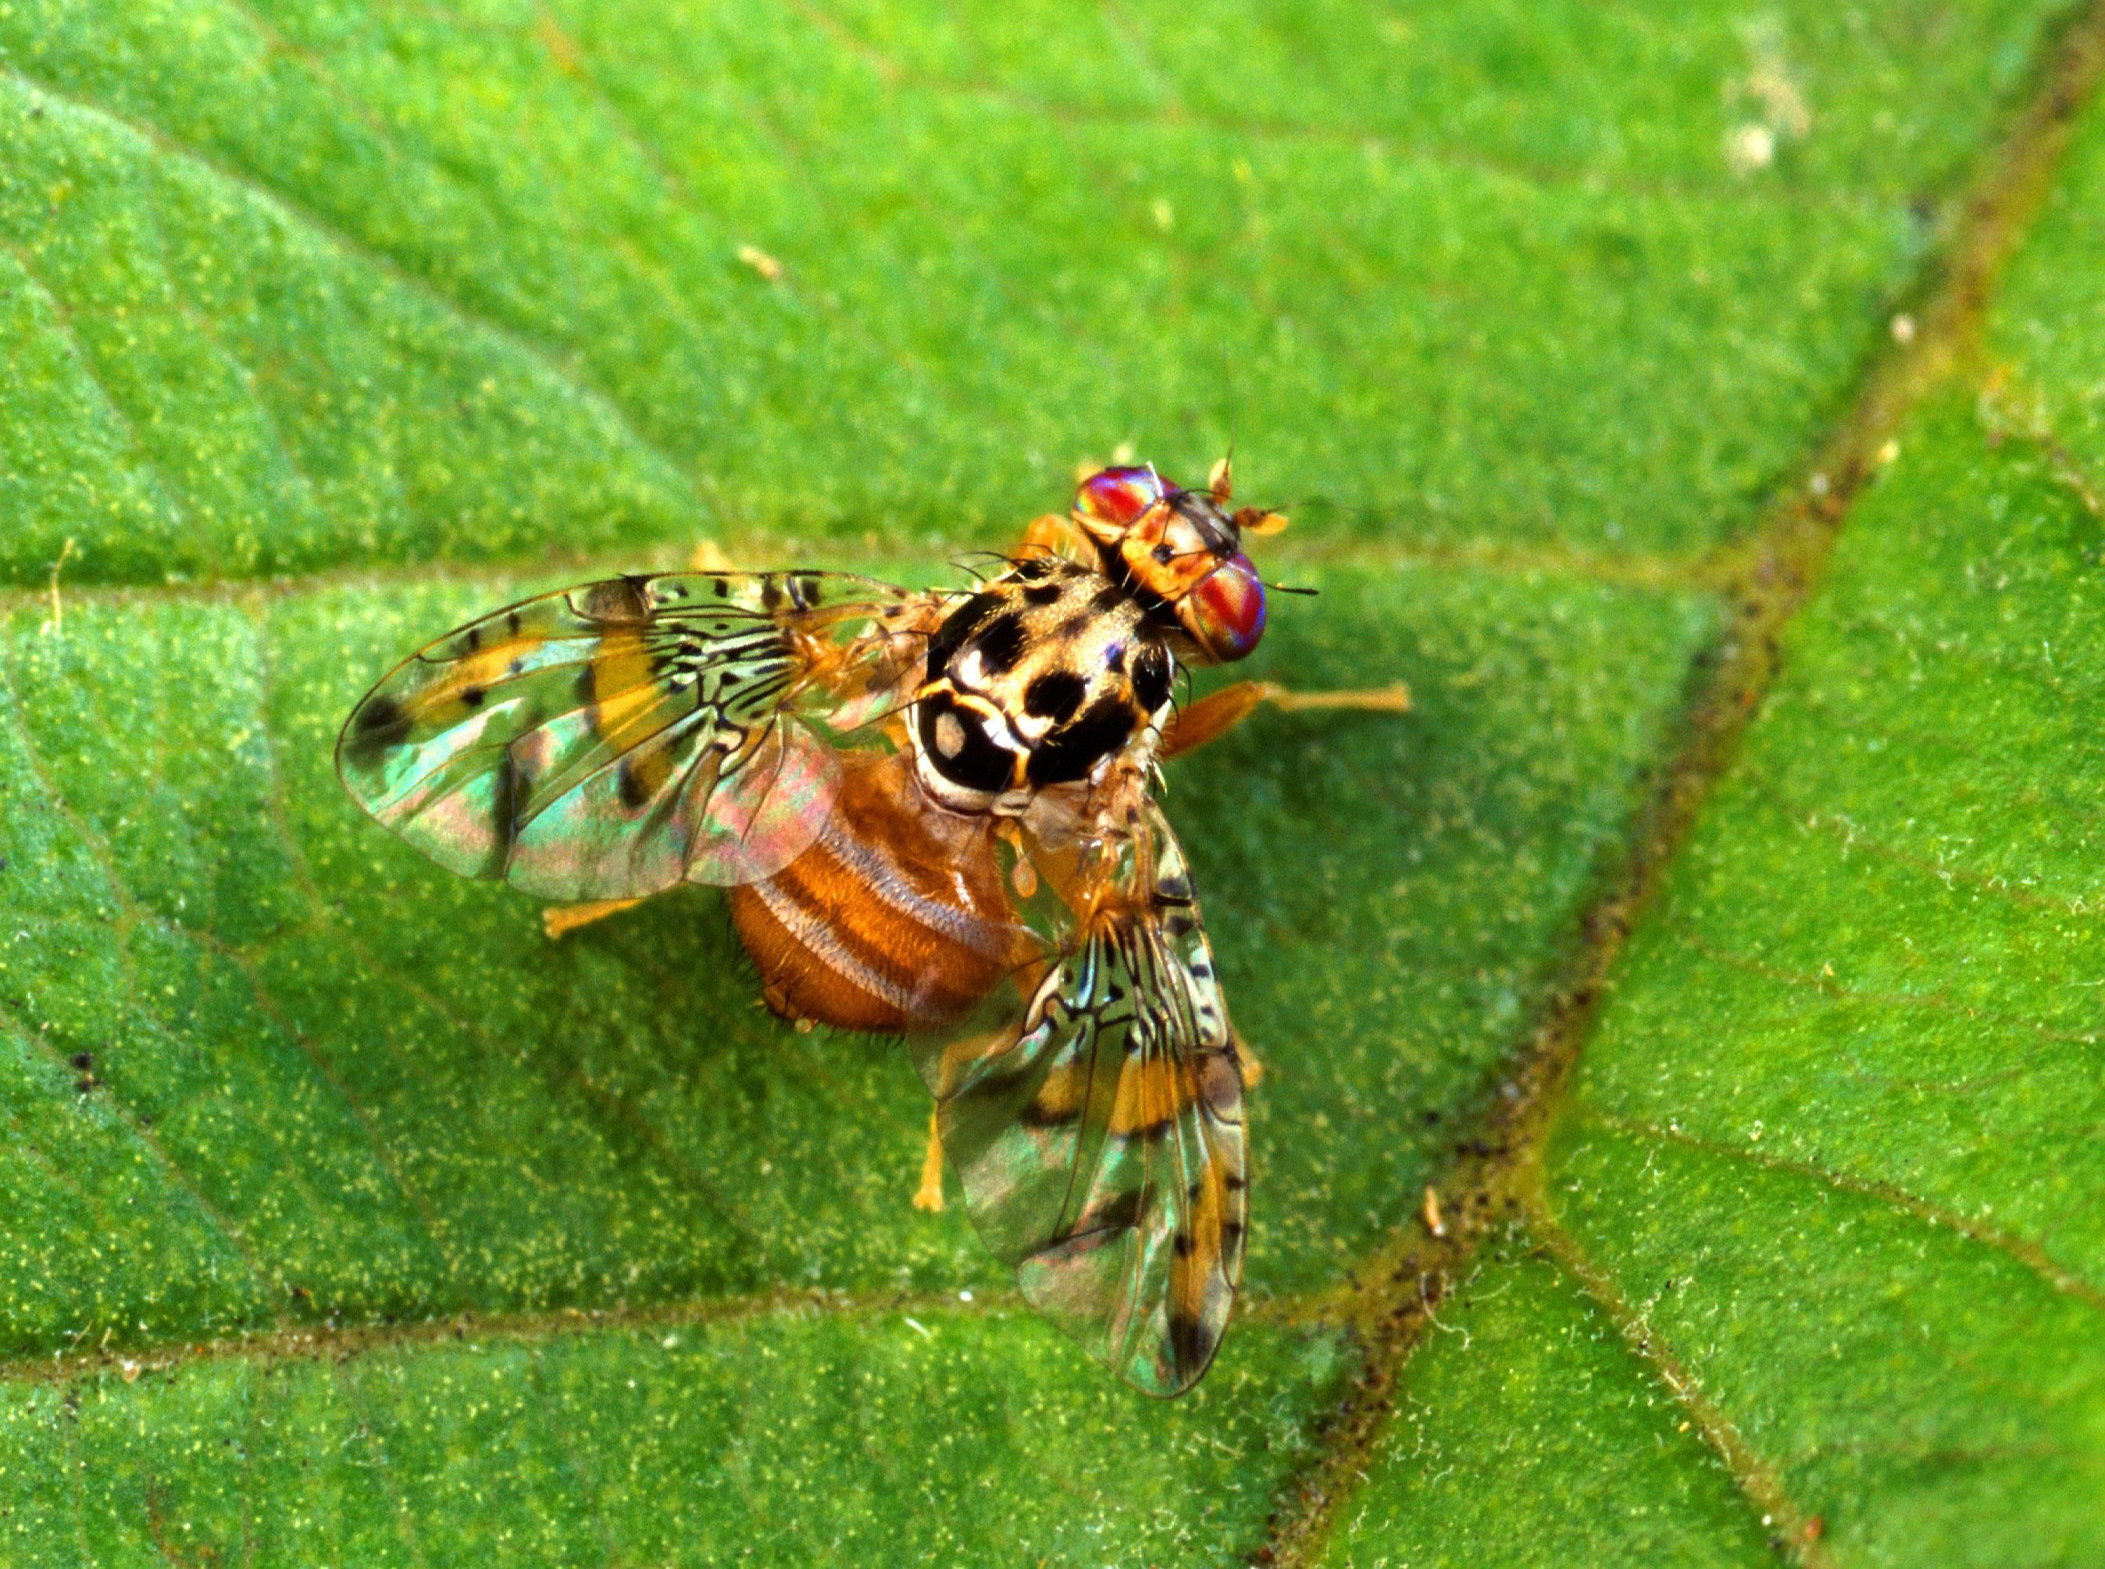
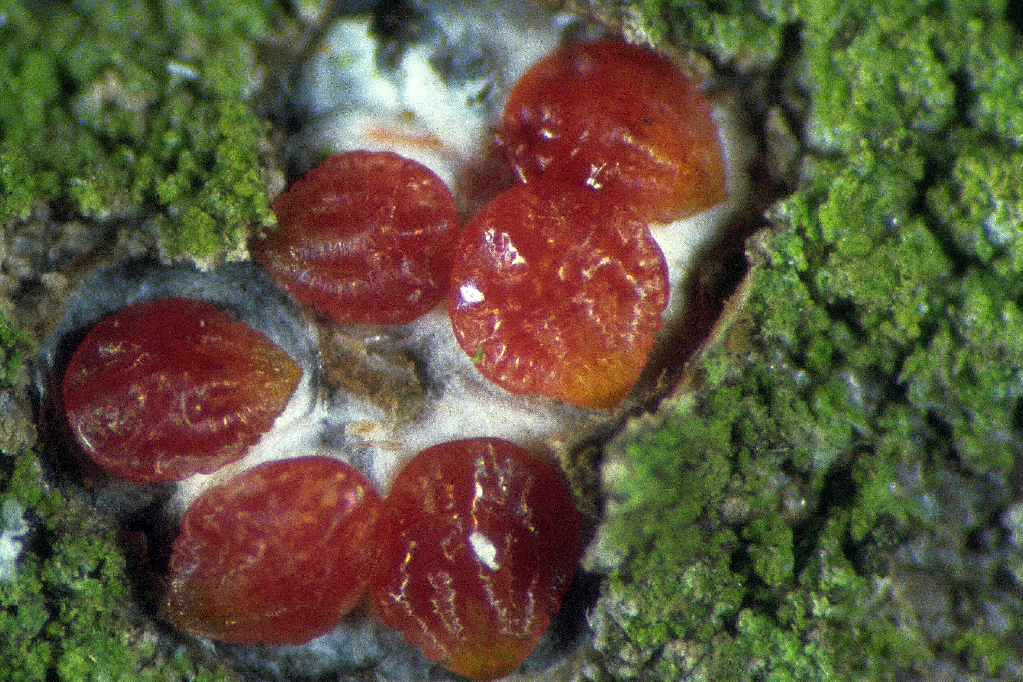
Research Activities
Potsdam Institute for Climate Impact Research
RD2 – Climate Resilience
Hydroclimatic Risks
Personal Research Activities
Potsdam Institute for Climate Impact Research
Modelling
Regional climate modelling
Statistical weather generator
Vine phenology modelling
Species habitat and spread modelling
Processing
Bias adjustment
Imputation
Diagnostics
Hydroclimatic extremes
Impact of climate change on animal
Hectonichus (CC BY-SA 4.0)
Scott Bauer
U.S. Department of Agriculture
(public domain)
Klaus Schrameyer
(LTZ)

Slide 11
THANK YOU
Website:
Check our social media platforms
@xxxxx
@xxxxx
@xxxxx

Slide 12
Climate Resilience | Climate Change and Health
 | Land Use and Resilience
 | Adaptation in Agricultural Systems
 | Forest and Ecosystem Resilience
 | Hydroclimatic Risks
 | Urban Transformations
global/regional
regional

