Slide 1
Fred F. Hattermann hattermann@pik-potsdam.de
Climate change and the Water-Food-Energy Nexus: Impacts and adaptation

Slide 2
Outline
Introduction
Selected ongoing projects

Slide 3
Curriculum vitae and reseach interests
Curriculum vitae
Born on a farm in East Frisia (Ostfriesland)
Civil service at the seal nursery and care station in Norddeich.
1992 - 1998: Studies of Geoecology and System Analysis, Techn. University Braunschweig
1999 - 2000: Potsdam Institut for Climate Impact Research (PIK), Odra flood project
2001 - 2005: PhD in Geoecology, Uni Potsdam / PIK
Since 2011: Working Group Lead „Hydroclimatic Risks“
Since 2019: Deputy Head of Reserach Department II „Climate Resilience“

Slide 4
Topics and interests
Research topics and interests
Climate change impacts on water and vegetation
The Nexus Water – Energy – Food – Health
Adaptation and mitigation
Hydroclimatic extremes
Model development
At the local to the regional and continental scales
Co-design

Slide 5

The Nexus Water – Energy – Food
FAO 2019:
Water security, energy security and food security are very much linked to one another, and
actions in one area have effects in one or both of the other areas.
One could add other sectors such as health and ecology.
Strong links to Sustainable Development Goals
https://www.water-energy-food.org/

Slide 6
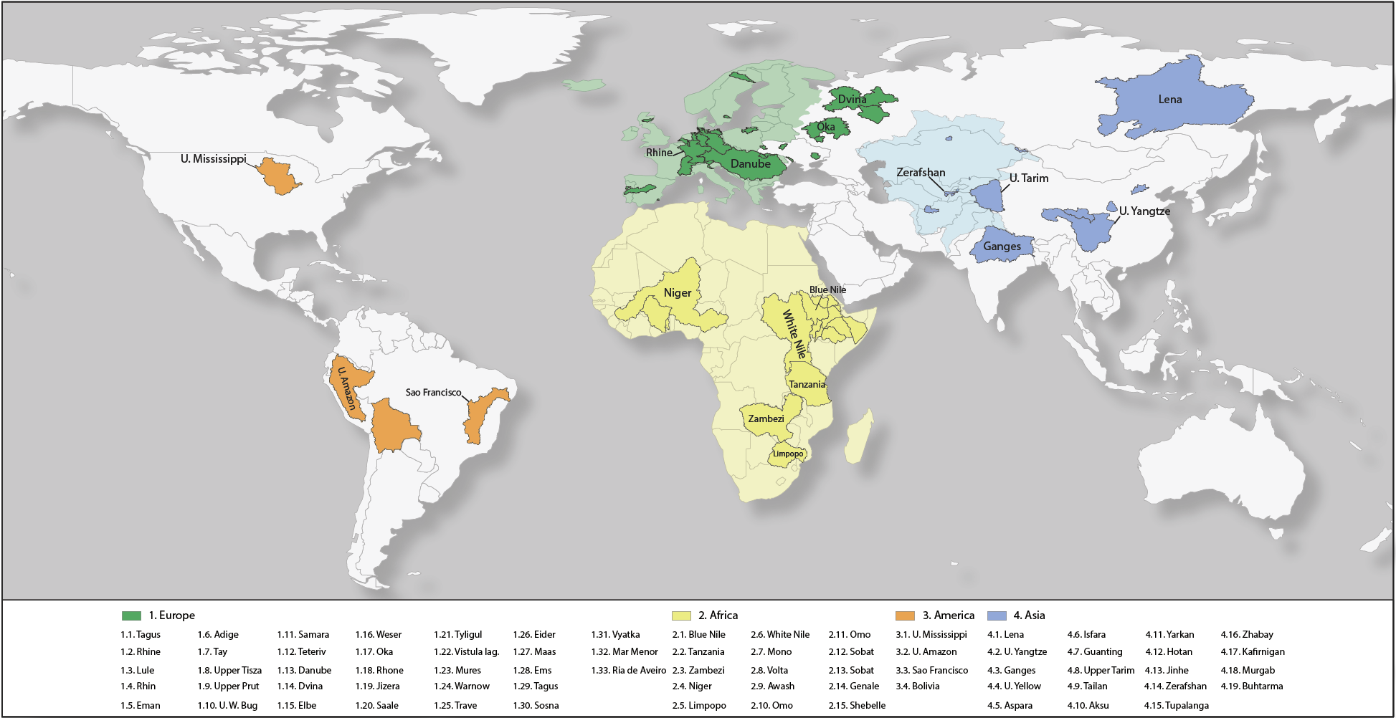
Map of case studies and projects

Slide 7
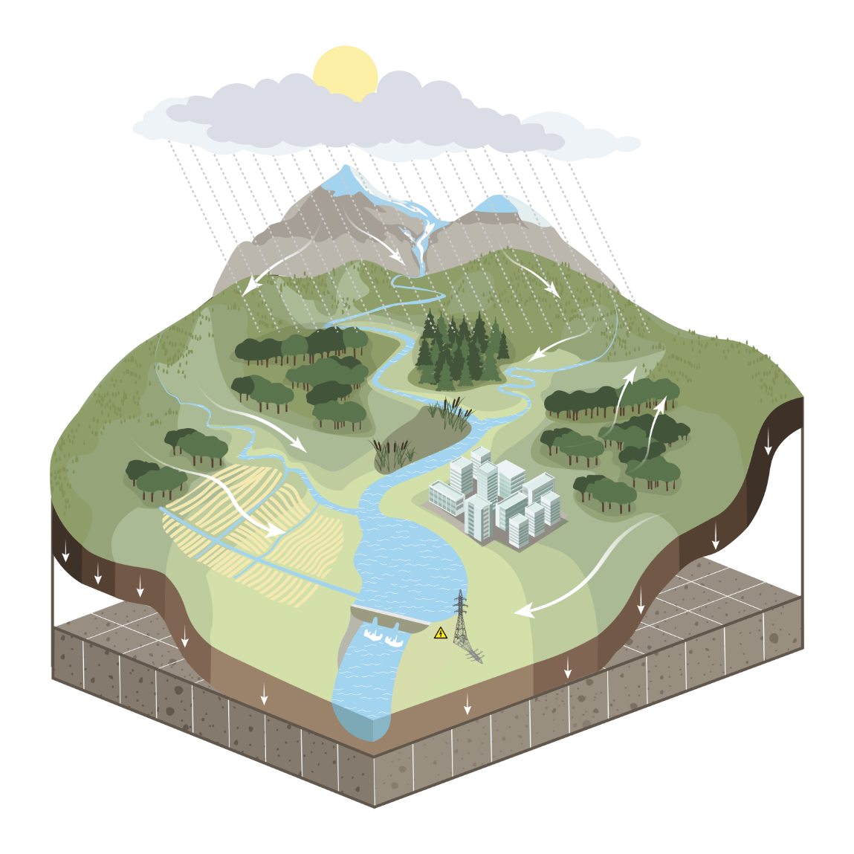
Eco-hydrological model
Natural processes
Weather / climate (input)
  Precipitation (rain & snow)
  Temperature, solar radiation, rel. humidity
Hydrology
  Infiltration
  Runoff: surface, sub-surface, groundwater
  River discharge
  Evapotranspiration
Vegetation
  Natural: forests, grasslands, savannah...
  Managed crops
Glaciers

Slide 8
Eco-hydrological model
Water and land management
Crop management
  Crop rotations
  Fertilization
Irrigation
  Crop water demand / deficits
  Water use efficiency
Water allocation
Reservoirs
  Hydropower
  Flood protection
  Water supply

Slide 9
Outline
Introduction
Selected ongoing projects

Slide 10
Ongoing projects: The nexus and energy and health in Africa

Slide 11
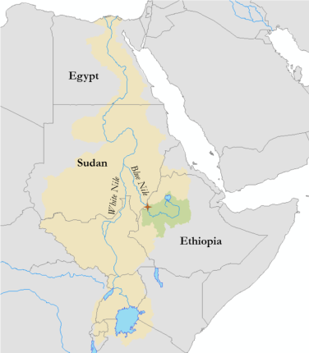
Political tension
Blue Nile contributes 60-80% of flows to Egypt
  Ethiopia controls the major source of Egypt‘s lifeline
  Water & energy shortage during filling and operation
  Lack of transparency
    No environmental / social impact assessment conducted
Lack of willingness to cooperate (all parties)
Construction began in 2011 without consent
  Filling of dead storage started in rainy season 2020
    Without agreed filling timetable
HAD
10⁶ ha
irrigated cropland
GERD

Slide 12
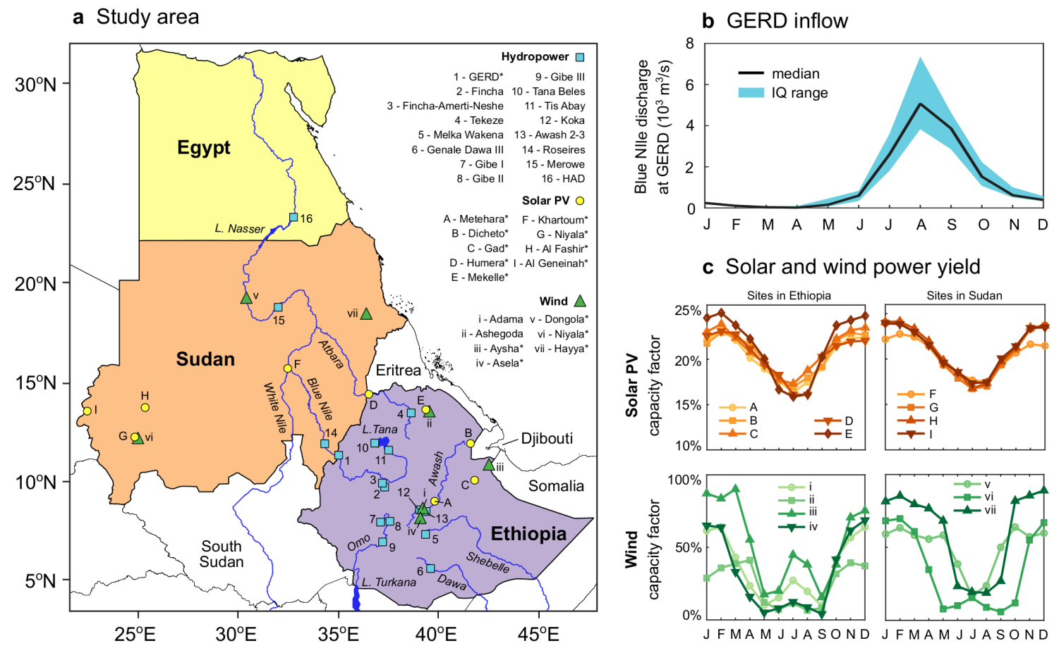
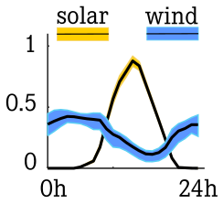
Improving management by integration of solar & wind
Complementarity of RE sources at diurnal and seasonal time scales

Slide 13
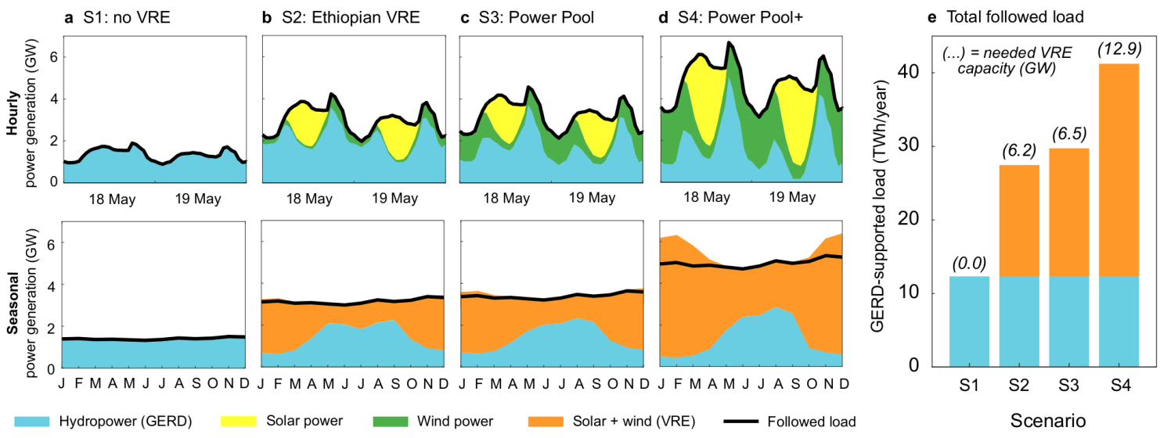
Supporting the integration of hydro, solar & wind
-> -> -> integration of solar and wind with hydro -> -> ->

Slide 14
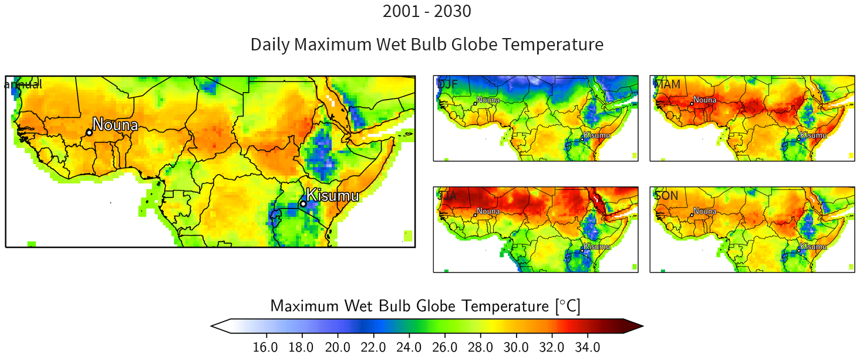
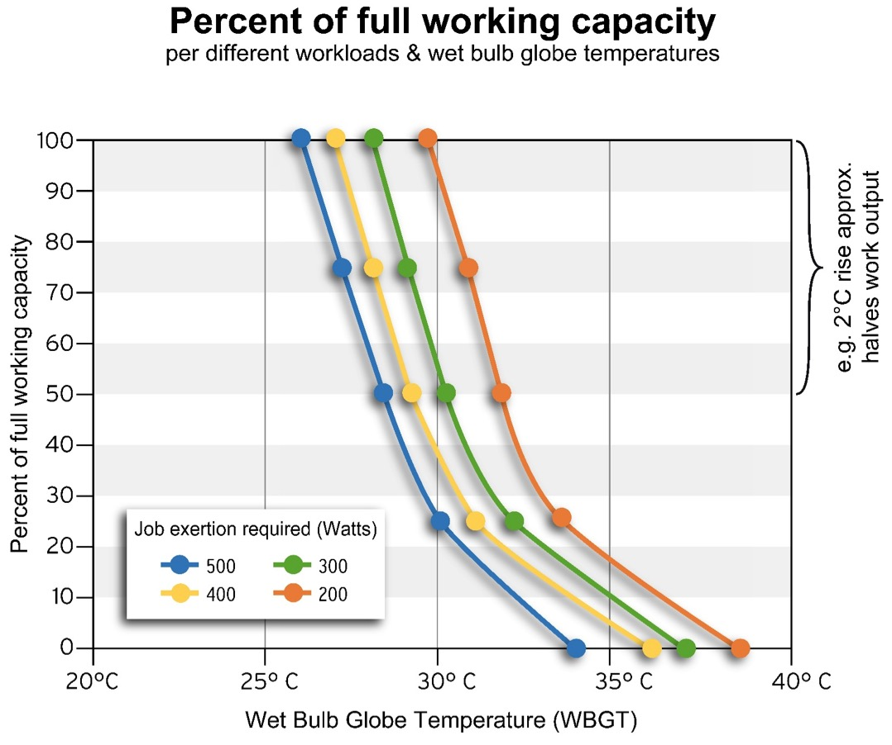
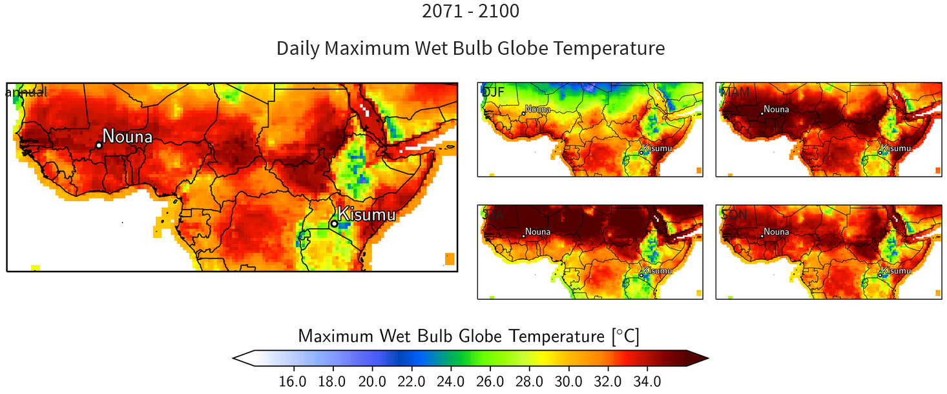
FRIELER, Potsdam
CC and health: Heat stress
Percent of full working capacity with changing WBGT and different workloads
Notes:
We coded the equations provided in the literature as a new module to calculate the WBGT. Here the results for Nouna and Kisumu

Slide 15
Ongoing projects: Central Asia and the Aral Lake

Slide 16
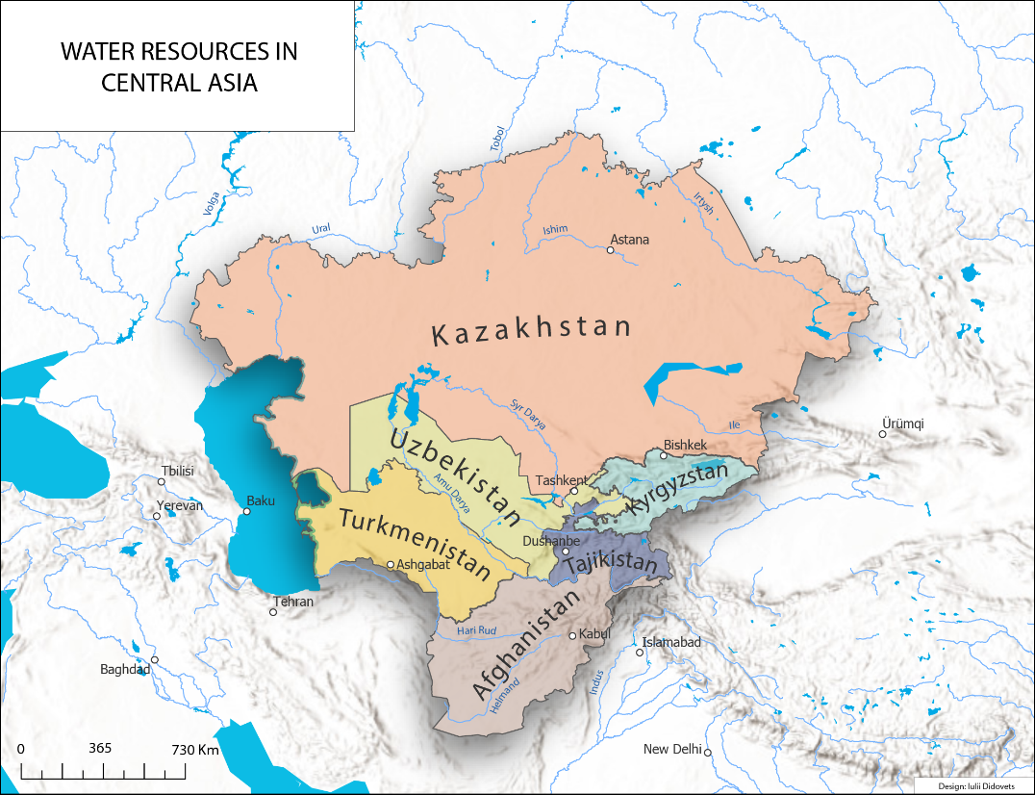
Water conflicts in Central Asia
Water scarce region with strong dependence on water resources
Most rivers are fed by snow and ice melt in the high mountains and don’t drain into the ocean but into endorheic lakes, Amu Darya and Syr Darya into the Aral Sea
Majority of glaciers in the region are losing mass since 1960

Slide 17
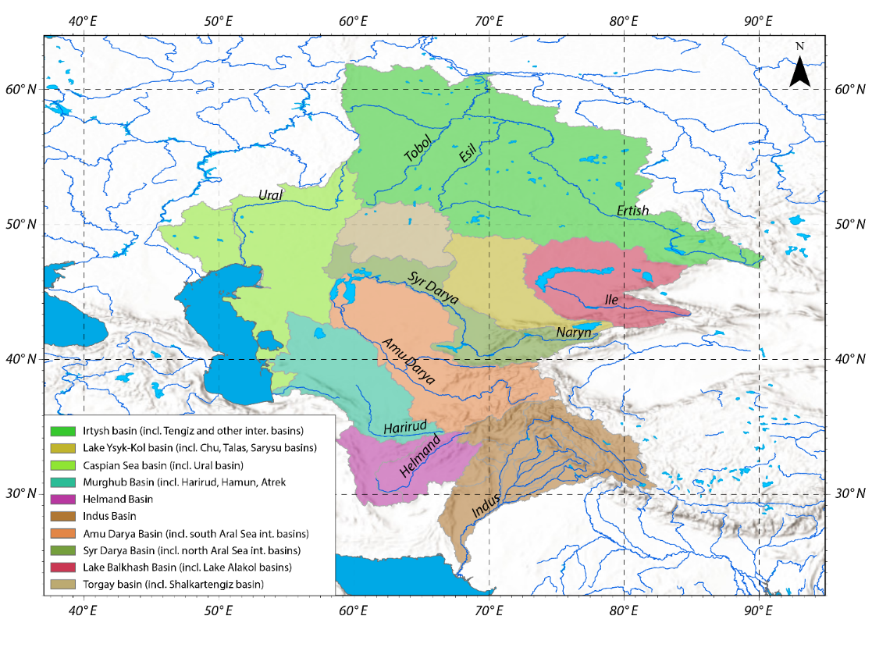
Water resources in CA
Water scarce region with strong dependence on water resources
Most rivers are fed by snow and ice melt in the high mountains and don’t drain into the ocean but into endorheic lakes, Amu Darya and Syr Darya into the Aral Sea
Majority of glaciers in the region are losing mass since 1960

Slide 18



Importance of water resources in Central Asia
All
Downstream
Upstream
GDP from Agriculture
Irrigated land
Share of energy from HPP
20-22%
90%
85%
98%
63%
(except for Kazakhstan - 5%)
Turkmenistan
Usbekistan
Kyrgyzstan
Tajikistan
Afghanistan
Source: World Bank
Development Indices
Notes:
Water is inextricably intertwined with development challenges of the region;
Up to 92% of the total arable land in Uzbekistan, Turkmenistan and around 70% in the south of Kazakhstan are irrigated areas;
Up to 85% of electricity in Kyrgyzstan is generated from hydropower, 98% in Tajikistan and 65% in Afghanistan;
Changes in temperature and precipitation in the region have led to regression in glaciers which were confirmed number of studies (Ibatullin et al., 2009, Farinotti et al., 2015, Chen et al, 2017, Barandun et al, 2018).

Slide 19
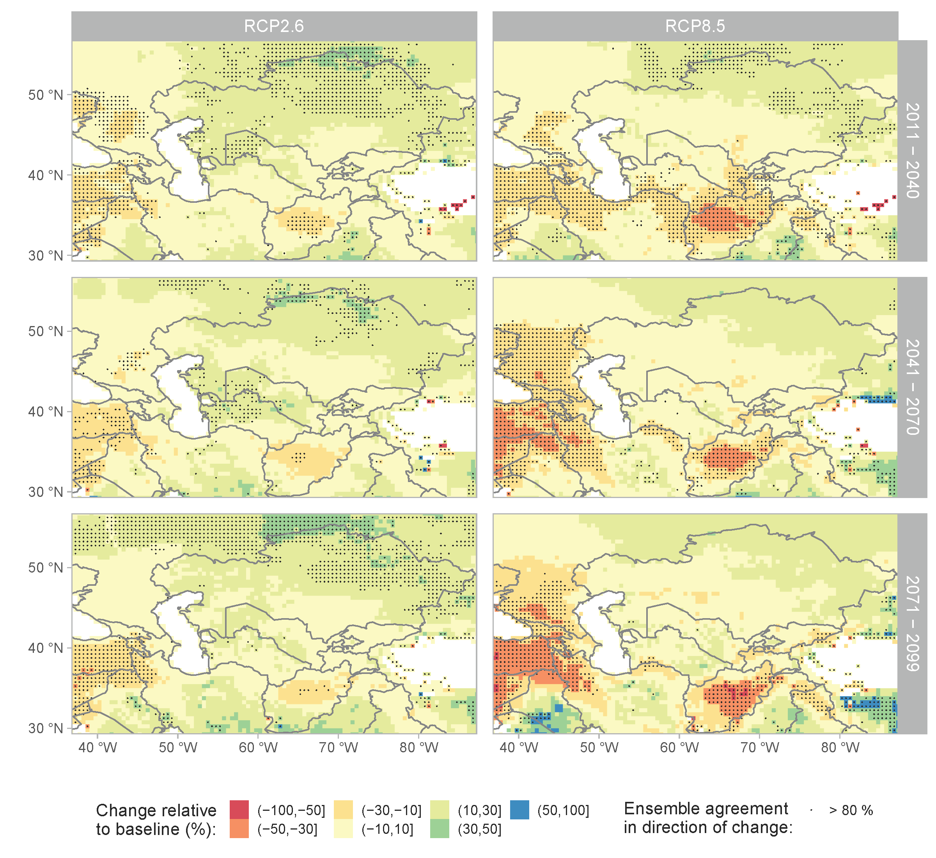
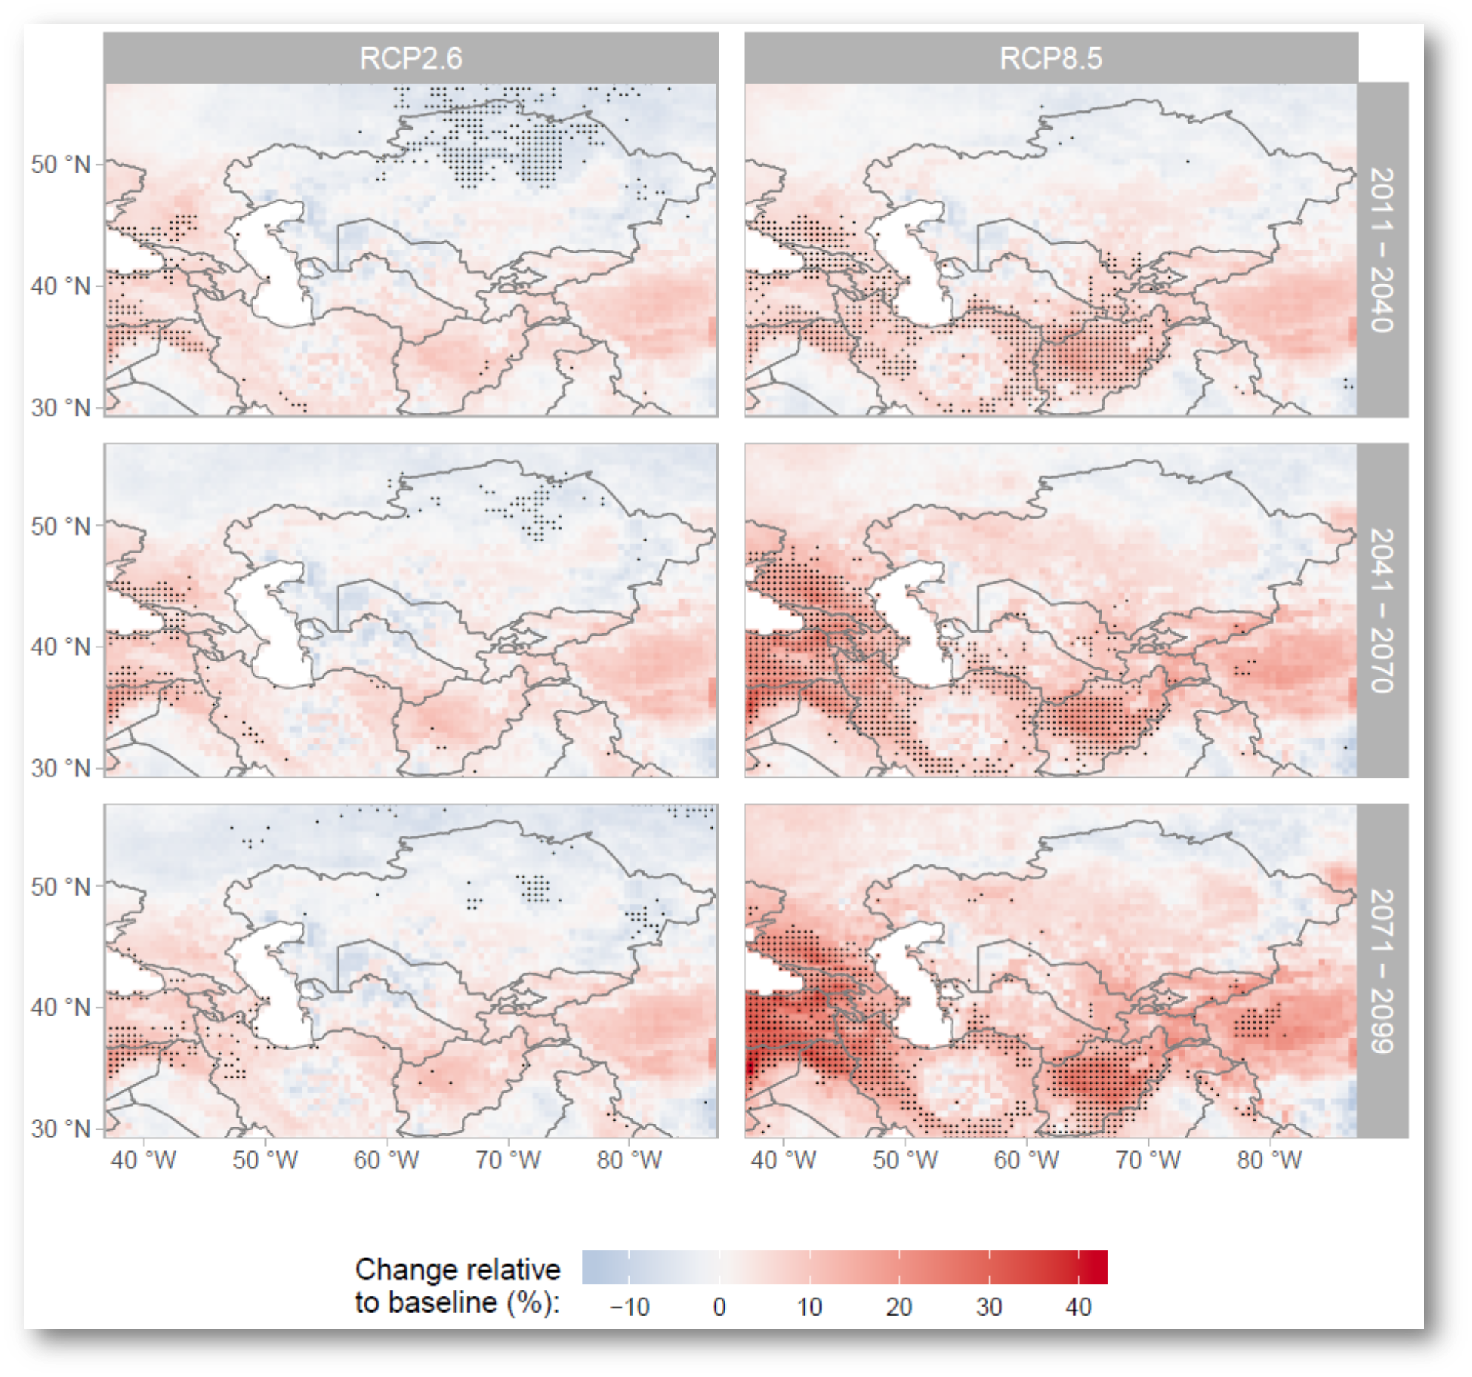
Future projections for CA: Hydrological Impacts (Hattermann et al. 2022)
Changes in local water yield
Number of days with drought
Hattermann et al. 2021

Slide 20
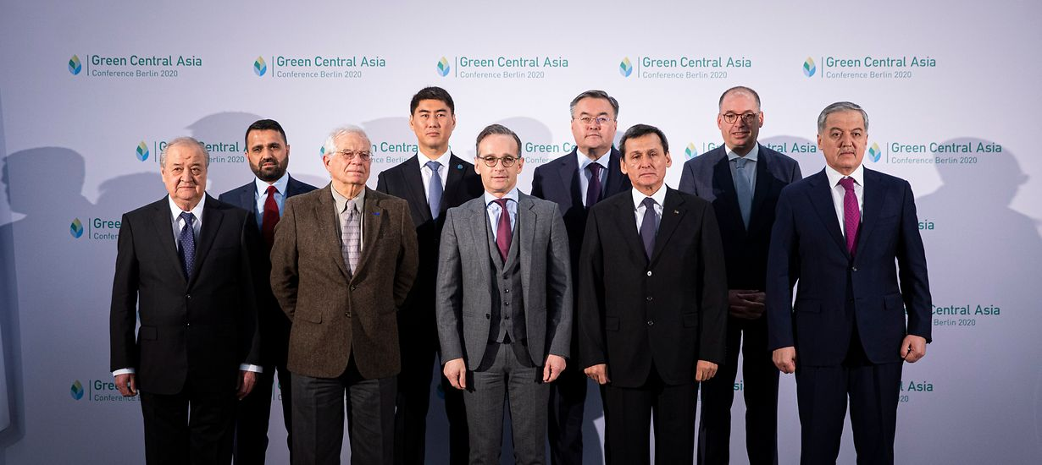

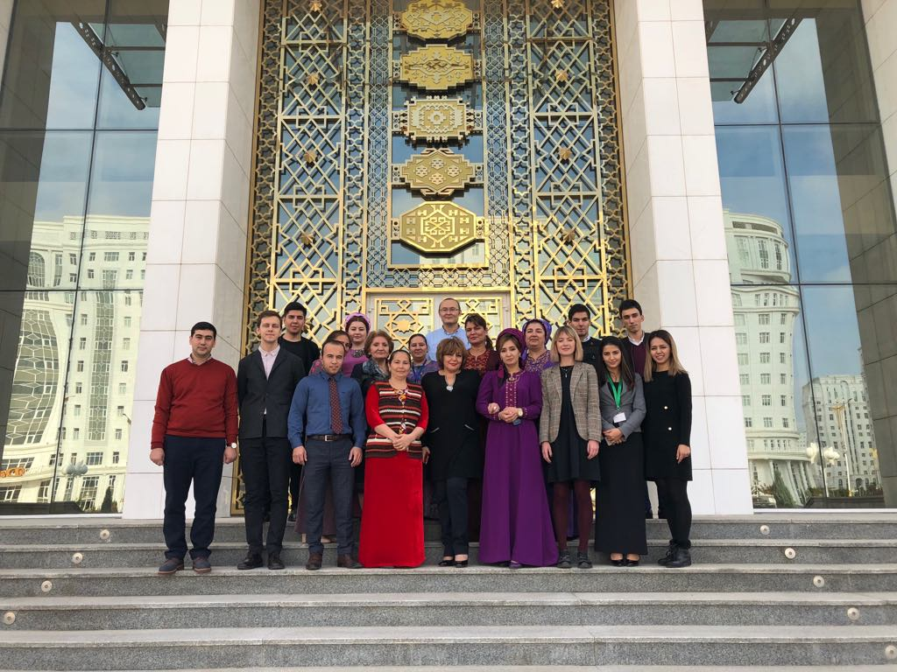
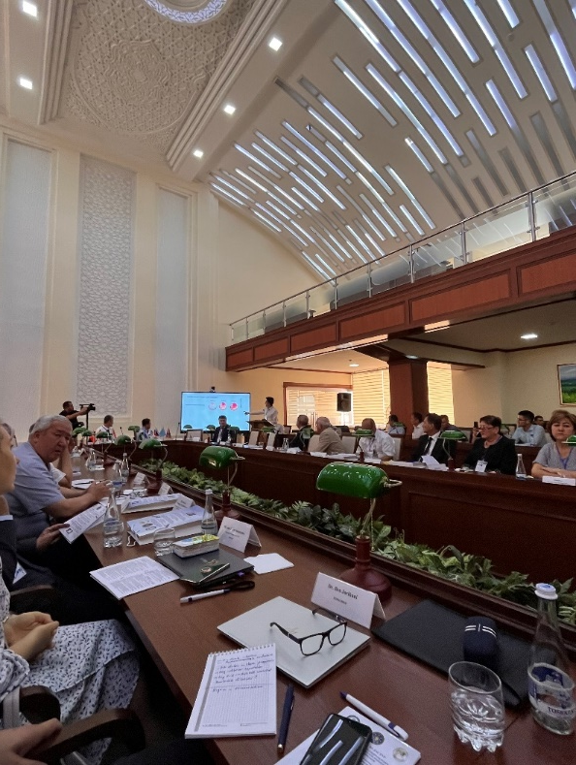
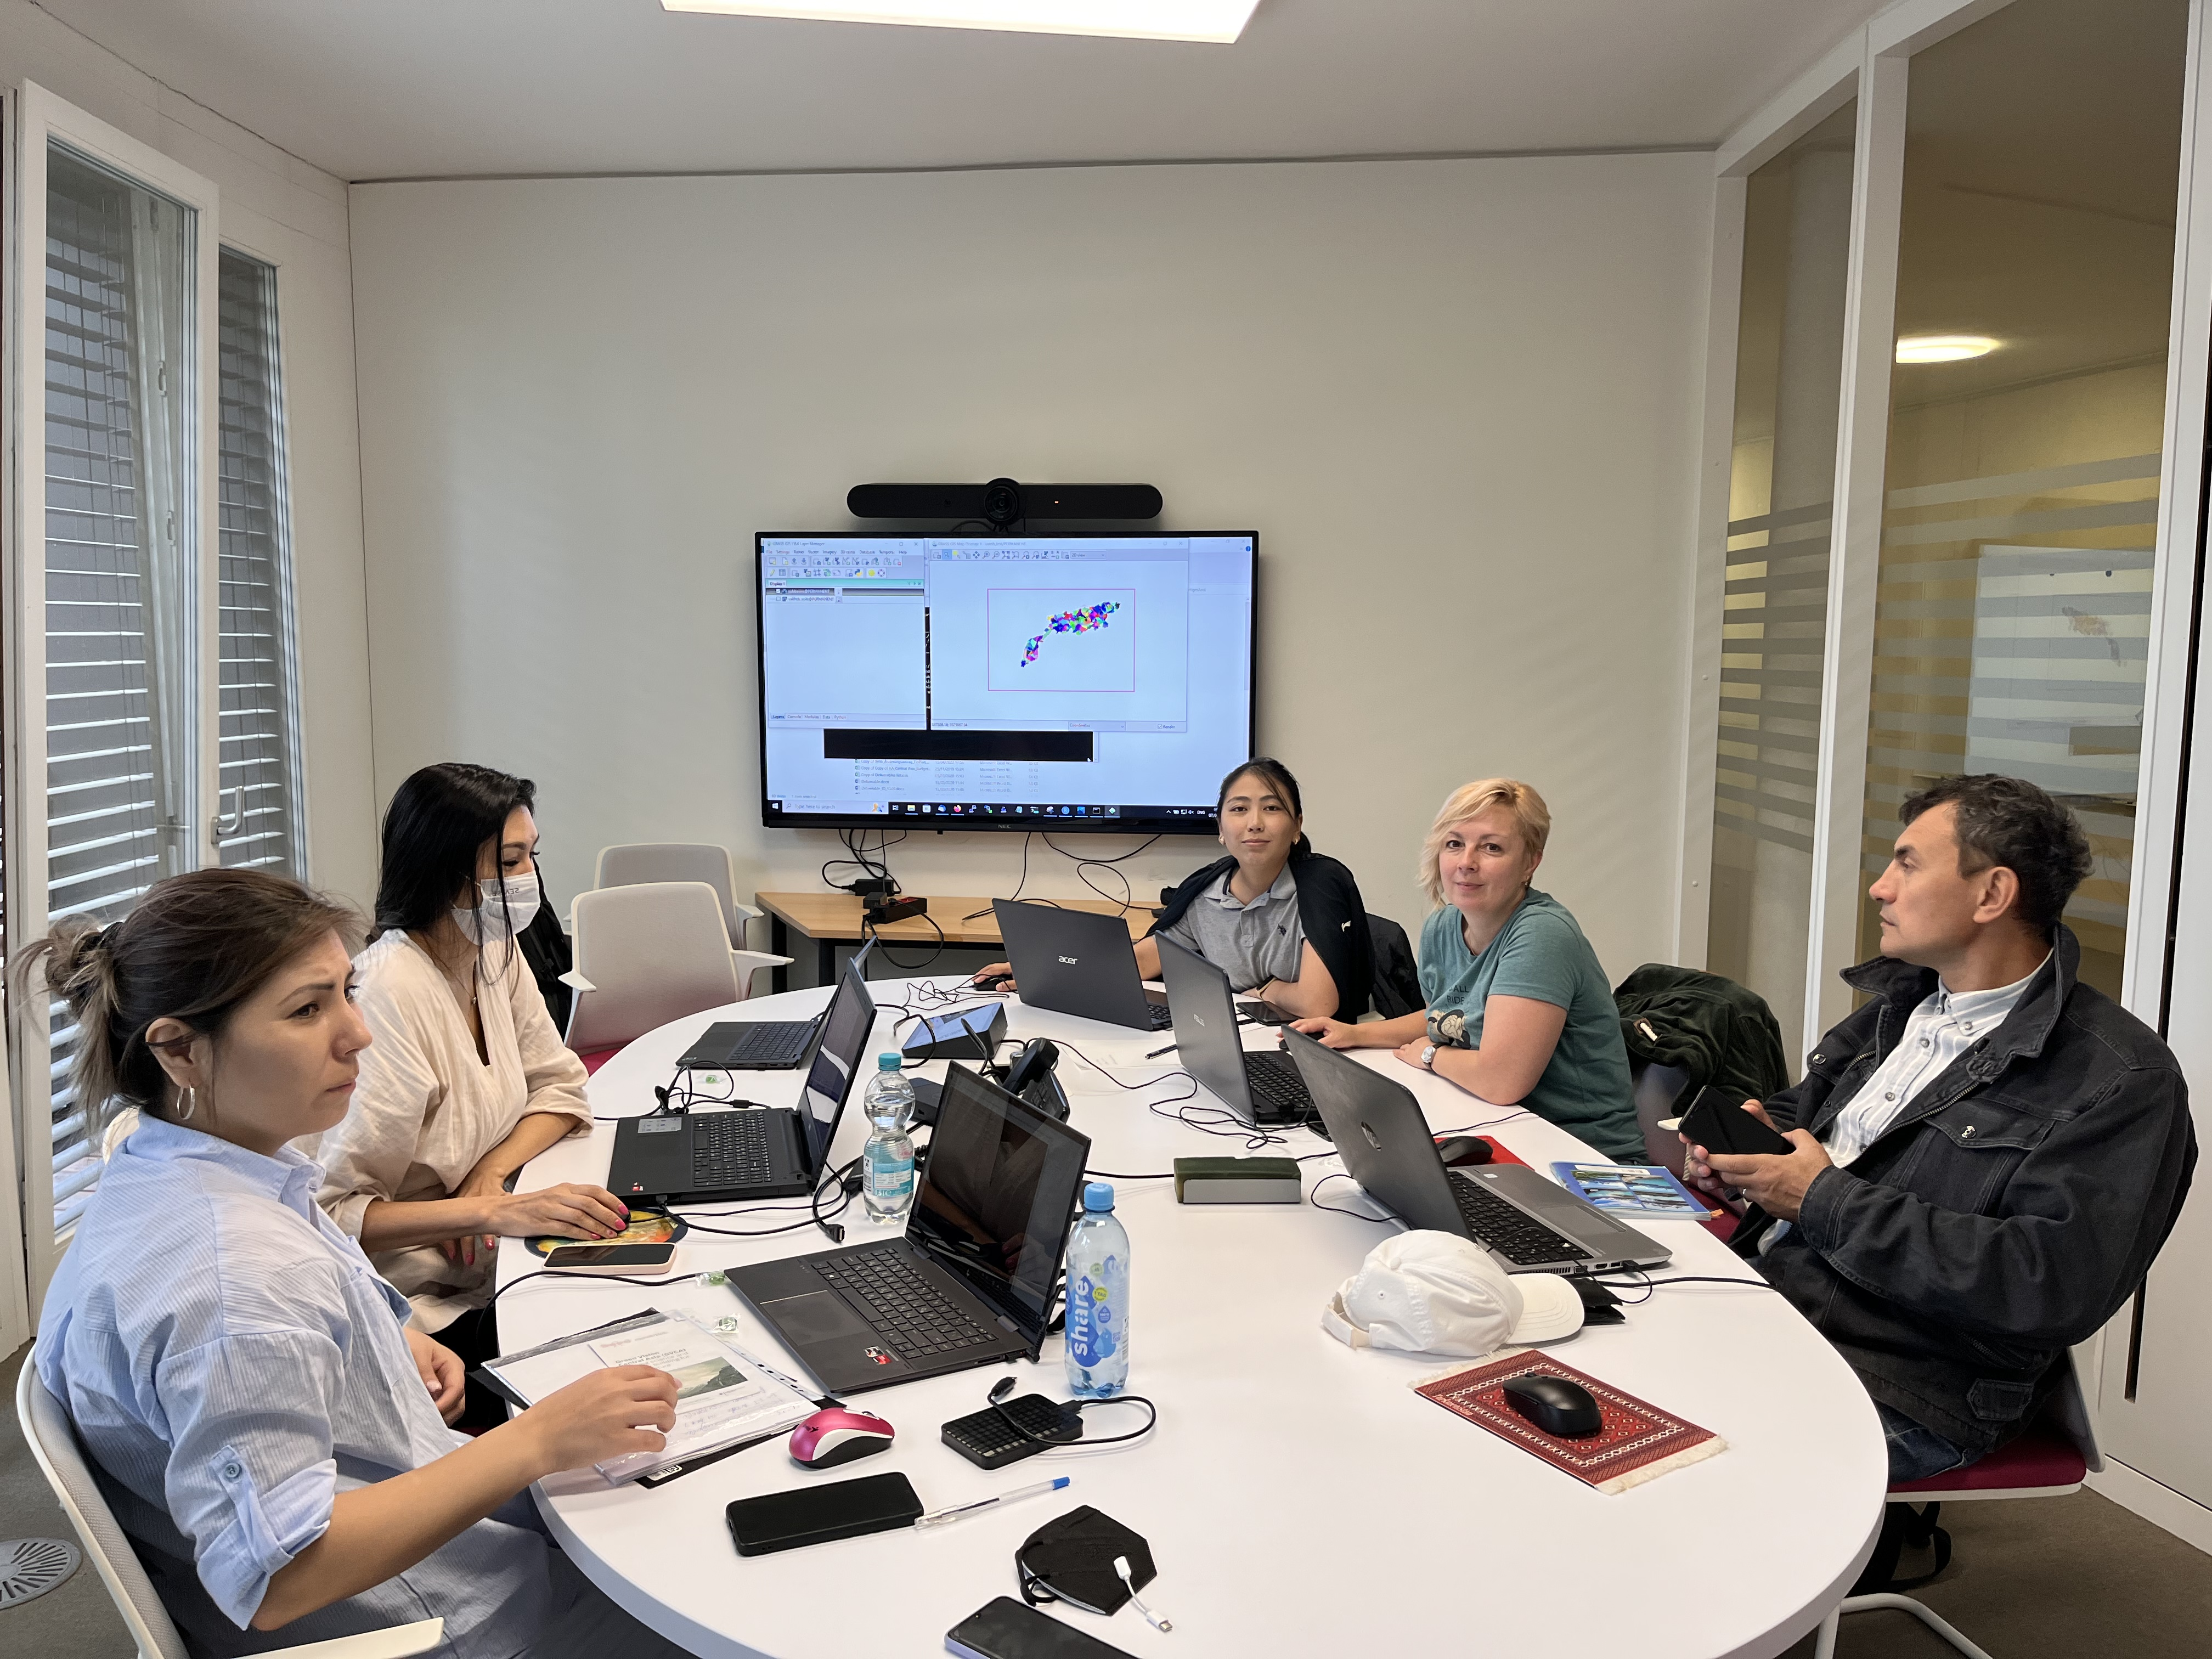
Capacity building

Slide 21
Ongoing projects: Upper Amazon / Bolivia and Peru

Slide 22
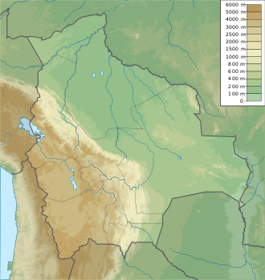
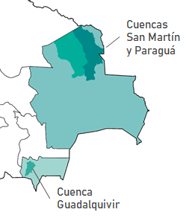
Target region

Slide 23
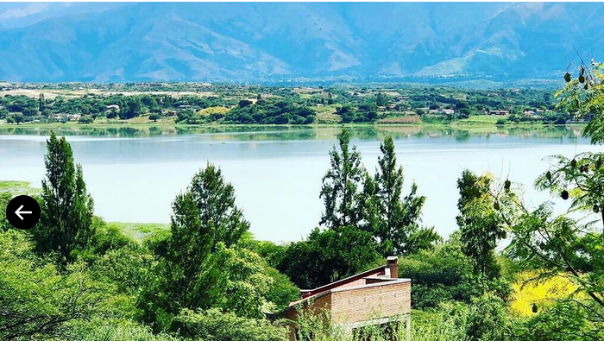
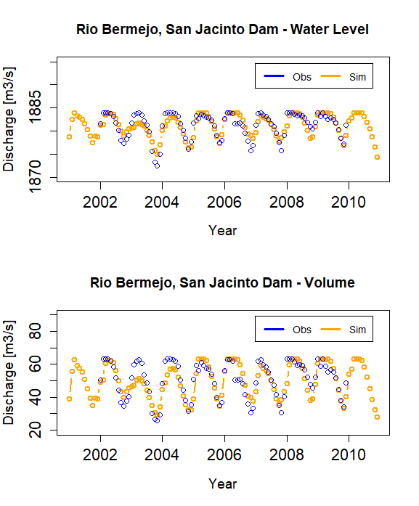
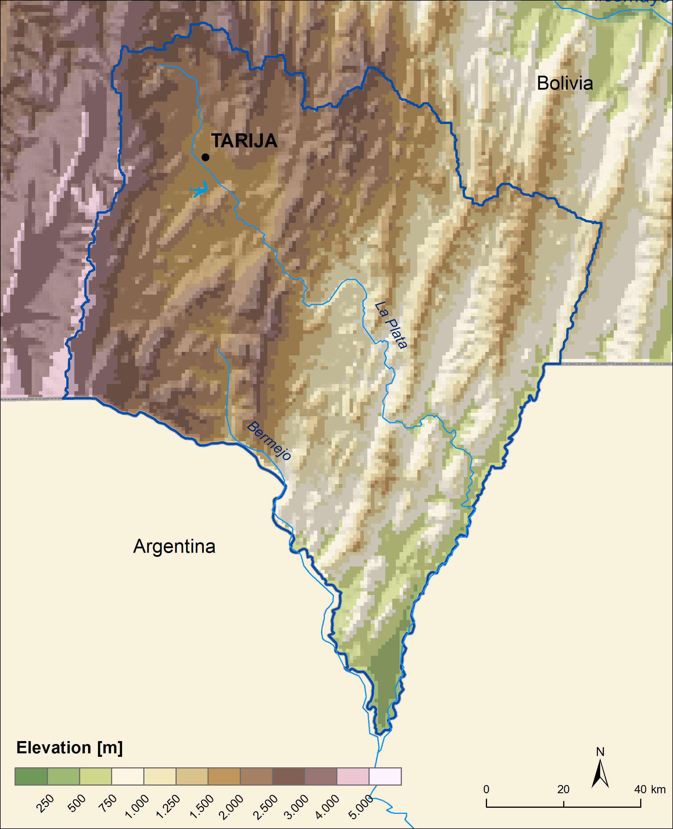
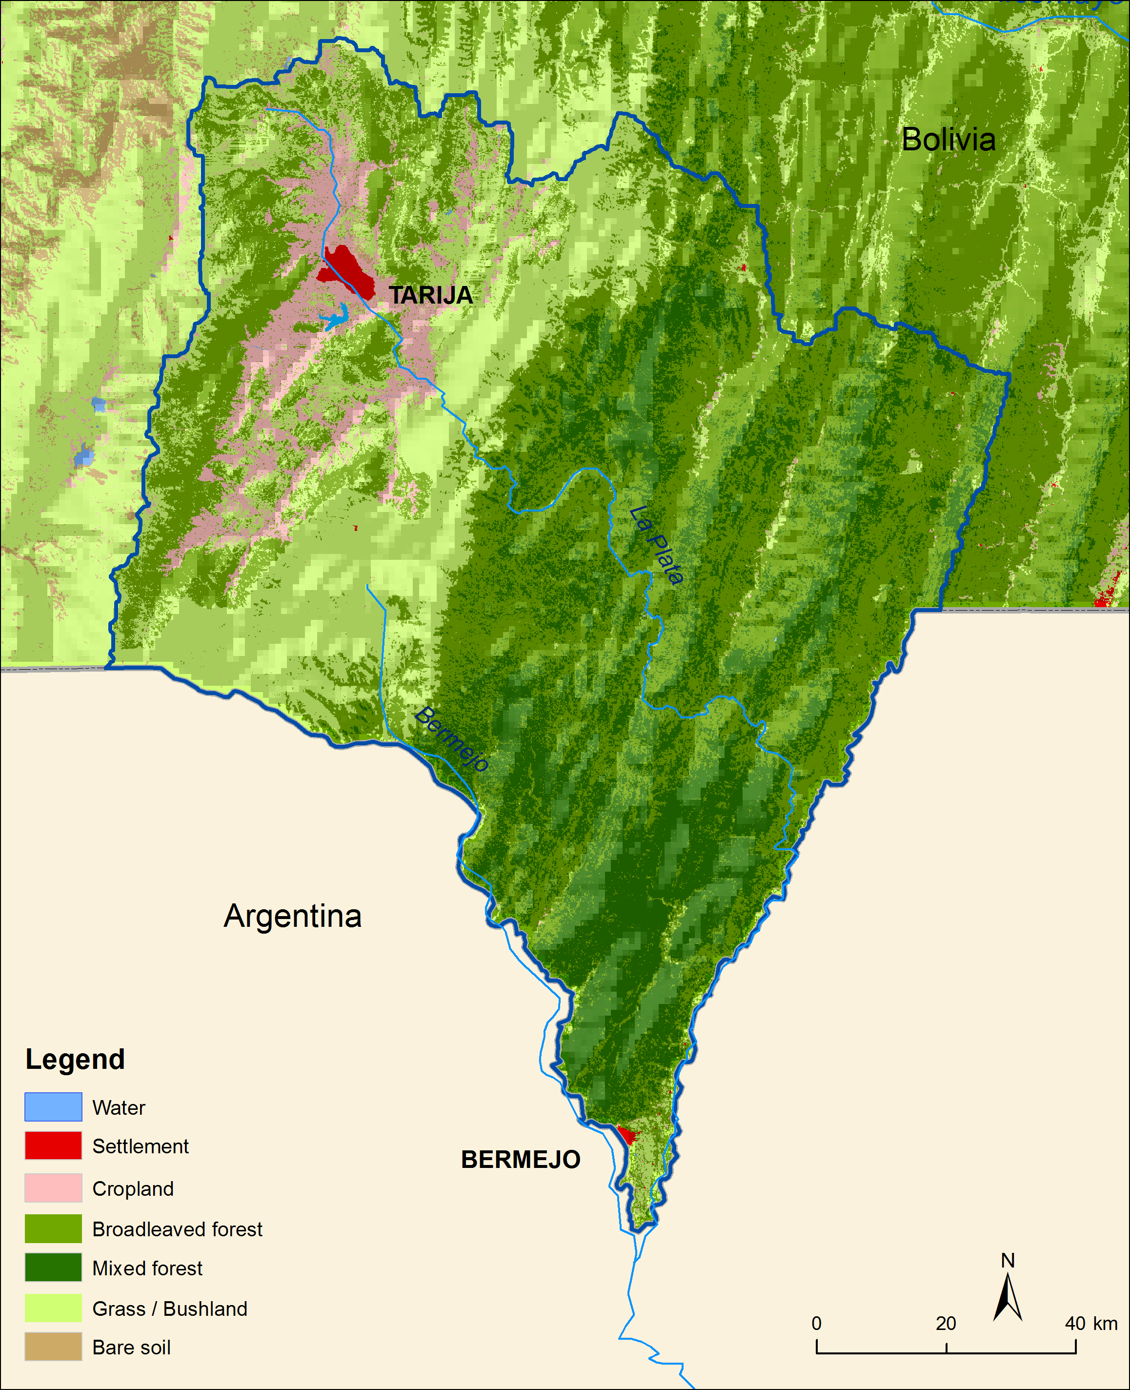
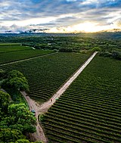
Tarija-Basin
[m]
[m3]

Slide 24

Scenario development Tarija
Scenarios | Change of crop rotations | Irrigation of strawberries | Change of reservoir management
Baseline (under current climate conditions) | Corn cultivation | Strawberry cultivation (16 ha) with flood irrigation | Priority (first operational objective) on hydropower generation with generation peaks in rainy season, second objective is irrigation (no flood control)
Noadaptation (under CC)
No regret (under current climate conditions) | Wine | Strawberry cultivation (3000 ha) with drop irrigation | Priority on irrigation, second goal hydropower generation (peak generation in rainy season, no flood control).
Adaptation (under CC)

Slide 25
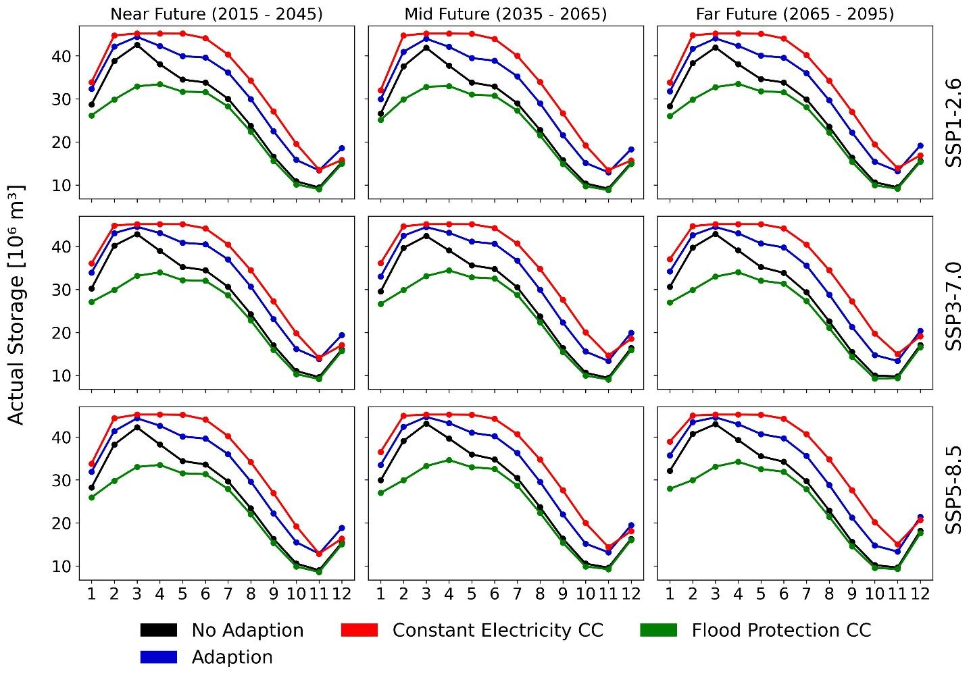
Water volume in reservoir under scenario conditions

Slide 26
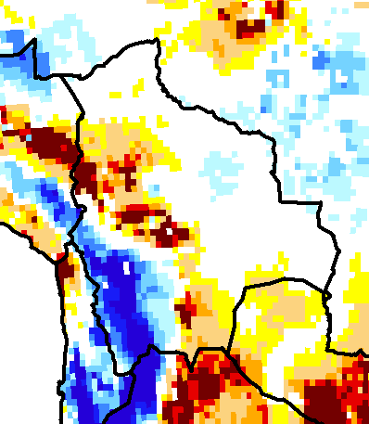
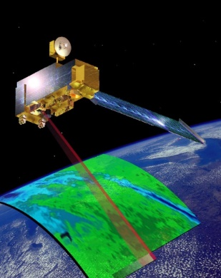
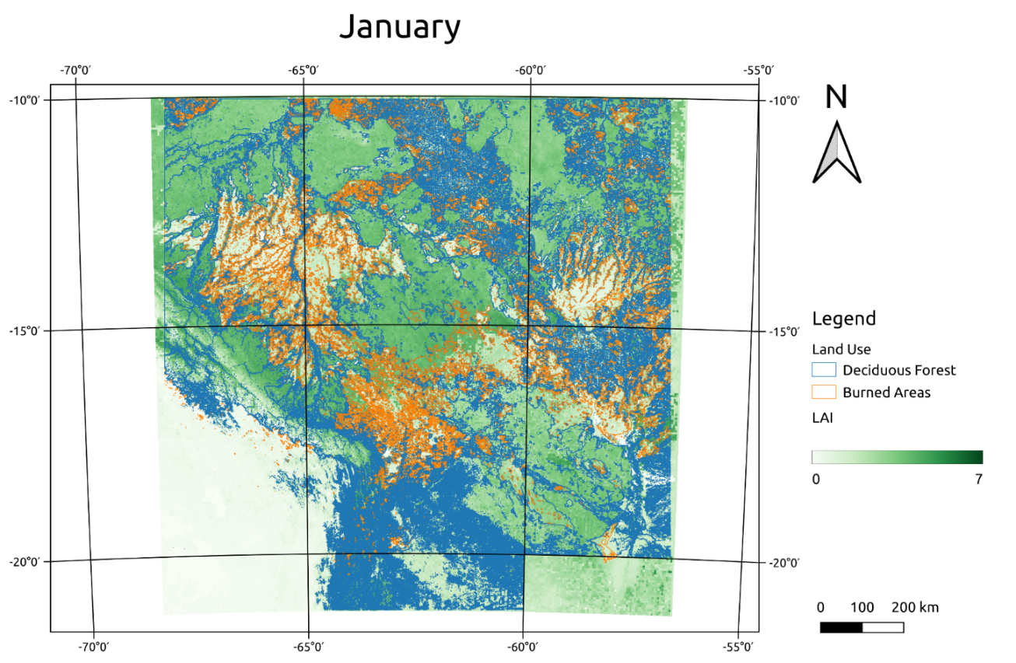
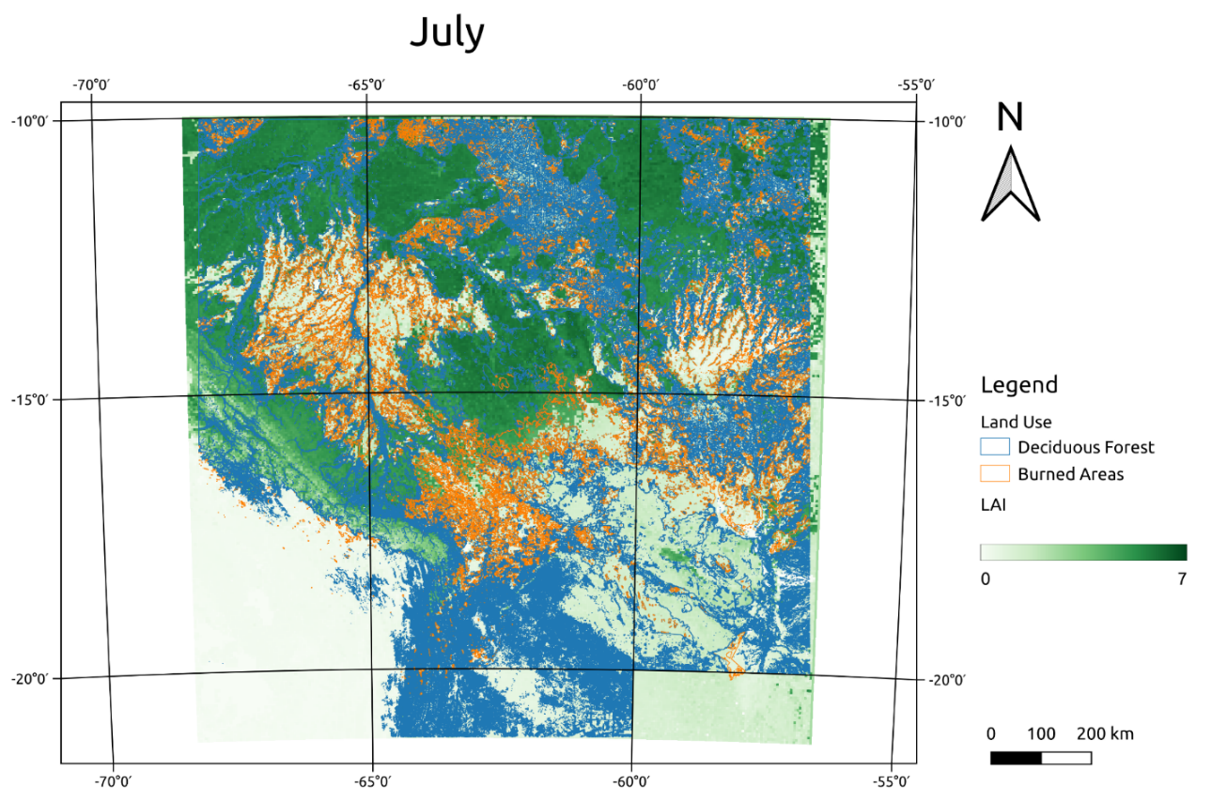
Impacts of forest fires in the Upper Amazon
Leaf area index LAI (MODIS satellite data)
GRACE data
Notes:
The pattern seem to be comparable: Water loss, where the forest was burned.

Slide 27
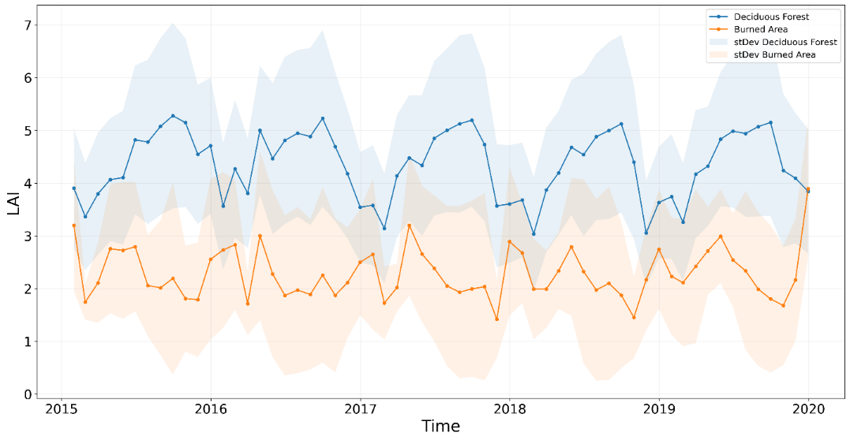
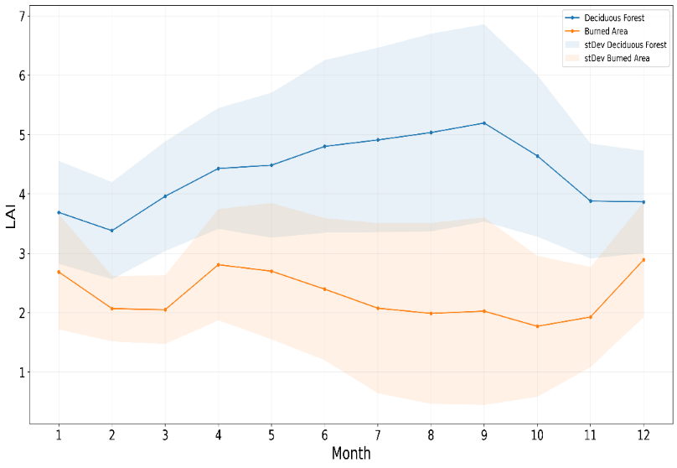
Natural an burned forest areas:
Leaf area index LAI (MODIS satellite data)
LAI natural forest
LAI after fire
Strong and permanent decrease of vegetation cover
Highly variable annual course of vegetation cover
Agriculture?
Notes:
This is the areal average of LAI of natural and burned forest. It is anti-correlated. Often two peaks in burned areas: Agriculture?

Slide 28
Ongoing projects: focus regions

Slide 29
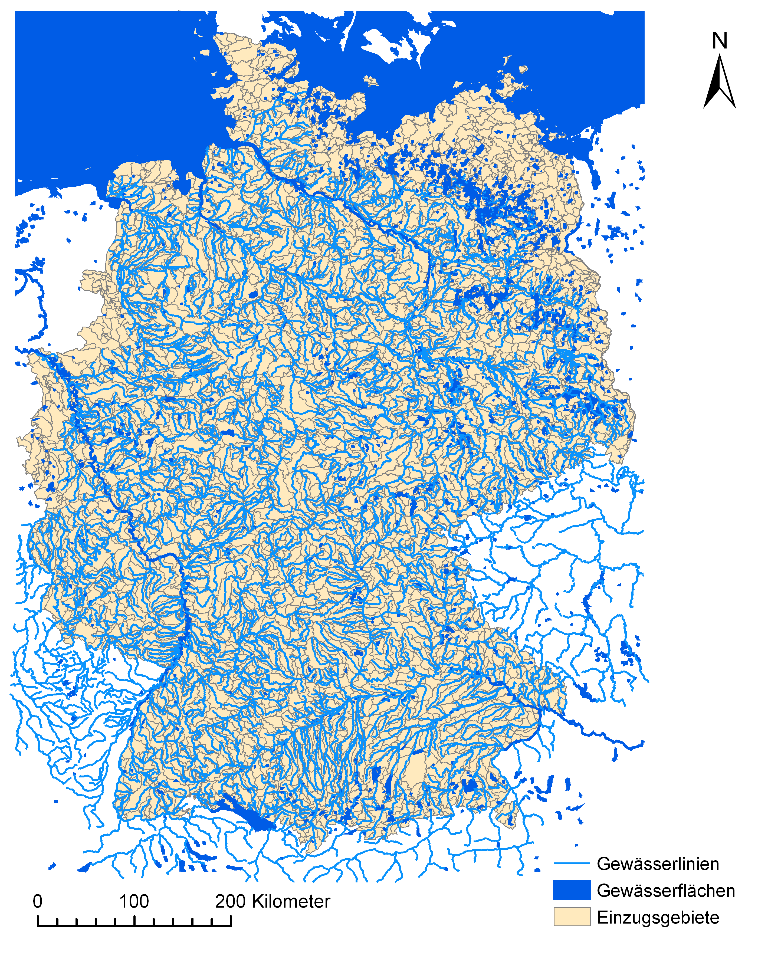
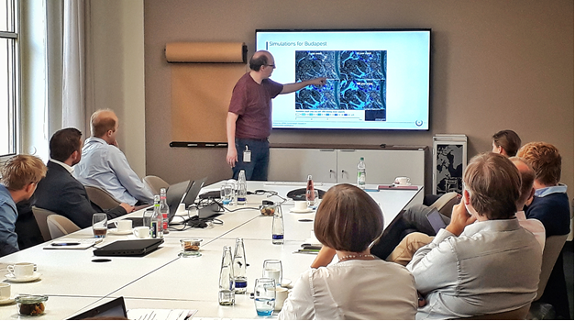
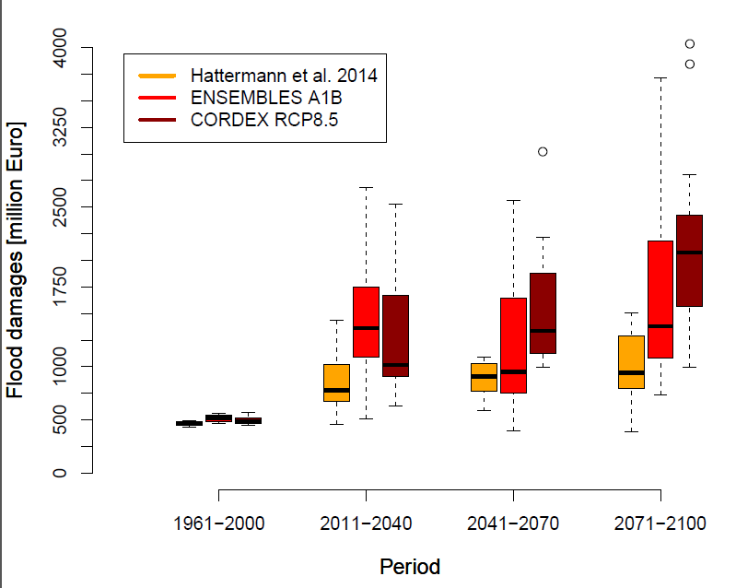
Flood risk in Central Europe
Expert workshops

Slide 30
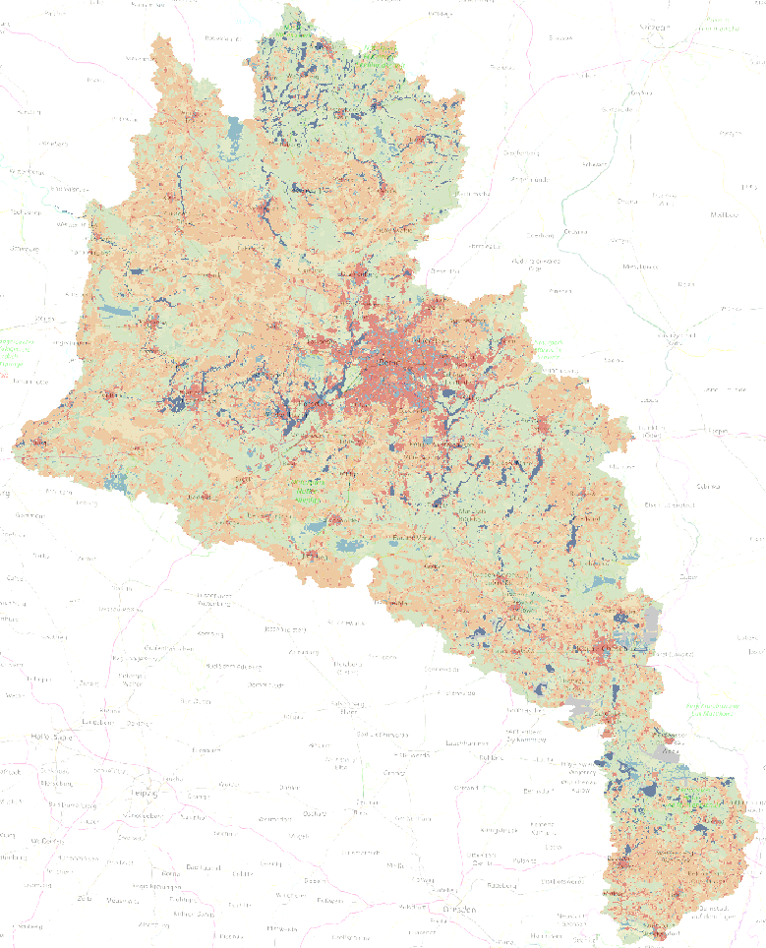
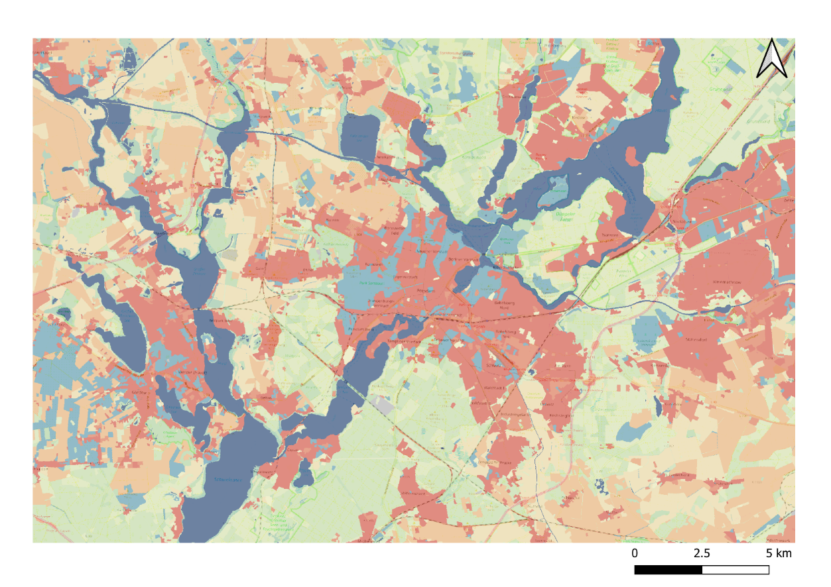
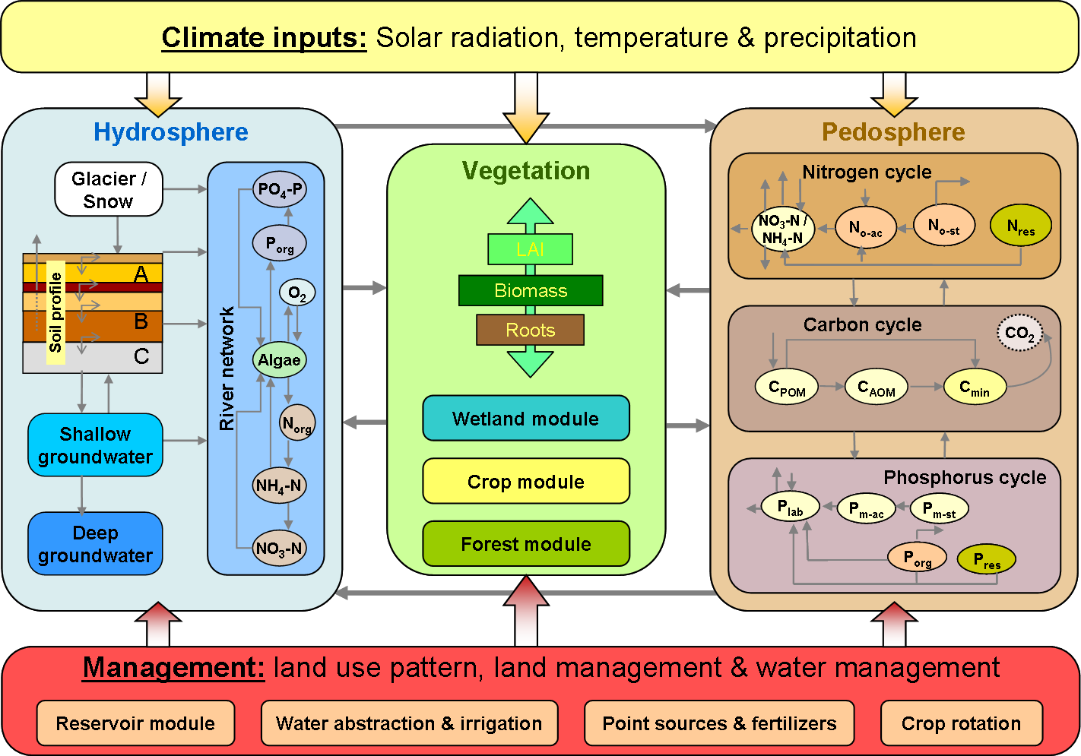
SWIM model implementation (Spree-Havel)
Water
Forest
All maps (soils, land use, DEM etc.) have a resolution of 10 m.
Arable land
Settlement
Grass

Slide 31
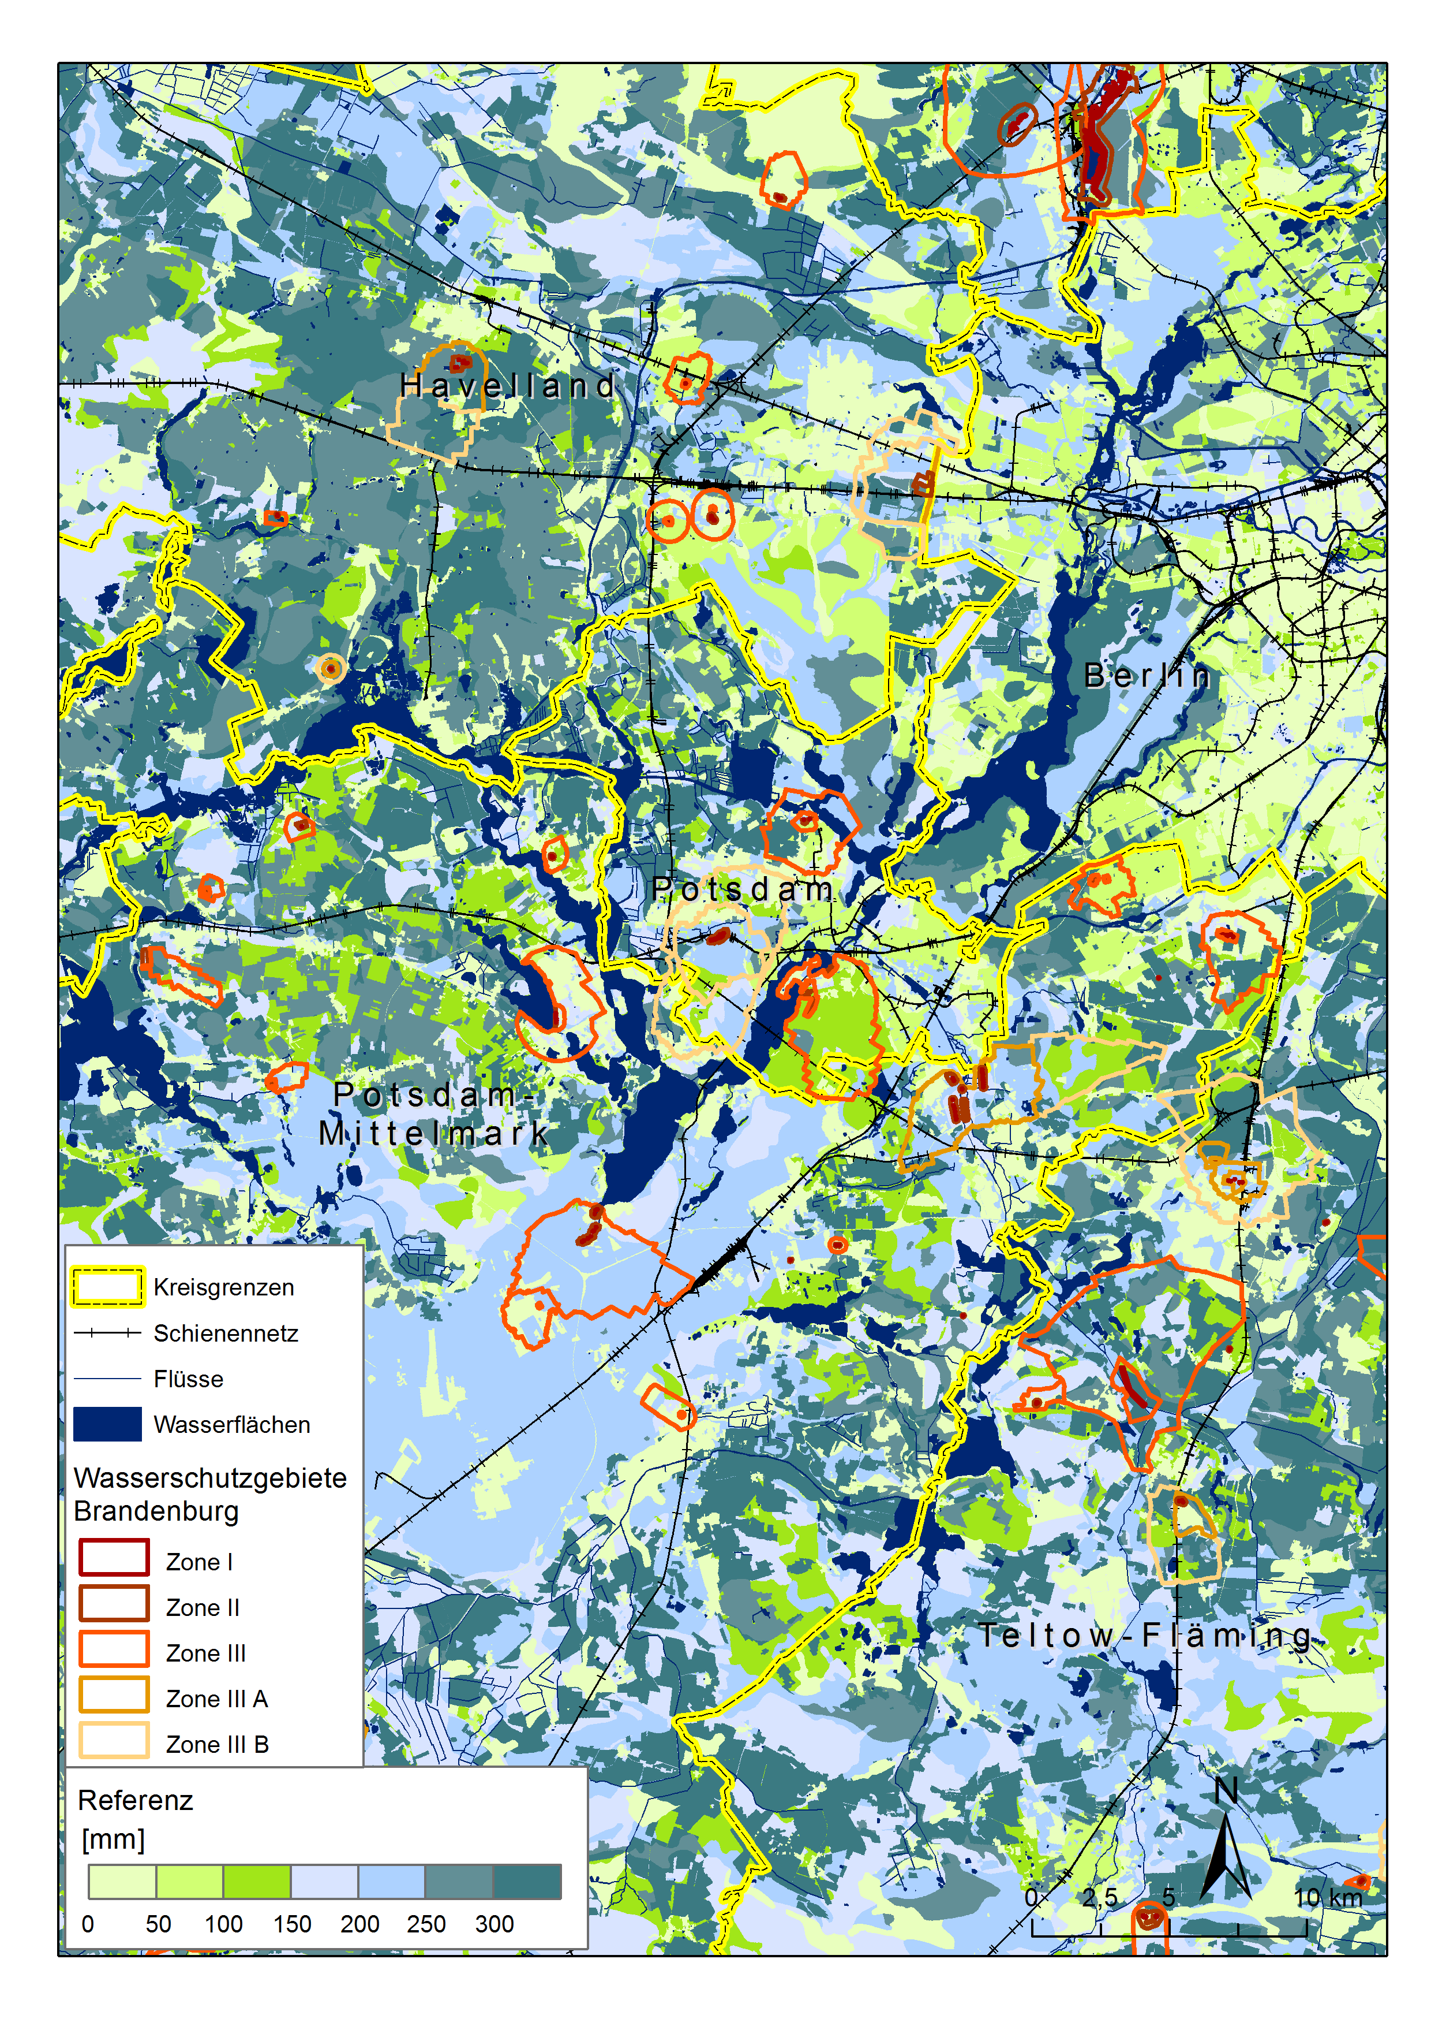
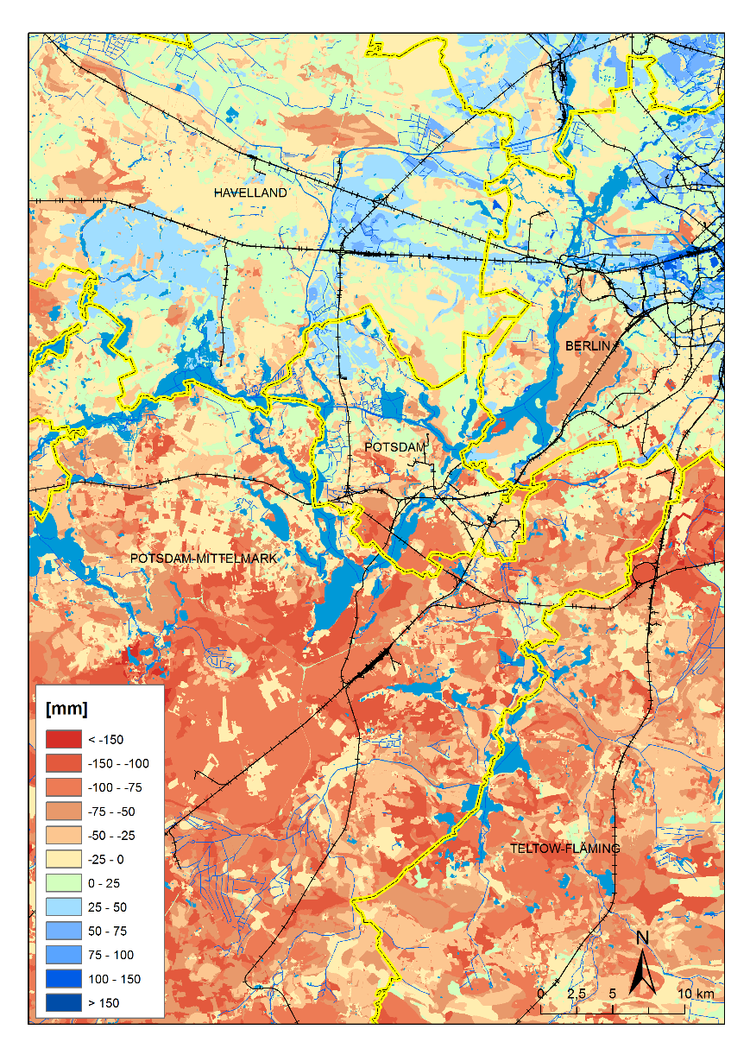
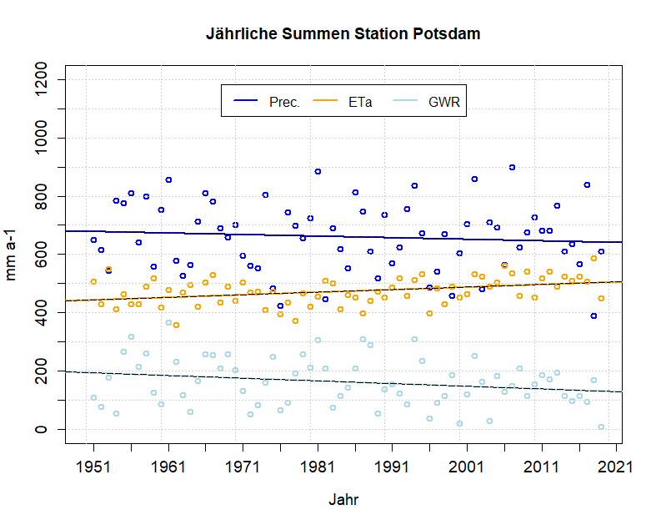
Development of water components 1951-2020
Diff in GWR 2019
Annual sums Potsdam
F.F. Hattermann 2020, PIK

Slide 32
Thanks!

Slide 33
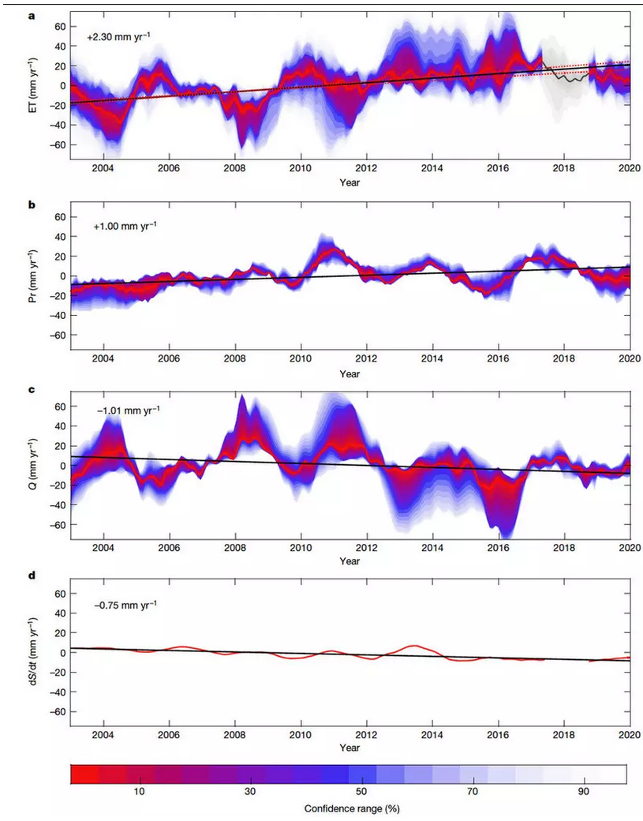
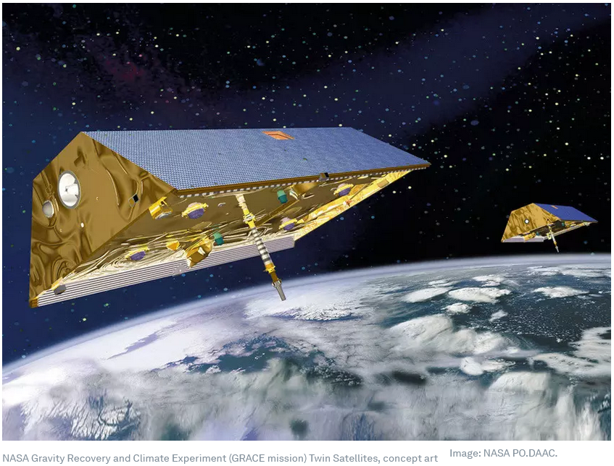
Global water trends
Evapotranspiration
Precipitation
Runoff
Gravity Recovery and Climate Experiment (GRACE)
Groundwater
Pascolini-Campbell et al (2021)
Notes:
Pascolini-Campbell, M. et al. (2021) A 10 per cent increase in global land evapotranspiration from 2003 to 2019, Nature, doi:10.1038/s41586-021-03503-5

Slide 34
Summary and conclusions

Slide 35
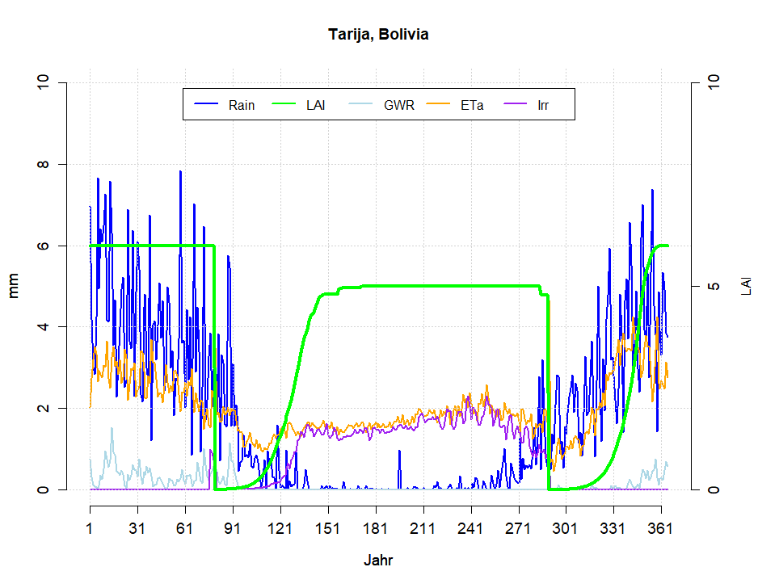
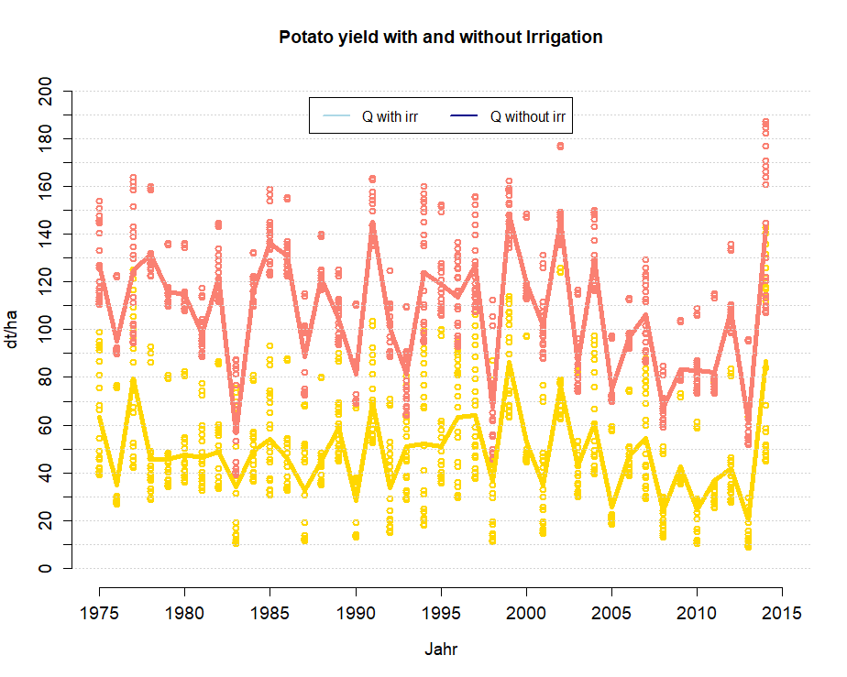
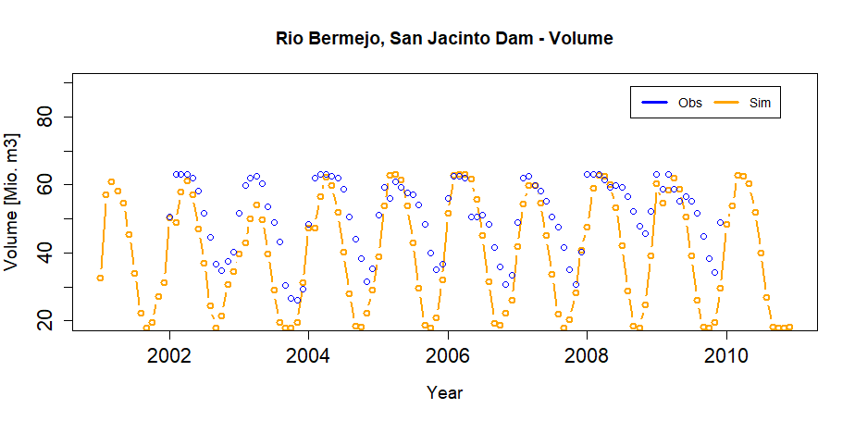
Example irrigation
Rotation maize – potatoes
2155 m asl
Average Temperature 15.5 °C
Sum precipitation 642 mm
Sum irrigation ~250 mm
no
with

