Slide 1
Fred F. Hattermann hattermann@pik-potsdam.de
Earth System Analysis &
Stewardship

Slide 2
Outline
Monday Nov. 20
The hydrological classics: Background and presentation about AMOC, presentation of topics
Tuesday Nov. 21
Water as a basic need, water as a threat: The nexus water – energy – food – health, hydrological extremes, erosion, selection of topics
Wednesday Nov. 22
Eco-hydrological modelling, groupwork
Thursday Nov. 23
Groupwork
Friday Nov. 24
Presentation of selected tasks, visiting PIK

Slide 3
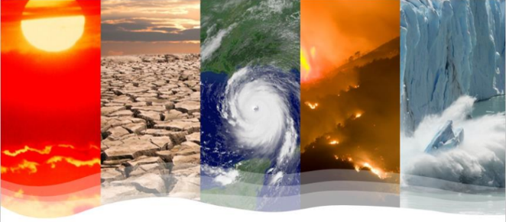
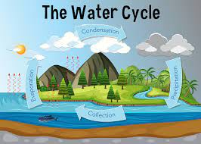
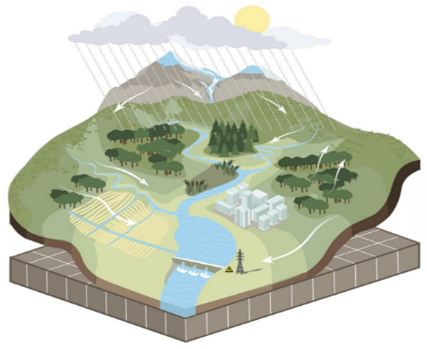

What we will do
Theory
Background and conceptualization
Examples
Modelling and interpretation
Application
Presentation of selected topics

Slide 4
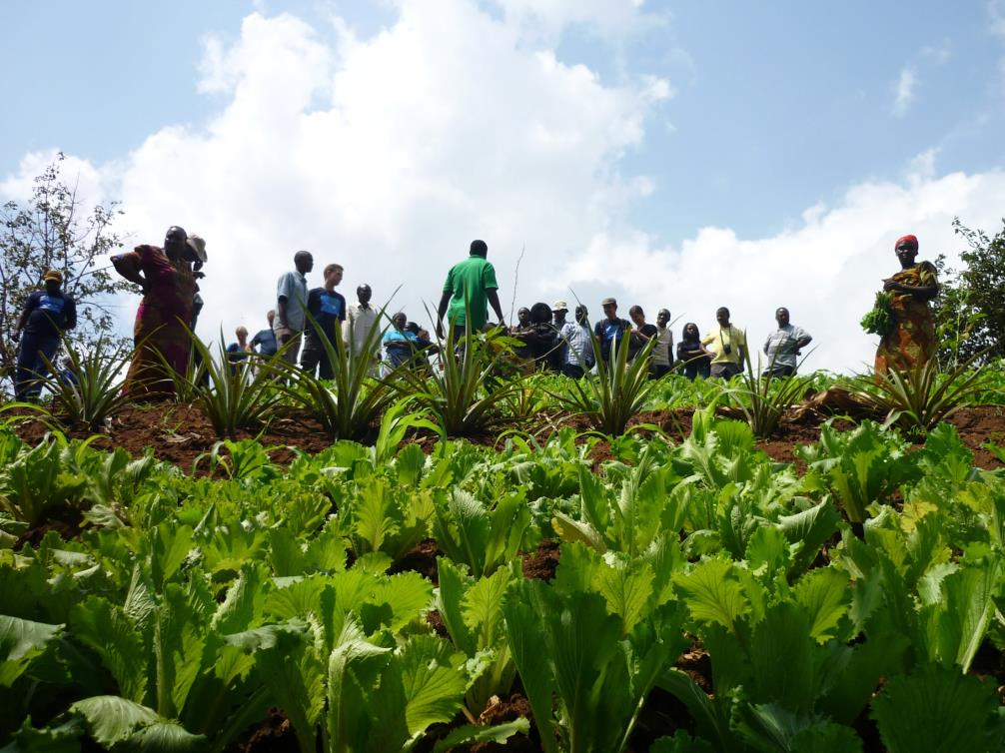
Solutions

Slide 5
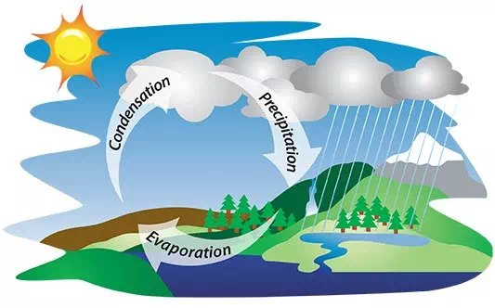
Water cycle, simple
Main processes:
Precipitation
Evaporation
Condensation
Driver:
Solar radiation and gravity

Slide 6
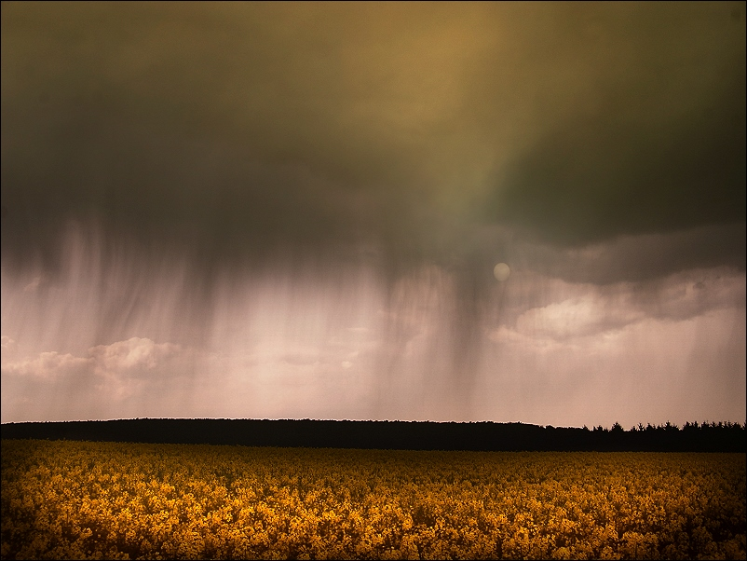
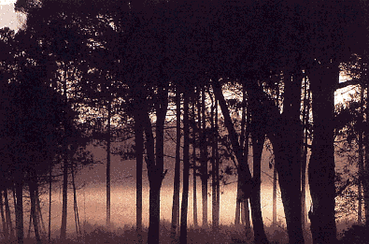
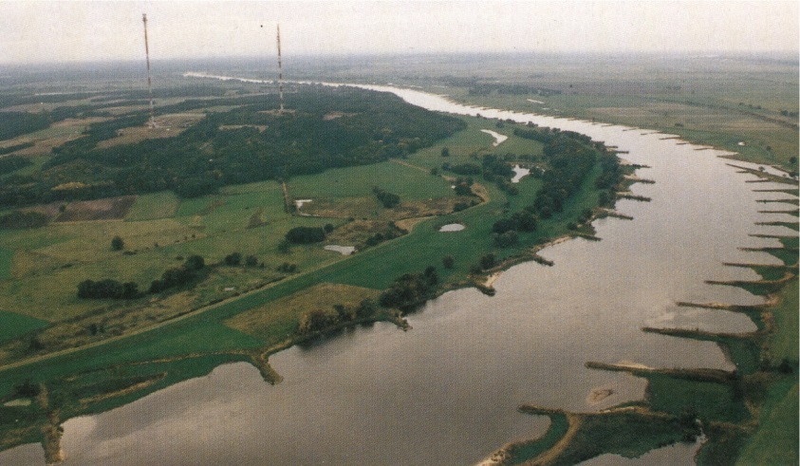
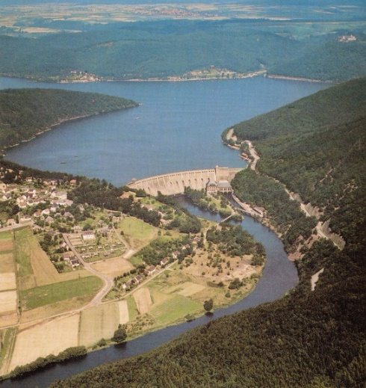
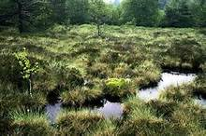
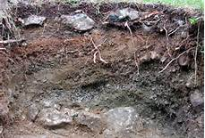
Water balance equation
Precipitation
Evaporation
=
Discharge
+/- storage
+
+

Slide 7
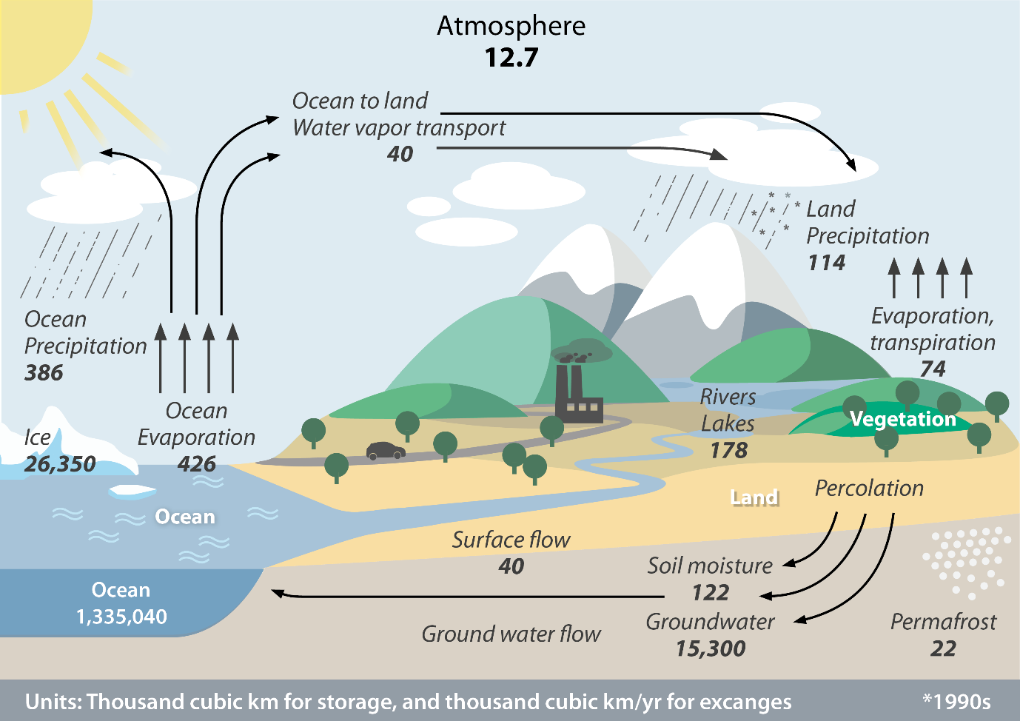
Water cycle, global
Water reservoirs
Oceans, inland waters, glaciers, groundwater, atmosphere, soil water, organisms ...
Processes
Precipitation,
evaporation,
seepage,
Runoff
The global water cycle. Illustration: GIZ (2020) with data from Trenberth et al. (2011).

Slide 8
Erosion

Slide 9
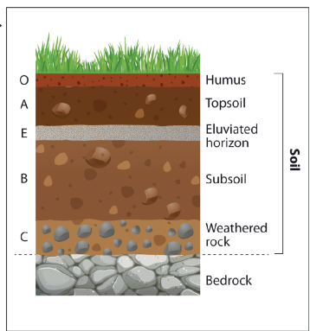
Definition
Soil erosion is the denudation/ removal of the upper layer of soil. It is a form of soil degradation.
It is a natural process caused by the dynamic activity of erosive agents, that is:
water,
ice (glaciers),
snow,
air (wind),
plants,
and animals (including humans)

Slide 10
Mechanism of soil erosion
Soil erosion goes through three main processes. These are:
Detachment,
Transport and
Deposition.
They depend on the soil characteristics, land use, slope and land cover.
https://blogs.ubc.ca/erosioncontrol

Slide 11
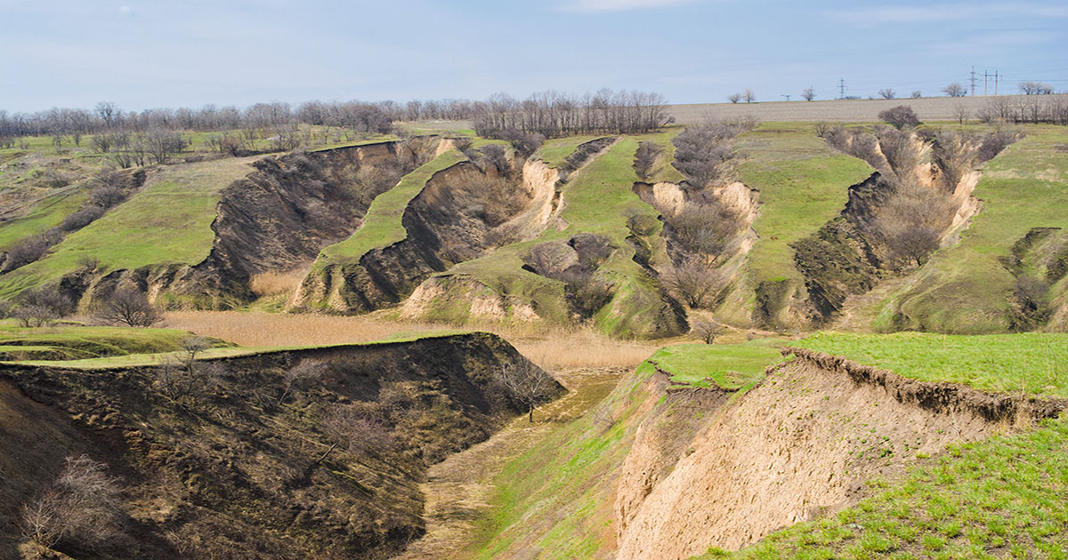
Factors affecting soil erosion
Natural:
Climate
Soil structure and composition
Vegetative cover
Topography
Human activities
Agricultural practices
Deforestation
Roads and human impact

Slide 12
Factors affecting soil erosion
Soil:
The composition, moisture, and compaction of soil are all major factors in determining the erosivity of rainfall
Sediments containing more clay tend to be more resistant to erosion than those with sand or silt, because the clay helps binding soil particles together
Human activities
Vegetation shelters the soil from rain and wind, and has a better microclimate.
The roots of the plants bind the soil together, and interweave with other roots, forming a more solid mass

Slide 13
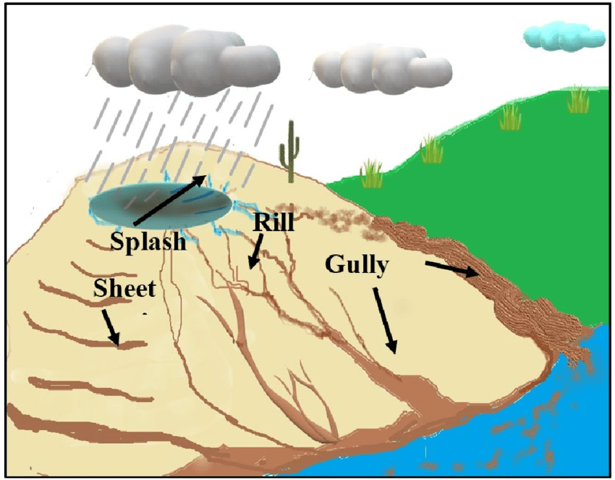
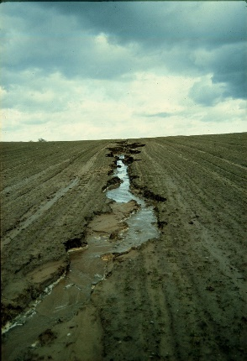
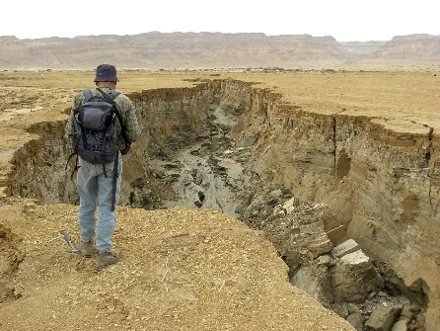
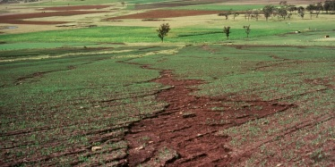
Types of water erosion
Rill
Gully
Sheet
Senanayake et al. 2020, Remote Sensing & wikipedia

Slide 14
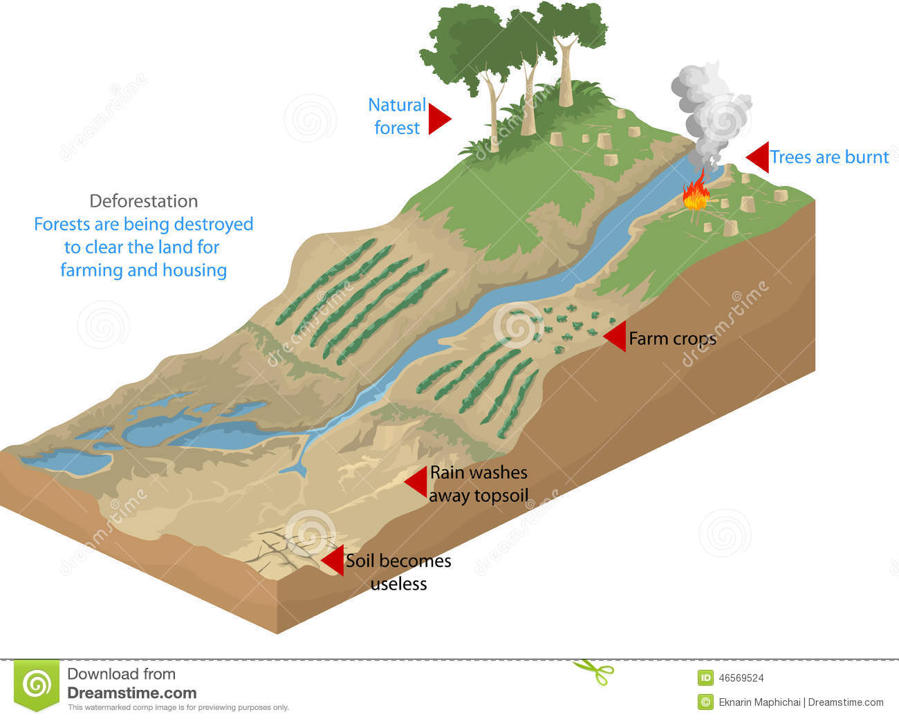
Human impacts on land use: forest fires

Slide 15
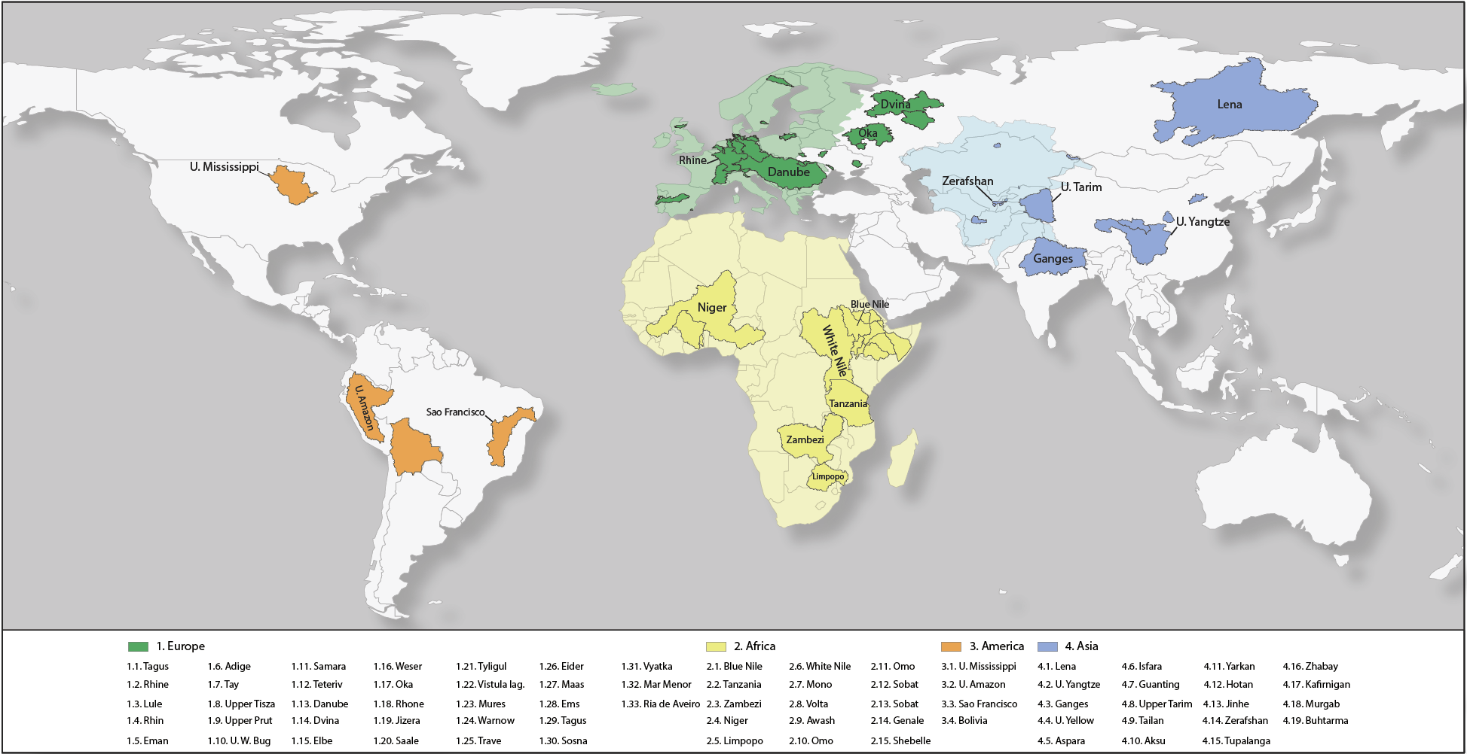
Current study regions

Slide 16
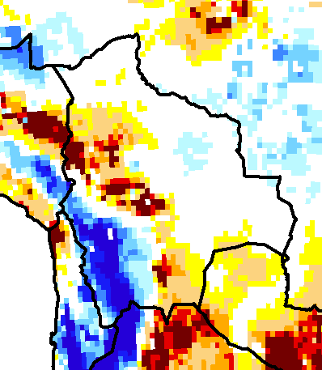
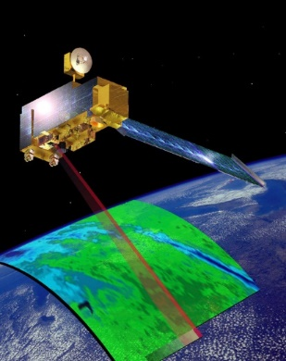
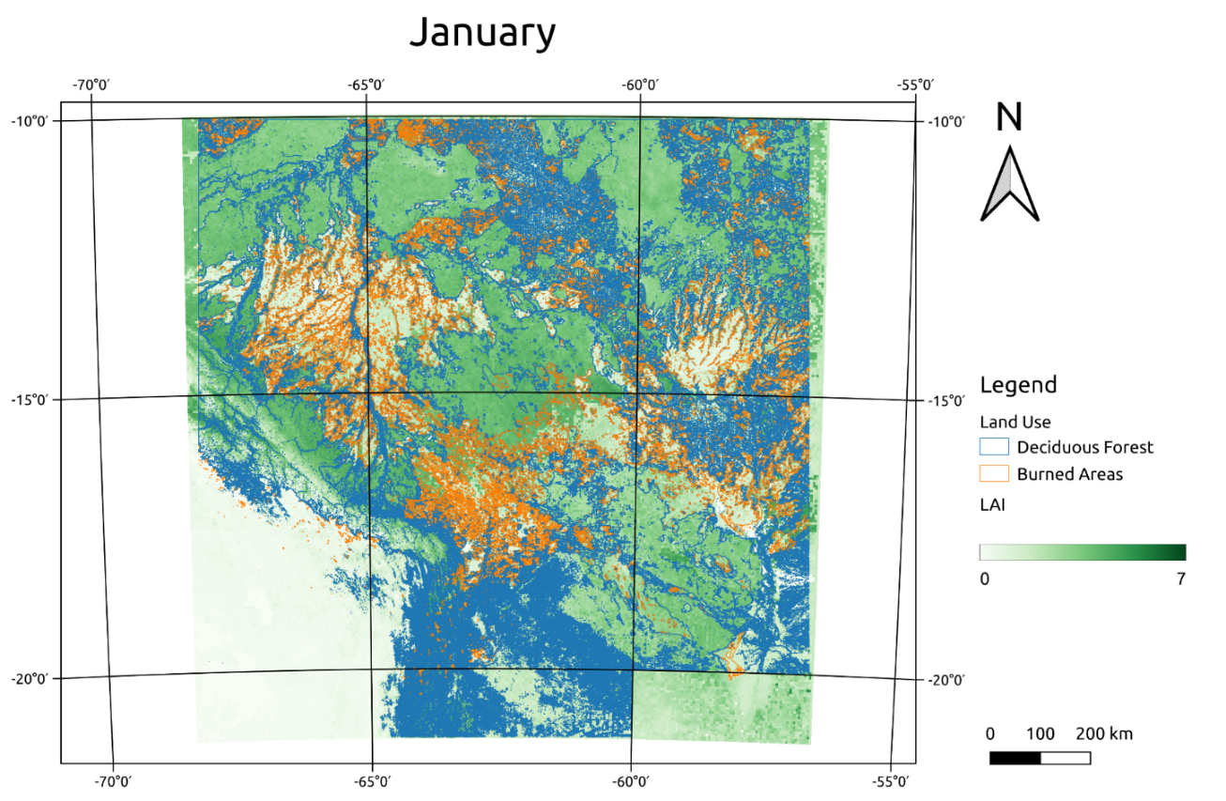
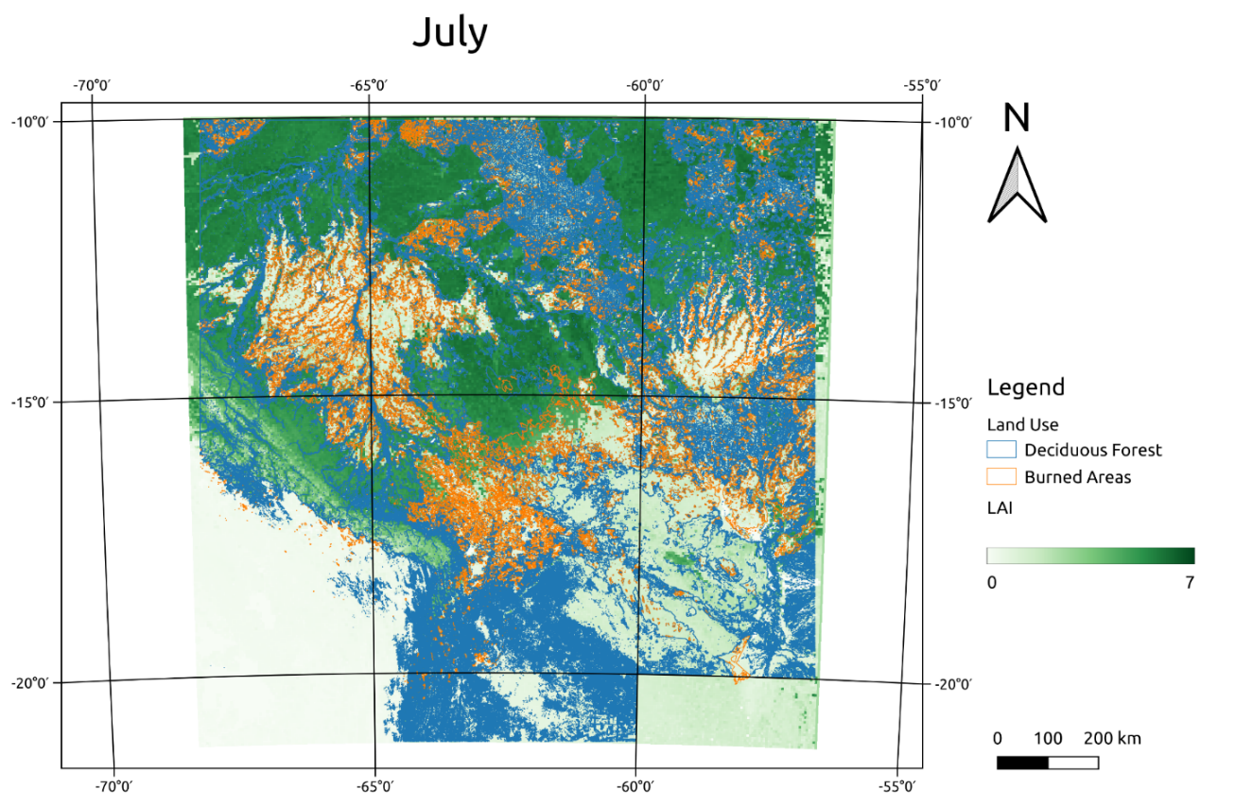
Impacts of forest fires in the Upper Amazon
Leaf area index LAI (MODIS satellite data)
GRACE data
Notes:
The pattern seem to be comparable: Water loss, where the forest was burned.

Slide 17
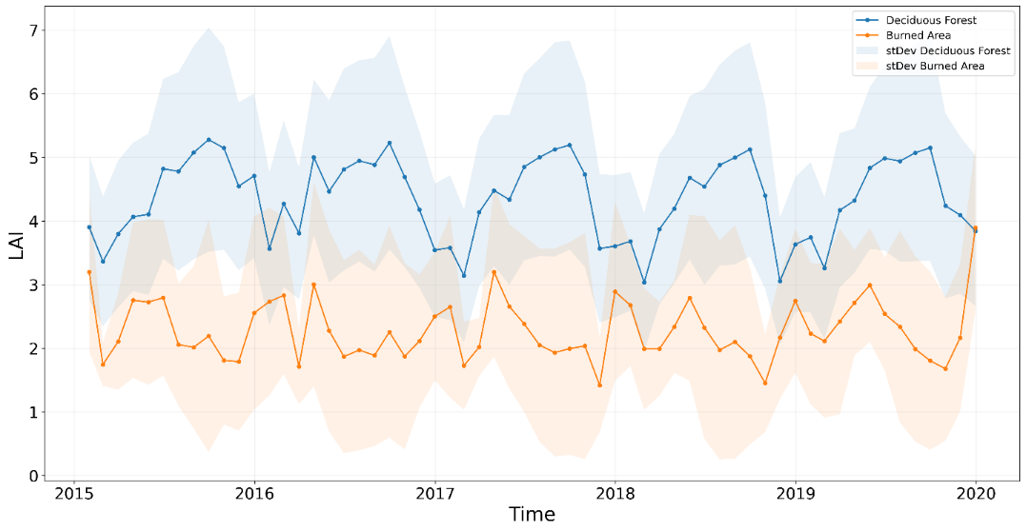
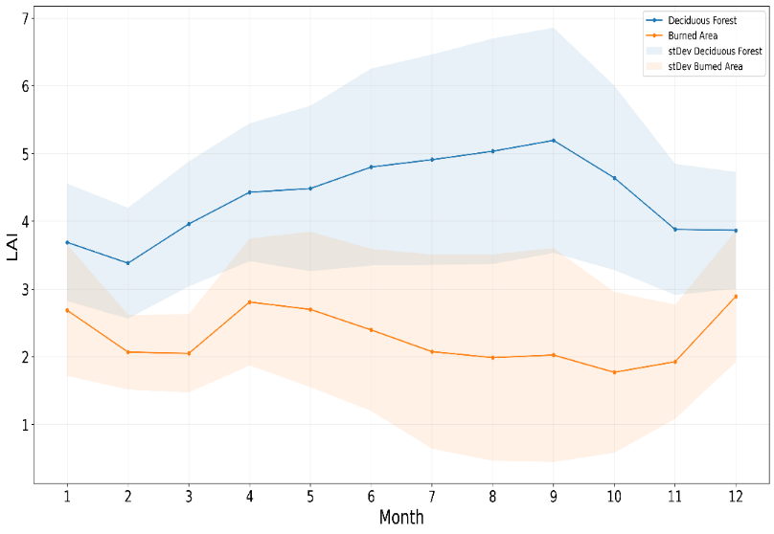
Natural and burned forest areas:
Leaf area index LAI (MODIS satellite data)
LAI natural forest
LAI after fire
Strong and permanent decrease of vegetation cover
Highly variable annual course of vegetation cover
Agriculture?
Notes:
This is the areal average of LAI of natural and burned forest. It is anti-correlated. Often two peaks in burned areas: Agriculture?

Slide 18
Consequences of wildfire on the local water balance – Parametrization of SWIM
Estimation of runoff parametrization
following forest fires By Konstantinos X. Soulis, DOI: 10.1080/02626667.2018.1501482
Leaf area index: Aus MODIS Satellitendaten.
Verbrannte Fläche: Aus Satellitendaten
Geänderte Bodeneigenschaften: Aus Konstantinos 2018 (rechts).
Notes:
C value is a parameter in SWIM applied to calculate the surface runoff. In this publication we found values for burned und ~natural forest.

Slide 19
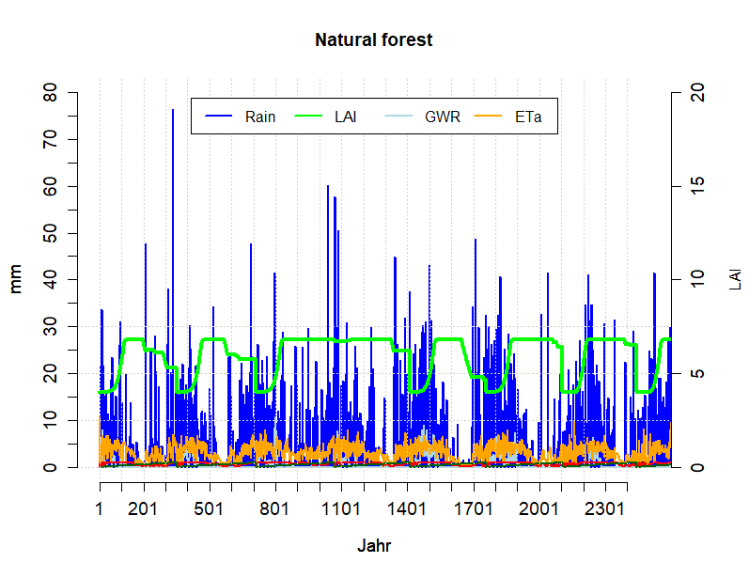
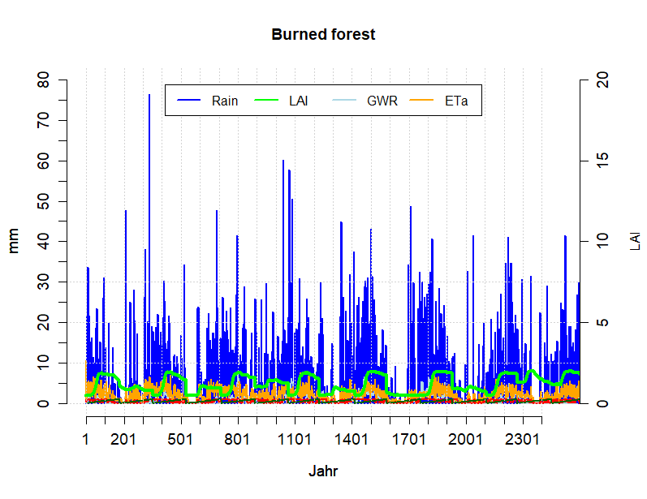
SWIM: Water cycle before and after fire
LAI – Leaf Area Index
Notes:
SWIM results for the same hydrotop to have a 1:1 comparison of a burned and natural forest. LAI adjusted according to the satellite data, CN according to the literature.

Slide 20
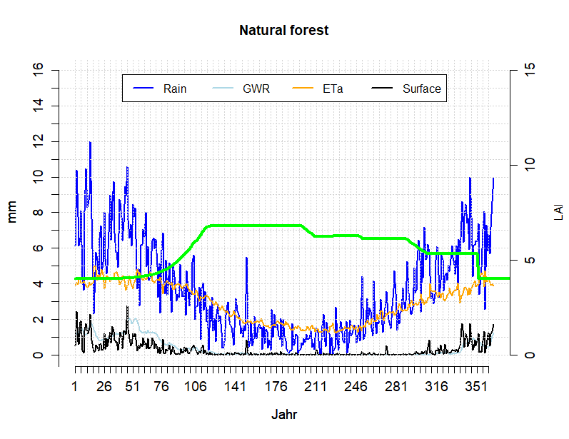
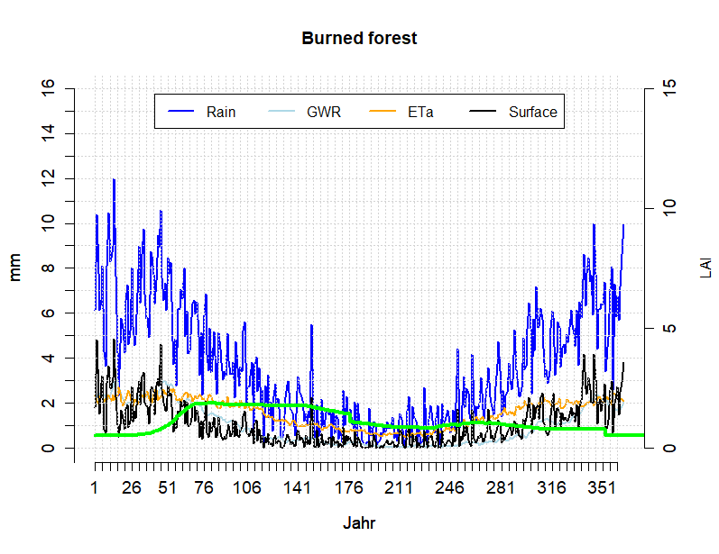
SWIM: Water cycle before and after fire
111.7882
Natural forest:
Surface runoff 112 mm
Burned forest:
Surface runoff: 376 mm
Possibly much more surface runoff in the burned forest areas, so heavy erosion is likely to occur.
Notes:
SWIM results for the same hydrotop to have a 1:1 comparison of a burned and natural forest. LAI adjusted according to the satellite data, CN according to the literature.

Slide 21
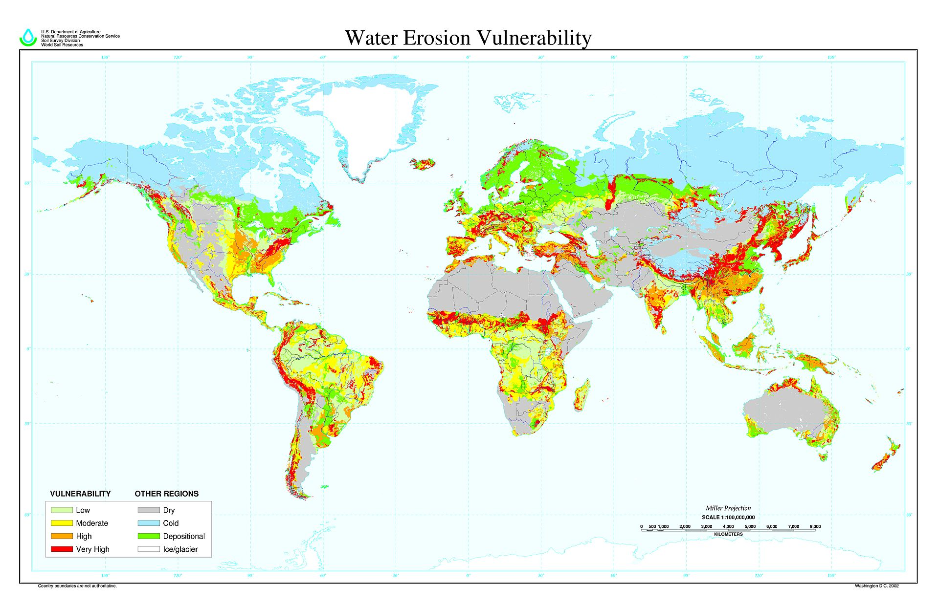
Vulnerable regions

Slide 22
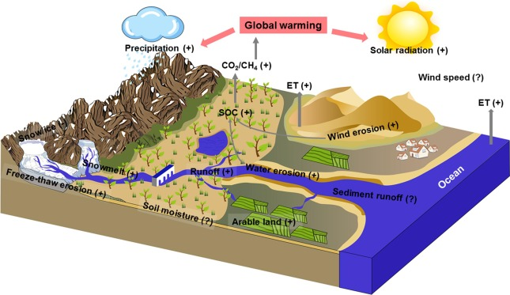
Climate change impact on erosion
Possibly more erosion because:
Heavier precipitation;
Droughts destroy vegetation cover;
More wind erosion;
Ma et al. 2021, Science

Slide 23
Universal soil loss equation
The severity of an erosion event depends on the combination of a number of factors. This is summarized in a model known as the universal soil loss equation (USLE). The USLE relates the rate of erosion from an exposed area (A) to the erosive power of the rain (R), the soil erodibility (K), the land slope and length (LS), the degree of soil cover (C), and conservation practices (P):
A = R x K x LS x C x P
The important aspect of this equation to note is the linear relationship between the equation’s parameters. As any parameter is changed, the resulting erosion yield is similarly changed.

Slide 24
The Nexus Water – Food – Energy – Health

Slide 25
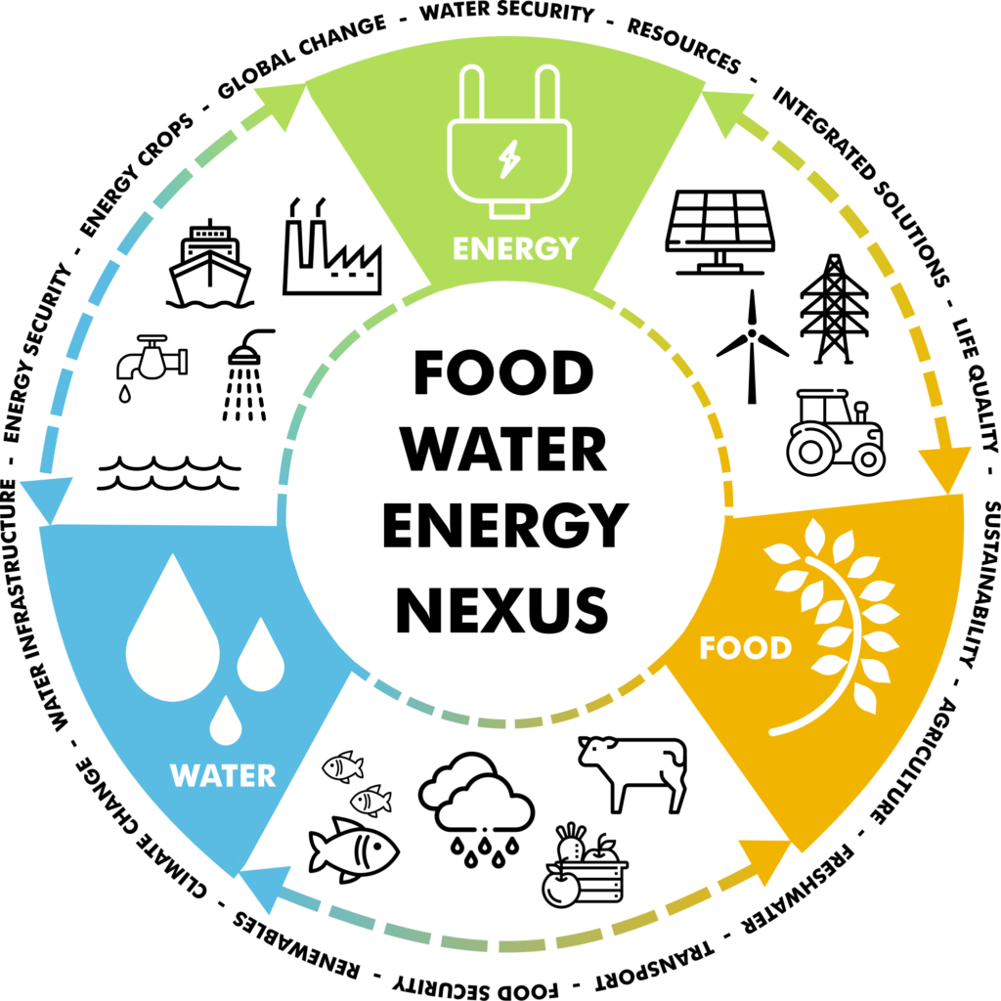
The WEF NEXUS
Food, Water and Energy are elements that are inevitably linked with each other.
Impacts on one part might also cause changes in the other ones.
To provide a sustainable development on a global scale, solutions concerning food, water and energy challenges have to be created and established

Slide 26
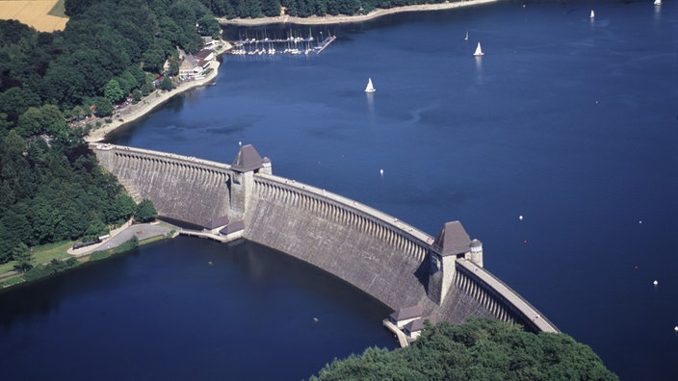
Definition water management
    DIN 4049:
    Water management: Control and operation of water management systems for
    water supply,
    wastewater disposal,
    irrigation and drainage,
    canal and flood protection and
    hydraulic engineering facilities (dams, navigation channels)
    with the aim of protecting water resources and the water ecosystem and balancing the interests of different uses.
Rurtalsperre (Eifel)

Slide 27
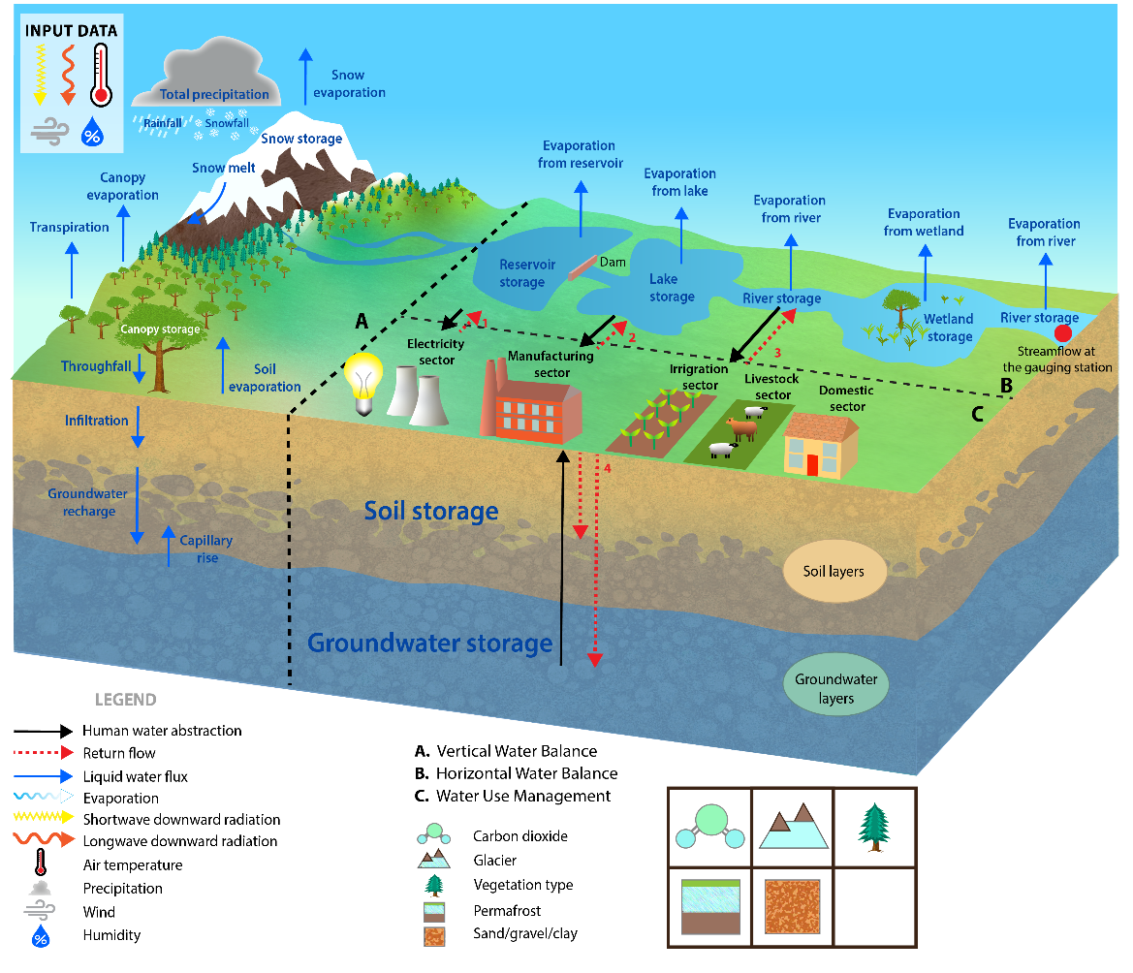
Management of water
Source: Camelia Telteu (Universität Frankfurt)

Slide 28
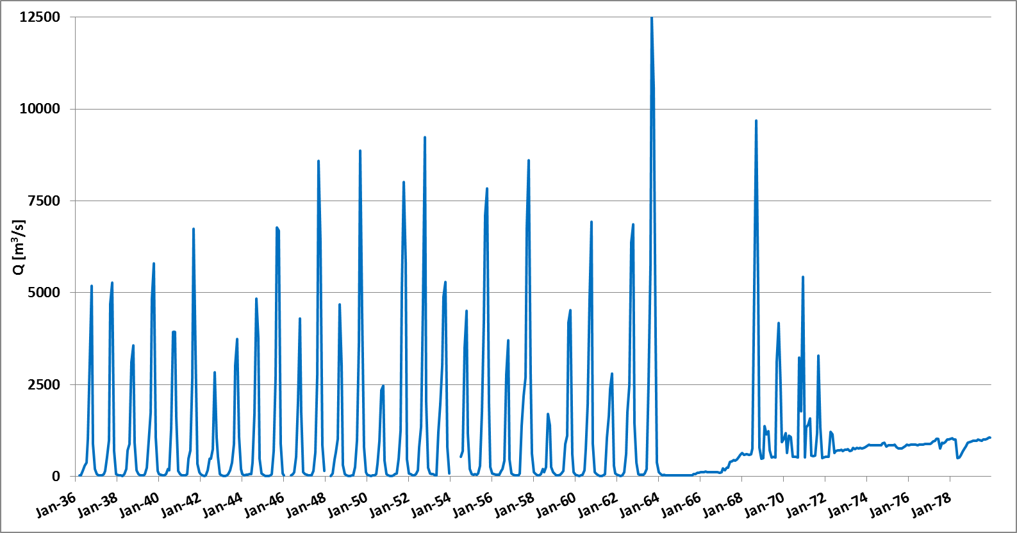
Impact of management on river discharge
Discharge at gauge Senchi / Volta (Ghana, uh. Lake Volta)
natural System <= => managened System
Daten: GRDC, Koch 2020
28

Slide 29
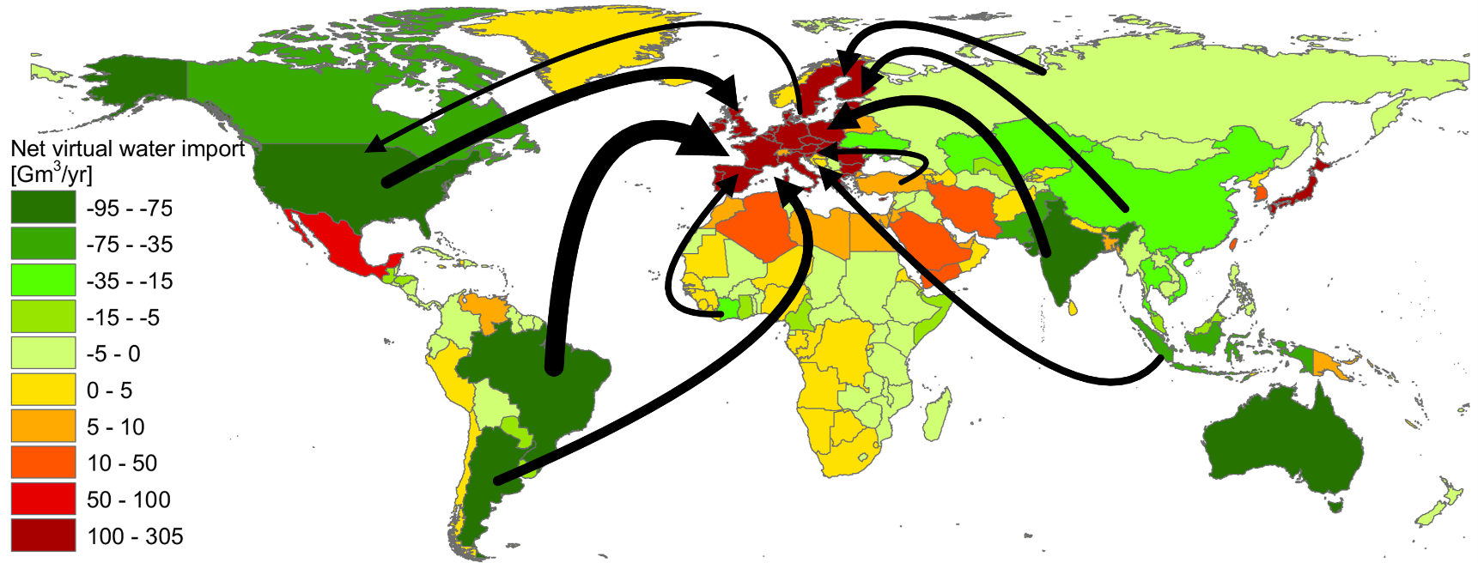
Virtual water import
Mekonnen, M.M. and Hoekstra, A.Y. (2011)

Slide 30
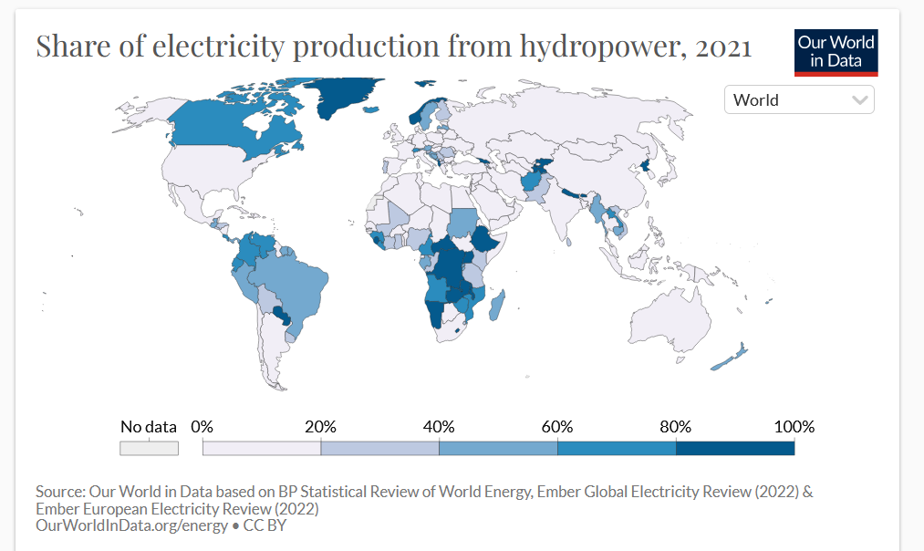
Share of hydropower per capita

Slide 31
Integrated water management
Integrated water resources management:
Integrated water resources management (IWRM) has been defined by the Global Water Partnership (GWP) as "a process which promotes the coordinated development and management of water, land and related resources, in order to maximize the resultant economic and social welfare in an equitable manner without compromising the sustainability of vital ecosystems".
Integrated river basin management:
Integrated River Basin Management (IRBM) emphasises cross-disciplinary coordination of water, land and related resources in a river basin, watershed or catchment to achieve long-term sustainability.
IRBM highlights the importance of ecosystem function in the long term, and reminds us that an integration of policies, decisions and costs are necessary across a multitude of sectors.

Slide 32
Einführung
1.2 Aufgaben der wasserwirtschaftlichen Planung
The European Water Framework Directive (WFD)
Since Sept. 14, 2001, the EU Water Framework Directive has been in effect in the states of the European Union:
Directive establishing a framework for Community action in the field of water policy - Water Framework Directive (WFD)
Management plans for entire river basins
Focus on the protection and improvement of aquatic ecosystems
The promotion of sustainable use of water resources
Reduction of water pollution by hazardous substances in accordance with marine protection agreements
Reduction of the ecological impact of floods and droughts
32

Slide 33
WFD
Einführung
1.2 Aufgaben der wasserwirtschaftlichen Planung
The Directive aims for 'good status' for all ground and surface waters (rivers, lakes, transitional waters, and coastal waters) in the EU.
The ecological and chemical status of surface waters are assessed according to the following criteria (see also: freshwater environmental quality parameters):
Biological quality (fish, benthic invertebrates, aquatic flora)
Hydromorphological quality such as river bank structure, river continuity or substrate of the river bed
Physical-chemical quality such as temperature, oxygenation and nutrient conditions
Chemical quality that refers to environmental quality standards for river basin specific pollutants.
These standards specify maximum concentrations for specific water pollutants. If even one such concentration is exceeded, the water body will not be classed as having a “good ecological status”.

Slide 34
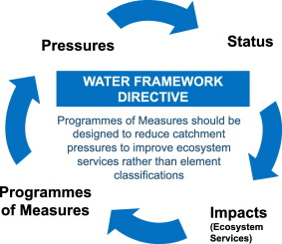
The European Water Framework Directive

Slide 35
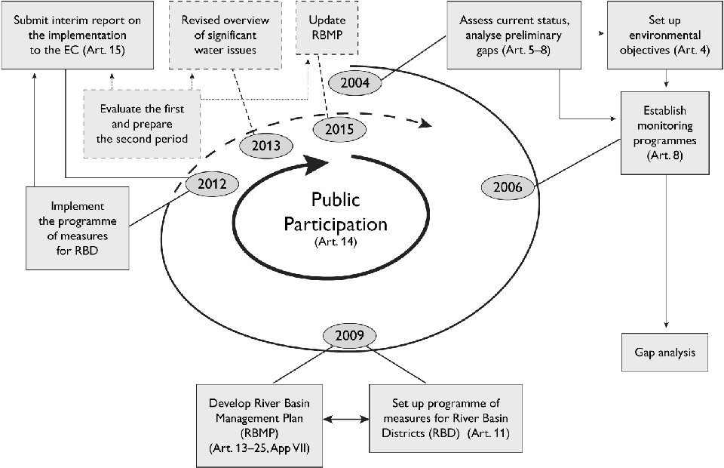
The European Water Framework Directive

Slide 36
WEF Nexus Examples

Slide 37
Ongoing projects: focus regions

Slide 38
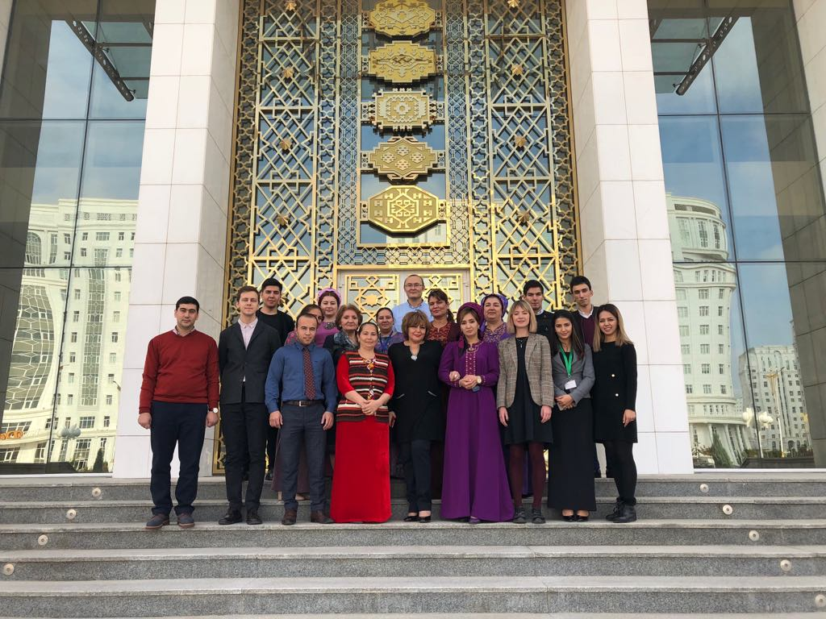
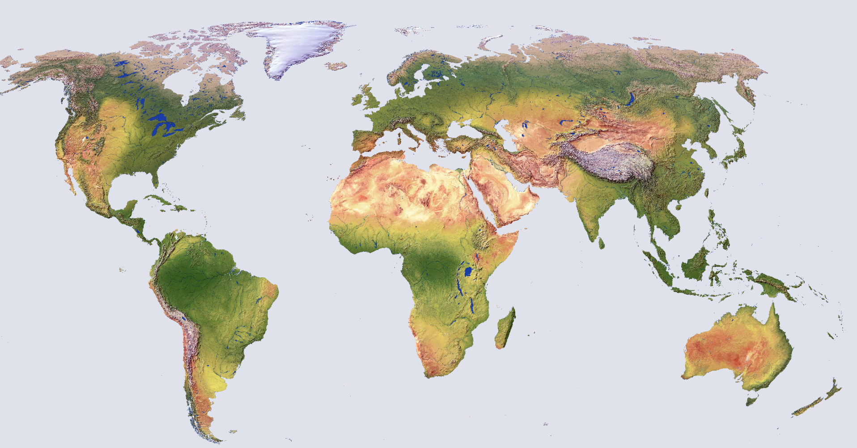
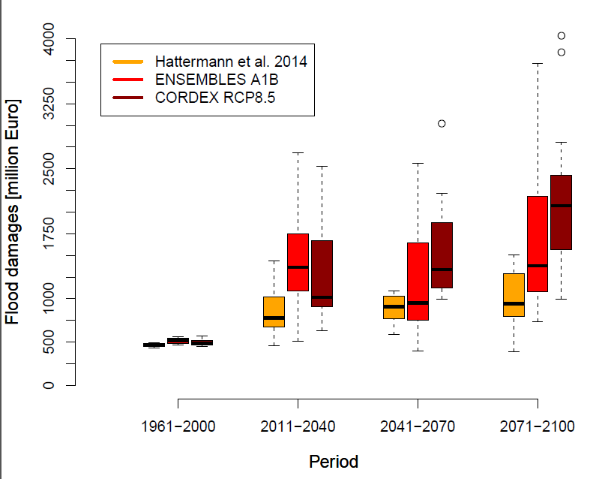
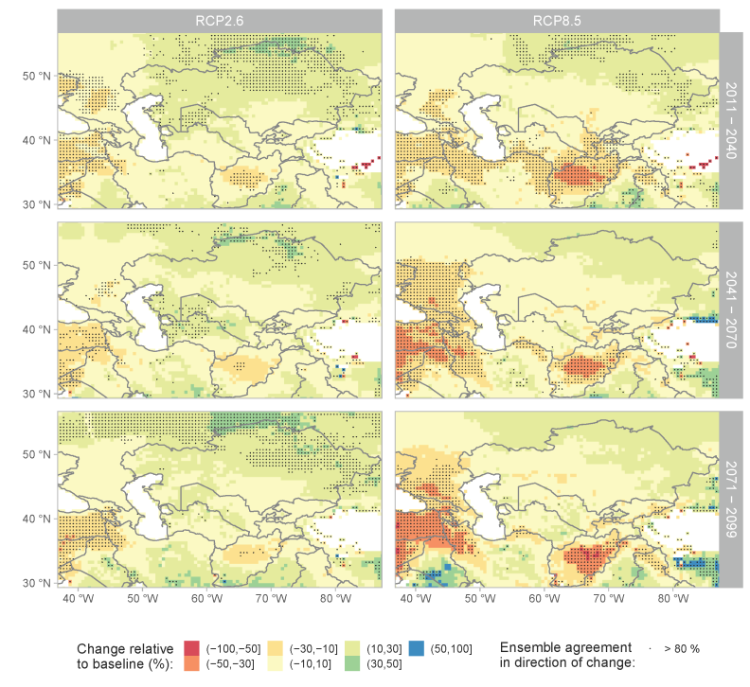
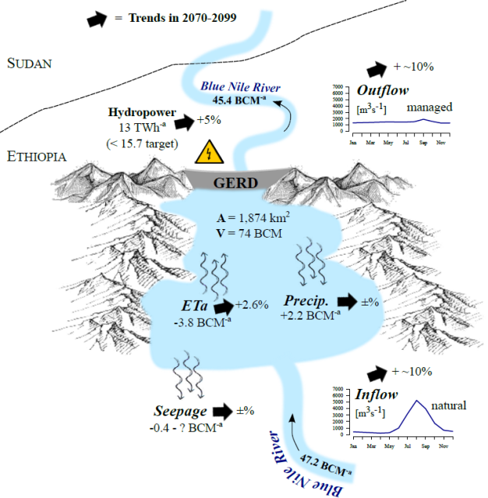


Slide 39
WEF Nexus Examples
1 The Grand Ethiopian Renaissance Dam (GERD)

Slide 40
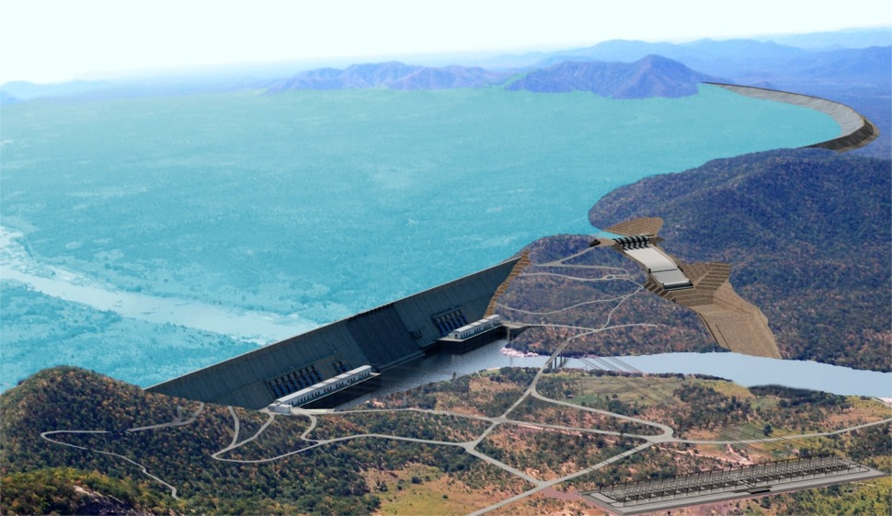
The Grand Ethiopian Renaissance Dam (GERD)
Africa‘s largest hydropower project:
Installed capacity: ~6000 MW, 16 turbines
  (~4 nuclear power plants)
Storage: 74 billion m³
  (~1.5 years Blue Nile flows)
Lake area: 1874 km²
  (>2 times Berlin area)
Source: www.brusselstimes.com

Slide 41
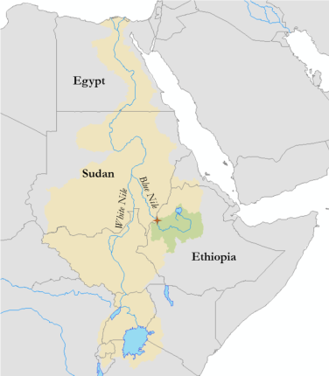
Political tension
Blue Nile contributes 60-80% of flows to Egypt
  Ethiopia controls the major source of Egypt‘s lifeline
  Water & energy shortage during filling and operation
  Lack of transparency
    No environmental / social impact assessment conducted
Lack of willingness to cooperate (all parties)
Construction began in 2011 without consent
  Filling of dead storage started in rainy season 2020
    Without agreed filling timetable
HAD
10⁶ ha
irrigated cropland
GERD

Slide 42
The Upper Blue Nile SWIM
The basin and calibration/ validation
Liersch et al. 2018

Slide 43
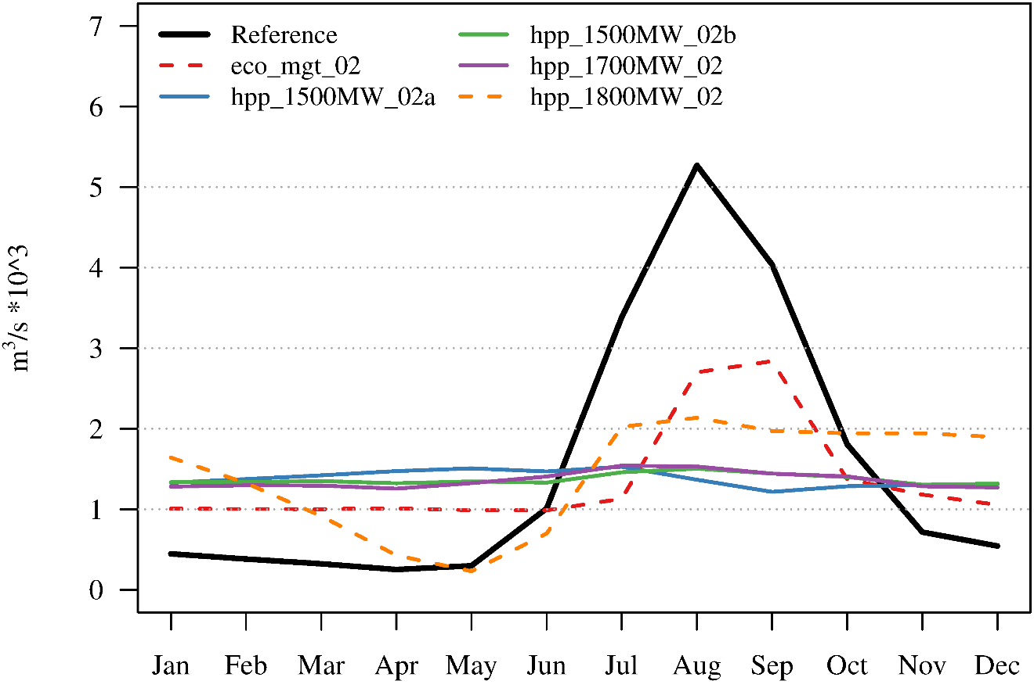
GERD in operation (SWIM simulation)
Hydropower targets
  1500 MW
  1700 MW
  1800 MW
Environmental flows
  eco_mgt
Average 1961-1999
Notes:
This was the conclusion of our 1st study...
Why else would you build a reservoir this size?

Slide 44
Goals
Investigate functioning of GERD under climate change conditions
Support water management to mediate upstream downstream conflicts
Support integration of renewable energies to stabilize energy generation and natural flow regime

Slide 45
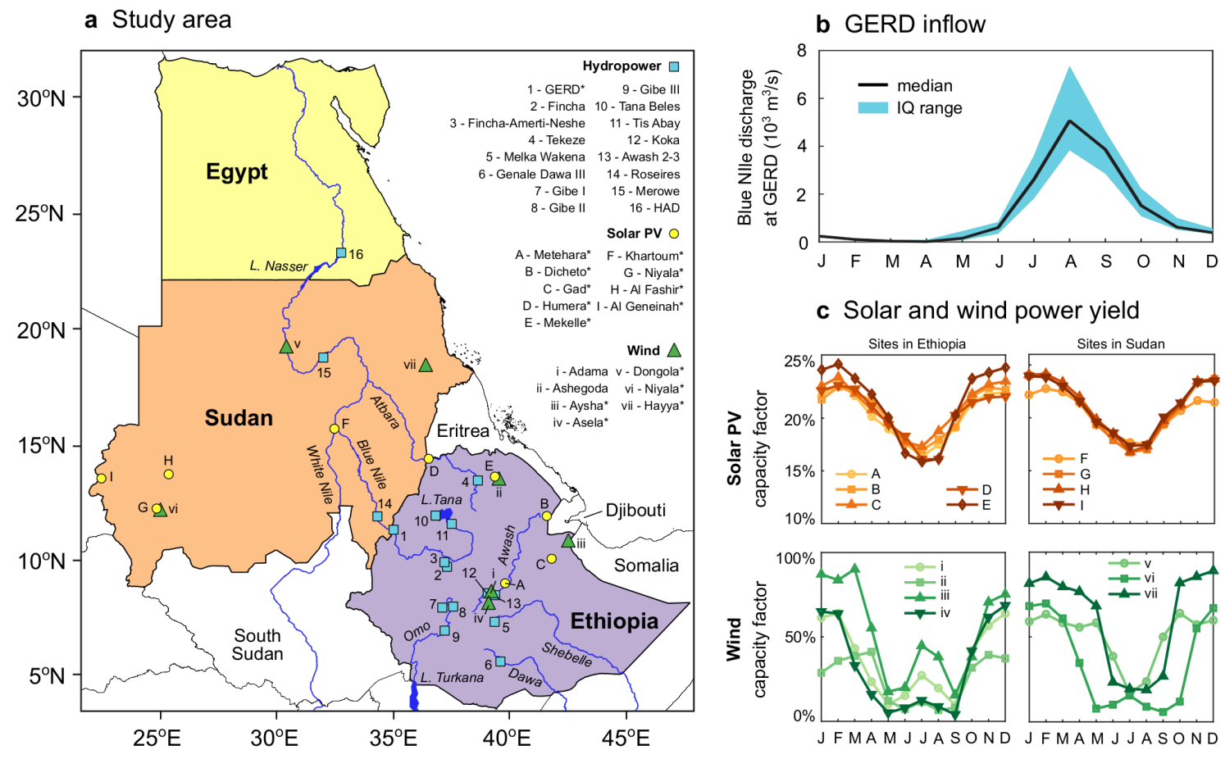
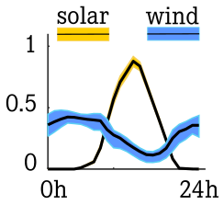
Improving management by integration of solar & wind
Complementarity of RE sources at diurnal and seasonal time scales

Slide 46

Supporting the integration of hydro, solar & wind
-> -> -> integration of solar and wind with hydro -> -> ->

Slide 47
Supporting the integration of solar & wind
The higher the share of solar & wind integrated by GERD, the more the released discharge follows the natural regime!
Win-win situation can be achievable but requires a high degree of cooperation between riparian countries Ethiopia, Sudan and Egypt
Sterl, S., Fadly, D., Liersch, S., Koch, H., Thiery, W. (2021). Linking solar and wind power in eastern Africa with operation of the Grand Ethiopian Renaissance Dam. Nature Energy (currently with Editor after 2nd submission)

Slide 48
WEF Nexus Examples
2 Assessment of climate impacts on land and water management and adaptation options in Bolivia

Slide 49




Overview and goals
Target: Climate impact and adaptation study in the water - food - energy nexus
Target group: Lokal water experts, farmers and energy suppliers
Methods: Data analysis, workshops, integrated modelling,
economical evaluation

Slide 50


Target region and climate

Slide 51

Trends from satellite data (Grace - Gravity Recovery and Climate Experiment)

Slide 52


Climate change – temperature
(10 CMIP6-GCM-Läufe pro Szenario mit Downskaling und Korrektur)
Tarija
Santa Cruz
Notes:
Show plot for air temperature development – precipitation , also for seasons

Slide 53


Precipitation
(10 CMIP6-GCM-Läufe pro Szenario mit Downskaling und Korrektur)
Tarija
Santa Cruz

Slide 54
Niederschlagstrends bis 2100
Precipitación (mm/año)
Diferencia al año 2000 (%)

Slide 55




Tarija-Basin

Slide 56



ecohydrological Model
Water and vegetation processes
Agriculture and natural vegetation (forests, grasslands, ...)
Water management (irrigation, dams, hydropower, ...)

Slide 57

The reservoir modul: Parametrization
63.0 million m³ Maximum capacity of Reservoir
17.8 million m³ Dead storage
54.15 m Maximum fall heigth of HPP

Slide 58

Reservoir: Discharge observed and simulated
Obs: 6.3 m³
Sim: 6.1 m³

Slide 59

Reservoir: Water level and volume
[m]
[m3]

Slide 60

Reservoir: Hydropower

Slide 61



Example irrigation
Rotation maize – potatoes
2155 m asl
Average Temperature 15.5 °C
Sum precipitation 642 mm
Sum irrigation ~250 mm
ohne
mit

Slide 62

Scenario development Tarija
Scenarios | Change of crop rotations | Irrigation of strawberries | Change of reservoir management
Baseline (under current climate conditions) | Corn cultivation | Strawberry cultivation (16 ha) with flood irrigation | Priority (first operational objective) on hydropower generation with generation peaks in rainy season, second objective is irrigation (no flood control)
Noadaptation (under CC)
No regret (under current climate conditions) | Wine | Strawberry cultivation (3000 ha) with drop irrigation | Priority on irrigation, second goal hydropower generation (peak generation in rainy season, no flood control).
Adaptation (under CC)

Slide 63


Development of crops under CC
Soy bean (Santa Cruz)
Corn (Tarija)

Slide 64

CC impact on discharge into reservoir
Indicators of low (Q90, Q95, Q99) and high runoff (Q10, Q5, Q1) in San Jacinto. SWIM simulations driven by 10 bias-adjusted CMIP6 models and three scenarios.

Slide 65

Water volume in reservoir under scenario conditions

Slide 66


Summary example 2
Climate change has different manifestations in the different regions of Bolivia;
The different adaptation strategies are now being systematically simulated and discussed with the experts and those affected;
Based on this, an economic evaluation will be carried out;

Slide 67
WEF Nexus Examples
3 Water management in mining areas of east Germany

Slide 68

Coal mining and import Europe in Mio t (2019/2020)
Germany is the European leader in lignite (brown coal) production with ~100 million t in 2020
Lignite/ brown coal mining
Black coal mining
Black coal import

Slide 69

What is open pit mining?

Slide 70

Brown coal mining in Germany
Most of them are in East Germany
Some in West Germany (e.g. Hambach)

Slide 71
Overview of Lausitz mining district
Gauge Große Tränke – Inflow to Berlin

Slide 72
Lusatian mining district - key figures
Ratio coal to water = 1:6 (For 1 million tonnes of raw coal ~ 6-7 million m³ of water extraction)
Landscape consumption per million tonnes of coal = 10 ha
Groundwater drawdown: 1-70 m below normal level
Groundwater drawdown catchment (1989) 2,100 km² ( area of the federal state of Saarland)
Groundwater deficit (1989) 13 billion m³
- Pore space 9 billion m³
- Backfilling of open-cast mining holes 4 billion m³

Slide 73


Number of village destroyed

Slide 74

Effects of lignite mining on the soil and water balance
Huge open pits
Land and villages destroyed
Withdrawl of water, lowering of GW table
Huge impacts on hydrology and ecology

Slide 75
Effects of lignite mining on the soil and water balance
Large water demand for flooding of pits
Groundwater passes browncoal layers ->
- Acidification
- Iron clogging (Verockerung)

Slide 76
Self-flooding with groundwater (GW)
GWN
Erosion
P
ET
New GW level
Kippe
pH 3-5
pH < 3
GW level because of mining
pH 6-7

Slide 77
Discharges of water into the Spree and Schwarze Elster rivers

Slide 78
Discharge below Spreewald
Daten: LUA Cottbus
78

Slide 79

Iron clogging (Verockerung)

Slide 80
Water transfer (flooding) from next rivers
OW
Erosion
GWN
P
ET
GW level while flooding
Kippe
Old GW level
Benefits:
Displacement of acid groundwater
Dillution of acid lake water
Chemical compensation/ neutralisation of the lake water

Slide 81

Challenges to restore the mining landscapes
High concentration of sulfate
Low water availability
Iron clogging
Low discharge
Water quantity
acidification
Water quality
Schwarze Elster bei Buchwalde
Partwitzer See
Spree bei Bühlow

Slide 82

Water management concept – flooding of the pits
Bereits entstandene
Wasserfläche = 14.000 ha
Geplant: ~16.000 ha (LMBV + 7.700 Hektar der LEAG)

Slide 83
Water quantity – water deficits

Slide 84

Climate change impacts on Berlin inflow (8 m³/s needed)
Un-managed flow Große Tränke
SWIM EGMO
Q_{min}= 8,00 m³/s
Pohle, et al. 2016, Hydrologie und Wasserbewirtschaftung
84

Slide 85
Adaptation options

Slide 86






Water deficit in Germany

Slide 87

Energy – Water – Carbon

Slide 88



Thermal image (Landsat, August)

Slide 89



Predominant regional biophysical cooling from recent land cover changes in Europe (Huang et al. 2020, Nature Communications)
From 1992 to 2015, approximately 25 Mha of agricultural land was left abandoned. Declines in agricultural land mostly occurred in favor of forests (15 Mha, 7 Mha of net gain) and urban settlements (8 Mha).
Two simulations with the land cover in 1992 and 2015 are performed and the resulting relative differences in 2-m air temperature and surface air humidity investigated.
Regional climate model WRF (Weather Research and Forecasting model)

Slide 90

Proportion of annual precipitation from land evaporation.
Average ratio of recycled precipitation (1999-2008). The higher the number, the more precipitation comes from land evaporation (Van der Ent 2010 & 2014).

Slide 91

Forest conversion
Groundwater recharge is higher under broadleaf forest than under coniferous forest
About 40 % of Brandenburg is covered with forest, around 1.1 million hectares.
More than 75 % of this is pine forest.

Slide 92

Examples for adaptation in agriculture
Under discussion, but often of little effectiveness in practice:
Reduced tillage
Increasing the humus content of the soil
Agroforest
Higher water use efficiency through CO₂ fertilisation effect
Adaptation to shift in the vegetation period
...
(Foto: Philipp Weckenbrock; https://www.uni-giessen.de/fbz/fb09/forschung/zentrenundprojekte/agroforst)

Slide 93

Irrigation
Beregnung
In Brandenburg currently mainly in private areas, on sports fields, in parks, and for special crops (e.g. quality potatoes).
High evaporation when applied during the day and with the usual technology
High costs and high effort for the installation of drip irrigation
Notes:
Knut Kaiser (1996), Petermanns Geographische Mitteilungen 140: 323-342
Jahr (v./n. Chr.) Wasserstand [m ü. NN]
-7500 57
-3500 61
-1000 61
-500 59.5
1100 61
1280 62.5
1300 65
1786 63.5
1996 62
Küster, H. (1999): Geschichte der Landschaft in Mitteleuropa. Von der Eiszeit bis zur Gegenwart. Verlag C.H. Beck, München
S. 116: Wärmeperiode mit niedrigen Seewasserspiegeln im Alpenvorland um 1000 v. Chr. => Siedlungen z.B. am Bodensee und Starnberger See in heute überschwemmten Bereichen; danach nie wieder besiedelt (S. 122 u.)

Slide 94

Maximal groundwater recharge
Minimal evapotranspiration (low plants, shading of the soil).
Protection against erosion caused by heavy rainfall
Energy efficiency approx. 10x that of bioenergy
(https://um.baden-wuerttemberg.de/de/energie/erneuerbare-energien/sonnenenergie/photovoltaik/photovoltaik-freiflaechenanlagen/)

Slide 95

Alternative Agri-Photovoltaik?
Solar panels over arable or vegetable fields (e.g. Fraunhofer ISE 2020).
Positive effects:
Multiple use of the area
Lower evapotranspiration due to shading
Lower wind speeds
Protection against heavy rain

Slide 96

Water retention in wetlands/ paludiculture
Plus:
High ecological value
Cooling by evapotranspiration
Carbon storage
Minus:
The bog and riparian vegetation has never "learned" to use water sparingly.
=> Therefore, especially in small wetlands, disproportionate transpiration!
Notes:
Reed canary grass = Rohrglanzgras (Phalaris arundinacea)
Perennial ryegrass = Deutsches Weidelgrass
Müller, L., Behrendt, A., Schalitz, G., Schindler, U. (2005): Above ground biomass and water use efficiency of crops at shallow water tables in a temperate climate. Agricultural Water Management 75(2): 117-136

Slide 97

Sponge cities
Sponge city in Berlin
Increase of groundwater recharge
Flash flood protection
Cooling effect

Slide 98

Adaptation in cities
Smart cities world

Slide 99

Adaptation inagriculture
LIFE AgriAdapt project

Slide 100
Possible task for the groupwork
Adaptation in a water related sector / field:
Cities (adaptation to flash floods, droughts, heat waves),
Nature based solutions in river basins or landscapes,
Re-thinking water storage (at different scales),
Adaptation to counteract erosion,
Integrating adaptation and mitigation,
Water re-use
…

Slide 101
Thanks!

Slide 102

Undernurishment

Slide 103

Transboundary river systems with upstream-downstream water conflicts
Central Asia
Euphrat/
Tigris
Niger
Mekong
Blue
Nile
Upper
Amazon

