Slide 1



Climate change impacts on water resources and extremes in the Juba basin, Somalia
Fred F. Hattermann, Iulii Didovets & Annika Kramer

Slide 2
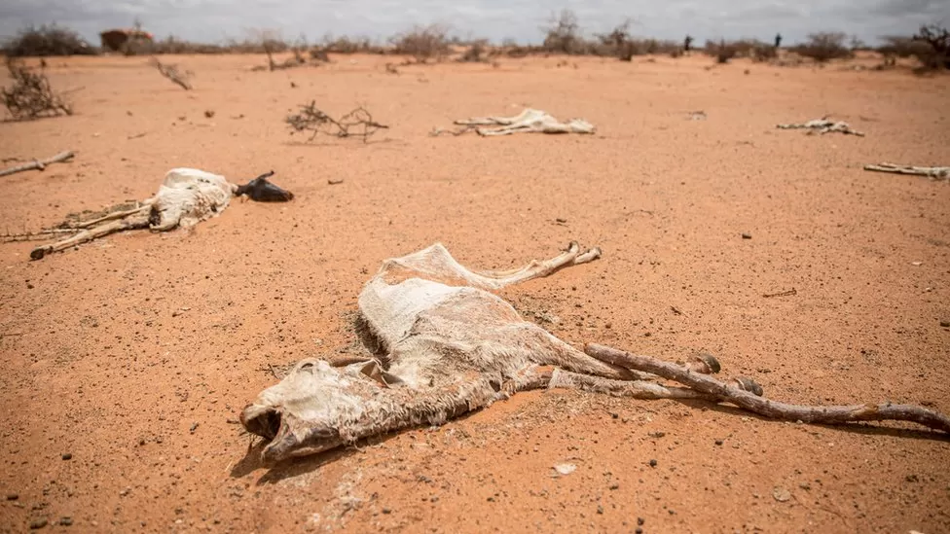
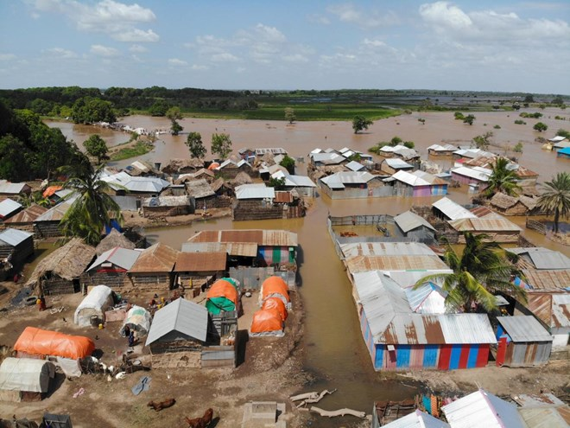
The situation at the Horn of Africa
Somalia, March 2023
Somalia, November 2023
Source: BBC
Notes:
First drought, and then flood in November 2023 with possibly 600 000 people displacesd. ‚Somalia floods ‘once-in-a-century event’, says UN.
Same pattern in the Mediterranean: first drought, then flood. Flood possibly connected to starting El Nino: https://en.wikipedia.org/wiki/El_Ni%C3%B1o

Slide 3
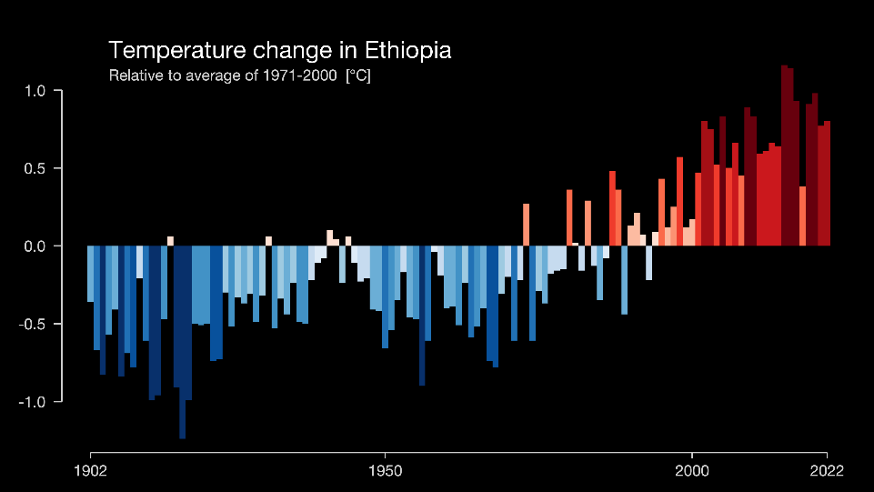
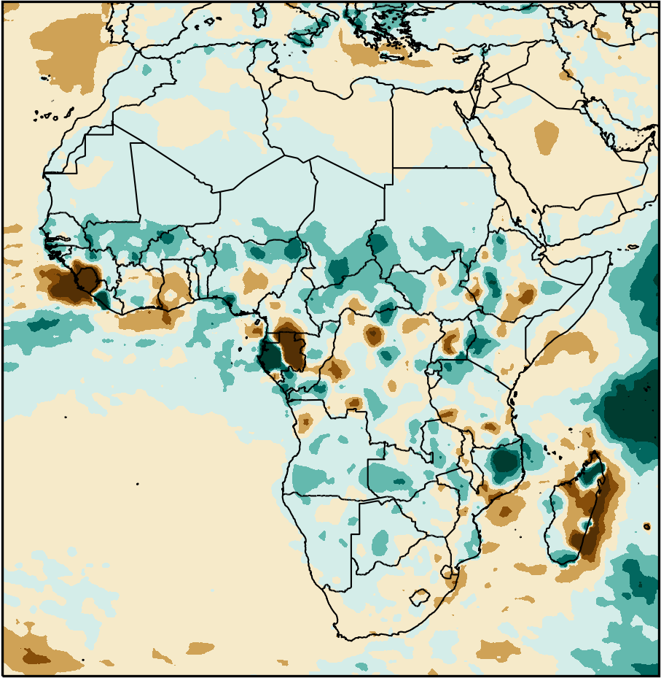
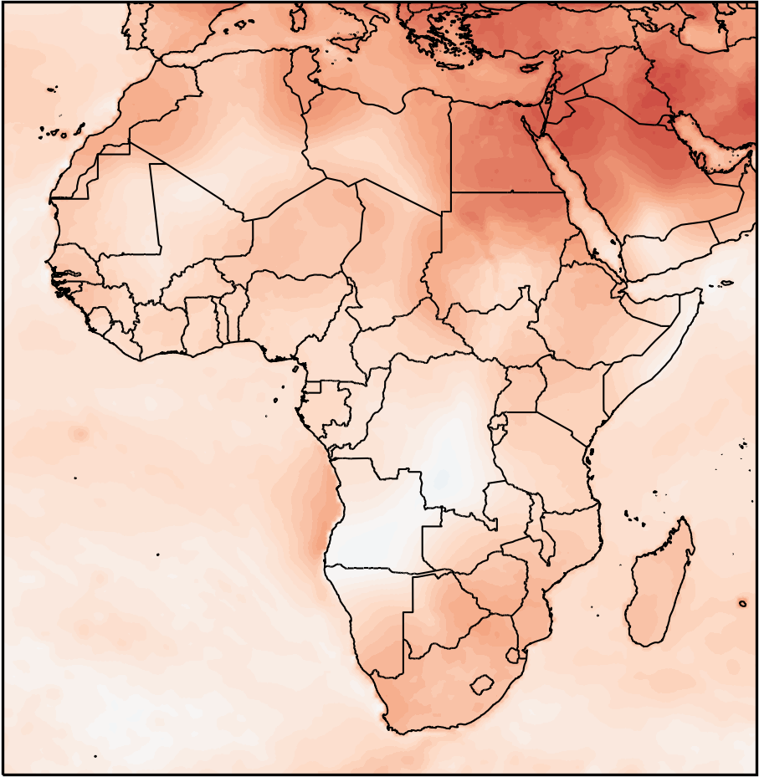
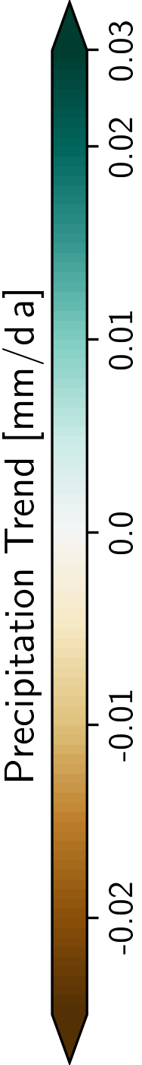
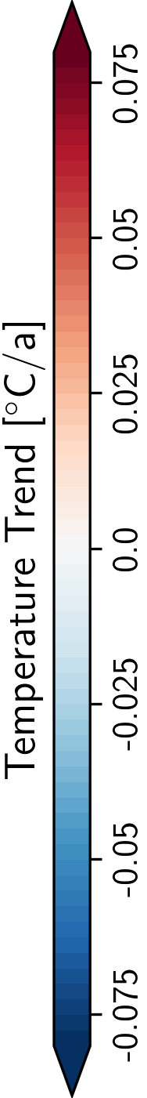
Observed climate change
1981-2020
Notes:
Trend

Slide 4
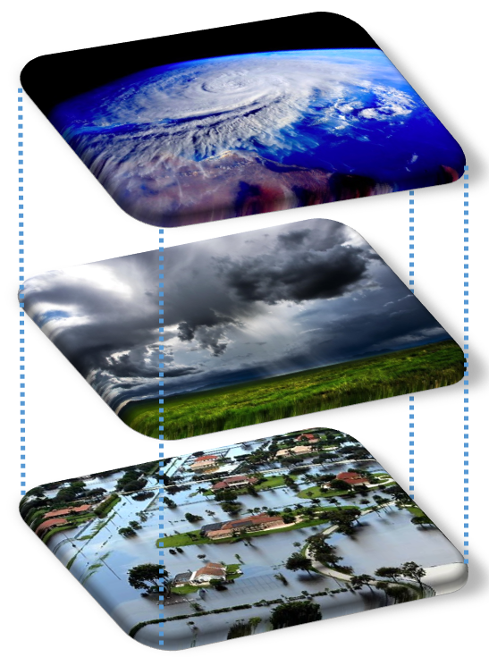
Models and data applied in the study
3 scenarios (low end, medium and high end warming) with 10 global climate model outputs each of the latest scenario generation (CMIP6)
The data were statistically downscaled and bias adjusted within the ISIMIP project
An eco-hydrological model was applied to translate the climate scenario data into change in water resources and extremes

Slide 5
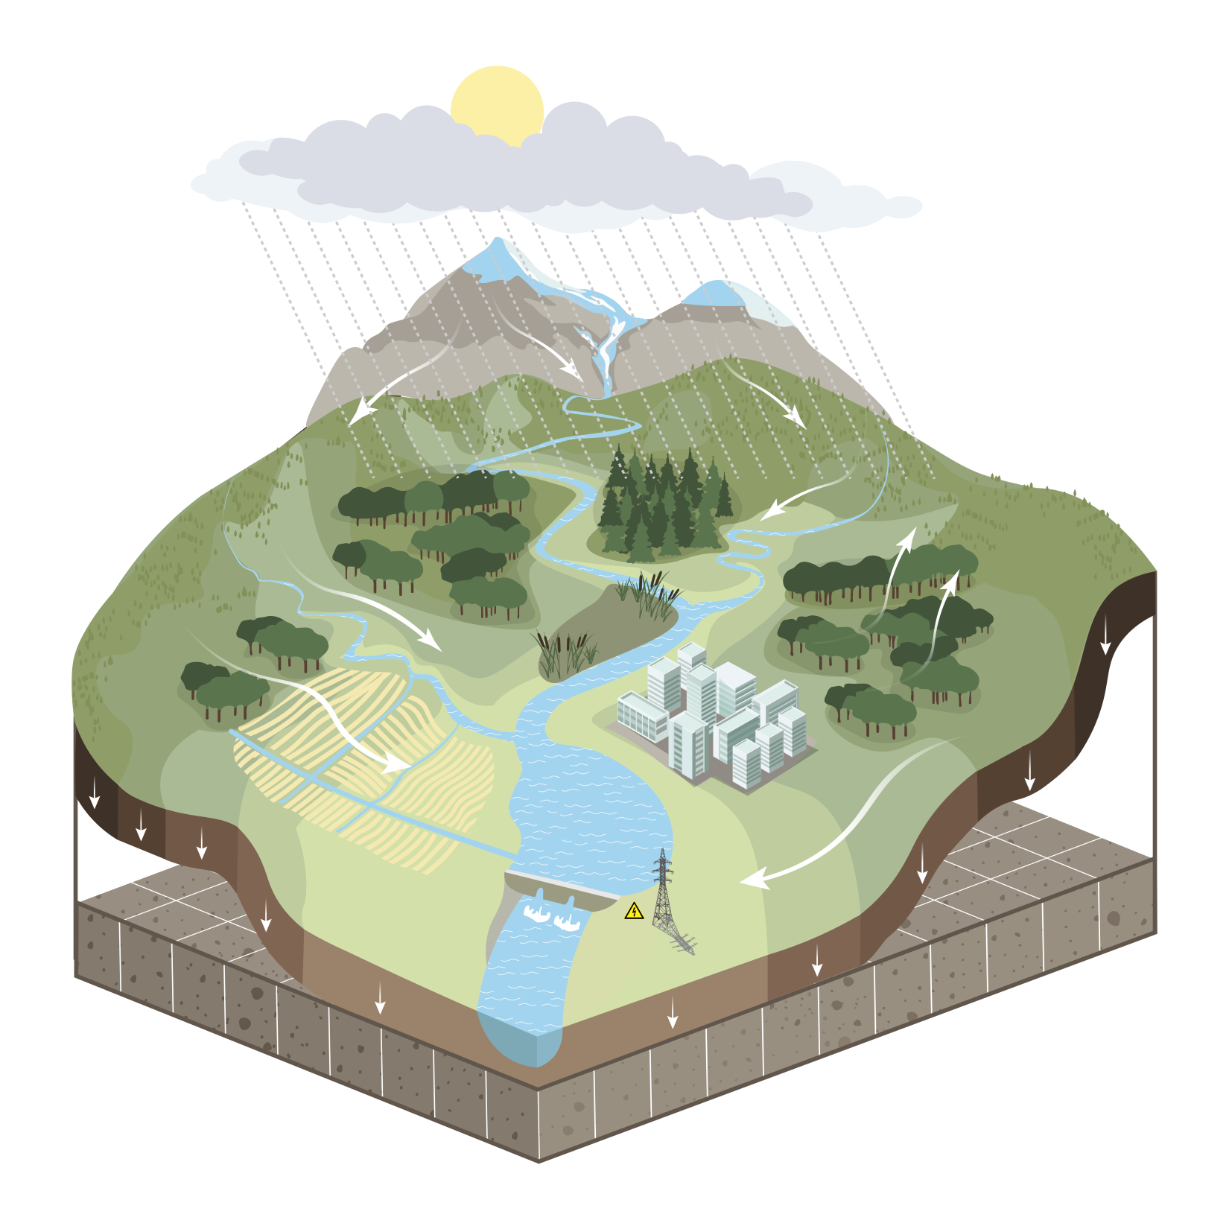
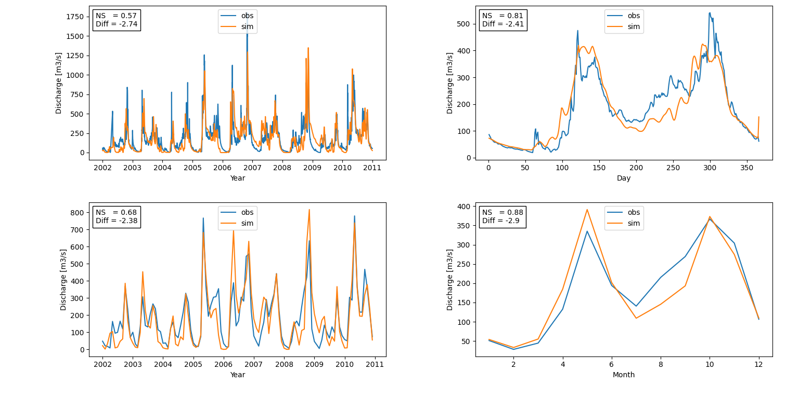
Eco-hydrological model
Natural processes
Juba at Luuq
Weather / climate (input)
  Precipitation (rain & snow)
  Temperature, solar radiation, rel. humidity
Hydrology
  Infiltration
  Runoff: surface, sub-surface, groundwater
  River discharge
  Evapotranspiration
Vegetation
  Natural: forests, grasslands, savannah...
  Managed crops
Glaciers

Slide 6

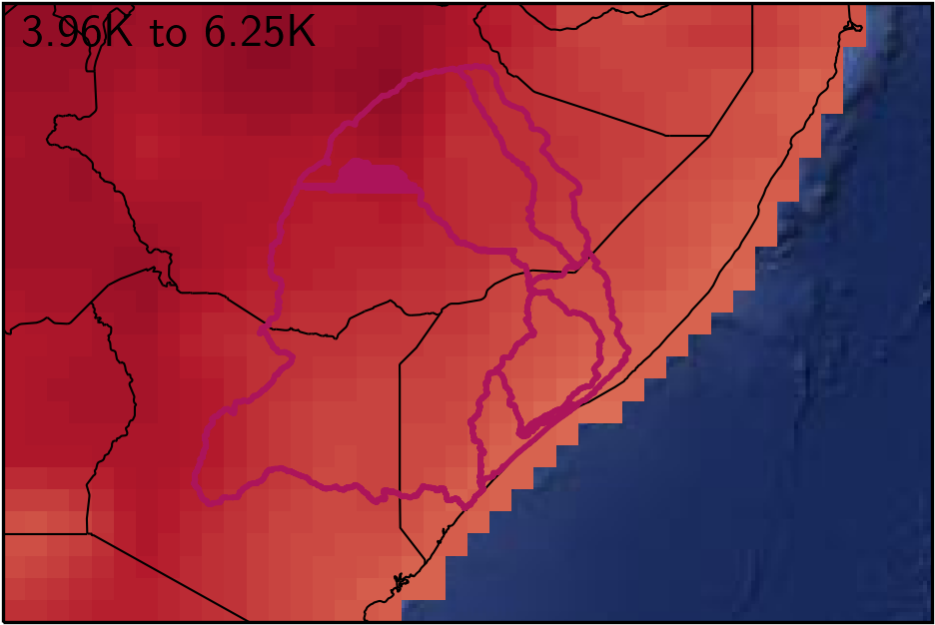
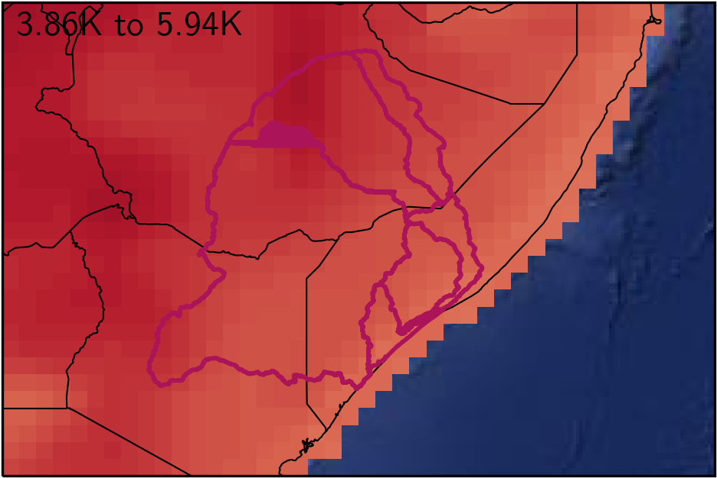
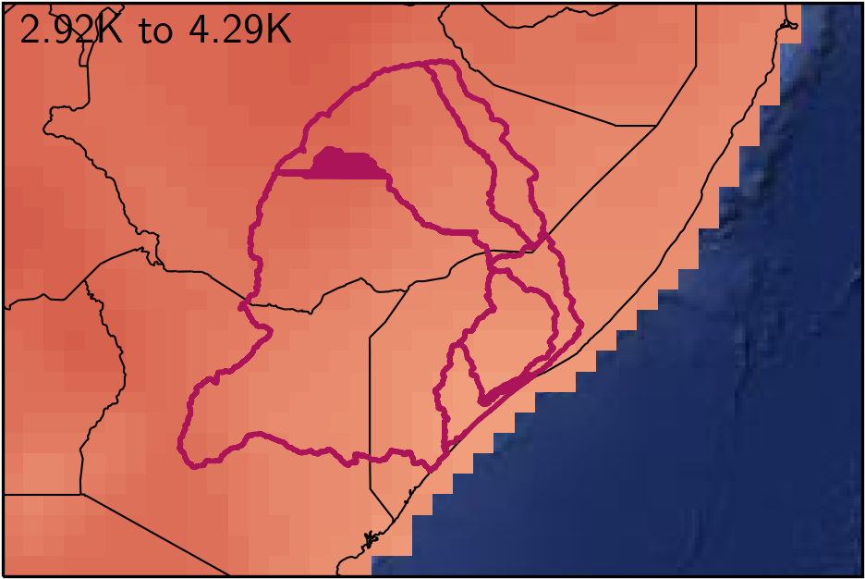
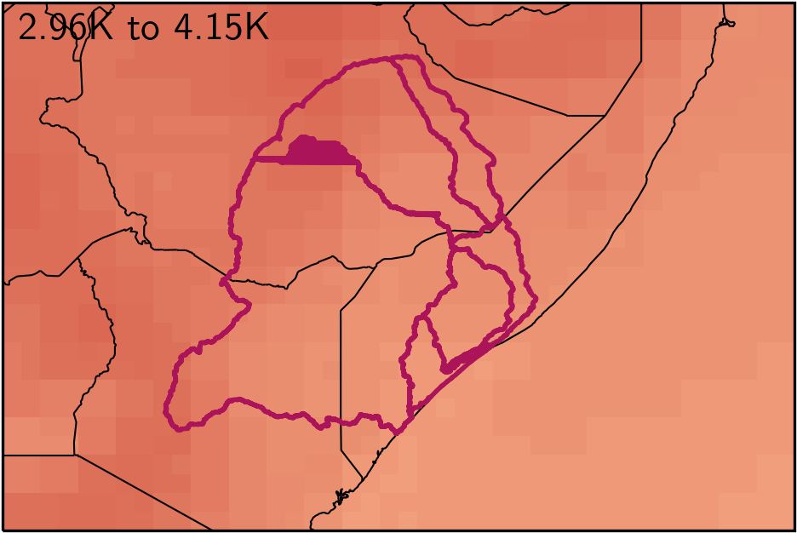
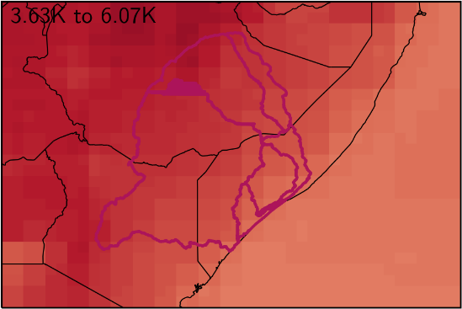
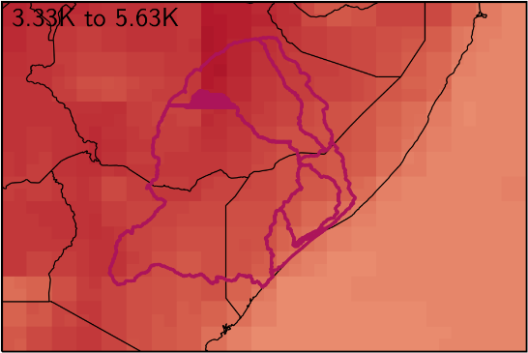
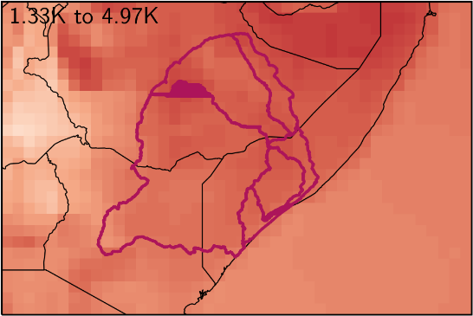
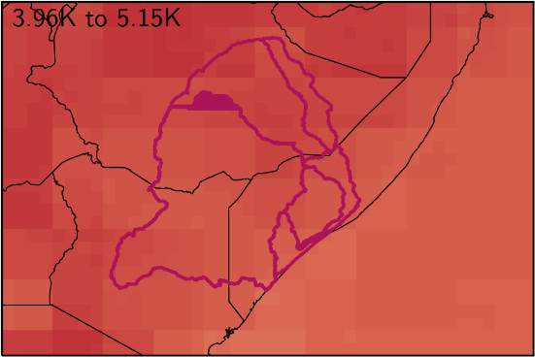
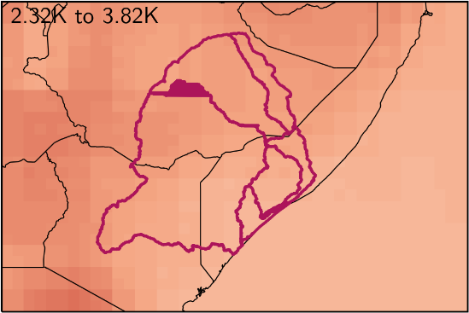
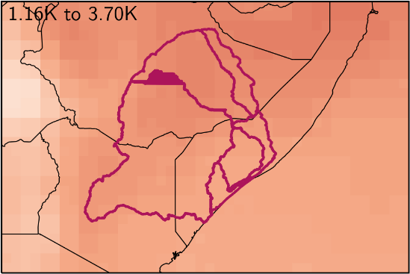
Results: Trends in temperature
Comparison climate 1971-2000 and 2071-2100, SSP5-8.5
The maps show the results of the 10 climate simulations for SSP5-8.5
Increase in Temperatue 3.3°C - 5.4°C
until end of the century in high end scenario
Notes:
Here only for high-end scenario. One map gives results of one GCM. I think this is the best way to show the variability of results.

Slide 7
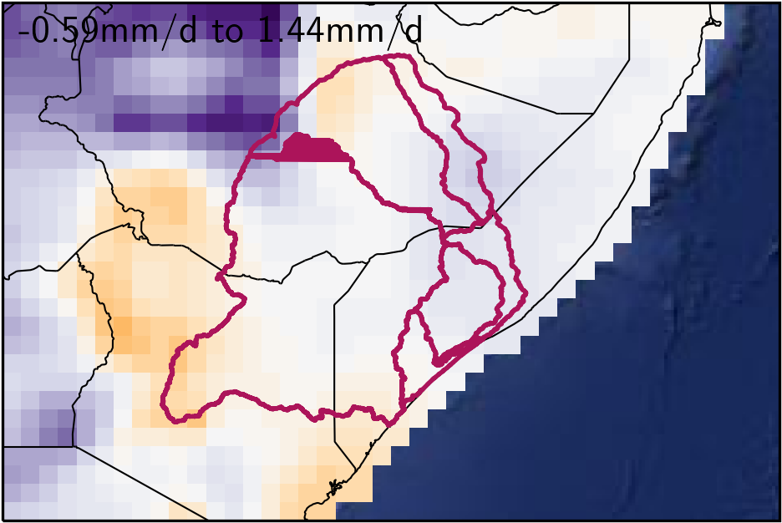
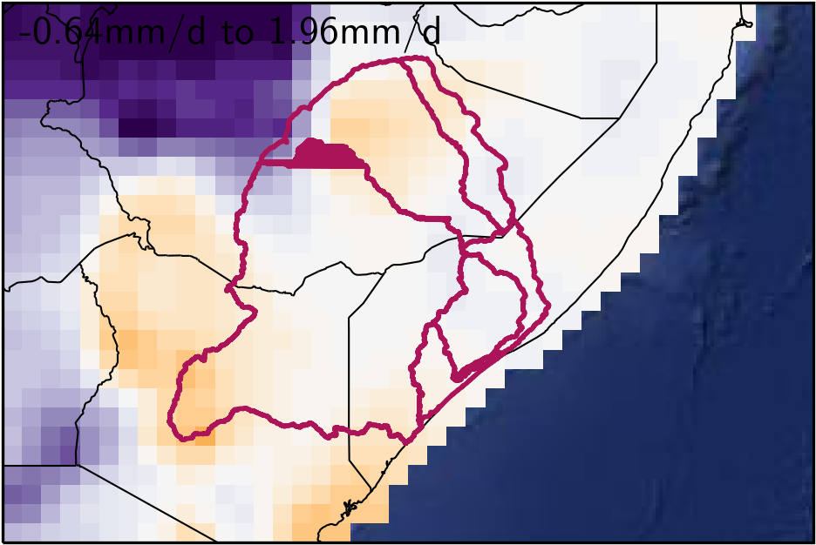
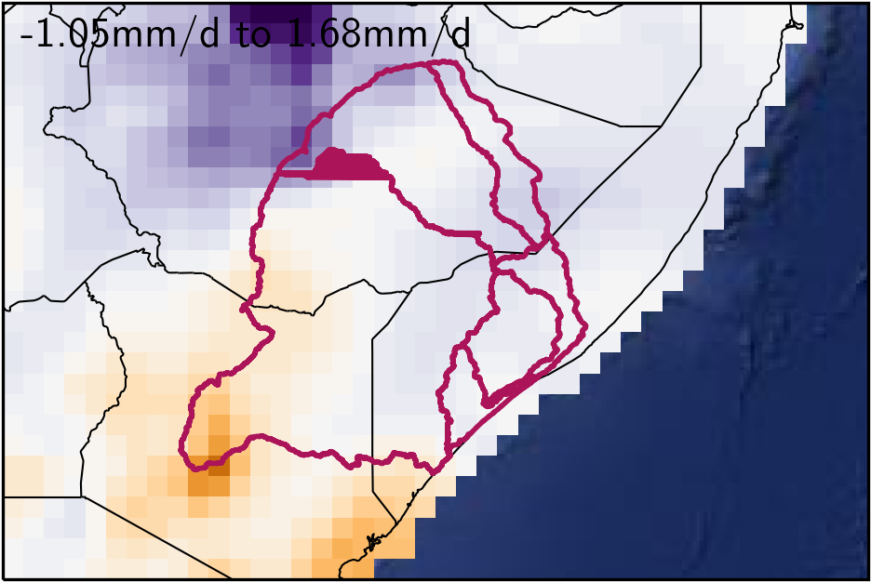
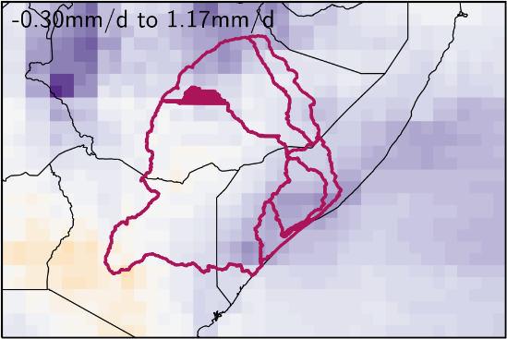
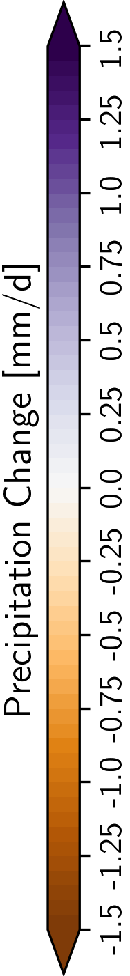
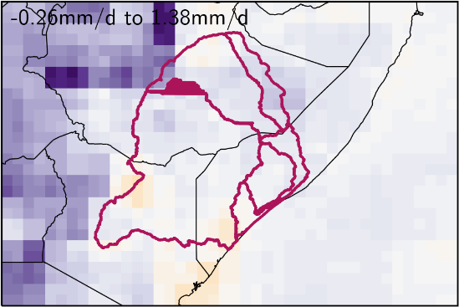
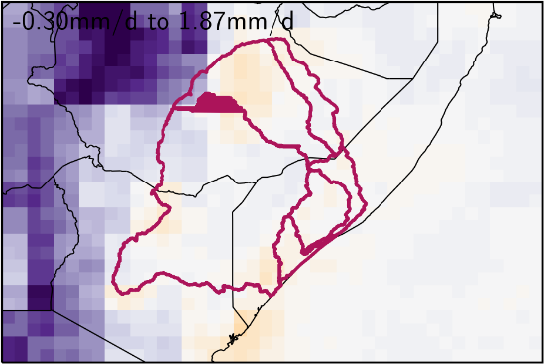
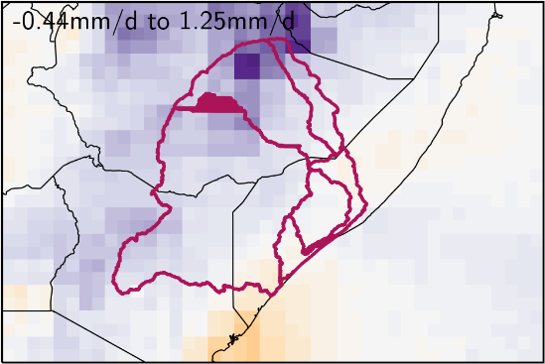
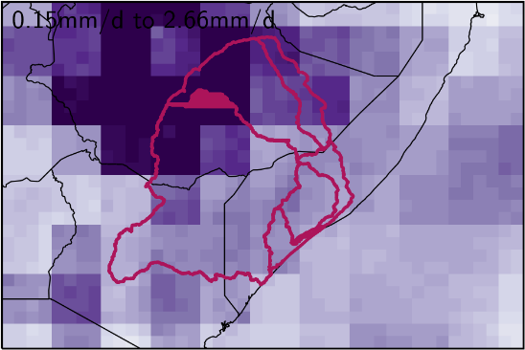
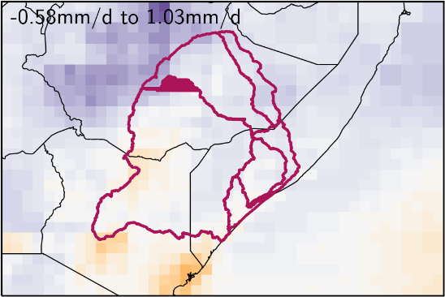
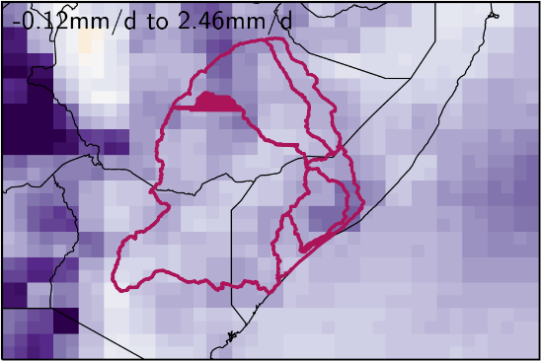
Results: Trends in precipitation
Comparison climate 1971-2000 and 2071-2100, SSP5-8.5
The maps show the results of the 10 climate simulations for SSP5-8.5
Change in precipitation -50 mm to +350 mm as map average
Notes:
Here only for high-end scenario. One map gives results of one GCM. I think this is the best way to show the variability of results.

Slide 8
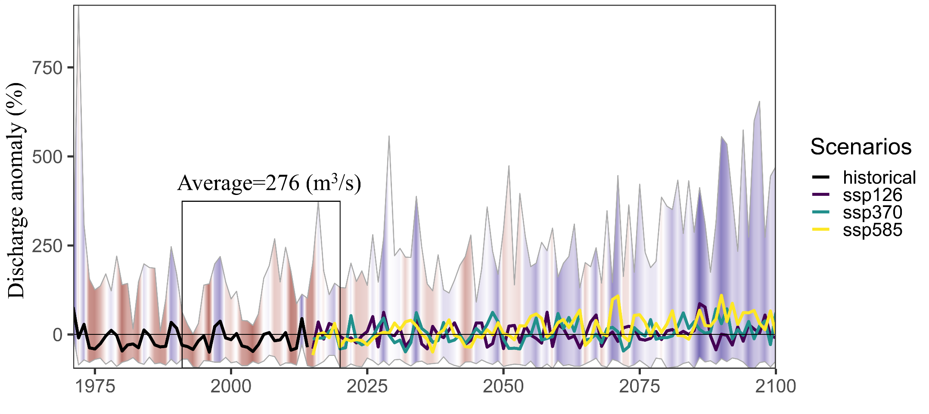
Climate change impacts Juba at Luuq
10 hydrological simulations per climate scenario (SSP)
Juba (Luuq)
Annual discharge anomaly. Mean increase over all scenarios and runs 41% until mid of the century and 72% until end of the century.
Notes:
But also drier future is possible, see later.

Slide 9
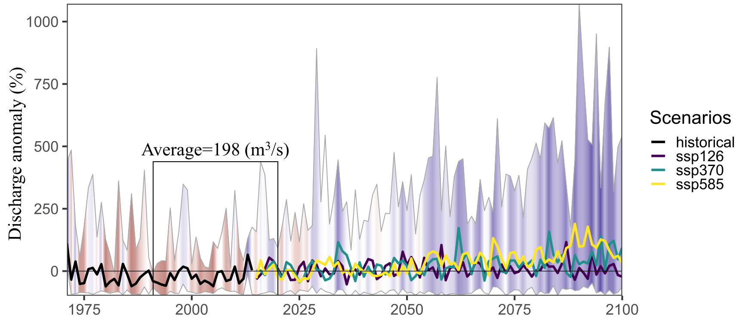
Climate change impacts Shabelle at Belad Weyne
10 hydrological simulations per climate scenario (SSP)
Shabelle (Belad Weyne)
Annual discharge anomaly. Mean increase over all scenarios and runs 17% until mid of the century and 32% until end of the century.
Notes:
I need to get the exact numbers still.

Slide 10
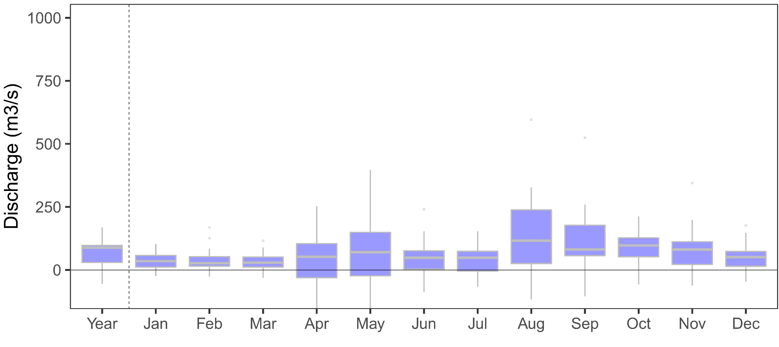
Seasonal change in discharge
Difference of discharge 1971-2000 to 2031-2060
Juba (Luuq)
Change in discharge [m3/s]
Notes:
Whiskers show also pissible dryer conditions. Near future because this is the planning horizon.

Slide 11
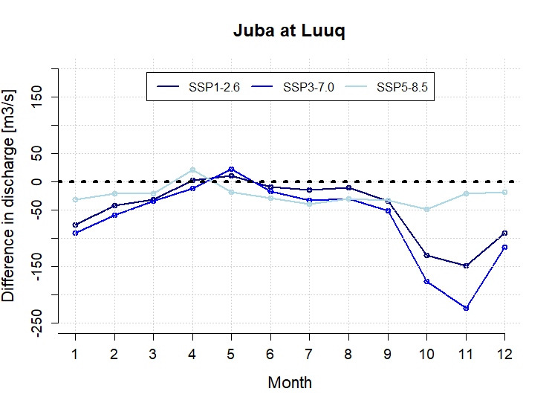
More droughts? Possibly
Monthly change in discharge in driest ensemble run per scenario (SSP) until mid of century
+
-
Notes:
I selected the dries ensemble runs per scenario (out of the 10). The change is from 1971-2000 to 2031-2060 „End of the century“

Slide 12
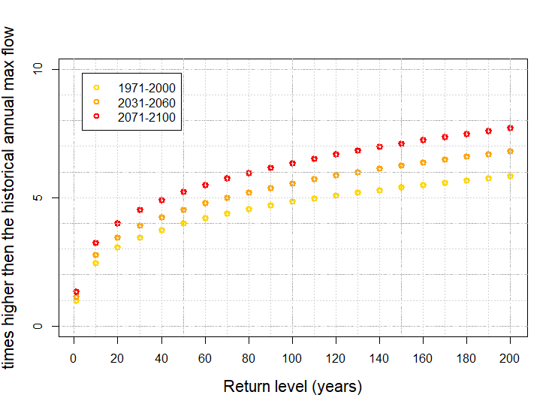
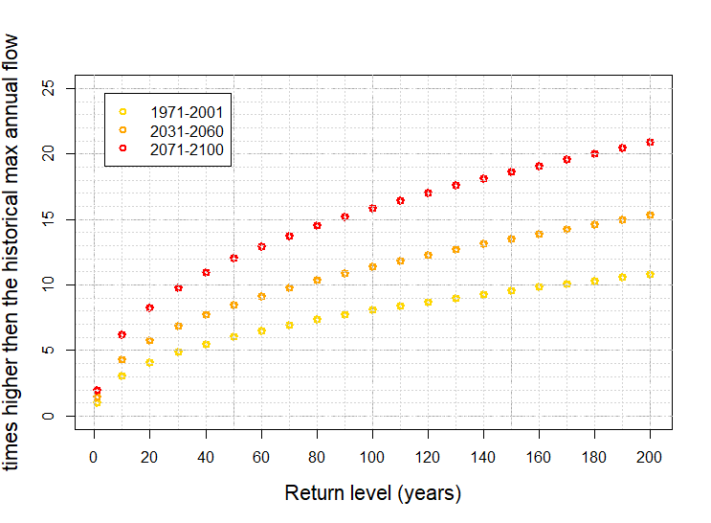
More floods? Very likely
Scenario SSP3-7.0
Juba
Shabelle
more
more often

Slide 13
Conclusions
As a next step MoEWR will develop a strategic action plan for the management of the Juba basin based on the insights from this study
Under all future emission scenarios, temperatures are expected to increase in the Juba and Shabelle basin until end of the century. Projection are Temperature increase of 0.5°C-2.2°C for the low-end and 2.9°C-4.3°C for the high-end scenario
Projections for changes in precipitation are more divers, depending on the scenario, precipitation may increase, but especially in the western parts of the catchment and south-west of Somalia, also decreases in precipitation are possible in high end climate scenarios.
Still, mean increase in precipitation in the upstream parts of the catchments may consequently leads to more discharge in most projections
More and more extreme floods are very likely
More droughts are possible

Slide 14
Thanks!

Slide 15
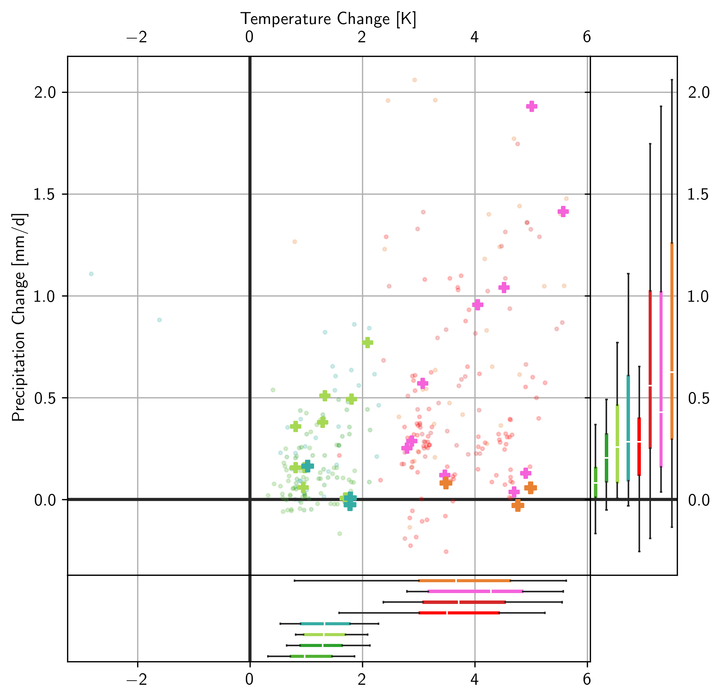
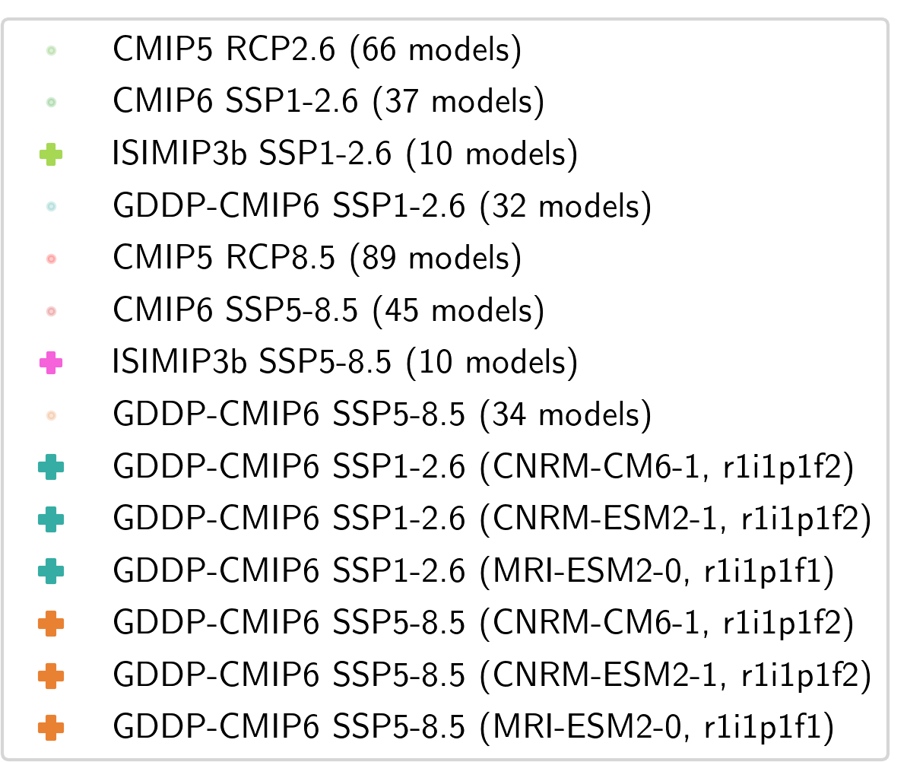
Trend in precipitation against trend in temperature comparing 1971-2000 against 2071-2100
wetter
drier
Notes:
Here, we excluded the upper 3 ISIMIP3b runs and took in 3 GDDP (drier) runsd

Slide 16
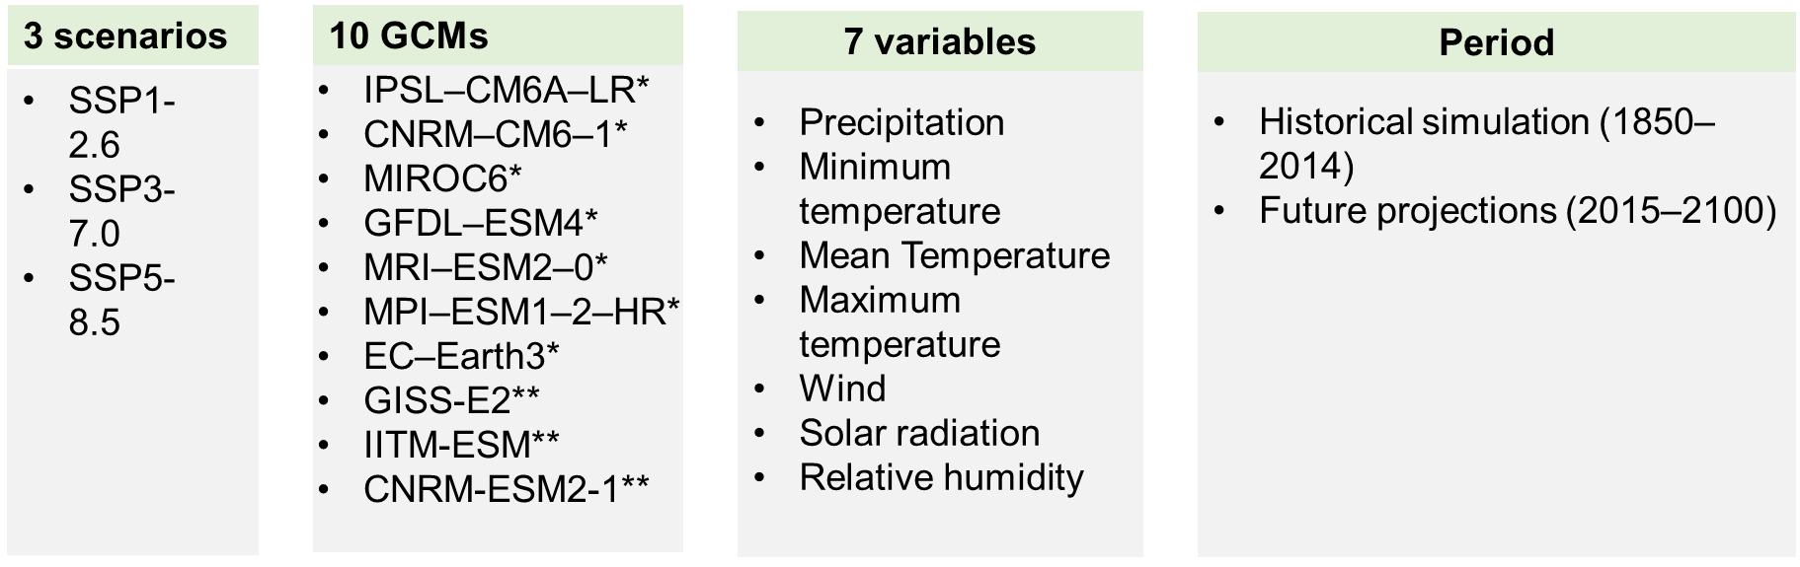
The GCM ensemble
The selected Shared Socioeconomic Pathways (SSPs), Global Climate Models (GCMs), climate variables and time periods (* of ISIMIP3b, ** of GDDP).

Slide 17
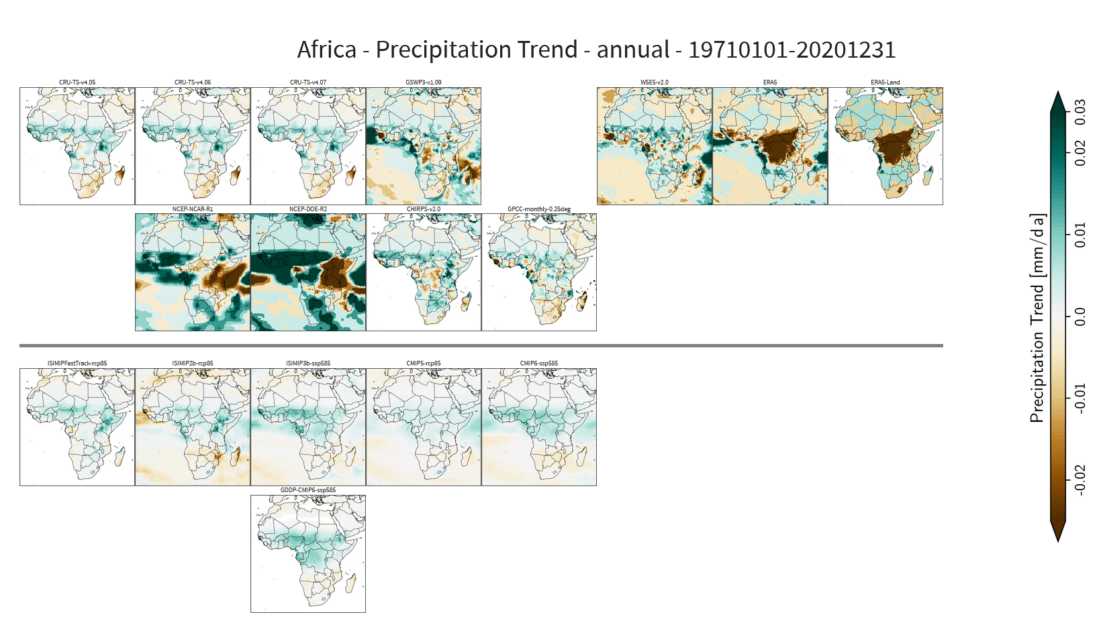
Comparison observed and modelled trends 1971-2020
Trends in observation and re-analysis data products
Trends in climate ensembles

Slide 18
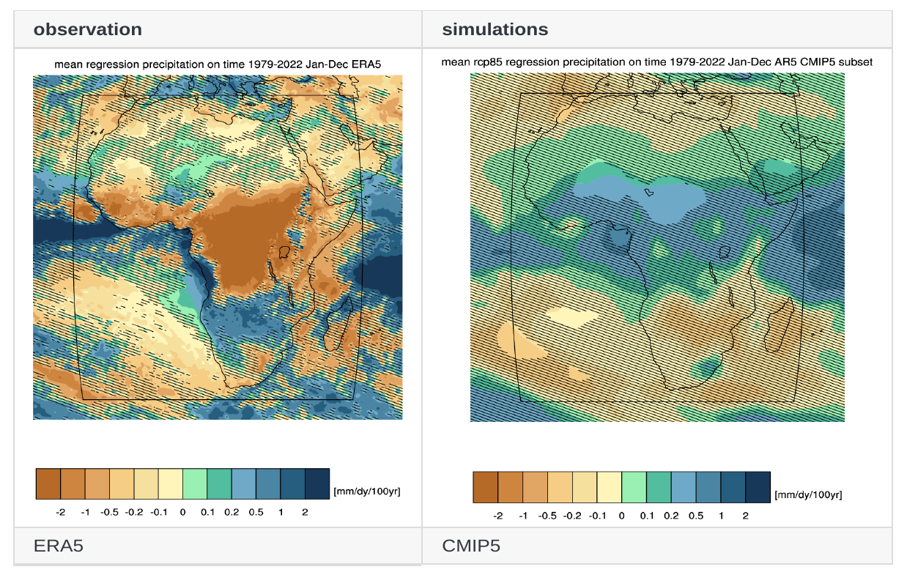
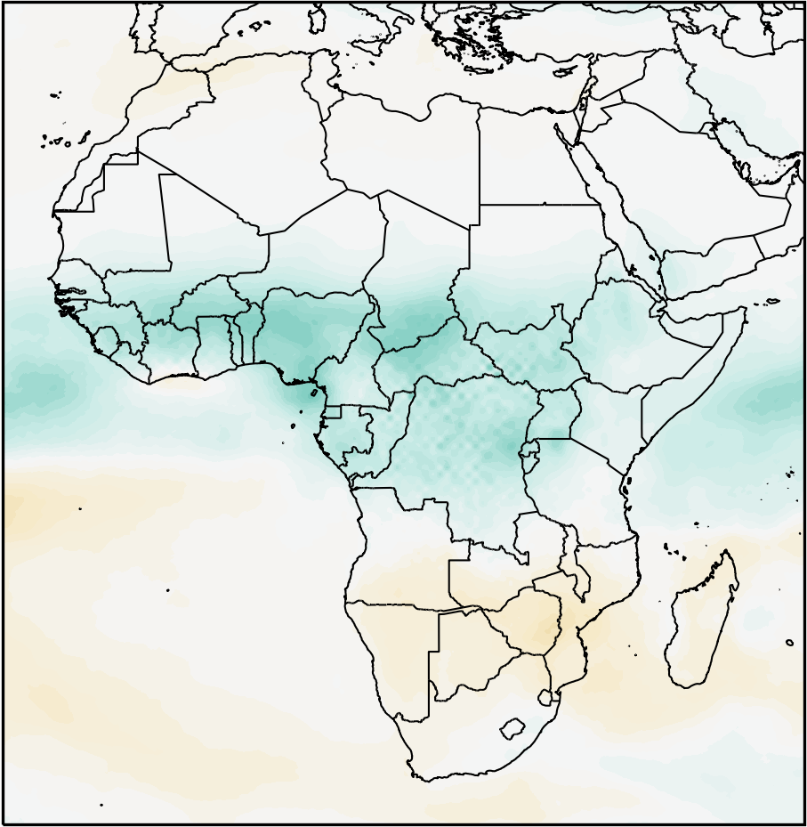
Comparison of historical Trends 1979-2021: simulated und observed extracted via Climate Explorer
AFRICA
ERA5 vs CMIP5
W5E5 vs CMIP6

Slide 19
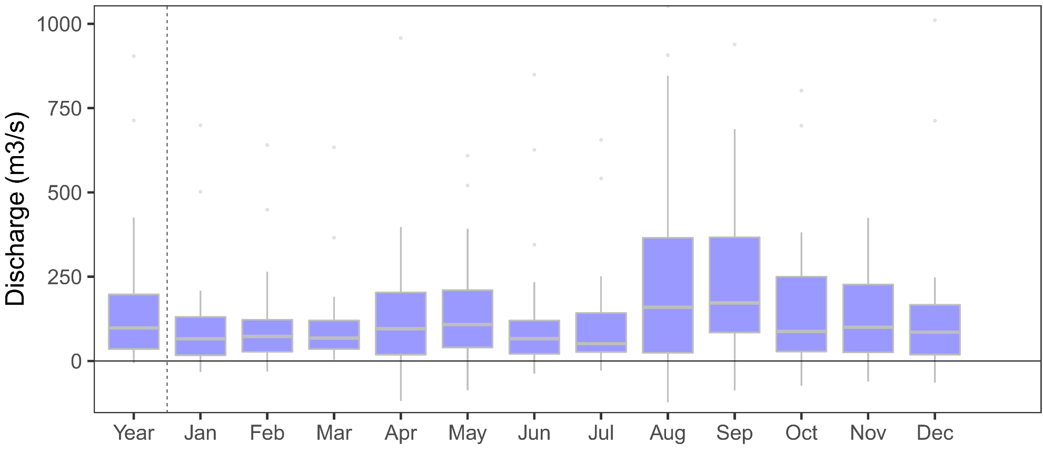
Seasonal change in discharge
Difference of discharge 1971-2000 to 2071-2100
Juba (Luuq)
Change in discharge [m3/s]
Notes:
Whiskers show also pissible dryer conditions. Far future.

Slide 20
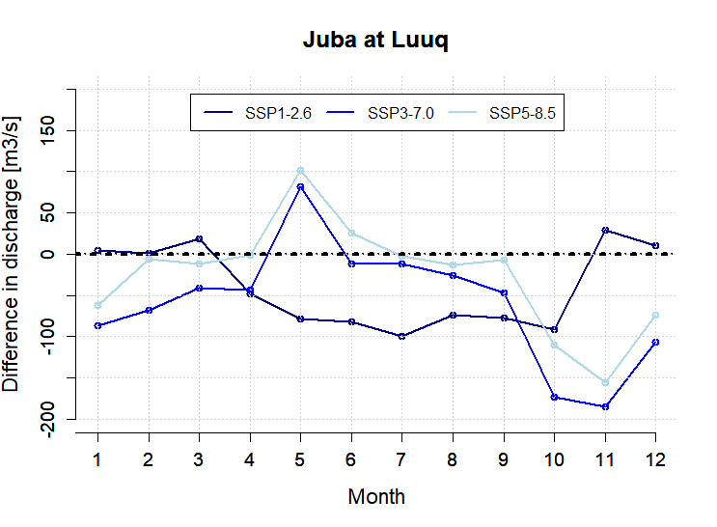
More droughts? Possibly
Monthly change in discharge in driest ensemble run per scenario (SSP) until end of century
+
-
Notes:
I selected the dries ensemble runs per scenario (out of the 10). The change is from 1971-2000 to 2071-2100 „End of the century“

Slide 21


Introduction
Model structure
Stefan Liersch
2021

Slide 22
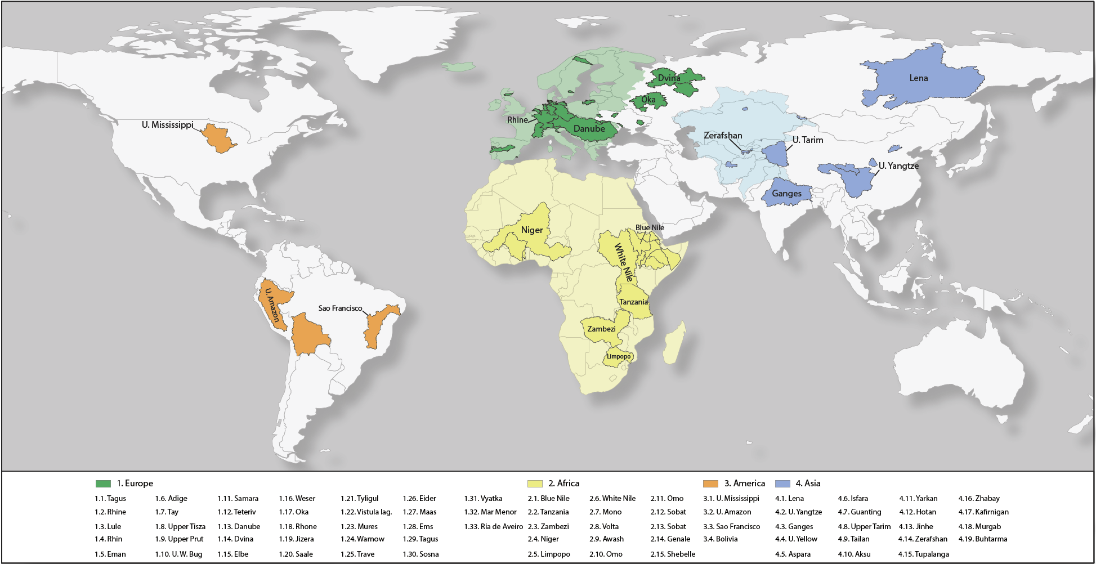
Map of focus regions and model domains
Frank
Tobias
Christoph
Bijan
Iulii
Iulii
Mustafa
Peter
Fred
Qaisar
Stefan
Carlos
Hagen

Slide 23


Modelling approach
Catchment-scale eco-hydrological model
Process-based
  Physical equations: evapotranspiration, percolation...
  Empirical approaches: curve number-based infiltration...
  Daily time step
Spatially semi-distributed
  Hydrological Response Units (HRUs)
  HRUs are laterally not connected
Mesoscale applications (>1000 km²)
based on
Version 1993
&
MATSALU

Slide 24
Eco-hydrological model
Water and land management
Crop management
  Crop rotations
  Fertilization
Irrigation
  Crop water demand / deficits
  Water use efficiency
Water allocation
Reservoirs
  Hydropower
  Flood protection
  Water supply

Slide 25
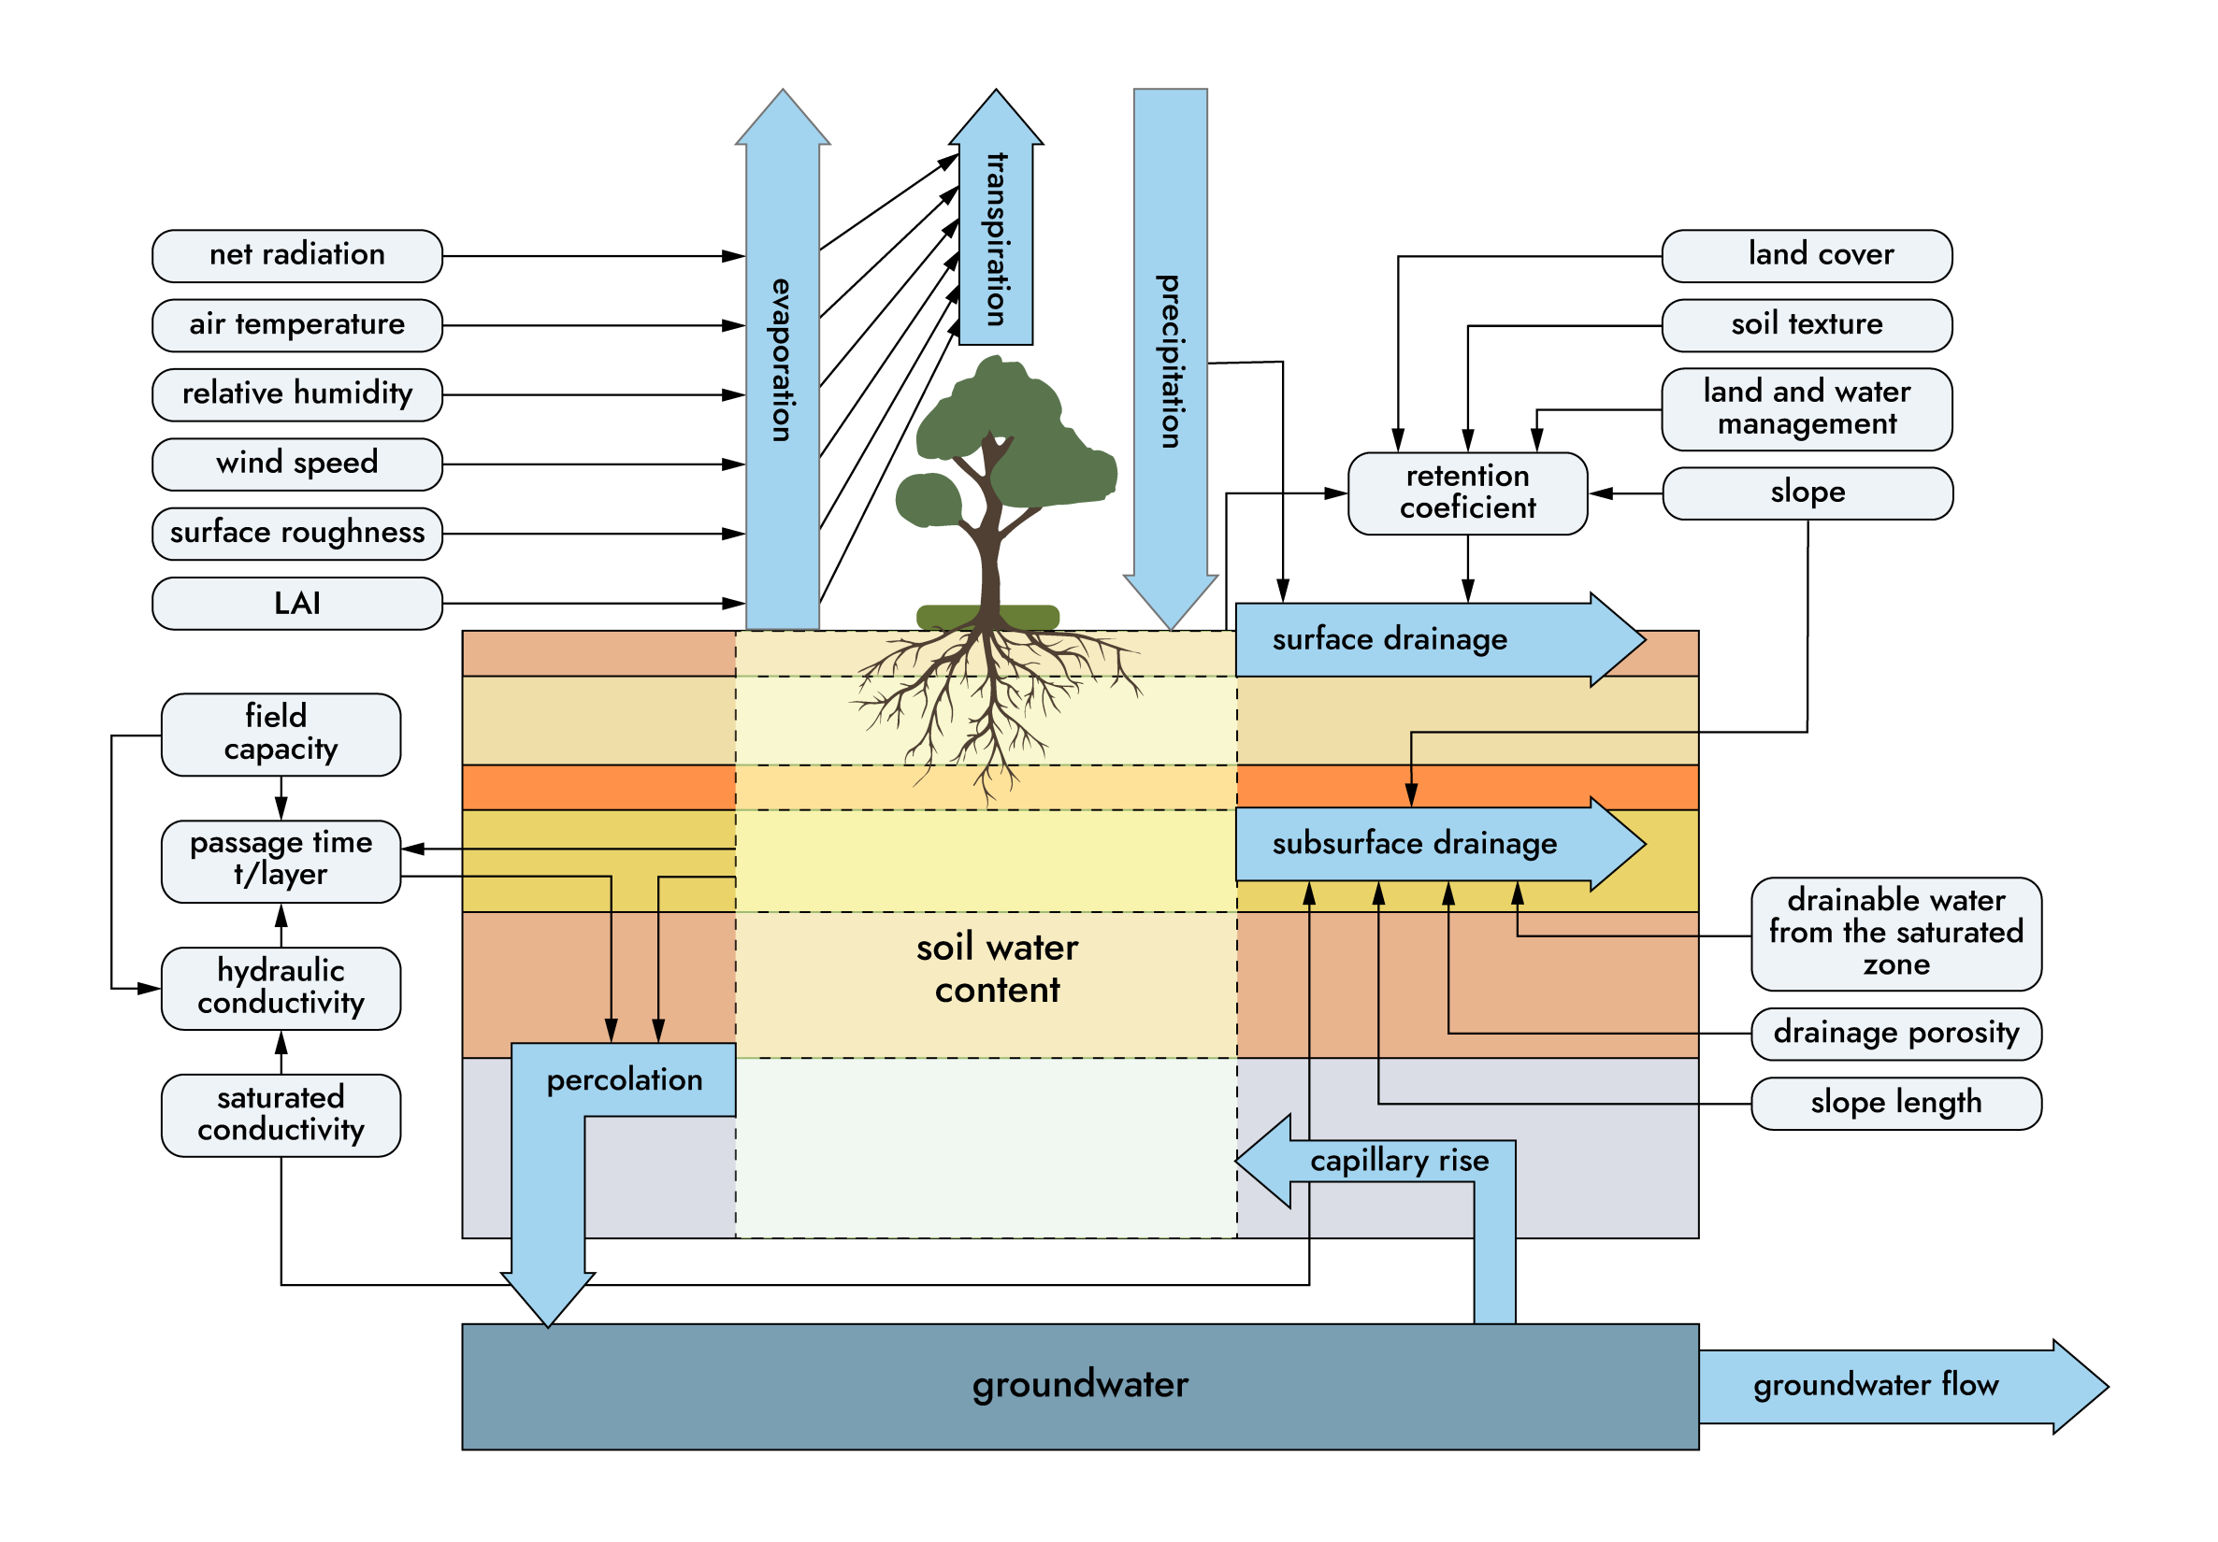
Hydrological processes

Slide 26
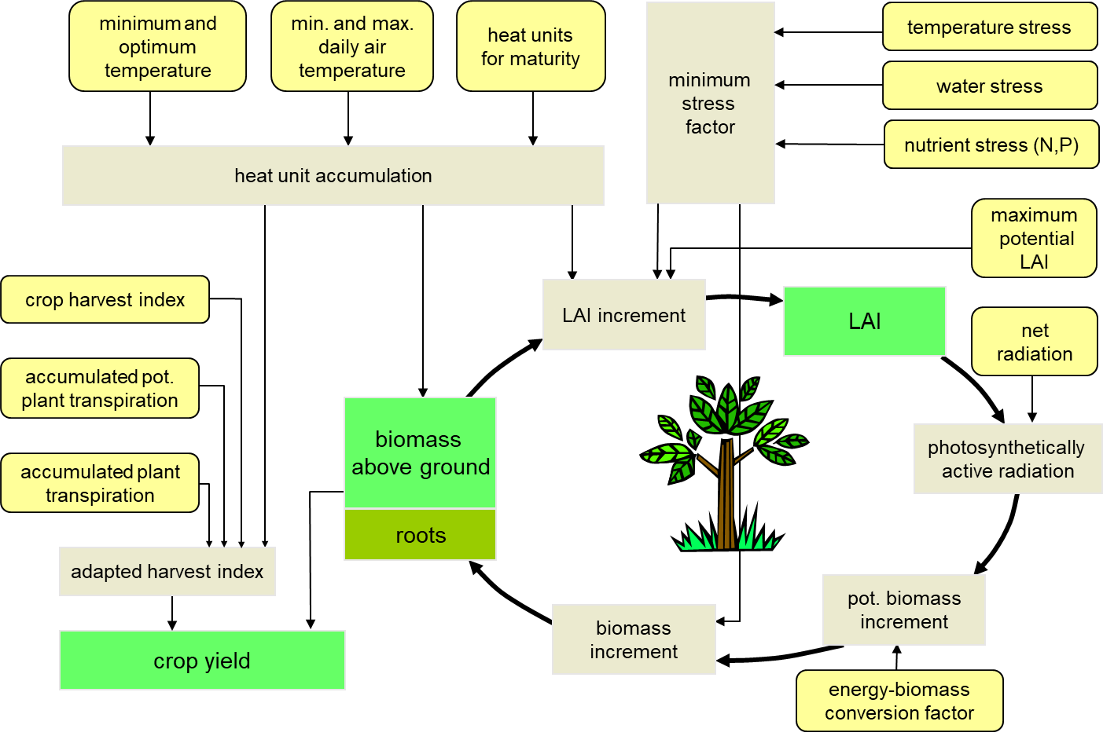
Plant processes

Slide 27
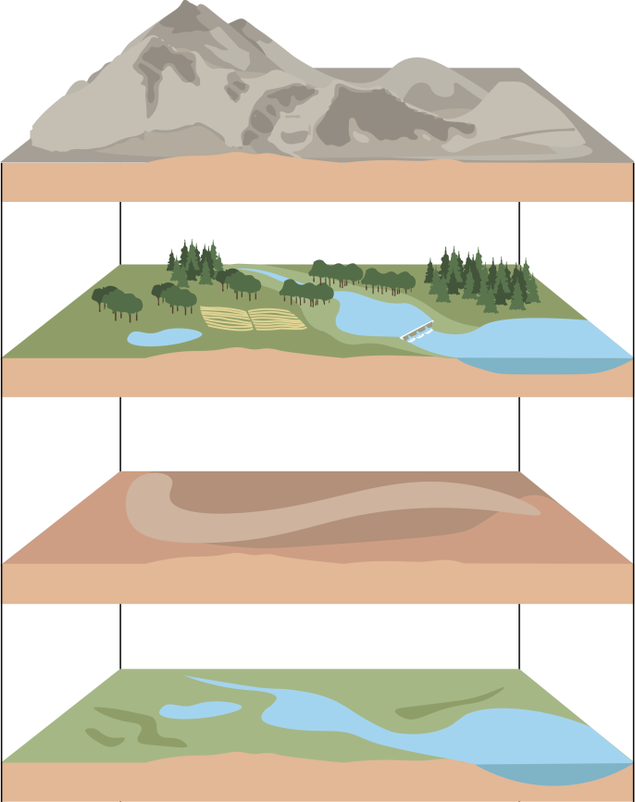
Spatial data
GIS layers
Elevation, slope (DEM)
Land use / cover (LULC)
Natural, managed
Soils
Other
Reservoirs, irrigation,
wetlands, glaciers, elevation

Slide 28
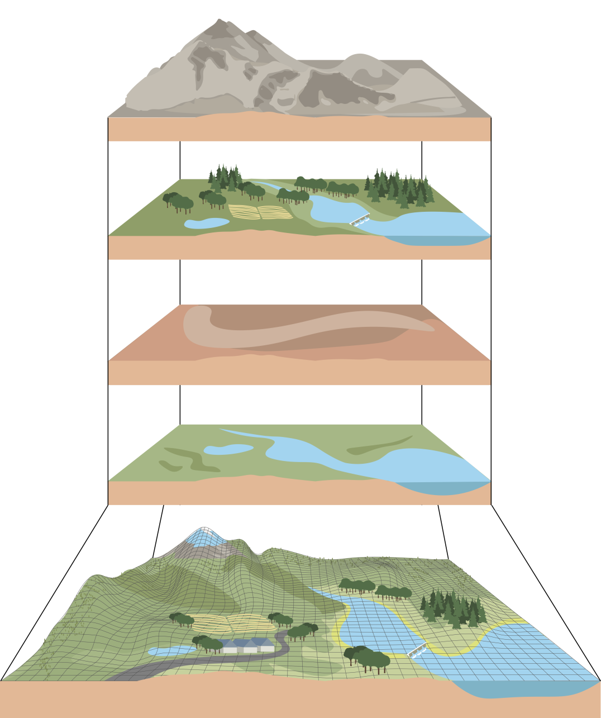
Spatial data
Basic GIS layers
Elevation, slope (DEM)
Overlay in GIS
  HRUs
  Hydrological Response Units
  SWIM input file: *.str
Land use / cover (LULC)
Natural, managed
Soils
Other
Reservoirs, irrigation,
wetlands, glaciers, elevation
Hydrotopes (HRUs)

Slide 29
Spatial data
Optional GIS layers
Elevation, slope (DEM)
Overlay in GIS
  HRUs
  Hydrological Response Units
  SWIM input file: *.str
Land use / cover (LULC)
Natural, managed
Soils
Optional layers
Other
Reservoirs, irrigation,
wetlands, glaciers, elevation
Hydrotopes (HRUs)

Slide 30



Data: Soils, land use and elevation
Land use ... Copernicus Global Land Cover
Soils ... FAO Harmonized World Soil Database
DEM ... NASA Shuttle Radar Topography Mission (SRTM)(2013)

Slide 31

Final basin considered in model set-up
After discussion with experts
Excluding catchment of the Turkana lake
Very dry area anyway

Slide 32

Data: Climate
Comparision obeserved – reanalysis (W5E5)
We analyzed data from 45 manual rainfall stations across Somalia and 6 weather stations of Ethiopia.
Somalia manual rainfall stations data was taken from the following database:
https://climseries.faoswalim.org/station/
Data for Ethiopia was collected from various sources, as there is no open database (as in case with Somalia): http://www.ethiomet.gov.et/stations/regional_information/3
We used monthly rainfall data. Time series are not the same for all analyzed stations. For some stations it is 1997-2023, 1999-2023, 2000-2023 (such as Belet Weyne station, Bulo Burti station and Jownar station respectively, with the longest observational periods among analyzed stations). For all other stations time series are somewhat shorter, such as 2005-2023, 2006-2023, 2007-2023, 2009-2023, 2011-2023, 2014-2023, 2015-2023.
Overestimation of precipitation by re-analysis dataset

Slide 33

Data for calibration

Slide 34


Calibration and validation: maps of hydrological components (average 1971-2000)
ETa
Groundwater recharge
Evapotranspiration

Slide 35
Monthly impacts ISIMIP CMIP6 climate
General increase, without outliers
Change until 2031-2060

Slide 36


Calibration and validation results Shabelle1
Belad Weyne

Slide 37

Calibration and validation results Juba1
Luuq

