Slide 1
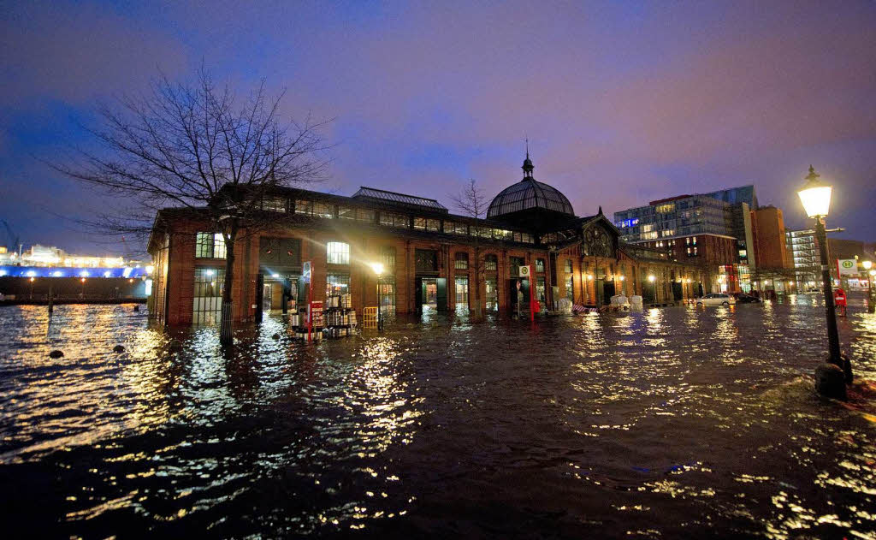
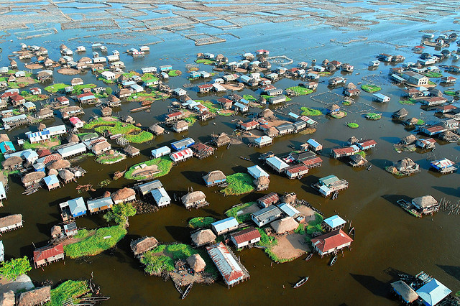
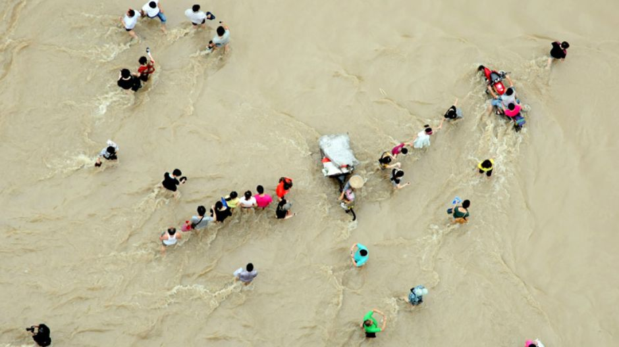
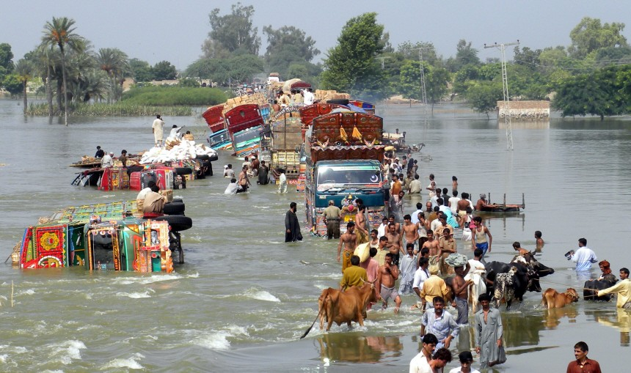
Is this climate change?

Slide 2
Comparison of methods to attribute climate change impacts
Method 1: ISIMIP
ISIMIP counterfactual (de-trended) climate data as input for subsequent hydrological modelling
Comparison for historical events possible
Low number of events
Method 2: Weather generator
Weather gerator simulates long (10000a) daily climate time series for historical climate (1971-2000) and „now climate“ (2006-2035) as input for subsequent hydrological modeling
Comparison for historical events not possible
High number of events

Slide 3
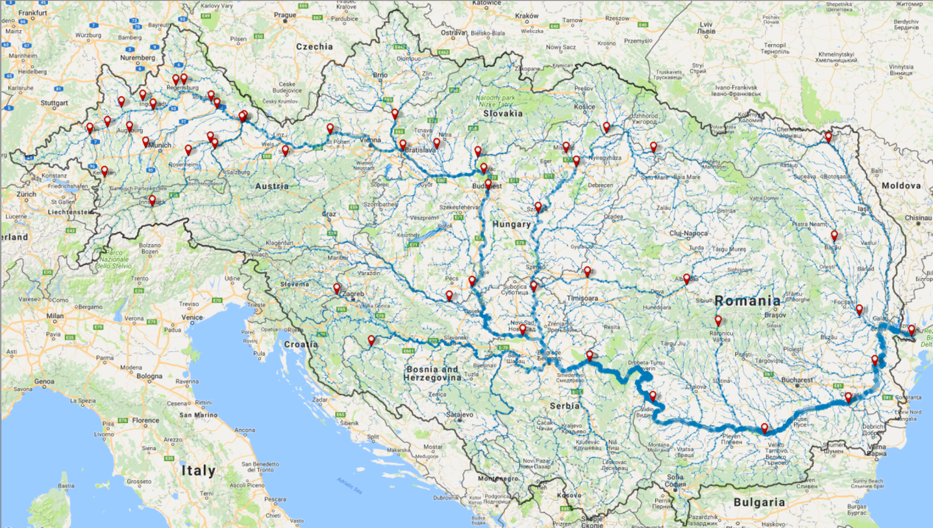
The Danube

Slide 4
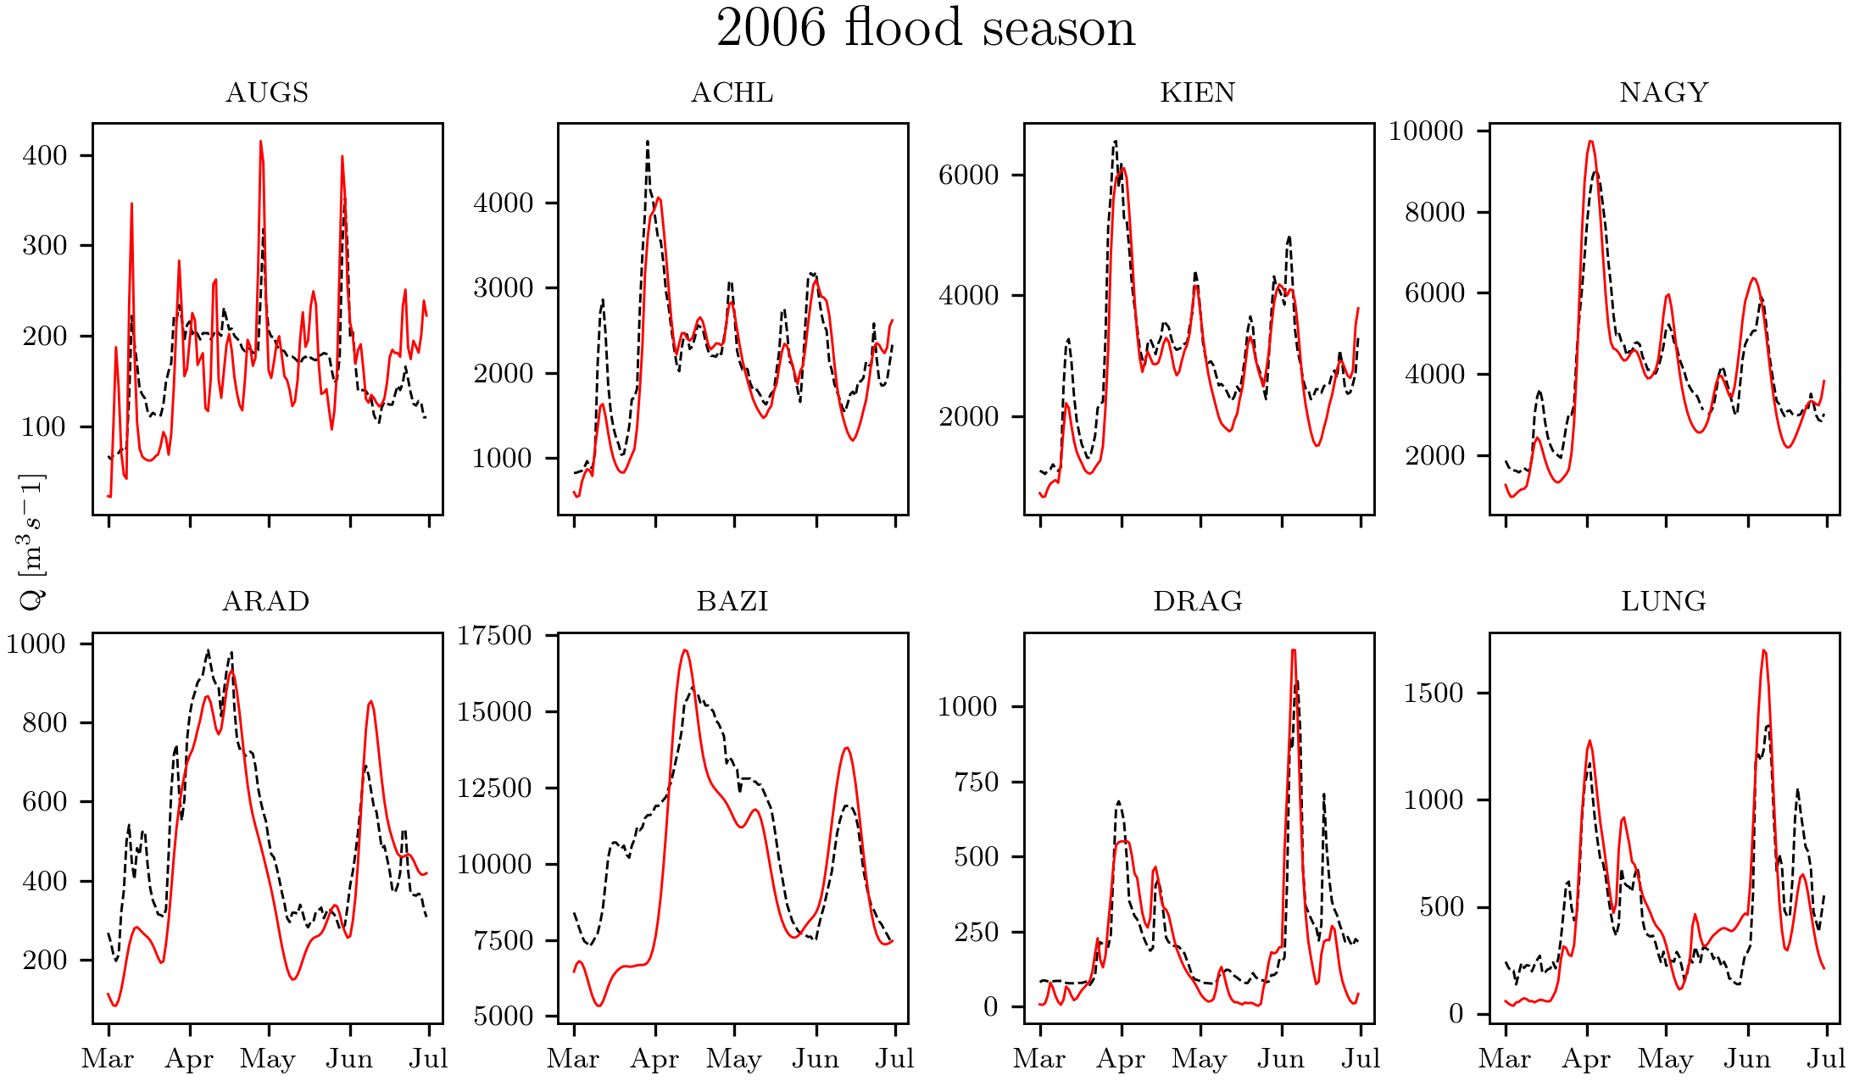
Hydrological validation
Notes:
Lower row all in lower Danube/Romania

Slide 5
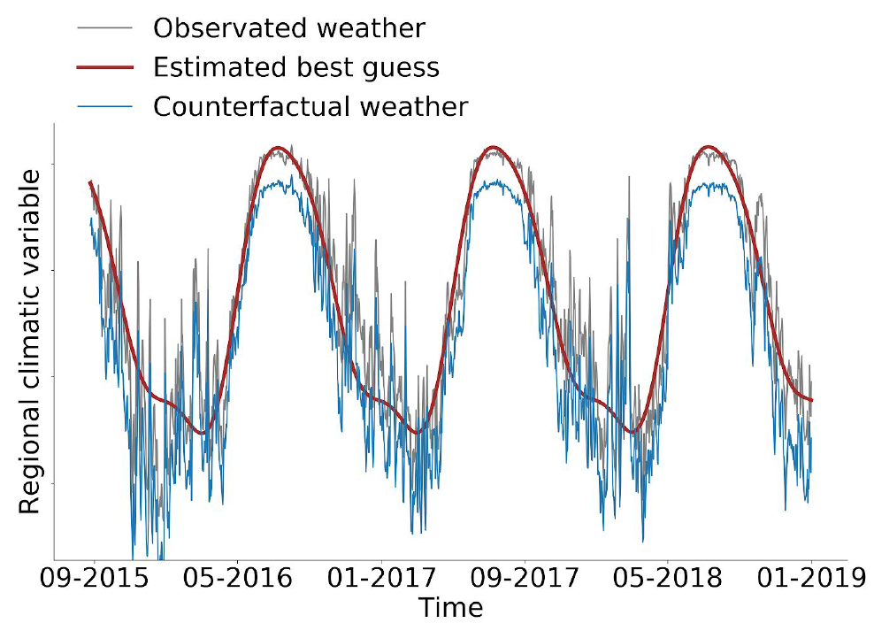
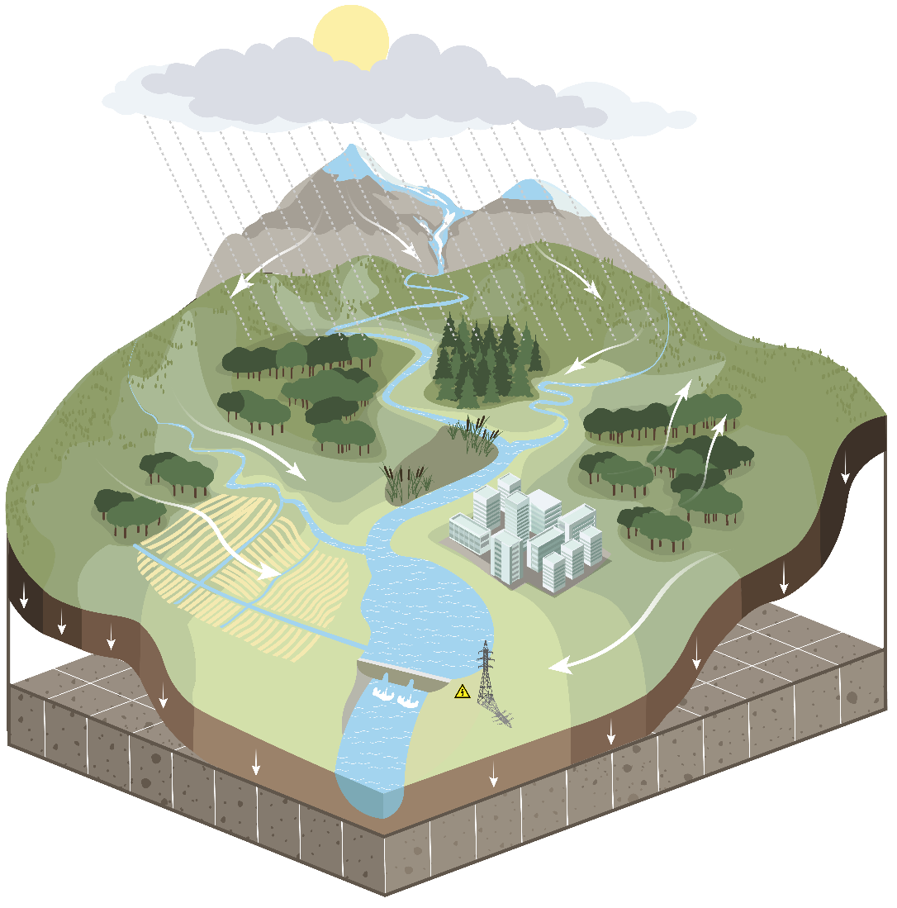
Method 1: The ISIMIP3a data for climate impact attribution (https://www.isimip.org/newsletter/isimip3a3b-protocol-published/)

Slide 6
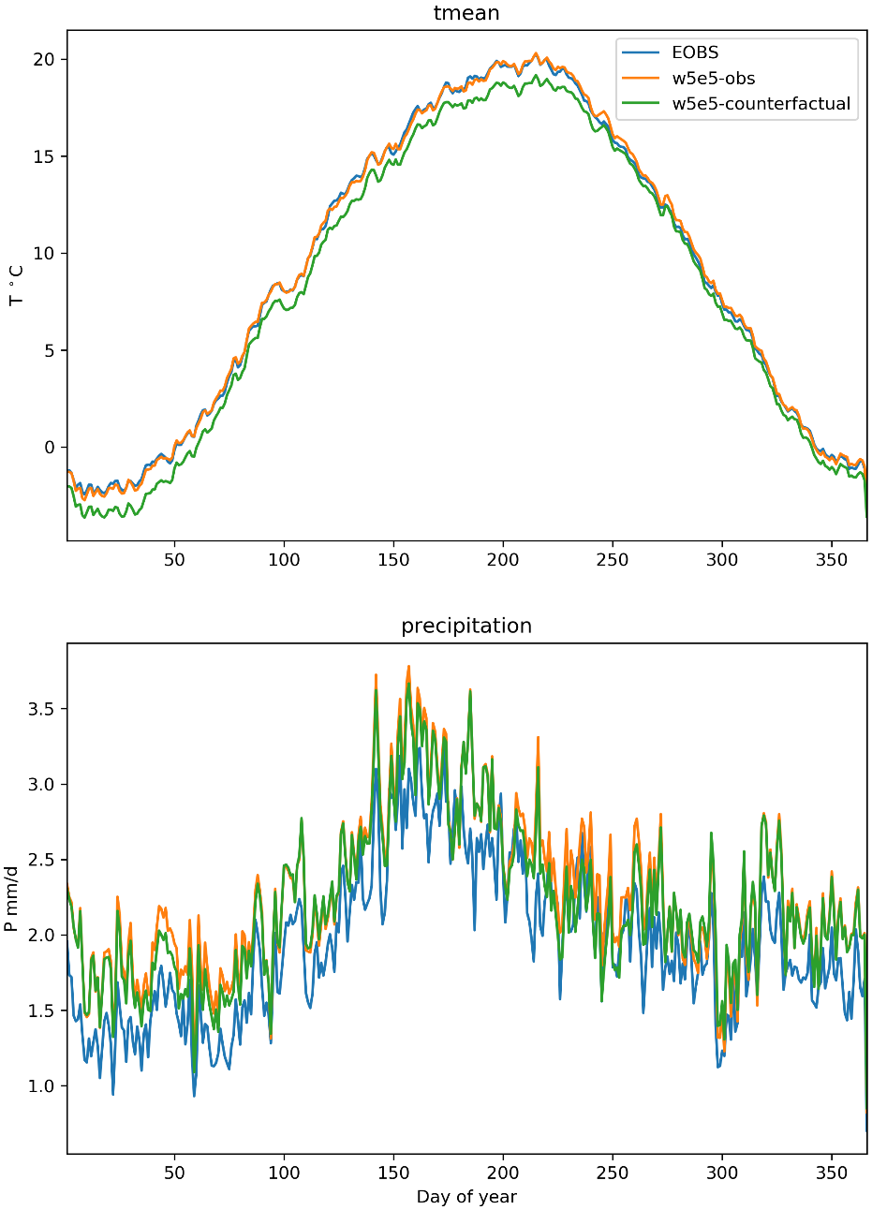
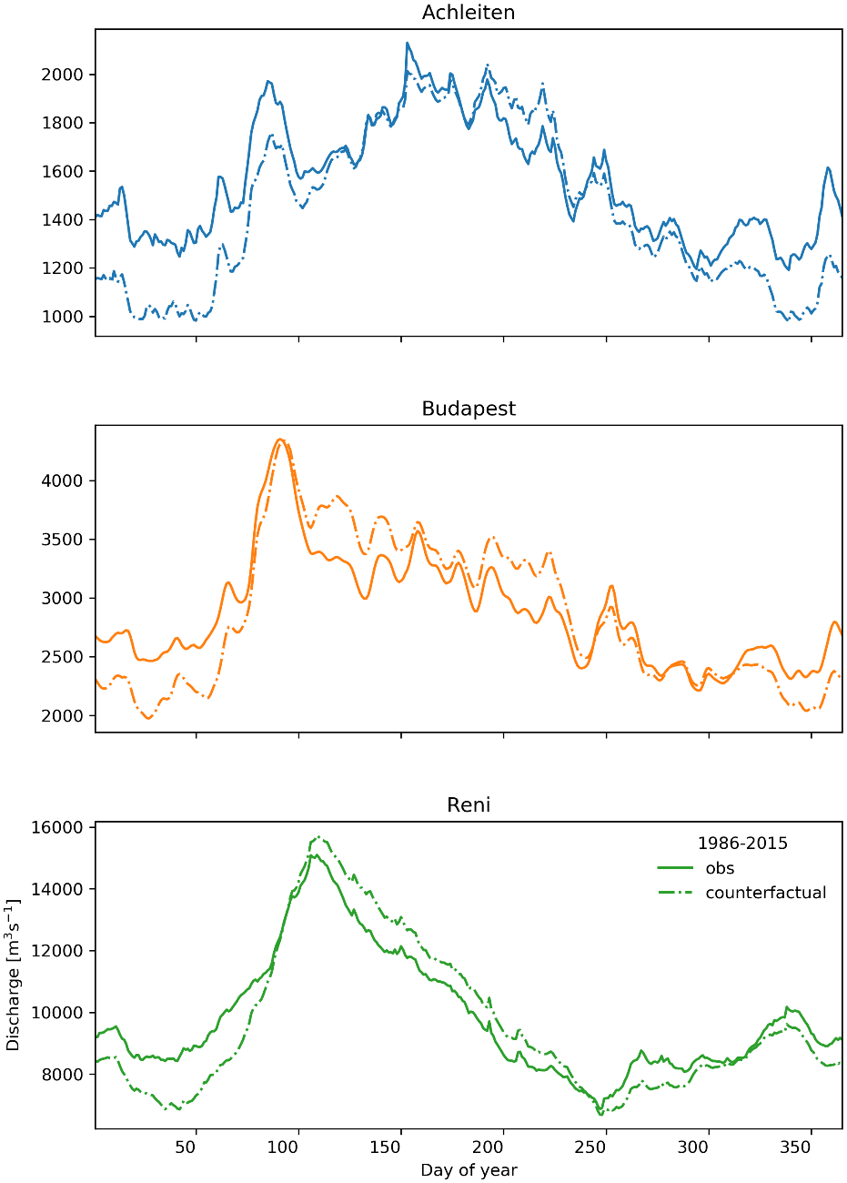
Counterfactual data first results
Observed
Counterfactual
Discharge

Slide 7
Attribution method 2
IMAGE
Multisite, multivariate stochastic weather generator
CaMa Flood
Hydraulic model
BN-FLEMOps
Probabilistic flood loss model
SWIM
Hydrological model
CORDEX-EU
Imperial College London
PIK Potsdam
PIK Potsdam
GFZ Potsdam
GCM-RCM climate model simulations
Partners:
OASIS LMF
Genillard & Co
Pannon Pro
Uni. Novi Sad
Insurance sector
Pluvial flood model for selected cities
DTU Copenhagen
MIKE flood

Slide 8
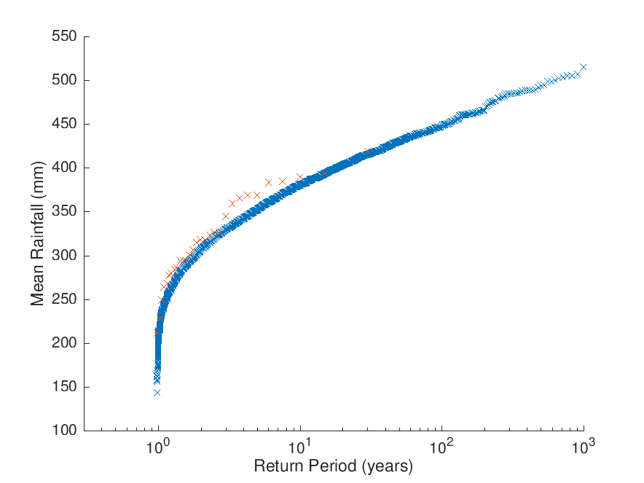
Valididation climate data method 2
JJA precipitation for Upper Danube basin
The largest observed event
X – 30 years of CORDEX data
X – 10,000 years of IMAGE data
These extreme events were never observed, but are possible and cause the huge damages
Sparks et al. 2017

Slide 9
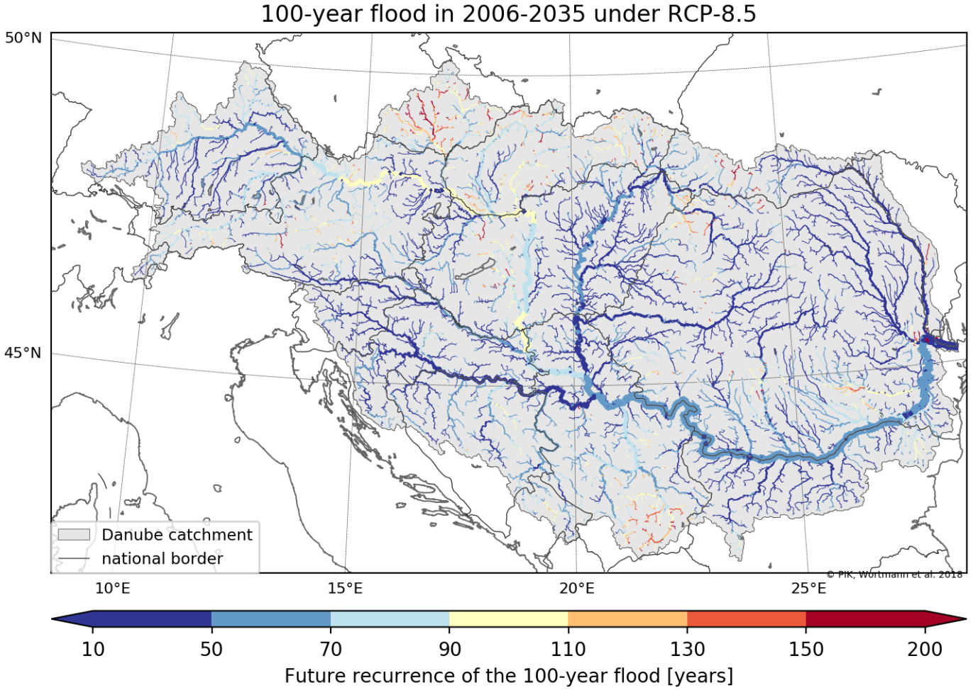
Changes from 1971-2000 to “now” 2006-2035
Actual return period of former 100year flood
Nagymaros (Danube, Hungary)
Bazias (Danube, Romania)

Slide 10
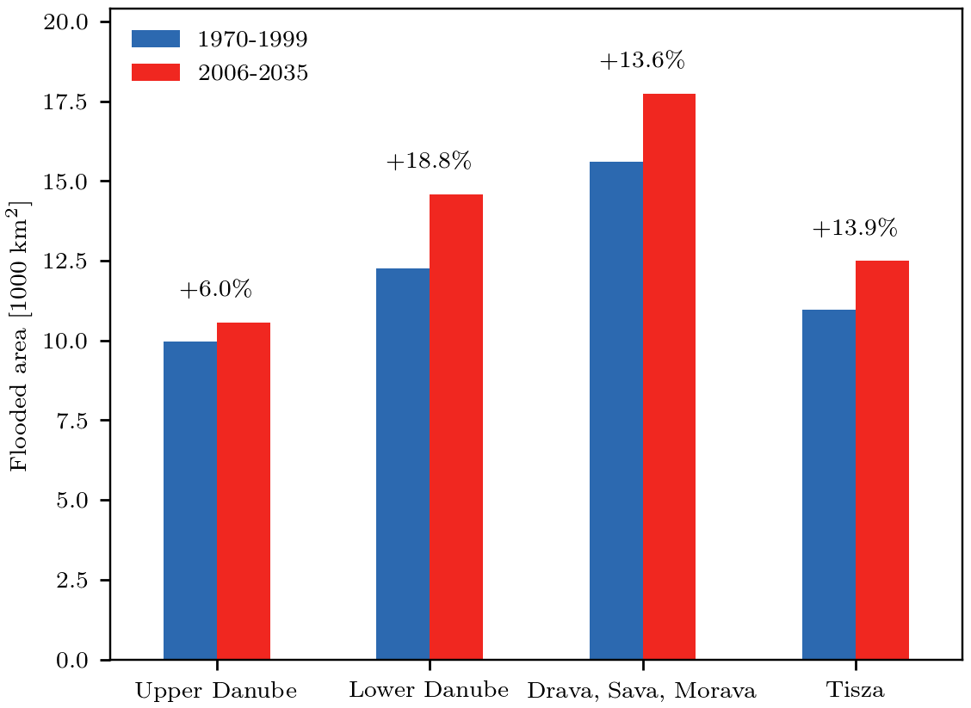
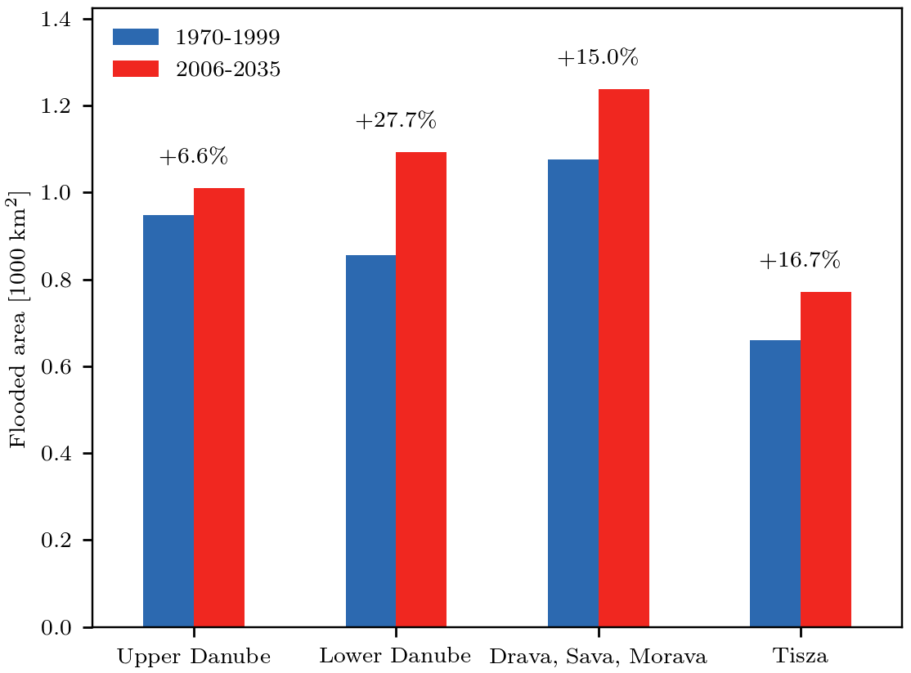
Change of 1971-2000 to “now” 2006-2035
Increase of flooded areas
Total basin
Urban and industrial areas
100-year flooded area, reference vs current climate period
Notes:
Wieviel Fläche ist schon jetzt mehr betroffen.

Slide 11
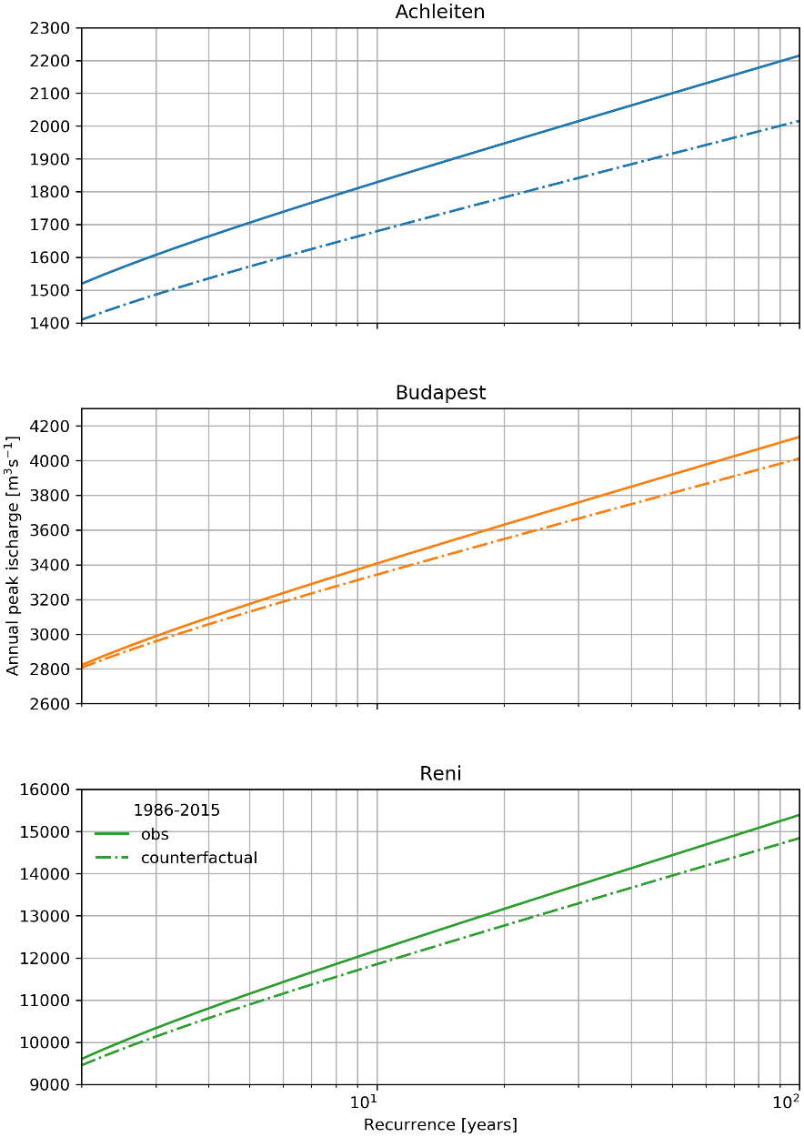
Climate change attribution: comparison of methods
Method 1 (ISIMIP)
Method 2 Weather Generator)
Nagymaros (Danube, Hungary)
Observed
Counterfactual
Now
Historical
Bazias (Danube, Romania)

Slide 12
Thanks

